Slide 1
Topology and experimental distinguishability
Gabriele Carcassi
Christine A Aidala
David J Baker
Mark J Greenfield
University of Michigan

Slide 2
Motivation for this work
This work has its root in an effort to better understand fundamental physics in general and classical Hamiltonian/Lagrangian particle mechanics in particular
Why are classical states points in a cotangent bundle? What does the symplectic form represent? Why is time evolution a symplectomorphism? Must time evolution always be a diffeomorphism or a homeomorphism?
At some point we realized that to give a satisfactory answer to those questions, we would have to better understand topological spaces on their own merit
What physical concept is captured by a topology? What do open sets and continuous functions correspond to?
We believe we have found the answer: a topology keeps track of what can be distinguished through experimentation
It seems fitting that topology maps to such a fundamental concept for an experimental science

Slide 3
Overview
Experimental observation
Observations are statements combined with a way to experimentally verify them. We’ll define a Boolean-like algebra on them which is similar to topological structure.
Experimental distinguishability
Study observations that can identify an object within a set of possibilities. This will lead to Hausdorff and second countable topological spaces.
Experimental relationships
Study relationships between experimentally distinguishable objects. This will lead to continuous functions and homeomorphisms.

Slide 4
Experimental Observations
Keeping track of what is experimentally verifiable

Slide 5
Experimental observations
In science, something is true if and only if it can be experimentally verified
It is not enough to claim something
E.g. “Bob likes chocolate” “The ball is moving at about 1 m/s” “Birds descend from Dinosaurs”
We must provide a clear procedure such that the result can be independently replicated
Let’s see if we can capture this requirement more precisely

Slide 6
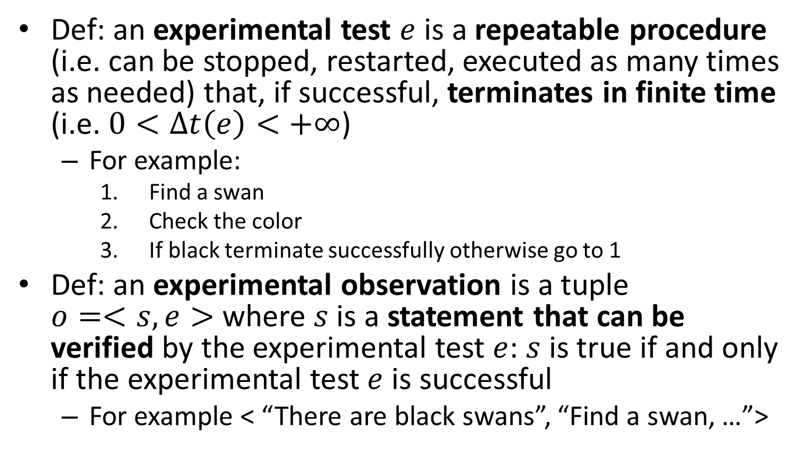
Experimental observations
Def: an experimental test $e$ is a repeatable procedure (i.e. can be stopped, restarted, executed as many times as needed) that, if successful, terminates in finite time (i.e. $0<Δt\left(e\right)<+∞$)
For example:
Find a swan
Check the color
If black terminate successfully otherwise go to 1
Def: an experimental observation is a tuple $o=<s,e>$ where $s$ is a statement that can be verified by the experimental test $e$: $s$ is true if and only if the experimental test $e$ is successful
For example < “There are black swans”, “Find a swan, …”>

Slide 7
Algebra of experimental observations
Now we want to understand how experimental observations behave under logical operations:
Negation/logical NOT
Conjunction/logical AND
Disjunction/logical OR

Slide 8
Negation/Logical NOT
Note: the negation of an experimental observation is not necessarily an experimental observation
Being able to verify a statement in finite time does not imply the ability to verify its negation in finite time
Non-verification is not verification of the negation. Not finding black swans does not verify “there are no black swans”
This idea has been intuitively present in the scientific community
James Randi’s “You can’t prove a negative”: pushing a few reindeer off the Empire State Building doesn’t prove they can’t fly
“Absence of evidence is not evidence of absence”
This formalizes that intuition more precisely

Slide 9
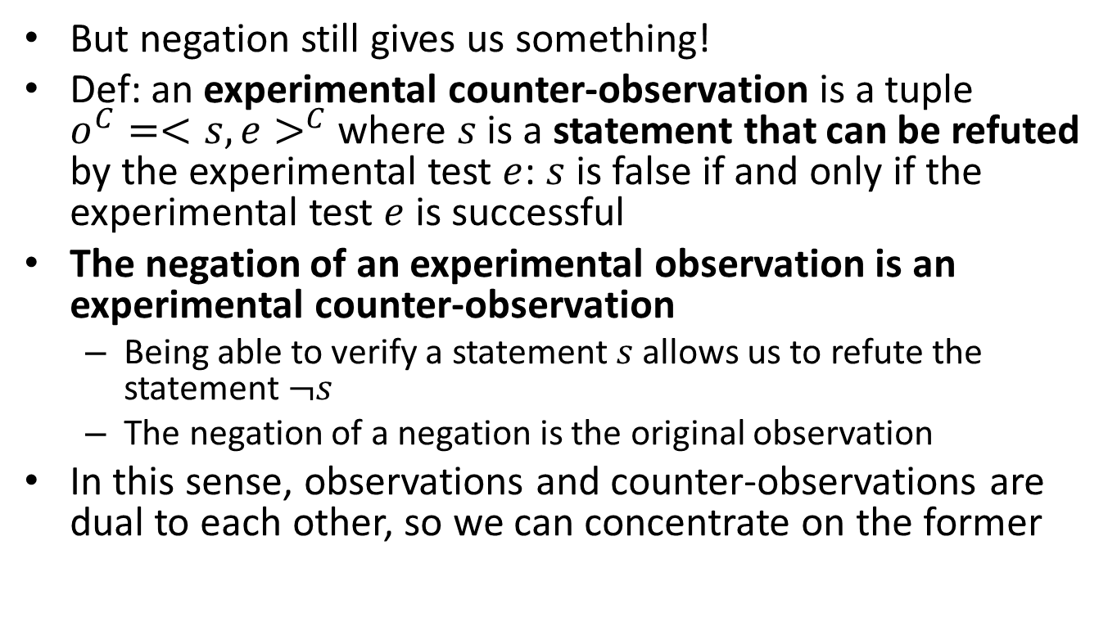
Negation/Logical NOT
But negation still gives us something!
Def: an experimental counter-observation is a tuple $o^{C}=<s,e>^{C}$ where $s$ is a statement that can be refuted by the experimental test $e$: $s$ is false if and only if the experimental test $e$ is successful
The negation of an experimental observation is an experimental counter-observation
Being able to verify a statement $s$ allows us to refute the statement $¬s$
The negation of a negation is the original observation
In this sense, observations and counter-observations are dual to each other, so we can concentrate on the former

Slide 10
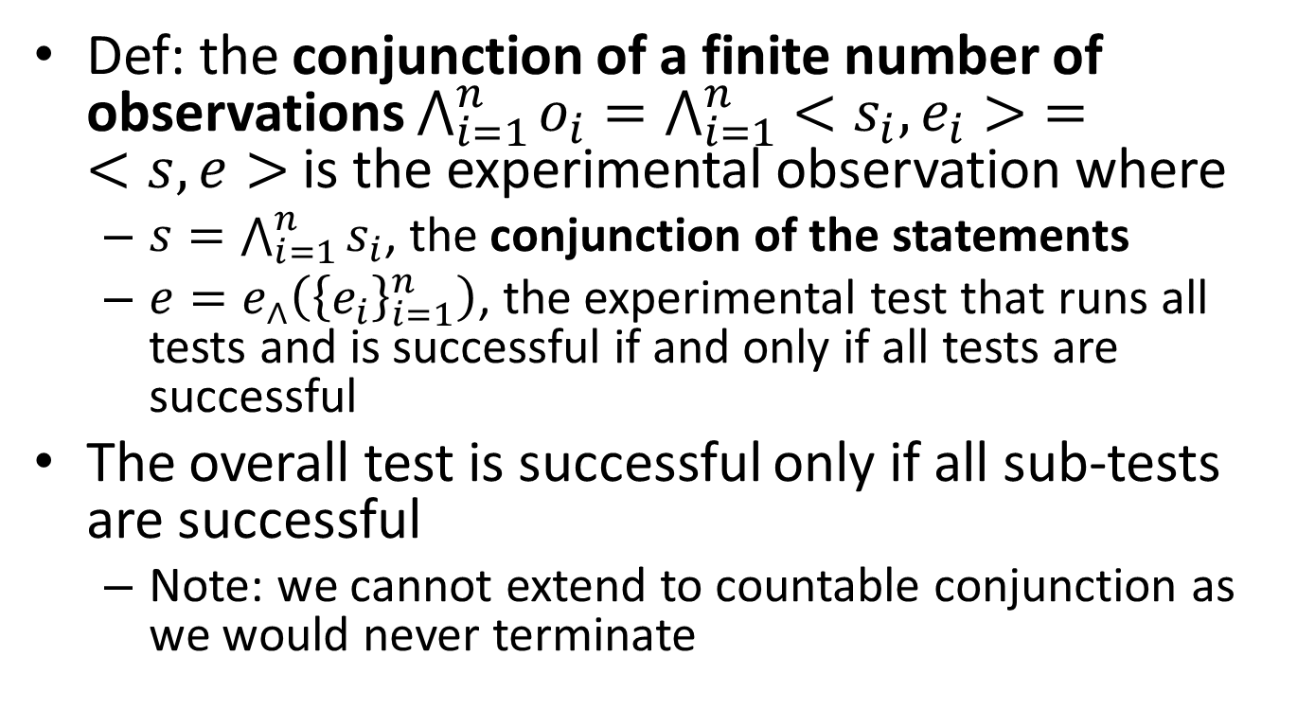
Conjunction/Logical AND
Def: the conjunction of a finite number of observations $\bigwedge_{i=1}^{n}{o_{i}}=\bigwedge_{i=1}^{n}{<s_{i},e_{i}>}=$ $<s,e>$ is the experimental observation where
$s=\bigwedge_{i=1}^{n}{s_{i}}$, the conjunction of the statements
$e=e_{∧}\left({\left\{e_{i}\right\}}_{i=1}^{n}\right)$, the experimental test that runs all tests and is successful if and only if all tests are successful
The overall test is successful only if all sub-tests are successful
Note: we cannot extend to countable conjunction as we would never terminate

Slide 11
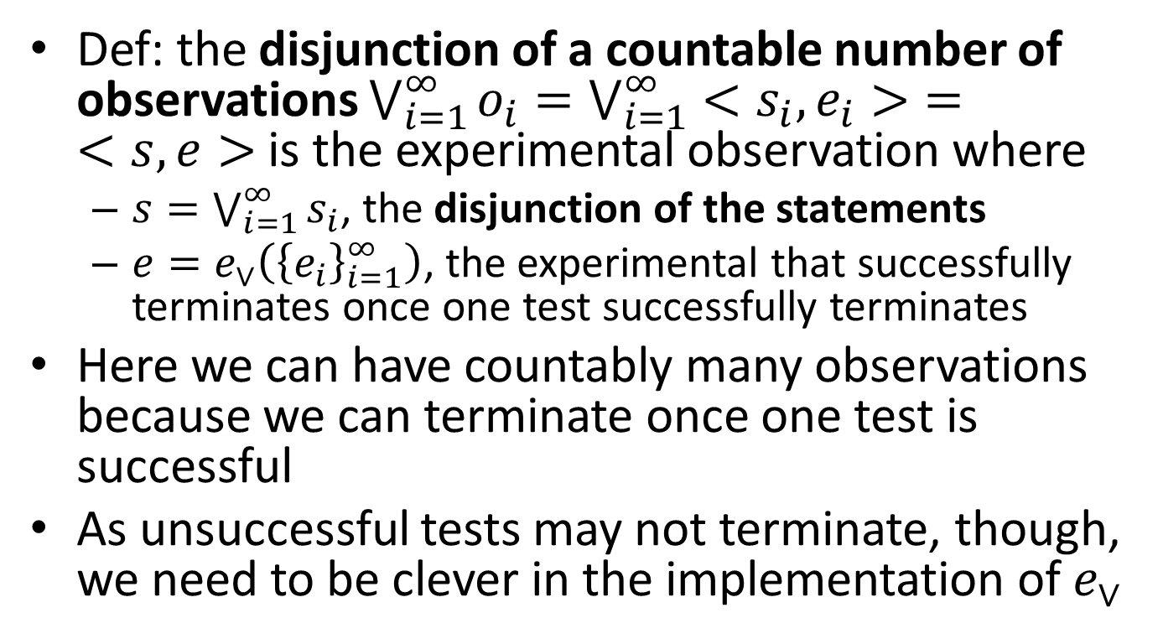
Disjunction/Logical OR
Def: the disjunction of a countable number of observations $\bigvee_{i=1}^{∞}{o_{i}}=\bigvee_{i=1}^{∞}{<s_{i},e_{i}>}=$ $<s,e>$ is the experimental observation where
$s=\bigvee_{i=1}^{∞}{s_{i}}$, the disjunction of the statements
$e=e_{∨}\left({\left\{e_{i}\right\}}_{i=1}^{∞}\right)$, the experimental that successfully terminates once one test successfully terminates
Here we can have countably many observations because we can terminate once one test is successful
As unsuccessful tests may not terminate, though, we need to be clever in the implementation of $e_{∨}$

Slide 12
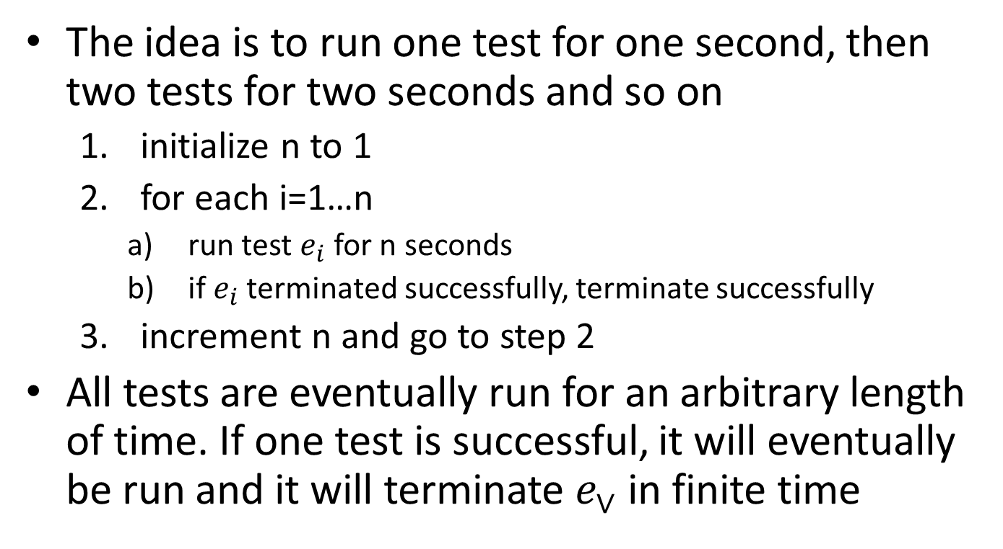
Disjunction/Logical OR
The idea is to run one test for one second, then two tests for two seconds and so on
initialize n to 1
for each i=1…n
run test $e_{i}$ for n seconds
if $e_{i}$ terminated successfully, terminate successfully
increment n and go to step 2
All tests are eventually run for an arbitrary length of time. If one test is successful, it will eventually be run and it will terminate $e_{∨}$ in finite time

Slide 13
Algebra of experimental observations
Experimental observations are
Not closed under negation/logical NOT
Closed under finite conjunction/logical AND (but not under countable)
Closed under countable disjunction/logical OR

Slide 14
Things we can do with this algebra
We can define mutually exclusive observations if verifying one implies the other will never be verified. We can define the empty/zero observation as the one that is never verified.
Given a set of experimental observations (sub-basis), we can always close it under finite conjunction and countable disjunction
We can define a basis for such a set
A set of experimental observations that we can use to verify all other experimental observations
That is: we can take many ideas from set theory and topology and apply them to experimental observations!

Slide 15
Experimental domain
Note: if we have a set of observations and we want (at least in the infinite time limit) to be able to find all experimental observations that are verified, then we must have a countable basis
If there does not exist a countable basis, there will be observations we’ll never be able to test
Def: an experimental domain is a set of experimental observations, closed under finite conjunction and countable disjunction, that allows a countable basis
This represents the enumeration of all possible answers to a question that can be settled experimentally

Slide 16
Experimental Distinguishability
Using experimental observations to identify elements from a set

Slide 17
Observations and identifications
Many experimental observations are about identifying an element from a set of possibilities
E.g. “Bob’s illness is malaria” “The position of the ball is 5.1±0.05 meters” “This fossilized animal was a bird”
Let’s look more carefully at how this works

Slide 18
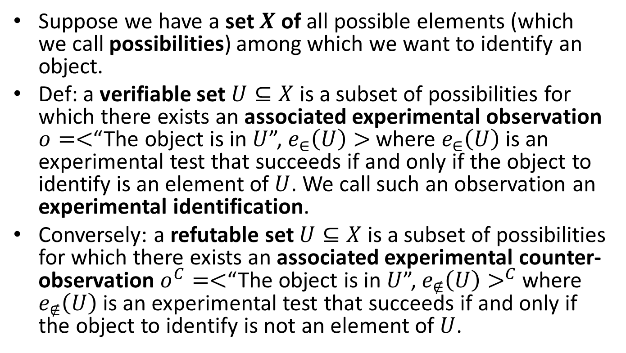
Experimental identification
Suppose we have a set $X$ of all possible elements (which we call possibilities) among which we want to identify an object.
Def: a verifiable set $U⊆X$ is a subset of possibilities for which there exists an associated experimental observation $o=<$“The object is in $U$”, $e_{∈}\left(U\right)>$ where $e_{∈}\left(U\right)$ is an experimental test that succeeds if and only if the object to identify is an element of $U$. We call such an observation an experimental identification.
Conversely: a refutable set $U⊆X$ is a subset of possibilities for which there exists an associated experimental counter-observation $o^{C}=<$“The object is in $U$”, $e_{∉}\left(U\right)>^{C}$ where $e_{∉}\left(U\right)$ is an experimental test that succeeds if and only if the object to identify is not an element of $U$.

Slide 19
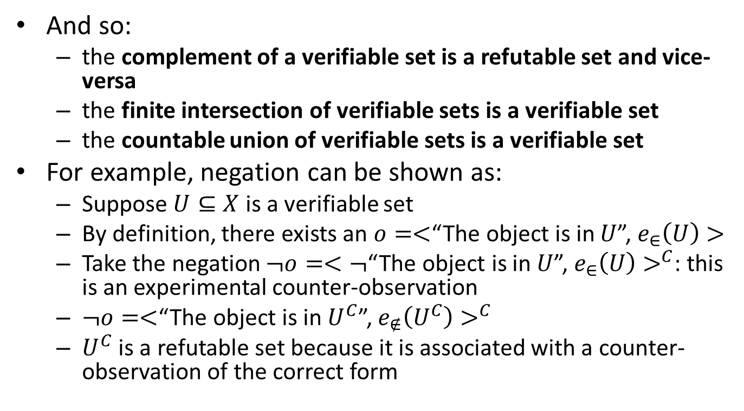
Experimental identification
And so:
the complement of a verifiable set is a refutable set and vice-versa
the finite intersection of verifiable sets is a verifiable set
the countable union of verifiable sets is a verifiable set
For example, negation can be shown as:
Suppose $U⊆X$ is a verifiable set
By definition, there exists an $o=<$“The object is in $U$”, $e_{∈}\left(U\right)>$
Take the negation $¬o=<¬$“The object is in $U$”, $e_{∈}\left(U\right)>^{C}$: this is an experimental counter-observation
$¬o=<$“The object is in $U^{C}$”, $e_{∉}\left(U^{C}\right)>^{C}$
$U^{C}$ is a refutable set because it is associated with a counter-observation of the correct form

Slide 20
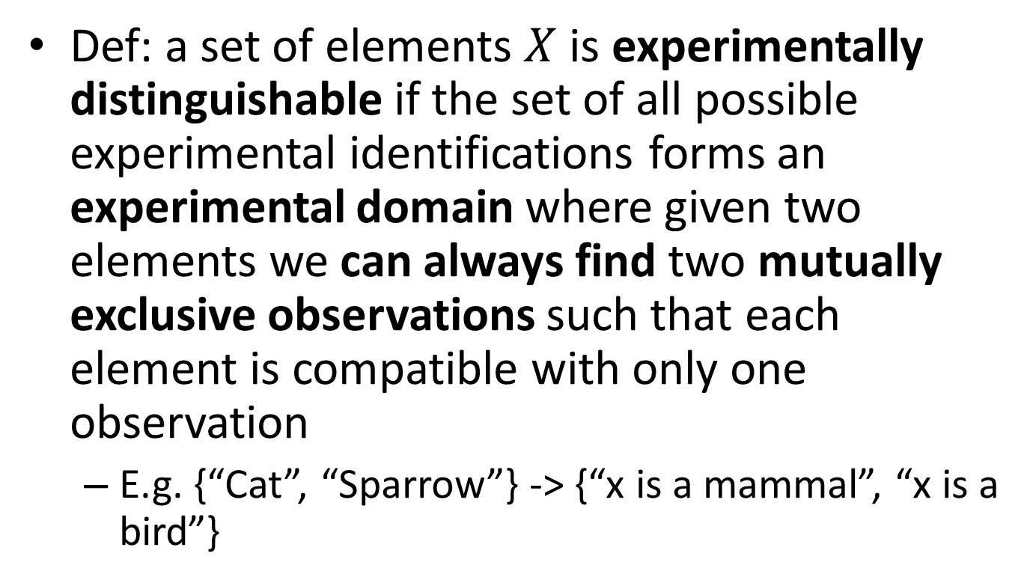
Experimental distinguishability
Def: a set of elements $X$ is experimentally distinguishable if the set of all possible experimental identifications forms an experimental domain where given two elements we can always find two mutually exclusive observations such that each element is compatible with only one observation
E.g. {“Cat”, “Sparrow”} -> {“x is a mammal”, “x is a bird”}

Slide 21
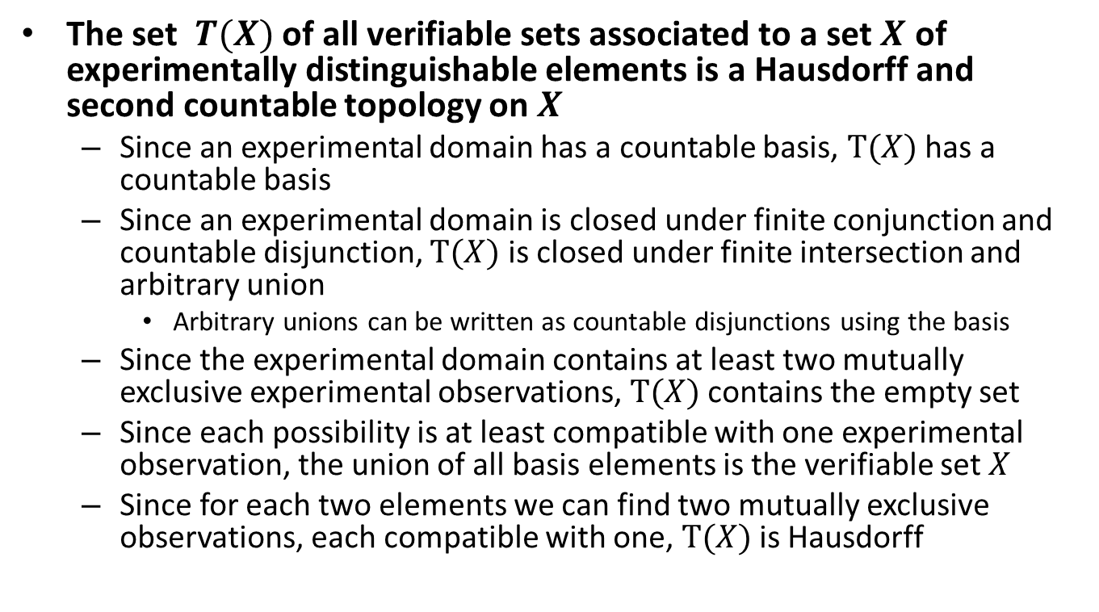
Hausdorff and second countable topology
The set $T(X)$ of all verifiable sets associated to a set $X$ of experimentally distinguishable elements is a Hausdorff and second countable topology on $X$
Since an experimental domain has a countable basis, $T(X)$ has a countable basis
Since an experimental domain is closed under finite conjunction and countable disjunction, $T(X)$ is closed under finite intersection and arbitrary union
Arbitrary unions can be written as countable disjunctions using the basis
Since the experimental domain contains at least two mutually exclusive experimental observations, $T(X)$ contains the empty set
Since each possibility is at least compatible with one experimental observation, the union of all basis elements is the verifiable set $X$
Since for each two elements we can find two mutually exclusive observations, each compatible with one, $T(X)$ is Hausdorff

Slide 22
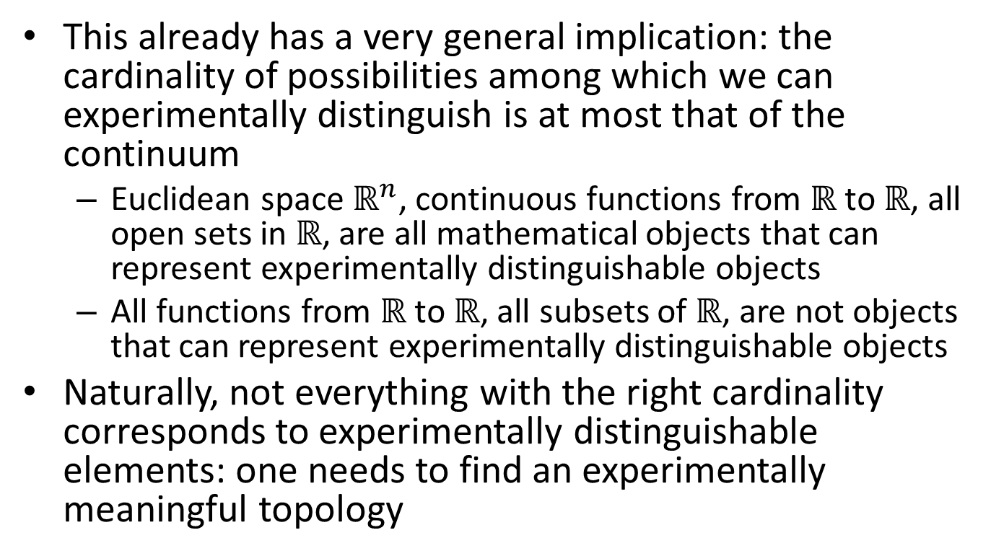
Cardinality of the elements
This already has a very general implication: the cardinality of possibilities among which we can experimentally distinguish is at most that of the continuum
Euclidean space $ℝ^{n}$, continuous functions from $ℝ$ to $ℝ$, all open sets in $ℝ$, are all mathematical objects that can represent experimentally distinguishable objects
All functions from $ℝ$ to $ℝ$, all subsets of $ℝ$, are not objects that can represent experimentally distinguishable objects
Naturally, not everything with the right cardinality corresponds to experimentally distinguishable elements: one needs to find an experimentally meaningful topology

Slide 23
Relationships and Experimental Distinguishability
Establishing experimental relationships between elements

Slide 24
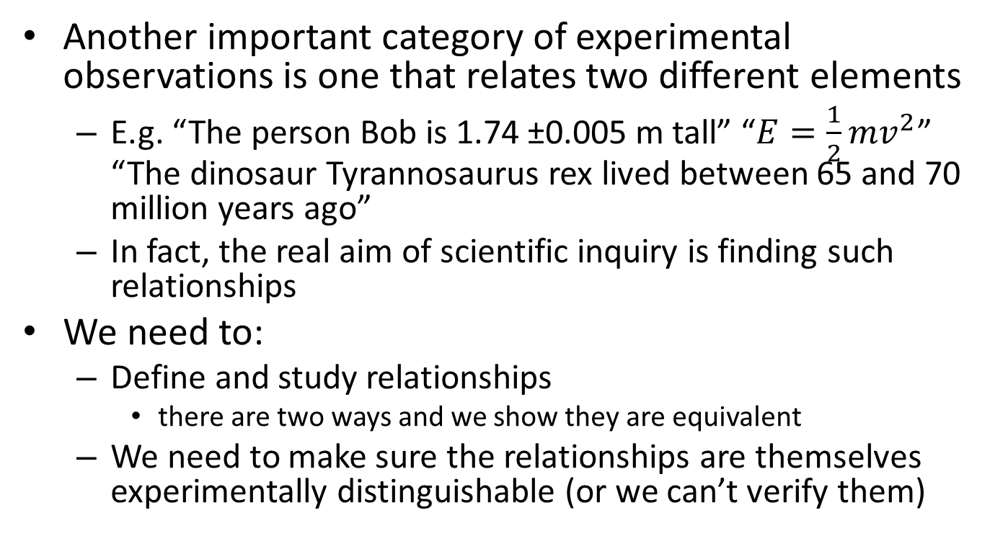
Relationships between experimentally distinguishable elements
Another important category of experimental observations is one that relates two different elements
E.g. “The person Bob is 1.74 ±0.005 m tall” “$E=\frac{1}{2}mv^{2}$” “The dinosaur Tyrannosaurus rex lived between 65 and 70 million years ago”
In fact, the real aim of scientific inquiry is finding such relationships
We need to:
Define and study relationships
there are two ways and we show they are equivalent
We need to make sure the relationships are themselves experimentally distinguishable (or we can’t verify them)

Slide 25

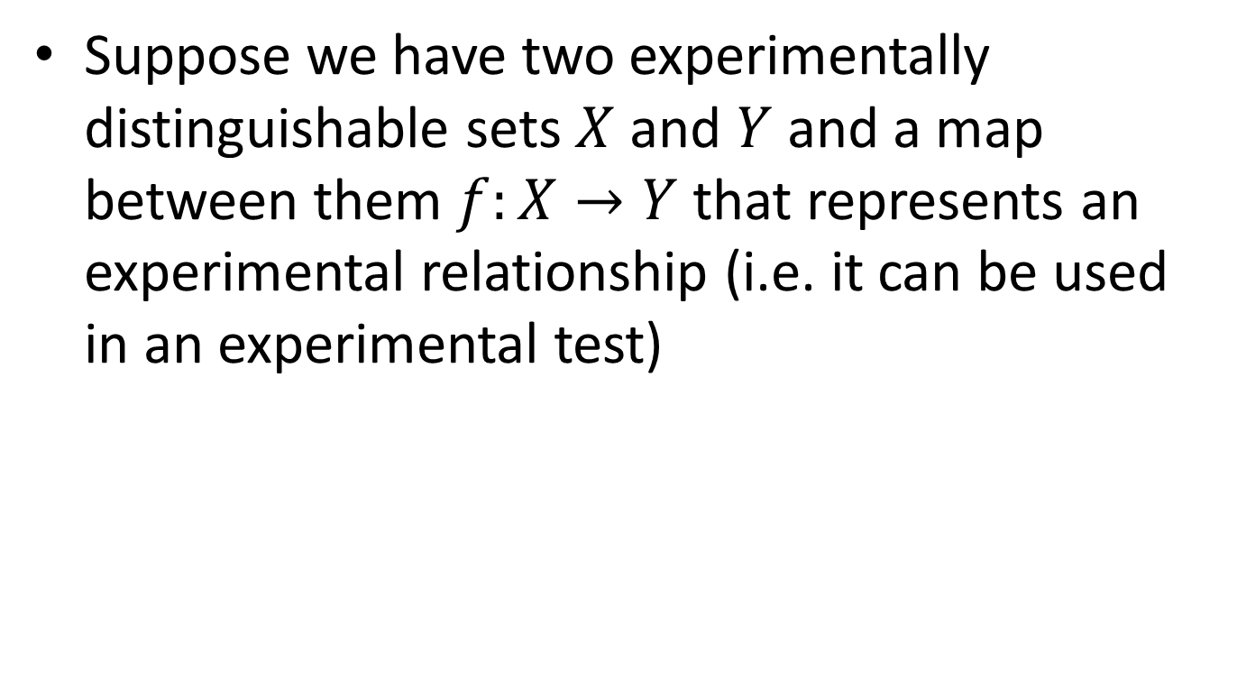


Relationships between experimentally distinguishable elements
Suppose we have two experimentally distinguishable sets $X$ and $Y$ and a map between them $f:X→Y$ that represents an experimental relationship (i.e. it can be used in an experimental test)
$$f$$
$$X$$
$$Y$$

Slide 26





Relationships between experimentally distinguishable elements
If we are able to test if $y∈V⊆Y$, then we can test if $x∈U=f^{−1}(V)⊆X$
First map $x$ to $y=f(x)$ then check $y∈V⊆Y$
$$f^{−1}$$
$$e_{∈}(V)$$
$$U$$
$$V$$
$$f$$
$$X$$
$$Y$$

Slide 27
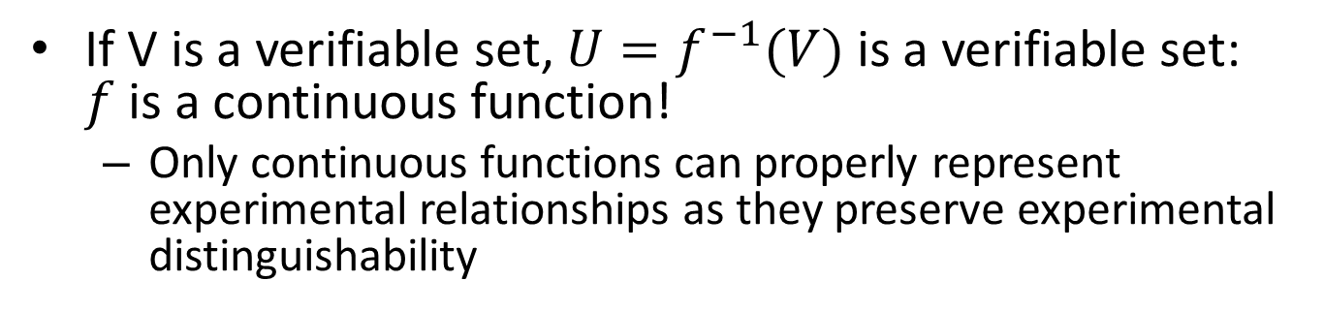

Relationships between experimentally distinguishable elements
If V is a verifiable set, $U=f^{−1}(V)$is a verifiable set: $f$is a continuous function!
Only continuous functions can properly represent experimental relationships as they preserve experimental distinguishability
$$e_{∈}(U)$$
$$f^{−1}$$
$$e_{∈}(V)$$
$$U$$
$$V$$
$$f$$
$$X$$
$$Y$$

Slide 28
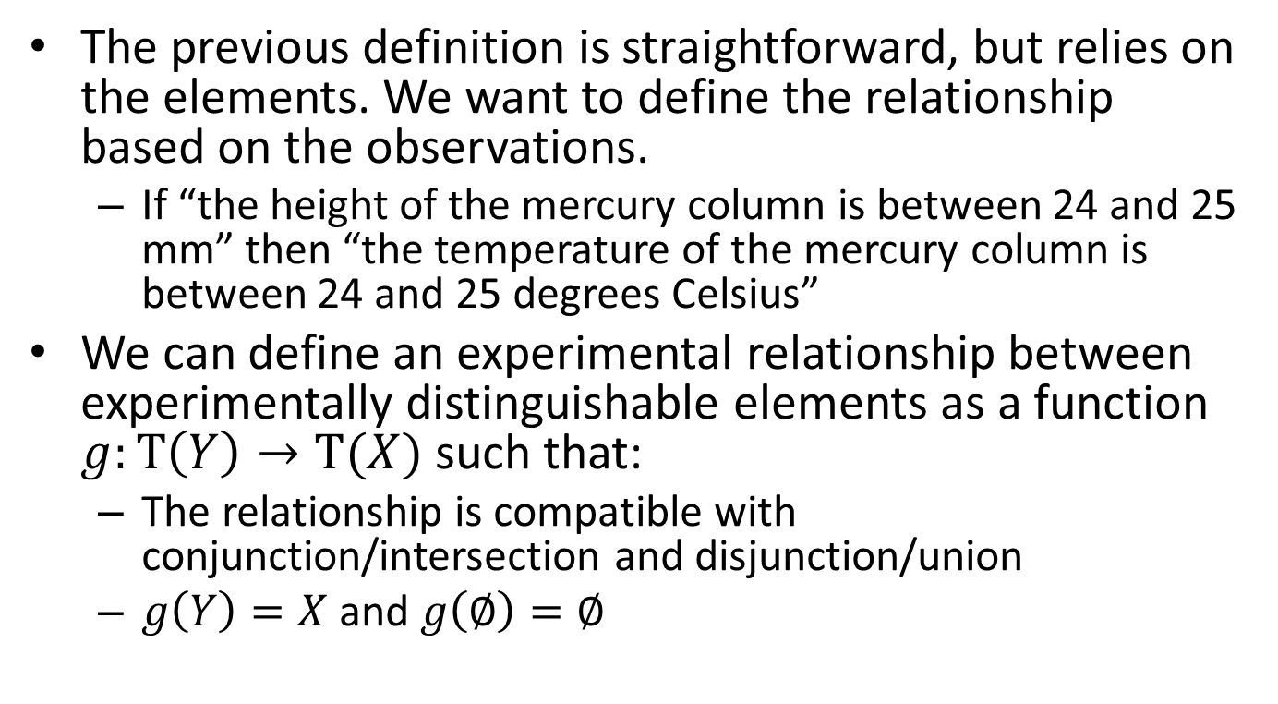
Relationships between experimentally distinguishable elements
The previous definition is straightforward, but relies on the elements. We want to define the relationship based on the observations.
If “the height of the mercury column is between 24 and 25 mm” then “the temperature of the mercury column is between 24 and 25 degrees Celsius”
We can define an experimental relationship between experimentally distinguishable elements as a function $g:T\left(Y\right)→T(X)$ such that:
The relationship is compatible with conjunction/intersection and disjunction/union
$g\left(Y\right)=X$ and $g\left(∅\right)=∅$

Slide 29
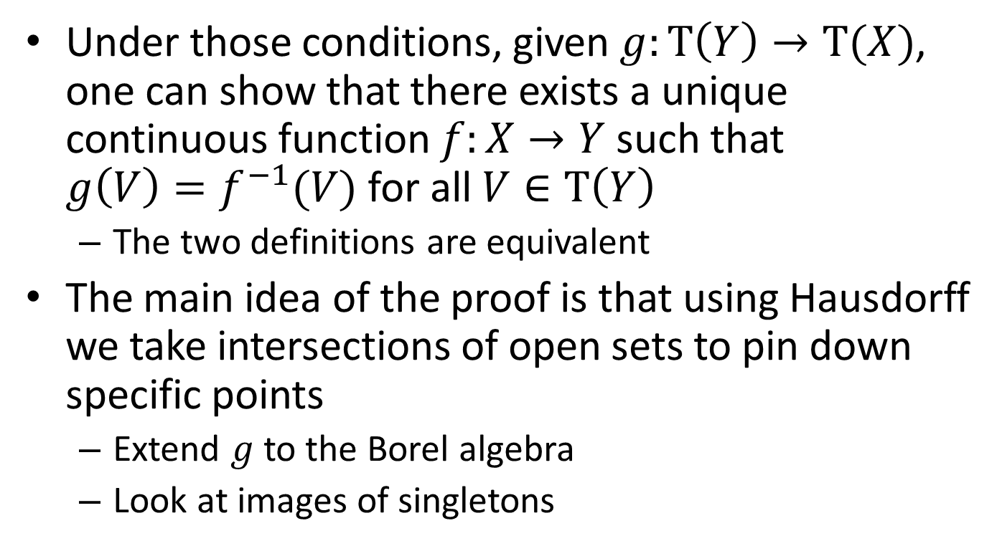
Relationships between experimentally distinguishable elements
Under those conditions, given $g:T\left(Y\right)→T(X)$, one can show that there exists a unique continuous function $f:X→Y$ such that $g\left(V\right)=f^{−1}(V)$ for all $V∈T\left(Y\right)$
The two definitions are equivalent
The main idea of the proof is that using Hausdorff we take intersections of open sets to pin down specific points
Extend $g$ to the Borel algebra
Look at images of singletons

Slide 30
Continuity in physics
This tells us why continuity is so important in physics: it preserves experimental distinguishability!
A dynamical system that preserves experimental distinguishability is a continuous map
A reversible dynamical system that preserves experimental distinguishability is a homeomorphism

Slide 31
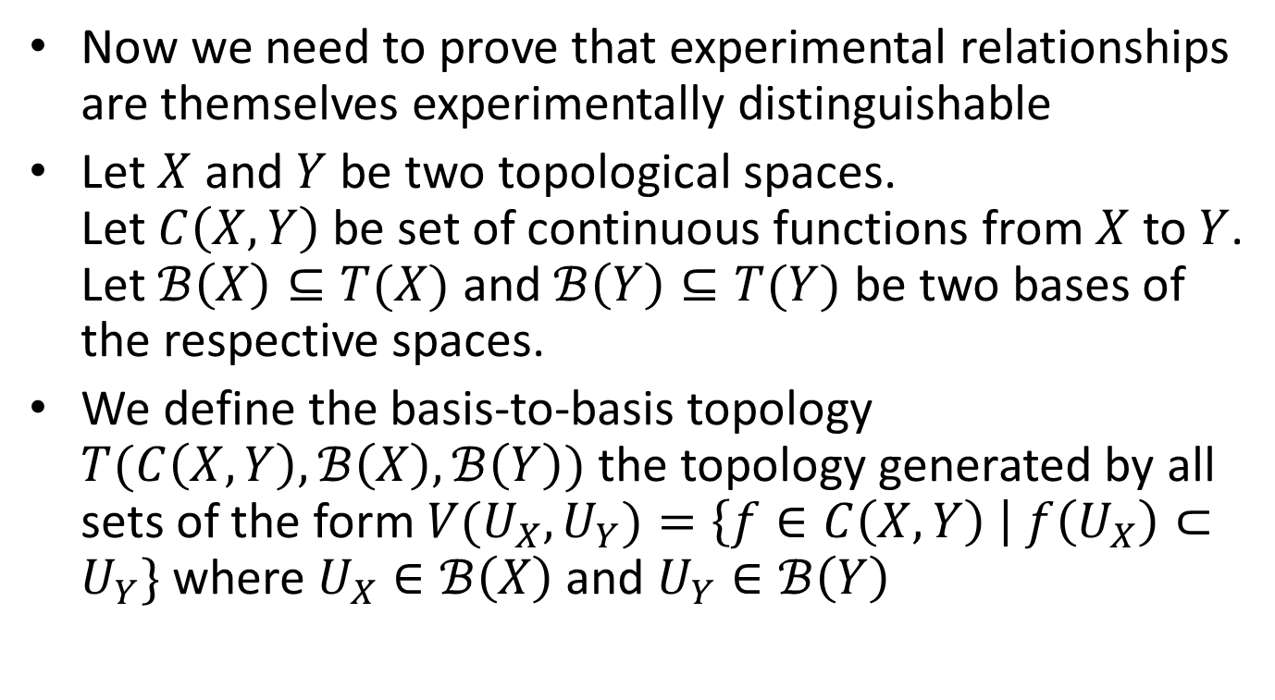
Experimental distinguishability of experimental relationships
Now we need to prove that experimental relationships are themselves experimentally distinguishable
Let $X$ and $Y$ be two topological spaces. Let $C\left(X,Y\right)$ be set of continuous functions from $X$ to $Y$. Let $ℬ\left(X\right)⊆T(X)$ and $ℬ\left(Y\right)⊆T(Y)$ be two bases of the respective spaces.
We define the basis-to-basis topology $T(C\left(X,Y\right),ℬ\left(X\right),ℬ\left(Y\right))$ the topology generated by all sets of the form $V(U_{X},U_{Y})=\left\{f∈C\left(X,Y\right) \right| f\left(U_{X}\right)⊂U_{Y}\}$ where $U_{X}∈ℬ\left(X\right)$ and $U_{Y}∈ℬ\left(Y\right)$

Slide 32
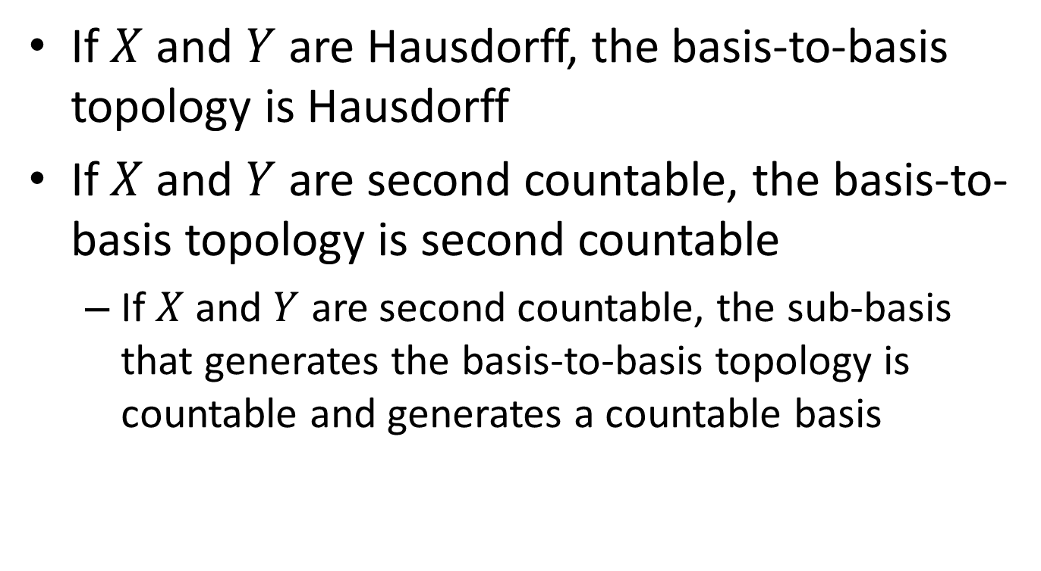
Basis-to-basis topology preserves “Hausdorff and second countable”
If $X$ and $Y$ are Hausdorff, the basis-to-basis topology is Hausdorff
If $X$ and $Y$ are second countable, the basis-to-basis topology is second countable
If $X$ and $Y$ are second countable, the sub-basis that generates the basis-to-basis topology is countable and generates a countable basis

Slide 33
Putting it all together
Sets of experimentally distinguishable elements are Hausdorff and second countable topological spaces
Relationships between experimentally distinguishable elements are continuous functions and form themselves a set of experimentally distinguishable elements
We can recursively create relationships of relationships: they too will be experimentally distinguishable and form Hausdorff and second countable topological spaces.
The universe of discourse is closed!!!

Slide 34
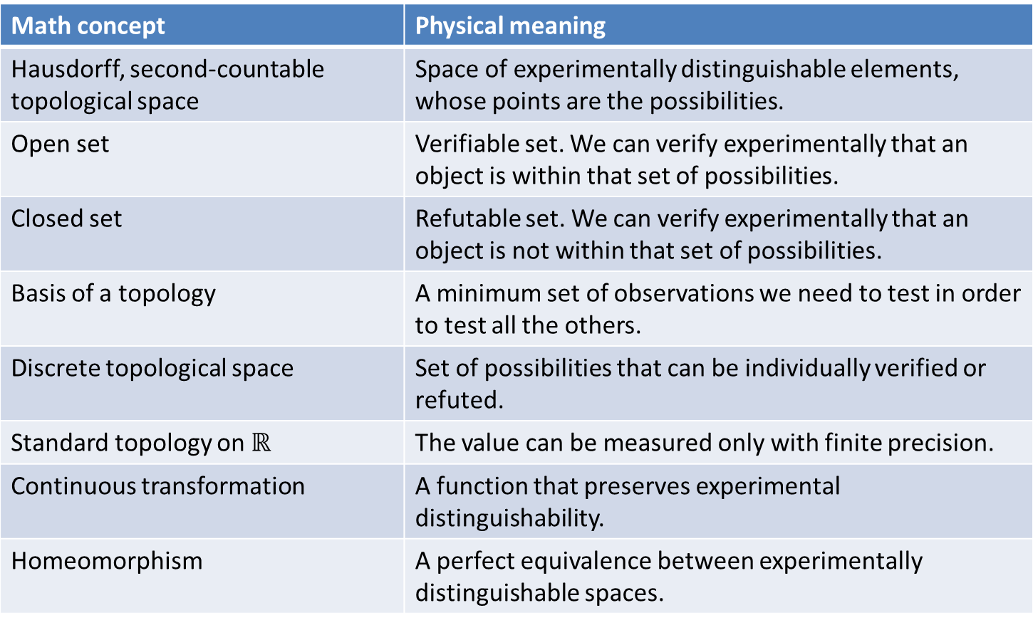
Dictionary
Math concept | Physical meaning
Hausdorff, second-countable topological space | Space of experimentally distinguishable elements, whose points are the possibilities.
Open set | Verifiable set. We can verify experimentally that an object is within that set of possibilities.
Closed set | Refutable set. We can verify experimentally that an object is not within that set of possibilities.
Basis of a topology | A minimum set of observations we need to test in order to test all the others.
Discrete topological space | Set of possibilities that can be individually verified or refuted.
Standard topology on $ℝ$ | The value can be measured only with finite precision.
Continuous transformation | A function that preserves experimental distinguishability.
Homeomorphism | A perfect equivalence between experimentally distinguishable spaces.

Slide 35
Conclusion
The application of topology in science is to capture experimental distinguishability
This insight allows us to understand why topological spaces and continuous functions are pervasive in physics and other domains
The hope is that we can build upon these ideas to understand why other mathematical concepts (e.g. differentiability, measures, symplectic forms) are also fundamental in science
A better understanding of the concepts of today may lead to the new ideas of tomorrow

