Slide 1
The logic and topology of experimentally verifiable statements
Gabriele Carcassi, Christine Aidala, Mark Greenfield
University of Michigan

Slide 2
Motivation for this work
This work has its root in an effort to better understand fundamental physics:
Why is Hamiltonian time evolution a symplectomorphism?
Why are classical states points of a cotangent bundle?
Why are they points of a manifold?
Why are they points of a topological space?
Last year we presented our basic insight: a topology keeps track of what can be distinguished through experimentation
It seems fitting that topology maps to such a fundamental concept for experimental science
This year we try to see if we can construct a formal framework around these ideas

Slide 3
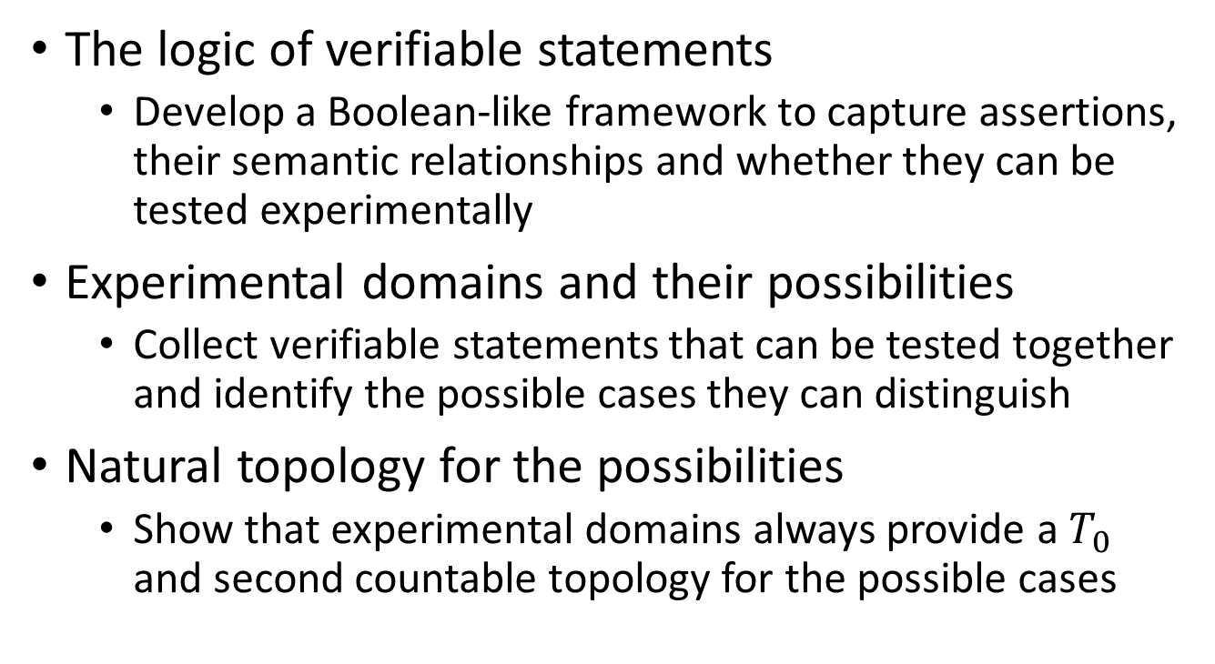
Overview
The logic of verifiable statements
Develop a Boolean-like framework to capture assertions, their semantic relationships and whether they can be tested experimentally
Experimental domains and their possibilities
Collect verifiable statements that can be tested together and identify the possible cases they can distinguish
Natural topology for the possibilities
Show that experimental domains always provide a $T_{0}$ and second countable topology for the possible cases

Slide 4
The logic of verifiable statements

Slide 5
Requirements
The first task is to develop a “logic framework” that recognizes these basic two requirements:
Our truth bearers are not sentences (e.g. sequences of symbols in a language) but the assertions they make (regardless of the language)
“This animal is a cat” and “Quest’animale e’ un gatto” state the same assertion
The truth value in science is found experimentally. The role of logic (and math) is to keep track of what is meaningful and consistent
“This animal is a cat” and “This animal is a dog” can’t both be true

Slide 6
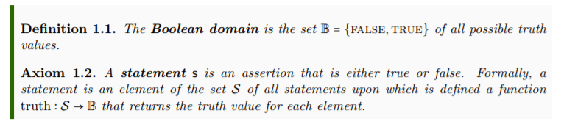
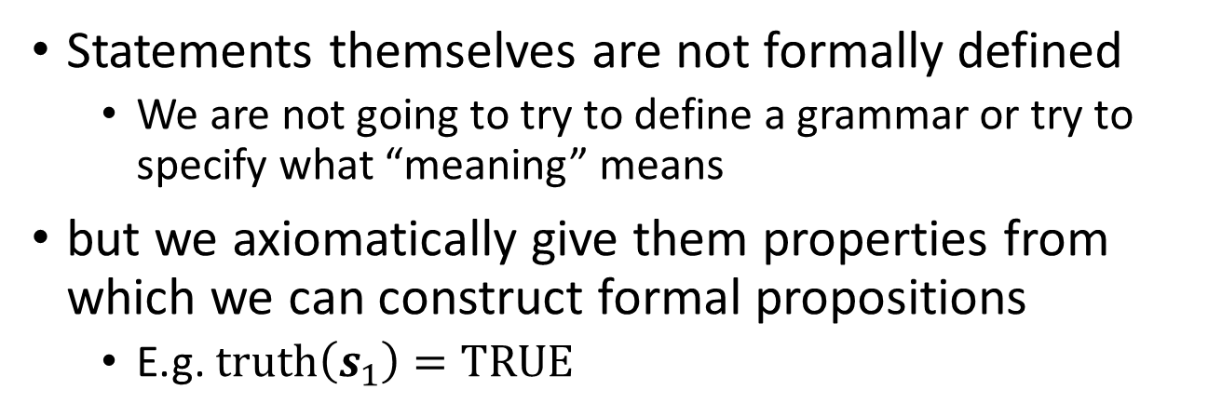
Statements
Statements themselves are not formally defined
We are not going to try to define a grammar or try to specify what “meaning” means
but we axiomatically give them properties from which we can construct formal propositions
E.g. $truth\left(s_{1}\right)=TRUE$

Slide 7
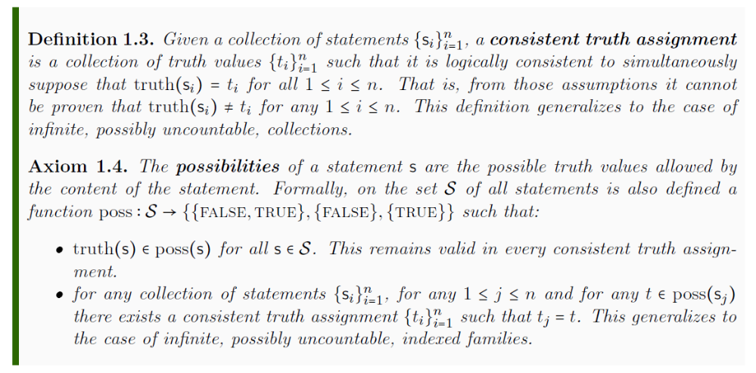
Possibilities of statements
Each statement has a set of possible truth values it can be hypothetically assigned

Slide 8
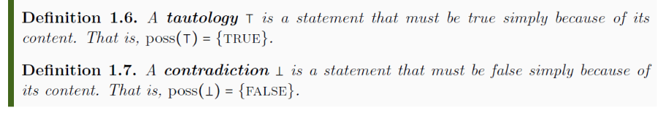
Possibilities of statements
For example, “This swan is a bird” is a tautology and “This cat is a dog” is a contradiction

Slide 9
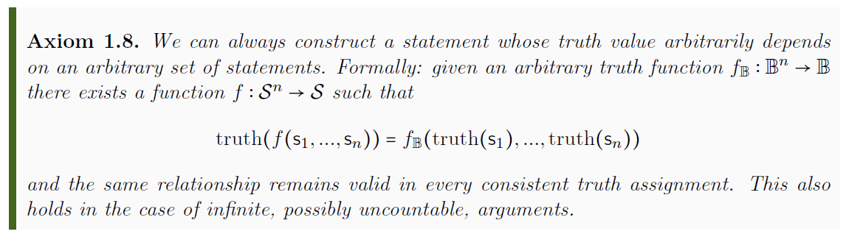
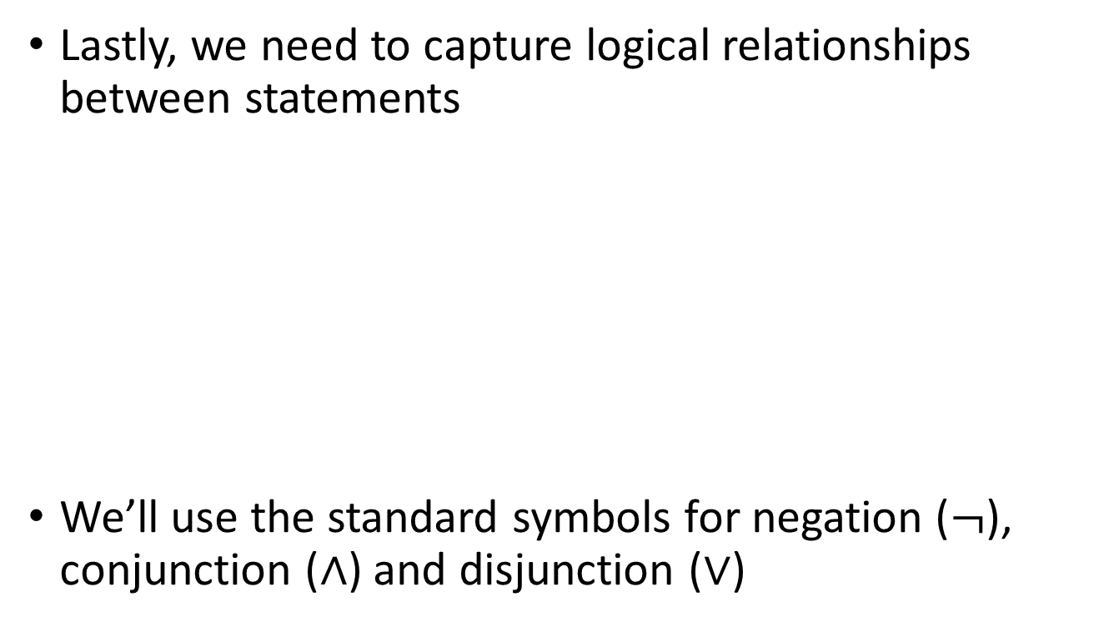
Logic relationships
Lastly, we need to capture logical relationships between statements
We’ll use the standard symbols for negation ($¬$), conjunction ($∧$) and disjunction ($∨$)

Slide 10
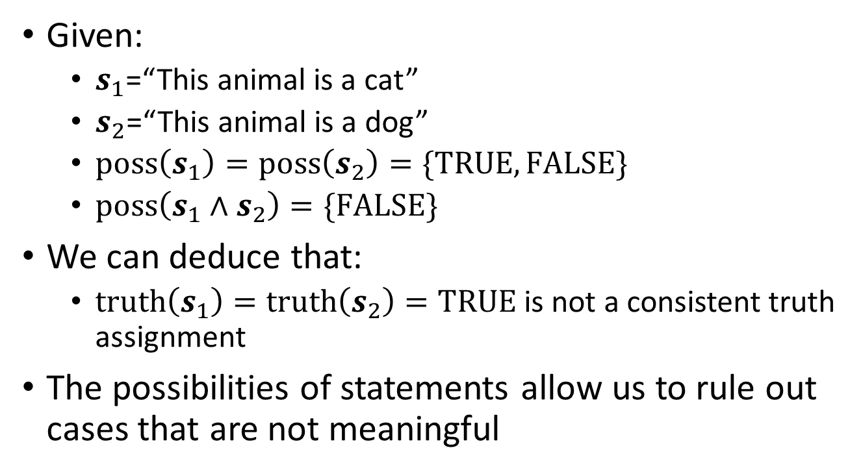
Logic relationships
Given:
$s_{1}$=“This animal is a cat”
$s_{2}$=“This animal is a dog”
$poss\left(s_{1}\right)=poss\left(s_{2}\right)=\{TRUE, FALSE\}$
$poss\left(s_{1}∧s_{2}\right)=\{FALSE\}$
We can deduce that:
$truth\left(s_{1}\right)=truth\left(s_{2}\right)=TRUE$ is not a consistent truth assignment
The possibilities of statements allow us to rule out cases that are not meaningful

Slide 11
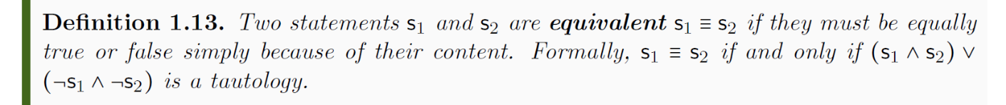
Statement equivalence
From these starting points, we can:
Define statement equivalence
Are the same statement
“This animal is a bird” = “Questo animale e’ un uccello”
“This animal is a bird” ≡ “This animal has feathers”
truth(“This animal is a bird”) = truth(“That animal is a mammal”)
Must have the same truth
Happen to have the same truth

Slide 12
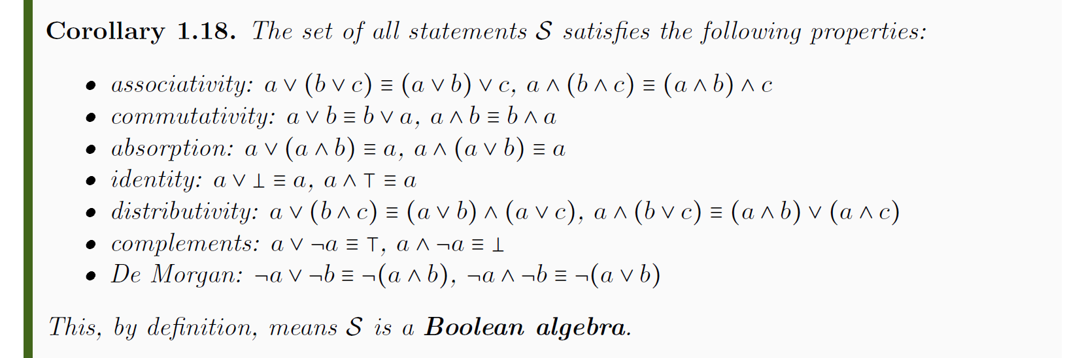
Boolean algebra
From these starting points, we can:
Show the set of all statements is a (complete) Boolean algebra (in terms of the equivalence classes)

Slide 13
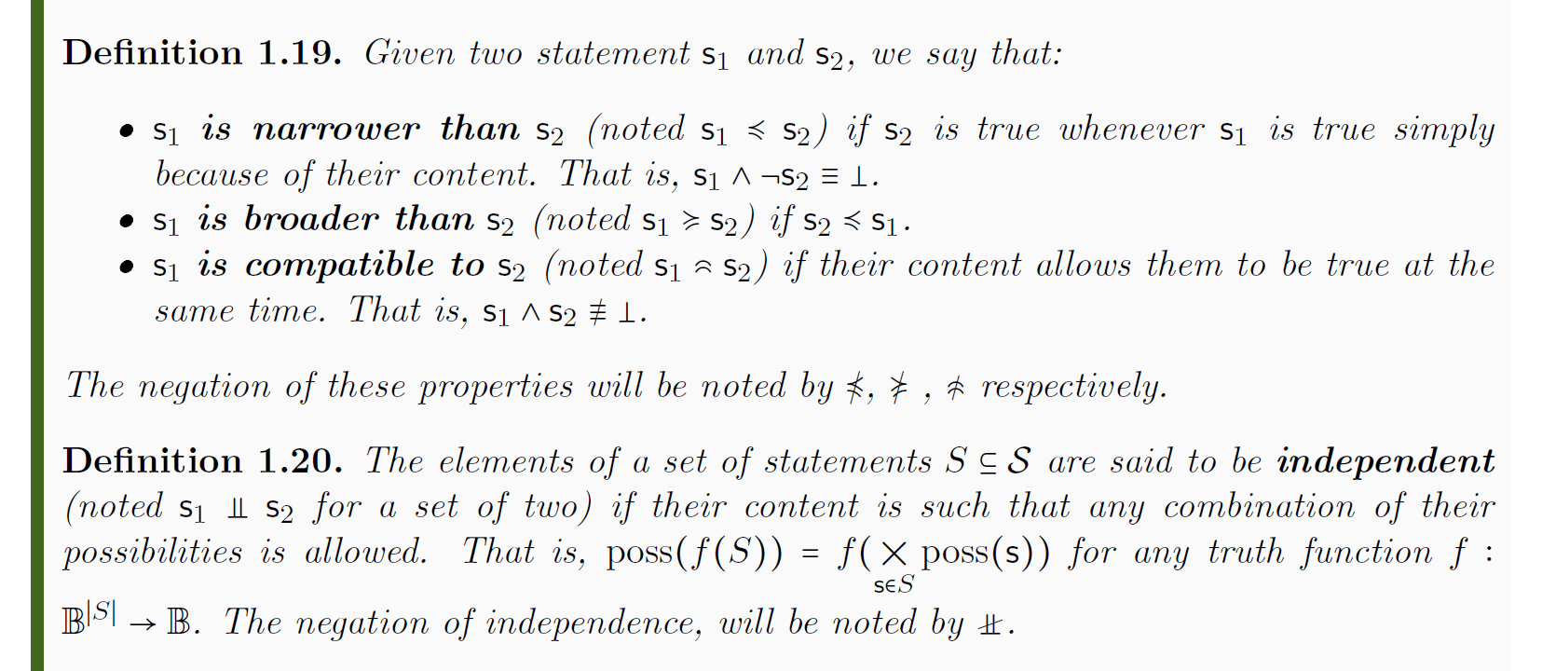
Other operators
From these starting points, we can:
Define other statement relationships

Slide 14
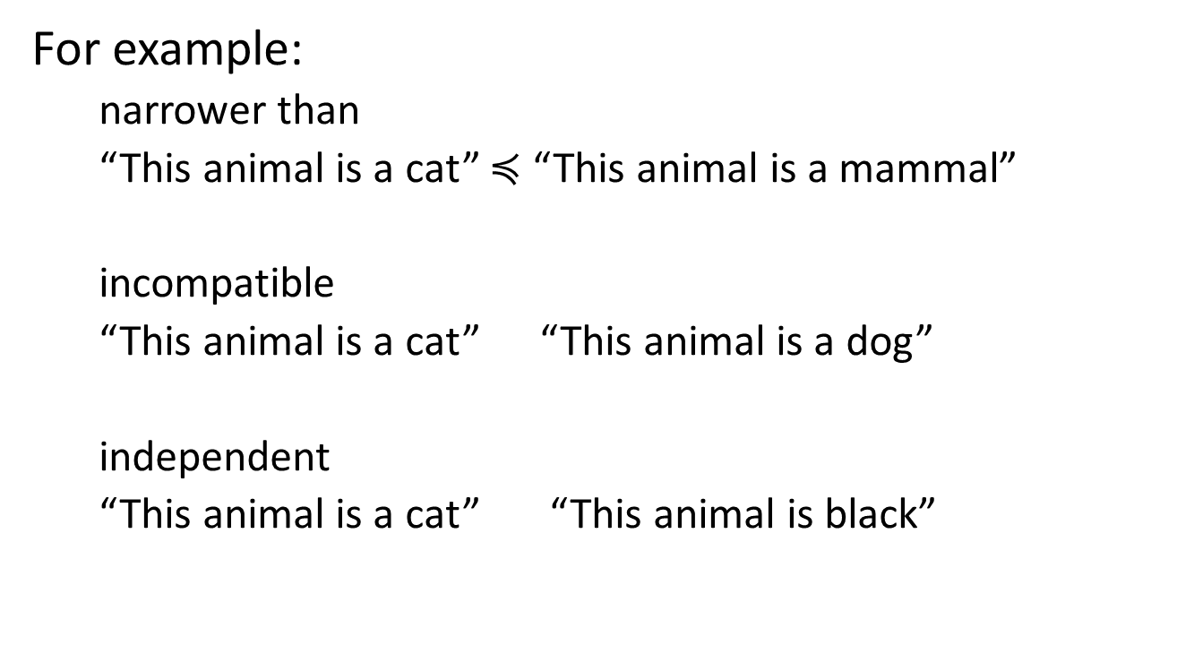
Other operators
For example:
narrower than
“This animal is a cat” $≼$ “This animal is a mammal”
incompatible
“This animal is a cat” “This animal is a dog”
independent
“This animal is a cat” “This animal is black”

Slide 15
Verifiable statements
Now that we have a framework rich enough to capture all the statement relationships we need, we turn our attention to experimental verification
A statement is verifiable if we have a repeatable procedure that terminates successfully in finite time if and only if the statement is true
This is hard to define formally so we won’t
Note that not all statements are experimentally verifiable
We can verify that “there exists extra-terrestrial life” or that “the mass of the photon is less than 10⁻¹⁸ eV”
We cannot verify that “there exists no extra-terrestrial life” or that “the mass of the photon is exactly 0 eV”

Slide 16
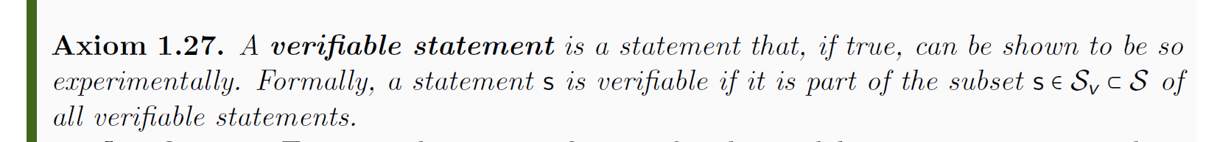
Verifiable statements
What makes a statement verifiable is not formally defined
There is a sense that trying to fully specify what can be measured is equivalent to already knowing the laws of physics
But we have to ask: under what operations is the set of verifiable statements closed?
Is it a Boolean algebra?

Slide 17
Logic of verifiable statements
We can’t always test negation
The test is not guaranteed to terminate if the test is unsuccessful
If we can, we say the statement is decidable
We can always test the finite conjunction
Just test one statement at a time: if they are all true all tests will terminate in finite time
We cannot have infinitely many tests though: we wouldn’t terminate in finite time
We can always test the countable disjunction
Once just one test terminates successfully, we are done
We cannot extend to uncountably many: we wouldn’t be able to find the test that terminates in finite time

Slide 18
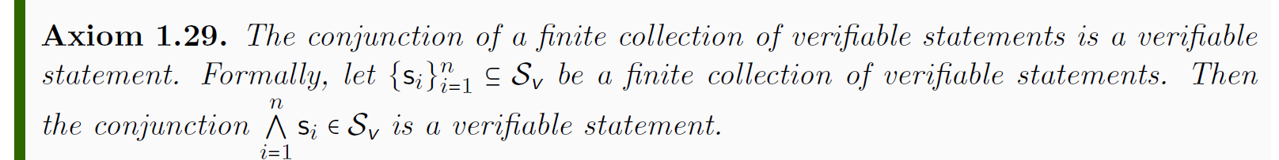
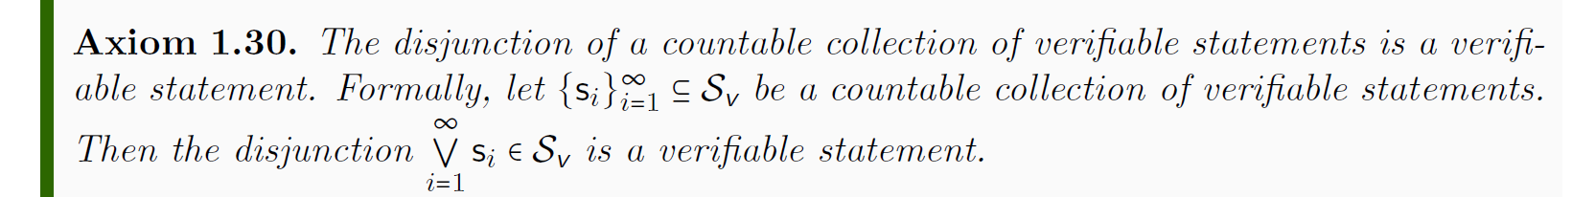
Logic of verifiable statements
We capture what operations are allowed on verifiable statements with the following axioms

Slide 19
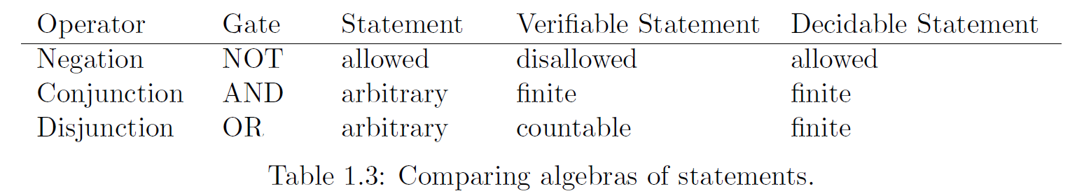



Comparing algebras
$$𝒮_{d}$$
$$𝒮_{v}$$
$$𝒮$$

Slide 20
Experimental domains and their possibilities

Slide 21
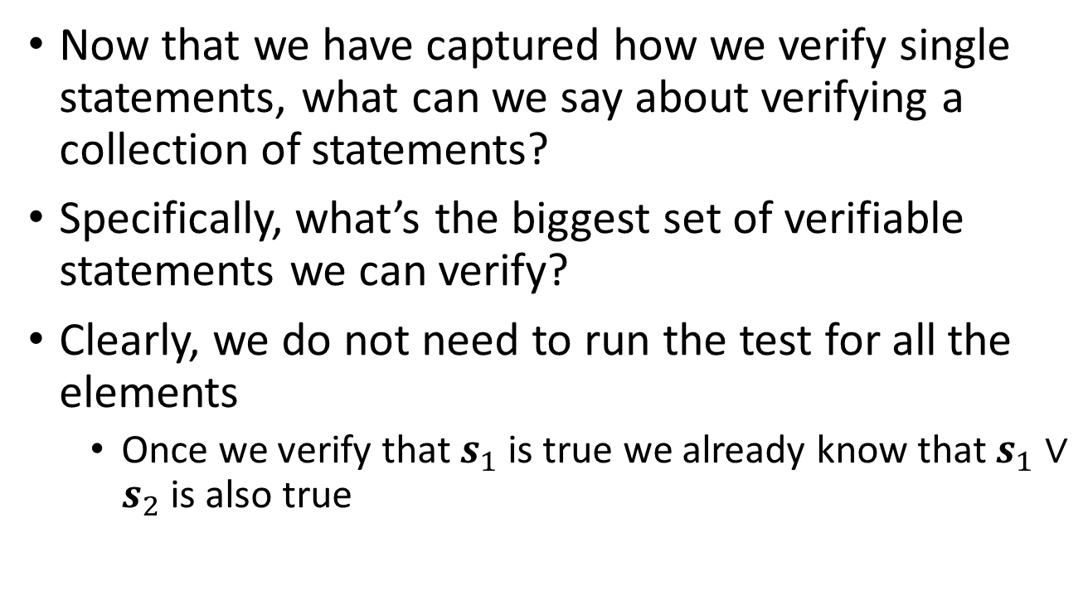
Sets of verifiable statements
Now that we have captured how we verify single statements, what can we say about verifying a collection of statements?
Specifically, what’s the biggest set of verifiable statements we can verify?
Clearly, we do not need to run the test for all the elements
Once we verify that $s_{1}$ is true we already know that $s_{1}∨s_{2}$ is also true

Slide 22
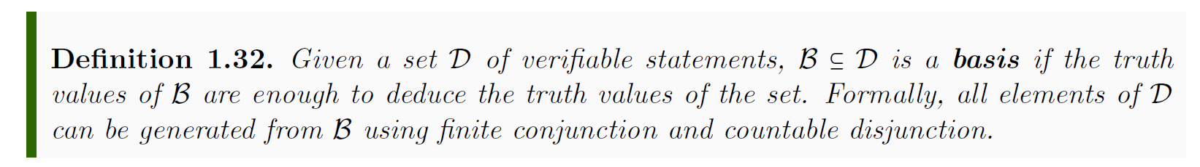
Basis
What is the biggest basis we can experimentally test?
A countable set
Even with unlimited time, we can only test countably many statements

Slide 23
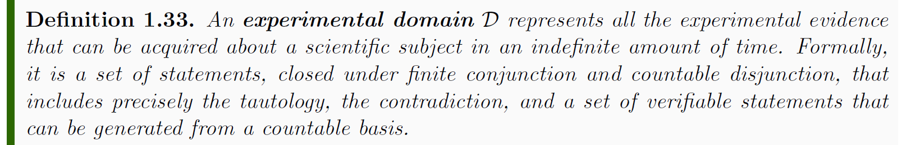
Experimental domain
This represents be biggest set of verifiable statements we can test
Any scientific theory, in the end, is equivalent to a set of verifiable statements, which forms at most an experimental domain

Slide 24
Predictions
Science is also about making predictions, but not all predictions are directly verifiable
For example, “there exists no extra-terrestrial life” predicts that the test for “there exists extra-terrestrial life” is never going to terminate
While we cannot always experimentally confirm negation, it still makes sense logically as a possible way things could be

Slide 25
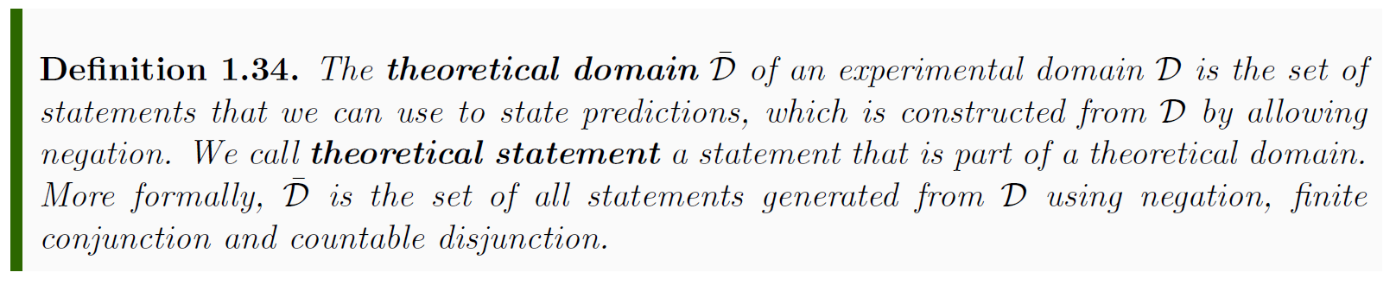
Theoretical domain
This represents all statements that give meaningful predictions to (and only to) the verifiable statements in the domain

Slide 26
Possibilities for the domain
Among all the predictions we look for the ones that give the full picture
For example, if we knew “This animal is a cat” to be true, we would also know that “This animal has whiskers” and “This animal is a mammal” are true while “This animal has feathers” is false

Slide 27
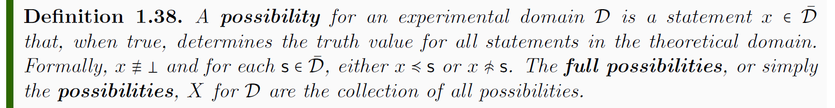
Possibilities for the domain
A possibility, if true, gives a prediction for all theoretical and verifiable statements
The set of possibilities corresponds to all the cases we can experimentally distinguish given the experimental domain

Slide 28
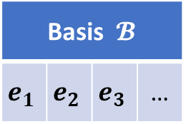
Start with a countable set of verifiable statements (the most we can verify experimentally)
Basis $𝓑$
$$e_{1}$$ | $$e_{2}$$ | $$e_{3}$$ | …

Slide 29
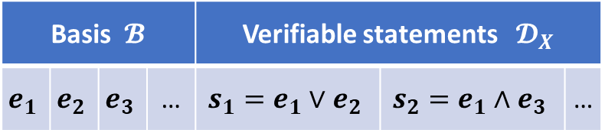
Construct all verifiable statements that can be verified from the basis (close under finite conjunction and countable disjunction)
Basis $𝓑$ |  |  |  | Verifiable statements $𝓓_{X}$
$$e_{1}$$ | $$e_{2}$$ | $$e_{3}$$ | … | $$s_{1}=e_{1}∨e_{2}$$ | $$s_{2}=e_{1}∧e_{3}$$ | …

Slide 30
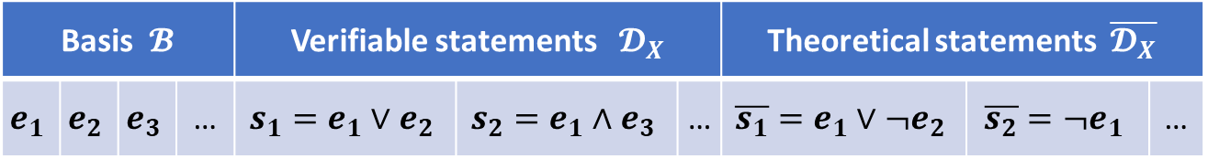
Construct all statements that give a prediction for those verifiable statements (close under negation as well)
Basis $𝓑$ |  |  |  | Verifiable statements $𝓓_{X}$ |  |  | Theoretical statements $\overline{𝓓_{X}}$
$$e_{1}$$ | $$e_{2}$$ | $$e_{3}$$ | … | $$s_{1}=e_{1}∨e_{2}$$ | $$s_{2}=e_{1}∧e_{3}$$ | … | $$\overline{s_{1}}=e_{1}∨¬e_{2}$$ | $$\overline{s_{2}}=¬e_{1}$$ | …

Slide 31
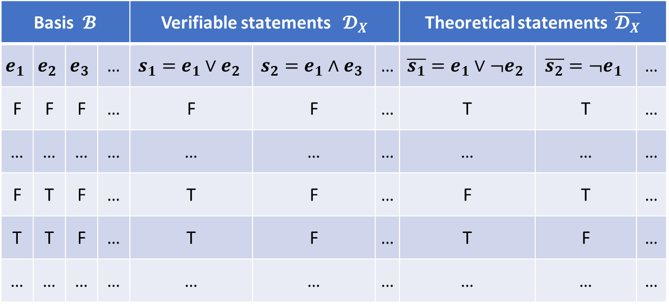
Consider all truth assignments: it is sufficient to assign the basis
Basis $𝓑$ |  |  |  | Verifiable statements $𝓓_{X}$ |  |  | Theoretical statements $\overline{𝓓_{X}}$
$$e_{1}$$ | $$e_{2}$$ | $$e_{3}$$ | … | $$s_{1}=e_{1}∨e_{2}$$ | $$s_{2}=e_{1}∧e_{3}$$ | … | $$\overline{s_{1}}=e_{1}∨¬e_{2}$$ | $$\overline{s_{2}}=¬e_{1}$$ | …
F | F | F | … | F | F | … | T | T | …
… | … | … | … | … | … | … | … | … | …
F | T | F | … | T | F | … | F | T | …
T | T | F | … | T | F | … | T | F | …
… | … | … | … | … | … | … | … | … | …

Slide 32
Remove truth assignments that are not consistent with the possibilities of the statements
Basis $𝓑$ |  |  |  | Verifiable statements $𝓓_{X}$ |  |  | Theoretical statements $\overline{𝓓_{X}}$
$$e_{1}$$ | $$e_{2}$$ | $$e_{3}$$ | … | $$s_{1}=e_{1}∨e_{2}$$ | $$s_{2}=e_{1}∧e_{3}$$ | … | $$\overline{s_{1}}=e_{1}∨¬e_{2}$$ | $$\overline{s_{2}}=¬e_{1}$$ | …
F | F | F | … | F | F | … | T | T | …
… | … | … | … | … | … | … | … | … | …
F | T | F | … | T | F | … | F | T | …
T | T | F | … | T | F | … | T | F | …
… | … | … | … | … | … | … | … | … | …

Slide 33


Each consistent truth assignment is associated with a possibility of the domain
Basis $𝓑$ |  |  |  | Verifiable statements $𝓓_{X}$ |  |  | Theoretical statements $\overline{𝓓_{X}}$
$$e_{1}$$ | $$e_{2}$$ | $$e_{3}$$ | … | $$s_{1}=e_{1}∨e_{2}$$ | $$s_{2}=e_{1}∧e_{3}$$ | … | $$\overline{s_{1}}=e_{1}∨¬e_{2}$$ | $$\overline{s_{2}}=¬e_{1}$$ | …
F | F | F | … | F | F | … | T | T | …
… | … | … | … | … | … | … | … | … | …
F | T | F | … | T | F | … | F | T | …
T | T | F | … | T | F | … | T | F | …
… | … | … | … | … | … | … | … | … | …
Possibilities $X$
$$x=¬e_{1}∧e_{2}∧¬e_{3}∧…$$
For each consistent truth assignment we have a minterm that is true only in that case. Each minterm is a possibility of the domain.

Slide 34
Each consistent truth assignment is associated with a possibility of the domain
Basis $𝓑$ |  |  |  | Verifiable statements $𝓓_{X}$ |  |  | Theoretical statements $\overline{𝓓_{X}}$
$$e_{1}$$ | $$e_{2}$$ | $$e_{3}$$ | … | $$s_{1}=e_{1}∨e_{2}$$ | $$s_{2}=e_{1}∧e_{3}$$ | … | $$\overline{s_{1}}=e_{1}∨¬e_{2}$$ | $$\overline{s_{2}}=¬e_{1}$$ | …
F | F | F | … | F | F | … | T | T | …
… | … | … | … | … | … | … | … | … | …
F | T | F | … | T | F | … | F | T | …
T | T | F | … | T | F | … | T | F | …
… | … | … | … | … | … | … | … | … | …
Possibilities $X$
$$x=¬e_{1}∧e_{2}∧¬e_{3}∧…$$
For each consistent truth assignment we have a minterm that is true only in that case. Each minterm is a possibility of the domain.
The role of logic (and math) in science is to capture
what is consistent (i.e. the possibilities) and what is verifiable (i.e. the verifiable statements)

Slide 35
Natural topology for the possibilities

Slide 36
Each consistent truth assignment is associated with a possibility of the domain
Basis $𝓑$ |  |  |  | Verifiable statements $𝓓_{X}$ |  |  | Theoretical statements $\overline{𝓓_{X}}$
$$e_{1}$$ | $$e_{2}$$ | $$e_{3}$$ | … | $$s_{1}=e_{1}∨e_{2}$$ | $$s_{2}=e_{1}∧e_{3}$$ | … | $$\overline{s_{1}}=e_{1}∨¬e_{2}$$ | $$\overline{s_{2}}=¬e_{1}$$ | …
F | F | F | … | F | F | … | T | T | …
… | … | … | … | … | … | … | … | … | …
F | T | F | … | T | F | … | F | T | …
T | T | F | … | T | F | … | T | F | …
… | … | … | … | … | … | … | … | … | …
Possibilities $X$
$$x=¬e_{1}∧e_{2}∧¬e_{3}∧…$$
For each consistent truth assignment we have a minterm that is true only in that case. Each minterm is a possibility of the domain.
Where is the topology?!?

Slide 37
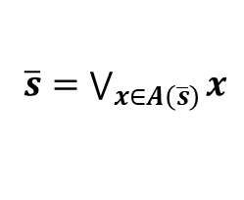


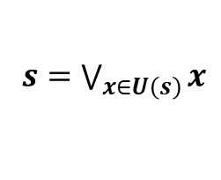
Each statement can be expressed as the disjunction of a set of possibilities
Basis $𝓑$ |  |  |  | Verifiable statements $𝓓_{X}$ |  |  | Theoretical statements $\overline{𝓓_{X}}$
$$e_{1}$$ | $$e_{2}$$ | $$e_{3}$$ | … | $$s_{1}=e_{1}∨e_{2}$$ | $$s_{2}=e_{1}∧e_{3}$$ | … | $$\overline{s_{1}}=e_{1}∨¬e_{2}$$ | $$\overline{s_{2}}=¬e_{1}$$ | …
F | F | F | … | F | F | … | T | T | …
… | … | … | … | … | … | … | … | … | …
F | T | F | … | T | F | … | F | T | …
T | T | F | … | T | F | … | T | F | …
… | … | … | … | … | … | … | … | … | …
Possibilities $X$
$$x=¬e_{1}∧e_{2}∧¬e_{3}∧…$$
$U:𝓓_{X}→2^{X}$
$A:\overline{𝓓_{X}}→2^{X}$
For each consistent truth assignment we have a minterm that is true only in that case. Each minterm is a possibility of the domain.
$s=\bigvee_{x∈U\left(s\right)}{x}$
$\overline{s}=\bigvee_{x∈A\left(\overline{s}\right)}{x}$
Each statement can be expressed in the disjunctive normal form (disjunction of minterms, OR of ANDs): a disjunction of possibilities.

Slide 38
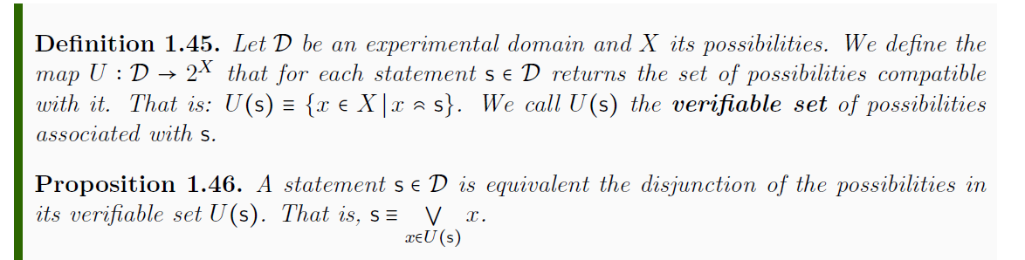
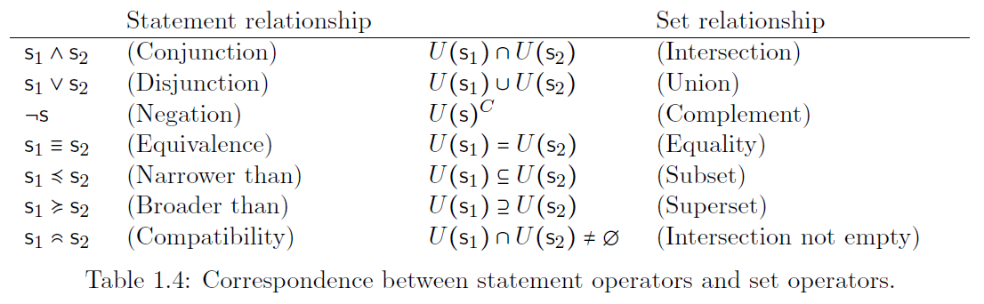
We can express each verifiable statement in terms of a set of possibilities. Relationships between statements become relationships between sets.

Slide 39
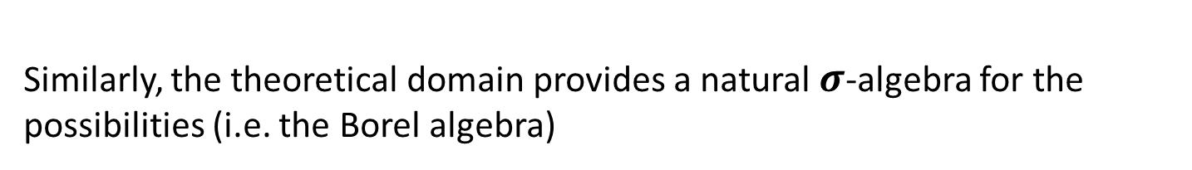
Closure of the experimental domain under finite conjunction and countable disjunction means the set of verifiable sets is closed under finite intersection and countable union.
Similarly, the theoretical domain provides a natural $σ$-algebra for the possibilities (i.e. the Borel algebra)

Slide 40
Basis $𝓑$ |  |  |  | Verifiable statements $𝓓_{X}$ |  |  | Theoretical statements $\overline{𝓓_{X}}$
$$e_{1}$$ | $$e_{2}$$ | $$e_{3}$$ | … | $$s_{1}=e_{1}∨e_{2}$$ | $$s_{2}=e_{1}∧e_{3}$$ | … | $$\overline{s_{1}}=e_{1}∨¬e_{2}$$ | $$\overline{s_{2}}=¬e_{1}$$ | …
F | F | F | … | F | F | … | T | T | …
… | … | … | … | … | … | … | … | … | …
F | T | F | … | T | F | … | F | T | …
T | T | F | … | T | F | … | T | F | …
… | … | … | … | … | … | … | … | … | …
Possibilities $X$
The lines of the truth table (i.e. the consistent truth assignments) are the points

Slide 41
Basis $𝓑$ |  |  |  | Verifiable statements $𝓓_{X}$ |  |  | Theoretical statements $\overline{𝓓_{X}}$
$$e_{1}$$ | $$e_{2}$$ | $$e_{3}$$ | … | $$s_{1}=e_{1}∨e_{2}$$ | $$s_{2}=e_{1}∧e_{3}$$ | … | $$\overline{s_{1}}=e_{1}∨¬e_{2}$$ | $$\overline{s_{2}}=¬e_{1}$$ | …
F | F | F | … | F | F | … | T | T | …
… | … | … | … | … | … | … | … | … | …
F | T | F | … | T | F | … | F | T | …
T | T | F | … | T | F | … | T | F | …
… | … | … | … | … | … | … | … | … | …
Possibilities $X$
Each column is a set (i.e. the set of possibilities that are true in that column)

Slide 42
Basis $𝓑$ |  |  |  | Verifiable statements $𝓓_{X}$ |  |  | Theoretical statements $\overline{𝓓_{X}}$
$$e_{1}$$ | $$e_{2}$$ | $$e_{3}$$ | … | $$s_{1}=e_{1}∨e_{2}$$ | $$s_{2}=e_{1}∧e_{3}$$ | … | $$\overline{s_{1}}=e_{1}∨¬e_{2}$$ | $$\overline{s_{2}}=¬e_{1}$$ | …
F | F | F | … | F | F | … | T | T | …
… | … | … | … | … | … | … | … | … | …
F | T | F | … | T | F | … | F | T | …
T | T | F | … | T | F | … | T | F | …
… | … | … | … | … | … | … | … | … | …
Possibilities $X$
The experimental domain is the topology (i.e. each verifiable statement is an open set)

Slide 43
Basis $𝓑$ |  |  |  | Verifiable statements $𝓓_{X}$ |  |  | Theoretical statements $\overline{𝓓_{X}}$
$$e_{1}$$ | $$e_{2}$$ | $$e_{3}$$ | … | $$s_{1}=e_{1}∨e_{2}$$ | $$s_{2}=e_{1}∧e_{3}$$ | … | $$\overline{s_{1}}=e_{1}∨¬e_{2}$$ | $$\overline{s_{2}}=¬e_{1}$$ | …
F | F | F | … | F | F | … | T | T | …
… | … | … | … | … | … | … | … | … | …
F | T | F | … | T | F | … | F | T | …
T | T | F | … | T | F | … | T | F | …
… | … | … | … | … | … | … | … | … | …
Possibilities $X$
The basis of the experimental domain is a sub-basis of the topology

Slide 44
Basis $𝓑$ |  |  |  | Verifiable statements $𝓓_{X}$ |  |  | Theoretical statements $\overline{𝓓_{X}}$
$$e_{1}$$ | $$e_{2}$$ | $$e_{3}$$ | … | $$s_{1}=e_{1}∨e_{2}$$ | $$s_{2}=e_{1}∧e_{3}$$ | … | $$\overline{s_{1}}=e_{1}∨¬e_{2}$$ | $$\overline{s_{2}}=¬e_{1}$$ | …
F | F | F | … | F | F | … | T | T | …
… | … | … | … | … | … | … | … | … | …
F | T | F | … | T | F | … | F | T | …
T | T | F | … | T | F | … | T | F | …
… | … | … | … | … | … | … | … | … | …
Possibilities $X$
The theoretical domain is the 𝝈-algebra (i.e. each theoretical statement is a Borel set)

Slide 45
Examples
Discrete topology means every statement is decidable
All tests terminate and we can experimentally tell whether any statement is true or false
Standard topology on the real numbers means we can experimentally measure with arbitrarily small, but always finite, precision
A Hausdorff topology means that each possibility can be seen as a limit of a sequence of verifiable statements
The statements become narrower and narrower

Slide 46
General results
Every set of experimentally distinguishable objects will be a Kolmogorov second-countable topological space
Each point is the finest description the experimental technique allows
Each open set is a partial description that can be verified experimentally
This is true no matter which branch of science, what experimental technique or how clever we are
All we are doing is keeping track of the consistent truth assignments in that gigantic truth table
Consequence: we cannot experimentally distinguish elements of sets with cardinality greater than the continuum

Slide 47
Peculiarities of this framework
In topology the empty set is the same in all cases but the full set is not. In these topologies, the full set corresponds to the tautology, so it is the “same” in all cases as well.
In topology, points and open sets are different objects. In these topologies they are all statements.
In topology, first you must define the points and then you define the open sets. In these topologies you only define the open sets (i.e. the verifiable statements) and the points (i.e. the possibilities) are generated.

Slide 48
Conclusion
We believe this framework successfully formalizes the fundamental structure for experimental science, shedding light as to what role mathematical structures, such as topologies, play
We are working to extend this framework to other areas of math and science
For example, states are possibilities of some experimental domain, deterministic and reversible evolution is equivalence between past and future domains which will correspond to an isomorphism in the category

Slide 49
Acknowledgements and further information
We’d like to thank all the individuals in this community for the warm welcome, interest and insights, all of which helped push this project further
Mathew Timm and John Mayer in particular for the help throughout the year
For further information and details, see the draft of our open access book:
http://assumptionsofphysics.org/book/

