Slide 1


What we learned from proving a quantum postulate redundant
Gabriele Carcassi
Physics Department
University of Michigan

Slide 2
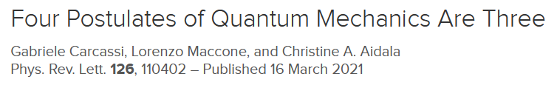



The paper
Gabriele Carcassi
Christine A. Aidala
Lorenzo Maccone
University of Michigan
Universita’ di Pavia

Slide 3
Plan
The setup
Postulates, how to remove them and the nature of composite systems
The proof
Projective spaces, their bridge between probabilistic events and quantum states, the fundamental theorem of projective geometry and the universal property of the tensor product
The commentary
The 12 page referee report, the anti-linearity debacle, the lack of tensor product in Hilbert spaces and the wrong math

Slide 4
THE SET-UP

Slide 5
Physics
Math
State of a quantum system
Ray in a Hilbert space
Quantities and measurements
Hermitian operators and Born rule
Composite quantum system
Tensor product
Time evolution
Schrödinger equation

Slide 6
Physics
Math
State of a quantum system
Ray in a Hilbert space
Quantities and measurements
Hermitian operators and Born rule
Composite quantum system
Tensor product
Time evolution
Schrödinger equation

Slide 7
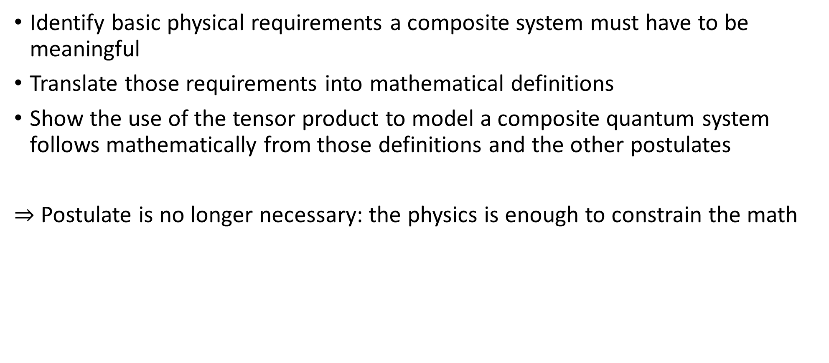
Recipe for removing a postulate
Identify basic physical requirements a composite system must have to be meaningful
Translate those requirements into mathematical definitions
Show the use of the tensor product to model a composite quantum system follows mathematically from those definitions and the other postulates
$⇒$ Postulate is no longer necessary: the physics is enough to constrain the math

Slide 8
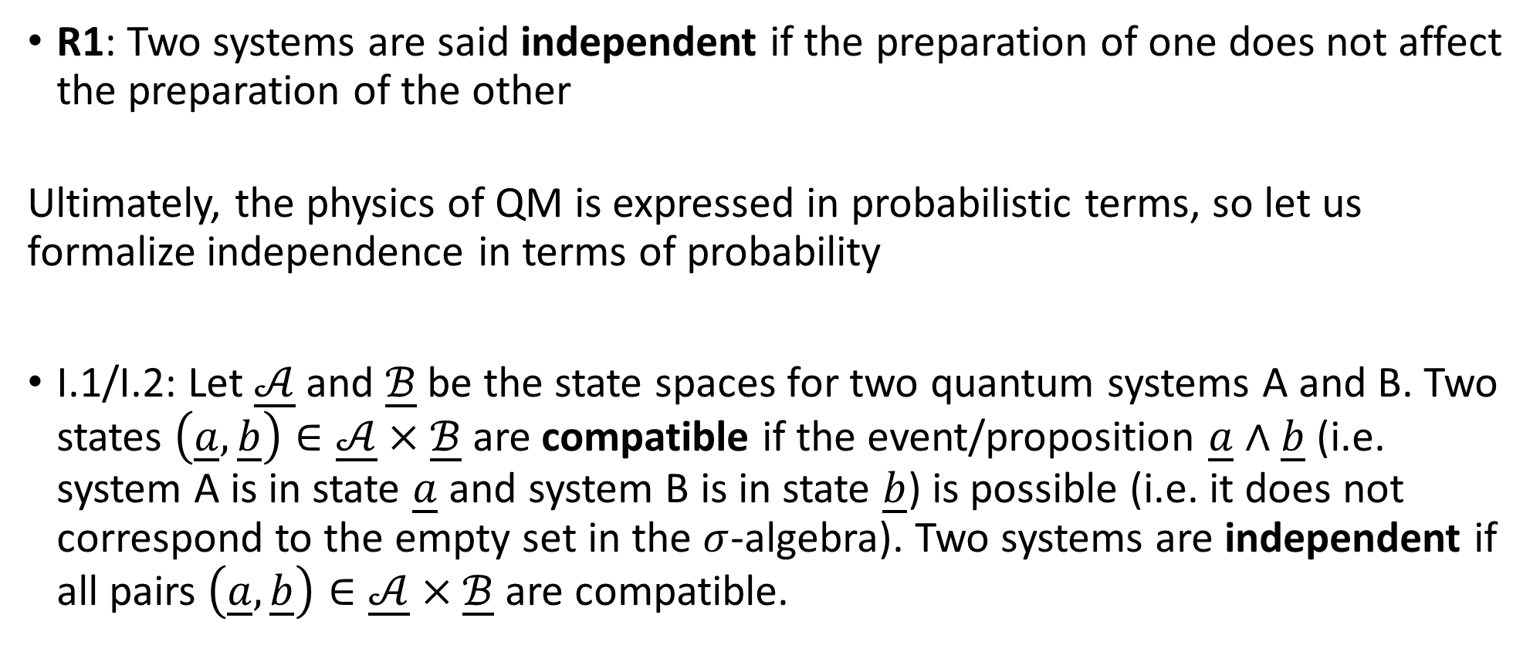
Requirement one: preparation independence
R1: Two systems are said independent if the preparation of one does not affect the preparation of the other
Ultimately, the physics of QM is expressed in probabilistic terms, so let us formalize independence in terms of probability
I.1/I.2: Let $\underline{𝒜}$ and $\underline{ℬ}$ be the state spaces for two quantum systems A and B. Two states $\left(\underline{a},\underline{b}\right)∈\underline{𝒜}×\underline{ℬ}$ are compatible if the event/proposition $\underline{a}∧\underline{b}$ (i.e. system A is in state $\underline{a}$ and system B is in state $\underline{b}$) is possible (i.e. it does not correspond to the empty set in the $σ$-algebra). Two systems are independent if all pairs $\left(\underline{a},\underline{b}\right)∈\underline{𝒜}×\underline{ℬ}$ are compatible.

Slide 9

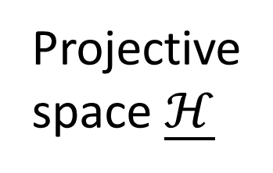

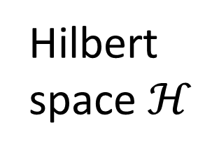

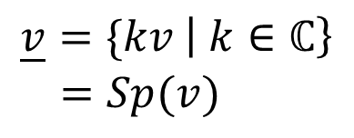

$$\underline{Sp\left(v_{1},v_{2},v_{3}\right)}$$
$$\underline{v}=\{kv \left| k∈ℂ\right\} \\ =Sp(v)$$
Projective space $\underline{ℋ}$
quantum state
$P\left(v | w\right)=\frac{{\left|\left\langle v,w\right\rangle \right|}^{2}}{\left\langle v,v\right\rangle \left\langle w,w\right\rangle }=P(\underline{v}|\underline{w}$)
ray
quantum state
Hilbert space $ℋ$
$$v$$
vector
$$Sp(v_{1},v_{2},v_{3})$$

Slide 10
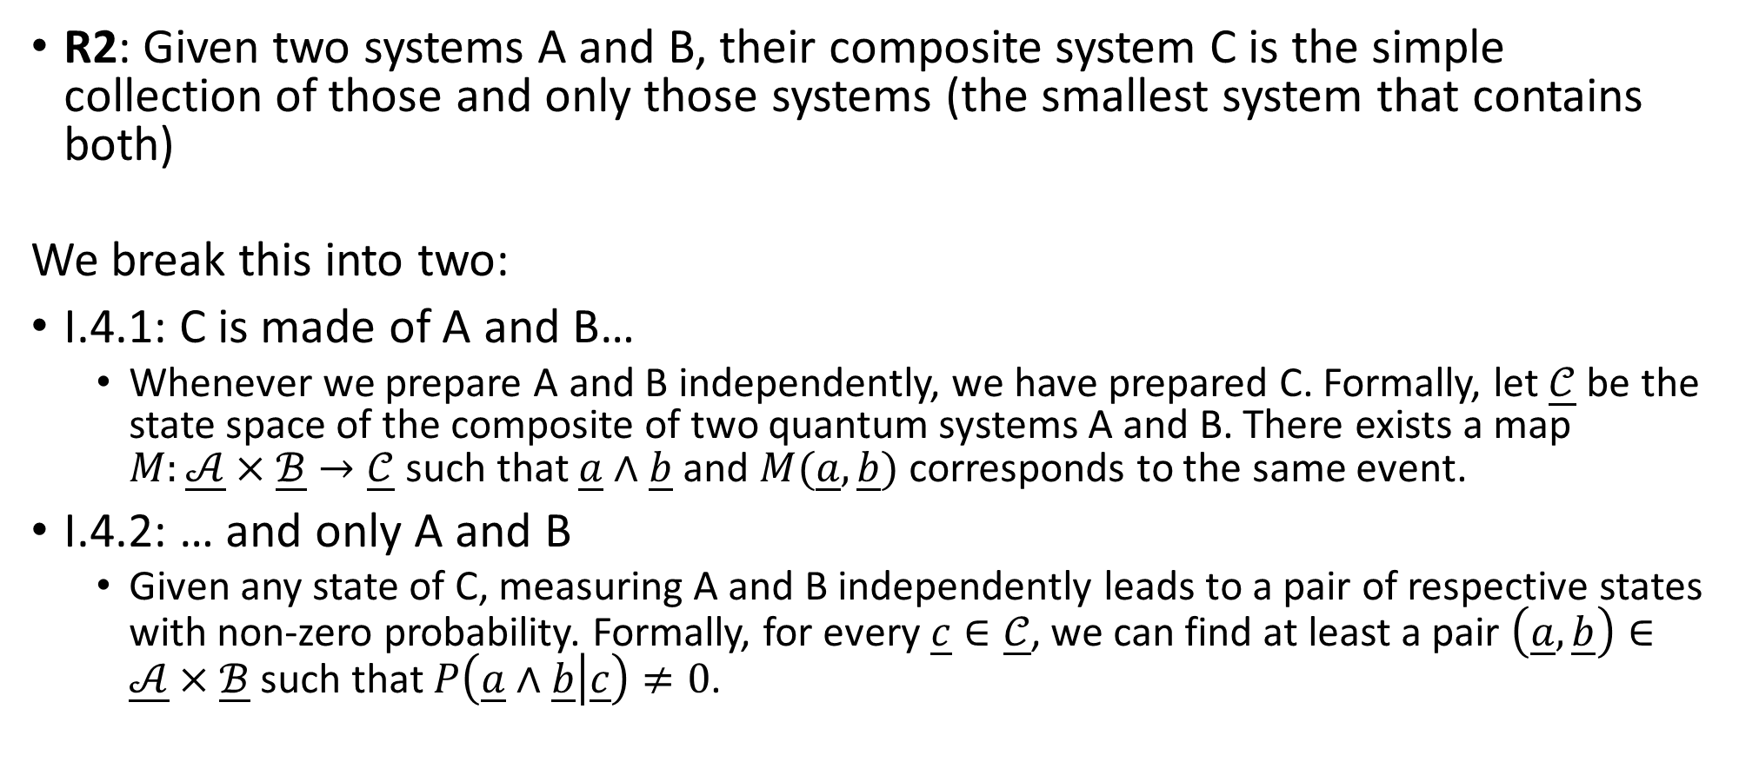
Requirement two: composite system
R2: Given two systems A and B, their composite system C is the simple collection of those and only those systems (the smallest system that contains both)
We break this into two:
I.4.1: C is made of A and B…
Whenever we prepare A and B independently, we have prepared C. Formally, let $\underline{𝒞}$ be the state space of the composite of two quantum systems A and B. There exists a map $M:\underline{𝒜}×\underline{ℬ}→\underline{𝒞}$ such that $\underline{a}∧\underline{b}$ and $M(\underline{a},\underline{b})$ corresponds to the same event.
I.4.2: … and only A and B
Given any state of C, measuring A and B independently leads to a pair of respective states with non-zero probability. Formally, for every $\underline{c}∈\underline{𝒞}$, we can find at least a pair $\left(\underline{a},\underline{b}\right)∈\underline{𝒜}×\underline{ℬ}$ such that $P\left(\underline{a}∧\underline{b} | \underline{c}\right)≠0$.

Slide 11









$$\underline{𝒜}$$
Projective space $\underline{ℋ}$
$$\underline{𝒞}$$
$$M$$
$$\underline{ℬ}$$
$$𝒜$$
Hilbert space $ℋ$
$$𝒞$$
$$m$$
$$ℬ$$
WTS $m$ exists and it is the tensor product

Slide 12
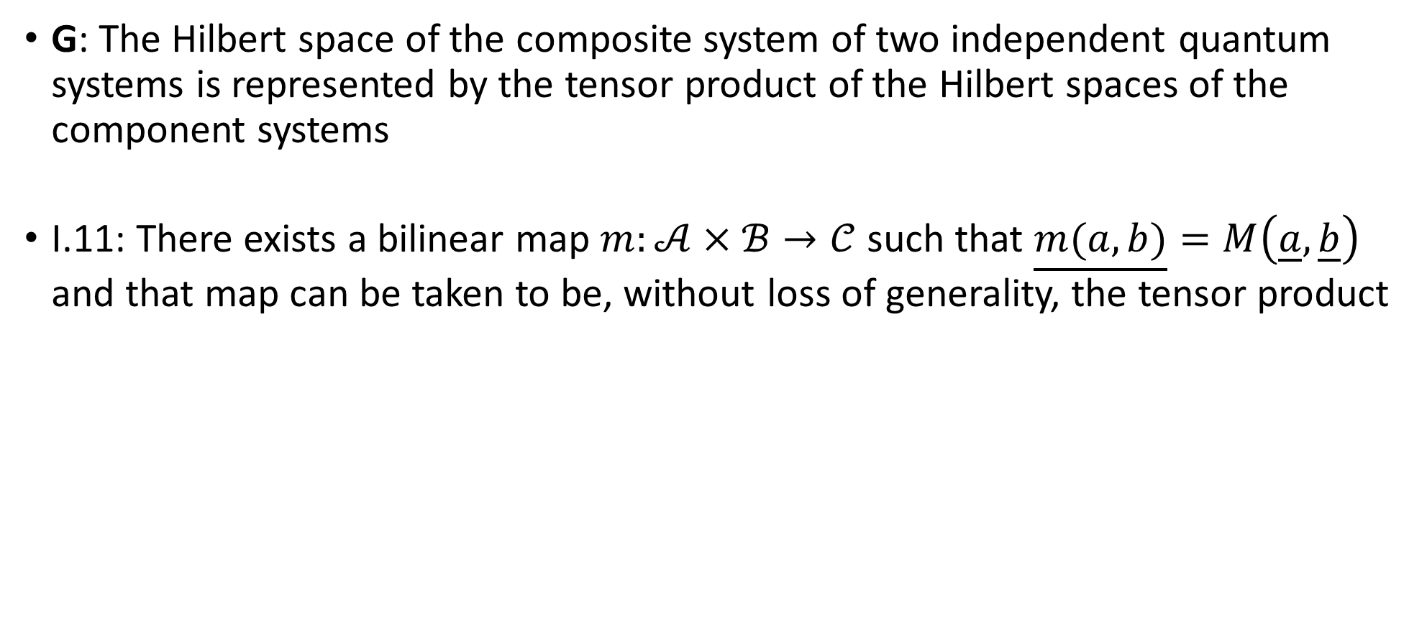
Goal: tensor product
G: The Hilbert space of the composite system of two independent quantum systems is represented by the tensor product of the Hilbert spaces of the component systems
I.11: There exists a bilinear map $m:𝒜×ℬ→𝒞$ such that $\underline{m(a,b)}=M\left(\underline{a},\underline{b}\right)$ and that map can be taken to be, without loss of generality, the tensor product

Slide 13
THE PROOF

Slide 14

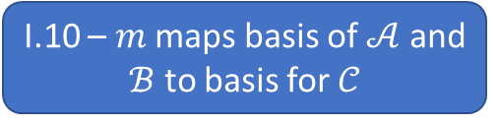

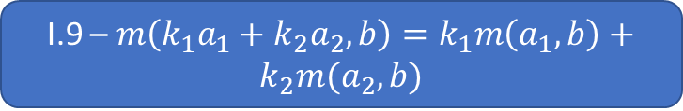


I.3 – $P\left({\underline{a}}_{1} | {\underline{a}}_{2}∧\underline{b}\right)=P\left({\underline{a}}_{1} | {\underline{a}}_{2}\right)$
P2 – Born rule
Not the simplest thing
I’ll try to cover the main points
I.5 – $span\left(M\left(\underline{𝒜}×\underline{ℬ}\right)\right)=\underline{𝒞}$
I.2 – Prep indep
I.6 – $M$ is a total function
I.4 – Composite map
P1 – State postulate
I.7 – $P\left({\underline{a}}_{1}∧\underline{b} | {\underline{a}}_{2}∧\underline{b}\right)=P\left({\underline{a}}_{1} | {\underline{a}}_{2}\right)$
I.8 – Inner product preserving projective maps can be represented by a linear map
I.10 – $m$ maps basis of $𝒜$ and $ℬ$ to basis for $𝒞$
I.9 – $m\left(k_{1}a_{1}+k_{2}a_{2},b\right)=k_{1}m\left(a_{1},b\right)+k_{2}m(a_{2},b)$
I.11 – $m$ can be taken to be the tensor product

Slide 15



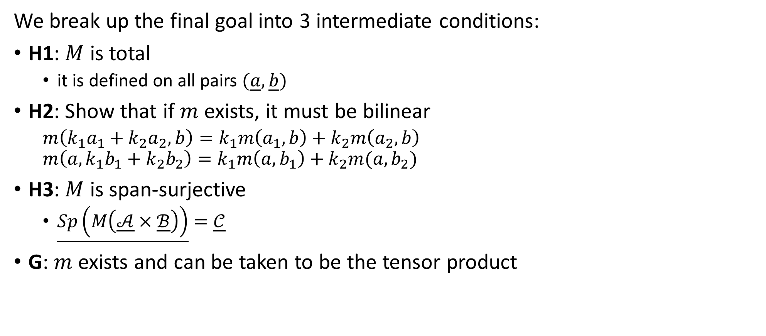





Outline
We break up the final goal into 3 intermediate conditions:
H1: $M$ is total
it is defined on all pairs $(\underline{a},\underline{b})$
H2: Show that if $m$ exists, it must be bilinear
$m\left(k_{1}a_{1}+k_{2}a_{2},b\right)=k_{1}m\left(a_{1},b\right)+k_{2}m\left(a_{2},b\right)$ $m\left(a,k_{1}b_{1}+k_{2}b_{2}\right)=k_{1}m\left(a,b_{1}\right)+k_{2}m(a,b_{2})$
H3: $M$ is span-surjective
$\underline{Sp\left(M\left(\underline{𝒜}×\underline{ℬ}\right)\right)}=\underline{𝒞}$
G: $m$ exists and can be taken to be the tensor product
$$\underline{𝒜}$$
$$M$$
$$\underline{𝒞}$$
$$\underline{ℬ}$$
$$𝒜$$
$$m$$
$$𝒞$$
$$ℬ$$
These are the harder bits

Slide 16
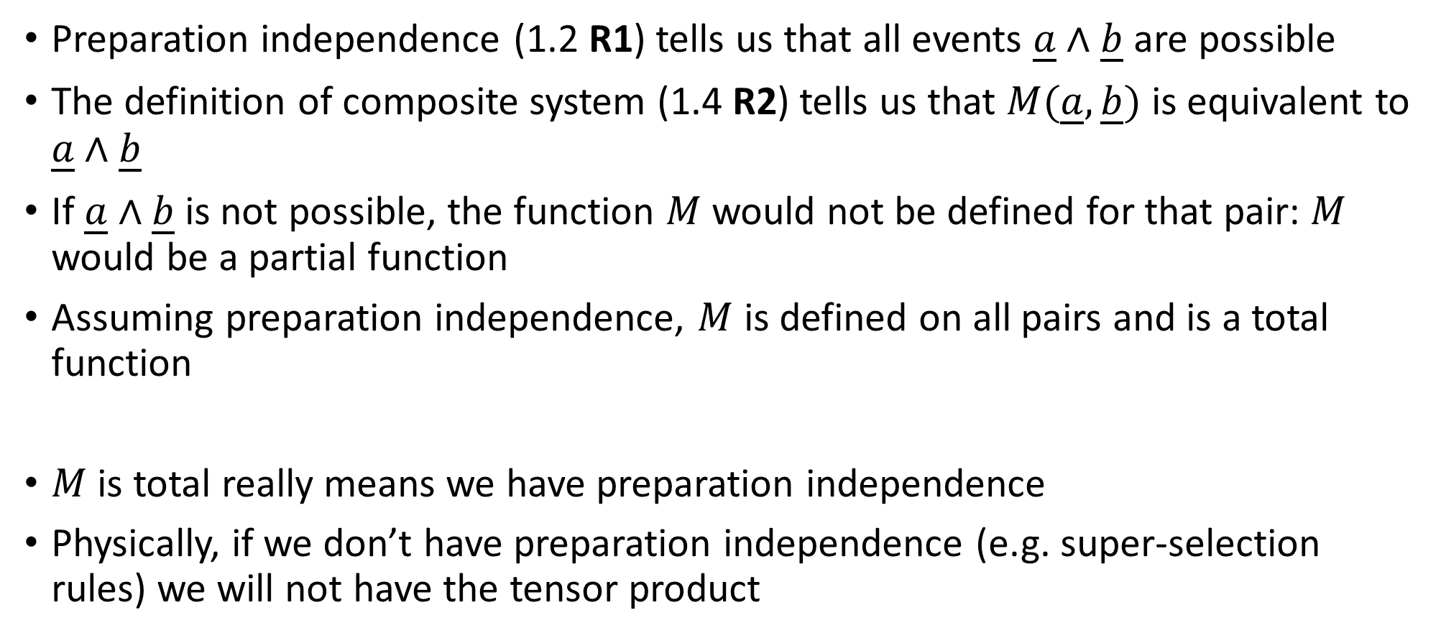
I.6 H1: $M$ is total
Preparation independence (1.2 R1) tells us that all events $\underline{a}∧\underline{b}$ are possible
The definition of composite system (1.4 R2) tells us that $M(\underline{a},\underline{b})$ is equivalent to $\underline{a}∧\underline{b}$
If $\underline{a}∧\underline{b}$ is not possible, the function $M$ would not be defined for that pair: $M$ would be a partial function
Assuming preparation independence, $M$ is defined on all pairs and is a total function
$M$ is total really means we have preparation independence
Physically, if we don’t have preparation independence (e.g. super-selection rules) we will not have the tensor product

Slide 17
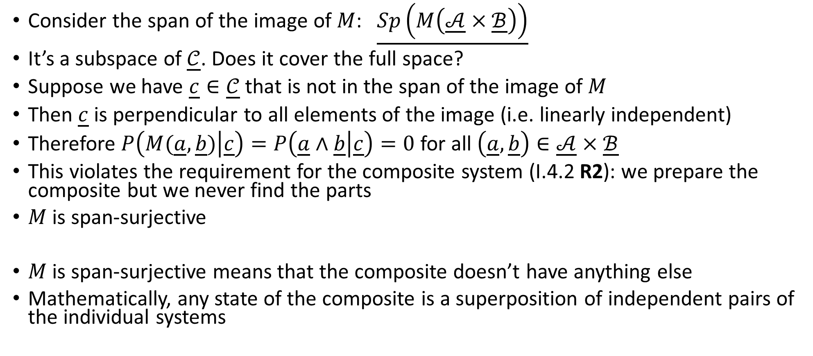
I.5 H3: $M$ is span-surjective
Consider the span of the image of $M$: $\underline{Sp\left(M\left(\underline{𝒜}×\underline{ℬ}\right)\right)}$
It’s a subspace of $\underline{𝒞}$. Does it cover the full space?
Suppose we have $\underline{c}∈\underline{𝒞}$ that is not in the span of the image of $M$
Then $\underline{c}$ is perpendicular to all elements of the image (i.e. linearly independent)
Therefore $P\left(M(\underline{a},\underline{b}) | \underline{c}\right)=P\left(\underline{a}∧\underline{b} | \underline{c}\right)=0$ for all $\left(\underline{a},\underline{b}\right)∈\underline{𝒜}×\underline{ℬ}$
This violates the requirement for the composite system (I.4.2 R2): we prepare the composite but we never find the parts
$M$ is span-surjective
$M$ is span-surjective means that the composite doesn’t have anything else
Mathematically, any state of the composite is a superposition of independent pairs of the individual systems

Slide 18






The road to bilinearity
Projective space $\underline{ℋ}$
$$\underline{𝒜}$$
$$\underline{𝒞}$$
$$F$$
Colinear: preserves subgroup structure $$G_{1}⊆G_{2}⟺F\left(G_{1}\right)⊆F\left(G_{2}\right)$$
Hilbert space $ℋ$
$$𝒜$$
$$𝒞$$
$$f$$
Linear: $f\left(k_{1}a_{1}+k_{2}a_{2}\right)=k_{1}f\left(a_{1}\right)+k_{2}(a_{2})$

Slide 19
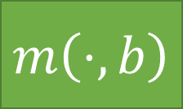
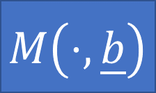
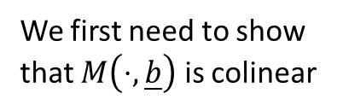
The road to bilinearity
Projective space $\underline{ℋ}$
$$\underline{𝒜}$$
$$\underline{𝒞}$$
$$M\left(⋅,\underline{b}\right)$$
We first need to show that $M\left(⋅,\underline{b}\right)$ is colinear
Hilbert space $ℋ$
$$𝒜$$
$$𝒞$$
$$m\left(⋅,b\right)$$

Slide 20
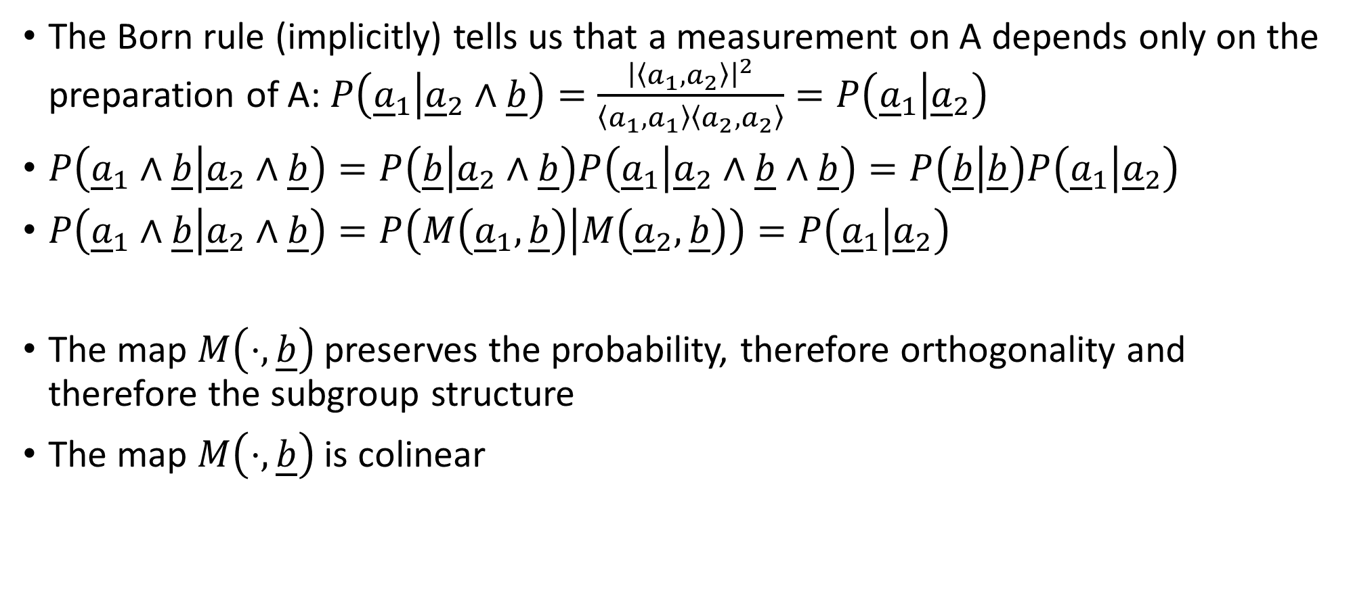
Colinearity of $M\left(⋅,\underline{b}\right)$
The Born rule (implicitly) tells us that a measurement on A depends only on the preparation of A: $P\left({\underline{a}}_{1} | {\underline{a}}_{2}∧\underline{b}\right)=\frac{{\left|\left\langle a_{1},a_{2}\right\rangle \right|}^{2}}{\left\langle a_{1},a_{1}\right\rangle \left\langle a_{2},a_{2}\right\rangle }=P\left({\underline{a}}_{1} | {\underline{a}}_{2}\right)$
$P\left({\underline{a}}_{1}∧\underline{b} | {\underline{a}}_{2}∧\underline{b}\right)=P\left(\underline{b} | {\underline{a}}_{2}∧\underline{b}\right)P\left({\underline{a}}_{1} | {\underline{a}}_{2}∧\underline{b}∧\underline{b}\right)=P\left(\underline{b} | \underline{b}\right)P\left({\underline{a}}_{1} | {\underline{a}}_{2}\right)$
$P\left({\underline{a}}_{1}∧\underline{b} | {\underline{a}}_{2}∧\underline{b}\right)=P\left(M\left({\underline{a}}_{1},\underline{b}\right) | M\left({\underline{a}}_{2},\underline{b}\right)\right)=P\left({\underline{a}}_{1} | {\underline{a}}_{2}\right)$
The map $M\left(⋅,\underline{b}\right)$ preserves the probability, therefore orthogonality and therefore the subgroup structure
The map $M\left(⋅,\underline{b}\right)$ is colinear

Slide 21
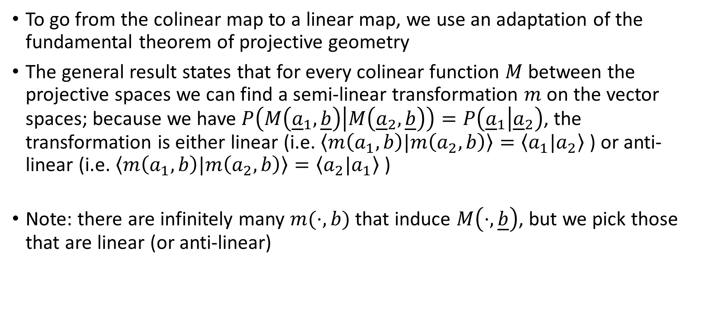
Fundamental theorem of projective geometry
To go from the colinear map to a linear map, we use an adaptation of the fundamental theorem of projective geometry
The general result states that for every colinear function $M$ between the projective spaces we can find a semi-linear transformation $m$ on the vector spaces; because we have $P\left(M\left({\underline{a}}_{1},\underline{b}\right) | M\left({\underline{a}}_{2},\underline{b}\right)\right)=P\left({\underline{a}}_{1} | {\underline{a}}_{2}\right)$, the transformation is either linear (i.e. $\left\langle m\left(a_{1},b\right)|m\left(a_{2},b\right)\right\rangle =\left\langle a_{1}|a_{2}\right\rangle$ ) or anti-linear (i.e. $\left\langle m\left(a_{1},b\right)|m\left(a_{2},b\right)\right\rangle =\left\langle a_{2}|a_{1}\right\rangle$ )
Note: there are infinitely many $m(⋅,b)$ that induce $M\left(⋅,\underline{b}\right)$, but we pick those that are linear (or anti-linear)

Slide 22
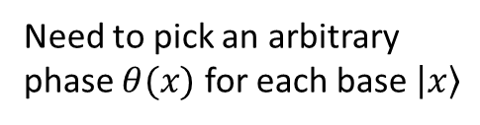
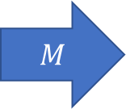
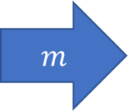
Projective space $\underline{ℋ}$
One way to go from vectors to rays
$M$
Hilbert space $ℋ$
$m$
Infinitely many ways to go from rays to vectors
Need to pick an arbitrary phase $θ(x)$ for each base $\left|x\right\rangle$
basis...
… to basis

Slide 23
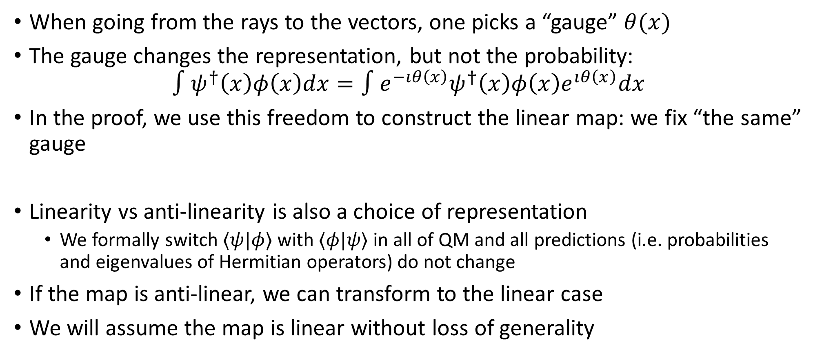
Fixing the representation
When going from the rays to the vectors, one picks a “gauge” $θ(x)$
The gauge changes the representation, but not the probability: $∫ψ^{†}\left(x\right)φ\left(x\right)dx=∫e^{−ıθ\left(x\right)}ψ^{†}\left(x\right)φ\left(x\right)e^{ıθ\left(x\right)}dx$
In the proof, we use this freedom to construct the linear map: we fix “the same” gauge
Linearity vs anti-linearity is also a choice of representation
We formally switch $⟨ψ|φ⟩$ with $⟨φ|ψ⟩$ in all of QM and all predictions (i.e. probabilities and eigenvalues of Hermitian operators) do not change
If the map is anti-linear, we can transform to the linear case
We will assume the map is linear without loss of generality

Slide 24

I.9 H2: $m$ is bilinear
Without loss of generality, we can say that if $m$ exists it must be linear when fixing either side:
$m\left(k_{1}a_{1}+k_{2}a_{2},b\right)=k_{1}m\left(a_{1},b\right)+k_{2}m\left(a_{2},b\right)$ $m\left(a,k_{1}b_{1}+k_{2}b_{2}\right)=k_{1}m\left(a,b_{1}\right)+k_{2}m(a,b_{2})$
We have all the ingredients we needed

Slide 25
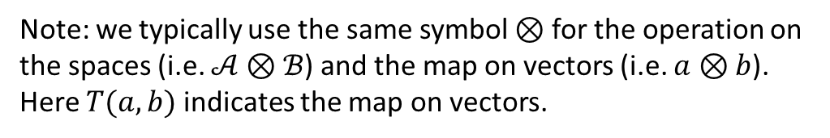
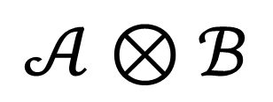

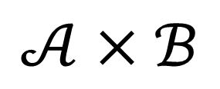


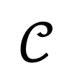
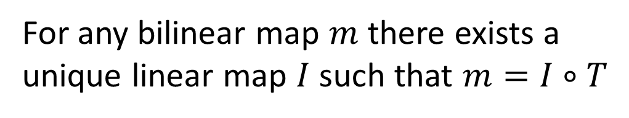
Universal property of the tensor product
Any bilinear map factors uniquely through the tensor product
$$T$$
$$𝒜×ℬ$$
$$𝒜⊗ℬ$$
$$m$$
$$I$$
Note: we typically use the same symbol $⊗$ for the operation on the spaces (i.e. $𝒜⊗ℬ$) and the map on vectors (i.e. $a⊗b$). Here $T(a,b)$ indicates the map on vectors.
$$𝒞$$
For any bilinear map $m$ there exists a unique linear map $I$ such that $m=I∘T$

Slide 26
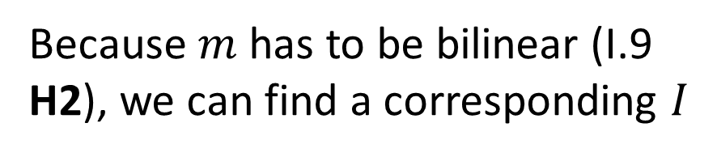
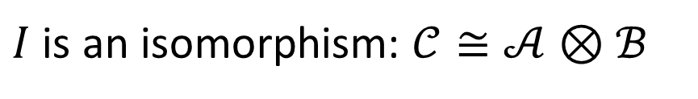
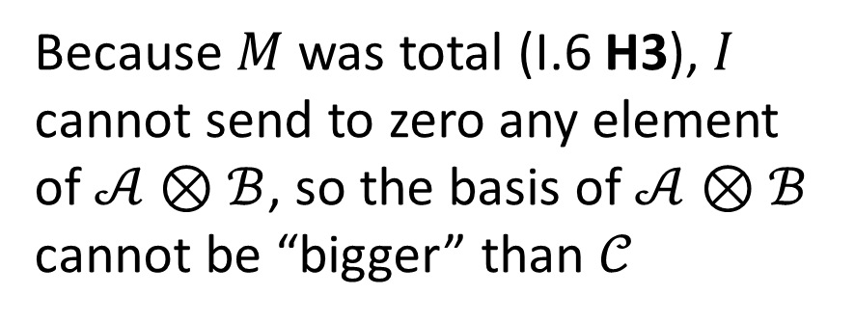
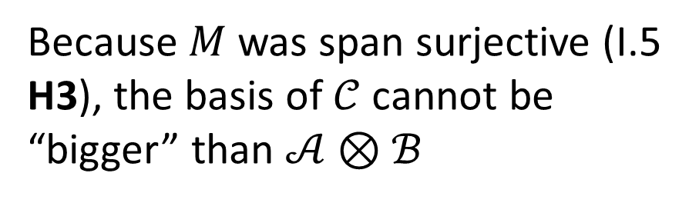
Final proof
Because $m$ has to be bilinear (I.9 H2), we can find a corresponding $I$
$$T$$
$$𝒜×ℬ$$
$$𝒜⊗ℬ$$
Because $M$ was span surjective (I.5 H3), the basis of $𝒞$ cannot be “bigger” than $𝒜⊗ℬ$
$$m$$
$$I$$
nothing but A and B
$$𝒞$$
Because $M$ was total (I.6 H3), $I$ cannot send to zero any element of $𝒜⊗ℬ$, so the basis of $𝒜⊗ℬ$ cannot be “bigger” than $𝒞$
$I$ is an isomorphism: $𝒞≅𝒜⊗ℬ$
preparation independence

Slide 27
Postulate removed
We showed that we can recover the tensor product for the composite system based on very narrow physically motivated requirements (preparation independence and the composite made of only the parts)
Could we use something else apart from the tensor product? Yes! We could use other maps that introduce arbitrary gauges and phase flips. But why should we make our life complicated, since we can always pick a representation that behaves nicely?
Now we know exactly, at both a physical level and a mathematical level, why we use the tensor product for composite systems in quantum mechanics

Slide 28
THE COMMENTARY

Slide 29
The long review
We originally submitted to Nature Communication
One referee wrote a 12 pages review (longer than the paper) to:
show that the work was equivalent to that of Matolcsi (though it takes 8 pages to do so)
claim we couldn’t dismiss the anti-linear case as it is physically significant (Matolcsi in fact finds two tensor products)
claim we couldn’t use the universal property of the tensor product since this does not work in Hilbert spaces
We had the option to discuss with him, though by the time I got the chance many months later, we had already resubmitted to PRL
Let’s look at the two main objections

Slide 30

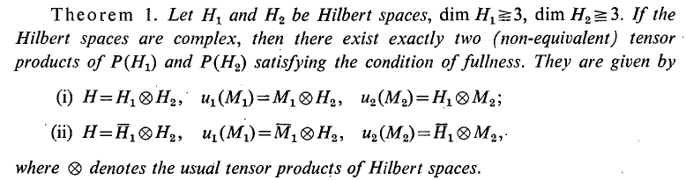
The anti-linear debacle
Some take the anti-linear case to be physically distinct (e.g. related to time reversal)

Slide 31
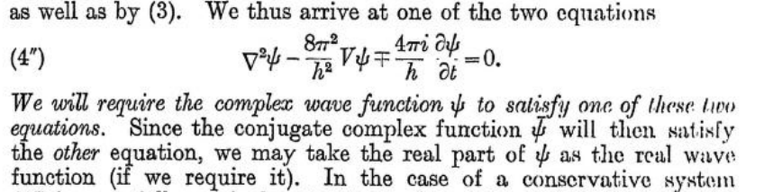

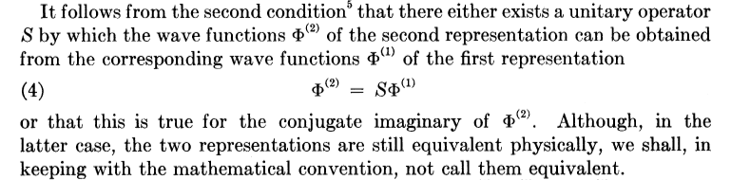

The anti-linear debacle
The fact that the conjugate representation is physically equivalent was something known to the founders of quantum mechanics
Maybe we should stop doing that?!?!?

Slide 32
No tensor product on Hilbert spaces
Another objection comes from the use of the universal property of the tensor product
The objection is that, in the category of Hilbert spaces, the universal property of the tensor product yields nothing: there is no tensor product (according to category theory)
In the proof, we use the universal property on linear spaces (not Hilbert spaces) so there is no issue
However, the fact that the “proper” tensor product on Hilbert space does not exist should make us think…
https://www-users.cse.umn.edu/~garrett/m/v/nonexistence_tensors.pdf

Slide 33

Are Hilbert spaces right for quantum mechanics?
We saw that the physical content is really in the projective space
We saw that anti-linear case is not considered in the same category, and causes confusion
We saw that it is not the right category to yield a tensor product
Maybe it’s the wrong math?
Should we, in physics, perhaps stop simply using the tools the mathematicians create for themselves, and maybe start developing some that have a tighter connection to the physics (though still mathematically sound)?

Slide 34
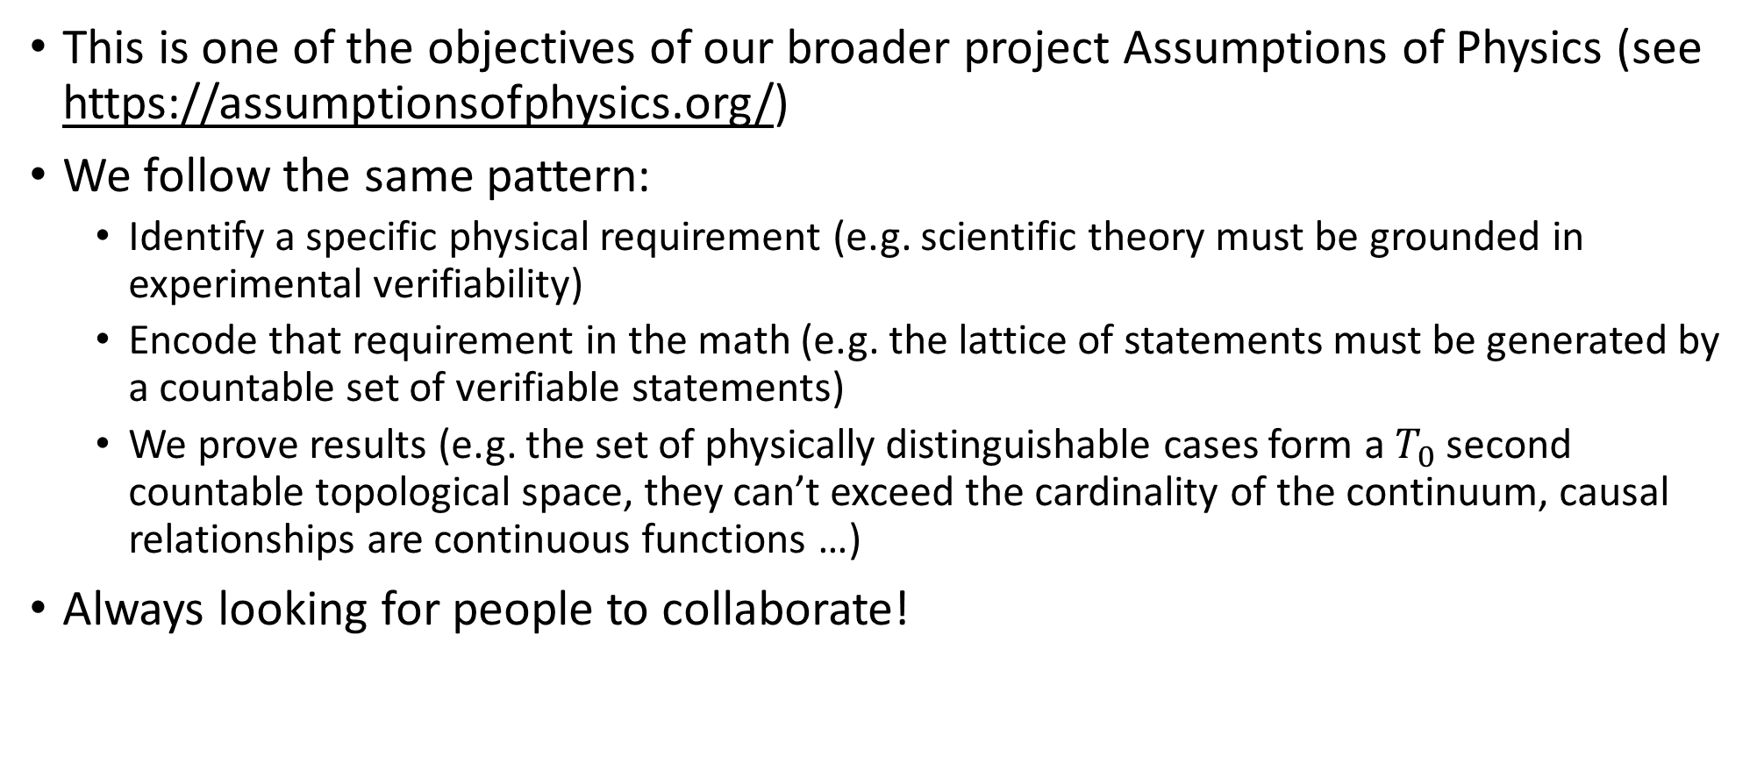
Assumptions of Physics
This is one of the objectives of our broader project Assumptions of Physics (see https://assumptionsofphysics.org/)
We follow the same pattern:
Identify a specific physical requirement (e.g. scientific theory must be grounded in experimental verifiability)
Encode that requirement in the math (e.g. the lattice of statements must be generated by a countable set of verifiable statements)
We prove results (e.g. the set of physically distinguishable cases form a $T_{0}$ second countable topological space, they can’t exceed the cardinality of the continuum, causal relationships are continuous functions …)
Always looking for people to collaborate!

Slide 35
Space of the well-posed scientific theories
Physical theories
Specializations of the general theory under the different assumptions
Hamiltonian mechanics
Unitary evolution
Quantum state-space
Classical phase-space
Assumptions
Infinitesimal reducibility
Determinism/
reversibility
Irreducibility
States and processes
General theory
Informational granularity
Basic requirements and definitions valid in all theories
Experimental verifiability

Slide 37
SUPPLEMENTAL

Slide 38
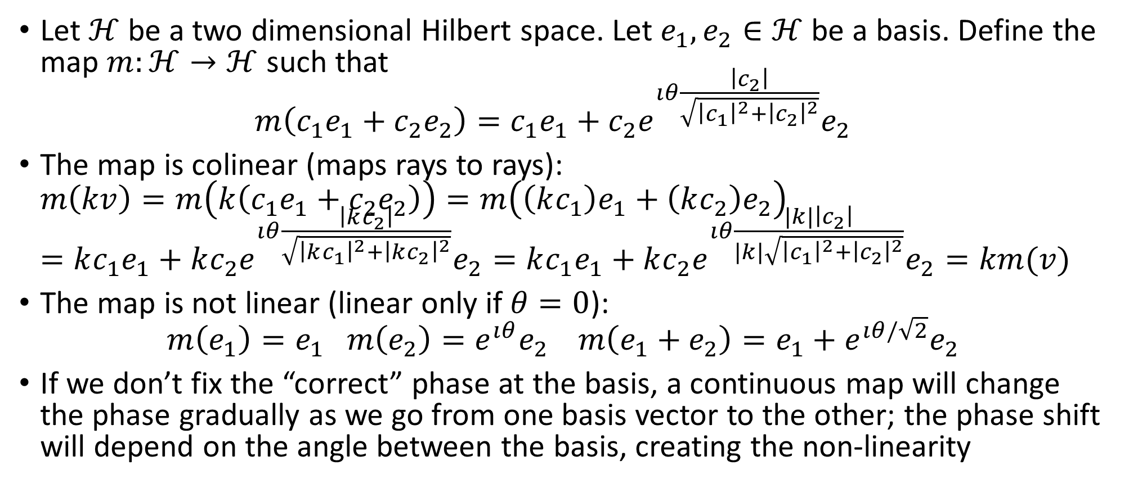
Example of colinear but non-linear map
Let $ℋ$ be a two dimensional Hilbert space. Let $e_{1},e_{2}∈ℋ$ be a basis. Define the map $m:ℋ→ℋ$ such that $m\left(c_{1}e_{1}+c_{2}e_{2}\right)=c_{1}e_{1}+c_{2}e^{ıθ\frac{\left|c_{2}\right|}{\sqrt{{\left|c_{1}\right|}^{2}+{\left|c_{2}\right|}^{2}}}}e_{2}$
The map is colinear (maps rays to rays): $m\left(kv\right)=m\left(k\left(c_{1}e_{1}+c_{2}e_{2}\right)\right)=m\left(\left(kc_{1}\right)e_{1}+\left(kc_{2}\right)e_{2}\right)$ $=kc_{1}e_{1}+kc_{2}e^{ıθ\frac{\left|kc_{2}\right|}{\sqrt{{\left|kc_{1}\right|}^{2}+{\left|kc_{2}\right|}^{2}}}}e_{2}=kc_{1}e_{1}+kc_{2}e^{ıθ\frac{|k|\left|c_{2}\right|}{|k|\sqrt{{\left|c_{1}\right|}^{2}+{\left|c_{2}\right|}^{2}}}}e_{2}=km(v)$
The map is not linear (linear only if $θ=0$): $m\left(e_{1}\right)=e_{1} m\left(e_{2}\right)=e^{ıθ}e_{2} m\left(e_{1}+e_{2}\right)=e_{1}+e^{ıθ/\sqrt{2}}e_{2}$
If we don’t fix the “correct” phase at the basis, a continuous map will change the phase gradually as we go from one basis vector to the other; the phase shift will depend on the angle between the basis, creating the non-linearity
cosine of the angle across basis

Slide 39

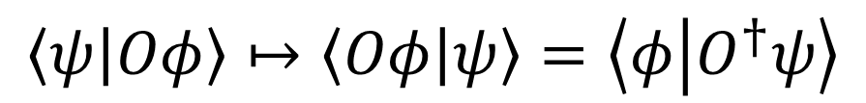




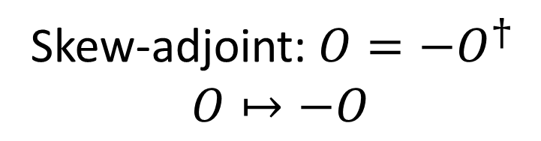

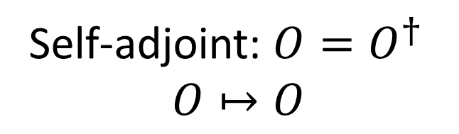

Anti-linear
Time reversal
$$\left\langle ψ | φ\right\rangle ↦⟨φ|ψ⟩$$
$$\left\langle ψ | Oφ\right\rangle ↦\left\langle Oφ | ψ\right\rangle =\left\langle φ | O^{†}ψ\right\rangle$$
$$E↦E$$
$$t↦−t$$
Self-adjoint: $O=O^{†}$
$$O↦O$$
$$Q↦Q$$
$$P↦−P$$
$$θ↦θ$$
$$S↦−S$$
Skew-adjoint: $O=−O^{†}$
$$O↦−O$$
Self-adjoint

