Slide 1


On the reality of the quantum state once again
Gabriele Carcassi
Physics Department
University of Michigan

Slide 2



The paper
On the reality of the quantum state once again
Gabriele Carcassi, Andrea Oldofredi, Christine A. Aidala
Under review
Gabriele Carcassi
Christine A. Aidala
Andrea Oldofredi
University of Michigan
University of Lisbon

Slide 3

Thesis
$ψ$-ontic models are not compatible with quantum mechanics
Combined with PBR $⇒$ Harrigan-Spekkens categorization is essentially “empty”
More in general: measure theory cannot reproduce quantum probability and quantum information theory

Slide 4
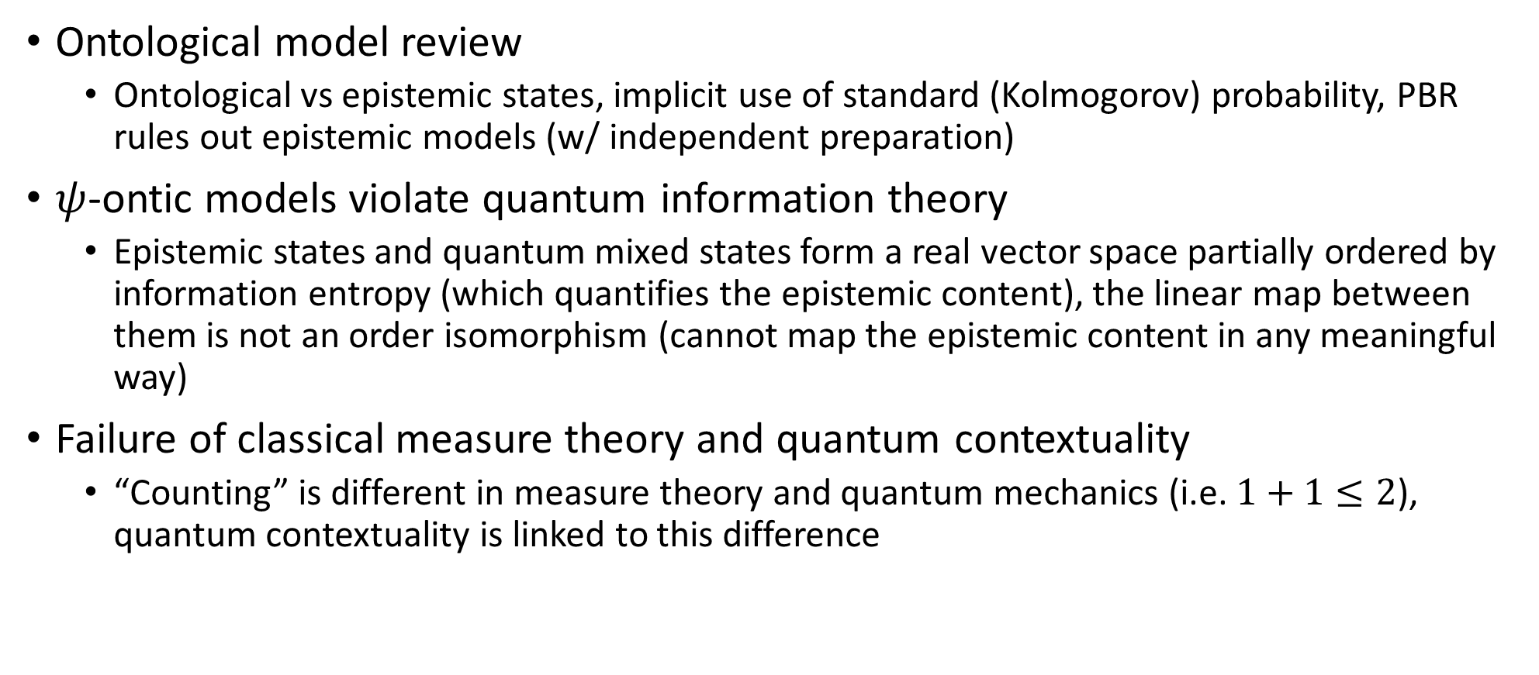
Plan
Ontological model review
Ontological vs epistemic states, implicit use of standard (Kolmogorov) probability, PBR rules out epistemic models (w/ independent preparation)
$ψ$-ontic models violate quantum information theory
Epistemic states and quantum mixed states form a real vector space partially ordered by information entropy (which quantifies the epistemic content), the linear map between them is not an order isomorphism (cannot map the epistemic content in any meaningful way)
Failure of classical measure theory and quantum contextuality
“Counting” is different in measure theory and quantum mechanics (i.e. $1+1≤2$), quantum contextuality is linked to this difference

Slide 5
Disclaimer
We are not going to talk about specific interpretations
ONLY about Harrigan-Spekkens categorization
We are not going to talk about epistemic and ontological models in general
ONLY the narrow definition given by the Harrigan-Spekkens categorization
We are not going to talk about the philosophical implications
ONLY the mathematical and physical implications

Slide 6
Ontological model review

Slide 7
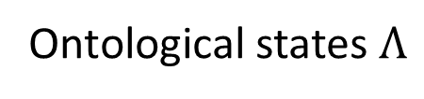

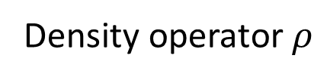


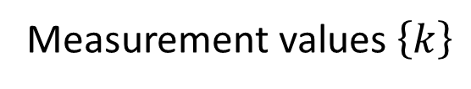
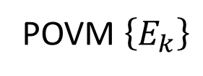
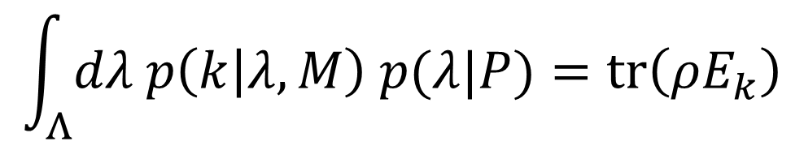
Start with the operational settings for Quantum Mechanics
Preparation protocol $P$
Measurement protocol $M$
Density operator $ρ$
Measurement values $\left\{k\right\}$
POVM $\left\{E_{k}\right\}$
$$p\left(k | P,M\right)=tr\left(ρE_{k}\right)$$
Ontological model puts an intermediate step
Ontological states $Λ$
$$\int_{Λ}{dλ p\left(k | λ,M\right) p(λ|P)}=tr\left(ρE_{k}\right)$$
Epistemic state

Slide 8
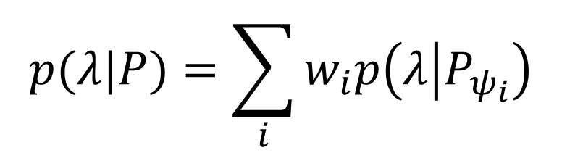
Epistemic states mix according to standard (Kolmogorov) rules
Mixture of pure states $\left\{ψ_{i}\right\}$ with probabilities $\left\{w_{i}\right\}$
$$p(λ|P)=\sum_{i}{w_{i}p\left(λ | P_{ψ_{i}}\right)}$$
Each ontological model is therefore characterized simply by the epistemic states that correspond to pure states
We will gloss over some technical imprecisions (e.g. probability and probability densities are different objects)

Slide 9







Classify models based on $p\left(λ | P_{ψ_{i}}\right)$
Epistemic models
Ontological models
$$p\left(λ | P_{ψ}\right)$$
$$p\left(λ | P_{φ}\right)$$
$$p\left(λ | P_{ψ}\right)$$
$$p\left(λ | P_{φ}\right)$$
$$λ$$
$$λ$$
Can overlap: same ontological state can be prepared in different ways
No overlap: ontological state retains information about preparation
PBR claims these are ruled out (w/ independent preparation)
Complete if $p\left(λ_{ψ} | P_{ψ}\right)=1$ for all $ψ$
What about these?

Slide 10

$ψ$-ontic models violate quantum information theory

Slide 11
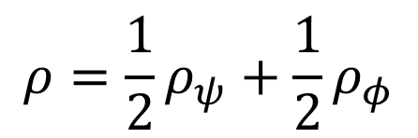




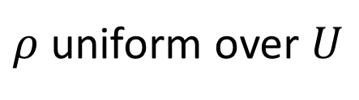
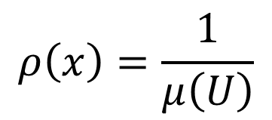
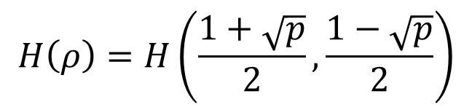
$$ρ\left(x\right)=\frac{1}{μ\left(U\right)}$$
$$μ\left(U\right)$$
Standard probability
Measure theory
Information theory
$$H\left(ρ\right)=\log{μ\left(U\right)}$$
$ρ$ uniform over $U$
Violation of probability $≡$ violation of information theory $≡$ measure theory does not reproduce Hilbert spaces
$$\left\langle ψ | φ\right\rangle$$
Quantum probability
$$p\left(ψ | φ\right)={\left|\left\langle ψ | φ\right\rangle \right|}^{2}$$
Inner product
*quotient the phase
$$ρ=\frac{1}{2}ρ_{ψ}+\frac{1}{2}ρ_{φ}$$
$$H\left(ρ\right)=H\left(\frac{1+\sqrt{p}}{2},\frac{1−\sqrt{p}}{2}\right)$$
Quantum information theory

Slide 12
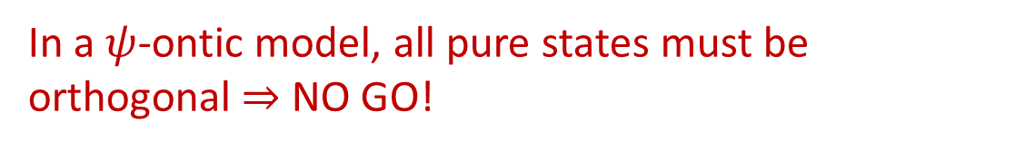
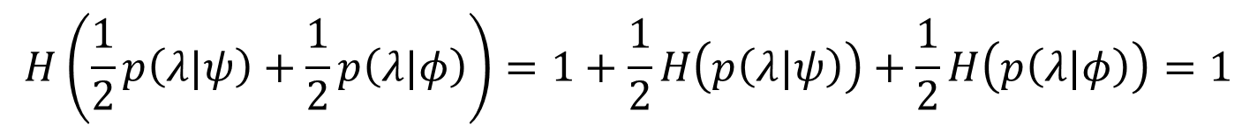

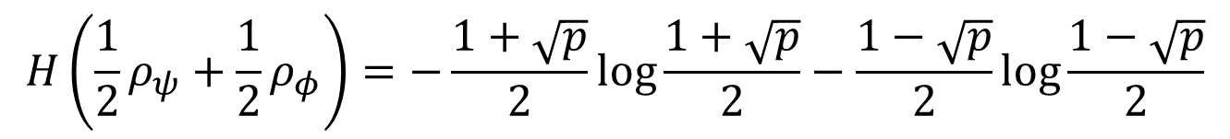
Since in a $ψ$-ontic model the distributions are not overlapping, and since the entropy of each
pure state must be zero, we have:
$$H\left(\frac{1}{2}p\left(λ|ψ\right)+\frac{1}{2}p\left(λ|φ\right)\right)=1+\frac{1}{2}H\left(p\left(λ|ψ\right)\right)+\frac{1}{2}H\left(p\left(λ|φ\right)\right)=1$$
In a $ψ$-ontic model, the equal mixture of any two distinct pure states has unitary entropy
In quantum mechanics, the entropy of the equal mixture of two pure states is given by:
$$H\left(\frac{1}{2}ρ_{ψ}+\frac{1}{2}ρ_{φ}\right)=−\frac{1+\sqrt{p}}{2}\log{\frac{1+\sqrt{p}}{2}}−\frac{1−\sqrt{p}}{2}\log{\frac{1−\sqrt{p}}{2}}$$
$$p={\left|\left\langle ψ | φ\right\rangle \right|}^{2}$$
This is equal to one if and only if $p=0$, the states are orthogonal
In a $ψ$-ontic model, all pure states must be orthogonal $⇒$ NO GO!
The degree of overlap between epistemic states is constrained by the entropic structure of the mixed states

Slide 13
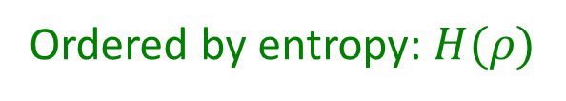
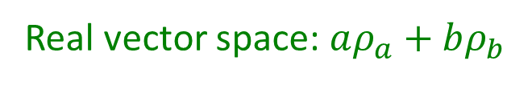


To dig deeper, consider a complete ontological model of a qubit
Epistemic states $E_{HS}$ : $p\left(λ | P\right)$
Quantum mixed states $E_{QM}$ : $ρ$
Epistemic states and density matrices one-to-one for pure states
Real vector space: $aρ_{a}+bρ_{b}$
Ordered by entropy: $H(ρ)$
Pure states are one-to-one but not the mixed states!!!
$$ρ\left(θ,φ\right)$$
$$x^{2}+y^{2}+z^{2}≤1$$
Continuous distributions over the surface
Closed three dimensional unit ball
Infinite dimensional function space
Three dimensional manifold

Slide 14



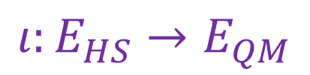







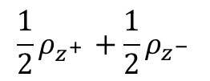





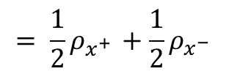






Not all is lost: clear way to go from $E_{HS}$ to $E_{QM}$
Entropy
Lost information about preparation?
Information is lost but entropy goes down!
$$p\left(λ | \frac{1}{4}P_{z^{+ }}+\frac{1}{4}P_{z^{− }}+\frac{1}{4}P_{x^{+ }}+\frac{1}{4}P_{x^{− }}\right)$$
$$ι:E_{HS}→E_{QM}$$
2
$$\frac{1}{2}$$
$$\frac{1}{2}$$
$$p\left(λ | \frac{1}{2}P_{z^{+ }}+\frac{1}{2}P_{z^{− }}\right)$$
$$p\left(λ | \frac{1}{2}P_{x^{+ }}+\frac{1}{2}P_{x^{− }}\right)$$
$$\frac{1}{2}ρ_{z^{+ }}+\frac{1}{2}ρ_{z^{− }}$$
$$= \frac{1}{2}ρ_{x^{+ }}+\frac{1}{2}ρ_{x^{− }}$$
1
$$\frac{1}{2}$$
$$\frac{1}{2}$$
$$\frac{1}{2}$$
$$\frac{1}{2}$$
$$\frac{1}{2}$$
$$\frac{1}{2}$$
$$\frac{1}{2}$$
$$\frac{1}{2}$$
$$p(λ|P_{z^{− }})$$
$$p(λ|P_{x^{− }})$$
$$ρ_{z^{− }}$$
$$ρ_{x^{− }}$$
0
$$p(λ|P_{z^{+ }})$$
$$p(λ|P_{x^{+ }})$$
$$ρ_{z^{+ }}$$
$$ρ_{x^{+ }}$$

Slide 15
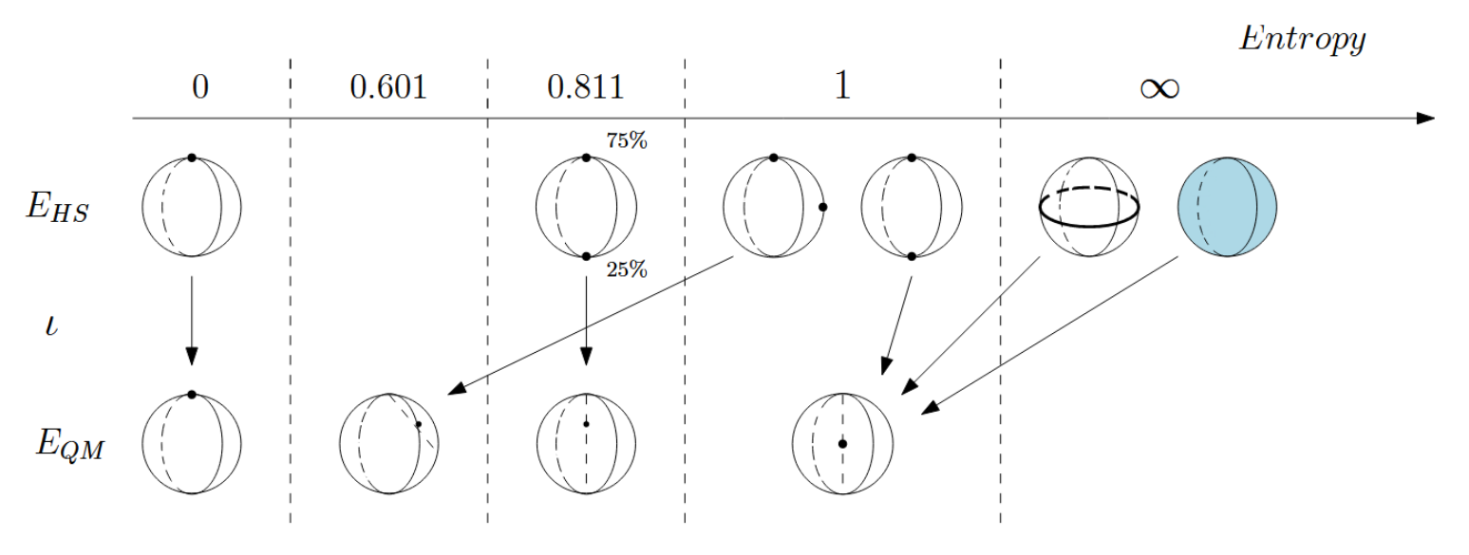
Entropic order is lost when going from $E_{HS}$ to $E_{QM}$

Slide 16
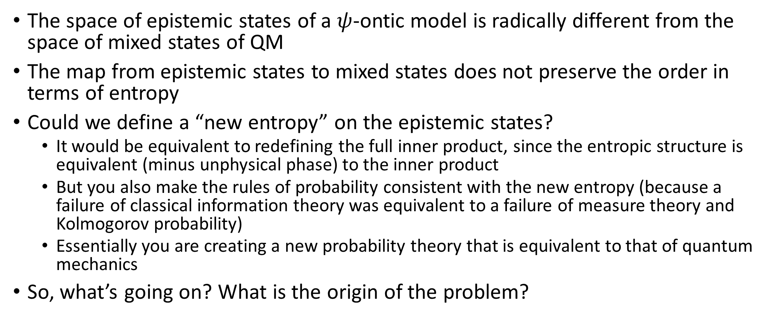
No $ψ$-ontic models
The space of epistemic states of a $ψ$-ontic model is radically different from the space of mixed states of QM
The map from epistemic states to mixed states does not preserve the order in terms of entropy
Could we define a “new entropy” on the epistemic states?
It would be equivalent to redefining the full inner product, since the entropic structure is equivalent (minus unphysical phase) to the inner product
But you also make the rules of probability consistent with the new entropy (because a failure of classical information theory was equivalent to a failure of measure theory and Kolmogorov probability)
Essentially you are creating a new probability theory that is equivalent to that of quantum mechanics
So, what’s going on? What is the origin of the problem?

Slide 17
Failure of measure theory and quantum contextuality

Slide 18
Measure theory defines “how big sets are”, “how many elements are there in a set”, “how we count”
$$μ\left(U\right)→[0,+∞]$$
Countable additivity is a fundamental axiom of measure theory
$μ\left(∪_{i}U_{i}\right)=\sum_{i}{μ\left(U_{i}\right)}$
Disjoint sets

Slide 19



















Single point
Finite continuous range
$$μ(U)$$
$$\log{μ(U)}$$
$$μ(U)$$
$$\log{μ(U)}$$
Counting measure
$$μ\left(U\right)=\#U$$
$1$
$0$
$+∞$
$+∞$
Number of points
Lebesgue measure
$$μ\left(\left[a,b\right]\right)=b−a$$
$0$
$−∞$
$<∞$
$<∞$
Interval size
“Quantum” measure
$$μ\left(U\right)=2^{H(ρ_{U})}$$
$1$
$0$
$<∞$
$<∞$
Entropy over uniform distribution

Slide 20
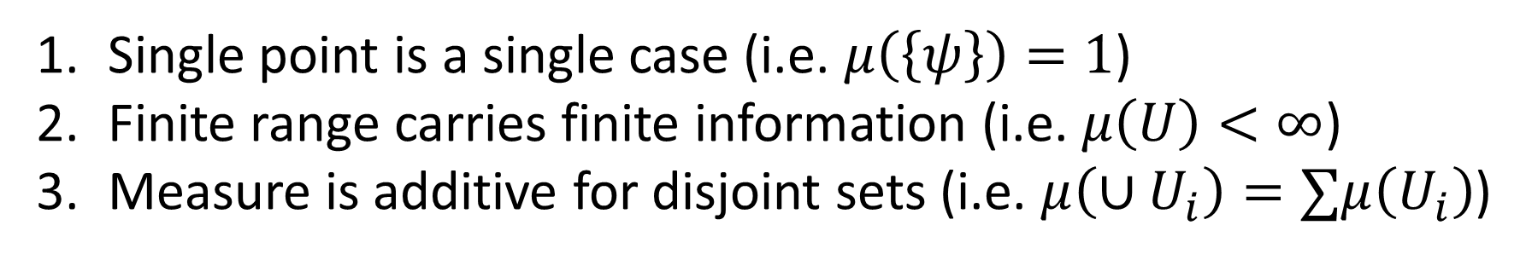
Single point is a single case (i.e. $μ\left(\left\{ψ\right\}\right)=1$)
Finite range carries finite information (i.e. $μ\left(U\right)<∞$)
Measure is additive for disjoint sets (i.e. $μ\left(∪U_{i}\right)=∑μ\left(U_{i}\right)$)
Pick two!
Counting measure picks 1 and 3 Lebesgue measure picks 2 and 3
Quantum mechanics picks 1 and 2
But QM is tested using standard probability!!!
and that is why measure theory (classical probability and information theory) cannot reproduce quantum mechanics

Slide 21
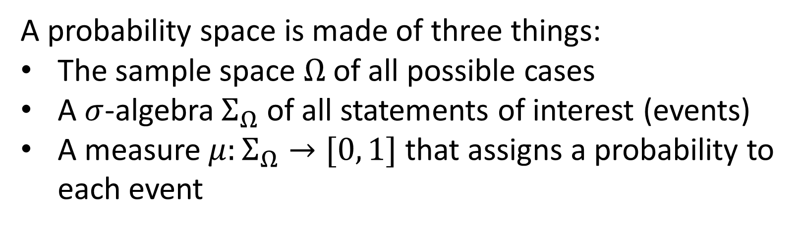
Let’s further unpack the difference
A probability space is made of three things:
The sample space $Ω$ of all possible cases
A $σ$-algebra $Σ_{Ω}$ of all statements of interest (events)
A measure $μ:Σ_{Ω}→[0, 1]$ that assigns a probability to each event
In standard probability, the measure is over the whole $σ$-algebra $Σ_{Ω}$
This is not what happens in quantum mechanics

Slide 22
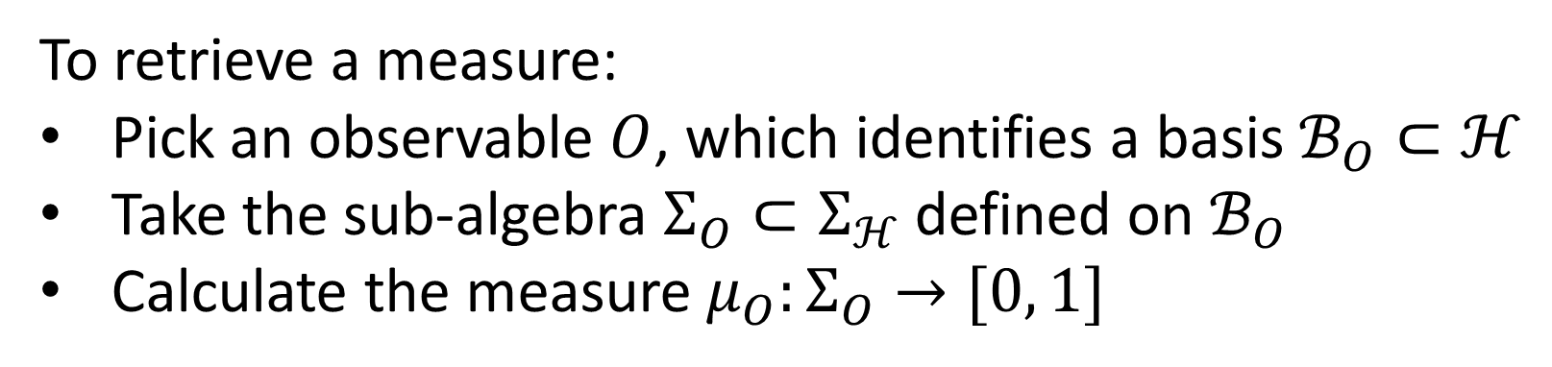
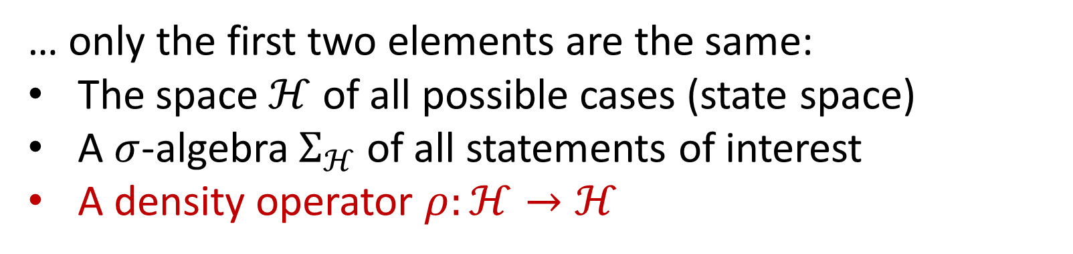
In quantum mechanics…
… only the first two elements are the same:
The space $ℋ$ of all possible cases (state space)
A $σ$-algebra $Σ_{ℋ}$ of all statements of interest
A density operator $ρ:ℋ→ℋ$
To retrieve a measure:
Pick an observable $O$, which identifies a basis $ℬ_{O}⊂ℋ$
Take the sub-algebra $Σ_{O}⊂Σ_{ℋ}$ defined on $ℬ_{O}$
Calculate the measure $μ_{O}:Σ_{O}→[0, 1]$

Slide 23
No single measure: one for each sub-algebra
There are infinitely many sub-algebras (and measures)
The sub-algebras are “classical” in the sense that allow additive measures… (though not countably additive!)
Physically, each sub-algebra represents a “context”
Only once a context is selected, QM gives us a probability measure
But it also allows us to do something standard measure theory will never be able to do: mix contexts themselves

Slide 24
Spin up and spin left “live” in two different contexts
An equal mixture of spin up and spin left “live” in a “combined context” that is different from both
Physically, the “combined context” is the one associated to the measurement that extracts the most information
The HS model assumes every preparation (epistemic state) is represented by a single probability measure on all ontic states
This assumes that there is a single 𝜎-algebra over which the whole distribution is defined, a single “context”

Slide 25
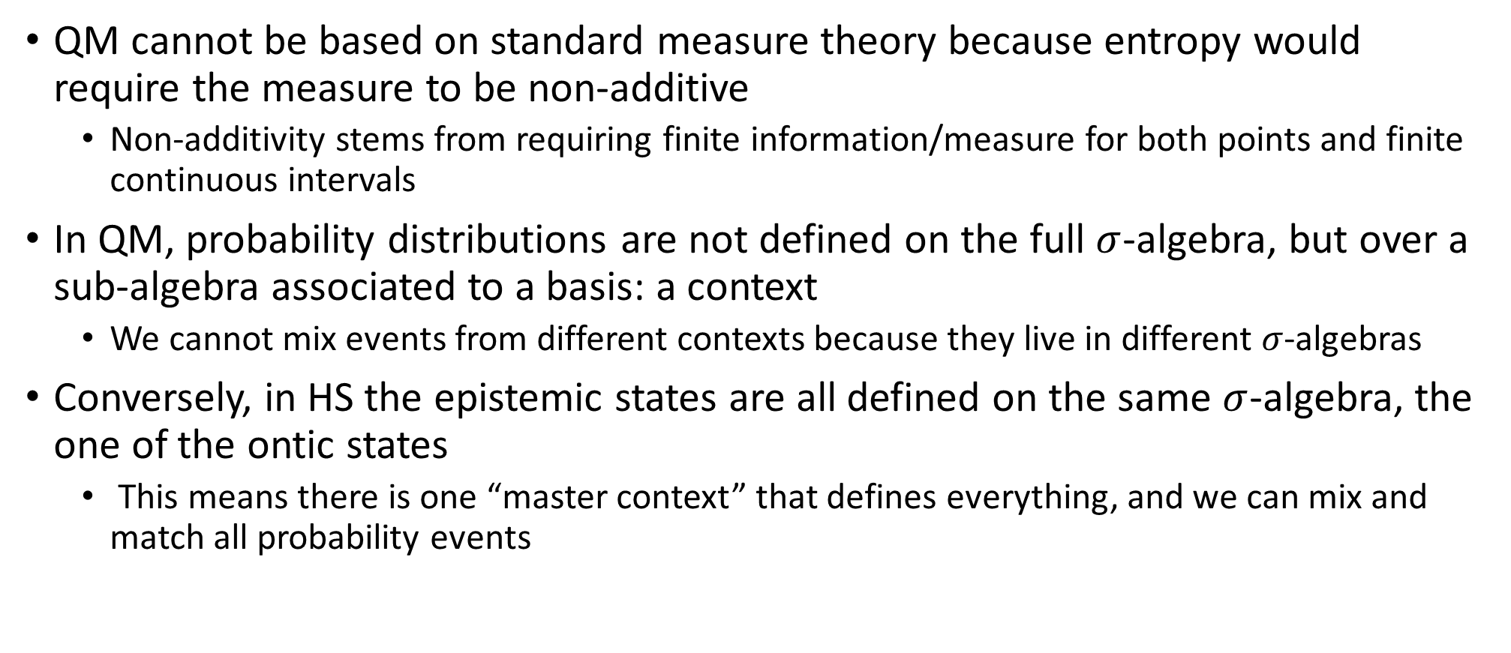
Failure of measure theory and quantum contextuality
QM cannot be based on standard measure theory because entropy would require the measure to be non-additive
Non-additivity stems from requiring finite information/measure for both points and finite continuous intervals
In QM, probability distributions are not defined on the full $σ$-algebra, but over a sub-algebra associated to a basis: a context
We cannot mix events from different contexts because they live in different $σ$-algebras
Conversely, in HS the epistemic states are all defined on the same $σ$-algebra, the one of the ontic states
This means there is one “master context” that defines everything, and we can mix and match all probability events

Slide 27
Supplemental

Slide 28
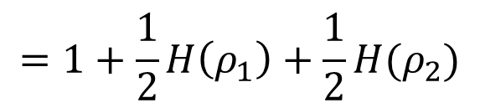
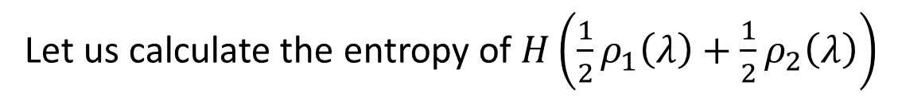
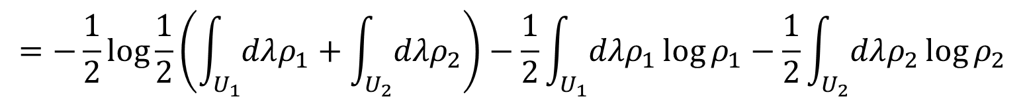
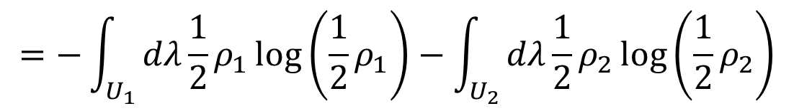
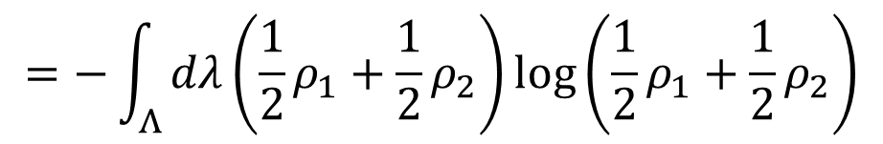
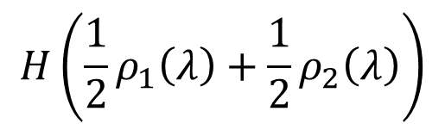
Let $ρ_{1}(λ)$ and $ρ_{2}\left(λ\right)$ be two disjoint probability (or probability density) distributions over $Λ$ with support $U_{1}$ and $U_{2}$ respectively
Let us calculate the entropy of $H\left(\frac{1}{2}ρ_{1}\left(λ\right)+\frac{1}{2}ρ_{2}\left(λ\right)\right)$
$$H\left(\frac{1}{2}ρ_{1}\left(λ\right)+\frac{1}{2}ρ_{2}\left(λ\right)\right)$$
$$=−\int_{Λ}{dλ\left(\frac{1}{2}ρ_{1}+\frac{1}{2}ρ_{2}\right)\log\left(\frac{1}{2}ρ_{1}+\frac{1}{2}ρ_{2}\right)}$$
$$=−\int_{U_{1}}{dλ\frac{1}{2}ρ_{1}\log\left(\frac{1}{2}ρ_{1}\right)}−\int_{U_{2}}{dλ\frac{1}{2}ρ_{2}\log\left(\frac{1}{2}ρ_{2}\right)}$$
$$=−\frac{1}{2}\log{\frac{1}{2}}\left(\int_{U_{1}}{dλρ_{1}}+\int_{U_{2}}{dλρ_{2}}\right)−\frac{1}{2}\int_{U_{1}}{dλρ_{1}\log{ρ_{1}}}−\frac{1}{2}\int_{U_{2}}{dλρ_{2}\log{ρ_{2}}}$$
$$=1+\frac{1}{2}H\left(ρ_{1}\right)+\frac{1}{2}H(ρ_{2})$$

