Slide 1


Assumptions of Physics Project overview
Gabriele Carcassi and Christine A. Aidala
Physics Department University of Michigan
https://assumptionsofphysics.org

Slide 2



Main goal of the project
Identify a handful of physical starting points from which the basic laws can be rigorously derived
For example:
Infinitesimal reducibility $⇒$ Classical state
Irreducibility $⇒$ Quantum state
https://assumptionsofphysics.org
?
time
time
This also requires rederiving all mathematical structures from physical requirements
For example:
Science is evidence based $⇒$ scientific theory must be characterized by experimentally verifiable statements $⇒$ topology and $σ$-algebras

Slide 3
Underlying perspective
Foundations of physics
Foundations of mathematics
Metaphysical reality
What really exists
Physical reality
What can be accessed experimentally
Philosophy of science
What is the boundary?
What are the requirements?
Physical theories
Idealized account of empirical reality
Empirical reality
What can be reliably studied experimentally
How exactly does the abstraction/idealization process work?

Slide 4
If physics is about creating models of empirical reality, the foundations of physics should be a theory of models of empirical reality
Requirements of experimental verification, assumptions of each theory, realm of validity of assumptions, …

Slide 5
Different approach to the foundations of physics
Find ultimate theory
approximation
…
Typical approaches
Construct interpretations
Weak interactions
QED -Electromagnetism
Measurement problem
Role of the observer
QCD – Strong Interactions
Electro-weak
Quantum mechanics
Contextuality
Local realism
General Relativity
Grand Unified Theory
Ontology of observables
What “really” happens
Theory of Everything
Our approach
A theory about physical models
General physical principles and requirements
General mathematical framework
Specific assumptions
Classical mechanics
Quantum mechanics
derivation
Thermodynamics
…
specialization

Slide 6
Find the right overall concepts
Reverse physics: Start with the equations, reverse engineer physical assumptions/principles
Reverse Physics
Physics
Smallest set of assumptions required to rederive the theory
Physical theory
Physical result/ effect/prediction
Reverse Mathematics
Mathematics
Smallest set of axioms required to prove the theorem
Theorem
Mathematical result/ corollary/calculation
Found Phys 52, 40 (2022)
Goal: find the right overall physical concepts, “elevate” the discussion from mathematical constructs to physical principles
Physical mathematics: Start from scratch and rederive all mathematical structures from physical requirements
Physics
Physical requirements
Semantics
Physical mathematics
Goal: get the details right, perfect one-to-one map between mathematical and physical objects

Slide 7
Reverse Physics
Assumptions of Physics, Michigan Publishing (v2 2023)
J. Phys. Commun. 2 045026 (2018)

Slide 8














7 equivalent characterizations of Hamiltonian mechanics
12 in the book
one DOF
(1) Hamilton’s equations
(2) Divergenceless displacement
$$p$$
$$S^{q}=\frac{dq}{dt}=\frac{∂H}{∂p}$$
$$div\left(S^{a}\right)=\frac{∂S^{q}}{∂q}+\frac{∂S^{p}}{∂p}=0$$
$$q$$
$$S^{p}=\frac{dp}{dt}=−\frac{∂H}{∂q}$$
(3) Area conservation ($|J|$ = 1)
(4) Deterministic and reversible evolution
(7) Uncertainty conservation
$$dQdP=|J|dqdp$$
Area conservation $⟺$ state count conservation
for peaked distributions
$$\left|Σ\left(t+dt\right)\right|=\left|J\right|\left|Σ\left(t\right)\right|\left|J\right|$$
$⟺$ deterministic and reversible evolution
(5) Deterministic and thermodynamically reversible evolution
(6) Information conservation
$$S=k_{B}\log{W}$$
$$I\left[ρ\left(t+dt\right)\right]=I\left[ρ\left(t\right)\right]−∫ρ\log{|J|}dqdp$$
Area conservation $⟺$ entropy conservation
$⟺$ thermodynamically reversible evolution
A full understanding of classical mechanics means understanding these connections

Slide 9
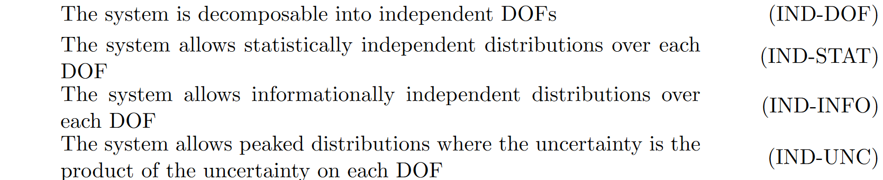
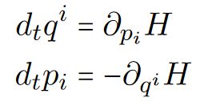




$$⇒$$
$$⇒$$
Mathematical conditions and physical assumptions are not necessarily one-to-one
$$⟺$$

Slide 10

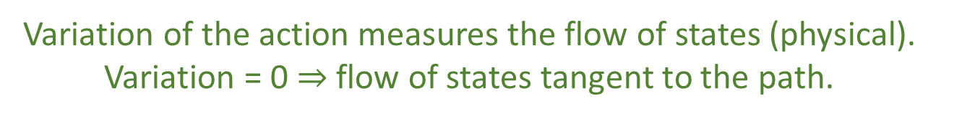
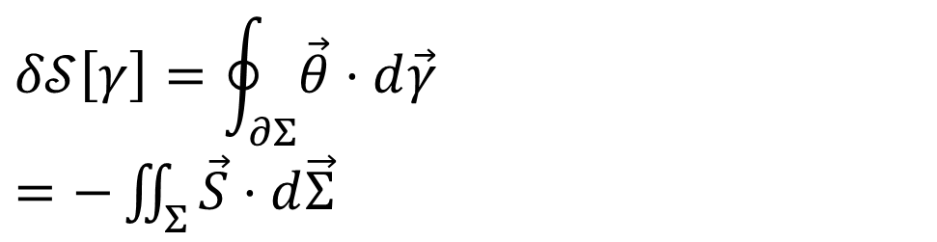


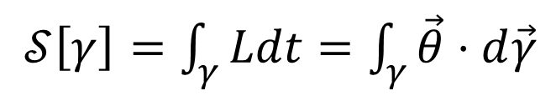






Reversing the principle of least action
DR
$$\left[p,0,−H\right]$$
KE
$$∇⋅\vec{S}=0$$
$$\vec{S}=−∇×\vec{θ}$$
$𝒮\left[γ\right]=\int_{γ}{Ldt}=\int_{γ}{\vec{θ}⋅d\vec{γ}}$
No state is “lost” or “created” as time evolves
(Minus sign to match convention)
Sci Rep 13, 12138 (2023)
The action is the line integral of the vector potential (unphysical)
$$p$$
$$q$$
Variation of the action
$$Σ$$
Gauge independent, physical!
$$δ𝒮\left[γ\right]=\oint_{∂Σ}{\vec{θ}⋅d\vec{γ}}$$ $=−\iint_{Σ}{\vec{S}⋅d\vec{Σ}}$
$$γ$$
$$γ′$$
$$t$$
Variation of the action measures the flow of states (physical). Variation = 0 $⇒$ flow of states tangent to the path.

Slide 11

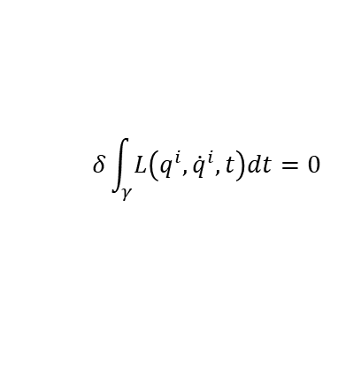











Assumptions of classical mechanics
$$\frac{dq^{i}}{dt}=\frac{∂H}{∂p_{i}}$$
$$\frac{dp_{i}}{dt}=−\frac{∂H}{∂q^{i}}$$
$$δ\int_{γ}{L\left(q^{i},{\dot{q}}^{i},t\right)dt}=0$$
$$[q^{i},p_{i}]$$
(IR) Infinitesimal reducibility
Classical Phase Space
Hamiltonian Mechanics
Lagrangian Mechanics
+
+
+
Massive particles under potential forces
(DR) Determinism /Reversibility
weak
+
(IND) Degree of freedom independence
(KE) Kinematic Equivalence
full
$$H=\frac{1}{2m}\left(p_{i}−𝔮A_{i}\right)g^{ij}\left(p_{j}−𝔮A_{j}\right)+𝔮V$$
$$\#s=\#c_{1}\#c_{2}$$
$$p$$
$$p$$
$$z$$
$$y$$
$$q$$
$$q$$
$$x$$
Newtonian Mechanics
Hamiltonian Mechanics
Lagrangian Mechanics

Slide 12
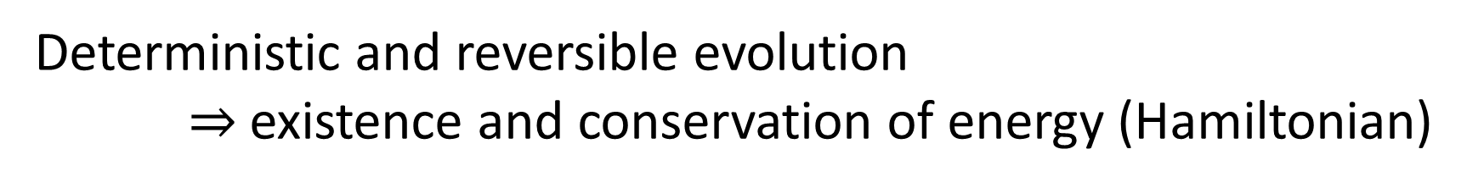
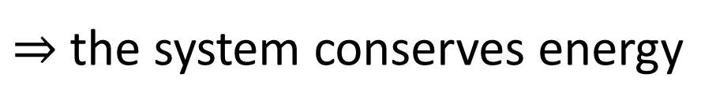

Reverse physics gives us links between theories
Deterministic and reversible evolution $⇒$existence and conservation of energy (Hamiltonian)
Why?
Stronger version of the first law of thermodynamics
Deterministic and reversible evolution
$⇒$ past and future depend only on the state of the system
$⇒$ the evolution does not depend on anything else
$⇒$ the system is isolated
First law of thermodynamics!
$⇒$ the system conserves energy
Notes:
Structure of phase space exactly what is needed to do statistical mechanics - Comes out of invariance of the entropy under coordinate transformations

Slide 13
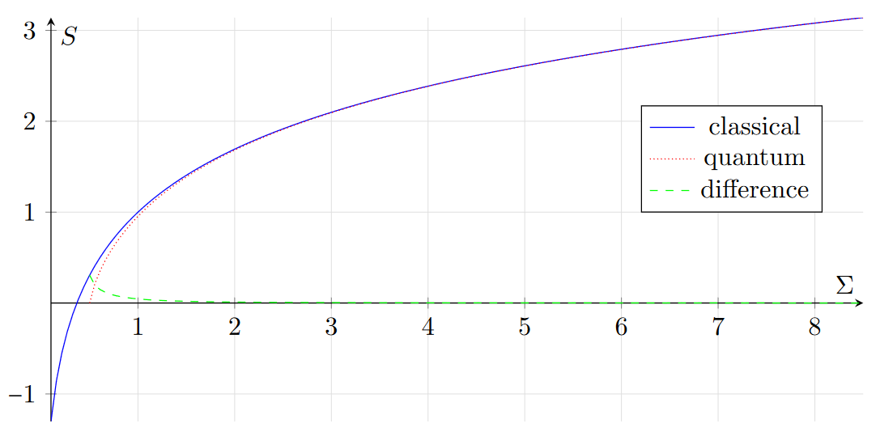
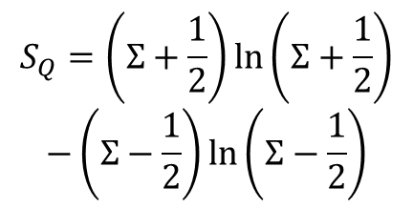
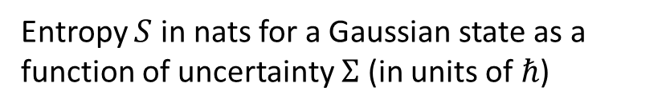


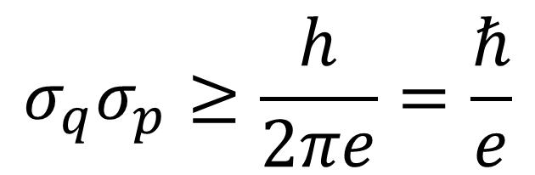

Classical uncertainty principle
excluded by bound
Gaussian states minimize uncertainty at a given entropy
Let $h$ be the volume of phase space over which a uniform distribution has zero entropy.
$$σ_{q}σ_{p}≥\frac{h}{2πe}=\frac{ℏ}{e}$$
excluded by 3rd law of thermodynamics
Entropy $S$ in nats for a Gaussian state as a function of uncertainty $Σ$ (in units of $ℏ$)
Lower bound on entropy $⇒$ lower bound on uncertainty
$$S_{C}=\ln{Σ}+1$$
$$S_{Q}=\left(Σ+\frac{1}{2}\right)\ln\left(Σ+\frac{1}{2}\right)$$
$$−\left(Σ−\frac{1}{2}\right)\ln\left(Σ−\frac{1}{2}\right)$$

Slide 14
3rd law of thermodynamics and uncertainty principle
Classical mechanics
Third law of thermodynamics
Lower bound on entropy
+
Uncertainty principle
Quantum mechanics
Principle of maximal description
No state can describe a system more accurately than stating the system is not there in the first place
The uncertainty principle is a consequence of the principle of maximal description
Can we understand the rest of quantum mechanics in the same way?

Slide 15









Quantum mechanics as irreducibility
Classical
Quantum
Entropy
Minimum uncertainty
$$p$$
?
time
0
time
$$q$$
Can prepare ensembles at arbitrarily low entropy: we can study arbitrarily small parts
Entropy is bounded at zero: we cannot study parts
Can’t squeeze ensemble arbitrarily
We always have access to the internal dynamics
No access to the internal dynamics
Superluminar effects that can’t carry information
Probability of transition
Non-locality
$$\left|x^{+}\right\rangle$$
$$\left|y^{+}\right\rangle$$
$$\left|x^{−}\right\rangle$$
$$\left|y^{−}\right\rangle$$
Can’t refine ensembles $⇒$ Can’t interact with parts
Can’t refine ensembles $⇒$ Can’t extract information
$$p\left(x^{+} | y^{−}\right)=p(y^{−}|x^{+})$$
Symmetry of the inner product

Slide 16



















Time evolution and measurements
$$ρ_{I}$$
$$P$$
$ρ_{O}=P\left(ρ_{I}\right)$
Any process (deterministic or stochastic) will take an ensemble as input and return an ensemble as output
$$P\left(p_{1}ρ_{1}+p_{2}ρ_{2}\right)=p_{1}P\left(ρ_{1}\right)+p_{2}P\left(ρ_{2}\right)$$
$$\left|E_{1}\right\rangle$$
$$\left|E_{1}\right\rangle$$
Deterministic and reversible
Measurement
$$ρ_{I}$$
$$P$$
$$ρ_{O}$$
$$P^{−1}$$
$$ρ_{I}$$
$$ρ_{I}$$
$$P$$
$$ρ_{O}$$
$$P$$
$$ρ_{O}$$
$$Δθ$$
Conserves probability and allows an “inverse”
Must be repeatable
$⇒$ Unitary operation
$⇒$ Projection
$$|E_{0}⟩$$
$$|E_{0}⟩$$
Measurement problem: unitary $⇏$ projections … projections $⇒$ unitary
Unitary evolution $≡$ sequence of infinitesimal projections
Unitary evolution is for det/rev, isolated processes System being measured can’t be isolated

Slide 17






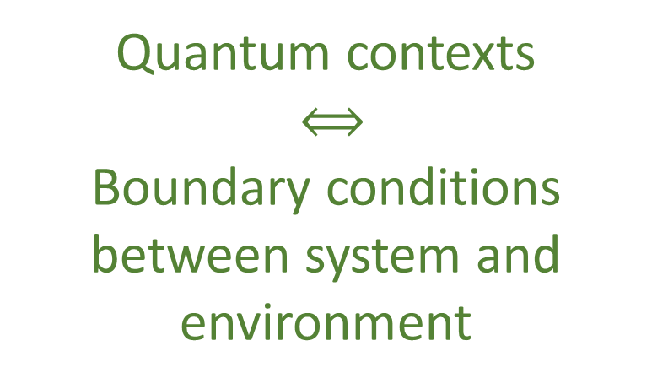





Parallels between QM and thermodynamics
$$U=e^{\frac{OΔt}{ıℏ}}$$
Eigenstates $→$ states unchanged by the process $→$ equilibria of the process
Every state is an eigenstate of some unitary / Hermitian operator $→$ all states are equilibria
Quantum contexts
$⟺$
Boundary conditions between system and environment
Every mixed state commutes with some unitary operator (same eigenstates used calculate entropy)
Spin up meas.
Equilibration
$$[N_{1},V,T]$$
$$\left|x^{+}\right\rangle$$
$$\left|z^{+}\right\rangle$$
Projections $⟺$ Measurements
$$[μ,V,T]$$
$$\left|z^{−}\right\rangle$$
$$[N_{2},V,T]$$
Unitary $⟺$ Quasi-static
Different equilibria, different variables
Different contexts, different variables
$$[….,V,T]$$

Slide 18

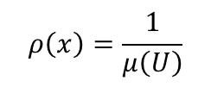








Entropic nature of physical theories
Thermodynamics/Statistical mechanics are not built on top of mechanics
Mechanics is the ideal case of thermodynamics/statistical mechanics
Best preparation $⇒$ pure state
Best process $⇒$ map between pure states
$$μ\left(U\right)$$
Standard probability
$$ρ\left(x\right)=\frac{1}{μ\left(U\right)}$$
The geometric structure of both classical and quantum mechanics is ultimately an entropic structure
Symplectic manifold
We can only prepare/measure ensembles. Ensembles can offer a unified way of thinking about states.
$ρ$ uniform over $U$
Information theory
$$H\left(ρ\right)=\log{μ\left(U\right)}$$
$$\left\langle ψ | φ\right\rangle$$
Quantum probability
$$p\left(ψ | φ\right)={\left|\left\langle ψ | φ\right\rangle \right|}^{2}$$
Projective Hilbert space
$$ρ=\frac{1}{2}ρ_{ψ}+\frac{1}{2}ρ_{φ}$$
Quantum information theory
$$H\left(ρ\right)=H\left(\frac{1+\sqrt{p}}{2},\frac{1−\sqrt{p}}{2}\right)$$

Slide 19
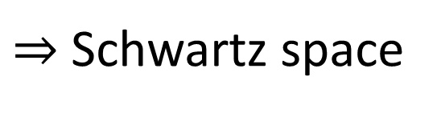
Unphysicality of Hilbert spaces
Hilbert space: complete inner product vector space
Redundant on finite-dimensional spaces. For infinite-dimensional spaces, it allows us to construct states with infinite expectation values from states with finite expectation values
Exactly captures measurement probability/entropy of mixtures and superposition/statistical mixing
Physically required
Extremely physically suspect!!!
$⇒$ Thus requires us to include unitary transformations (e.g. change of representations and finite time evolution) that change finite expectation values into infinite ones
Suppose we require all polynomials of position and momentum to have finite expectation
$⇒$ Schwartz space
Maybe more physically appropriate?

Slide 20
Physical mathematics

Slide 21
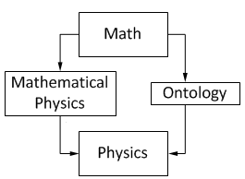
In modern physics, mathematics is used as the foundation of our physical theories
Mathematical content of a theory can never tell us the full physical content
From Hossenfelder’s Lost in Math: “[…] finding a neat set of assumptions from which the whole theory can be derived, is often left to our colleagues in mathematical physics […]”
David Hilbert: “Mathematics is a game played according to certain simple rules with meaningless marks on paper.”
Bertrand Russell: “It is essential not to discuss whether the first proposition is really true, and not to mention what the anything is, of which it is supposed to be true.”
Physics
We need to identify which parts of mathematics are “correct” to capture physical properties in a specific realm of applicability
Physical requirements
Semantics
Physical Mathematics
From Wikipedia “Mathematical Physics”
Mathematical structures must be justified by physical requirements

Slide 22
Choose axioms/primitive notions so that the justification is straightforward
Physics
Physical objects live in the physical (informal) world
Physical requirements
Semantics
Informal
Formal
Mathematical objects are “crisper idealization” of physical objects
(e.g. connection to experiment is outside of the formal system)
physics
math
Physical mathematics
All physical content is captured by the definitions and axioms
Physical concepts are “fuzzy”
Mathematical concepts cannot have circular definitions
Physical concepts may have circular definitions
The map between informal and formal is the most delicate and important step, and it is also the least studied!!!

Slide 23


Examples: symplectic space and probability spaces
Hamiltonian mechanics
Phase space (symplectic manifold)
Hamiltonian evolution
Differentiable manifold
Symplectic structure
Manifold
Differentiable structure
Determinism/reversibility
Observer independent count of states
Topological space
Locally $ℝ^{n}$
Infinitesimal reducibility
Experimentally distinguishable cases with verifiable statements
Identified by independent continuous quantities
We can see what each additional mathematical layer represents and under what assumptions
Probability space
Set of points
$σ$-algebra
Measure
Experimentally distinguishable cases
Statements associated with experimental tests
Probability that a statement is true

Slide 24












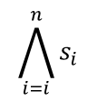


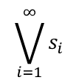
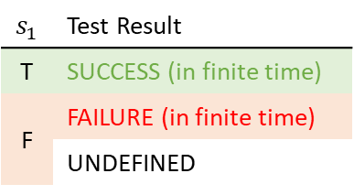

Logic of experimental verifiability
Top. Proc. 54 pp. 271-282 (2019)
verifiable statements
$$𝒮$$
$$s_{1}$$ | Test Result
T | SUCCESS (in finite time)
F | FAILURE (in finite time)
 | UNDEFINED
$$\bigwedge_{i=i}^{n}{s_{i}}$$
$$𝒮_{\text{v}}$$
Finite conjunction (logical AND)
$$s_{1}$$
$$s_{2}$$
$$s_{3}$$
statements
All tests must succeed
$$s_{1}$$
experimental test
Countable disjunction (logical OR)
$$\bigvee_{i=1}^{∞}{s_{i}}$$
$$s_{1}$$
$$s_{2}$$
$$s_{3}$$
$$…$$
Physical theories (evidence based)
$⇒$ all theoretical statements associated with tests
One successful test is sufficient
Operator | Gate | Statement | Theoretical Statement | Verifiable Statement | Decidable Statement
Negation | NOT | allowed | allowed | disallowed | allowed
Conjunction | AND | arbitrary | countable | finite | finite
Disjunction | OR | arbitrary | countable | countable | finite
$$𝒮_{d}$$
$$𝒮_{v}$$
$$𝒮_{t}$$
$$𝒮$$
Some mathematical theories (formally well-posed) have “too many statements” to be physically meaningful

Slide 25
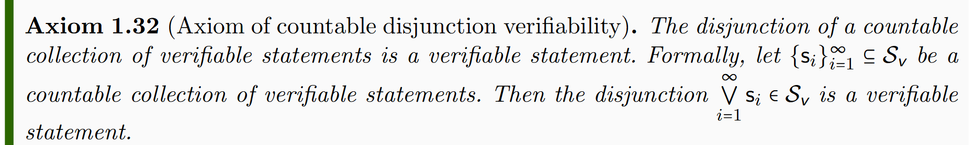
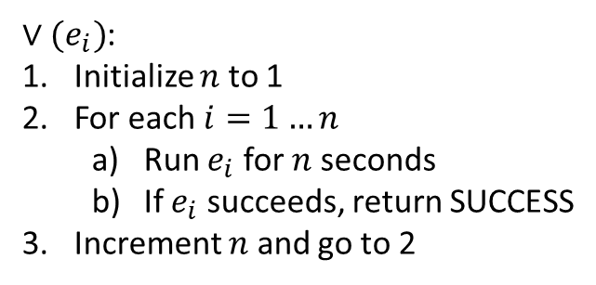
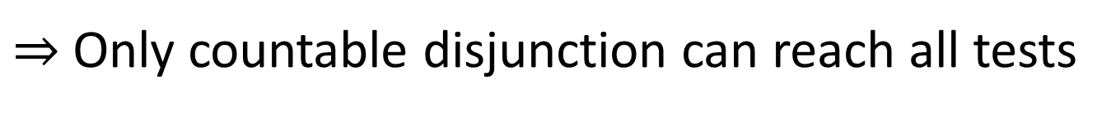
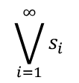
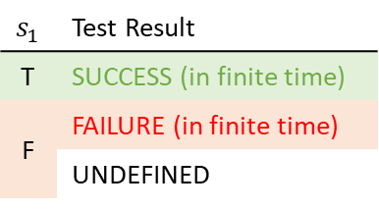
Disjunction (OR) of verifiable statements: check that ONE test terminates successfully
$$s_{1}$$ | Test Result
T | SUCCESS (in finite time)
F | FAILURE (in finite time)
 | UNDEFINED
$∨(e_{i})$:
Initialize $n$ to 1
For each $i=1…n$
Run $e_{i}$ for $n$ seconds
If $e_{i}$ succeeds, return SUCCESS
Increment $n$ and go to 2
watch out for non-termination!
$$\bigvee_{i=1}^{∞}{s_{i}}$$
$$s_{1}$$
$$s_{2}$$
$$s_{3}$$
$$…$$
$⇒$ Only countable disjunction can reach all tests

Slide 26
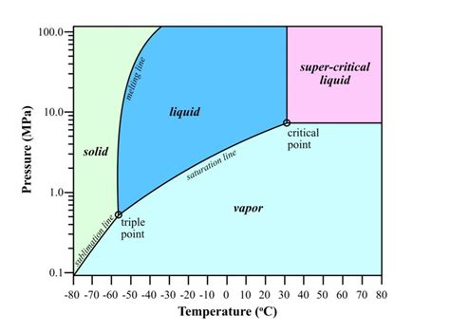

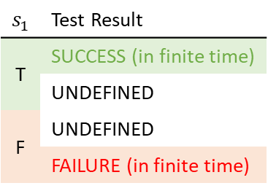


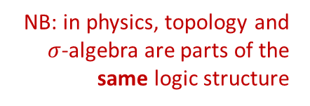





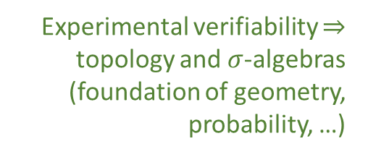

Topology and $σ$-algebra
Experimental verifiability $⇒$ topology and $σ$-algebras (foundation of geometry, probability, …)
Theoretical statements
$int(A)$ corresponds to the verifiable part of a statement
$$s_{1}$$ | Test Result
T | SUCCESS (in finite time)
 | UNDEFINED
F | UNDEFINED
 | FAILURE (in finite time)
Verifiable statements
Perfect map between math and physics
Possibilities
$∂A$ corresponds to the undecidable part of a statement
$ext(A)$ corresponds to the falsifiable part of a statement
NB: in physics, topology and $σ$-algebra are parts of the same logic structure
Open sets
Points
Open set $(\text{5}\text{09.5, 510.5})$ $⟺$ Verifiable “the mass of the electron is 510 $±$ 0.5 KeV”
Borel sets
Closed set $[510]$ $⟺$ Falsifiable “the mass of the electron is exactly 510 KeV”
Borel set $ℚ$ ($int\left(ℚ\right)∪ext\left(ℚ\right)=∅$) $⟺$Theoretical “the mass of the electron in KeV is a rational number” (undecidable)
Inference relationship $𝓇:𝒟_{Y}→𝒟_{X}$ such that $𝓇\left(s\right)≡s$
$$𝒟_{X}$$
$$𝒟_{Y}$$
Topologically continuous consistent with analytic discontinuity on isolated points
Inference relationship $$⟺$$ Causal relationship
Relationships must be topologically continuous
$$X$$
$$Y$$
Causal relationship $f:X→Y$ such that $x≼f\left(x\right)$
Phase transition $⟺$ Topologically isolated regions

Slide 27







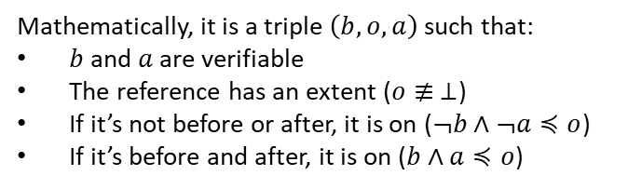










Quantities and ordering
Phys. Scr. 95 084003 (2020)
Goal: deriving the notion of quantities and numbers (i.e. integers, reals, …) from an operational (metrological) model
A reference (i.e. a tick of a clock, notch on a ruler, sample weight with a scale) is something that allows us to distinguish between a before and an after
before
on
after
Mathematically, it is a triple $\left(b,o,a\right)$ such that:
$b$ and $a$ are verifiable
The reference has an extent ($o≢ ⊥$)
If it’s not before or after, it is on ($¬b∧¬a≼o$)
If it’s before and after, it is on ($b∧a≼o$)
Numbers defined by metrological assumptions, NOT by ontological assumptions
Dense
The hard part is to recover ordering. After that, recovering reals and integers is simple.
$$o_{1}$$
$$o_{3}$$
$$o_{2}$$
$$⇒ \left(X,≤\right)≅(ℝ,≤)$$
To define an ordered sequence of possibilities, the references must be (nec/suff conditions):
+
Strict
Aligned
Refinable
Sparse
before
on
after
$$b_{2}$$
$$a_{2}$$
$$o_{3}$$
$$o_{1}$$
$$o_{2}$$
$$o_{2}$$
$$⇒ \left(X,≤\right)≅(ℤ,≤)$$
$$o_{1}$$
$$o_{2}$$
$$o_{1}$$
$$b_{1}$$
$$a_{1}$$
$$⇒ \left(X,≤\right)$$
Assumptions untenable at Planck scale: no consistent ordering: no “objective” “before” and “after”

Slide 28
Space of the well-posed scientific theories
Physical theories
Unitary evolution
Specializations of the general theory under the different assumptions
Hamiltonian mechanics
Quantum state-space
Classical phase-space
Infinitesimal reducibility
Determinism/
reversibility
Irreducibility
Assumptions
States and processes
General theory
Information granularity
Basic requirements and definitions valid in all theories
Experimental verifiability

Slide 29

If physical theories are to be repeatably experimentally testable, then they must (at least) be able to describe statistical ensembles (i.e. outputs of repeatable procedures)
If physical laws describe relationship that are always applicable (i.e. whenever this is prepared, this is measured), then they are statements about statistical ensembles
$⇒$ Want a general theory of ensemble that is applicable to all physical theories (i.e. minimum requirements for a space of ensemble)

Slide 30


Axiom of ensemble
Covered by previous work
Since a physical theory needs to provide repeatedly testable results, it must be able to describe statistical ensembles that are distinguishable experimentally.
$⇒$Topological structure
Every ensemble space must be a $T_{0}$ second countable topological space. The open sets represent statements that are experimentally verifiable: there is a test and the test succeeds in finite time if and only if the statement is true.
The Borel sets represent statements that are associated to a test, regardless of termination.
Theoretical statements
Verifiable statements
Possibilities
Open sets
Points
Borel sets

Slide 31

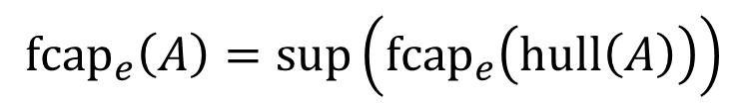


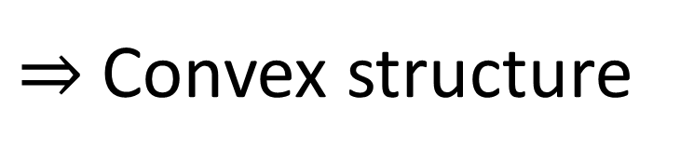

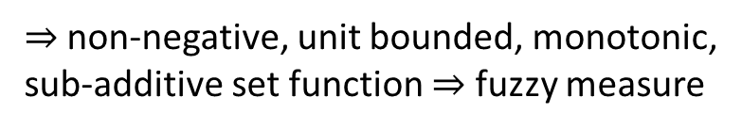



Fraction capacity
Axioms of mixture
Generalized non-additive probability
Given two ensembles, we can always obtain new ones using statistical mixtures (e.g. selecting one 40% of the times and the other 60%).
Given an ensemble $e$ and a set of ensembles $A$, what is the biggest component of $e$ that can be achieved with a mixture of $A$?
$⇒$Convex structure
$${fcap}_{e}\left(a\right)=sup\left(\left\{p∈\left[0,1\right] \right| e=pa+\overline{p}e_{1}\right\})$$
Ensemble spaces allow convex combinations
$${fcap}_{e}\left(A\right)=sup\left({fcap}_{e}\left(hull\left(A\right)\right)\right)$$
$$e=pa+\overline{p}b$$
$$\overline{p}=1−p$$
$$e$$
$$b$$
$⇒$ non-negative, unit bounded, monotonic, sub-additive set function $⇒$ fuzzy measure
$$a$$
Recovers probability (additive) in classical mechanics and quantum measurements
Ultimately responsible for all linear and probabilistic structures

Slide 32

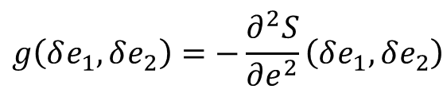
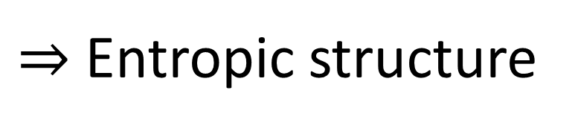

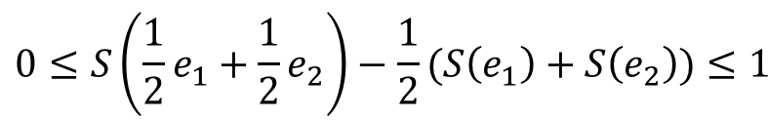

Axioms of entropy
Entropic geometry
Every ensemble must have a well defined entropy that represents the variability of the elements within the ensemble.
Pseudo-distance (recovers Jensen-Shannon Divergence)
$$0≤S\left(\frac{1}{2}e_{1}+\frac{1}{2}e_{2}\right)−\frac{1}{2}(S\left(e_{1}\right)+S\left(e_{2}\right))≤1$$
$⇒$ Entropic structure
Entropy is strictly concave
$$S\left(p_{1}e_{1}+p_{2}e_{2}\right)≥∑p_{i}S\left(e_{i}\right)$$
Strict concavity of entropy $⇒$ Hessian negative definite (recovers Fisher-Rao metric and Bures metric)
$$g\left(δe_{1}, δe_{2}\right)=−\frac{∂^{2}S}{∂e^{2}}\left(δe_{1}, δe_{2}\right)$$
Upper bound on entropy increase
$$S\left(p_{1}e_{1}+p_{2}e_{2}\right)≤∑p_{i}S\left(e_{i}\right)−p_{i}log p_{i}$$
Orthogonality!
Ultimately responsible for all geometric structures (i.e. metrics, symplectic forms and inner products)

Slide 33
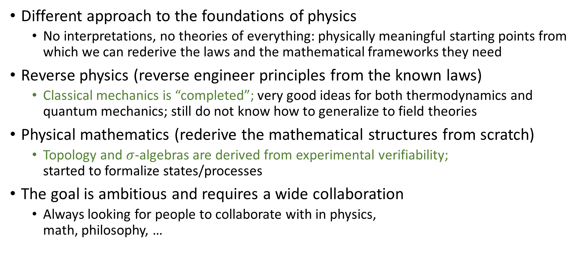
Wrapping it up
Different approach to the foundations of physics
No interpretations, no theories of everything: physically meaningful starting points from which we can rederive the laws and the mathematical frameworks they need
Reverse physics (reverse engineer principles from the known laws)
Classical mechanics is “completed”; very good ideas for both thermodynamics and quantum mechanics; still do not know how to generalize to field theories
Physical mathematics (rederive the mathematical structures from scratch)
Topology and $σ$-algebras are derived from experimental verifiability; started to formalize states/processes
The goal is ambitious and requires a wide collaboration
Always looking for people to collaborate with in physics, math, philosophy, …

Slide 34
To learn more
Project website
https://assumptionsofphysics.org for papers, presentations, …
https://assumptionsofphysics.org/book for our open access book (updated every few years with new results)
YouTube channels
https://www.youtube.com/@gcarcassi Videos with results and insights from the research
https://www.youtube.com/@AssumptionsofPhysicsResearch Research channel, with open questions and livestreamed work sessions
GitHub
https://github.com/assumptionsofphysics Book, research papers, slides for videos...

