Slide 1
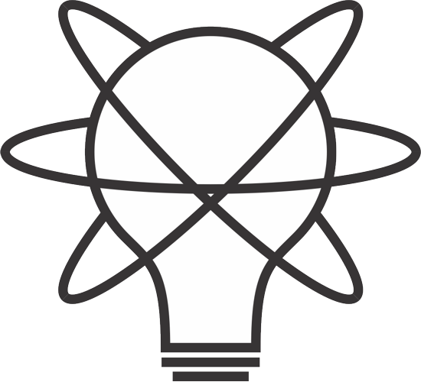
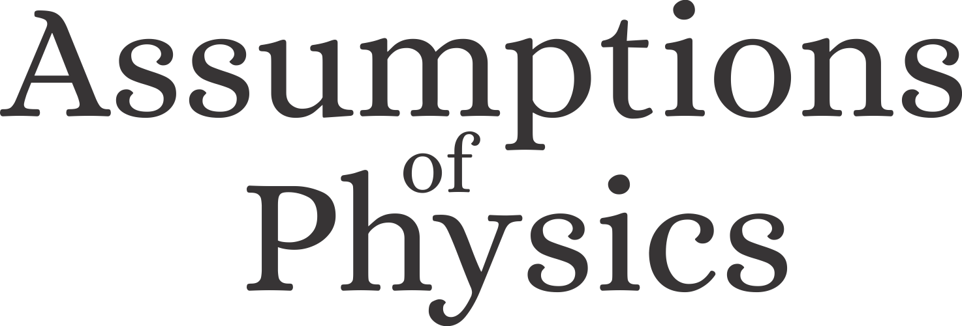
Reverse Physics for GR
Reverse Physics: from laws to physical assumptions,
Found Phys 52, 40 (2022)
Gabriele Carcassi and Christine A. Aidala
Physics Department University of Michigan
https://assumptionsofphysics.org

Slide 2

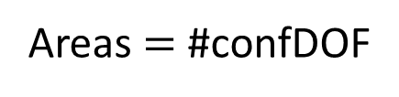

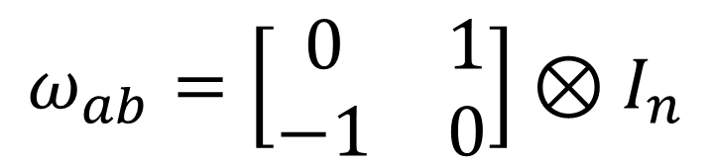






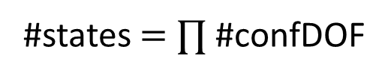
Hamiltonian mechanics $⟺$ det/rev + DOF independence
$$d_{t}q^{i}=∂_{p_{i}}H$$
$$S_{a}=d_{t}ξ^{a}ω_{ab}=∂_{b}H$$
$$ω_{ab}\left(t+dt\right)=ω_{ab}\left(t\right)+\left(∂_{a}S_{b}−∂_{b}S_{a}\right)dt+O\left(dt^{2}\right)$$
$$d_{t}p_{i}=∂_{q^{i}}H$$
Assumptions of Physics, Michigan Publishing (v2 2023)
$$(q^{2},p_{2})$$
$$({\hat{q}}^{2},{\hat{p}}_{2})$$
$$ω_{ab}=\left[\begin{matrix}0 & 1 \\ −1 & 0\end{matrix}\right]⊗I_{n}$$
$$(q^{1},p_{1})$$
$$({\hat{q}}^{1},{\hat{p}}_{1})$$
Scalar product across DOFs
Area within each DOF
Volume $=$ #states
#states $=$ $∏$ #confDOF
Areas $=$ #confDOF
Hamiltonian is the continuous version of
Recovers relativistic particle mechanics without additional assumptions

Slide 3

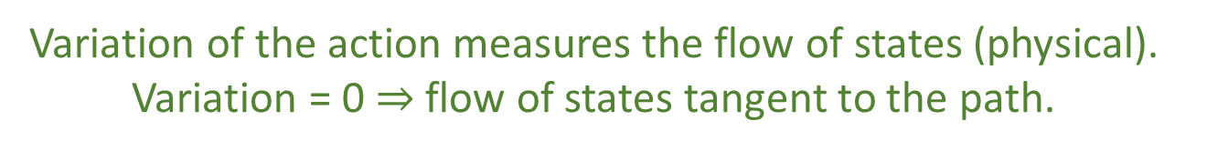
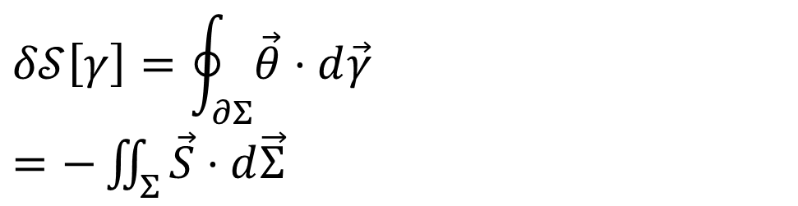


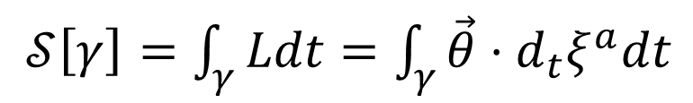







Geometry of principle of least action (SDOF)
DR
$$\left[p,0,−H\right]$$
KE
$$pd_{t}q+0d_{t}p−Hd_{t}t$$
$$∇⋅\vec{S}=0$$
$$\vec{S}=−∇×\vec{θ}$$
$𝒮\left[γ\right]=\int_{γ}{Ldt}=\int_{γ}{\vec{θ}⋅d_{t}ξ^{a}dt}$
No state is “lost” or “created” as time evolves
(Minus sign to match convention)
Sci Rep 13, 12138 (2023)
The action is the line integral of the vector potential (unphysical)
$$p$$
$$q$$
Variation of the action
$$Σ$$
Gauge independent, physical!
$$δ𝒮\left[γ\right]=\oint_{∂Σ}{\vec{θ}⋅d\vec{γ}}$$ $=−\iint_{Σ}{\vec{S}⋅d\vec{Σ}}$
$$γ$$
$$γ′$$
$$t$$
Variation of the action measures the flow of states (physical). Variation = 0 $⇒$ flow of states tangent to the path.

Slide 4


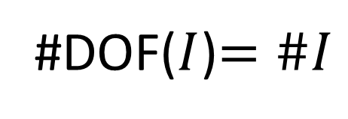

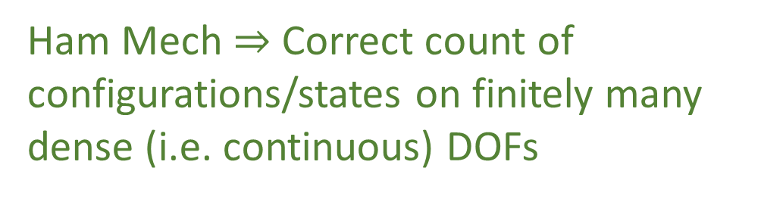

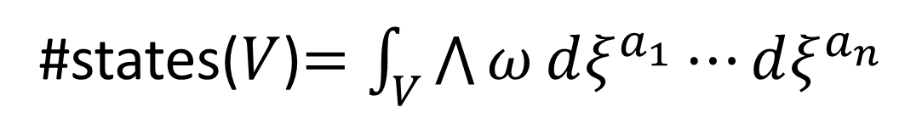
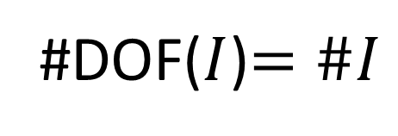


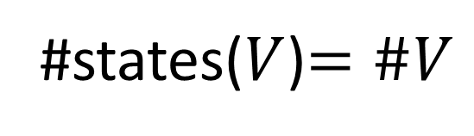
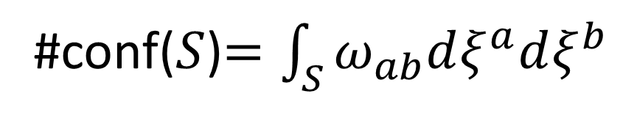


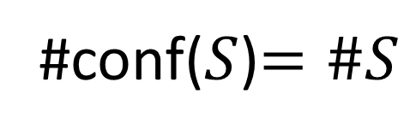

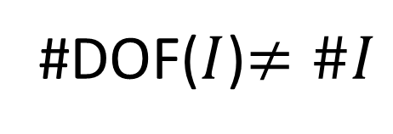
Counting states and configurations
Discrete case
$$S$$
$$q^{2}$$
#conf($S$)$=\#S$
#states($V$)$=\#V$
#DOF($I$)$=\#I$
$$V$$
$$q^{1}$$
Configuration density
State density
Continuous case
$$≠\#V=∞$$
#conf($S$)$=\int_{S}{ω_{ab}dξ^{a}dξ^{b}}$
#states($V$)$=\int_{V}{\bigwedge{ω}dξ^{a_{1}}⋯dξ^{a_{n}}}$
$$(q^{2},p_{2})$$
#DOF($I$)$=\#I$
$$S$$
Ham Mech $⇒$ Correct count of configurations/states on finitely many dense (i.e. continuous) DOFs
$$(q^{1},p_{1})$$
$$V$$
Field theory $⇒$ DOFs themselves are dense (i.e. continuous)
#DOF($I$)$≠\#I$

Slide 5
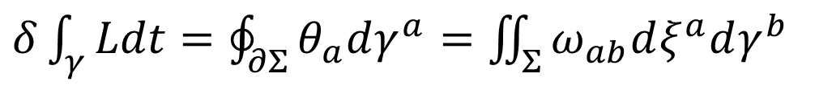

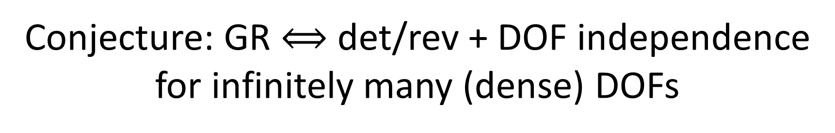

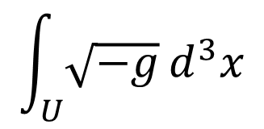
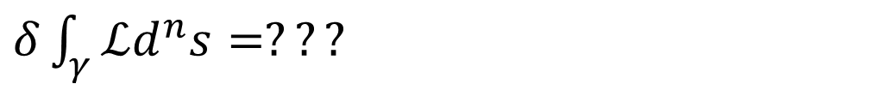
Conjecture: GR $⟺$ det/rev + DOF independence for infinitely many (dense) DOFs
$δ\int_{γ}{Ldt}=\oint_{∂Σ}{θ_{a}dγ^{a}}=\iint_{Σ}{ω_{ab}dξ^{a}dγ^{b}}$
#conf
Flow of states
$$=?$$
$δ\int_{γ}{ℒd^{n}s}=???$
#DOFs
Line integral of the vector potential of the flow of state density?
$$\int_{U}{\sqrt{−g}}d^{3}x$$
#DOFs?
$$ℒ=ℒ_{g}+ℒ_{matter}$$
Flow of DOFs?
Flow of configurations?
We are mapping values between Cauchy surfaces, #DOFs are the points on the Cauchy surface, #conf are the possible field values at each point

Slide 6





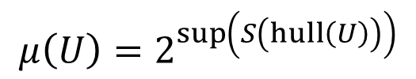
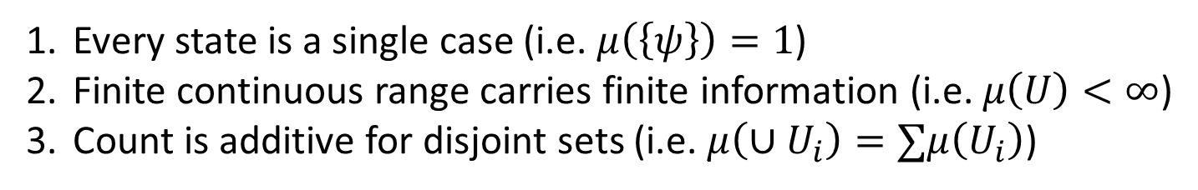






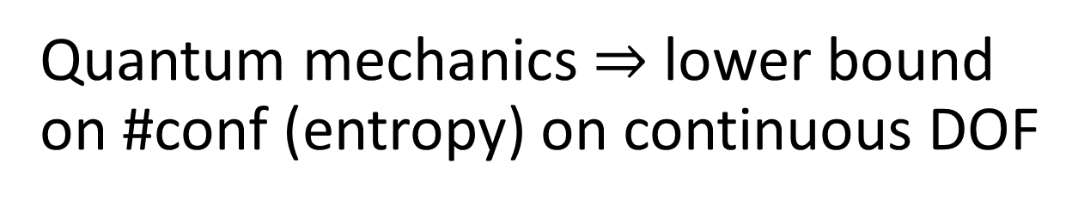
The problem with counting on the continuum
We’d like:
Every state is a single case (i.e. $μ\left(\left\{ψ\right\}\right)=1$)
Finite continuous range carries finite information (i.e. $μ\left(U\right)<∞$)
Count is additive for disjoint sets (i.e. $μ\left(∪U_{i}\right)=∑μ\left(U_{i}\right)$)
Incompatible!
Pick two!
Discard 1 $⇒$ Lebesgue measure
Discard 2 $⇒$ counting measure
$$A$$
Non-orthogonal states: different states but in different contexts
Discard 3 $⇒$ “Quantum measure”
additive
$$C$$
sub-additive
Orthogonal states: different states all else equal
$$μ\left(U\right)=2^{\sup\left(S\left(hull\left(U\right)\right)\right)}$$
$$B$$
$$μ\left(\left\{A\right\}\right)=2^{0}=1$$
Exponential of the maximum entropy reachable with convex combinations (statistical mixtures) of $U$ (reduces to counting/Liouville measure)
$$μ\left(\left\{A,B\right\}\right)=2^{1}=2$$
$$μ\left(\left\{A,C\right\}\right)<2=μ\left(\left\{A\right\}\right)+μ\left(\left\{C\right\}\right)$$
Quantum mechanics $⇒$ lower bound on #conf (entropy) on continuous DOF

Slide 7
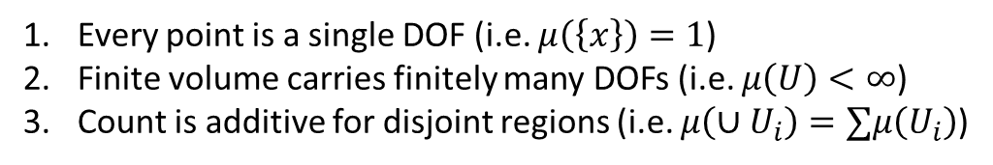
Conjecture: quantum gravity $⇒$ lower bound on DOF count
#conf
Same problem!
#conf=#DOFs
Every point is a single DOF (i.e. $μ\left(\left\{x\right\}\right)=1$)
Finite volume carries finitely many DOFs (i.e. $μ\left(U\right)<∞$)
Count is additive for disjoint regions (i.e. $μ\left(∪U_{i}\right)=∑μ\left(U_{i}\right)$)
#DOFs
Lower bound on this…
…requires a lower bound on this
Distant points: independent DOFs
additive
From QM: Lower bound on state count requires a severe revisitation of particle state space
sub-additive
Close points: DOFs not independent
Does lower bound on DOF count require an equally severe revisitation of space-time?

Slide 8
Wrapping up
Classical mechanics is exactly det/rev mapping of configurations over finitely many DOFs
Conjecture: is general relativity exactly det/rev mapping of configurations over infinitely many (dense) DOFs (i.e. a field theory)?
Quantum mechanics sets a lower bound on state count
Entropy of pure state is zero, pure states count as one state
Conjecture: is quantum gravity setting a lower bound on the DOF count?
No region of space can contain less than one DOF
Can we generalize the physical/geometric interpretation of the action principle to field theory and to QM?

