Slide 1

Assumptions of Physics Summer School 2025 Introduction to Reverse Physics
Gabriele Carcassi and Christine A. Aidala
Physics Department University of Michigan

Slide 2





Main goal of the project
Identify a handful of physical starting points from which the basic laws can be rigorously derived
For example:
Infinitesimal reducibility $⇒$ Classical state
Irreducibility $⇒$ Quantum state
https://assumptionsofphysics.org
?
time
time
This also requires rederiving all mathematical structures from physical requirements
For example:
Science is evidence based $⇒$ scientific theory must be characterized by experimentally verifiable statements $⇒$ topologies and $σ$-algebras

Slide 3
Standard view of the foundations of physics
Goal of physics is to find the true laws of the universe!
approximation
…
The “real” physics!
Weak interactions
QED -Electromagnetism
The foundations of physics!
Everything else is an approximation
QCD – Strong Interactions
Electro-weak
General Relativity
Grand Unified Theory
What “really” happens
Theory of Everything
Measurement problem
Hidden variables
Role of the observer
Ontology of observables
Perfect description of the universe
Dark matter/energy

Slide 4
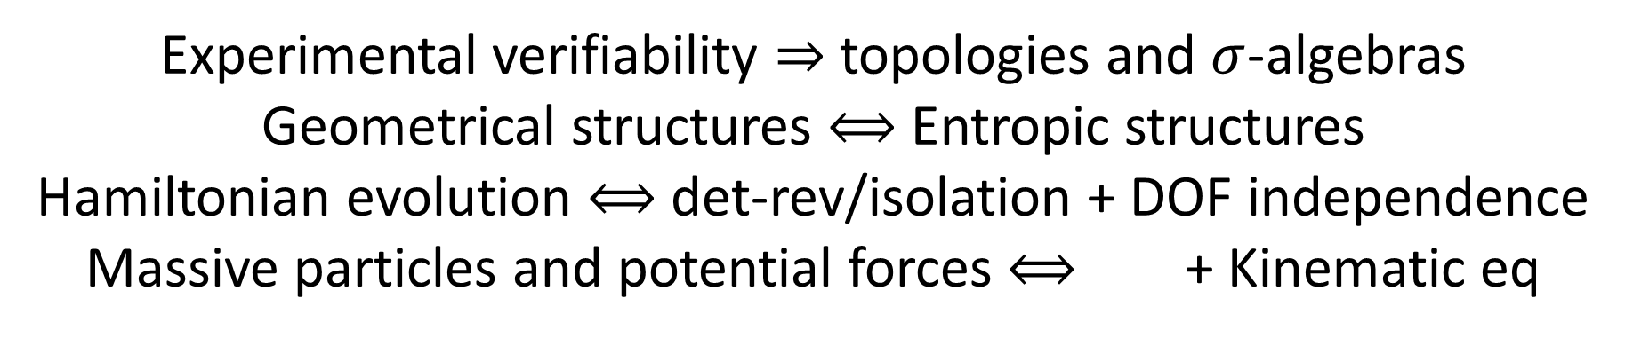
We found:
Experimental verifiability $⇒$ topologies and $σ$-algebras
Geometrical structures $⟺$ Entropic structures
Hamiltonian evolution $⟺$ det-rev/isolation + DOF independence
Massive particles and potential forces $⟺$ + Kinematic eq
Physical requirements and assumptions drive most of the theoretical apparatus
Goal of physics is to find the true laws of the universe!
Goal of physics is to find models that can be empirically tested
Less productive point of view
More productive point of view

Slide 5
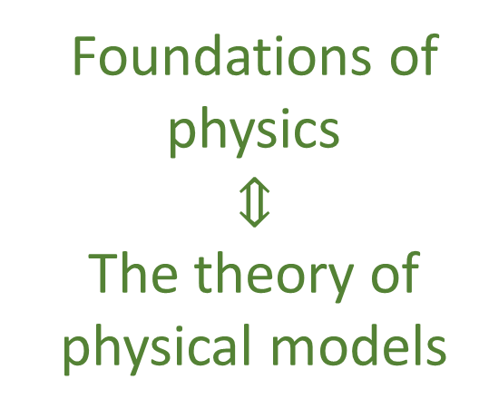
Our view of the foundations of physics
Foundations of physics $$⇕$$ The theory of physical models
General physical principles and requirements
General mathematical framework
Specific assumptions
Classical mechanics
Quantum mechanics
derivation
Thermodynamics
…
specialization

Slide 6
Find the right overall concepts
Reverse physics: Start with the equations, reverse engineer physical assumptions/principles
Reverse Physics
Physics
Smallest set of assumptions required to rederive the theory
Physical theory
Physical result/ effect/prediction
Reverse Mathematics
Mathematics
Smallest set of axioms required to prove the theorem
Theorem
Mathematical result/ corollary/calculation
Found Phys 52, 40 (2022)
Goal: find the right overall physical concepts, “elevate” the discussion from mathematical constructs to physical principles
Physical mathematics: Start from scratch and rederive all mathematical structures from physical requirements
Physics
Physical requirements
Semantics
Physical mathematics
Goal: get the details right, perfect one-to-one map between mathematical and physical objects

Slide 7
Reverse Physics
Assumptions of Physics, Michigan Publishing (v2 2023)
J. Phys. Commun. 2 045026 (2018)

Slide 8
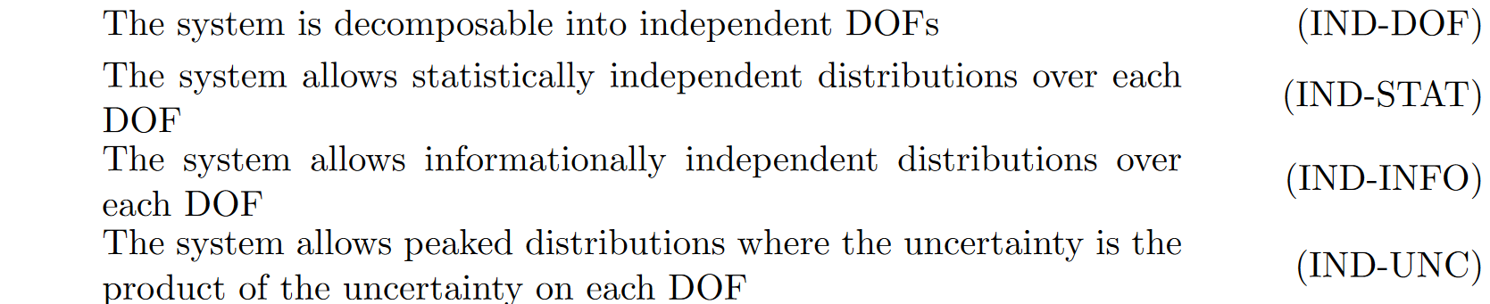
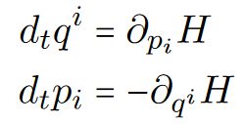







$$p$$
$$⇔$$
$$⇔$$
$$\vec{S}$$
$$q$$
$$⟺$$

Slide 9
Is the uncertainty principle really a feature of quantum mechanics alone?

Slide 10


$$⇒$$
$$⇒$$
$$⟺$$

Slide 11
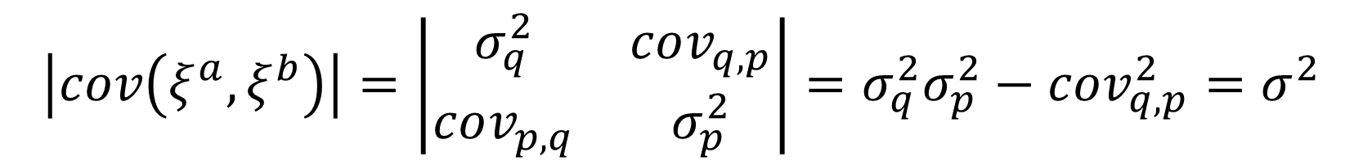



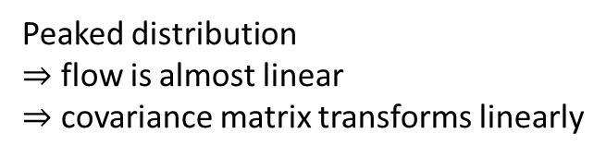
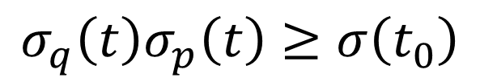
evolution of covariance matrix
Determinant of covariance matrix:
$$p$$
$$\left|cov\left(ξ^{a},ξ^{b}\right)\right|=\left|\begin{matrix}σ_{q}^{2} & cov_{q,p} \\ cov_{p,q} & σ_{p}^{2}\end{matrix}\right|=σ_{q}^{2}σ_{p}^{2}−cov_{q,p}^{2}=σ^{2}$$
Peaked distribution
$⇒$ flow is almost linear $⇒$ covariance matrix transforms linearly
$$q$$
$$\left|cov\left(ξ^{a}\left(t\right),ξ^{b}\left(t\right)\right)\right|=\left|J\right| \left|cov\left(ξ^{a}\left(t_{0}\right),ξ^{b}\left(t_{0}\right)\right)\right|\left|J\right|$$
$$σ_{q}^{2}\left(t\right)σ_{p}^{2}\left(t\right)−cov_{q,p}^{2}\left(t\right)=σ^{2}\left(t_{0}\right)$$
1 under Hamiltonian flow
$$σ_{q}\left(t\right)σ_{p}\left(t\right)≥σ\left(t_{0}\right)$$
Uncertainty is bounded during classical evolution
Notes:
TODO: put the axis on the ellipses. Make them move according to the map

Slide 12
$$⇒$$
$$⇒$$
$$⟺$$

Slide 13
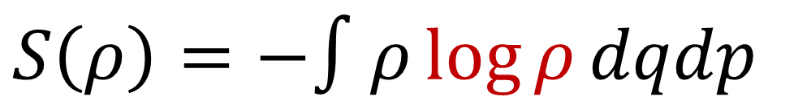
Standard formula for entropy
Logarithm must take a dimensionless quantity
$S\left(ρ\right)=−∫ρ\log{ρ}dqdp$
In reverse physics, all issues of units must be resolved: if units are not clear, the physics is not clear!!

Slide 14
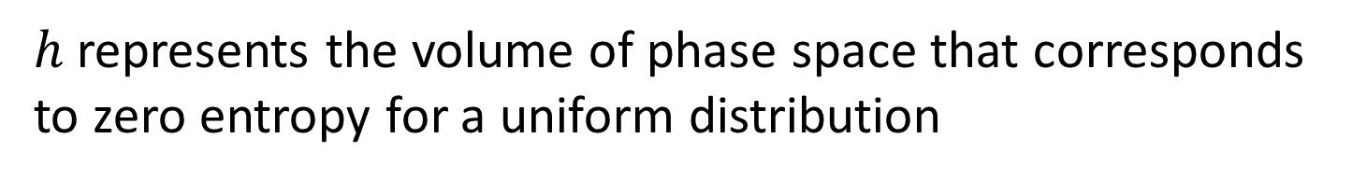


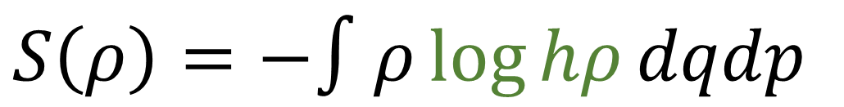



Formula for entropy with entropy fixed
$$p$$
$$S=0$$
$$h$$
$S\left(ρ\right)=−∫ρ\log{hρ}dqdp$
$$x$$
$$ρ=\frac{1}{h} ⇒ S\left(ρ\right)=0$$
$h$ represents the volume of phase space that corresponds to zero entropy for a uniform distribution
No relation to quantum mechanics… just sets the scale for entropy

Slide 15
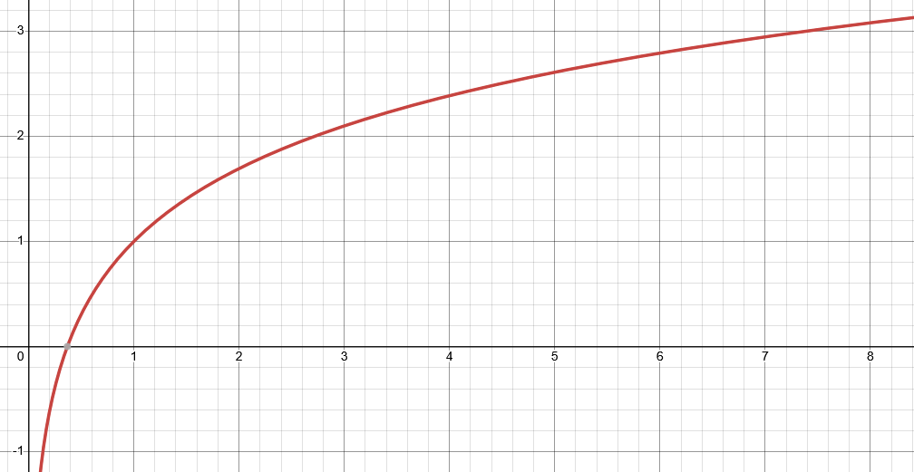


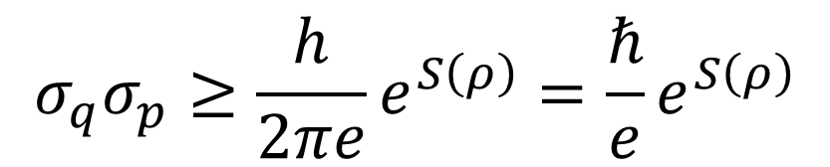
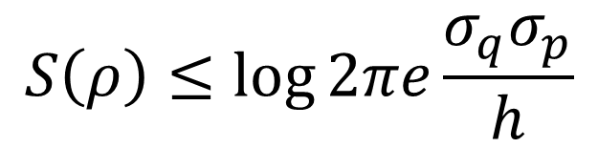
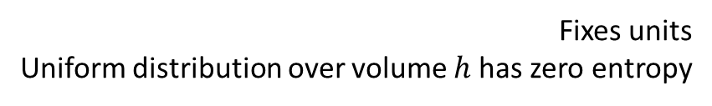

Let’s plot entropy against uncertainty
$S\left(ρ\right)=−∫ρ\log{hρ}dqdp$
$$S\left(ρ\right)≤\log{2πe\frac{σ_{q}σ_{p}}{h}}$$
Fixes units Uniform distribution over volume $h$ has zero entropy
$$S$$
Gaussian maximizes entropy for a given uncertainty
excluded by gaussian bound
$$σ_{q}σ_{p}≥\frac{h}{2πe}e^{S\left(ρ\right)}=\frac{ℏ}{e}e^{S\left(ρ\right)}$$
$$\frac{σ_{q}σ_{p}}{ℏ}$$
Entropy puts a lower bound on the uncertainty
Hamiltonian evolution conserves entropy

Slide 16
Is there anything that puts a lower bound on the entropy?
Every substance has a finite positive entropy, but at the absolute zero of temperature the entropy may become zero, and does so become in the case of perfect crystalline substances.
G. N. Lewis and M. Randall, Thermodynamics and the
free energy of chemical substances (McGraw-Hill, 1923)
The third law of thermodynamics!

Slide 17
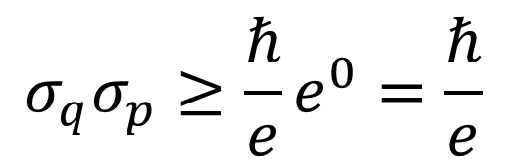


Third law puts a lower bound on the entropy which puts a lower bound on the uncertainty
$$S$$
excluded by gaussian bound
$$σ_{q}σ_{p}≥\frac{ℏ}{e}e^{0}=\frac{ℏ}{e}$$
$$\frac{σ_{q}σ_{p}}{ℏ}$$
excluded by 3rd law of thermodynamics
Classical uncertainty principle!

Slide 18
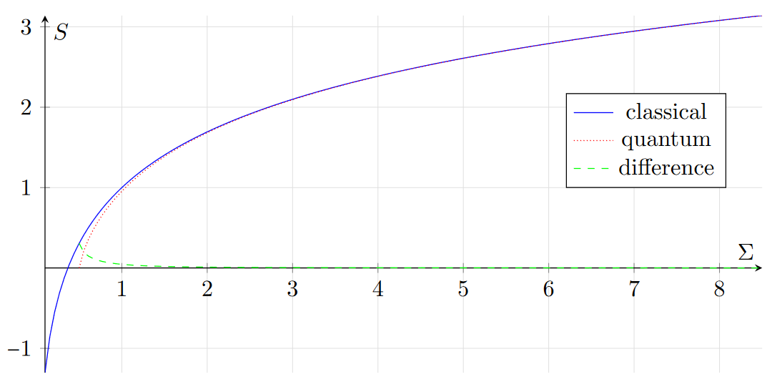
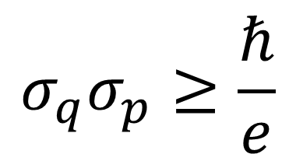
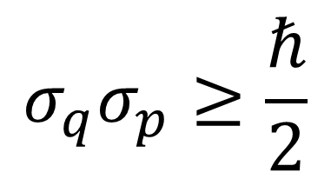



Comparing theories
excluded by gaussian bound
$$σ_{q}σ_{p}≥\frac{ℏ}{e}$$
$$σ_{q}σ_{p}≥\frac{ℏ}{2}$$
classical
quantum
$$\frac{σ_{q}σ_{p}}{ℏ}$$
2.71828…
excluded by 3rd law of thermodynamics
Entropy of quantum states is already non-negative
$$S_{C}=\ln{eσ}$$
The gaussian bound quickly becomes very similar across theories
$S_{Q}=\left(σ+\frac{1}{2}\right)\ln\left(σ+\frac{1}{2}\right)−\left(σ−\frac{1}{2}\right)\ln\left(σ−\frac{1}{2}\right)$
Quantum mechanics incorporates the third law Classical mechanics does not

Slide 19

Comparing theories
excluded by gaussian bound
$$σ_{q}σ_{p}≥\frac{ℏ}{e}$$
$$σ_{q}σ_{p}≥\frac{ℏ}{2}$$
classical
quantum
$$\frac{σ_{q}σ_{p}}{ℏ}$$
2.71828…
excluded by 3rd law of thermodynamics
The uncertainty principle is a consequence of the lower bound of the entropy imposed by the third law of thermodynamics
$$S_{C}=\ln{eσ}$$
$S_{Q}=\left(σ+\frac{1}{2}\right)\ln\left(σ+\frac{1}{2}\right)−\left(σ−\frac{1}{2}\right)\ln\left(σ−\frac{1}{2}\right)$
In quantum mechanics, $L_{q}L_{p}≥πeℏ$ is a stronger inequality
exponential of entropy for position
$$e^{−∫ρ\left(q\right)\log{ρ(q)}dq}$$

Slide 20
Suppose the lower bound on the entropy is the only difference, then in the limit of high entropy of quantum mechanics we should recover classical mechanics
Can we?

Slide 21
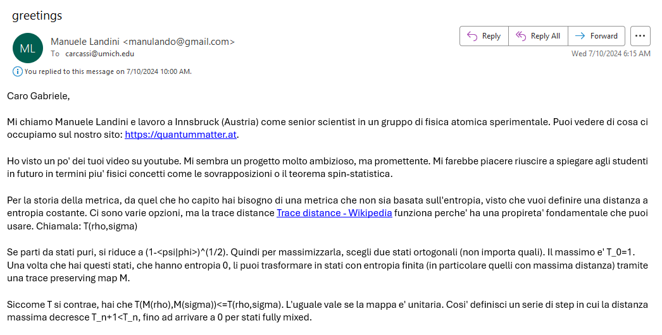
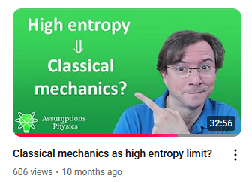
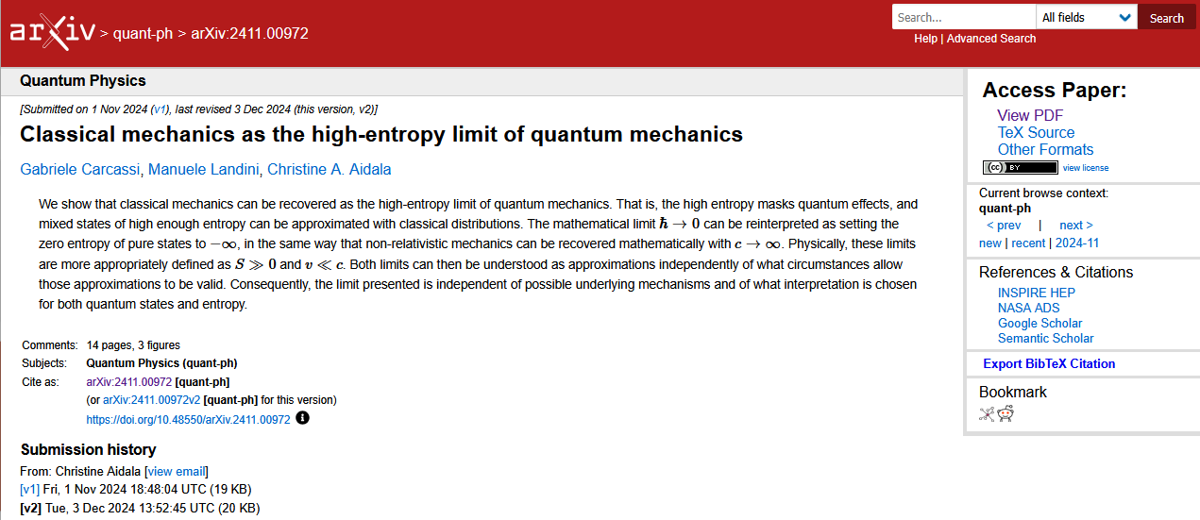
06/01/2024

Slide 22
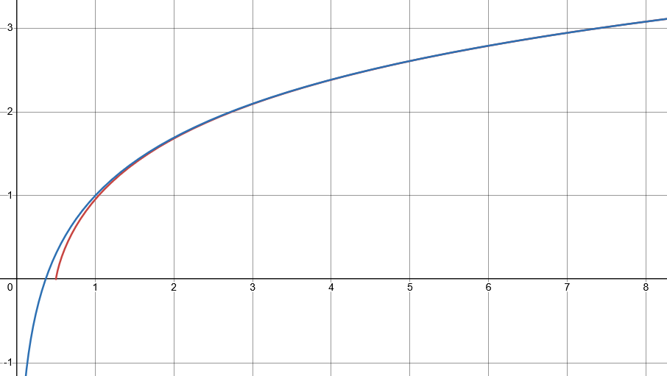
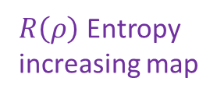



Looking for a map $R(ρ)$ that increases entropy of all mixed states, such that every level set of entropy maps to another level set
$$S$$
$⇒$ Unitary must be mapped to unitary
excluded by gaussian bound
$R\left(ρ\right)$ Entropy increasing map
Unitary map
$$\frac{σ_{x}σ_{p}}{ℏ}$$
excluded by 3rd law of thermodynamics
classical
quantum

Slide 23
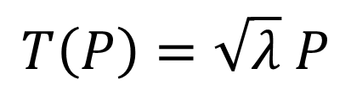
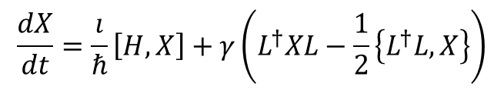
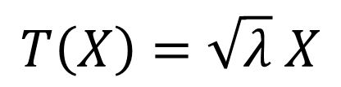


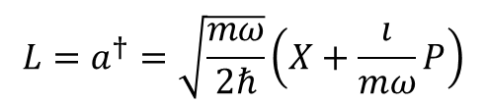
In classical mechanics
$$S\left(R\left(ρ\right)\right)=S\left(ρ\right)+\log{λ}⟺\left\{R\left(x\right),R\left(p\right)\right\}=λ\{x,p\}$$
In quantum mechanics
Jacobian is a constant: all volumes rescaled by the same factor
Stretching map
$$\left[R\left(X\right),R\left(P\right)\right]=λ\left[X,P\right]$$
Pure stretching map
$$T\left(X\right)=\sqrt{λ} X$$
$$T\left(P\right)=\sqrt{λ} P$$
Need to take care of operator ordering!!!
Infinitesimal pure stretching map
$$\frac{dX}{dt}=\frac{ı}{ℏ}\left[H,X\right]+γ\left(L^{†}XL−\frac{1}{2}\left\{L^{†}L,X\right\}\right)$$
Lindblad eq
(open quantum system)
$$L=a^{†}=\sqrt{\frac{mω}{2ℏ}}\left(X+\frac{ı}{mω}P\right)$$
$$γ=λ$$
Anti-normal ordering and Husimi Q are preferred

Slide 24
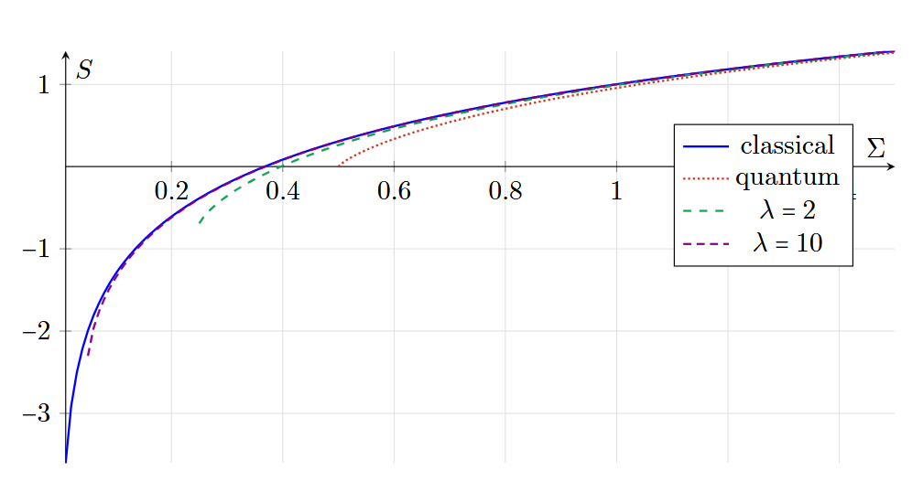
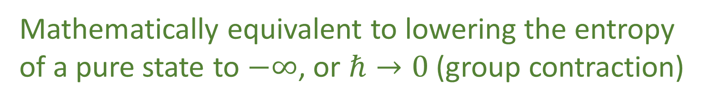
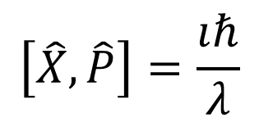



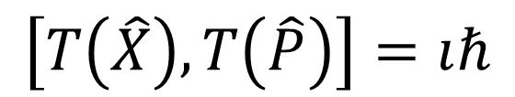
Another perspective: move the pure states to minus infinite entropy
Instead of
$$\left[X,P\right]=ıℏ$$
$$\left[T\left(X\right),T\left(P\right)\right]=λıℏ$$
Redefine original space such that
$$\left[\hat{X},\hat{P}\right]=\frac{ıℏ}{λ}$$
$$\left[T\left(\hat{X}\right),T\left(\hat{P}\right)\right]=ıℏ$$
$λ→∞ ⇒ \frac{ℏ}{λ}→0$
Mathematically equivalent to lowering the entropy of a pure state to $−∞$, or $ℏ→0$ (group contraction)

Slide 25


Low speed
Speed
“$c→∞$”
Dirac’s correspondence principle: putting an entropic lower bound on classical theory
Classical Mechanics | Relativistic Mechanics
Quantum Mechanics | Quantum Field Theory
High entropy
“$ℏ→0$”
Only one way to do it
Entropy
No-mechanism limit (same as non-relativistic limit)

Slide 26
Entropy seems to play a very important role in both classical and quantum mechanics
How far can we push this role?

Slide 27
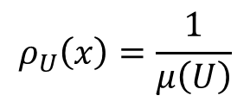
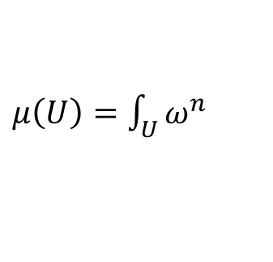


In classical mechanics
Uniform probability densities are inverse of volumes
Geometry gives us areas/volumes
Standard probability
$$ρ_{U}\left(x\right)=\frac{1}{μ\left(U\right)}$$
$μ\left(U\right)=\int_{U}{ω^{n}}$
Symplectic manifold
Entropy of uniform distributions is the logarithm of volumes
$ρ$ uniform over $U$
Information theory
$$S_{U}\left(ρ\right)=\log{μ\left(U\right)}$$
You can either provide the volume of each region or, equivalently, the entropy of all uniform distributions
Geometry is entropy!

Slide 28


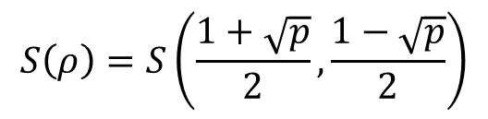
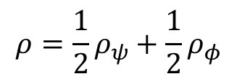
In quantum mechanics
Probability given by inner product
Geometry given by inner product
$$\left\langle ψ | φ\right\rangle$$
Quantum probability
$$p\left(ψ | φ\right)={\left|\left\langle ψ | φ\right\rangle \right|}^{2}$$
Projective Hilbert space
Entropy of mixtures of pairs given by the probability
$$ρ=\frac{1}{2}ρ_{ψ}+\frac{1}{2}ρ_{φ}$$
$$S\left(ρ\right)=S\left(\frac{1+\sqrt{p}}{2},\frac{1−\sqrt{p}}{2}\right)$$
Quantum information theory
You can either provide the inner product between each pair of states, of the entropy of the mixtures of all pairs
Geometry is entropy!

Slide 29

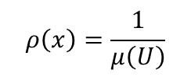

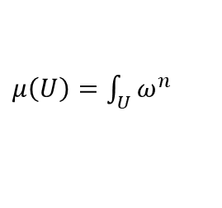



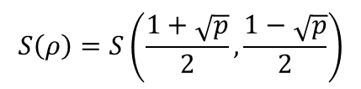
Geometry is entropy!
The geometric structures of both classical and quantum mechanics are equivalent to the entropic structure
Standard probability
$$ρ\left(x\right)=\frac{1}{μ\left(U\right)}$$
Thermodynamics/Statistical mechanics are not built on top of mechanics
$μ\left(U\right)=\int_{U}{ω^{n}}$
Symplectic manifold
Mechanics is the ideal case of thermodynamics/statistical mechanics
$ρ$ uniform over $U$
Information theory
$$S\left(ρ\right)=\log{μ\left(U\right)}$$
$$\left\langle ψ | φ\right\rangle$$
Quantum probability
$$p\left(ψ | φ\right)={\left|\left\langle ψ | φ\right\rangle \right|}^{2}$$
Projective Hilbert space
$$ρ=\frac{1}{2}ρ_{ψ}+\frac{1}{2}ρ_{φ}$$
Quantum information theory
$$S\left(ρ\right)=S\left(\frac{1+\sqrt{p}}{2},\frac{1−\sqrt{p}}{2}\right)$$

Slide 30
Extracting principles/assumptions behind the laws gives us solid intuition that cuts across fields and leads to new insights/results
Strive for multiple equivalent starting points
Hamiltonian mechanics/entropy conservation/uncertainty conservation
Every detail counts
dimensional analysis (e.g. $−∫ρ\log{ρ}⇒−∫ρ\log{hρ}$ )
Always be ready to reinterpret/recombine results

Slide 31
Many insights from reverse physics started as “preposterous tricks”
It took time to see there was truth to them
You can’t judge arguments you are unfamiliar with
yours or others’
A superficial understanding of an argument does not allow you to see potential connections to other things Conversely, entrenched ideas prevent you from seeing the merit of the unfamiliar
It’s essential to remain playful and not to be too attached to “your ideas”

Slide 32
Wrapping it up
Assumptions of Physics: different approach to the foundations of physics
No interpretations, no theories of everything: physically meaningful starting points from which we can rederive the laws and the mathematical frameworks they need
Physical theories are models
Need to clarify exactly what the realm of applicability of each model is
Reverse physics: reverse engineer principles from the known laws
Current laws are given through mathematical structures, which make it hard to understand the physics
We have to find physical principles and assumptions from which to rederive the laws
These starting points must have a clear intuitive meaning for the majority of physicists and engineers
Investigate physics as a whole (no theory is “more fundamental”)

Slide 33
Assumption of Physics is an open project
Our main output is an open access book: https://assumptionsofphysics.org/book/
All our material is developed on GitHub: https://github.com/assumptionsofphysics
Livestream discussions
One YouTube channel dedicated to publicize results: https://www.youtube.com/user/gcarcassi
Another YouTube channel dedicated to research: https://www.youtube.com/@AssumptionsofPhysicsResearch
Activities coordinated through a Discord server (contact me for an invite)
Always looking for experts to gain insights and/or help
Always looking for collaborations
Always looking for editors/journals/conferences that are sympathetic to the mission

Slide 34
To learn more
Project website
https://assumptionsofphysics.org for papers, presentations, …
https://assumptionsofphysics.org/book for our open access book (updated every few years with new results)
YouTube channels
https://www.youtube.com/@gcarcassi Videos with results and insights from the research
https://www.youtube.com/@AssumptionsofPhysicsResearch Research channel, with open questions and livestreamed work sessions
GitHub
https://github.com/assumptionsofphysics Book, research papers, slides for videos...

