Slide 1

Assumptions of Physics Summer School 2025 Reverse Physics for classical mechanics
Gabriele Carcassi and Christine A. Aidala
Physics Department University of Michigan

Slide 2
Overview

Slide 3
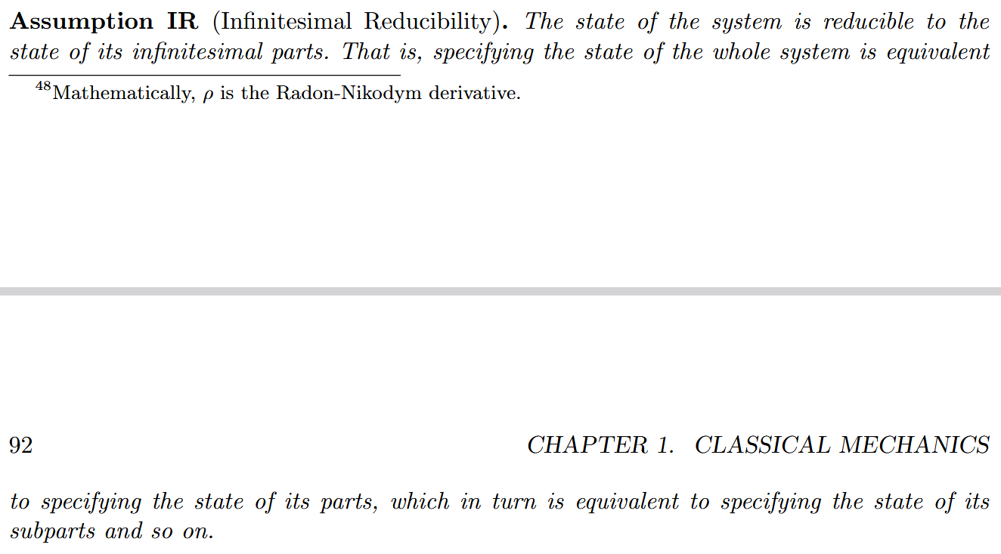
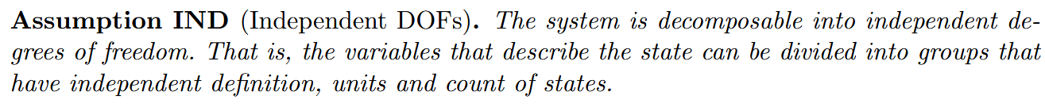
Classical state is a distribution over the states of infinitesimal parts (i.e. particles)
Recovers pairs of conjugate variables for each DOF, frame-invariant entropy and count of states
Conservation of entropy/count of states and DOF independence recovers Hamiltonian evolution
Links trajectories in space with dynamics, recovering inertia, masses and scalar/vector potential forces
Classical Mechanics (CM): IR + IND
Assumptions for classical mechanics
Newtonian Mechanics: CM + KE
Lagrangian Mechanics: CM + KE + DR
Hamiltonian Mechanics : CM + DR

Slide 4

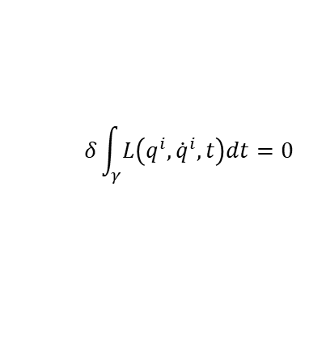











Assumptions of classical mechanics
$$\frac{dq^{i}}{dt}=\frac{∂H}{∂p_{i}}$$
$$\frac{dp_{i}}{dt}=−\frac{∂H}{∂q^{i}}$$
$$δ\int_{γ}{L\left(q^{i},{\dot{q}}^{i},t\right)dt}=0$$
$$[q^{i},p_{i}]$$
(IR) Infinitesimal reducibility
Classical Phase Space
Hamiltonian Mechanics
Lagrangian Mechanics
+
+
+
Massive particles under potential forces
(DR) Determinism /Reversibility
weak
+
(IND) Degree of freedom independence
(KE) Kinematic Equivalence
full
$$H=\frac{1}{2m}\left(p_{i}−𝔮A_{i}\right)g^{ij}\left(p_{j}−𝔮A_{j}\right)+𝔮V$$
$$ρ_{1}ρ_{2}⇒ρ$$
$$p$$
$$p$$
$$z$$
$$y$$
$$q$$
$$q$$
$$x$$

Slide 5
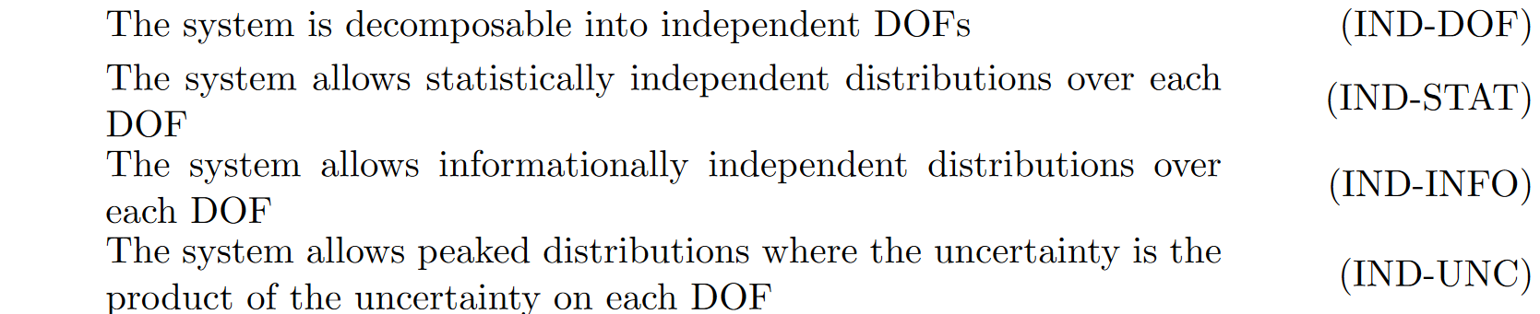
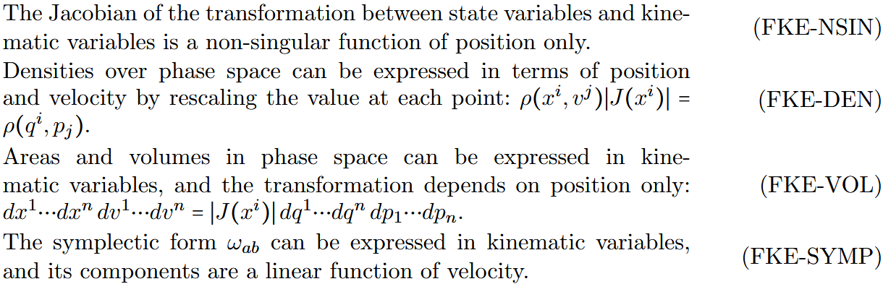
Each assumption can be expressed in multiple different but equivalent ways

Slide 6
Action principle one DOF

Slide 7
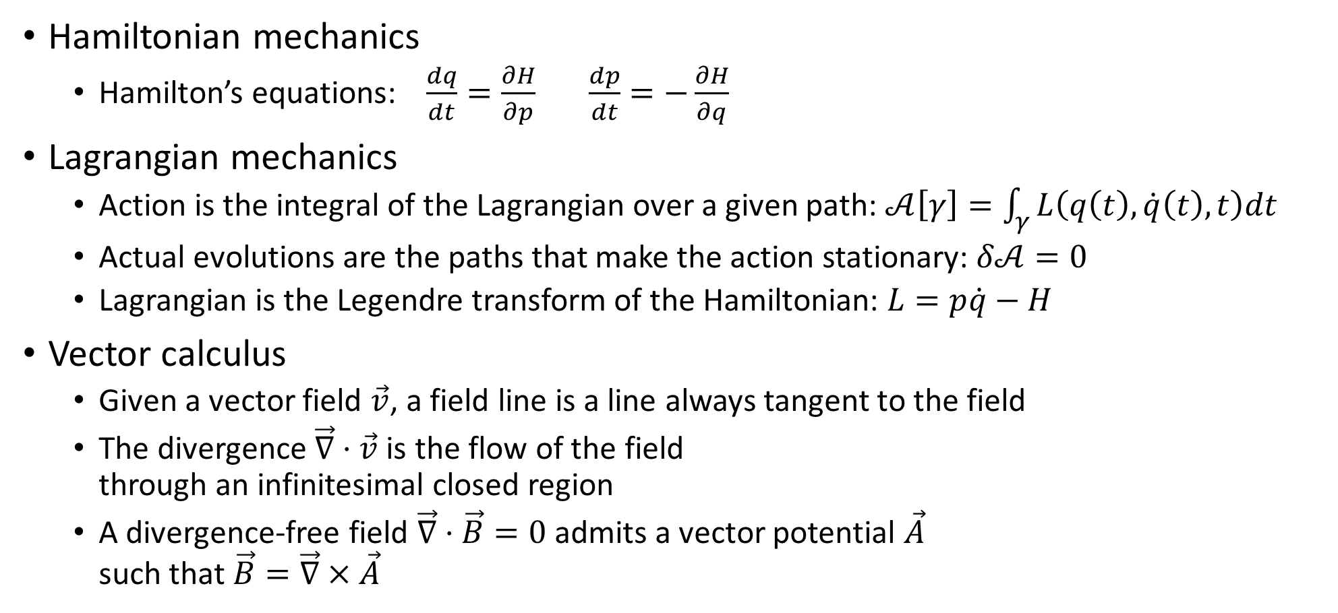
Required background
Hamiltonian mechanics
Hamilton’s equations: $\frac{dq}{dt}=\frac{∂H}{∂p}$ $\frac{dp}{dt}=−\frac{∂H}{∂q}$
Lagrangian mechanics
Action is the integral of the Lagrangian over a given path: $𝒜\left[γ\right]=\int_{γ}{L\left(q\left(t\right),\dot{q}\left(t\right), t\right)dt}$
Actual evolutions are the paths that make the action stationary: $δ𝒜=0$
Lagrangian is the Legendre transform of the Hamiltonian: $L=p\dot{q}−H$
Vector calculus
Given a vector field $\vec{v}$, a field line is a line always tangent to the field
The divergence $\vec{∇}⋅\vec{v}$ is the flow of the field through an infinitesimal closed region
A divergence-free field $\vec{∇}⋅\vec{B}=0$ admits a vector potential $\vec{A}$ such that $\vec{B}=\vec{∇}×\vec{A}$

Slide 8
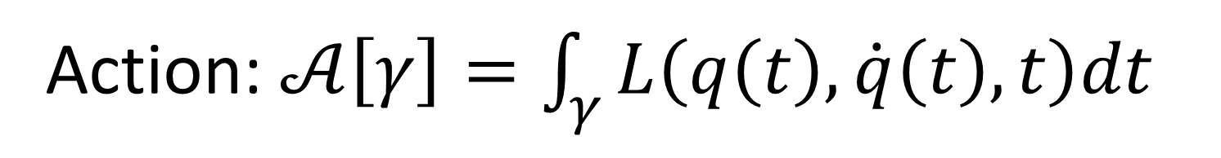
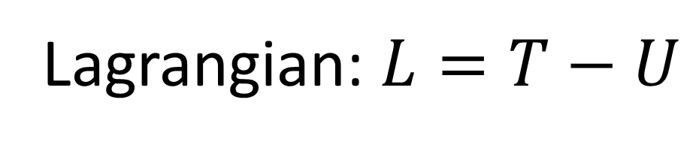
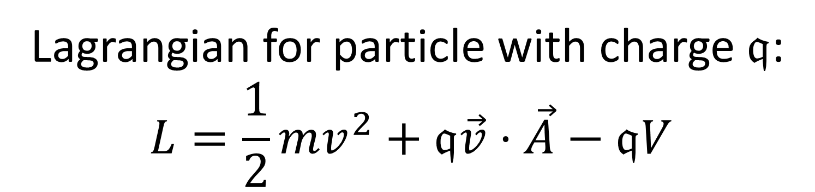
Action: $𝒜\left[γ\right]=\int_{γ}{L\left(q\left(t\right),\dot{q}\left(t\right), t\right)dt}$
Does not always work!
Lagrangian: $L=T−U$
Lagrangian for particle with charge $𝔮$: $$L=\frac{1}{2}mv^{2}+𝔮\vec{v}⋅\vec{A}−𝔮V$$
Kinetic
???
Potential

Slide 9


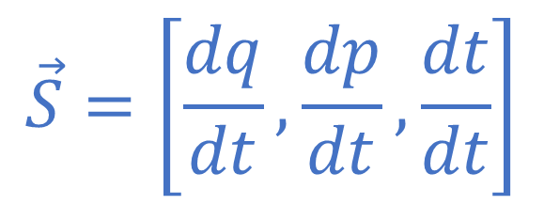


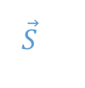

Displacement field
Tells us how states “move”
$$p$$
$$\vec{S}=\left[\frac{dq}{dt},\frac{dp}{dt},\frac{dt}{dt}\right]$$
$$q$$
$$γ$$
$$\vec{S}$$
Evolution
$$γ=[q\left(t\right), p\left(t\right), t]$$
$$t$$
Time is both a parameter and a variable
Evolutions are field lines of the displacement field
Always tangent to the field

Slide 10
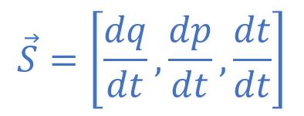


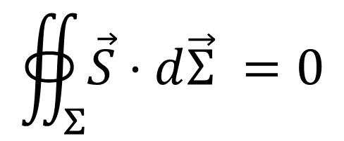

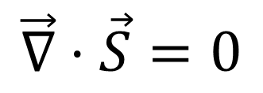
(DR) Determinism and Reversibility
$$\vec{S}=\left[\frac{dq}{dt},\frac{dp}{dt},\frac{dt}{dt}\right]$$
$$p$$
$$q$$
$$γ$$
$$Σ$$
$$\vec{S}$$
No states are lost or created
(count of states is preserved in time)
$$∯_{Σ}{\vec{S}⋅d\vec{Σ}} =0$$
$$t$$
$⇒$ Divergence-free displacement
$$\vec{∇}⋅\vec{S}=0$$
Vector potential
$$\vec{S}=−\vec{∇}×\vec{θ}$$
Displacement admits a vector potential
Minus sign added to match conventions

Slide 11
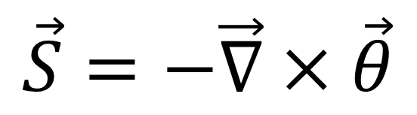




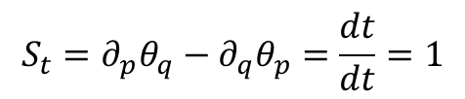

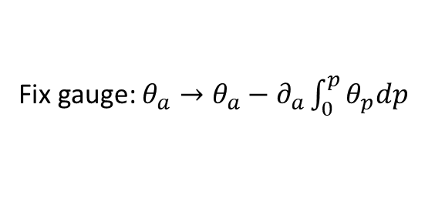
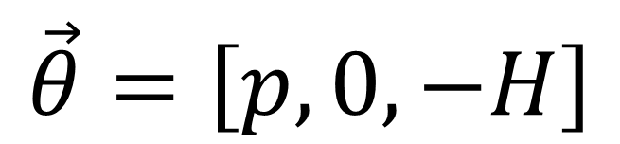
$$\vec{θ}=\left[θ_{q},θ_{p},θ_{t}\right]$$
Without loss of generality
$$\vec{S}=−\vec{∇}×\vec{θ}$$
Fix gauge: $θ_{a}→θ_{a}−∂_{a}\int_{0}^{p}{θ_{p}dp}$
$$\vec{θ}=\left[θ_{q},0,θ_{t}\right]$$
$$\vec{θ}=\left[p,0,−H\right]$$
$$S_{t}=∂_{p}θ_{q}−∂_{q}θ_{p}=\frac{dt}{dt}=1$$
similar to four-momentum
$$\vec{θ}=\left[p,0,θ_{t}\right]$$
Rename $θ_{t}$
$$\vec{θ}=\left[p,0,−H\right]$$

Slide 12


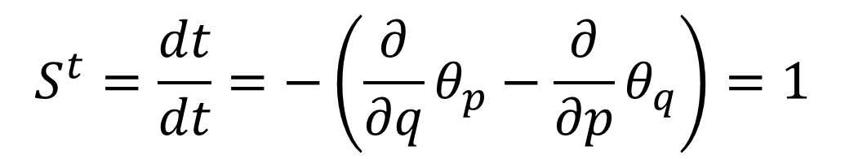


$$\vec{S}=−\vec{∇}×\vec{θ}$$
$$\vec{θ}=\left[p,0,−H\left(q,p\right)\right]$$
$$S^{q}=\frac{dq}{dt}=−\left(\frac{∂}{∂p}θ_{t}−\frac{∂}{∂t}θ_{p}\right)=\frac{∂H}{∂p}$$
Hamilton’s equations
$$S^{p}=\frac{dp}{dt}=−\left(\frac{∂}{∂t}θ_{q}−\frac{∂}{∂q}θ_{t}\right)=−\frac{∂H}{∂q}$$
$$S^{t}=\frac{dt}{dt}=−\left(\frac{∂}{∂q}θ_{p}−\frac{∂}{∂p}θ_{q}\right)=1$$

Slide 13

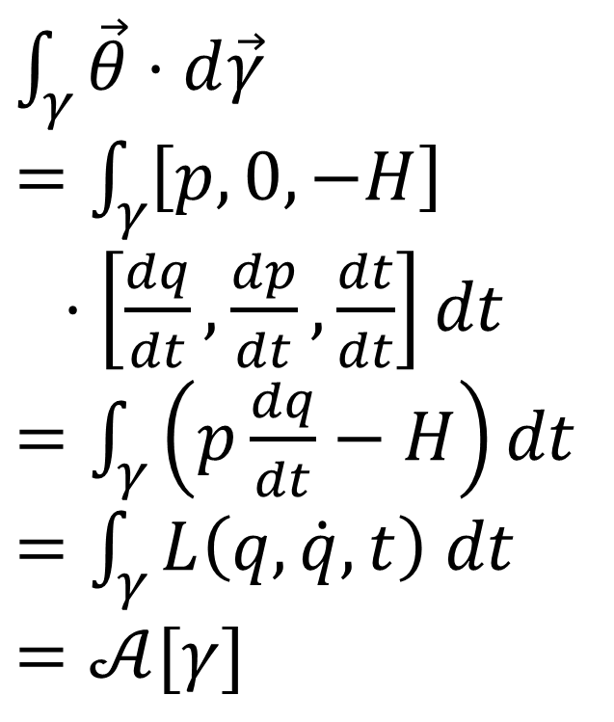
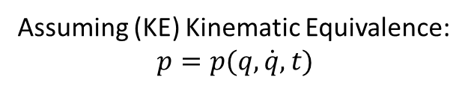
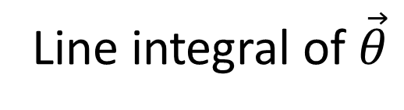
Line integral of $\vec{θ}$
$$p$$
$\int_{γ}{\vec{θ}⋅d\vec{γ}}$
$=\int_{γ}{\left[p,0,−H\right]}$
$⋅\left[\frac{dq}{dt},\frac{dp}{dt},\frac{dt}{dt}\right]dt$ $=\int_{γ}{\left(p\frac{dq}{dt}−H\right)dt}$
$=\int_{γ}{L\left(q,\dot{q},t\right) dt}$
$=𝒜[γ]$
$$q$$
Express in components
$$γ$$
$$\vec{S}$$
$$t$$
Assuming (KE) Kinematic Equivalence: $$p=p(q,\dot{q},t)$$
The action is the line integral of the vector potential of the flow of states

Slide 14

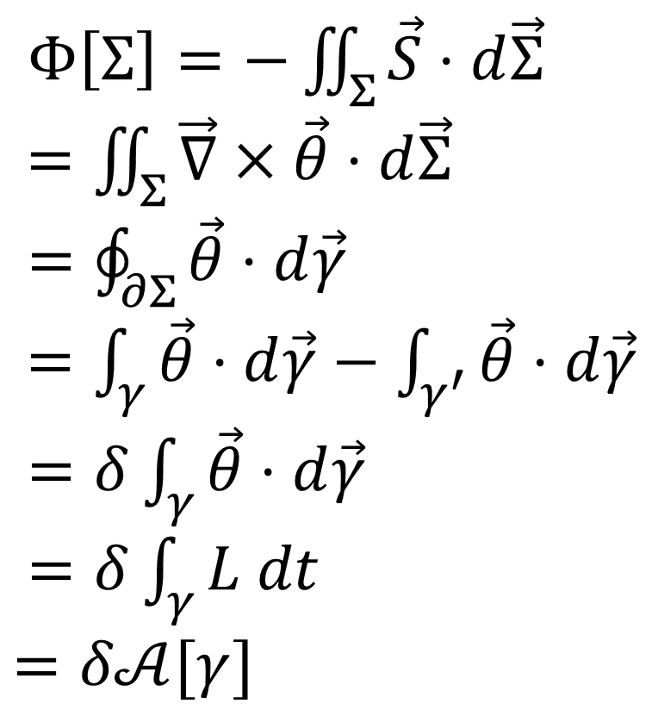


Flow between a path $γ$ and its variation $γ′$
$$p$$
$$q$$
$$γ$$
$$Σ$$
$Φ\left[Σ\right]=−\iint_{Σ}{\vec{S}⋅d\vec{Σ}}$
$=\iint_{Σ}{\vec{∇}×\vec{θ}⋅d\vec{Σ}}$
$=\oint_{∂Σ}{\vec{θ}⋅d\vec{γ}}$ $=\int_{γ}{\vec{θ}⋅d\vec{γ}}−\int_{γ^{′}}{\vec{θ}⋅d\vec{γ}}$ $=δ\int_{γ}{\vec{θ}⋅d\vec{γ}}$
$=δ\int_{γ}{L dt}$ $=δ𝒜[γ]$
$$\vec{S}$$
Hamilton equations
Stokes’ theorem
$$γ′$$
$$t$$
The variation of the action is the flow between
path and its variation

Slide 15



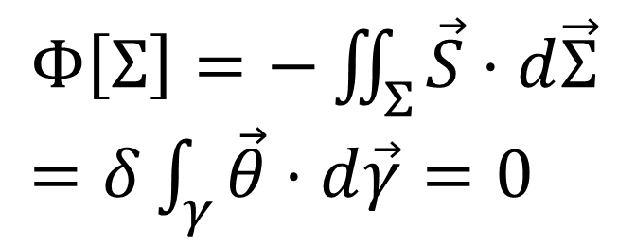



If the path $γ$ is an evolution of the system
$$p$$
$$q$$
$$γ$$
$$Σ$$
$$\vec{S}$$
$Φ\left[Σ\right]=−\iint_{Σ}{\vec{S}⋅d\vec{Σ}}$ $=δ\int_{γ}{\vec{θ}⋅d\vec{γ}}=0$
$$γ′$$
flow is tangent
$$t$$
If the path $γ$ is not an evolution of the system, we can always find a variation $γ′$ such that
Action is stationary over and only over evolutions
$−\iint_{Σ}{\vec{S}⋅d\vec{Σ}}=δ\int_{γ}{\vec{θ}⋅d\vec{γ}}≠0$

Slide 16
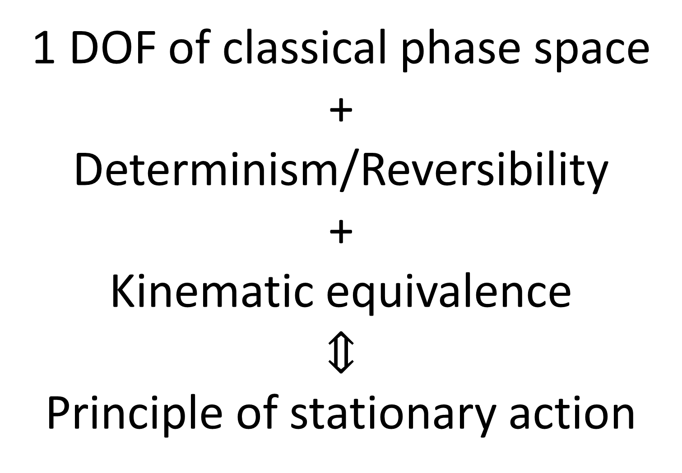
1 DOF of classical phase space +
Determinism/Reversibility
+
Kinematic equivalence
$$⇕$$
Principle of stationary action

Slide 17
Action principle multiple DOF

Slide 18
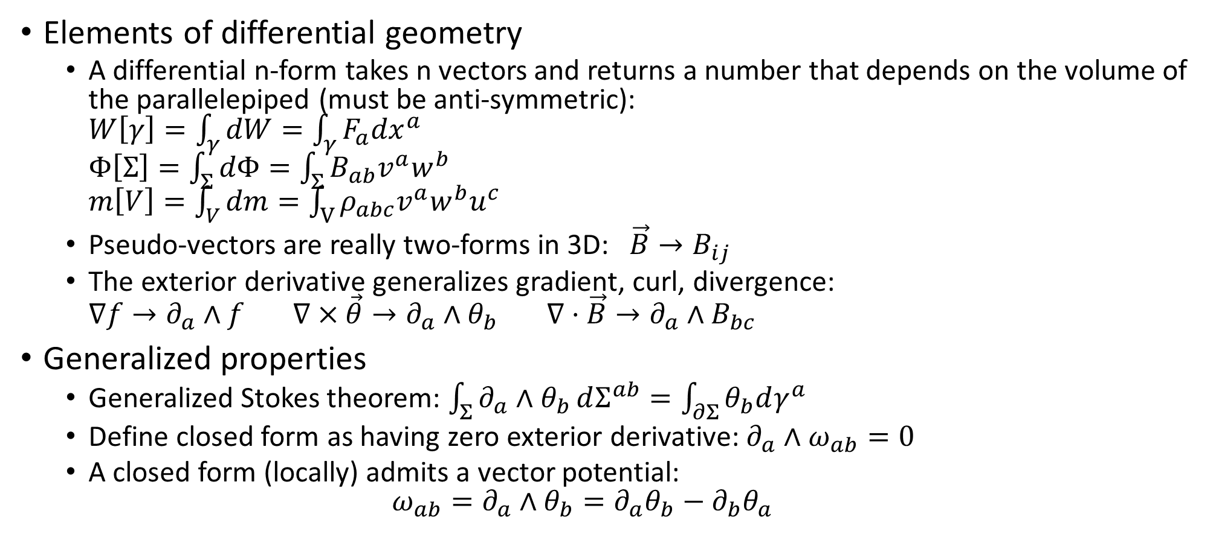
Required background
Elements of differential geometry
A differential n-form takes n vectors and returns a number that depends on the volume of the parallelepiped (must be anti-symmetric): $W\left[γ\right]=\int_{γ}{dW}=\int_{γ}{F_{a}{dx}^{a}}$ $Φ\left[Σ\right]=\int_{Σ}{dΦ}=\int_{Σ}{B_{ab}v^{a}w^{b}}$ $m\left[V\right]=\int_{V}{dm}=\int_{V}{ρ_{abc}v^{a}w^{b}u^{c}}$
Pseudo-vectors are really two-forms in 3D: $\vec{B}→B_{ij}$
The exterior derivative generalizes gradient, curl, divergence: $∇f→∂_{a}∧f$ $∇×\vec{θ}→∂_{a}∧θ_{b}$ $∇⋅\vec{B}→∂_{a}∧B_{bc}$
Generalized properties
Generalized Stokes theorem: $\int_{Σ}{∂_{a}∧θ_{b}}dΣ^{ab}=\int_{∂Σ}{θ_{b}dγ^{a}}$
Define closed form as having zero exterior derivative: $∂_{a}∧ω_{ab}=0$
A closed form (locally) admits a vector potential: $ω_{ab}=∂_{a}∧θ_{b}=∂_{a}θ_{b}−∂_{b}θ_{a}$

Slide 19









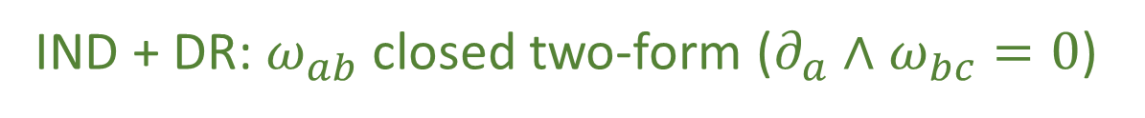





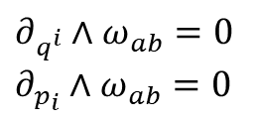



Characterize configuration flow
$$p_{1}$$
$$p_{2}$$
$$q^{1}$$
Flow of configurations through an infinitesimal surface
$$q^{2}$$
$$\vec{v}$$
$$\vec{S}$$
$$dΦ=v^{a}ω_{ab}w^{b}$$
$$\vec{w}$$
Function of surface: $ω_{ab}=−ω_{ba}$
$$\vec{v}$$
$$\vec{v}$$
$$t$$
$$\vec{w}$$
$$\vec{w}$$
change of order = change of orientation
(DR) Determinism and reversibility: $∂_{t}∧ω_{ab}=0$
Configurations are conserved through time
$$t$$
$∂_{q^{i}}∧ω_{ab}=0$
$∂_{p_{i}}∧ω_{ab}=0$
Configurations are conserved across DOF
(IND) DOF independence:
$$q^{i}$$
IND + DR: $ω_{ab}$ closed two-form ($∂_{a}∧ω_{bc}=0$)

Slide 20
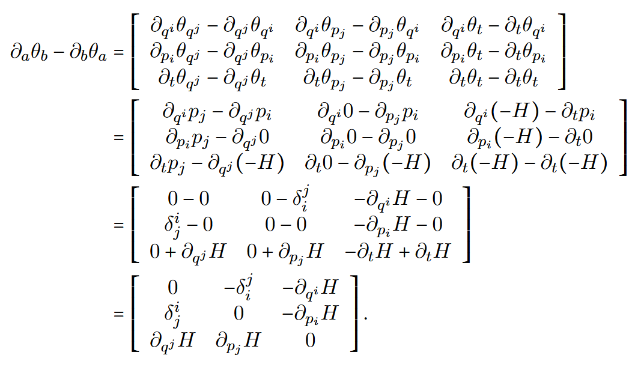

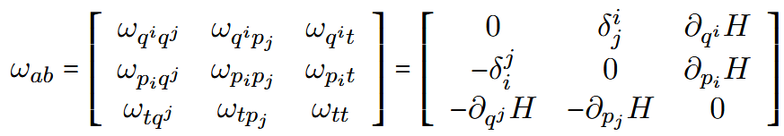

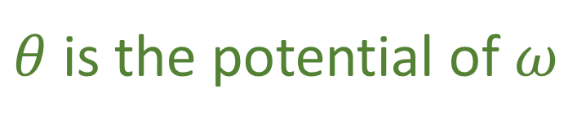
$$∂_{a}∧ω_{bc}=0$$
$$ω_{ab}=−∂_{a}∧θ_{b}=−\left(∂_{a}θ_{b}−∂_{b}θ_{a}\right)$$
Closed form (DR) + (IND)
Vector potential
$θ$ is the potential of $ω$
without loss of generality

Slide 21





Displacement kills the flow
$$p_{1}$$
$$p_{2}$$
$$q^{1}$$
Displacement only direction that “kills” the flow
$$q^{2}$$
$$\vec{w}$$
$$\vec{S}$$
$$S^{a}ω_{ab}w^{b}=0$$
For all $\vec{w}$
$$\vec{S}$$
Flow is tangent (and only tangent) to the displacement
$$S^{a}ω_{ab}=0$$
$$t$$
Let’s calculate!

Slide 22
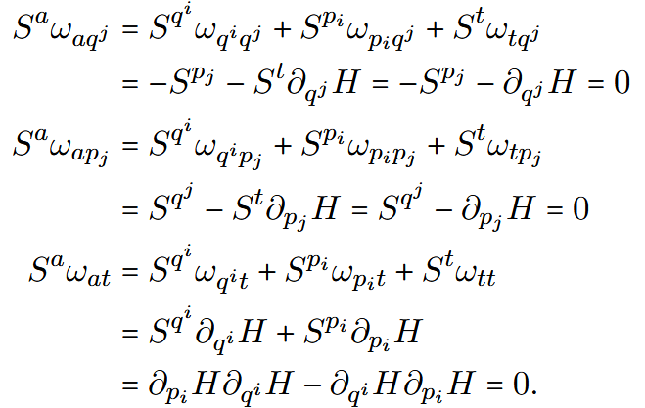
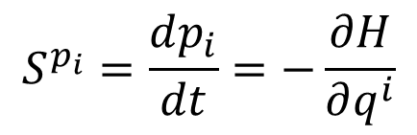

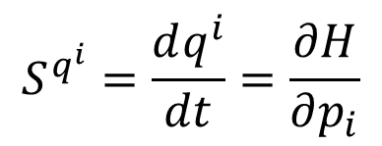
Displacement kills the flow
$$p_{1}$$
$$p_{2}$$
$$q^{1}$$
$$S^{a}ω_{ab}=0$$
$$q^{2}$$
$$\vec{v}$$
$$\vec{S}$$
$$\vec{w}$$
$$t$$
$$S^{p_{i}}=\frac{dp_{i}}{dt}=−\frac{∂H}{∂q^{i}}$$
$$S^{q^{i}}=\frac{dq^{i}}{dt}=\frac{∂H}{∂p_{i}}$$
Recovers Hamilton’s equations

Slide 23

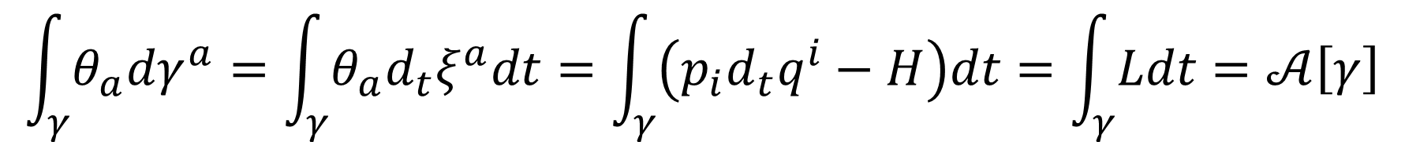




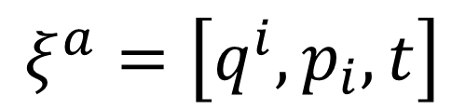

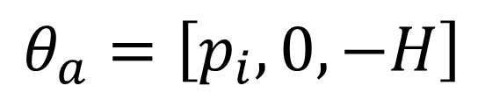
$$ξ^{a}=\left[q^{i},p_{i},t\right]$$
$$θ_{a}=\left[p_{i},0,−H\right]$$
$$\int_{γ}{θ_{a}dγ^{a}}=\int_{γ}{θ_{a}d_{t}ξ^{a}dt}=\int_{γ}{\left(p_{i}d_{t}q^{i}−H\right)dt}=\int_{γ}{Ldt}=𝒜\left[γ\right]$$
Action is the line integral of the vector potential
$$p$$
$$q$$
$$γ$$
$$Σ$$
$$\vec{S}$$
$$γ′$$
$$t$$

Slide 24


$$δ𝒜\left[γ\right]=δ\int_{γ}{Ldt}=δ\int_{γ}{θ_{a}d_{t}ξ^{a}dt}=\oint_{∂Σ}{θ_{a}dξ^{a}}=\int_{Σ}{∂_{a}∧θ_{b}dξ^{a}dη^{b}}=−\int_{Σ}{dξ^{a}ω_{ab}dη^{b}}=−Φ\left[Σ\right]$$
The variation of the action is the flow between path and its variation
$$δ𝒜\left[γ\right]=0 ⟺ dξ^{a}ω_{ab}dη^{b}=dtd_{t}ξ^{a}ω_{ab}dη^{b}=0 ∀dη^b$$
Action is stationary when the path kills the flow
$$⟺ d_{t}ξ^{a}ω_{ab}=0$$
$$d_{t}ξ^{a}=S^{a}$$
$$p$$
$$q$$
$$γ$$
$$Σ$$
$$\vec{S}$$
$$γ′$$
$$t$$

Slide 25
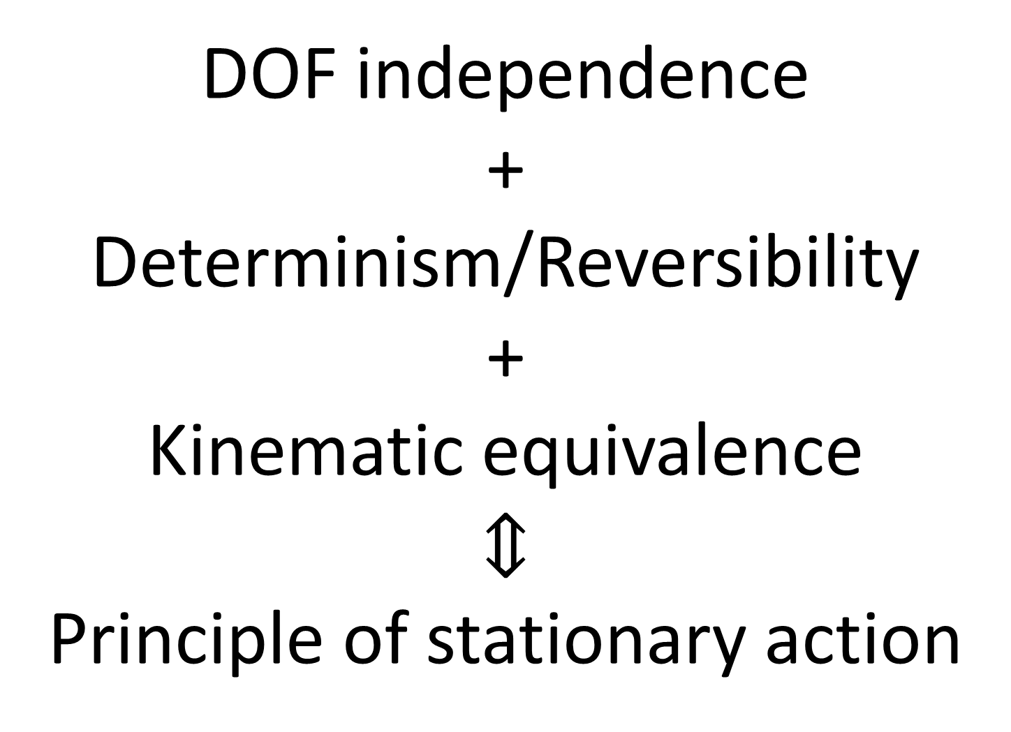
DOF independence +
Determinism/Reversibility
+
Kinematic equivalence
$$⇕$$
Principle of stationary action

Slide 26
Relativistic mechanics

Slide 27
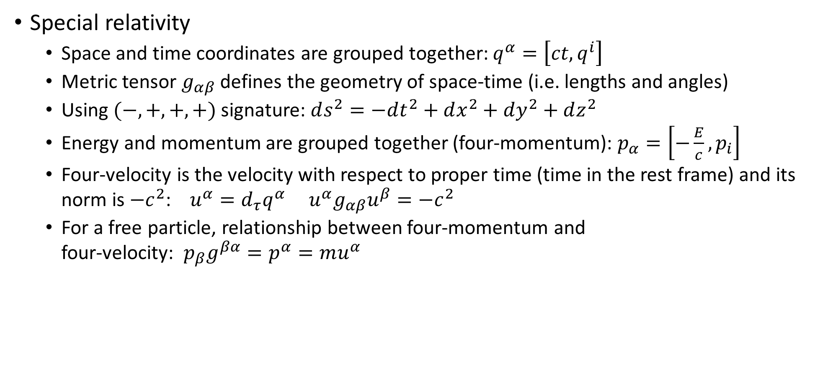
Required background
Special relativity
Space and time coordinates are grouped together: $q^{α}=\left[ct,q^{i}\right]$
Metric tensor $g_{αβ}$ defines the geometry of space-time (i.e. lengths and angles)
Using $(−,+,+,+)$ signature: $ds^{2}=−dt^{2}+dx^{2}+dy^{2}+dz^{2}$
Energy and momentum are grouped together (four-momentum): $p_{α}=\left[−\frac{E}{c},p_{i}\right]$
Four-velocity is the velocity with respect to proper time (time in the rest frame) and its norm is $−c^{2}$: $u^{α}=d_{τ}q^{α}$ $u^{α}g_{αβ}u^{β}=−c^{2}$
For a free particle, relationship between four-momentum and four-velocity: $p_{β}g^{βα}=p^{α}=mu^{α}$

Slide 28

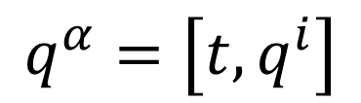
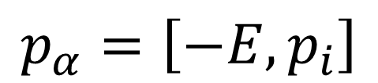
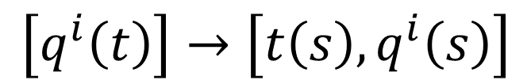

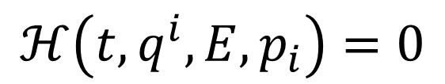

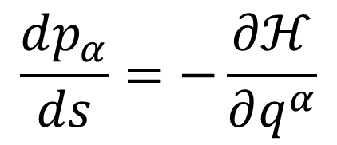
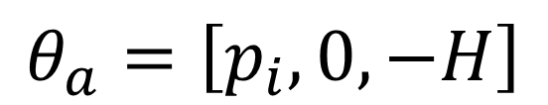
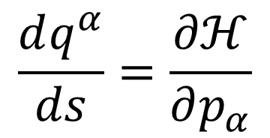
Want to extend Hamiltonian mechanics to handle change of coordinates that mix space and time variables
$$q^{α}=\left[t,q^{i}\right]$$
$$\left[q^{i}\left(t\right)\right]→\left[t\left(s\right), q^{i}\left(s\right)\right]$$
Hamiltonian mechanics on the extended phase space
Separate time-the-variable from time-the-parameter
Recall
$$θ_{q^{i}}$$
$$θ_{t}$$
$$θ_{a}=\left[p_{i},0,−H\right]$$
$$p_{α}=\left[−E,p_{i}\right]$$
$⇒$ only possible choice for conjugates
Form a covector
$$\frac{dq^{α}}{ds}=\frac{∂ℋ}{∂p_{α}}$$
$$\frac{dp_{α}}{ds}=−\frac{∂ℋ}{∂q^{α}}$$
Hamiltonian constraint
$$ℋ\left(t,q^{i},E,p_{i}\right)=0$$
Not just conserved quantity

Slide 29









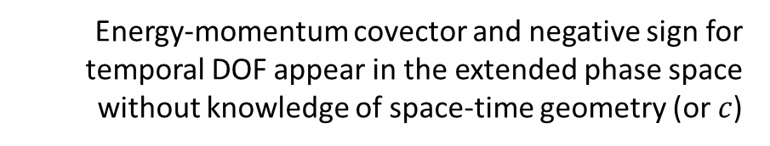
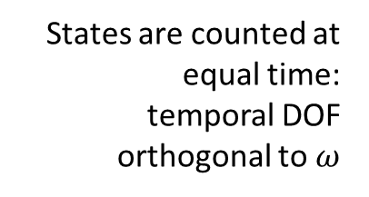
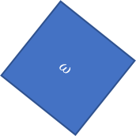

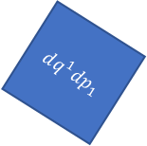
$$q^{α}=\left[t,q^{i}\right]$$
Energy-momentum covector and negative sign for temporal DOF appear in the extended phase space without knowledge of space-time geometry (or $c$)
$$ω=dq^{i}dp_{i}−dtdE$$
$$p_{a}=\left[−E,p_{i}\right]$$
Lorentzian relativity is the only “correct” one
It extends the count of configurations per DOF to the temporal DOF in the correct way
$$ω=dq^{1}dp_{1}+dq^{2}dp_{2}$$
$$ω=dq^{1}dp_{1}−dtdE$$
$$ω$$
$$dq^{1}dp_{1}=ω+dtdE$$
$$dq^{2}dp_{2}$$
States are counted at equal time: temporal DOF orthogonal to $ω$
2D representation of 4D relationship
$$dq^{1}dp_{1}$$
$$dq^{1}dp_{1}$$
$$dtdE$$
$$ω$$
Independent DOFs are orthogonal
Pythagoras's formula still present

Slide 30








Example: free particle in an inertial frame
$$ℋ=\frac{1}{2m}\left(p_{i}δ^{ij}p_{j}−{\left(\frac{E}{c}\right)}^{2}+m^{2}c^{2}\right)$$
$$\frac{dt}{ds}=\frac{∂ℋ}{∂\left(−E\right)}=−\frac{1}{2mc^{2}}\frac{∂}{∂\left(−E\right)}{\left(−E\right)}^{2}=−\frac{1}{2mc^{2}}\left(−2E\right)=\frac{E}{mc^{2}}$$
This Hamiltonian constraint is the generator for proper time (i.e. affine parameter $s$ corresponds to proper time)
$$\frac{dq^{i}}{ds}=\frac{∂ℋ}{∂p_{i}}=\frac{1}{2m}\frac{∂}{∂p_{i}}\left(p_{i}δ^{ij}p_{j}\right)=\frac{2δ^{ij}p_{j}}{2m}=\frac{p_{i}}{m}$$
$$\frac{dE}{ds}=−\frac{d\left(−E\right)}{ds}=\frac{∂ℋ}{∂t}=0$$
$$\frac{E}{c}=m\frac{d\left(ct\right)}{ds}$$
four momentum
four velocity
$$\frac{dp_{i}}{ds}=−\frac{∂ℋ}{∂q^{i}}=0$$
$$p_{i}=m\frac{dq^{i}}{ds}$$
proper time!

Slide 31








Compare to “standard” way
Generator for proper time
Nice and quadratic
$$ℋ=\frac{1}{2m}\left(p_{i}δ^{ij}p_{j}−{\left(\frac{E}{c}\right)}^{2}+m^{2}c^{2}\right)$$
$$H=c\sqrt{m^{2}c^{2}+p_{i}δ^{ij}p_{j}}$$
Hamiltonian is time generator
$$\frac{dq^{i}}{dt}=\frac{ds}{dt}\frac{dq^{i}}{ds}=\frac{mc^{2}}{E}\frac{p_{i}}{m}$$
$$\frac{dq^{i}}{dt}=\frac{∂H}{∂p_{i}}=c\frac{∂}{∂p_{i}}\sqrt{m^{2}c^{2}+p_{i}δ^{ij}p_{j}}$$
$$=\frac{c}{2}\frac{1}{\sqrt{m^{2}c^{2}+p_{i}δ^{ij}p_{j}}}\frac{∂}{∂p_{i}}\left(m^{2}c^{2}+p_{i}δ^{ij}p_{j}\right)$$
Hamiltonian mechanics on the extended phase-space comes out more naturally and is a nicer formulation
$$=\frac{1}{2}\frac{2δ^{ij}p_{j}}{\sqrt{m^{2}+\frac{p_{i}δ^{ij}p_{j}}{c^{2}}}}=\frac{p_{i}}{\sqrt{m^{2}+\frac{{\left|p_{i}\right|}^{2}}{c^{2}}}}$$
Wait… quadratic? Can $E$ be negative?
$$\frac{dp_{i}}{dt}=−\frac{∂H}{∂q^{i}}=0$$

Slide 32






Classical anti-particles
This can be negative
$$p$$
$$d_{s}t=∂_{−E}ℋ$$
$$d_{s}q^{i}=∂_{p_{i}}ℋ$$
$$d_{s}(−E)=∂_{t}ℋ$$
$$d_{s}p_{i}=∂_{q^{i}}ℋ$$
$$q$$
$$\frac{dξ^{a}}{ds}$$
$$t$$
Particle: affine parameter aligned with time
Anti-particle: affine parameter anti-aligned with time
Parametrization flows backwards with respect to time
Free particle
Anti-particle = negative energy
An evolution cannot change time alignment

Slide 33





Recover standard Hamiltonian
Over valid states $ℋ=0$ and $E=H\left(q^{i},p_{i},t\right)$
Assume no $E$ dependence
$$=0$$

Slide 34





Hamiltonian constraint can “hide” multiple $H$s
Free particle Hamiltonian constraint
Negative energy
Positive energy
$$H_{1}=−H_{2}$$

Slide 35





Classical-quantum parallel
Free particle Hamiltonian constraint
Hamiltonian constraint becomes Klein-Gordon equation in QM
minus sign from $ı^{2}$
$$ℋρ=0$$
Density can be non-zero only where $ℋ=0$
Also note:

Slide 36


Hamiltonian constraint for charged particles
pure four-velocity kinetic term
$$ℋ=\frac{1}{2m}\left(p_{α}−𝔮A_{α}\right)g^{αβ}\left(p_{β}−𝔮A_{β}\right)+\frac{1}{2}mc^{2}=\frac{1}{2}mu^{α}g_{αβ}u^{β}+\frac{1}{2}mc^{2}$$
$$mu_{α}=mu^{β}g_{βα}=p_{α}−𝔮A_{α}$$
Kinetic momentum
Momentum gauge and EM gauge must cancel out
Compare to EM Klein-Gordon equation
$$\left[c^{2}\left(∂_{α}−ı𝔮A_{α}\right)η^{αβ}\left(∂_{α}−ı𝔮A_{α}\right)+m^{2}c^{4}\right]ψ=\left[c^{2}D_{α}η^{αβ}D_{β}+m^{2}c^{4}\right]ψ=0$$
$$D_{α}=∂_{α}−ı𝔮A_{α}$$
Gauge-covariant derivative is kinetic momentum

Slide 37
Takeaways
Relativistic mechanics is recovered without additional assumptions
Relativity is needed to make densities/entropy invariant over time transformations
Hamiltonian mechanics on the extended phase space is a more relativistic formulation
Hamiltonian constraint is the generator of the affine parameter, and can be taken to generate proper time for particles and minus proper time for anti-particles
Multiple connections to quantum mechanics
Anti-particles already present in classical Hamiltonian particle mechanics
Hamiltonian constraint related to Klein-Gordon (and Dirac) operators
Gauge considerations are already present in classical particle mechanics

Slide 38
Directional DOF

Slide 39











Why DOFs are charted by two conjugate variables
Density, entropy, uniform distributions NOT in general coordinate-invariant
$$x↦x^{3}$$
$$x$$
$$x^{3}$$
The principle of indifference fails over continuous quantities
Phase space (symplectic) structure is the only one that supports coordinate-invariant density, entropy, state count
Each unit variable (i.e. coordinate) paired with a conjugate of inverse units: number of states $ΔqΔk$is invariant
$\hat{q}=100 cm/m q$
$$1$$
$Δk=1 m^{−1}$
$$1$$
$Δ\hat{k}=0.01 cm^{−1}$
$Δ\hat{q}=100 cm$
$Δq=1 m$
Conjugate quantities recover frame independence of states

Slide 40



Each DOF is charted by two variables
$$p_{x}$$
$$dxdp_{x}$$
momentum
possible configurations
(if conjugate)
$$x$$
position

Slide 41



Angular momentum
$$\vec{L}=\left[L_{x}, L_{y}, L_{z}\right]$$
$$θ$$
$$=\left[L\sin{θ}\cos{φ}, L\sin{θ}\sin{φ}, L\cos{θ} \right]$$
$$φ$$
Direction independent from the magnitude

Slide 42



Angular momentum direction
Direction is an independent DOF
$$θ$$
However, $θ$ and $φ$ are not conjugate
$$φ$$
$$dθdφ$$
$≠$ possible configurations

Slide 43



Angular momentum direction
$$LdΩ=L\sin{θ}dθdφ=d\left(\operatorname{Lcos}{θ}\right)dφ$$
$$=dL_{z}dφ_{xy}$$
$$θ$$
$φ_{xy}$ and $L_{z}$ are conjugate
$$φ$$
Direction is charted by two conjugate quantities
$⟺$ Space is three dimensional

Slide 44



Independent DOF
Two dimensional
$$p_{x}$$
$$θ$$
$$x$$
$$φ$$
Independent directional DOF
Space three dimensional

Slide 45


Suppose
Independent DOF
$$⇒$$
Two dimensional
$$p_{x}$$
$$θ$$
$$x$$
$$φ$$
Independent directional DOF
???
Space three dimensional
$$⇒$$
A single directional DOF could be made of multiple independent DOF

Slide 46


Direction in multiple dimensions
Direction is a point on a hypersphere
$$\hat{L}=\left[{\hat{L}}_{1},{\hat{L}}_{2},{\hat{L}}_{3},…,{\hat{L}}_{n}\right]$$
$\sum_{i}{{\hat{L}}_{i}}=1$
normalized vector
2-sphere is the only symplectic manifold
Direction cannot be described by multiple independent DOFs

Slide 47

Takeaways
Invariant densities, entropy and count of states cannot be defined in general over the continuum
The additional structure required is exactly the structure of phase space (symplectic structure)
If a direction in space forms an independent DOF, then it must be a sphere that has the structure of phase space
But the two-sphere is the only one possible
$⇒$ Space has three dimensions

Slide 48
Wrapping it up
All the core elements of classical mechanics can be rederived and understood using four physically meaningful assumptions
Infinitesimal Reducibility (IR), DOF independence (IND), Determinism and Reversibility (DR) and Kinematic Equivalence (KE)
Many physical ideas are a consequence of those assumptions
Principle of stationary action, massive particles under scalar/vector potential forces, relativistic mechanics, phase space (conjugate quantities), …
A great number of better insights from a theory that is generally considered as “understood”
Probably even better insights to be found

Slide 49
Reading group?
If there is interest, we can set up an online reading group, livestreamed on the research channel
Go through the book chapter on classical mechanics together, section by section, discuss and think of potential diagrams/figures that can help
I’d need one person to volunteer to organize
Help get list of interested people, find a time, send reminders, prepare thumbnail, etc…

Slide 50
To learn more
Project website
https://assumptionsofphysics.org for papers, presentations, …
https://assumptionsofphysics.org/book for our open access book (updated every few years with new results)
YouTube channels
https://www.youtube.com/@gcarcassi Videos with results and insights from the research
https://www.youtube.com/@AssumptionsofPhysicsResearch Research channel, with open questions and livestreamed work sessions
GitHub
https://github.com/assumptionsofphysics Book, research papers, slides for videos...

