Slide 1

Overview of the
Assumptions of Physics program
Gabriele Carcassi
Physics Department
University of Michigan

Slide 2
Reverse Physics and
Physical Mathematics
Gabriele Carcassi
Physics Department
University of Michigan

Slide 3
The current connection between
math and physics is “suboptimal”
A physically meaningful and
mathematically precise approach exists
New mathematics needs
to be developed

Slide 4


To gain insight into the foundations of mathematics, it is useful to understand exactly
what axioms lead to which result
Reverse
mathematics
When the theorem is derived from the right axioms,
the axioms can be derived from the theorem
Friedman
$$⟺$$
Axiom of Choice
$$⟹$$
Zorn’s lemma
Zermelo-Fraenkel set theory
Base theory

Slide 5

To have a physically meaningful and mathematically precise foundation for physics, we need
to understand exactly what mathematical property corresponds to which physical requirement
Reverse
physics
When the math is derived from the right physical assumptions,
the physical assumptions can be derived from the math
Mathematical
relationships
Physical
assumptions
$$⟺$$
Base theory

Slide 6




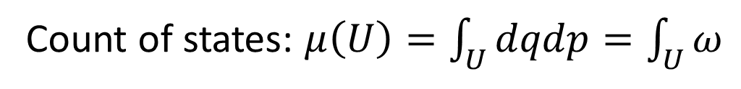





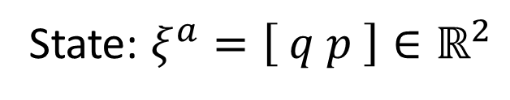








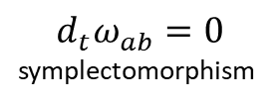

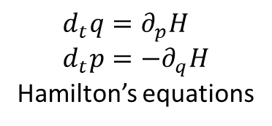
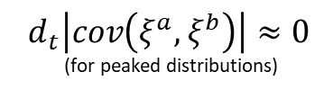


$$d_{t}μ\left(U\right)=0$$
$$⟺$$
$$d_{t}\log{μ\left(U\right)}=0$$
$$⟺$$
$$⟺$$
$d_{t}\int{−ρ\log{ρ}dμ}=0$
$$⟺$$
Conservation of
state count
Conservation of
thermodynamic entropy
$$⟺$$
$$⟺$$
Conservation of
information entropy
$$⟺$$
$$⟺$$
$$⟺$$
$$⟺$$
$$d_{t}\left|cov\left(ξ^{a},ξ^{b}\right)\right|≈0$$
(for peaked distributions)
$$d_{t}ω_{ab}=0$$
symplectomorphism
Determinism and
reversibility
$$⟺$$
$$⟺$$
$$⟺$$
Conservation of
uncertainty
$$d_{t}q=∂_{p}H \\ d_{t}p=−∂_{q}H$$
Hamilton’s equations
All equivalent conditions!!!
$$⟺$$
$$d_{t}ξ^{a}ω_{ab}=∂_{b}H$$
$$⟺$$
$$∂_{a}∧d_{t}ξ^{b}ω_{bc}=0$$
Base theory: classical states for 1 degree of freedom
State: $ξ^{a}=\left[ q p \right]∈ℝ^{2}$
Count of states: $μ\left(U\right)=\int_{U}{dqdp}=\int_{U}{ω}$

Slide 7
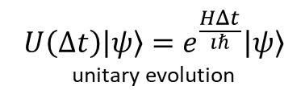
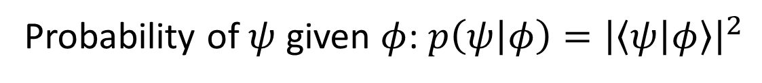

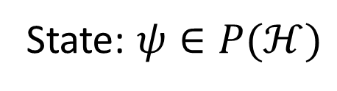


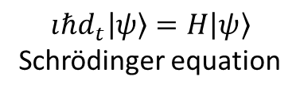
$ψ(0)=φ$ iff $ψ(t)=e^{\frac{HΔt}{ıℏ}}φ$
$$⟺$$
$$d_{t}\text{tr}\left(−ρ\log{ρ}\right)=0$$
$$⟺$$
$$…$$
$$⟺$$
$$⟺$$
Bijective map of
state and probability
Conservation of
information entropy
$$⟺$$
$$⟺$$
…
$$⟺$$
$$⟺$$
$$⟺$$
$$U\left(Δt\right)\left|ψ\right\rangle =e^{\frac{HΔt}{ıℏ}}\left|ψ\right\rangle$$
unitary evolution
Determinism and
reversibility
$$⟺$$
In both cases, the law of evolution is the same physical assumption!!!
$$ıℏd_{t}\left|ψ\right\rangle =H\left|ψ\right\rangle$$
Schrödinger equation
Base theory: quantum mechanics
State: $ψ∈P(ℋ)$
Probability of $ψ$ given $φ$: $p\left(ψ | φ\right)={\left|\left\langle ψ | φ\right\rangle \right|}^{2}$

Slide 8
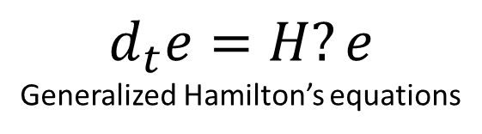

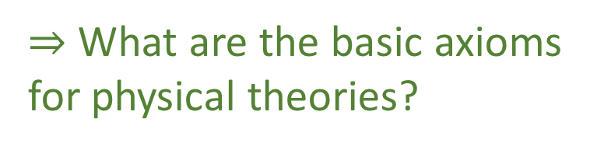


Is there a more general base theory in which we can define and prove the correspondence?
$⇒$ What are the basic axioms
for physical theories?
Determinism and
reversibility
$$d_{t}e=H?e$$
Generalized Hamilton’s equations
$$⟺$$
Base theory: ???
State: $e$ $???$
Entropy: $S(e)$ $???$

Slide 9
Physical world
(informal system)
Mathematical representation
(formal system)
How does this mapping work?
What standards of rigor
are desirable/attainable?

Slide 10
Physical world
(informal system)
Mathematical representation
(formal system)
Physical objects are “fuzzy”
Mathematical concepts are “crisper idealizations”
Mapping may not be unique
Some physical concepts may not be formalized
Physical specifications
Mathematical definitions
When physical objects are mapped to the right mathematical objects,
the physical specification maps to the mathematical definitions
Physical mathematics

Slide 11
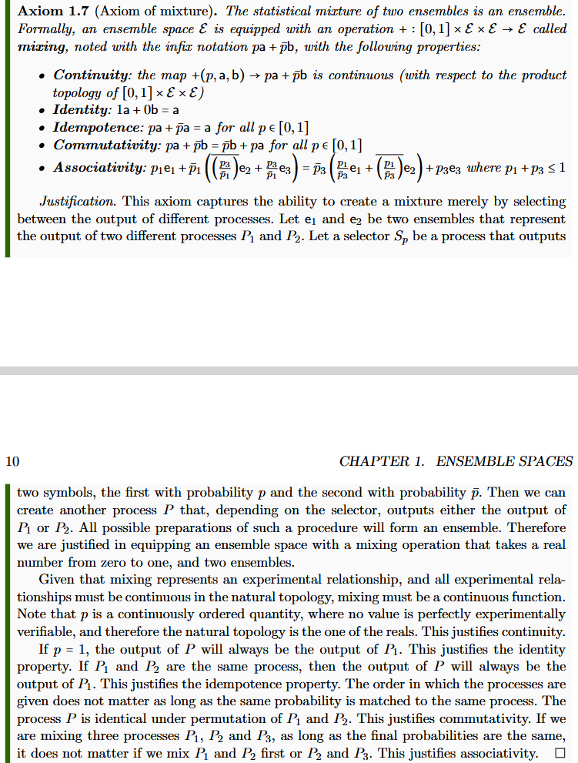
Informal intuitive requirement
(something that makes sense to a physicist or an engineer)

Slide 12
Informal intuitive requirement
(something that makes sense to a physicist or an engineer)
Formal definition
(something a mathematician will find precise)

Slide 13







Informal intuitive requirement
(something that makes sense to a physicist or an engineer)
Formal definition
(something a mathematician will find precise)
Show that the formal definition
follows from the intuitive requirement
$$P$$
Clear idea of what
is being modelled
$P_{1}$
$$e_{1}$$
$$S_{p}$$
$$pe_{1}+\left(1−p\right)e_{2}$$
$P_{2}$
$$e_{2}$$

Slide 14

Informal intuitive requirement
(something that makes sense to a physicist or an engineer)
Formal definition
(something a mathematician will find precise)
Show that the formal definition
follows from the intuitive requirement
$$\left(1−p_{1}\right)\left(1−\frac{p_{3}}{1−p_{1}}\right)=1−p_{1}−p_{3}=\left(1−p_{3}\right)\left(1−\frac{p_{1}}{1−p_{3}}\right)$$
$$P$$
$P_{1}$
$$e_{1}$$
$$pe_{1}+\left(1−p\right)e_{2}$$
Properties justified by
understanding the model
$$S_{p}$$
$P_{2}$
$$e_{2}$$

Slide 15
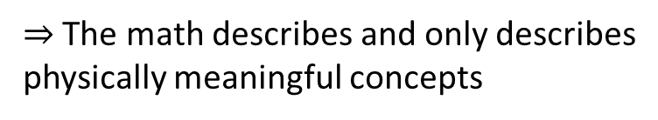
Informal intuitive requirement
(something that makes sense to a physicist or an engineer)
Formal definition
(something a mathematician will find precise)
Show that the formal definition
follows from the intuitive requirement
There is no question as to what the math describes
The properties are justified by, are a consequence of, what the model describes
Every math proof can be understood physically
$⇒$ The math describes and only describes
physically meaningful concepts
It’s physical mathematics

Slide 16
We have a methodology!
What are the most basic objects
for our base theory?

Slide 17
$⇒$ Science is about statements that are associated to experimental tests
Statements must be either true or false for everybody
Tests may or may not terminate (i.e. be conclusive)
Statement | Test Result
T | SUCCESS (in finite time)
 | UNDEFINED
F | UNDEFINED
 | FAILURE (in finite time)
Verifiable statement | Test Result
T | SUCCESS (in finite time)
F | UNDEFINED
 | FAILURE (in finite time)

Slide 18
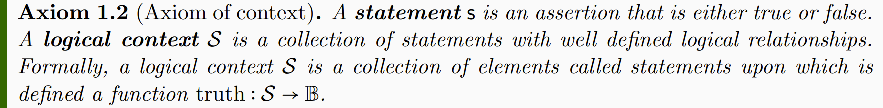
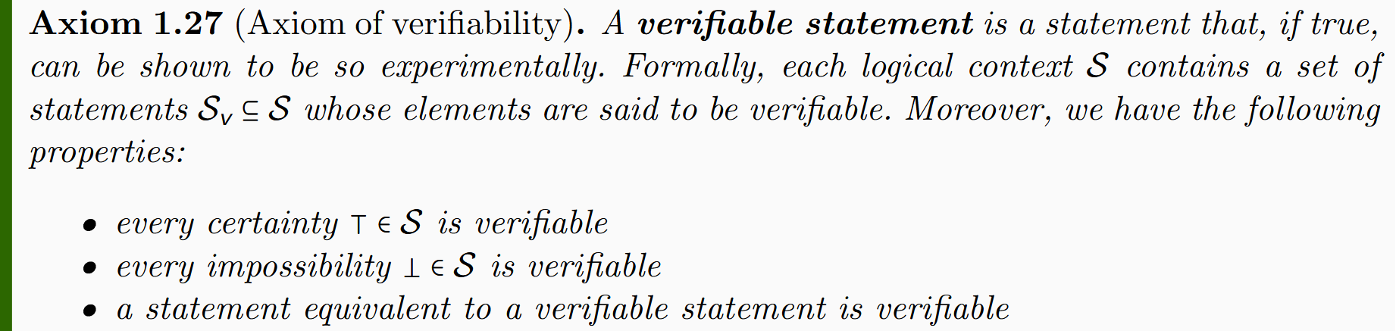
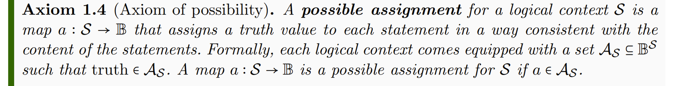
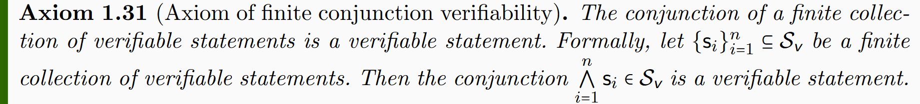
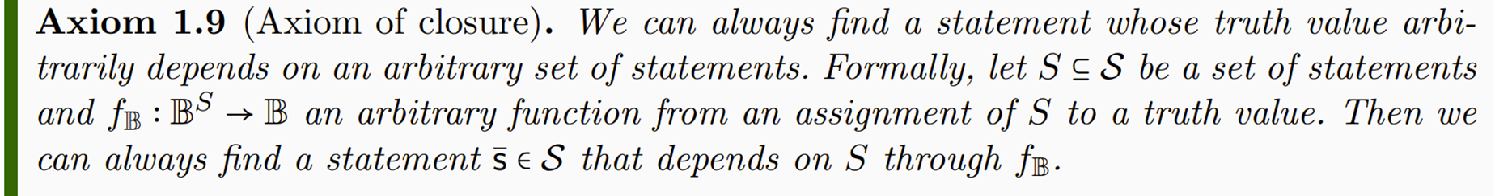
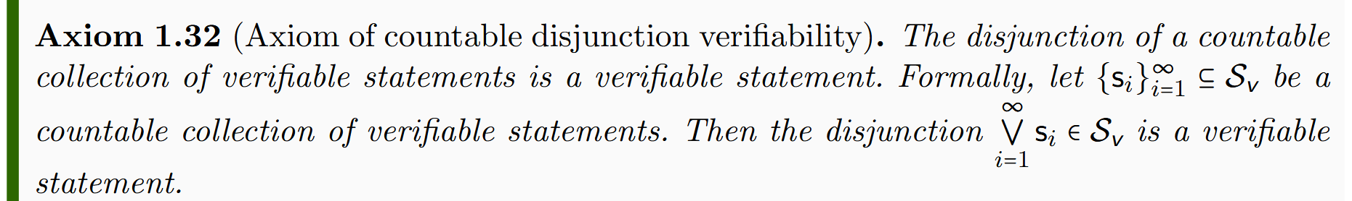
Axioms of logic
Axioms of verifiability
Lead to standard logic
(i.e. Boolean algebra)
Lead to intuitionist logic
(i.e. Heyting algebra)
two-valued logic
three-valued logic

Slide 19
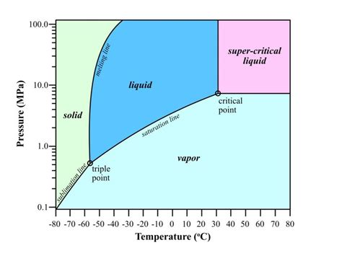

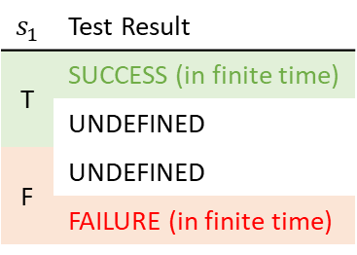

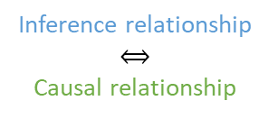
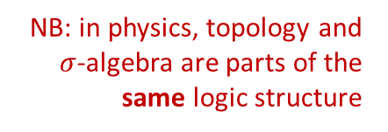





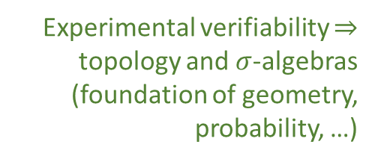

Topology and $σ$-algebra
Experimental verifiability $⇒$ topology and $σ$-algebras
(foundation of geometry, probability, …)
Theoretical statements
$int(A)$ corresponds to the verifiable
part of a statement
$$s_{1}$$ | Test Result
T | SUCCESS (in finite time)
 | UNDEFINED
F | UNDEFINED
 | FAILURE (in finite time)
Verifiable
statements
Perfect map between math and physics
Possibilities
$∂A$ corresponds to the undecidable
part of a statement
$ext(A)$ corresponds to the falsifiable
part of a statement
NB: in physics, topology and $σ$-algebra are parts of the same logic structure
Open sets
Points
Open set $(\text{5}\text{09.5, 510.5})$ $⟺$ Verifiable “the mass of the electron is 510 $±$ 0.5 KeV”
Borel sets
Closed set $[510]$ $⟺$ Falsifiable “the mass of the electron is exactly 510 KeV”
Borel set $ℚ$ ($int\left(ℚ\right)∪ext\left(ℚ\right)=∅$) $⟺$Theoretical “the mass of the electron in KeV is a rational number” (undecidable)
Inference relationship $𝓇:𝒟_{Y}→𝒟_{X}$ such that $𝓇\left(s\right)≡s$
$$𝒟_{X}$$
$$𝒟_{Y}$$
Topologically continuous consistent
with analytic discontinuity on isolated points
Inference relationship
$$⟺$$
Causal relationship
Relationships must be
topologically continuous
$$X$$
$$Y$$
Causal relationship $f:X→Y$ such that $x≼f\left(x\right)$
Phase transition $⟺$ Topologically isolated regions

Slide 20


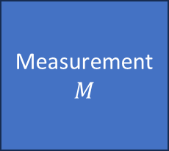




$⇒$ Scientific laws are relationships between ensembles
Preparation
$$P$$
Process
$$U$$
Measurement
$$M$$
$$e_{P}$$
$$e_{U}$$
$$e_{M}$$
Statistical
data
Initial
ensemble
Final
ensemble
Preparation
procedure
$$…$$
Ensemble of outputs

Slide 21
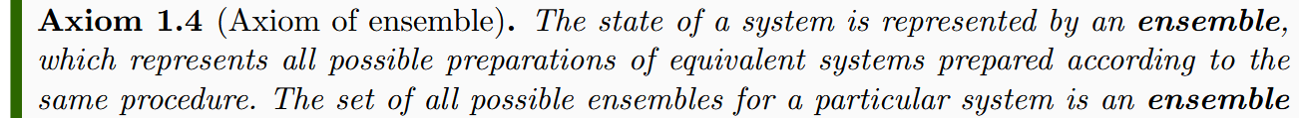
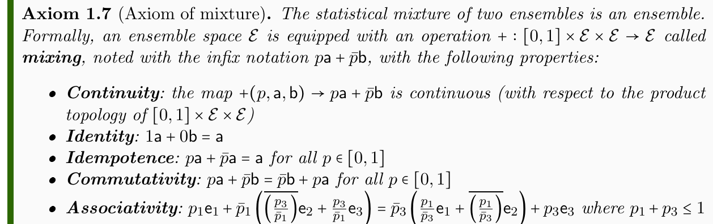
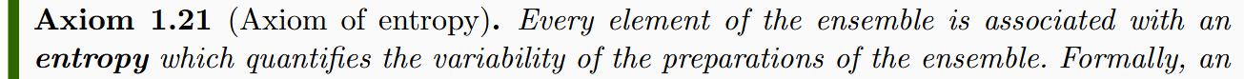



Minimal requirements for an ensemble space
Experimental verifiability $⇒$ Topology
Responsible for all topological structures
Ensembles can be mixed $⇒$ Convex structure
Responsible for all linear structures
Ensemble variability $⇒$Entropy
Responsible for all geometric structures
Still trying to find the right starting point for Poisson/commutator structure

Slide 22
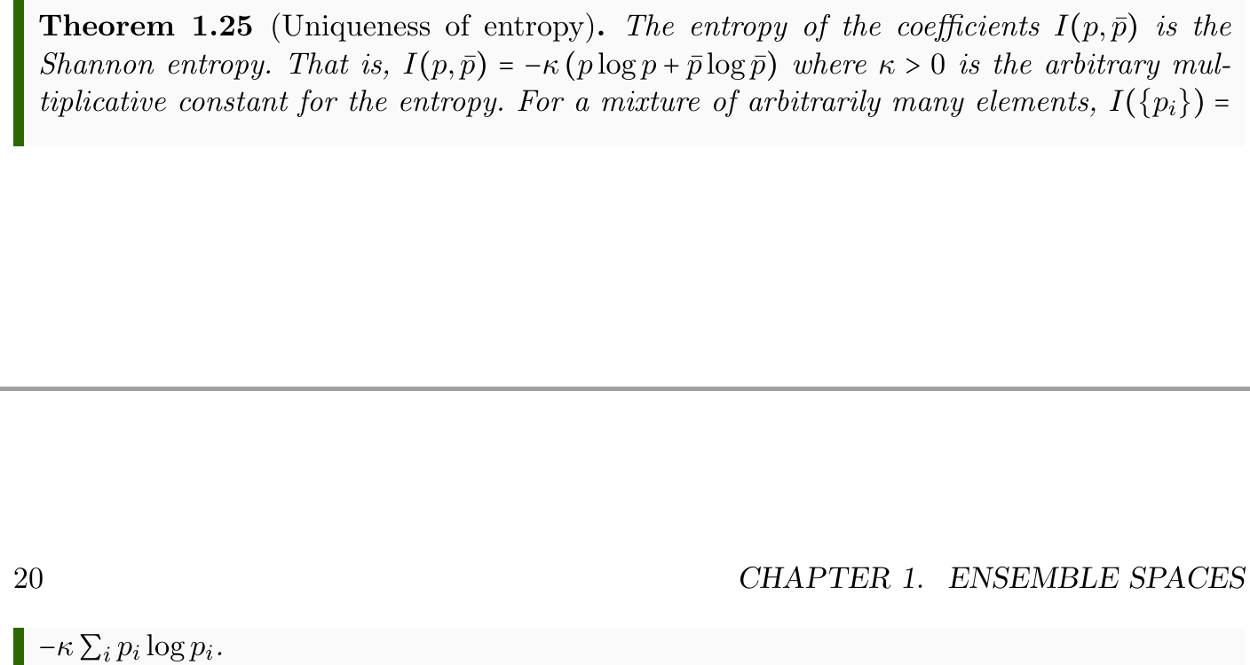
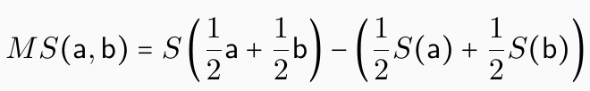


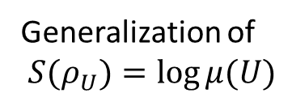
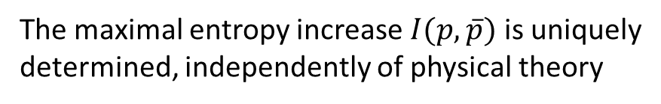
Some general results/constructions
The maximal entropy increase $I(p,\overline{p})$ is uniquely
determined, independently of physical theory
Ensembles embed into a vector space
(if continuously, we have a foundation for calculus)
Entropy increase during mixing generalizes
Jensen-Shannon Divergence (pseudo-distance)
Hessian of the entropy generalizes Fisher-Rao
metric from information geometry
Non-additive
generalization
of probability
Generalization of
$S(ρ_{U})=\log{μ(U)}$

Slide 23
Open problems
What theorems that hold in topological vector spaces also hold in topological convex spaces?
E.g. Is every ${\text{T}}_{1}$ second countable TCS metrizable? True for TVS.
Can we show the entropy induces a metric, which induces the topology?
Can we prove continuous embedding in a TVS?
Can we find a non-additive integral/derivative to generalize probability theory?
Standard approaches (e.g. Sugeno and Choquet integrals) do not work
How do we make field theories fit the framework?
E.g. What is the correct function space, on top of which we can define
(cylinder?) measures, a notion of entropy and a “symplectic” structure?
…

Slide 24
Conclusion
The current connection between math and physics is “suboptimal”
  Physicists typically ignore all the hard problems; mathematicians cannot know which choices are physically significant and which aren’t
A physically meaningful and mathematically precise approach exists
  Reverse physics allows us to understand what role each mathematical structure is playing in a physical theory; physical mathematics allows us to design mathematical structures that are physically justified and therefore map perfectly to the physics
New mathematics needs to be developed
  We have a number of mathematical questions that can be extracted from the framework and studied independently; we are actively looking for interested mathematicians

Slide 25
To learn more
Project website
  https://assumptionsofphysics.org for papers, presentations, …
  https://assumptionsofphysics.org/book for our open access book
  (updated every few years with new results)
YouTube channels
  https://www.youtube.com/@gcarcassi
  Videos with results and insights from the research
  https://www.youtube.com/@AssumptionsofPhysicsResearch
  Research channel, with open questions and livestreamed work sessions
GitHub
  https://github.com/assumptionsofphysics
  Book, research papers, slides for videos...

