Slide 1

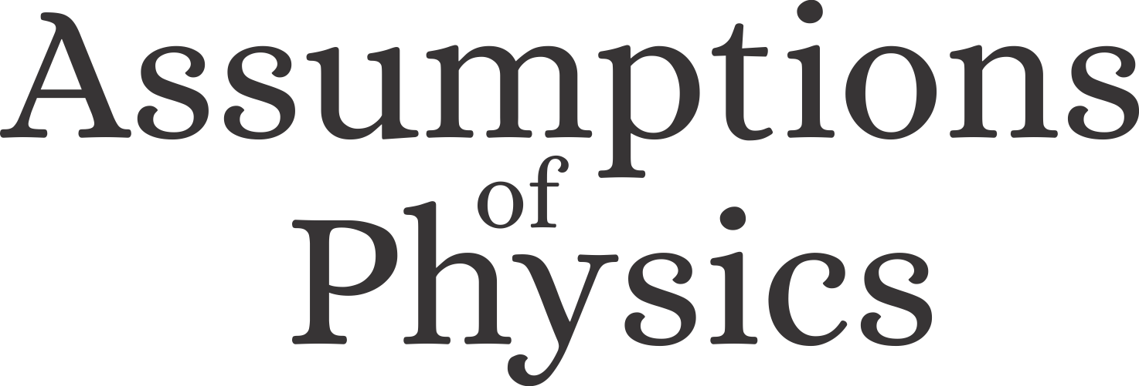
Counting evolutions: a simple foundation for thermodynamics
Gabriele Carcassi

Slide 2
Assumptions of Physics
This talk is part of a broader project called Assumptions of Physics (see http://assumptionsofphysics.org/)
The aim of the project is to find a handful of physical principles and assumptions from which the basic laws of physics can be derived

Slide 3
Space of the well-posed scientific theories
Physical theories
Specializations of the general theory under the different assumptions
Hamiltonian mechanics
Unitary evolution
Quantum state-space
Classical phase-space
Assumptions
Infinitesimal reducibility
Determinism/
reversibility
Irreducibility
States and processes
General theory
Informational granularity
Basic requirements and definitions valid in all theories
Experimental verifiability

Slide 4
Assumptions of Physics
Currently working on extending the framework to include non-deterministic and/or non-reversible processes
Required to make the theory general
Thermodynamics is a good test case

Slide 5
Outline
Draft a simple general approach to describing processes
Define (process) entropy in very general terms and derive its fundamental link to irreversibility
With a few extra assumptions, recover thermodynamics
Recover the thermodynamic laws
Show that the above entropy corresponds to the thermodynamic entropy for thermodynamic process
Extend the discussion to other theories
Show that the above notion of entropy is already embedded in classical/quantum/statistical mechanics
Argue that the concepts we introduced are intrinsic requirements to properly define systems and states

Slide 6
States, processes and evolutions

Slide 7
State space of a system

Slide 8



State space of a system at different times
$$t−Δt$$
$$t$$
$$t+Δt$$

Slide 9
Evolution: complete description of the system at all times
$$t−Δt$$
$$t$$
$$t+Δt$$

Slide 10
A process defines the set of all possible evolutions
$$t−Δt$$
$$t$$
$$t+Δt$$

Slide 11



Each description at each time corresponds to a set of evolutions
We can count the number of evolutions for a particular state $s$ at a particular time with a measure* $μ(s)$ since $s$ identifies a set of evolutions.
$$μ=2$$
$$μ=1$$
$$μ=2$$
$$t−Δt$$
$$t$$
$$t+Δt$$
* The full mathematical characterization is a bit more complicated (i.e. preorder that leads to a family of measures)… but conceptually it is like that

Slide 12

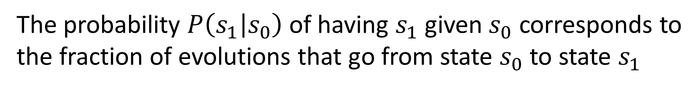

The probability $P\left(s_{1} | s_{0}\right)$ of having $s_{1}$ given $s_{0}$ corresponds to the fraction of evolutions that go from state $s_{0}$ to state $s_{1}$
That is, $P\left(s_{1} | s_{0}\right)=\frac{μ\left(s_{0}∩s_{1}\right)}{μ\left(s_{0}\right)}$
$$50\%$$
$$t−Δt$$
$$t$$
$$t+Δt$$

Slide 13
A process is deterministic if knowing the state at a time allows us to predict the state at a future time
For these processes, we can properly write a law of evolution $s\left(t+Δt\right)=f\left(s\left(t\right)\right)$
$$t−Δt$$
$$t$$
$$t+Δt$$

Slide 14






In a deterministic process, the evolutions can never split, only merge
That is, $μ\left(s\left(t+Δt\right)\right)≥μ\left(s\left(t\right)\right)$
$$μ=1$$
$$μ=2$$
$$μ=1$$
$$μ=1$$
$$μ=3$$
$$t−Δt$$
$$t$$
$$t+Δt$$

Slide 15
A process is reversible if knowing the state at a time allows us to reconstruct the state at a past time
$$t−Δt$$
$$t$$
$$t+Δt$$

Slide 16






In a reversible process, the evolutions can never merge, only split
That is, $μ\left(s\left(t+Δt\right)\right)≤μ\left(s\left(t\right)\right)$
$$μ=1$$
$$μ=3$$
$$μ=2$$
$$μ=1$$
$$μ=1$$
$$t−Δt$$
$$t$$
$$t+Δt$$

Slide 17

In a det/rev process, evolutions can never merge nor split
That is, $μ\left(s\left(t+Δt\right)\right)=μ\left(s\left(t\right)\right)$
$$t−Δt$$
$$t$$
$$t+Δt$$

Slide 18
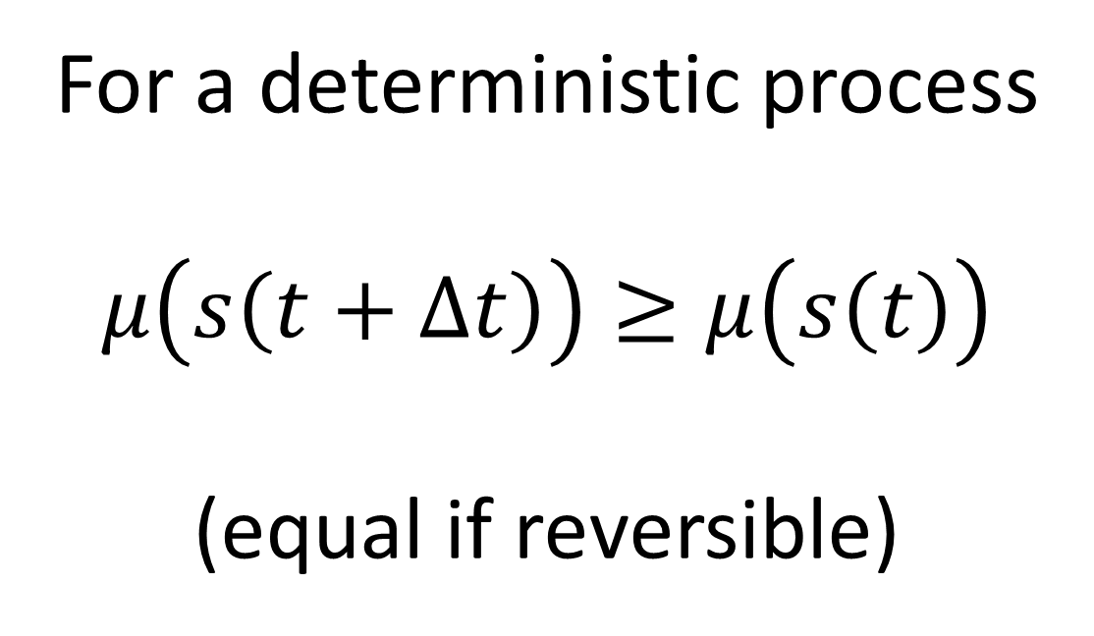
For a deterministic process
$$μ\left(s\left(t+Δt\right)\right)≥μ\left(s\left(t\right)\right)$$
(equal if reversible)

Slide 19
Consider a process where a system reaches a final equilibrium that can be predicted from the initial state
At equilibrium, evolutions cannot merge anymore
$$t−Δt$$
$$t$$
$$t+Δt$$

Slide 20
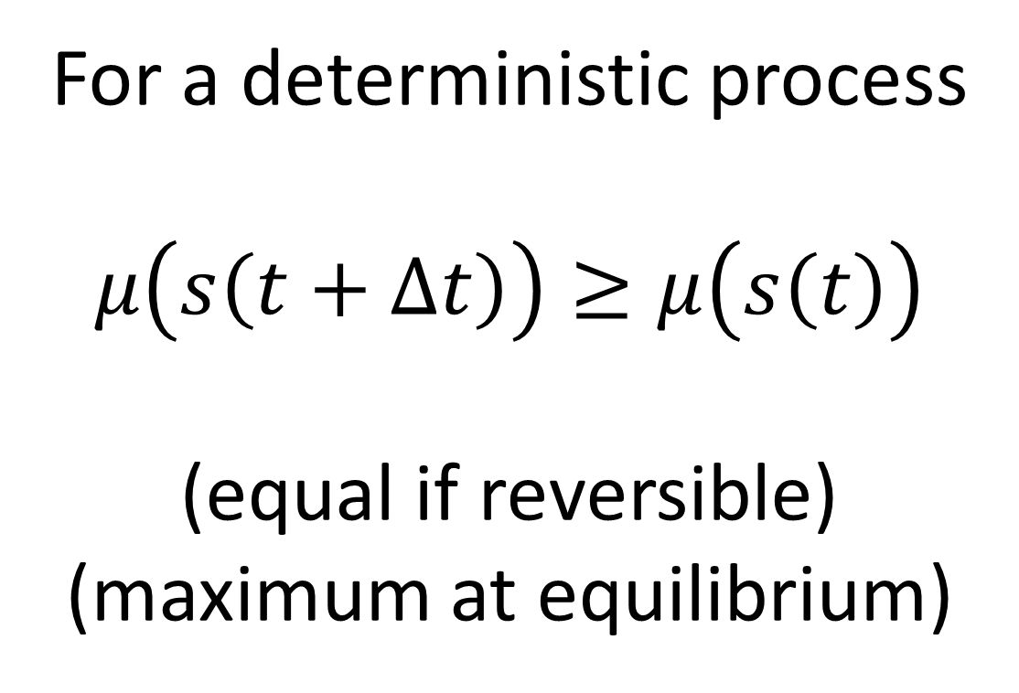
For a deterministic process
$$μ\left(s\left(t+Δt\right)\right)≥μ\left(s\left(t\right)\right)$$
(equal if reversible)
(maximum at equilibrium)

Slide 21






Suppose we have a composite of two systems
$$𝒮_{1}$$
$$𝒮=𝒮_{1}×𝒮_{2}$$
$$\left\{x\left(t\right),y\left(t\right)\right\}$$
$$𝒮_{2}$$
$$x(t)$$
$$y(t)$$
State space is the product
Evolutions, in general, are not the product: there may be correlations between the evolutions

Slide 22

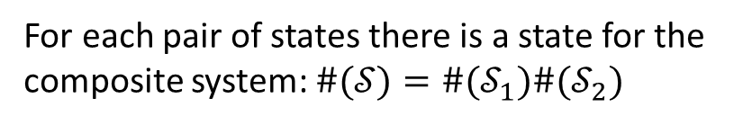

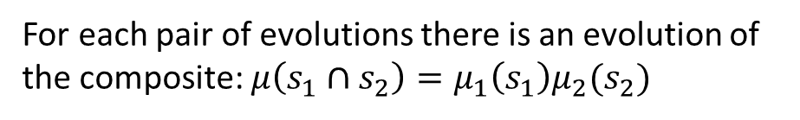

Suppose we have a composite of two systems
If the systems are independent, the evolution of one does not constrain the evolution of the other: all pairs are possible
$$\left\{x\left(t\right),y\left(t\right)\right\}$$
For each pair of states there is a state for the composite system: $\#(𝒮)=\#(𝒮_{1})\#(𝒮_{2})$
For each pair of evolutions there is an evolution of the composite: $μ\left(s_{1}∩s_{2}\right)=μ_{1}\left(s_{1}\right)μ_{2}(s_{2})$
$$x(t)$$
$$y(t)$$
Note: $log μ=\log{μ_{1}μ_{2}}=\log{μ_{1}}+\log{μ_{2}}$
$log μ$ is additive for independent systems

Slide 23


Define the process entropy as $S=\log{μ}$
The log of the count of evolutions per state
It is additive for independent systems
$$S=S_{1}+S_{2}$$
For a deterministic process
$S\left(s\left(t+Δt\right)\right)≥S\left(s\left(t\right)\right)$ (equal if reversible)
(maximum at equilibrium)

Slide 24
Process entropy
We have not mentioned uncertainty, disorder, statistical distributions, information, lack of information, …
Therefore those concepts are not fundamental in this context
We have not discussed what type of state or system we have (classical, quantum, biological, economic, …)
Therefore everything we said is valid independently of the type of system, which would explain the success of thermodynamic ideas outside the realm of physics
The process entropy increase is explained by the definitions and the settings (processes with equilibria that depend on the initial state)
The explanation is straightforward (i.e. does not require a complicated discussion)
The explanation is not mechanical (i.e. given by a particular mechanism)

Slide 25
Process entropy
The main difference is that process entropy is process dependent
The same state in different processes (or in the same process at different times) will yield a different process entropy
We typically think of entropy as state dependent
I.e. it is a state variable
In what circumstances can process entropy be associated to the state? And why?

Slide 26

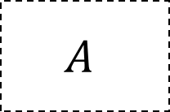
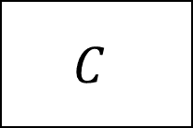
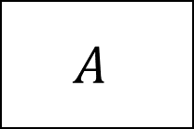
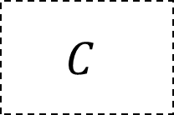
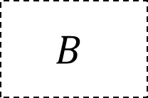



Note: if we want to “switch” processes, the evolution count at the junction must be uniquely defined
$$A$$
$$A$$
$$x$$
$$B$$
$$B$$
$$C$$
$$C$$
This is at least one reason why we would want to have a well defined entropy at the states at the junction points
$$…$$
$$…$$

Slide 27


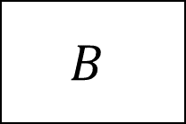


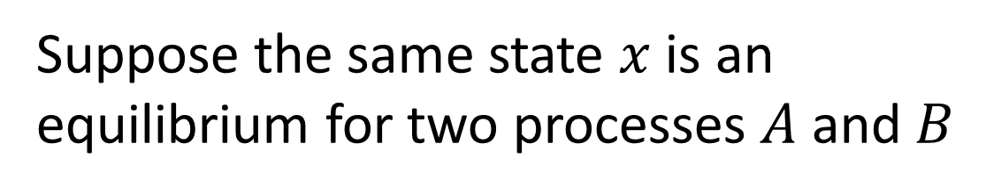
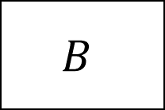


Equilibria can be assigned a unique entropy
Suppose the same state $x$ is an equilibrium for two processes $A$ and $B$
$$A$$
$$x$$
$$B$$
$$x$$
Two ways of combining the processes: first A then B and vice versa
$$B$$
$$x$$
$$A$$
$$x$$
All the evolutions of $A$that end in $x$ will also end in $x$ under $AB$ and $B$
All the evolutions of $B$that end in $x$ will also end in $x$ under $BA$ and $A$
Number of evolutions of $x$ must be independent of the process
Equilibria allow us to assign unique (maximal) entropy to states

Slide 28

For composite systems, recall
that in general the process entropy is not unique
$$\left\{x\left(t\right),y\left(t\right)\right\}$$
Due to correlations between subsystems
If the systems are independent, however, the process entropy is well defined
$$x(t)$$
$$y(t)$$
It sums and corresponds to the maximum
System independence allows us to assign unique (maximal) entropy to composite states

Slide 29
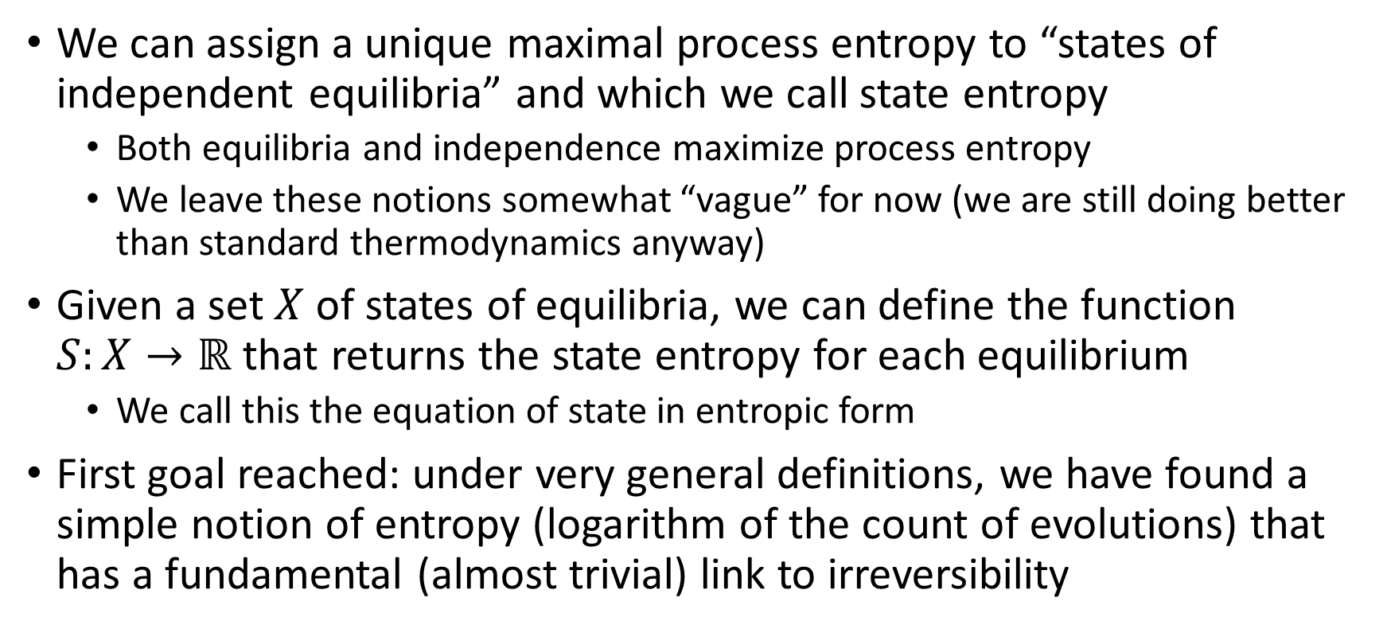
State entropy
We can assign a unique maximal process entropy to “states of independent equilibria” and which we call state entropy
Both equilibria and independence maximize process entropy
We leave these notions somewhat “vague” for now (we are still doing better than standard thermodynamics anyway)
Given a set $X$ of states of equilibria, we can define the function $S:X→ℝ$ that returns the state entropy for each equilibrium
We call this the equation of state in entropic form
First goal reached: under very general definitions, we have found a simple notion of entropy (logarithm of the count of evolutions) that has a fundamental (almost trivial) link to irreversibility

Slide 30
Thermodynamics

Slide 31









Suppose we take a composite system and at some point we split it such that each part will follow its own process
$$x$$
$$B$$
$$x_{1}$$
$$(x_{0},y_{0})$$
$$A$$
$$(x,y)$$
$$y$$
$$C$$
$$y_{1}$$
Not only we need a well defined evolution count for the composite, but also for each part
This requires us to extended the notion of equilibria to the parts

Slide 32







Thermodynamic process
Thermodynamic processes extend the notion of deterministic process with equilibria to composite systems
We define a thermodynamic process as a deterministic process with equilibria such that:
in the final equilibrium all parts are independent and at equilibrium
the final equilibrium depends non-trivially on the initial state of any part
at equilibrium
$$X⋃Y$$
$$X⋃Y$$
$$A$$
$$X$$
$$Y$$
$$X$$
$$Y$$
non-trivial dependence
independent

Slide 33










Thermodynamic equilibrium
$$…$$
A thermodynamic equilibrium is the output of a thermodynamic process
Two systems are in thermodynamic equilibrium if they are parts of the same thermodynamic equilibrium
$$X⋃Y⋃Z$$
$$…$$
$$X⋃Y$$
$$Y⋃Z$$
$$…$$
Mathematically, systems under composition form a Boolean algebra. An equilibrium is a downward set with a greatest element.
$$X$$
$$Y$$
$$Z$$
$$…$$

Slide 34
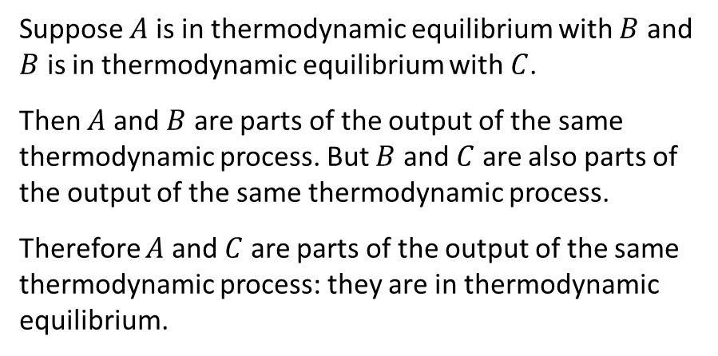
Thermodynamic equilibrium
$$…$$
Based on the definitions, we can show that thermodynamic equilibrium is transitive
Suppose $A$ is in thermodynamic equilibrium with $B$ and $B$ is in thermodynamic equilibrium with $C$.
Then $A$ and $B$ are parts of the output of the same thermodynamic process. But $B$ and $C$ are also parts of the output of the same thermodynamic process.
Therefore $A$ and $C$ are parts of the output of the same thermodynamic process: they are in thermodynamic equilibrium.
$$X⋃Y⋃Z$$
$$…$$
$$X⋃Y$$
$$Y⋃Z$$
$$…$$
$$X$$
$$Y$$
$$Z$$
$$…$$
This recovers the zeroth law of thermodynamics

Slide 35
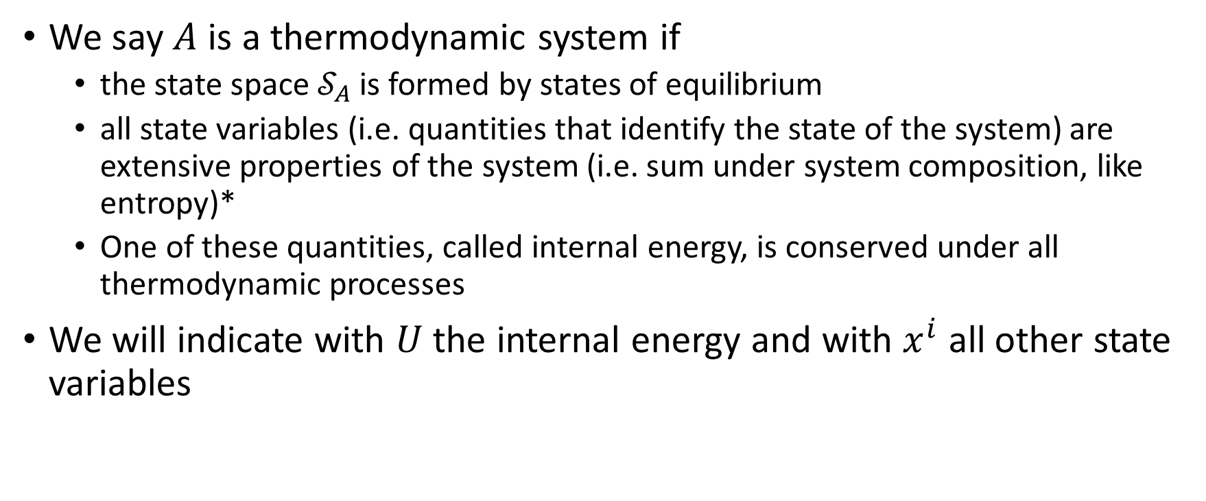
Thermodynamic systems
We say $A$ is a thermodynamic system if
the state space $𝒮_{A}$ is formed by states of equilibrium
all state variables (i.e. quantities that identify the state of the system) are extensive properties of the system (i.e. sum under system composition, like entropy)*
One of these quantities, called internal energy, is conserved under all thermodynamic processes
We will indicate with $U$ the internal energy and with $x^{i}$ all other state variables
* It may be possible to derive the existence of extensive quantities… For now we leave this as an extra assumption

Slide 36
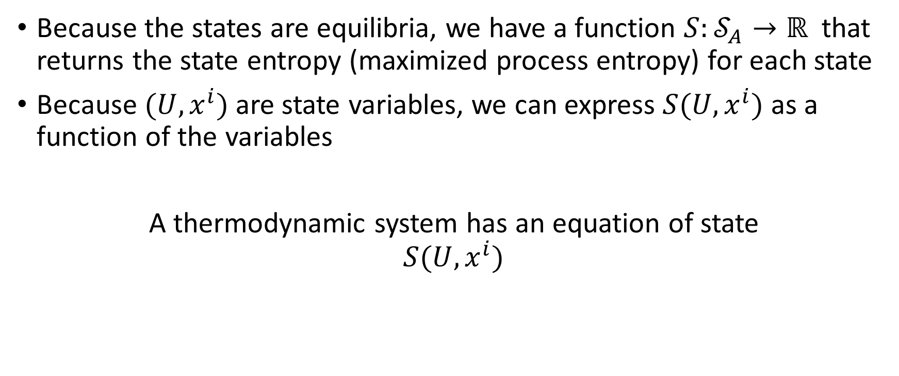
Existence of an equation of state
Because the states are equilibria, we have a function $S:𝒮_{A}→ℝ$ that returns the state entropy (maximized process entropy) for each state
Because $(U,x^{i})$are state variables, we can express $S(U,x^{i})$ as a function of the variables
A thermodynamic system has an equation of state $S(U,x^{i})$

Slide 37
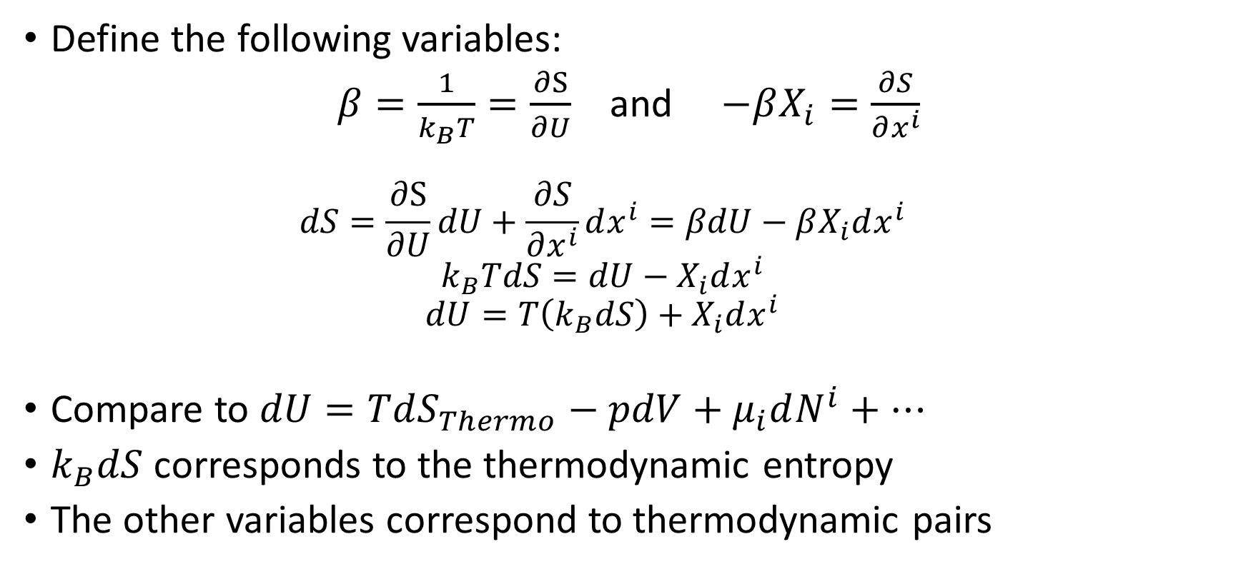
Thermodynamic quantities
Define the following variables:
$β=\frac{1}{k_{B}T}=\frac{∂S}{∂U}$ and $−βX_{i}=\frac{∂S}{∂x^{i}}$
$$dS=\frac{∂S}{∂U}dU+\frac{∂S}{∂x^{i}}dx^{i}=βdU−βX_{i}dx^{i} \\ k_{B}TdS=dU−X_{i}dx^{i} \\ dU=T\left(k_{B}dS\right)+X_{i}dx^{i}$$
Compare to $dU=TdS_{Thermo}−pdV+μ_{i}dN^{i}+…$
$k_{B}dS$ corresponds to the thermodynamic entropy
The other variables correspond to thermodynamic pairs

Slide 38
Changes of energy and entropy
Now we want to study how changes in energy and changes in entropy relate to each other
To do that, is useful to characterize two “orthogonal” directions:
changes of energy at equal entropy
changes of energy at maximum entropy change

Slide 39
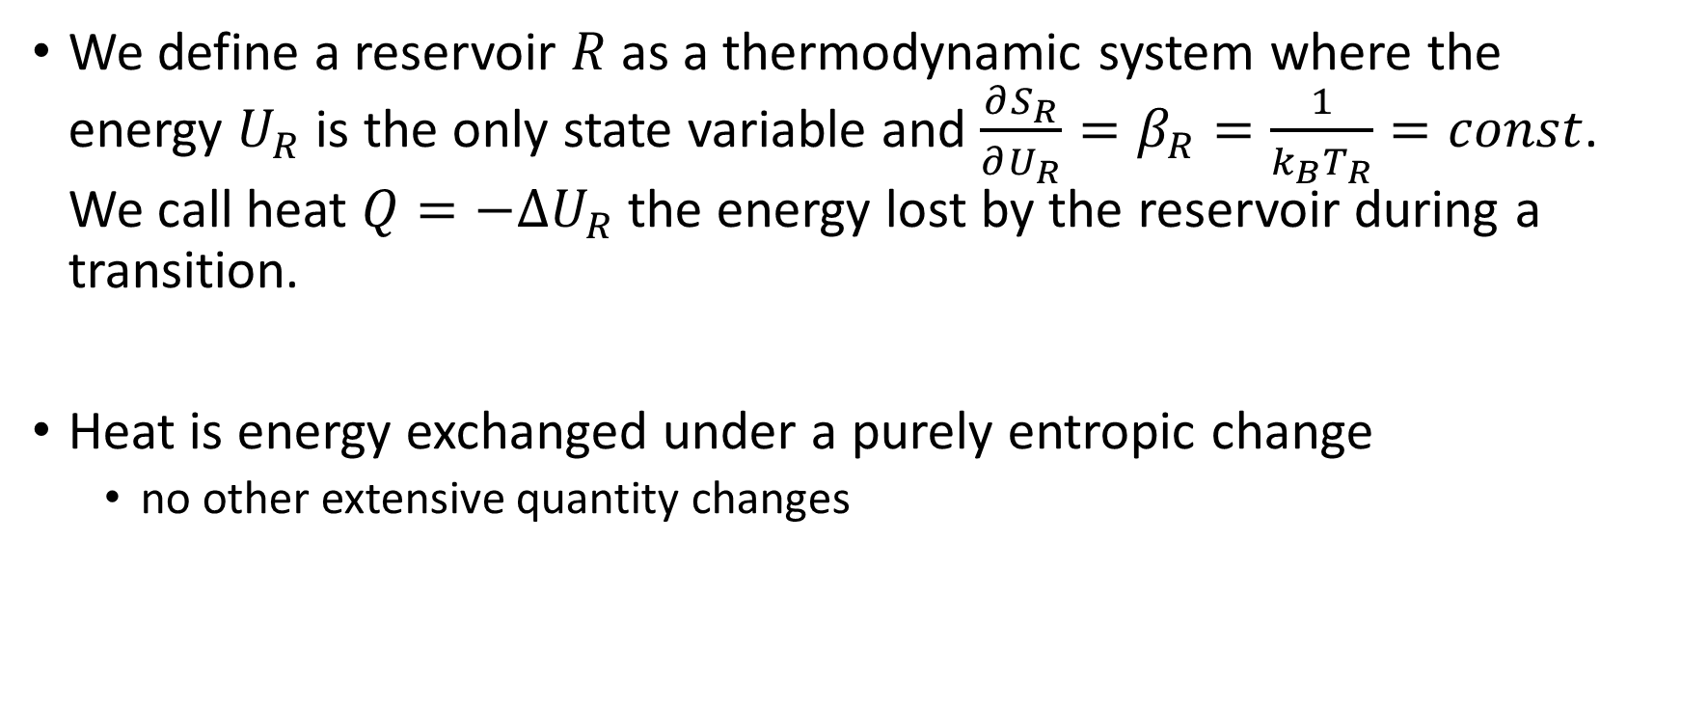
Reservoir
We define a reservoir $R$ as a thermodynamic system where the energy $U_{R}$ is the only state variable and $\frac{∂S_{R}}{∂U_{R}}=β_{R}=\frac{1}{k_{B}T_{R}}=const$. We call heat $Q=−ΔU_{R}$ the energy lost by the reservoir during a transition.
Heat is energy exchanged under a purely entropic change
no other extensive quantity changes

Slide 40
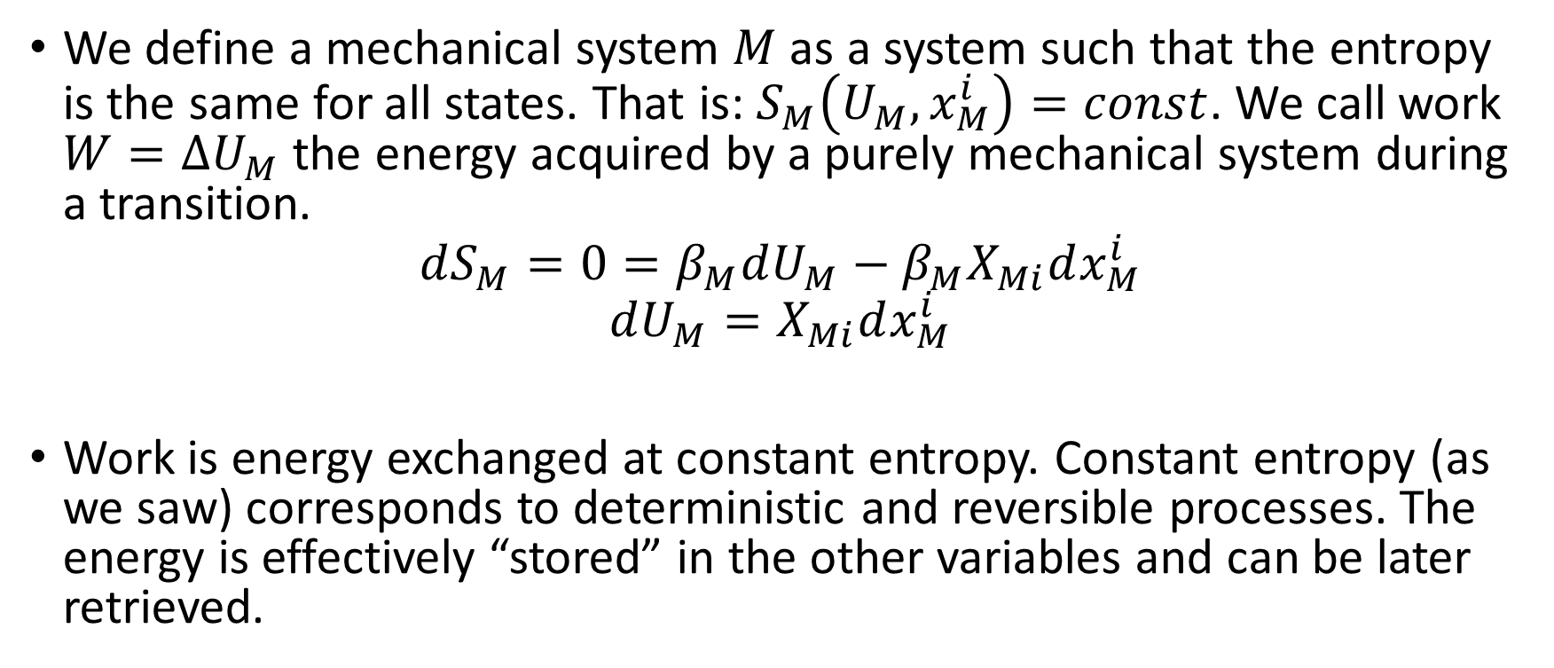
Mechanical system
We define a mechanical system $M$ as a system such that the entropy is the same for all states. That is: $S_{M}\left(U_{M},x_{M}^{i}\right)=const$. We call work $W=ΔU_{M}$ the energy acquired by a purely mechanical system during a transition.
$$dS_{M}=0=β_{M}dU_{M}−β_{M}X_{Mi}dx_{M}^{i}$$
$$dU_{M}=X_{Mi}dx_{M}^{i}$$
Work is energy exchanged at constant entropy. Constant entropy (as we saw) corresponds to deterministic and reversible processes. The energy is effectively “stored” in the other variables and can be later retrieved.

Slide 41


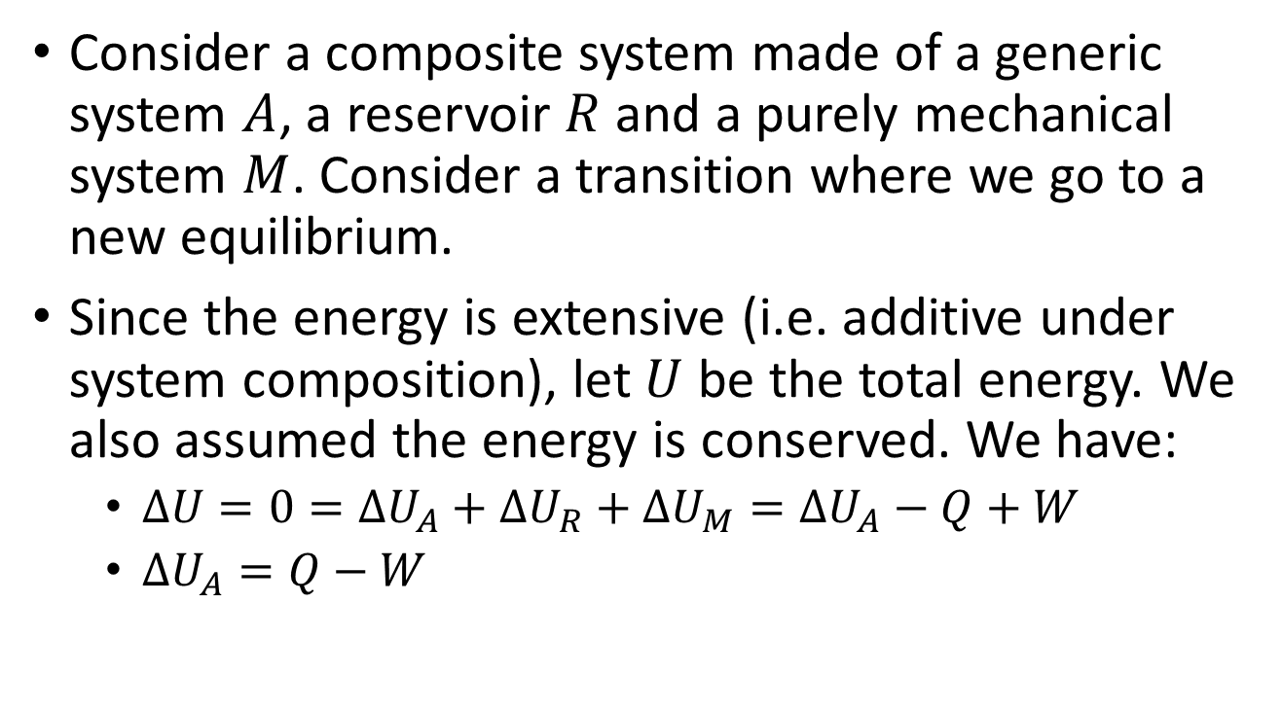



First law
Consider a composite system made of a generic system $A$, a reservoir $R$ and a purely mechanical system $M$. Consider a transition where we go to a new equilibrium.
Since the energy is extensive (i.e. additive under system composition), let $U$ be the total energy. We also assumed the energy is conserved. We have:
$ΔU=0=ΔU_{A}+ΔU_{R}+ΔU_{M}=ΔU_{A}−Q+W$
$ΔU_{A}=Q−W$
$$R$$
$$Q$$
$$A$$
$$M$$
$$W$$
This recovers the first law of thermodynamics

Slide 42
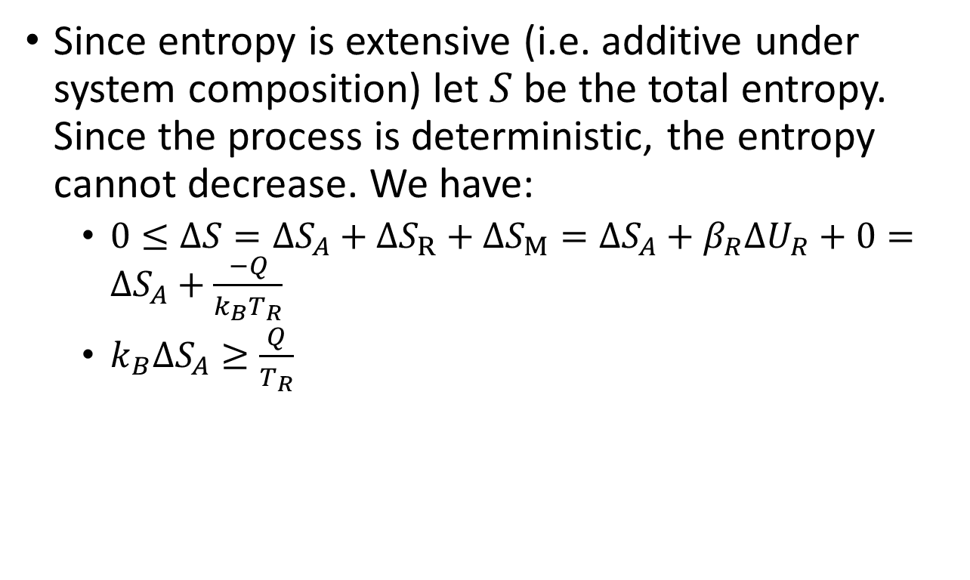
Second law
Since entropy is extensive (i.e. additive under system composition) let $S$ be the total entropy. Since the process is deterministic, the entropy cannot decrease. We have:
$0≤ΔS=ΔS_{A}+ΔS_{R}+ΔS_{M}=ΔS_{A}+β_{R}ΔU_{R}+0=ΔS_{A}+\frac{−Q}{k_{B}T_{R}}$
$k_{B}ΔS_{A}≥\frac{Q}{T_{R}}$
$$R$$
$$Q$$
$$A$$
$$M$$
$$W$$
This recovers the second law of thermodynamics

Slide 43

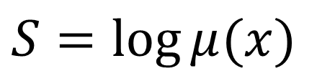
Recall the definition of state entropy
Count of evolutions
$S=\log{μ(x)}$
$$μ=3$$

Slide 44

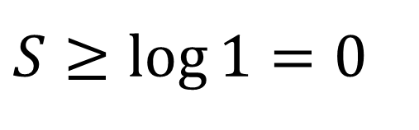
Recall the definition of state entropy
Count of evolutions
$S=\log{μ(x)}$
$μ=$ 1
The least we can have is a single evolution
The case where the equilibrium can be reached from only one starting condition
$S≥\log{1}=0$
State entropy is non-negative, bounded from below at zero
Evolution of a pure ground state fits into the single evolution case
This recovers part of the third law of thermodynamics

Slide 45




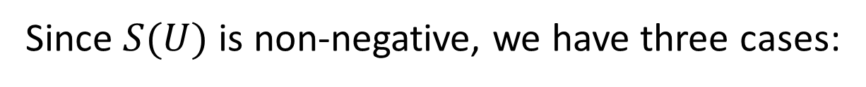

Existence of equilibria forces $S(U)$ to be concave
$$b$$
$$a$$
$$S$$
Since $S(U)$ is non-negative, we have three cases:
a) No maximum energy, entropy monotonically increasing b) No minimum energy, entropy monotonically decreasing
c) Minimum and maximum energy, entropy minimum at either edge
$$c$$
$$U$$
The first 2 cases can’t both exist:
If we combined two systems, one strictly monotonically increasing with another strictly monotonically decreasing, maximization of entropy would happen at infinity: we have no equilibrium
By convention, we say energy is bounded from below. Minimum entropy is reached at the lowest energy state.
This recovers the remaining part of the third law of thermodynamics

Slide 46
Thermodynamics recovered
The laws of thermodynamics as we recovered them apply simply because of the properties of the processes we decide to focus on
The notion of process entropy maps to thermodynamic entropy in a very natural way
The notion of thermodynamic equilibrium as an equilibrium at all scales is already something people discuss (citation needed)
Again: we have not mentioned uncertainty, disorder, statistical distributions, information, lack of information, …
Again: we have not discussed what type of state or system we have (classical, quantum, biological, economic, …)

Slide 47
States, state entropy and equilibria

Slide 48
Connection to statistical mechanics
One approach for entropy: fundamental postulate of statistical mechanics (entropy is the logarithm of the count of states)
Can be recovered in the following way (not the only one)
Assume macrostate is fully defined by a set of constraints over the microstates
Assume Hamiltonian evolution that preserves constraints (i.e. macrostate variables are unchanged, we are at equilibrium)
Since each microstate provides a full description of the system, all microstates correspond to the same number of evolutions
Process entropy of the macrostate is, up to a constant, the logarithm of the count of states that satisfy the constraint.

Slide 49

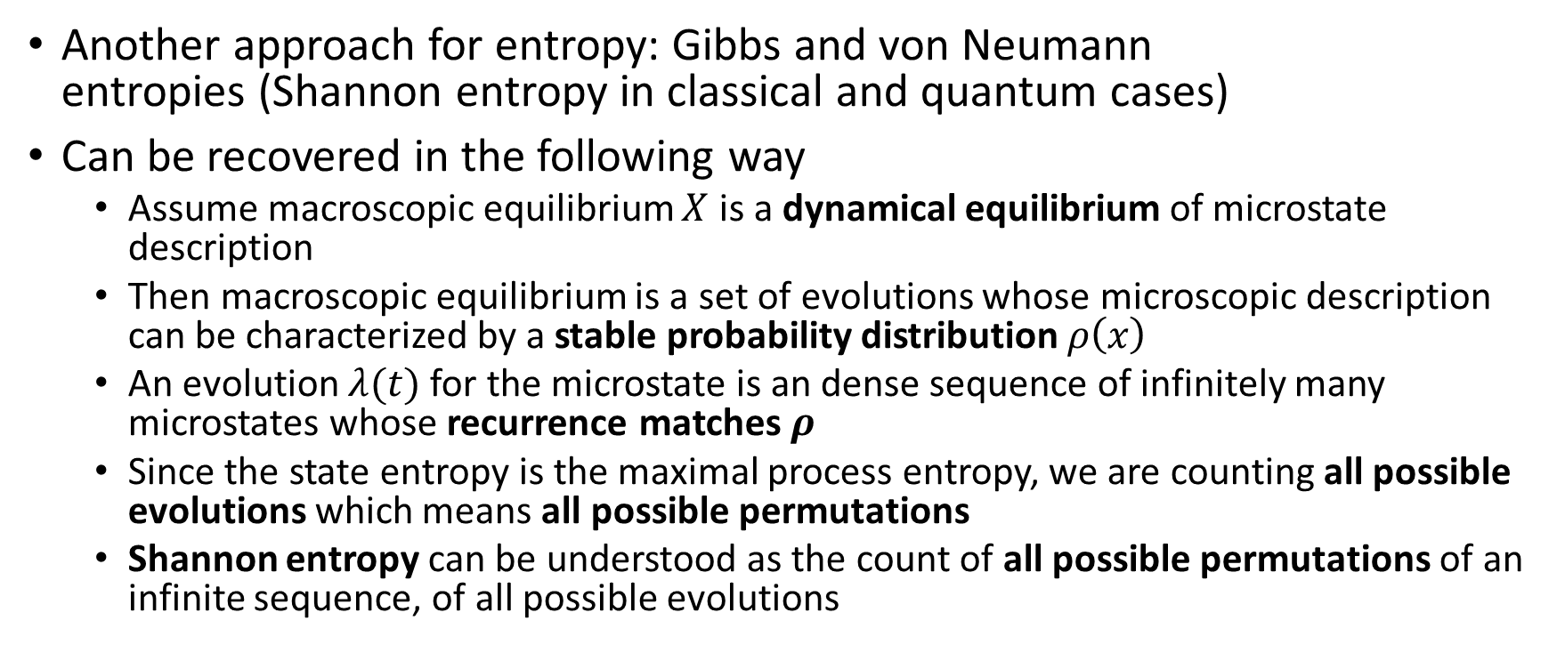

Connection to statistical mechanics
$$X$$
Another approach for entropy: Gibbs and von Neumann entropies (Shannon entropy in classical and quantum cases)
Can be recovered in the following way
Assume macroscopic equilibrium $X$ is a dynamical equilibrium of microstate description
Then macroscopic equilibrium is a set of evolutions whose microscopic description can be characterized by a stable probability distribution $ρ\left(x\right)$
An evolution $λ(t)$ for the microstate is an dense sequence of infinitely many microstates whose recurrence matches $ρ$
Since the state entropy is the maximal process entropy, we are counting all possible evolutions which means all possible permutations
Shannon entropy can be understood as the count of all possible permutations of an infinite sequence, of all possible evolutions
$$x$$

Slide 50
Connection to mechanics
Both classical and quantum systems are (implicitly) mechanical systems (i.e. entropy is the same for all states)
Von Neumann entropy for all pure quantum states is zero
Symplectic structure gives a uniform (i.e. translation invariant) measure: all classical states have the same entropy
Given any two states, we can (at least mathematically) find a deterministic/reversible evolution (i.e. symplectomorphisms and unitary transformations) that connects them

Slide 51
Classical phase space
The symplectic structure allows us to count evolution only under Hamiltonian evolution (i.e. isoentropic, deterministic and reversible evolution)
Count of states = count of evolutions
This does not work in general
Assume dissipative evolution (e.g. damped harmonic oscillator)
Evolution concentrate on fewer states
Count of states decreases
but entropy should increase for irreversible evolutions!
Count of evolutions per state increases
process entropy does increase

Slide 52




Quantum state space
The inner product of quantum mechanics characterizes probability of transitions for a ``black box’’ process (i.e. measurement projection)
Probability are ratios of evolution counts
The geometrical structure of quantum mechanics can also be understood in terms of evolution counts
Unitary evolution is deterministic and reversible
All evolutions from one state go to one and only one other state
Projections are idempotent processes
The output consists of eigenstates, which are left unchanged by the process itself
Eigenstates are equilibria (i.e. symmetries of the process)
Each state is an eigenstate of some projection (Hilbert spaces are Banach spaces with projections)
In this sense, each quantum states is an (isoentropic) equilibria of some process
$$\left|x^{+}\right\rangle$$
$$\left|y^{+}\right\rangle$$
$$\left|x^{−}\right\rangle$$
$$\left|y^{−}\right\rangle$$

Slide 53
Hints of a deeper connection
Process entropy can recover the standard entropies of statistical mechanics
Just by applying the same definition in particular cases
The ability to assign a unique process entropy to states is embedded in the state spaces of classical mechanics, quantum mechanics, thermodynamics and statistical mechanics
The geometrical structures can be fully understood in terms of evolution counts
Is this a coincidence or a fundamental property state spaces must possess?

Slide 54
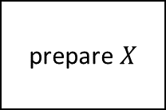
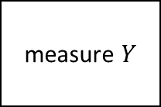
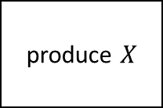
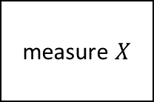
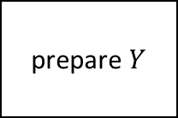
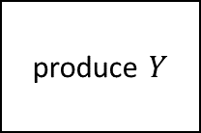
1) Process composition: we like to divide processes (including experiments) into a series of steps stitched together
produce $X$
prepare $X$
interaction
measure $X$
produce $Y$
prepare $Y$
measure $Y$
At the junction point, the evolution count from both processes for the same state has to match, physical theory must take that into account
States are junction points

Slide 55

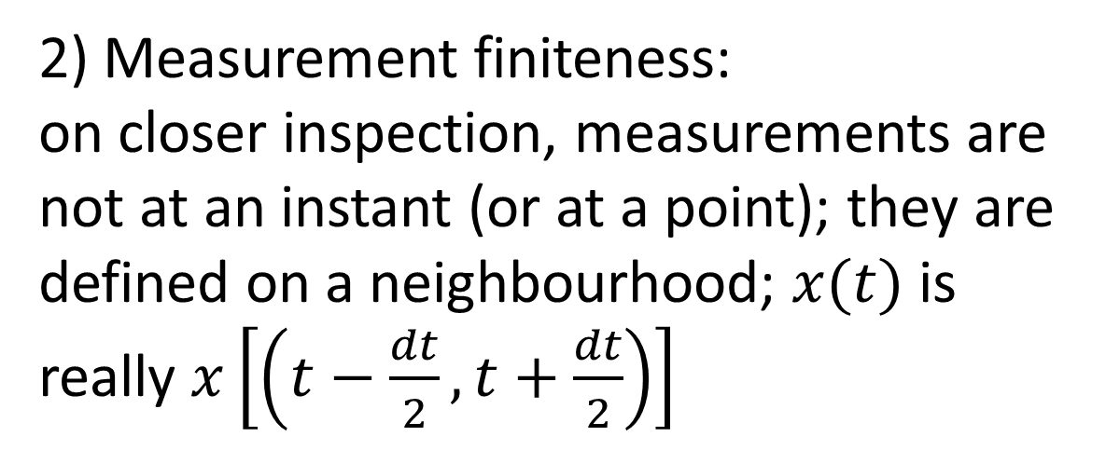
2) Measurement finiteness: on closer inspection, measurements are not at an instant (or at a point); they are defined on a neighbourhood; $x(t)$ is really $x\left[\left(t−\frac{dt}{2},t+\frac{dt}{2}\right)\right]$
$$x$$
Dynamics at a faster/smaller scale than the measurement resolution
We can talk about a single state in the interval if all state variables are “stable” enough
States are equilibria of faster/smaller scale processes

Slide 56
3) Independent description: a state should describe the system and only the system (with minimal correlations)
$$𝒮=𝒮_{1}×𝒮_{2}$$
$$𝒮_{1}$$
A state is properly defined on an independent system, when all correlations have been removed
$$𝒮_{2}$$
States are independent descriptions

Slide 57
States are junction points
States are equilibria of faster/smaller scale processes
States are independent descriptions
The very notion of state seems to be linked to equilibrium and state entropy (i.e. a unique, maximized evolution count)
These requirements are things we, maybe implicitly, look for when defining systems and states (epistemic desiderata); if they are not satisfied we change the system/state definition until they are; we look for sets of variables that “go together” in that way
How is unique maximized evolution count achieved?

Slide 58
Note: the notion of equilibrium as “nothing is changing” does not really work and needs to be amended
Take a volume of gas at equilibrium
It should be at equilibrium for every observer, yet only in the rest frame nothing is changing
Moreover, in presence of gravity, gas at equilibrium must follow geodesics
Relativistically, “nothing is changing” makes no sense
So, let’s try and find a way to put all these insights together in a consistent picture

Slide 59
To define a system we must define a boundary and what happens at the boundary
We need to say what is part of the system and what is not part of the system.
The interaction of the system at the boundary must be such that the system remains well defined. E.g. We can talk about a ball because we are on the surface of the earth at 20 Celsius. If we were on the surface of the sun, we would not be able to define a ball.
These processes must happen at a faster timescale than the one we are studying, so that we can consider the system well defined at all times.

Slide 60
To define a system we must define a boundary and what happens at the boundary
To characterize a system, we must have (at least in principle) processes at our disposal that render it independent
The state of the system should not tell us how the system came to be in that state, what process must act on it afterwards; it shouldn’t tell us anything more about its subsystems and their internal dynamics, other systems or the environment than what the system strictly tells us. If the system is independent, its description gives us the least amount of information, it selects the biggest number of possible evolutions.
Historically, we have been grouping quantities (e.g. position/momentum, pressure/volume, electric/magnetic fields) in such a way to achieve that goal (e.g. form independent degrees of freedom). We don’t define states by randomly putting quantities together.

Slide 61
To define a system we must define a boundary and what happens at the boundary
To characterize a system, we must have (at least in principle) processes at our disposal that render it independent
If the system is well defined and independent, this “decoupling process” does nothing: states are equilibria of this process
Mathematically, states are symmetries (i.e. invariants, equilibria) of a group (i.e. a set of transformations, a set of processes). Properly defining a system, then, means giving not only a set of states, but a set of processes for which the states are equilibria that maximize the process entropy

Slide 62
States
All states are really “independence equilibria” of some process
At the boundary, the process is such to keep the system well defined
The process minimizes the correlation with the environment, removes all correlations with other systems, subsystems and their dynamics such that the system is allowed an independent description
A measurement at the level of the system tells us nothing about the rest
They can be used as junction points under process composition, as they are defined independently of past and future processes
They are descriptions of the system when process entropy is maximized
They describe the evolution of the system and only of the system
State entropy is well-defined in these and only these conditions
Outside these assumptions, we can still have processes but we are not going to have systems and states
For now, there doesn’t seem to be a reason why would have to have group of descriptions that always form the same systems

Slide 63
Blueprint for a formal framework

Slide 64
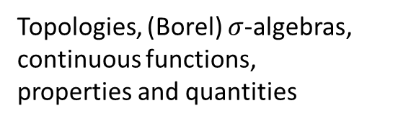
Physical theories
Different assumptions depending on the system and processes at hand
Thermodynamics, classical Hamiltonian mechanics, Newtonian mechanics, quantum mechanics, ….
State spaces
Group descriptions that can be grouped into patterns of independent behavior
Systems, state space, state entropy, state variables, process composition
Processes
Algebra of descriptions that can be parametrized by time
Process entropy, determinism/reversibility,
stochastic processes
Informational granularity
Ability to compare the granularity of the description provided by different statements (count possible cases)
Units, measures, geometry, probability,
differentiability
Logical consistency +
Experimental verification
Algebra of statements generated from a countable set of verifiable statements
Topologies, (Borel) $σ$-algebras, continuous functions, properties and quantities

Slide 66
Extra material

Slide 67
Predictability and Retrodictability

Slide 68
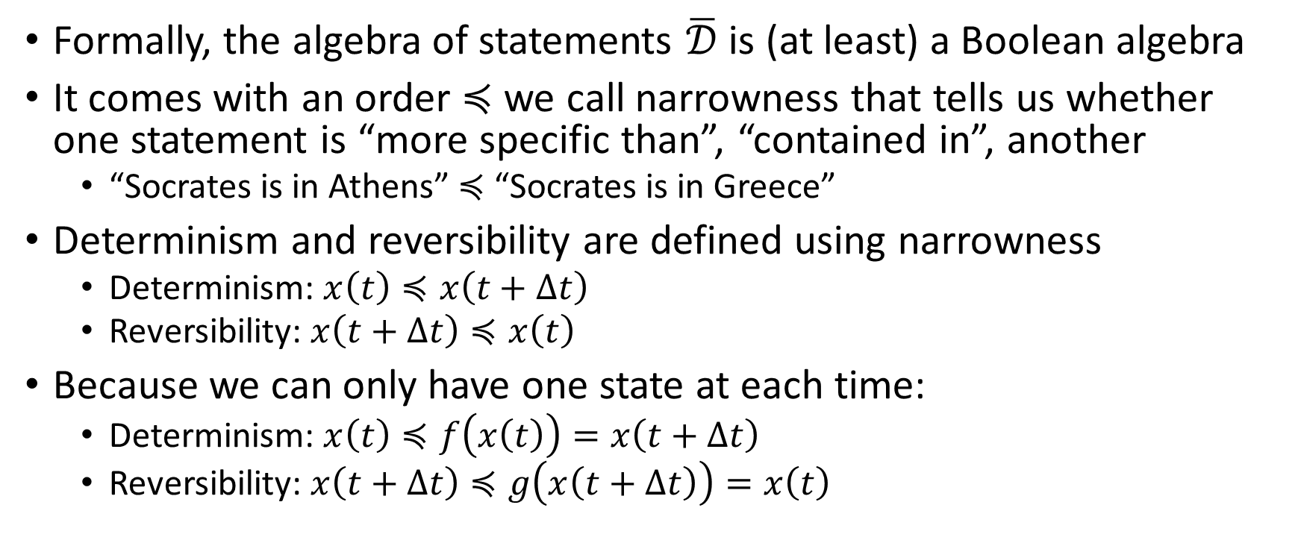
Predictability and Retrodictability
Formally, the algebra of statements $\overline{𝒟}$ is (at least) a Boolean algebra
It comes with an order $≼$ we call narrowness that tells us whether one statement is “more specific than”, “contained in”, another
“Socrates is in Athens” $≼$ “Socrates is in Greece”
Determinism and reversibility are defined using narrowness
Determinism: $x\left(t\right)≼x\left(t+Δt\right)$
Reversibility: $x\left(t+Δt\right)≼x\left(t\right)$
Because we can only have one state at each time:
Determinism: $x\left(t\right)≼f\left(x\left(t\right)\right)=x\left(t+Δt\right)$
Reversibility: $x\left(t+Δt\right)≼g\left(x\left(t+Δt\right)\right)=x\left(t\right)$
Predictable
Retrodictable

Slide 69
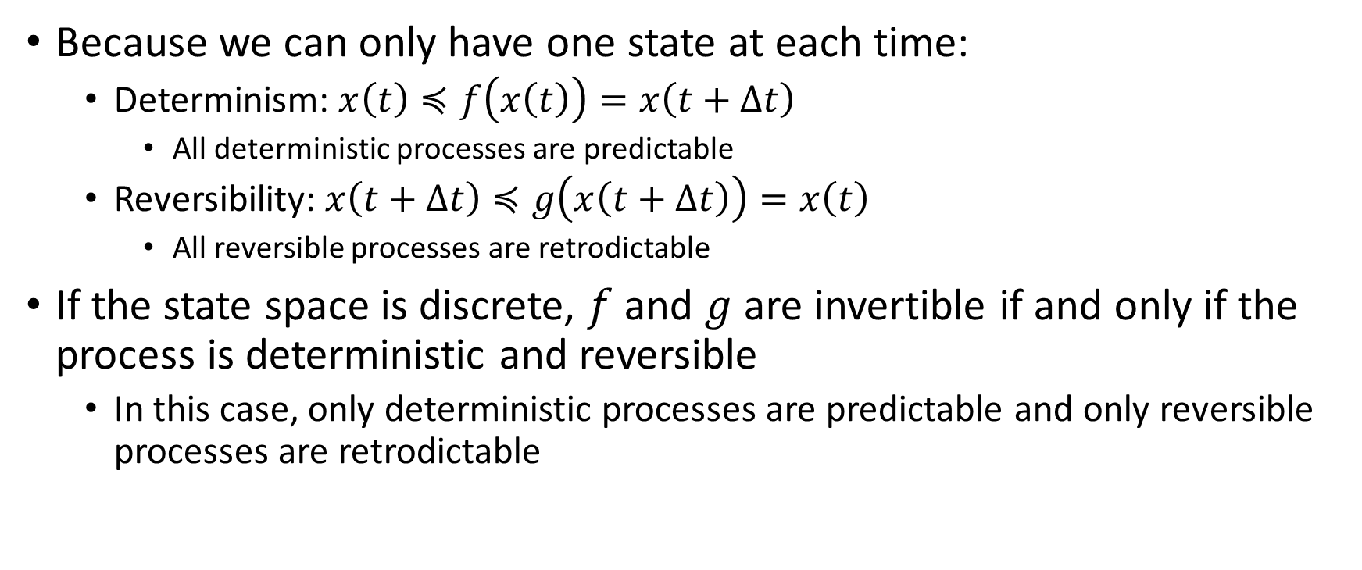
Predictability and Retrodictability
Because we can only have one state at each time:
Determinism: $x\left(t\right)≼f\left(x\left(t\right)\right)=x\left(t+Δt\right)$
All deterministic processes are predictable
Reversibility: $x\left(t+Δt\right)≼g\left(x\left(t+Δt\right)\right)=x\left(t\right)$
All reversible processes are retrodictable
If the state space is discrete, $f$ and $g$ are invertible if and only if the process is deterministic and reversible
In this case, only deterministic processes are predictable and only reversible processes are retrodictable

Slide 70
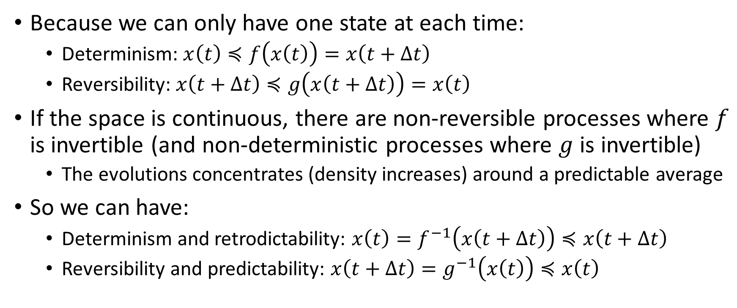
Predictability and Retrodictability
Because we can only have one state at each time:
Determinism: $x\left(t\right)≼f\left(x\left(t\right)\right)=x\left(t+Δt\right)$
Reversibility: $x\left(t+Δt\right)≼g\left(x\left(t+Δt\right)\right)=x\left(t\right)$
If the space is continuous, there are non-reversible processes where $f$ is invertible (and non-deterministic processes where $g$ is invertible)
The evolutions concentrates (density increases) around a predictable average
So we can have:
Determinism and retrodictability: $x\left(t\right)=f^{−1}\left(x\left(t+Δt\right)\right)≼x\left(t+Δt\right)$
Reversibility and predictability: $x\left(t+Δt\right)=g^{−1}\left(x\left(t\right)\right)≼x\left(t\right)$

Slide 71
Entropy on the continuum
Counting states vs counting evolutions

Slide 72


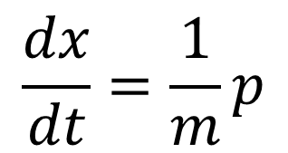
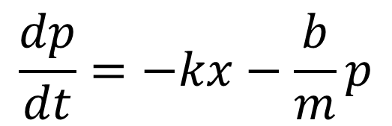
Entropy on the continuum: Harmonic oscillator
$$x$$
$$\frac{dx}{dt}=\frac{1}{m}p$$
$$\frac{dp}{dt}=−kx−\frac{b}{m}p$$
Areas shrink: entropy decreases?
$$p$$

Slide 73


Entropy on the continuum: Harmonic oscillator
$$p$$
Evolutions become more concentrated: process entropy increases!
$$x$$
Can’t really define state entropy: system is not at equilibrium

Slide 74
Thermodynamics: open details

Slide 75
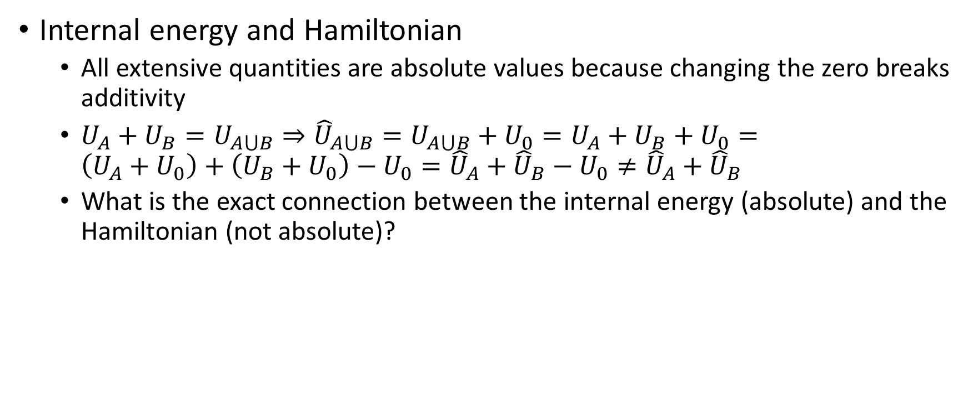
Few open details
Internal energy and Hamiltonian
All extensive quantities are absolute values because changing the zero breaks additivity
$U_{A}+U_{B}=U_{A⋃B}⇒{\hat{U}}_{A⋃B}=U_{A⋃B}+U_{0}=U_{A}+U_{B}+U_{0}=$ $\left(U_{A}+U_{0}\right)+\left(U_{B}+U_{0}\right)−U_{0}={\hat{U}}_{A}+{\hat{U}}_{B}−U_{0}≠{\hat{U}}_{A}+{\hat{U}}_{B}$
What is the exact connection between the internal energy (absolute) and the Hamiltonian (not absolute)?

Slide 76
Few open details
Zero for extensive quantities
We saw extensive quantities must have a fixed zero
Note that the extensive quantities for the “null/empty” system must be zero (i.e. composition must yield no change); so it must be for the “null” state (i.e. the system is missing)
Are there actual states where some or all extensive quantities are zero? Or is zero reserved only for the “null” state? E.g. if volume or number of particles is zero, there is no system. Are there counter-examples?

Slide 77
Few open details
Non-negativity for extensive quantities
Are all extensive quantities always non-negative? It is the case for volume and number of particles. Are there counter-examples?
If there are no counter-examples for non-negativity or zero value, is there are an argument that can be made in line of principle?

Slide 78
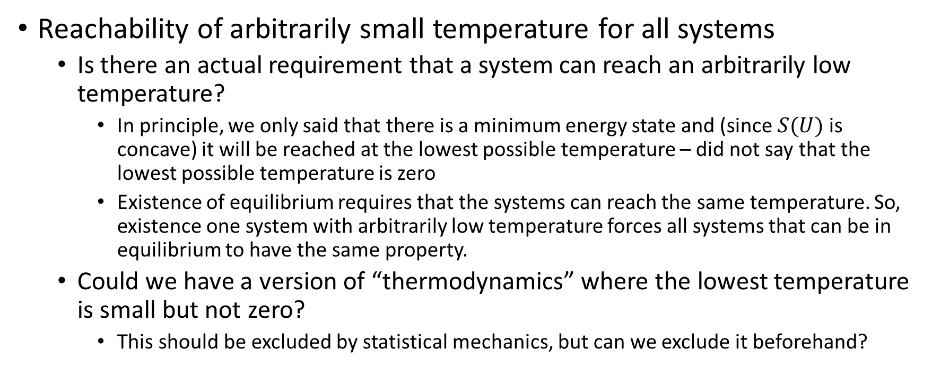
Few open details
Reachability of arbitrarily small temperature for all systems
Is there an actual requirement that a system can reach an arbitrarily low temperature?
In principle, we only said that there is a minimum energy state and (since $S(U)$ is concave) it will be reached at the lowest possible temperature – did not say that the lowest possible temperature is zero
Existence of equilibrium requires that the systems can reach the same temperature. So, existence one system with arbitrarily low temperature forces all systems that can be in equilibrium to have the same property.
Could we have a version of “thermodynamics” where the lowest temperature is small but not zero?
This should be excluded by statistical mechanics, but can we exclude it beforehand?

Slide 79
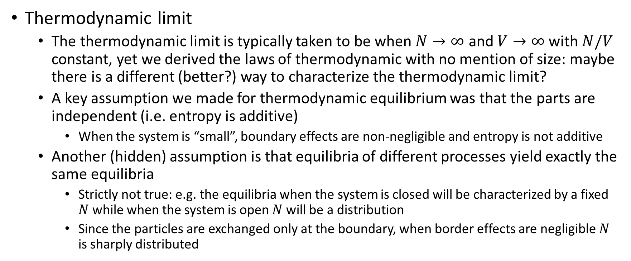
Few open details
Thermodynamic limit
The thermodynamic limit is typically taken to be when $N→∞$ and $V→∞$ with $N/V$ constant, yet we derived the laws of thermodynamic with no mention of size: maybe there is a different (better?) way to characterize the thermodynamic limit?
A key assumption we made for thermodynamic equilibrium was that the parts are independent (i.e. entropy is additive)
When the system is “small”, boundary effects are non-negligible and entropy is not additive
Another (hidden) assumption is that equilibria of different processes yield exactly the same equilibria
Strictly not true: e.g. the equilibria when the system is closed will be characterized by a fixed $N$ while when the system is open $N$ will be a distribution
Since the particles are exchanged only at the boundary, when border effects are negligible $N$ is sharply distributed

Slide 80
“Fundamentality of thermodynamics”
The existence of “thermodynamic-like” process that leave the parts independent and at equilibrium is a requirement for defining systems and states
What must fail is that the recursiveness (that all parts are independent or participate in the equilibrium) is something that must fail at the finest scale

