Slide 1



Quantum probability and quantum information theory require a novel approach to measure theory
Gabriele Carcassi
University of Michigan

Slide 2
Lead a project called Assumptions of Physics
https://assumptionsofphysics.org/
Find a set of minimal physical assumptions from which the laws can be rederived
Reverse Physics: Start with the equations, reverse engineer physical assumptions/principles
What are the basic concepts/idealizations behind the different physical theories?
Physical Mathematics: Start from scratch and rederive everything from physical requirements
Which mathematical structures (or which parts) are physical?

Slide 3
Goal and Outline
What exactly is the difference between classical and quantum mechanics?
Can we find a key feature that is physically meaningful, is significant in an obvious way, and is sufficient to imply other features?
Outline
Logical structure is the same between classical and quantum mechanics
Entropic/geometric/probabilistic structures form a joint structure, different between classical and quantum mechanics
The difference is in how states are counted
Quantum states do not describe different cases at-all-else-being equal
Need new type of measure theory to bring that to light

Slide 4
Is the difference between classical and quantum mechanics due to different rules of logic?
NO: they implement the same logical structure.
On the Common Logical Structure of Classical and Quantum Mechanics
Andrea Oldofredi, Gabriele Carcassi, Christine A. Aidala
Erkenntnis (2022)
In-depth comparison
Assumptions of Physics (Open Access Book)
Gabriele Carcassi, Christine A. Aidala
https://doi.org/10.3998/mpub.12204707
Develop a common logic framework for all scientific theories

Slide 5
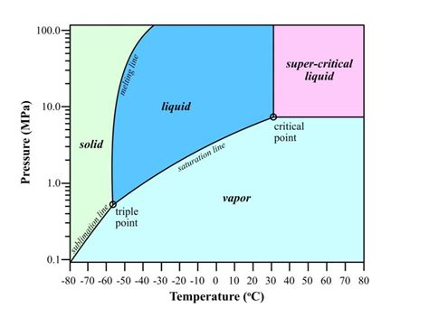


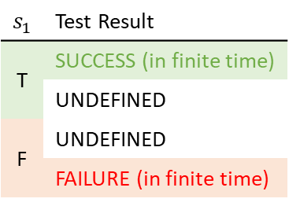







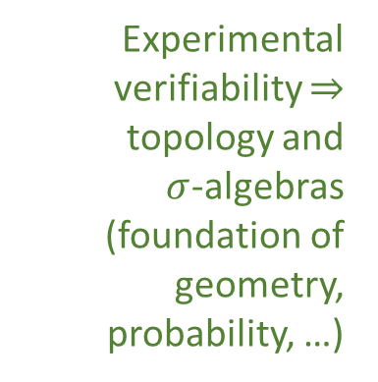

Topology and the logic of experimental verifiability
Statements formally associated with an experimental test
Theoretical statements
$int(A)$ corresponds to the verifiable part of a statement
Experimental verifiability $⇒$ topology and $σ$-algebras (foundation of geometry, probability, …)
$$s_{1}$$ | Test Result
T | SUCCESS (in finite time)
 | UNDEFINED
F | UNDEFINED
 | FAILURE (in finite time)
Verifiable statements
Possibilities
$∂A$ corresponds to the undecidable part of a statement
$ext(A)$ corresponds to the falsifiable part of a statement
Open sets
Points
Open set $(\text{5}\text{09.5, 510.5})$ $⟺$ Verifiable “the mass of the electron is 510 $±$ 0.5 KeV”
Borel sets
Closed set $[510]$ $⟺$ Falsifiable “the mass of the electron is exactly 510 KeV”
Borel set $ℚ$ ($int\left(ℚ\right)∪ext\left(ℚ\right)=∅$) $⟺$Theoretical “the mass of the electron in KeV is a rational number” (undecidable)
Inference relationship $𝓇:𝒟_{Y}→𝒟_{X}$ such that $𝓇\left(s\right)≡s$
$$𝒟_{X}$$
$$𝒟_{Y}$$
Topologically continuous consistent with analytic discontinuity on isolated points
Inference relationship $$⟺$$ Causal relationship
Perfect map between math and physics
Relationships must be topologically continuous
$$X$$
$$Y$$
Causal relationship $f:X→Y$ such that $x≼f\left(x\right)$
Phase transition $⟺$ Topologically isolated regions

Slide 6
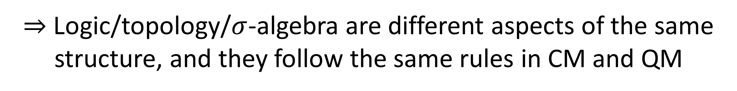
$⇒$ Logic/topology/$σ$-algebra are different aspects of the same structure, and they follow the same rules in CM and QM
Where is the difference?
Rules of probability?
Rules of information theory?
Rules of geometry?

Slide 7
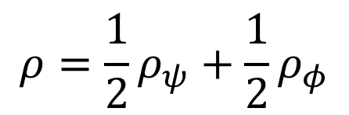




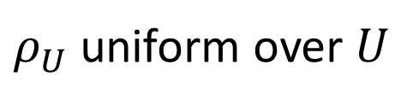
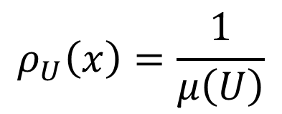
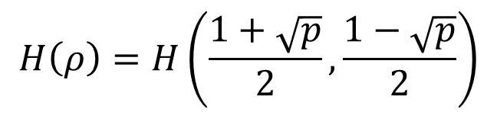
$$ρ_{U}\left(x\right)=\frac{1}{μ\left(U\right)}$$
$$μ\left(U\right)$$
Classical probability
Symplectic manifold
Hamiltonian mechanics is conservation of information entropy
Gabriele Carcassi, Christine A. Aidala
https://doi.org/10.1016/j.shpsb.2020.04.004
Information theory
$$H\left(ρ_{U}\right)=\log{μ\left(U\right)}$$
$ρ_{U}$ uniform over $U$
No other structure! Difference must be here.
Geometry/probability/information theory are different aspects of the same structure
$$\left\langle ψ | φ\right\rangle$$
Quantum probability
$$p\left(ψ | φ\right)={\left|\left\langle ψ | φ\right\rangle \right|}^{2}$$
Projective Hilbert space
$$ρ=\frac{1}{2}ρ_{ψ}+\frac{1}{2}ρ_{φ}$$
$$H\left(ρ\right)=H\left(\frac{1+\sqrt{p}}{2},\frac{1−\sqrt{p}}{2}\right)$$
Quantum information theory

Slide 8
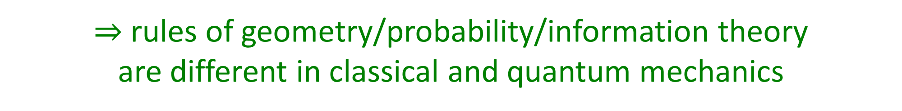
Easiest way to show the difference?
Quantum information theory: entropy cannot be negative but conditional entropy can
Classical information theory (discrete): neither entropy nor conditional entropy can be negative
Classical information theory (continuous): both entropy and conditional entropy can be negative
Quantum mechanics “mixes” discrete and continuous features
Neither classical/quantum can fully contain (and only contain) the other
$⇒$ rules of geometry/probability/information theory are different in classical and quantum mechanics

Slide 9
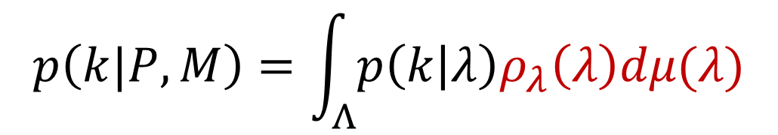

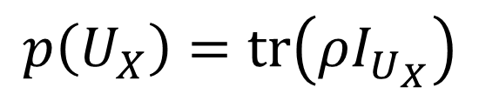
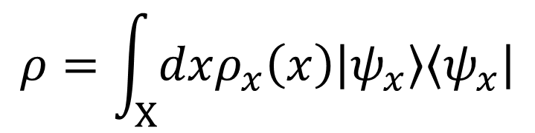
But how EXACTLY are they different?
Note that classical geometry/probability/information theory are based on the notion of measure $−$ no measure underneath quantum mechanics
Maybe measure theory is the problem?
OK!
No use of measure theory
$$p\left(k | P,M\right)=tr\left(ρE_{k}\right)$$
Uses measure theory
KO!
$$p\left(k|P,M\right)=\int_{Λ}{p\left(k | λ\right)ρ_{λ}\left(λ\right)dμ(λ)}$$
“Classical” hidden variables
WHEN is measure theory a problem?
$$ρ=\int_{X}{dxρ_{x}\left(x\right)\left|ψ_{x}\right\rangle \left\langle ψ_{x}\right|}$$
However, we do use measures on preparations and on measurements
$$p\left(U_{X}\right)=tr\left(ρI_{U_{X}}\right)$$

Slide 10

What IS measure theory anyway?
Measure theory defines “how big a set is”, “how many elements there are in a set”, “how we count”
$$μ\left(U\right)→[0,+∞]$$
Countable additivity is a fundamental axiom of measure theory
$μ\left(∪_{i}U_{i}\right)=\sum_{i}{μ\left(U_{i}\right)}$
Disjoint sets
A density is a ratio between two measures
$$ρ=\frac{dμ}{dx}$$
Units of $μ$ over units of $x$
Radon–Nikodym derivative

Slide 11
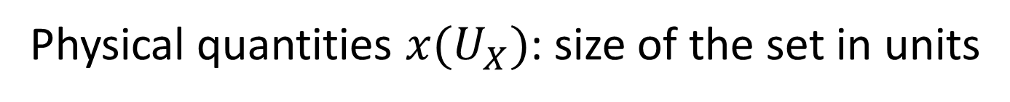


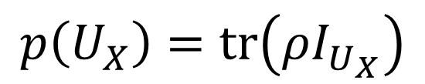
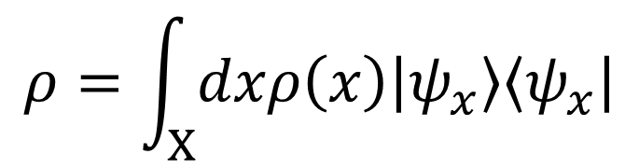
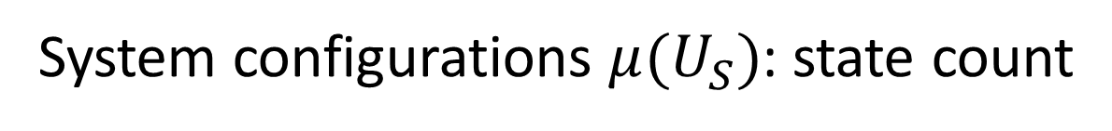
What do we use measures for?
Probability $p\left(U_{Σ}\right)$: how likely “$x∈U_{Σ}$” is true
Used both in CM and QM
Physical quantities $x(U_{X})$: size of the set in units
therefore
System configurations $μ(U_{S})$: state count
$$ρ=\int_{X}{dxρ\left(x\right)\left|ψ_{x}\right\rangle \left\langle ψ_{x}\right|}$$
Present in CM, absent in QM
$$p\left(k|P,M\right)=\int_{Λ}{p\left(k | λ\right)ρ_{λ}\left(λ\right)dμ(λ)}$$
$$p\left(U_{X}\right)=tr\left(ρI_{U_{X}}\right)$$
Invalid in QM
Valid in QM
Quantum mechanics does not provide a measure to count states!

Slide 12
How can we count states in QM?
In classical mechanics, count of states and entropy are linked by
$$H\left(ρ_{U}\right)=\log{μ\left(U\right)}$$
Suppose we keep this relationship in quantum mechanics. What type of “measure” do we get?

Slide 13



















Single point
Finite continuous range
$$μ(U)$$
$$\log{μ(U)}$$
$$μ(U)$$
$$\log{μ(U)}$$
Counting measure
$$μ\left(U\right)=\#U$$
$1$
$0$
$+∞$
$+∞$
Number of points
Lebesgue measure
$$μ\left(\left[a,b\right]\right)=b−a$$
$0$
$−∞$
$<∞$
$<∞$
Interval size
“Quantized” measure
$$μ\left(U\right)=2^{H(ρ_{U})}$$
$1$
$0$
$<∞$
$<∞$
Entropy over uniform distribution

Slide 14
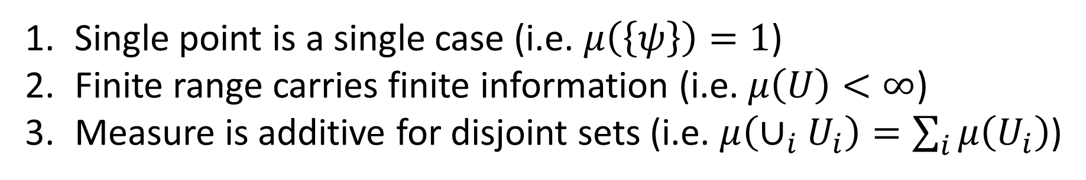
Single point is a single case (i.e. $μ\left(\left\{ψ\right\}\right)=1$)
Finite range carries finite information (i.e. $μ\left(U\right)<∞$)
Measure is additive for disjoint sets (i.e. $μ\left(∪_{i}U_{i}\right)=\sum_{i}{μ\left(U_{i}\right)}$)
Pick two!
Discrete classical mechanics (counting measure) picks 1 and 3 Continuum classical mechanics (Lebesgue measure) picks 2 and 3
Quantum mechanics picks 1 and 2
What is quantized? The count of states!

Slide 15
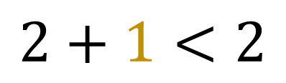
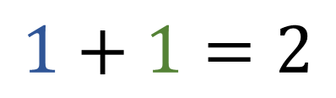
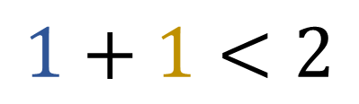

In quantum mechanics
Additive on orthogonal states
Measure not additive
Measure not monotonic
$$1+1$$
$$1+1=2$$
$$1+1<2$$
$$2+1<2$$
Quantum mechanics requires a new approach to measure theory (which is the basis of probability theory, information theory, theory of integration, differential geometry, …)
ONLY
This is the source of “quantum weirdness”
What is the physical meaning of this?

Slide 16
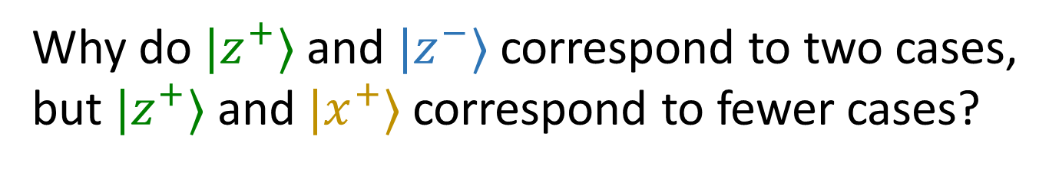
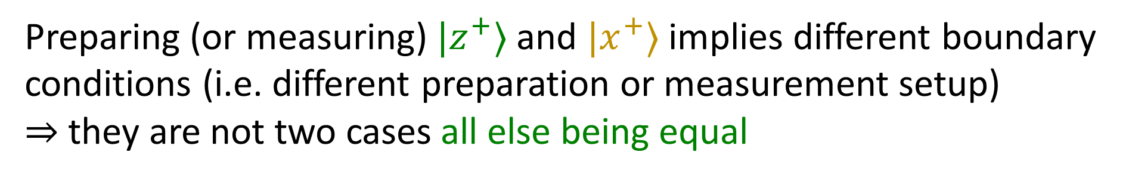
Why do $|z^{+}⟩$ and $|z^{−}⟩$ correspond to two cases, but $|z^{+}⟩$ and $|x^{+}⟩$ correspond to fewer cases?
The state of a system is never completely independent from the environment
There is a cat inside a box $⇒$ the box is not on the surface of the sun
Preparing (or measuring) $|z^{+}⟩$ and $|x^{+}⟩$ implies different boundary conditions (i.e. different preparation or measurement setup)
$⇒$ they are not two cases all else being equal
Contextuality $⟺$ non-additive measure

Slide 17
Why should we be interested in these “quantized measures”? They are equivalent to what we already have in QM!
Discrete measure and Lebesgue measure are (in a sense) unique
Are quantized measures (in some sense) unique as well?
In a field theory, one (independent) DOF at each point (i.e. local commutation relationship)
$⇒$ Measure of volume “counts” independent DOFs in a region
Lebesgue measure gives us regions with measure less than one $⇒$ less than one DOF
To quantize space-time, we may need a quantized measure

Slide 18
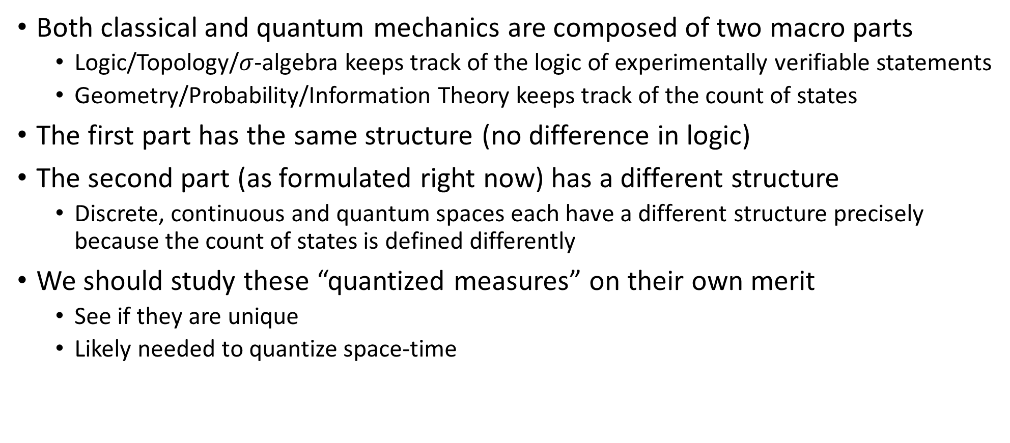
Conclusion
Both classical and quantum mechanics are composed of two macro parts
Logic/Topology/$σ$-algebra keeps track of the logic of experimentally verifiable statements
Geometry/Probability/Information Theory keeps track of the count of states
The first part has the same structure (no difference in logic)
The second part (as formulated right now) has a different structure
Discrete, continuous and quantum spaces each have a different structure precisely because the count of states is defined differently
We should study these “quantized measures” on their own merit
See if they are unique
Likely needed to quantize space-time

