Slide 1


Uncovering the Assumptions of Physics
Gabriele Carcassi
University of Michigan

Slide 2


Understanding fundamental structures
Hamiltonian mechanics
Phase space (symplectic manifold)
Hamiltonian evolution
Differentiable manifold
Symplectic structure
Manifold
Differentiable structure
We cannot truly understand this if we don’t first understand this
Topological space
Locally $ℝ^{n}$
Probability space
I.e. Before saying “there is a 50% chance to get tails” we need to define what tails, chance and 50% mean
Even probability spaces
are not fundamental structures
Set of points
$σ$-algebra
Measure
The desire to understand when and why the higher level structures are needed in science pushed us to backtrack to the most basic ones

Slide 3
Assumptions of Physics
This is the reason we started a project called Assumptions of Physics (see http://assumptionsofphysics.org/)
The aim of the project is to find a handful of physical principles and assumptions from which the basic laws of physics can be derived with the following goals in mind:
Clarify our assumptions
Put physics back at the center of the discussion
Derive mathematical structures from physical ideas
Give science sturdier mathematical grounds
Each mathematical object has a clear physical meaning and no object is unphysical
Foster connections between different fields of knowledge
Provide a solid basis for new theories

Slide 4



General mathematical theory of experimental science
Experimental verifiability leads to topological spaces, sigma-algebras, …
State-level assumptions
Infinitesimal reducibility
leads to classical phase space
Irreducibility
leads to quantum state space
Process-level assumptions
Hamilton’s equations $\frac{d}{dt}\left(q, p\right)=\left(\frac{∂H}{∂p},−\frac{∂H}{∂q}\right)$
Deterministic and reversible evolution
leads to isomorphism on state space
Schroedinger equation $$ıℏ\frac{∂}{∂t}ψ=Hψ$$
Non-reversible evolution
Thermodynamics
Euler-Lagrange equations $δ∫L\left(q, \dot{q},t\right)=0$
…
Kinematic equivalence
leads to massive particles

Slide 5
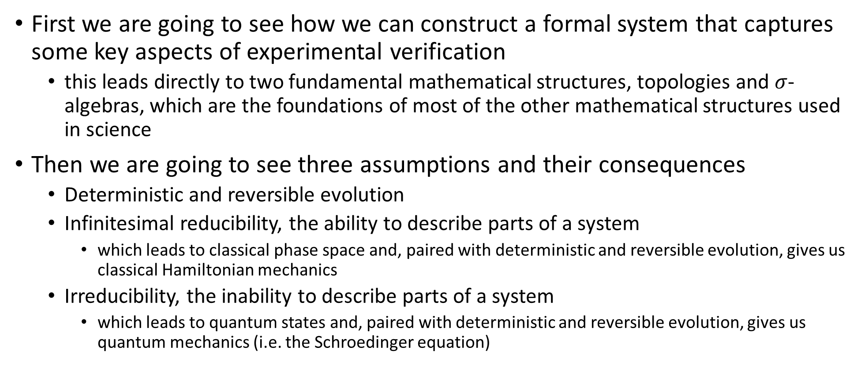
Summary
First we are going to see how we can construct a formal system that captures some key aspects of experimental verification
this leads directly to two fundamental mathematical structures, topologies and $σ$-algebras, which are the foundations of most of the other mathematical structures used in science
Then we are going to see three assumptions and their consequences
Deterministic and reversible evolution
Infinitesimal reducibility, the ability to describe parts of a system
which leads to classical phase space and, paired with deterministic and reversible evolution, gives us classical Hamiltonian mechanics
Irreducibility, the inability to describe parts of a system
which leads to quantum states and, paired with deterministic and reversible evolution, gives us quantum mechanics (i.e. the Schroedinger equation)

Slide 6
Experimental verifiability

Slide 7
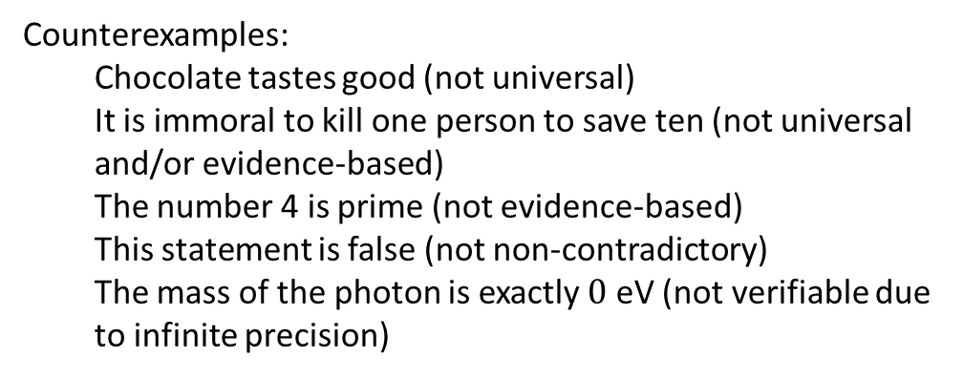
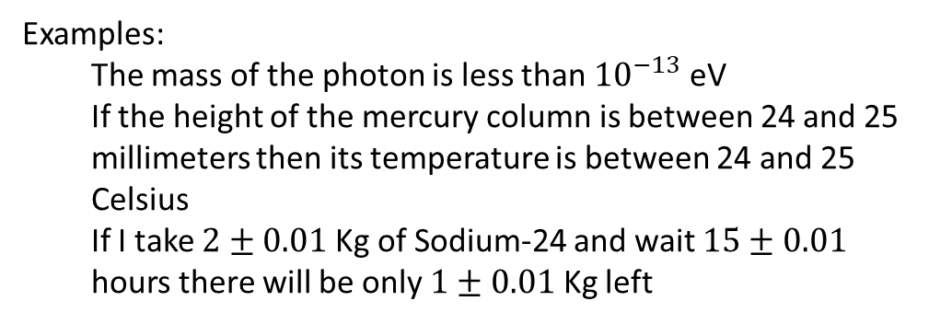

Verifiable statements
The basic objects of our frameork will be verifiable statements: objective assertions that can be shown to be true experimentally in a finite time
Examples:
The mass of the photon is less than ${10}^{−13}$ eV
If the height of the mercury column is between 24 and 25 millimeters then its temperature is between 24 and 25 Celsius
If I take $2±0.01$ Kg of Sodium-24 and wait $15±0.01$ hours there will be only $1±0.01$ Kg left
Counterexamples:
Chocolate tastes good (not universal)
It is immoral to kill one person to save ten (not universal and/or evidence-based)
The number 4 is prime (not evidence-based)
This statement is false (not non-contradictory)
The mass of the photon is exactly $0$ eV (not verifiable due to infinite precision)
We have to keep in mind that the meaning of the statements, their relationships and what truth values are allowed depends on context (e.g. premise, theory, etc…)
The mass of the electron is 510 $±$ 0.5 KeV
When measuring the mass is a verifiable hypothesis
Assumed to be true for particle identification

Slide 8
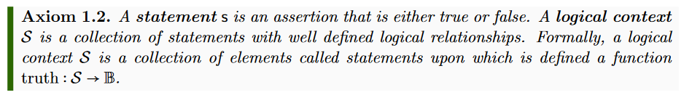
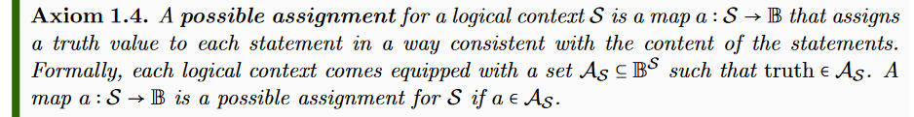
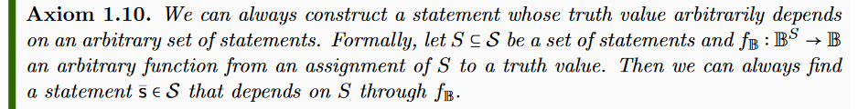


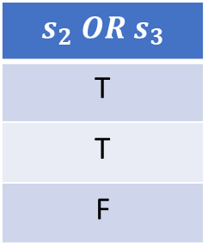
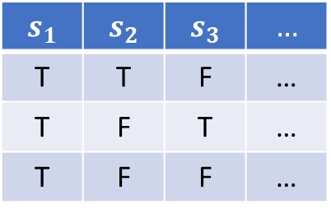

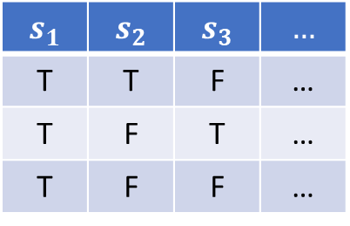

Basic axioms for statements
$$𝒮$$
$$s_{1}$$ | $$s_{2}$$ | $$s_{3}$$ | $$…$$
T | T | F | …
T | F | T | …
T | F | F | …
$$a$$
$$𝒜_{𝒮}$$
$$s_{1}$$ | $$s_{2}$$ | $$s_{3}$$ | $$…$$
T | T | F | …
T | F | T | …
T | F | F | …
$$s_{2} OR s_{3}$$
T
T
F
$$f_{𝔹}$$

Slide 9
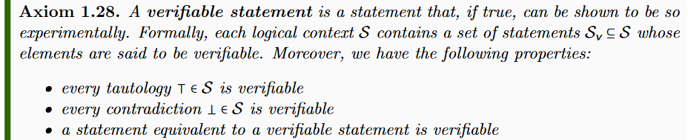
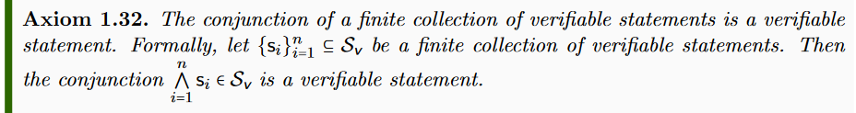
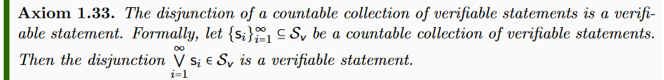


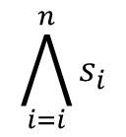

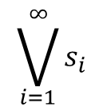







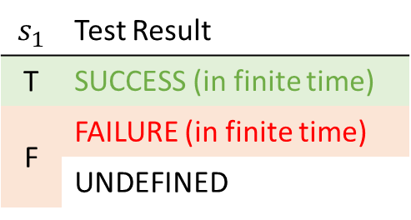
Basic axioms for verifiable statements
$$𝒮$$
$$s_{1}$$ | Test Result
T | SUCCESS (in finite time)
F | FAILURE (in finite time)
 | UNDEFINED
$$𝒮_{\text{v}}$$
$$s_{1}$$
experimental test
$$\bigwedge_{i=i}^{n}{s_{i}}$$
$$s_{1}$$
$$s_{2}$$
$$s_{3}$$
All tests must succeed
$$\bigvee_{i=1}^{∞}{s_{i}}$$
$$s_{1}$$
$$s_{2}$$
$$s_{3}$$
$$…$$
One successful test is sufficient

Slide 10
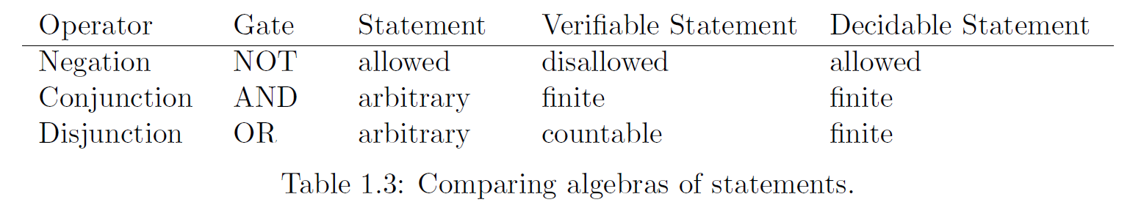




Properties of the logic system
Different algebras for the different types of statements
$$𝒮_{d}$$
$$𝒮_{v}$$
$$𝒮$$
(Different) notions of equivalences
Are the same statement
“This animal is a bird” = “Questo animale e’ un uccello”
“This animal is a bird” ≡ “This animal has feathers”
truth(“This animal is a bird”) = truth(“That animal is a mammal”)
Always have the same truth
Happen to have the same truth

Slide 11
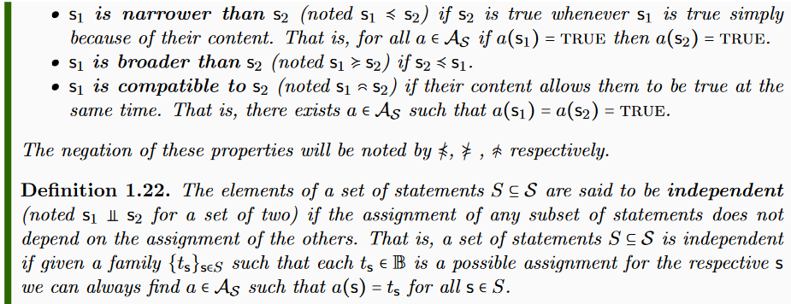
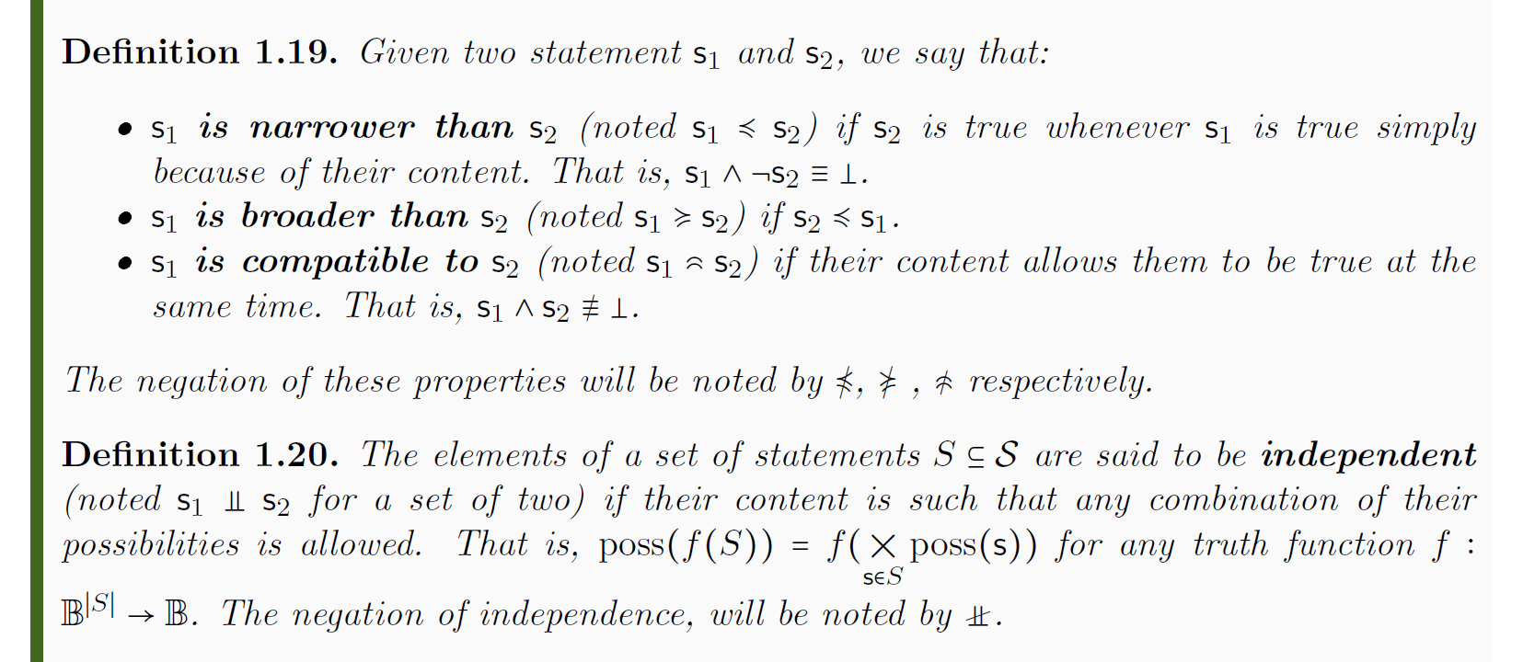
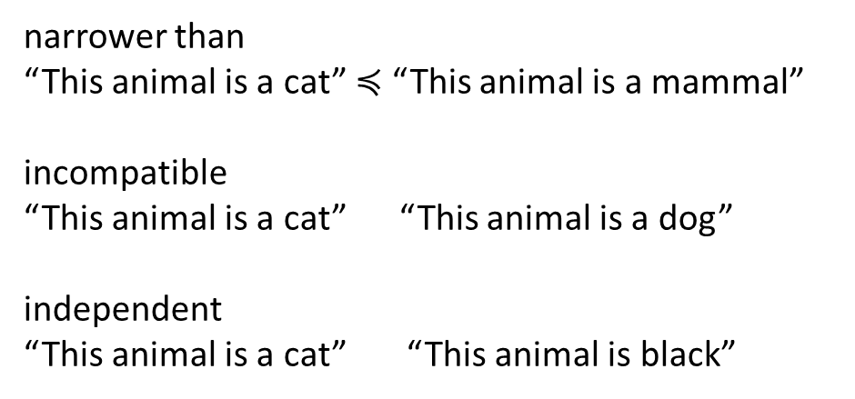
Properties of the logic system
Other semantic relationships
narrower than
“This animal is a cat” $≼$ “This animal is a mammal”
incompatible
“This animal is a cat” “This animal is a dog”
independent
“This animal is a cat” “This animal is black”
Minimal set of axioms (easy to justify)
Allows to capture experimental verification
Allows to describe semantic relationships of the type we have in science
Gives us a basic structure all other structures have to “play nice” with

Slide 12

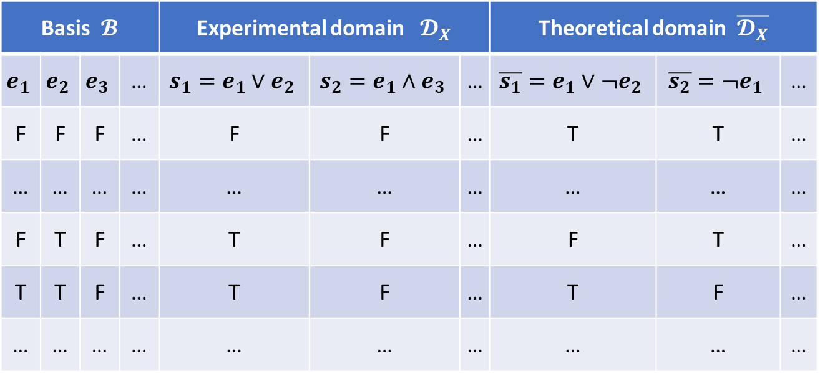

Experimental domains (scientific models)
From them generate all verifiable statements (close under finite AND countable OR)
Generate all meaningful predictions
(close under negation as well)
Start with a countable set of verifiable statements
Basis $𝓑$ |  |  |  | Experimental domain $𝓓_{X}$ |  |  | Theoretical domain $\overline{𝓓_{X}}$
$$e_{1}$$ | $$e_{2}$$ | $$e_{3}$$ | … | $$s_{1}=e_{1}∨e_{2}$$ | $$s_{2}=e_{1}∧e_{3}$$ | … | $$\overline{s_{1}}=e_{1}∨¬e_{2}$$ | $$\overline{s_{2}}=¬e_{1}$$ | …
F | F | F | … | F | F | … | T | T | …
… | … | … | … | … | … | … | … | … | …
F | T | F | … | T | F | … | F | T | …
T | T | F | … | T | F | … | T | F | …
… | … | … | … | … | … | … | … | … | …
Fill in all possible assignments
Possibilities $X$
$$x=¬e_{1}∧e_{2}∧¬e_{3}∧…$$
For each possible assignment we have a theoretical statement that is true only in that case. We call these statements possibilities of the domain.

Slide 13

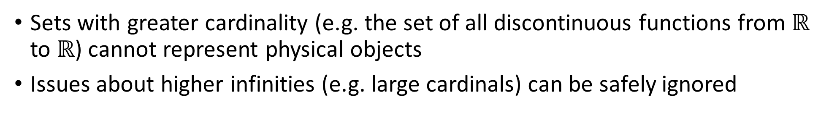


Maximum cardinality of distinguishable cases
Set of distinguishable cases
Test results for countable basis
Correspond to binary expansion
$$ℝ$$
FTFFFTTTFTFTT…
TFFTTFTTFFFTF…
FTFFFTTFTFFTF…
FTTFTFTTFTFFT…
0.0100011101011…
0.1001101100010…
0.0100011010010…
0.0110101101001…
1
Correspondence to binary sequence
0100011101011…
1001101100010…
0100011010010…
0110101101001…
$$X$$
$\left|X\right|≤|ℝ$|
0
Sets with greater cardinality (e.g. the set of all discontinuous functions from $ℝ$ to $ℝ$) cannot represent physical objects
Issues about higher infinities (e.g. large cardinals) can be safely ignored

Slide 14
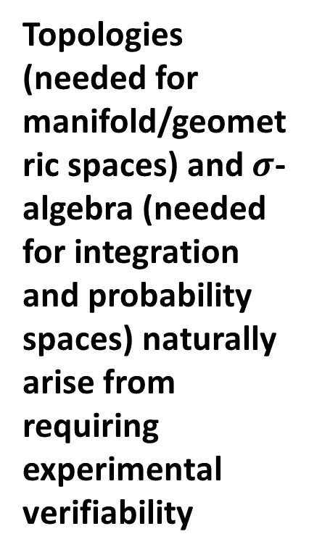
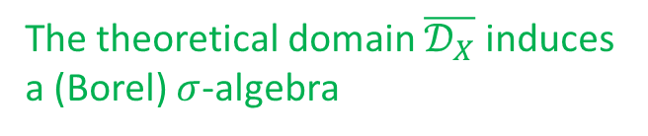
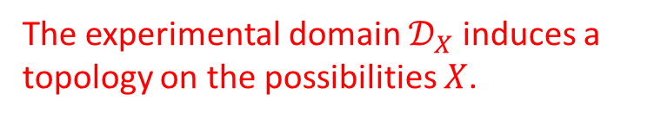
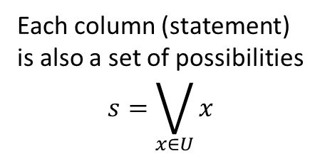
Topologies and $σ$-algebras
Each column (statement) is also a set of possibilities $$s=\bigvee_{x∈U}{x}$$
Finite AND and countable OR become finite intersection and countable union
Negation and countable AND become
complement and countable union
Basis $𝓑$ |  |  |  | Experimental domain $𝓓_{X}$ |  |  | Theoretical domain $\overline{𝓓_{X}}$
$$e_{1}$$ | $$e_{2}$$ | $$e_{3}$$ | … | $$s_{1}=e_{1}∨e_{2}$$ | $$s_{2}=e_{1}∧e_{3}$$ | … | $$\overline{s_{1}}=e_{1}∨¬e_{2}$$ | $$\overline{s_{2}}=¬e_{1}$$ | …
F | F | F | … | F | F | … | T | T | …
… | … | … | … | … | … | … | … | … | …
F | T | F | … | T | F | … | F | T | …
T | T | F | … | T | F | … | T | F | …
… | … | … | … | … | … | … | … | … | …
Topologies (needed for manifold/geometric spaces) and $σ$-algebra (needed for integration and probability spaces) naturally arise from requiring experimental verifiability
Possibilities $X$
The experimental domain $𝒟_{X}$ induces a topology on the possibilities $X$.
The theoretical domain $\overline{𝒟_{X}}$ induces a (Borel) $σ$-algebra

Slide 15
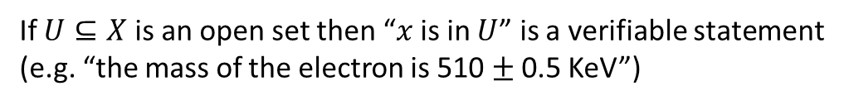
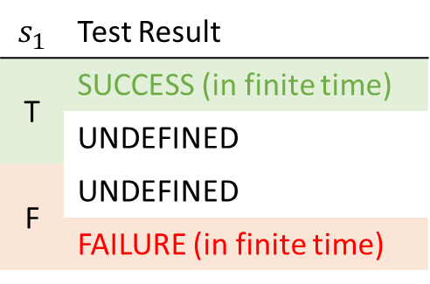
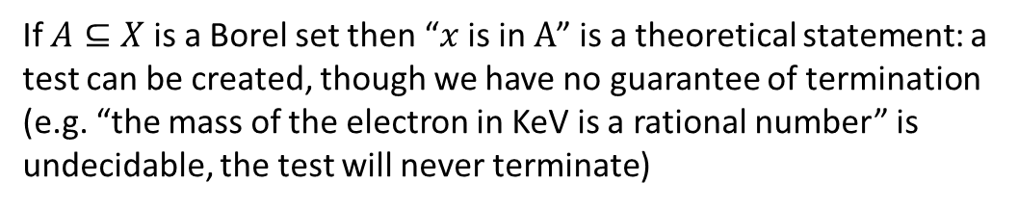
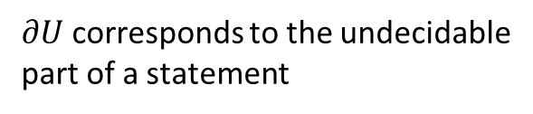
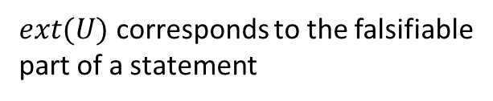
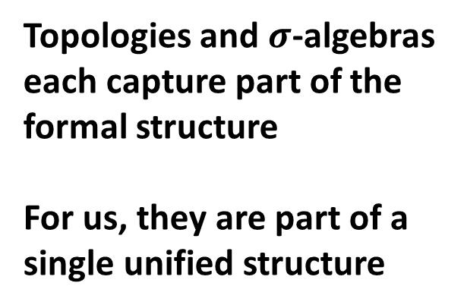
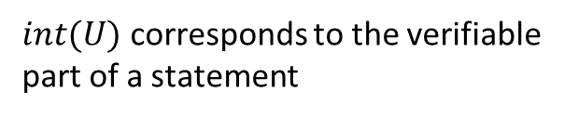
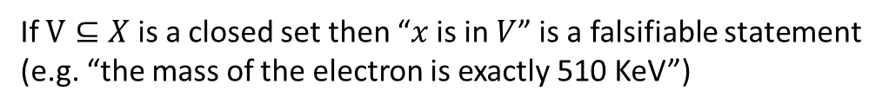
Topologies and $σ$-algebras
$int(U)$ corresponds to the verifiable part of a statement
All definitions and all proofs about these structures have precise physical meaning in this context
$$s_{1}$$ | Test Result
T | SUCCESS (in finite time)
 | UNDEFINED
F | UNDEFINED
 | FAILURE (in finite time)
$∂U$ corresponds to the undecidable part of a statement
$ext(U)$ corresponds to the falsifiable part of a statement
If $U⊆X$ is an open set then “$x$ is in $U$” is a verifiable statement (e.g. “the mass of the electron is 510 $±$ 0.5 KeV”)
Topologies and $σ$-algebras each capture part of the formal structure
For us, they are part of a single unified structure
If $V⊆X$ is a closed set then “$x$ is in $V$” is a falsifiable statement (e.g. “the mass of the electron is exactly 510 KeV”)
If $A⊆X$ is a Borel set then “$x$ is in $A$” is a theoretical statement: a test can be created, though we have no guarantee of termination (e.g. “the mass of the electron in KeV is a rational number” is undecidable, the test will never terminate)

Slide 16




Inference/causal relationships and continuity
An inference relationship is a map $𝓇:𝒟_{Y}→𝒟_{X}$ such that $𝓇\left(s\right)≡s$
$$𝒟_{X}$$
$$𝒟_{Y}$$
$$X$$
$$Y$$
A causal relationship is a map $f:X→Y$ such that $s≼f\left(s\right)$
If two domains admit an inference relationship if and only if they admin a causal relationship.
The causal relationship must be a continuous map in the natural topology.

Slide 17
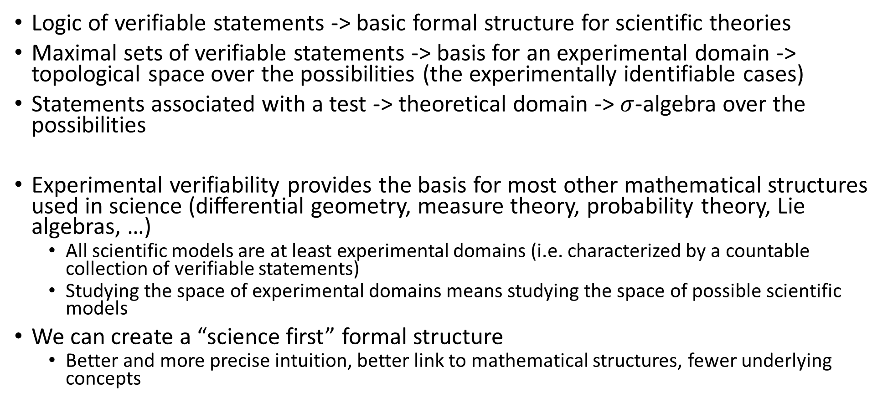
Takeaway
Logic of verifiable statements -> basic formal structure for scientific theories
Maximal sets of verifiable statements -> basis for an experimental domain -> topological space over the possibilities (the experimentally identifiable cases)
Statements associated with a test -> theoretical domain -> $σ$-algebra over the possibilities
Experimental verifiability provides the basis for most other mathematical structures used in science (differential geometry, measure theory, probability theory, Lie algebras, …)
All scientific models are at least experimental domains (i.e. characterized by a countable collection of verifiable statements)
Studying the space of experimental domains means studying the space of possible scientific models
We can create a “science first” formal structure
Better and more precise intuition, better link to mathematical structures, fewer underlying concepts

Slide 18
Determinism and reversibility

Slide 19


Assumption of determinism and reversibility
The system undergoes deterministic and reversible time evolution: given the initial state, we can identify the final state; given the final state, we can reconstruct the initial state
time
$$𝒟_{X_{t}}$$
$$𝒟_{X_{t+Δt}}$$
There is an experimental domain $𝒟_{X_{t}}$ consisting of verifiable statements on the past state
There is an experimental domain $𝒟_{X_{t+Δt}}$ consisting of verifiable statements on the future state
For each past statement $s_{t}∈𝒟_{X_{t}}$there is one future statement $s_{t+Δt}∈𝒟_{X_{t+Δt}}$ such that $s_{t}≡s_{t+Δt}$
Determinism and reversibility means equivalence of experimental domains

Slide 20


Assumption of determinism and reversibility
$$𝒟_{X_{t}}$$
$$𝒟_{X_{t+Δt}}$$
Domain equivalence is more than a bijective map: any extra structure that “plays nice” with the fundamental logical structure will be preserved under equivalence
Equivalence will, at least, map verifiable statements to verifiable statements -> open set to open set -> homeomorphism
If we have a group structure -> group isomorphism
If we have a differentiable structure -> diffeomorphism
If we have a vector space structure -> invertible linear transformation
Determinism and reversibility implies an isomorphism in the category

Slide 21
Takeaway
Determinism and reversibility is more than a one-to-one map: it has to preserve the nature of the system and the type of description
Mathematically it will be an isomorphism in the category used to capture states, the associated verifiable statements, and their logical structure
Determinism and reversibility is an assumption that can be taken to be valid in specific contexts with specific state definitions
The state of a balloon is position and velocity or pressure and volume depending whether we study its motion or its expansion
If we puncture the balloon, neither of those state definitions is sufficient to predict the future states and the evolution is neither deterministic nor reversible
But it’s an assumption we “need” at some level because it is connected to the ability to define a state
We need to prepare states: initial preparation setting must predict the (future) state
We need to measure states: final measurement reading must reconstruct the (past) state

Slide 22
Infinitesimal reducibility

Slide 23


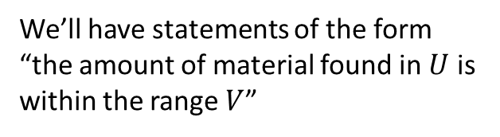
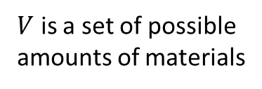


Assumption of infinitesimal reducibility
The system is reducible to its parts: giving the state of the whole is equivalent to giving the state of the parts. The system can be subdivided indefinitely.
time
$𝒮$ is the state of the infinitesimal parts (i.e. particles)
$$ℝ$$
$$𝒮$$
$U$ is a set of possible states for the particles
$$U$$
$V$ is a set of possible amounts of materials
We’ll have statements of the form “the amount of material found in $U$ is within the range $V$”
Assuming that the amount over disjoint areas sums, the state of the system can be characterized by a distribution $ρ:𝒮→ℝ$

Slide 24

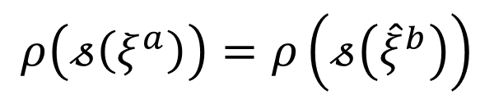


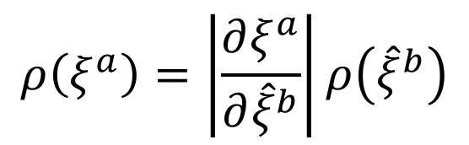

Assumption of infinitesimal reducibility
The system is reducible to its parts: giving the state of the whole is equivalent to giving the state of the parts. The system can be subdivided indefinitely.
time
The state of the whole is given by a distribution over the state of the infinitesimal parts (i.e. particles)
$$ρ:𝒮→ℝ$$
$$ρ\left(𝓈\left(ξ^{a}\right)\right)=ρ\left(ξ^{a}\right)$$
Density expressed in terms of state variables
Under a change of variables
$${\hat{ξ}}^{b}={\hat{ξ}}^{b}\left(ξ^{a}\right)$$
$$𝓈\left(ξ^{a}\right)=𝓈\left({\hat{ξ}}^{b}\right)$$
$$ρ\left(ξ^{a}\right)=\left|\frac{∂ξ^{a}}{∂{\hat{ξ}}^{b}}\right|ρ\left({\hat{ξ}}^{b}\right)$$
$$ρ\left(𝓈\left(ξ^{a}\right)\right)=ρ\left(𝓈\left({\hat{ξ}}^{b}\right)\right)$$
we have
We need the distribution to change both as a density and be an invariant. How can that work?

Slide 25





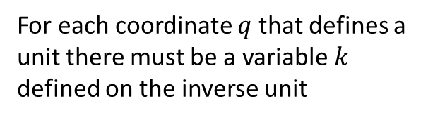



Invariant densities
Densities must be defined upon areas that are invariant under coordinate transformations
$\hat{q}=100 cm/m q$
For each coordinate $q$ that defines a unit there must be a variable $k$ defined on the inverse unit
$$1$$
$$1$$
$Δk=1 m^{−1}$
$Δ\hat{k}=0.01 cm^{−1}$
$Δ\hat{q}=100 cm$
$Δq=1 m$
Number of possibilities for the degree of freedom $ΔqΔk$is invariant
$$ρ(q^{i},k_{i})=ρ({\hat{q}}^{j},{\hat{k}}_{j})$$
$$∫ρ\left(q^{i},k_{i}\right)dq^{n}dk^{n}=∫ρ\left({\hat{q}}^{j},{\hat{k}}_{j}\right)d{\hat{q}}^{n}d{\hat{k}}^{n}$$
The structure of phase space is needed to define coordinate invariant densities over particle states
Without it we couldn’t compare whether we had more particles in one state or another

Slide 26









Hamiltonian evolution
Deterministic and reversible evolution means that densities (including marginals) are mapped exactly from initial to final states
$$ρ\left(𝓈\left(t\right)\right)=\hat{ρ}\left(𝓈\left(t+Δt\right)\right)$$
$$k_{i}$$
Possibilities (area) within a d.o.f. conserved
$${\hat{k}}_{i}$$
$$(q^{y},k_{y})$$
$$({\hat{q}}^{y},{\hat{k}}_{y})$$
$$q^{i}$$
$${\hat{q}}^{i}$$
Independent d.o.f. remain
independent (orthogonal)
$$(q^{x},k_{x})$$
$$({\hat{q}}^{x},{\hat{k}}_{x})$$
This is exactly what Hamilton’s equations do
Hamiltonian mechanics is just bookkeeping of the count of possibilities for each independent degree of freedom
Nothing else

Slide 27
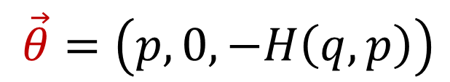

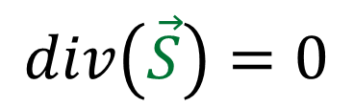

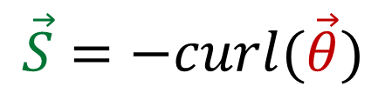
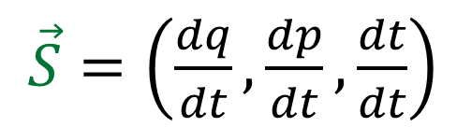
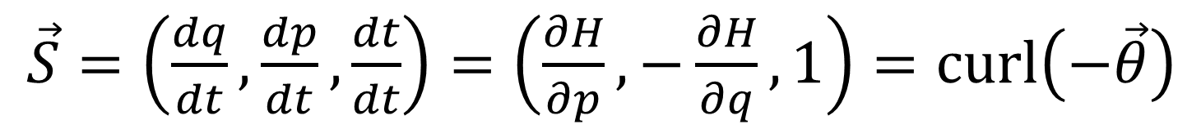


For one degree of freedom
Displacement along the trajectory
$\vec{S}=\left(\frac{dq}{dt},\frac{dp}{dt},\frac{dt}{dt}\right)$
$$q$$
Deterministic and reversible: flux over a closed surface is zero
$$div\left(\vec{S}\right)=0$$
$$\vec{S}=−curl(\vec{θ})$$
Because $\frac{dt}{dt}=1$ we can choose a gauge such that:
$$t$$
$$p$$
$\vec{θ}=\left(p, 0, −H\left(q,p\right)\right)$
$\vec{S}=\left(\frac{dq}{dt},\frac{dp}{dt},\frac{dt}{dt}\right)=\left(\frac{∂H}{∂p},−\frac{∂H}{∂q}, 1\right)=curl\left(−\vec{θ}\right)$

Slide 28

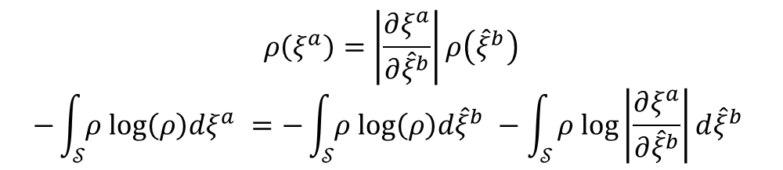
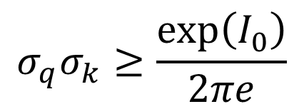

Conservation of information entropy
Information entropy is invariant over and only over the transformations for which the density is invariant
$$ρ\left(ξ^{a}\right)=\left|\frac{∂ξ^{a}}{∂{\hat{ξ}}^{b}}\right|ρ\left({\hat{ξ}}^{b}\right)$$
$$−\int_{𝒮}{ρ log\left(ρ\right)dξ^{a} }=−\int_{𝒮}{ρ log\left(ρ\right)d{\hat{ξ}}^{b} }−\int_{𝒮}{ρ log\left|\frac{∂ξ^{a}}{∂{\hat{ξ}}^{b}}\right|d{\hat{ξ}}^{b} }$$
Invariant distributions are precisely the distribution upon which entropy is invariant
If the evolution is deterministic and reversible, the information to identify the initial state is the same to identify the final state <-> Hamiltonian mechanics
$$I\left[ρ_{t}\right]=I_{0}=I\left[ρ_{t+Δt}\right]$$
If we fix the entropy, the gaussian distribution minimizes the spread
$$I_{G}=ln⁡(2πe σ_{q}σ_{k})$$
$$σ_{q}σ_{k}≥\frac{\exp\left(I_{0}\right)}{2πe}$$
During the evolution the spread over phase space is bounded

Slide 29
Takeaway
Infinitesimal reducibility -> distribution over particle states
Distributions over continuous variables -> differentiability
Invariant distributions over continuous variables -> phase space (symplectic structure)
Deterministic and reversible evolution -> Hamilton’s equations (symplectomorphism)
Hamiltonian mechanics is really just bookkeeping of the count of possibilities for each independent degree of freedom
Note how much it was implied by a seemingly simple assumption

Slide 30
Divisibility vs Reducibility vs Decomposability

Slide 31






Divisible
vs
Reducible
There exists a process where the final state consists of two or more independent systems (e.g. $𝒫_{t} :𝒮 →𝒮_{1}×𝒮_{2}$)
The state of the whole can be expressed as the state of the parts at the same time (e.g. $𝒮≡𝒮_{1}×𝒮_{2}$)
Planarian is divisible into three planaria (but not reducible to them)
A magnet is reducible to its north and south pole (but not divisible into them)
Muon is divisible into an electron and two neutrinos (but not reducible to them)
A proton is reducible to its quarks (but not divisible into them)

Slide 32






Divisible
vs
Decomposable
There exists a process where the final state consists of two or more independent systems (e.g. $𝒫_{t} :𝒮 →𝒮_{1}×𝒮_{2}$)
We can calculate a property by combining independent contributions (e.g. $+ :𝒮×𝒮→𝒮$ and $F\left(𝓈_{1}+𝓈_{2}\right)=F\left(𝓈_{1}\right)+$ $F\left(𝓈_{2}\right)$)
Reducible
An infinitesimal line segment is decomposable along coordinates (it is not divisible nor reducible to them)
The state of the whole can be expressed as the state of the parts at the same time (e.g. $𝒮≡𝒮_{1}×𝒮_{2}$)
$$dλ$$
$$dy{ e}_{y}$$
$$dx{ e}_{x}$$
Divisibility and reducibility are matter-of-fact properties of the system
(under given circumstances)
Decomposability (i.e. linearity) can be defined only over the properties that are linear on that decomposition (if they exist)
The work along an infinitesimal line segment is linear: $dW\left(dλ\right)=F_{x}dx+F_{y}dy$
The length of the line segment is not linear: $ℒ\left(dλ\right)≠dx+dy$

Slide 33
Irreducibility

Slide 34
Assumption of irreducibility
The system is irreducible to its parts: giving the state of the whole tells us nothing about the states of the parts.
?
time
Irreducibility does not mean there are no parts and there is no internal dynamics: it means the dynamics is not accessible
We do not have a way to interact with each “fragment” independently from the rest of the system, we cannot gather information about them
Irreducibility is not purely a property of the system: it depends on the process under study and the tools at our disposal
We can treat the proton as a single quantum system in many cases
We can’t when we perform deep inelastic scattering at suitable wavelength

Slide 35









Invariant distribution over random variables
State of the fragments is unknowable
Defined by “internal” random variables Still needs invariant distributions
which we take to be uniform (homogeneity)
Transformations that break uniformity are not allowed: only linear transformations
$$Y$$
$$X$$
$$Y$$
$$X$$
Only significant “internal” changes are those that change the integral (i.e. variance and covariance)
Some linear transformations have no effect Choose $X$ and $Y$ such that $ρ=1$ and $σ_{X}=σ_{Y}$, which means $∫ρdxdy∝σ_{X}σ_{Y}=σ_{X}^{2}$
$$\hat{Y}$$
$$\hat{X}=aX+bY \\ \hat{Y}=−bX+aY$$
$$\hat{X}$$
Internal transformations are identified by a complex number $𝒯(a+ıb):𝒮→𝒮$
The square modulus ${\left|a+ıb\right|}^{2}=a^{2}+b^{2}$ represents the change in variance and the phase represents the change in correlation as the arccosine of the Pearson correlation coefficient $ρ_{X,𝒯\left(a+ıb\right)\left(X\right)}=cos(\arg\left(a+ıb\right))$

Slide 36



Invariant distribution over random variables
The complex plane represents the space of pairs of random variables
A complex number represents one variable
The second one is implied by the symplectic structure (closing the square)
$$σ_{X+Y}^{2}=σ_{X}^{2}+σ_{Y}^{2}+2σ_{X}σ_{Y}ρ_{X,Y} \\ {\left|c_{1}+c_{2}\right|}^{2}={\left|c_{1}\right|}^{2}+{\left|c_{2}\right|}^{2}+2\left|c_{1}\right|\left|c_{2}\right|cos⁡(Δθ)$$
Linear composition obeys addition of random variables, variance adds linearly only if variables are uncorrelated
Homogeneity $→$ different d.o.f. carry the same spread and correlation A single complex plane for all d.o.f.
Pearson coefficient
The state space is a complex vector space
Complex inner product $\left\langle X | Y\right\rangle =σ_{X}σ_{Y}e^{ı arccos⁡(ρ_{X,Y})}$ gives variance and correlation information
The rest is mostly standard arguments
Measurable quantities must have a real valued average over all states $→$ Hermitian operators
Deterministic and reversible evolution must preserve the inner product $→$ unitary evolution $→$ Schroedinger equation
No real justification for Hilbert space, though
Cauchy limits are not necessarily physical
Assuming the expectations for all polynomials of $Q$ and $P$ are finite gives us Schwartz space

Slide 37


Effects due to irreducibility
Minimum uncertainty
$$k$$
Suppose arbitrarily small spread -> internal dynamics more and more constrained -> we can know more about it -> contradiction
In fact, all states must be associated with the same information entropy (which is set to zero)
$$q$$
Non-locality
System spread in space -> interact within a region -> but can’t interact with only a part-> must be interacting with the rest of the system as well
Superluminar effects …
… that can’t carry information
Suppose the internal dynamics is constrained by the speed of light -> we know something about the internal dynamics -> contradiction
Suppose we can use the internal dynamics to carry a message -> we have a way to manipulate the internal dynamics -> contradiction

Slide 38


Classical state
Quantum state
$$ρ(q^{i},k_{i})$$
$$ψ(q^{i})$$
Information Entropy
?
time
time
0
We always have access to the internal dynamics
We have no access to the internal dynamics
Any initial value for information entropy is allowed: we can study arbitrarily small parts
All pure quantum states have the same information entropy (i.e. zero): no description for parts

Slide 39
Takeaway
Irreducibility -> invariant uniform distribution over random variables -> space of random variables represented by a complex plane
Linear properties of random variables -> vector space over said complex plane
Statistical relationships between random variables -> inner product
Determinism and reversibility -> unitary evolution
The difference between quantum and classical systems is not size, is reducibility

Slide 40
…

Slide 41
Other results
With an additional assumption one can recover massive particles under potential forces
Kinematic assumption: giving the state is equivalent to giving the space-time trajectory
We have identified a set of necessary and sufficient conditions under which the possibilities of a domain can be identified by numbers
That is, how quantities are constructed through experimental verifiability
This gives us insights on what assumption are required by the continuum and how they would fail
We have started working on thermodynamics and statistical mechanics
The idea is to characterize evolution that is not reversible
Working on extending our logic structure to integrate additional concepts (e.g. measures, probability, entropy)

Slide 42
Project status

Slide 43
Status – future activities
Consolidate and expand the mathematical framework
We suspect that extended the framework with an extra axiom that allows to compare the level of description (i.e. granularity) of statements we can recover concepts from measure theory, probability theory, geometry and information theory
We also want to recover ideas from differential topology and geometric measure theory from finite value functions of finite valued shapes that are linear (i.e. value for the whole is the sum of the value for the parts)
Extend to other areas
Currently working on thermodynamic and statistical mechanics
Always looking for individuals that can provide insights/discussions/…
Collaborating with Julian Barbour on a better characterization of Shannon entropy
Collaborating with Lorenzo Maccone (Quantum Information) on system composition in quantum mechanics

Slide 44
Conclusions
Only a handful of physical assumptions are required to rederive classical/quantum particle mechanics
They capture idealizations for a system under certain conditions
They can be seen as characterizing information availability
(Reducibility) How much information is accessible? (Determinism/Reversibility) How is it mapped through time? (Kinematic equivalence) Are trajectories enough to gather that information?
We can create a physically meaningful formal structure for science that starts from simple well-motivated axioms (not abstract mathematical structures)
Maps very well to established mathematical structures
Objects are both physically and mathematically well defined (no “interpretation” needed, no unphysical objects)
A comprehensive reorganization of the current theories can lead to better understanding and new ideas

