Slide 1


Assumptions of physics: project overview
Christine A. Aidala (caidala@umich.edu)
Gabriele Carcassi (carcassi@umich.edu)
Department of Physics - University of Michigan

Slide 2
Typical view in the foundations of physics
Start with the theory that describes “what really happens”
With the most complicated and most complete description
Gradually derive other theories as approximations
approximation
…
Weak interactions
QED -Electromagnetism
QCD – Strong Interactions
Electro-weak
The Assumptions of Physics project does not proceed in this manner
General Relativity
Grand Unified Theory
Theory of Everything

Slide 3


Understanding fundamental structures
Hamiltonian mechanics
Phase space (symplectic manifold)
Hamiltonian evolution
Differentiable manifold
Symplectic structure
Manifold
Differentiable structure
We cannot truly understand this if we don’t first understand this
Topological space
Locally $ℝ^{n}$
Probability space
I.e. Before saying “there is a 50% chance to get tails” we need to define what tails, chance and 50% mean
Even probability spaces
are not fundamental structures
Set of points
$σ$-algebra
Measure
What are the “correct” axioms and definitions on which to build scientific theories? How can they be justified?

Slide 4
Space of the well-posed scientific theories
Physical theories
Specializations of the general theory under the different assumptions
Hamiltonian mechanics
Unitary evolution
Quantum state-space
Classical phase-space
Assumptions
Infinitesimal reducibility
Determinism/
reversibility
Irreducibility
States and processes
General theory
Informational granularity
Basic requirements and definitions valid in all theories
Experimental verifiability

Slide 5
Assumptions of Physics
Objectives:
Develop a mathematical framework that can serve as the foundation for all scientific theories (i.e. a mathematical theory about scientific theories)
Start from physical principles and assumptions and derive the math (not start from the math and add the physics later through an “interpretation”)
Each mathematical object must have a clear physical meaning (no object is unphysical, can read math proofs as logical arguments on the physics)
Construct concepts and tools that span different disciplines (nature does not care about divisions in fields of knowledge)
Explore what happens when the assumptions fail, possibly leading to new physics ideas

Slide 6
The logic of experimental verifiability

Slide 7
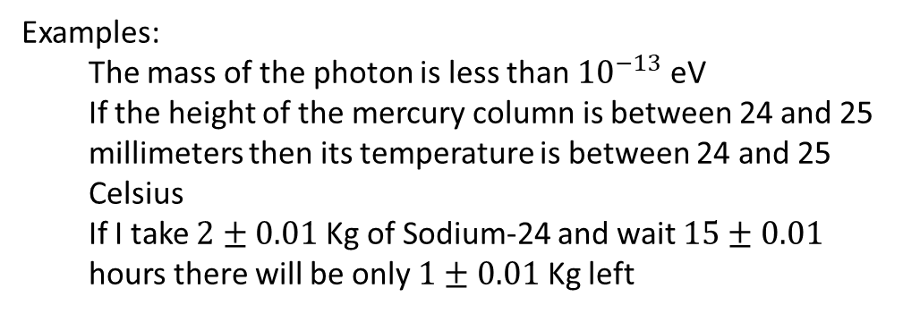
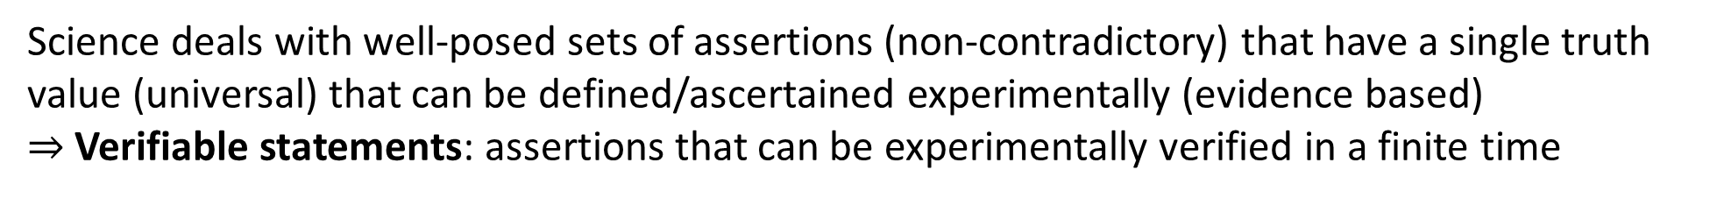

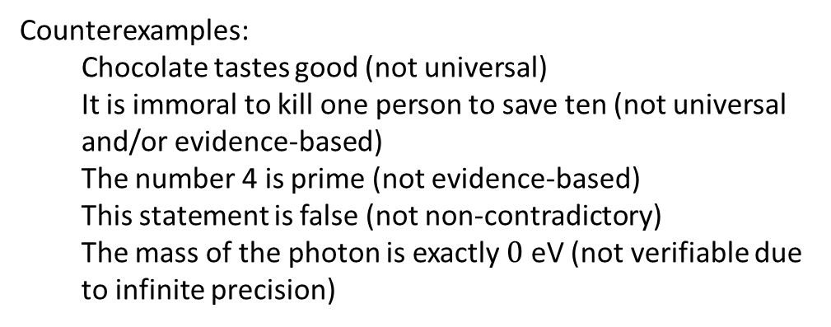
Science deals with well-posed sets of assertions (non-contradictory) that have a single truth value (universal) that can be defined/ascertained experimentally (evidence based) $⇒$ Verifiable statements: assertions that can be experimentally verified in a finite time
Examples:
The mass of the photon is less than ${10}^{−13}$ eV
If the height of the mercury column is between 24 and 25 millimeters then its temperature is between 24 and 25 Celsius
If I take $2±0.01$ Kg of Sodium-24 and wait $15±0.01$ hours there will be only $1±0.01$ Kg left
Counterexamples:
Chocolate tastes good (not universal)
It is immoral to kill one person to save ten (not universal and/or evidence-based)
The number 4 is prime (not evidence-based)
This statement is false (not non-contradictory)
The mass of the photon is exactly $0$ eV (not verifiable due to infinite precision)
We have to keep in mind that the meaning of the statements, their relationships and what truth values are allowed depends on context (e.g. premise, theory, etc…)
The mass of the electron is 511 $±$ 0.5 KeV
When measuring the mass, it is a verifiable hypothesis
When performing particle identification, it is assumed to be true

Slide 8
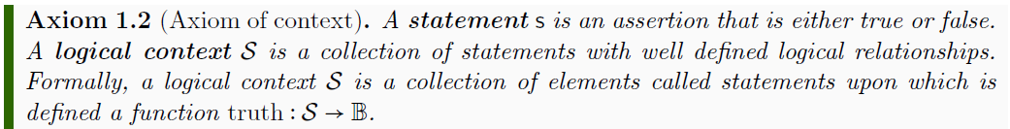
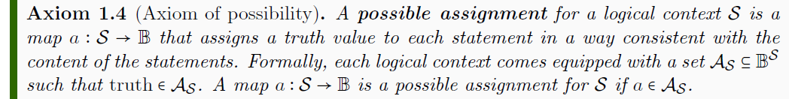
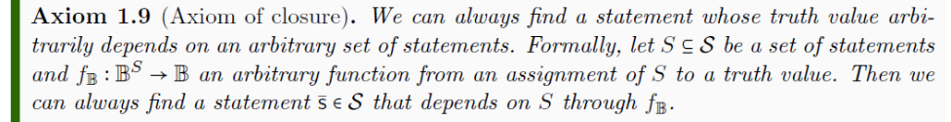


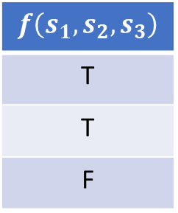
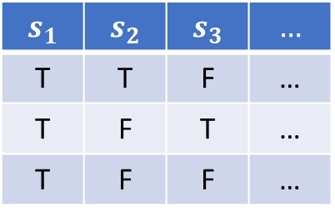

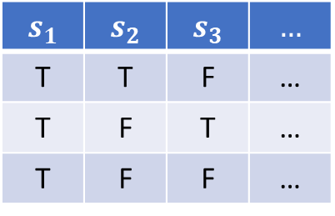

Axioms of logic
$$𝒮$$
$$s_{1}$$ | $$s_{2}$$ | $$s_{3}$$ | $$…$$
T | T | F | …
T | F | T | …
T | F | F | …
$$a$$
$$𝒜_{𝒮}$$
$$s_{1}$$ | $$s_{2}$$ | $$s_{3}$$ | $$…$$
T | T | F | …
T | F | T | …
T | F | F | …
$$f\left(s_{1},s_{2},s_{3}\right)$$
T
T
F
$$f_{𝔹}$$

Slide 9
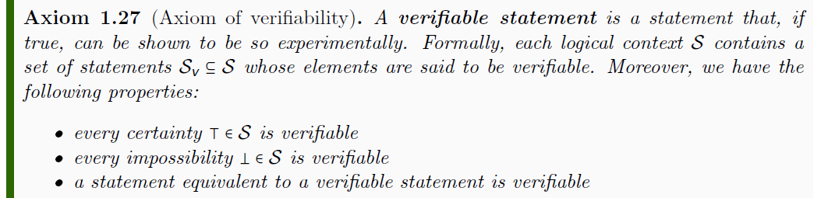
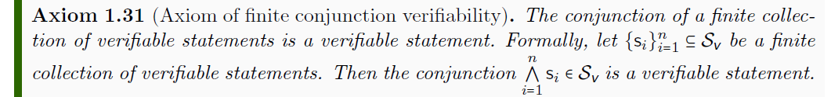
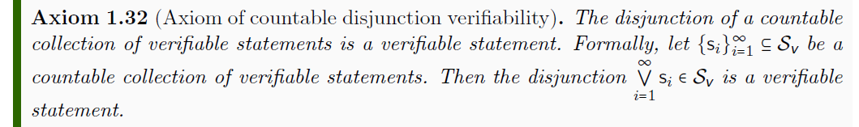


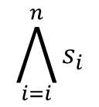

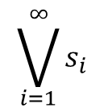







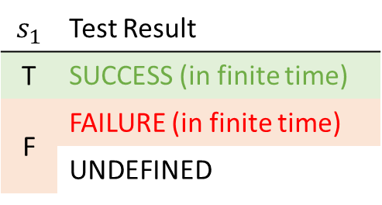
Axioms of verifiability
$$𝒮$$
$$s_{1}$$ | Test Result
T | SUCCESS (in finite time)
F | FAILURE (in finite time)
 | UNDEFINED
$$𝒮_{\text{v}}$$
$$s_{1}$$
experimental test
$$\bigwedge_{i=i}^{n}{s_{i}}$$
$$s_{1}$$
$$s_{2}$$
$$s_{3}$$
All tests must succeed
$$\bigvee_{i=1}^{∞}{s_{i}}$$
$$s_{1}$$
$$s_{2}$$
$$s_{3}$$
$$…$$
One successful test is sufficient

Slide 10
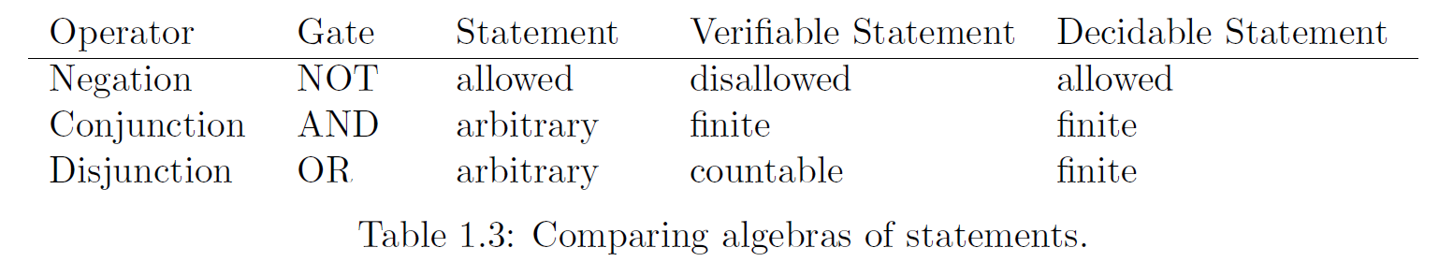



Properties of the logic system
Different algebras for the different types of statements
$$𝒮_{d}$$
$$𝒮_{v}$$
$$𝒮$$
(Different) notions of equivalences
Are the same statement
“This animal is a bird” = “Questo animale e’ un uccello”
“This animal is a bird” ≡ “This animal has feathers”
truth(“This animal is a bird”) = truth(“That animal is a mammal”)
Always have the same truth
Happen to have the same truth

Slide 11

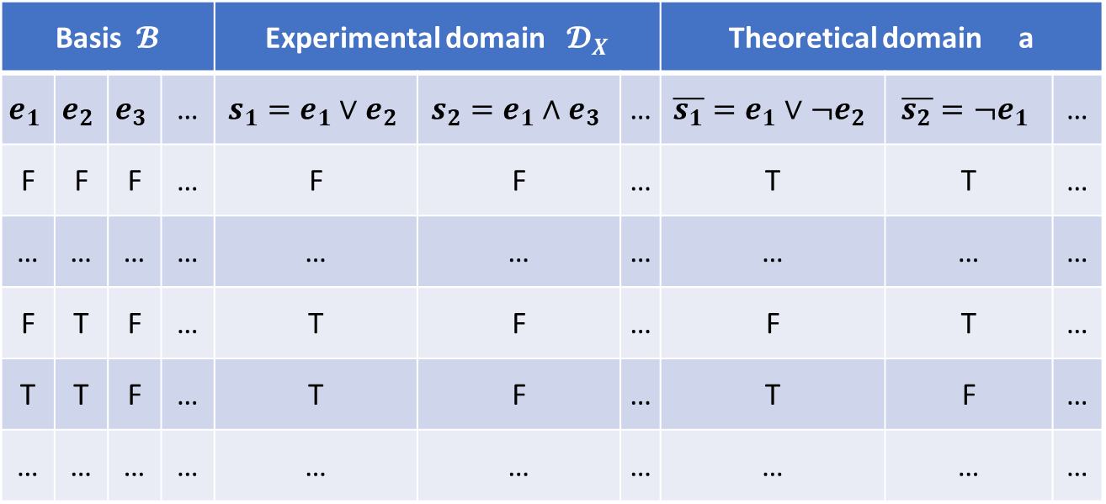


Experimental domains (scientific models)
From them generate all verifiable statements (close under finite AND countable OR)
Generate all meaningful predictions
(close under negation as well)
Start with a countable set of verifiable statements
Basis $𝓑$ |  |  |  | Experimental domain $𝓓_{X}$ |  |  | Theoretical domain a
$$e_{1}$$ | $$e_{2}$$ | $$e_{3}$$ | … | $$s_{1}=e_{1}∨e_{2}$$ | $$s_{2}=e_{1}∧e_{3}$$ | … | $$\overline{s_{1}}=e_{1}∨¬e_{2}$$ | $$\overline{s_{2}}=¬e_{1}$$ | …
F | F | F | … | F | F | … | T | T | …
… | … | … | … | … | … | … | … | … | …
F | T | F | … | T | F | … | F | T | …
T | T | F | … | T | F | … | T | F | …
… | … | … | … | … | … | … | … | … | …
${\overline{𝓓}}_{X}$
Fill in all possible assignments
Possibilities $X⊂{\overline{𝓓}}_{X}$
The points of the space (the possibilities, the distinguishable cases) are not given a priori but are constructed from the chosen verifiable statements
$$x=¬e_{1}∧e_{2}∧¬e_{3}∧…$$
For each possible assignment we have a theoretical statement that is true only in that case. We call these statements possibilities of the domain.

Slide 12
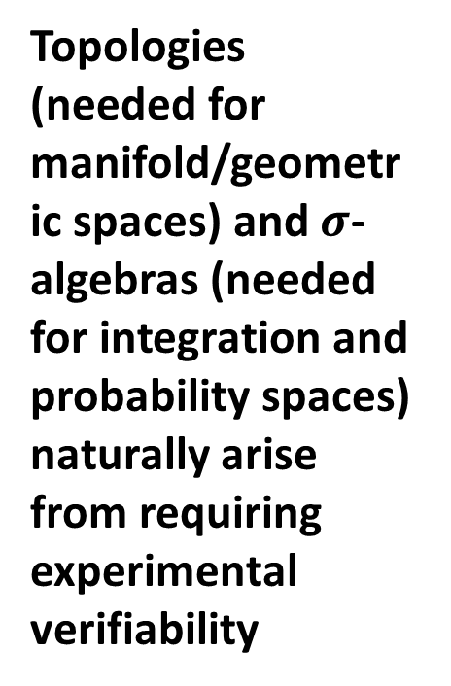
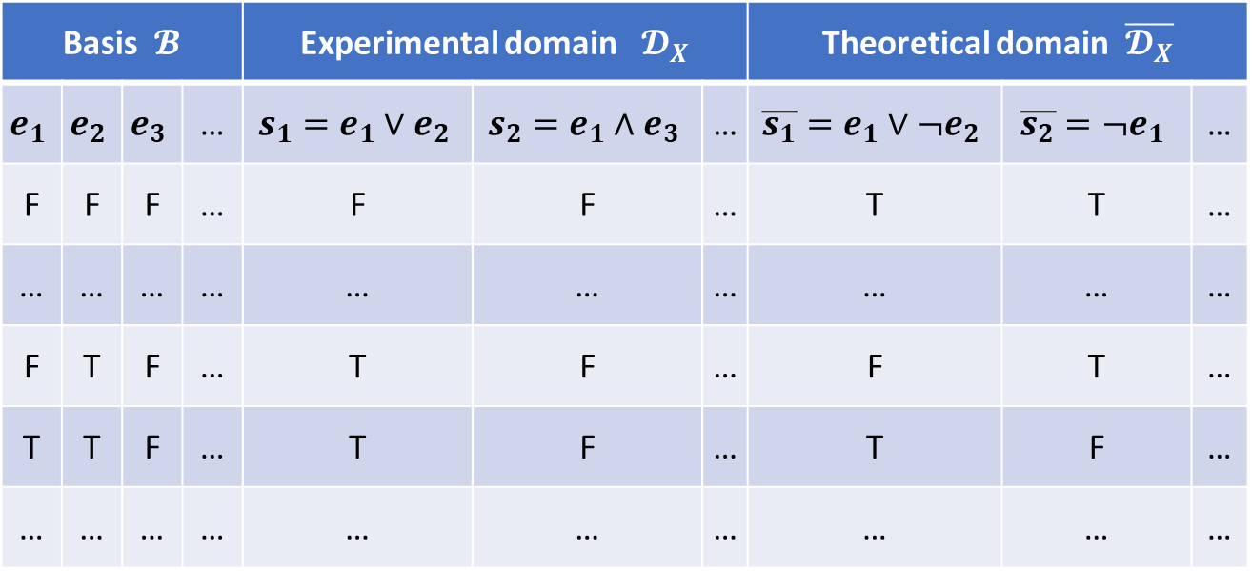
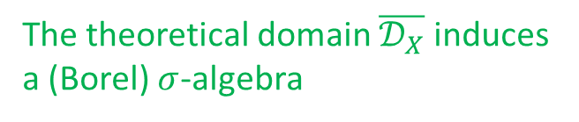
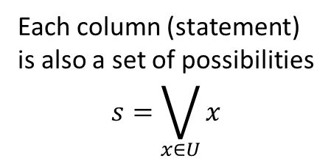
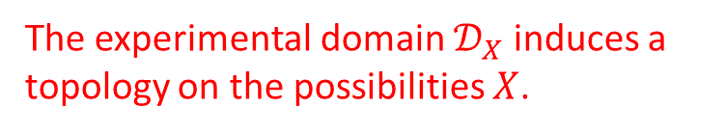

Topologies and $σ$-algebras
Each column (statement) is also a set of possibilities $$s=\bigvee_{x∈U}{x}$$
Finite AND and countable OR become finite intersection and countable union
Negation and countable AND become
complement and countable union
Basis $𝓑$ |  |  |  | Experimental domain $𝓓_{X}$ |  |  | Theoretical domain $\overline{𝓓_{X}}$
$$e_{1}$$ | $$e_{2}$$ | $$e_{3}$$ | … | $$s_{1}=e_{1}∨e_{2}$$ | $$s_{2}=e_{1}∧e_{3}$$ | … | $$\overline{s_{1}}=e_{1}∨¬e_{2}$$ | $$\overline{s_{2}}=¬e_{1}$$ | …
F | F | F | … | F | F | … | T | T | …
… | … | … | … | … | … | … | … | … | …
F | T | F | … | T | F | … | F | T | …
T | T | F | … | T | F | … | T | F | …
… | … | … | … | … | … | … | … | … | …
Topologies (needed for manifold/geometric spaces) and $σ$-algebras (needed for integration and probability spaces) naturally arise from requiring experimental verifiability
Possibilities $X$
The experimental domain $𝒟_{X}$ induces a topology on the possibilities $X$.
The theoretical domain $\overline{𝒟_{X}}$ induces a (Borel) $σ$-algebra

Slide 13
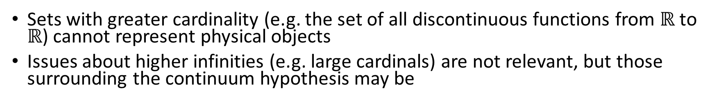



Maximum cardinality of distinguishable cases
Set of distinguishable cases
Test results for countable basis
Correspond to binary expansion
$$ℝ$$
FTFFFTTTFTFTT…
TFFTTFTTFFFTF…
FTFFFTTFTFFTF…
FTTFTFTTFTFFT…
0.0100011101011…
0.1001101100010…
0.0100011010010…
0.0110101101001…
1
Correspondence to binary sequence
0100011101011…
1001101100010…
0100011010010…
0110101101001…
$$X$$
$\left|X\right|≤|ℝ$|
0
Sets with greater cardinality (e.g. the set of all discontinuous functions from $ℝ$ to $ℝ$) cannot represent physical objects
Issues about higher infinities (e.g. large cardinals) are not relevant, but those surrounding the continuum hypothesis may be
Notes:
Large cardinals are defined to have a specific property and their existence cannot be proven (or disproven) in standard ZFC.

Slide 14
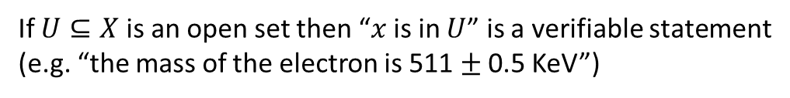
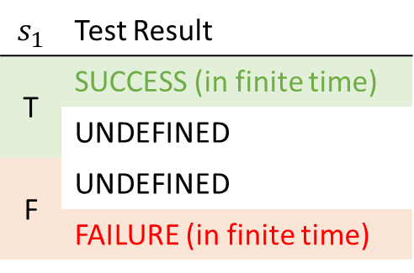
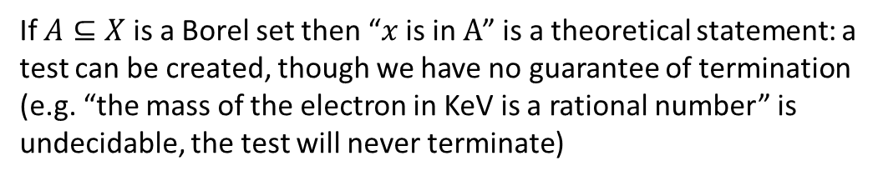
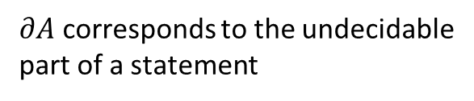
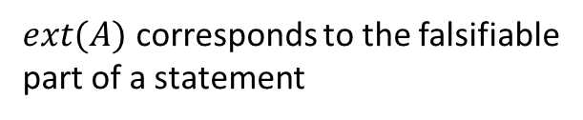
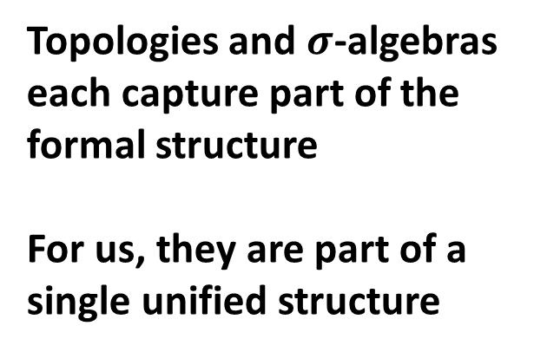
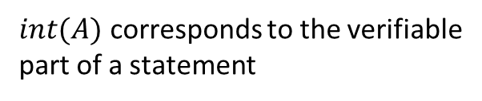
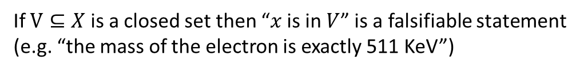
Topologies and $σ$-algebras
$int(A)$ corresponds to the verifiable part of a statement
All definitions and all proofs about these structures have precise physical meaning in this context
$$s_{1}$$ | Test Result
T | SUCCESS (in finite time)
 | UNDEFINED
F | UNDEFINED
 | FAILURE (in finite time)
$∂A$ corresponds to the undecidable part of a statement
$ext(A)$ corresponds to the falsifiable part of a statement
If $U⊆X$ is an open set then “$x$ is in $U$” is a verifiable statement (e.g. “the mass of the electron is 511 $±$ 0.5 KeV”)
Topologies and $σ$-algebras each capture part of the formal structure
For us, they are part of a single unified structure
If $V⊆X$ is a closed set then “$x$ is in $V$” is a falsifiable statement (e.g. “the mass of the electron is exactly 511 KeV”)
If $A⊆X$ is a Borel set then “$x$ is in $A$” is a theoretical statement: a test can be created, though we have no guarantee of termination (e.g. “the mass of the electron in KeV is a rational number” is undecidable, the test will never terminate)

Slide 15
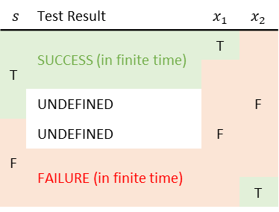
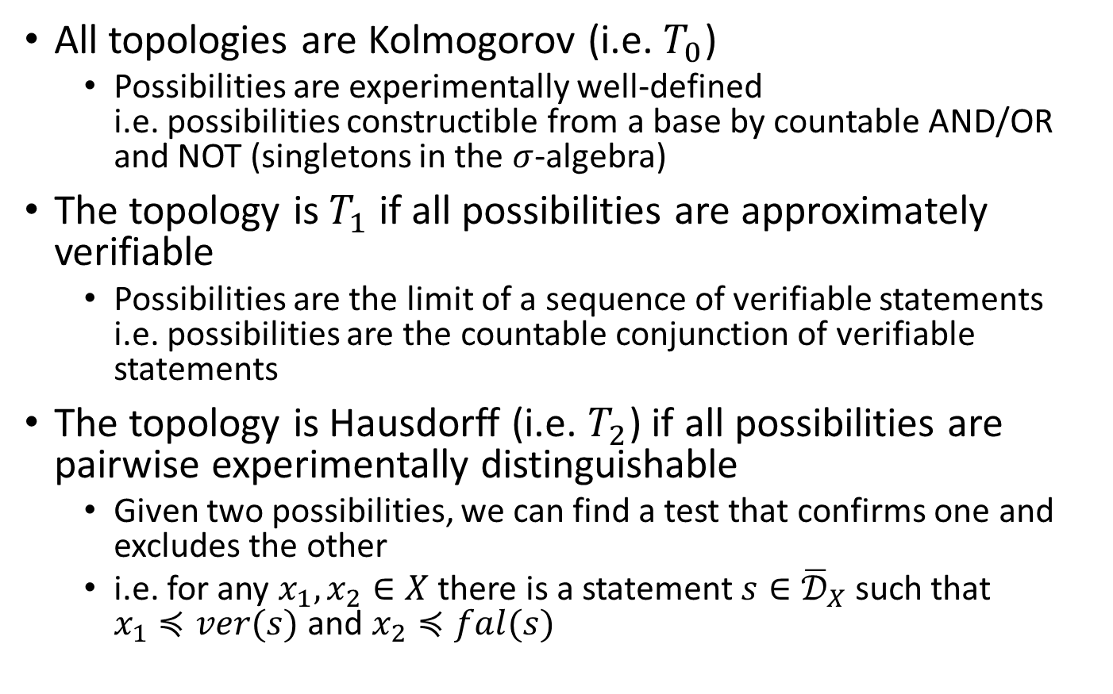
Physical meaning of separation axioms
All topologies are Kolmogorov (i.e. $T_{0}$)
Possibilities are experimentally well-defined i.e. possibilities constructible from a base by countable AND/OR and NOT (singletons in the $σ$-algebra)
The topology is $T_{1}$ if all possibilities are approximately verifiable
Possibilities are the limit of a sequence of verifiable statements i.e. possibilities are the countable conjunction of verifiable statements
The topology is Hausdorff (i.e. $T_{2}$) if all possibilities are pairwise experimentally distinguishable
Given two possibilities, we can find a test that confirms one and excludes the other
i.e. for any $x_{1},x_{2}∈X$ there is a statement $s∈{\overline{𝒟}}_{X}$ such that $x_{1}≼ver(s)$ and $x_{2}≼fal(s)$
$$s$$ | Test Result | $$x_{1}$$ | $$x_{2}$$
T | SUCCESS (in finite time) | T | F
 |  | F
 | UNDEFINED
F | UNDEFINED
 | FAILURE (in finite time)
 | FAILURE (in finite time) |  | T

Slide 16
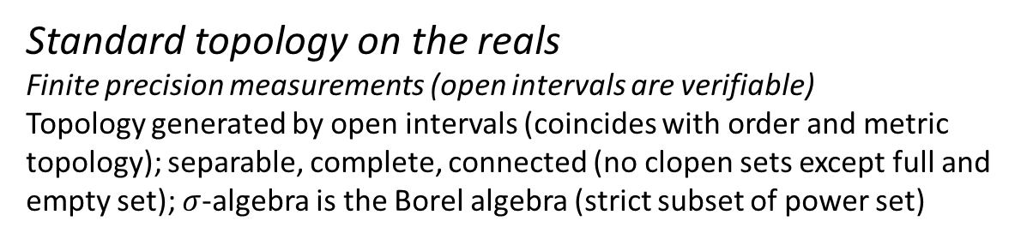
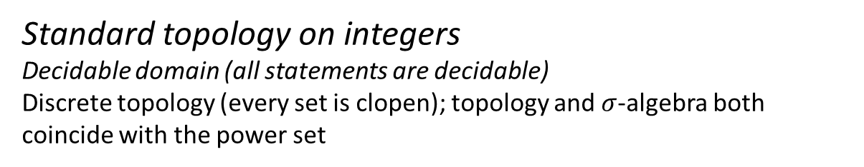
Examples
Standard topology on integers Decidable domain (all statements are decidable)
Discrete topology (every set is clopen); topology and $σ$-algebra both coincide with the power set
0
1
2
3
4
5
6
…
Standard topology on the reals Finite precision measurements (open intervals are verifiable)
Topology generated by open intervals (coincides with order and metric topology); separable, complete, connected (no clopen sets except full and empty set); $σ$-algebra is the Borel algebra (strict subset of power set)

Slide 17
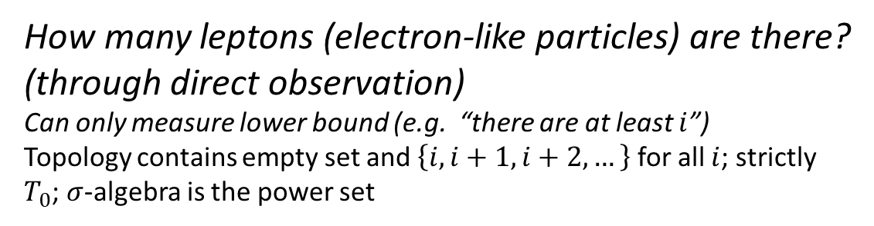
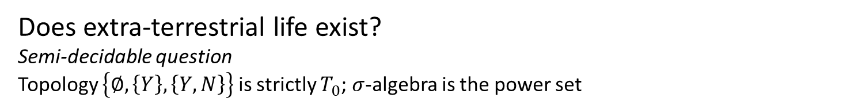
Examples
Does extra-terrestrial life exist?
Semi-decidable question
Topology $\left\{∅,\left\{Y\right\},\left\{Y,N\right\}\right\}$ is strictly $T_{0}$; $σ$-algebra is the power set
Y
N
How many leptons (electron-like particles) are there? (through direct observation)
Can only measure lower bound (e.g. “there are at least $i$”)
Topology contains empty set and $\left\{i, i+1, i+2, …\right\}$ for all $i$; strictly $T_{0}$; $σ$-algebra is the power set
0
1
2
3
4
5
6
…

Slide 18




Inference/causal relationships and continuity
An inference relationship is a map $𝓇:𝒟_{Y}→𝒟_{X}$ such that $𝓇\left(s\right)≡s$
$$𝒟_{X}$$
$$𝒟_{Y}$$
e.g. the water temperature is between 0 and 0.52 Celsius or between 7.6 and 9.12 Celsius
e.g. the water density is between 999.8 and 999.9 kg/m³
$$X$$
$$Y$$
e.g. the water temperature is exactly 4 Celsius
e.g. the water density is exactly 1 kg/m³
A causal relationship is a map $f:X→Y$ such that $x≼f\left(x\right)$
Two general and important results:
1) Two domains admit an inference relationship if and only if they admit a causal relationship
2) The causal relationship must be a continuous map in the natural topology

Slide 19
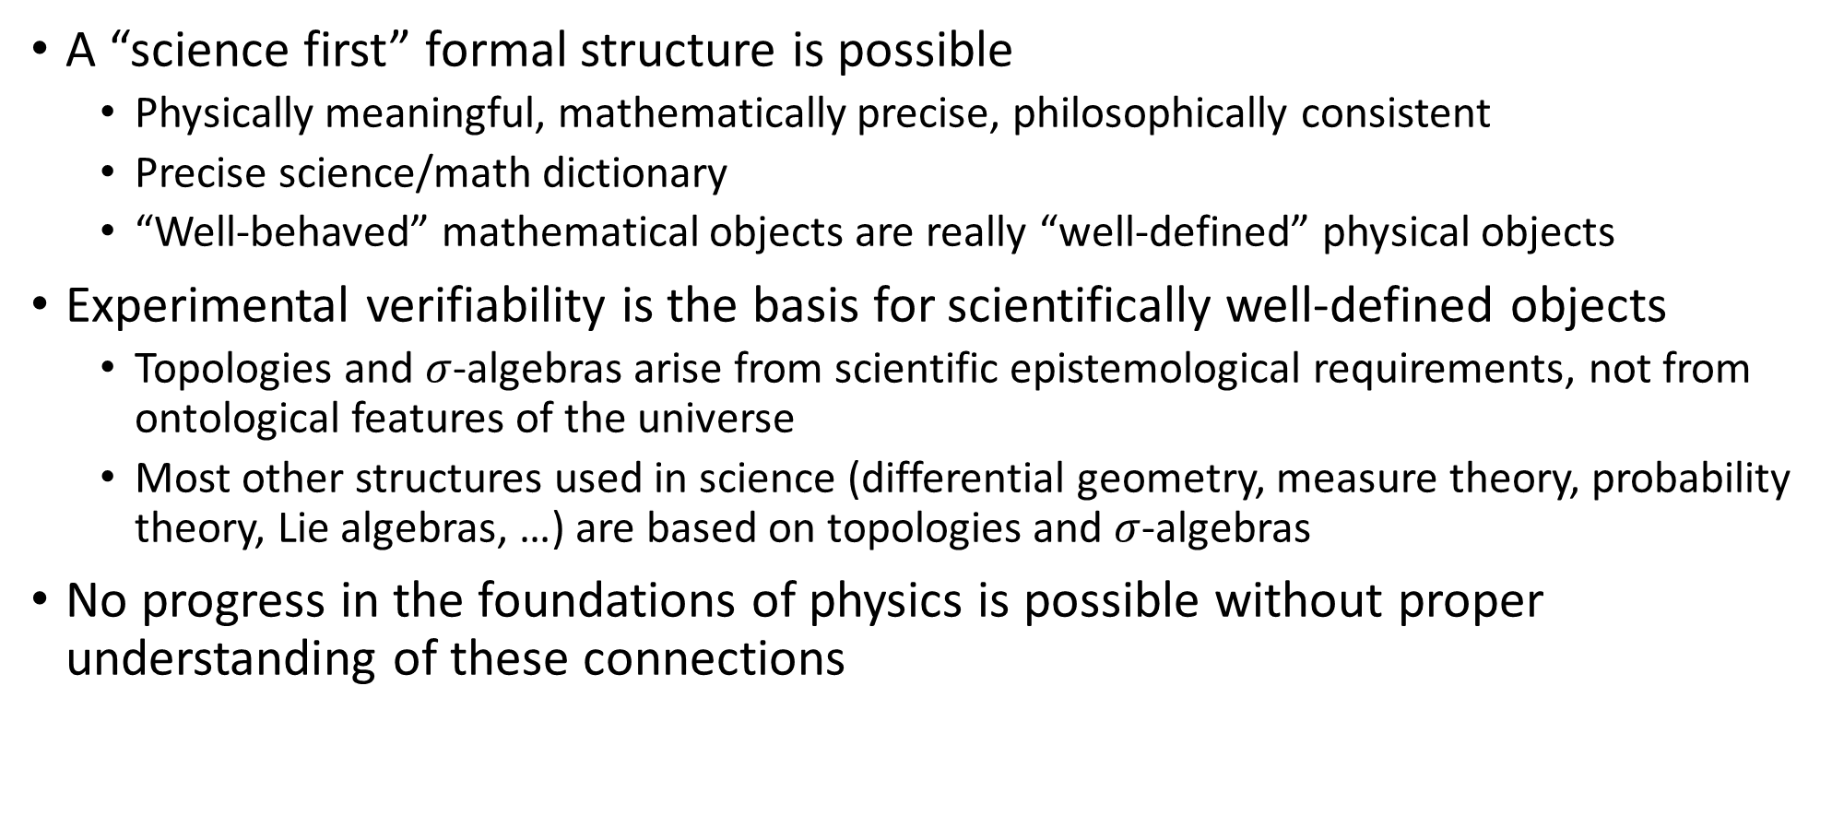
Takeaway
A “science first” formal structure is possible
Physically meaningful, mathematically precise, philosophically consistent
Precise science/math dictionary
“Well-behaved” mathematical objects are really “well-defined” physical objects
Experimental verifiability is the basis for scientifically well-defined objects
Topologies and $σ$-algebras arise from scientific epistemological requirements, not from ontological features of the universe
Most other structures used in science (differential geometry, measure theory, probability theory, Lie algebras, …) are based on topologies and $σ$-algebras
No progress in the foundations of physics is possible without proper understanding of these connections

Slide 20
The assumptions of classical mechanics

Slide 21


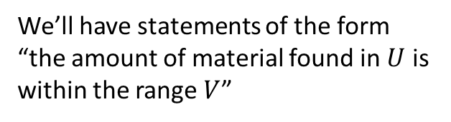
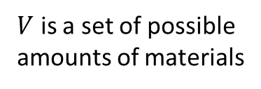


Assumption of infinitesimal reducibility
The system is reducible to its parts: giving the state of the whole is equivalent to giving the state of the parts. The system can be subdivided indefinitely.
time
$𝒮$ is the state of the infinitesimal parts (i.e. particles)
$$ℝ$$
$$𝒮$$
$U$ is a set of possible states for the particles
$$U$$
$V$ is a set of possible amounts of materials
We’ll have statements of the form “the amount of material found in $U$ is within the range $V$”

Slide 22

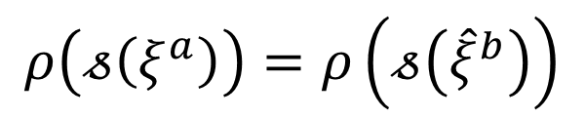


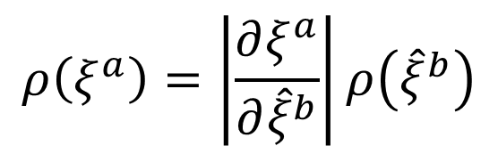


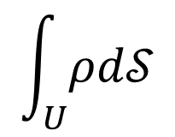
Density over states
The state of the whole is given by a distribution over the state of the infinitesimal parts (i.e. particles)
$$\int_{U}{ρd𝒮}$$
$$ρ:𝒮→ℝ$$
Fraction of the system in a region $U$
Density depends on the state; unit is [amount]/[states]
This presents a puzzle:
$$ρ\left(𝓈\left(ξ^{a}\right)\right)=ρ\left(ξ^{a}\right)$$
Under a change of variables
$${\hat{ξ}}^{b}={\hat{ξ}}^{b}\left(ξ^{a}\right)$$
$$𝓈\left(ξ^{a}\right)=𝓈\left({\hat{ξ}}^{b}\right)$$
$$ρ\left(ξ^{a}\right)=\left|\frac{∂ξ^{a}}{∂{\hat{ξ}}^{b}}\right|ρ\left({\hat{ξ}}^{b}\right)$$
$$ρ\left(𝓈\left(ξ^{a}\right)\right)=ρ\left(𝓈\left({\hat{ξ}}^{b}\right)\right)$$
we have
How can $ρ$ both change as a density and be an invariant?

Slide 23
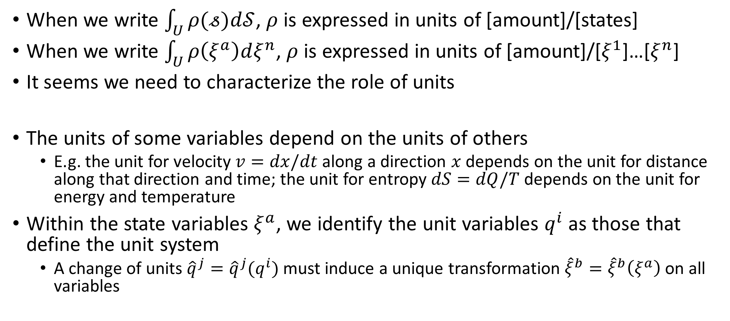
Units
When we write $\int_{U}{ρ(𝓈)d𝒮}$, $ρ$ is expressed in units of [amount]/[states]
When we write $\int_{U}{ρ\left(ξ^{a}\right)dξ^{n}}$, $ρ$ is expressed in units of [amount]/[$ξ^{1}$]…[$ξ^{n}$]
It seems we need to characterize the role of units
The units of some variables depend on the units of others
E.g. the unit for velocity $v=dx/dt$ along a direction $x$ depends on the unit for distance along that direction and time; the unit for entropy $dS=dQ/T$ depends on the unit for energy and temperature
Within the state variables $ξ^{a}$, we identify the unit variables $q^{i}$ as those that define the unit system
A change of units ${\hat{q}}^{j}={\hat{q}}^{j}(q^{i})$ must induce a unique transformation ${\hat{ξ}}^{b}={\hat{ξ}}^{b}\left(ξ^{a}\right)$ on all variables

Slide 24



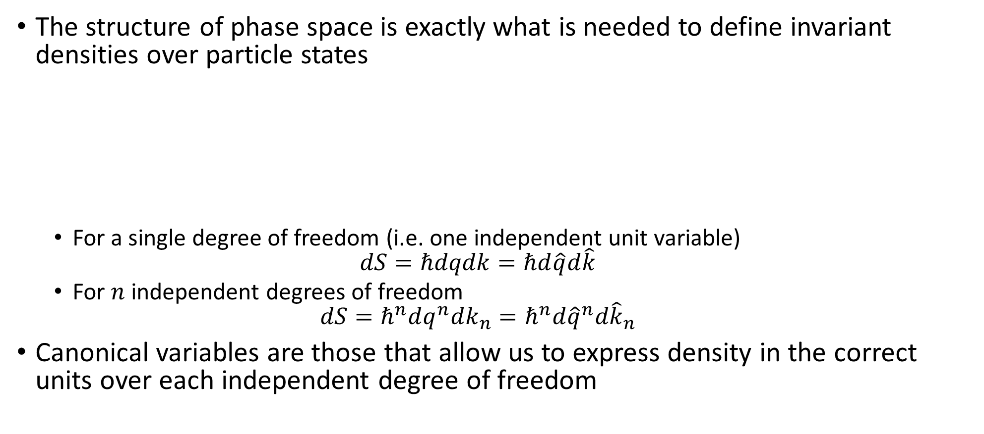





Phase space (symplectic manifold)
The structure of phase space is exactly what is needed to define invariant densities over particle states
For a single degree of freedom (i.e. one independent unit variable) $dS=ℏdqdk=ℏd\hat{q}d\hat{k}$
For $n$ independent degrees of freedom $dS=ℏ^{n}dq^{n}dk_{n}=ℏ^{n}d{\hat{q}}^{n}d{\hat{k}}_{n}$
Canonical variables are those that allow us to express density in the correct units over each independent degree of freedom
$\hat{q}=100 cm/m q$
$$1$$
$$1$$
The product $ΔqΔk$ is invariant
$Δk=1 m^{−1}$
$Δ\hat{k}=0.01 cm^{−1}$
$Δ\hat{q}=100 cm$
$Δq=1 m$

Slide 25
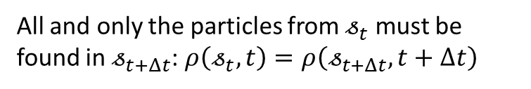

Assumption of deterministic and reversible evolution
Given the state of the system at one time, we are able to predict the state at future times (determinism) and reconstruct (reversibility) the state at past times.
time
$$𝒮$$
Dynamical system $𝓈_{t}↦𝓈_{t+Δt }$
Not enough!
time
All and only the particles from $𝓈_{t}$ must be found in $𝓈_{t+Δt}$: $ρ\left(𝓈_{t},t\right)=ρ\left(𝓈_{t+Δt},t+Δt\right)$
Independent degrees of freedom must be mapped to independent degrees of freedom
$⇒$ Hamiltonian mechanics (symplectic structure must be preserved)

Slide 26
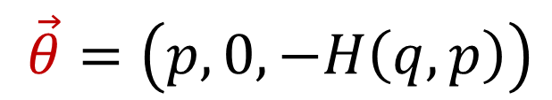

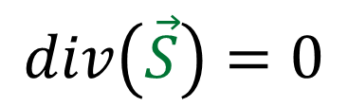

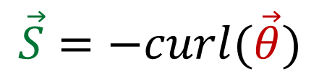
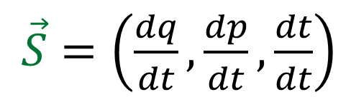



Hamiltonian mechanics for one degree of freedom
Displacement along the trajectory
$\vec{S}=\left(\frac{dq}{dt},\frac{dp}{dt},\frac{dt}{dt}\right)$
$$q$$
Deterministic and reversible: flux over a closed surface is zero
$$div\left(\vec{S}\right)=0$$
$$\vec{S}=−curl(\vec{θ})$$
Because $\frac{dt}{dt}=1$ we can choose a gauge such that:
$$t$$
$$p$$
$\vec{θ}=\left(p, 0, −H\left(q,p\right)\right)$
This recovers Hamilton’s equations
$\vec{S}=\left(\frac{dq}{dt},\frac{dp}{dt},\frac{dt}{dt}\right)=\left(\frac{∂H}{∂p},−\frac{∂H}{∂q}, 1\right)=−curl(\vec{θ})$

Slide 27
Understanding Hamiltonian mechanics
Hamiltonian mechanics
Phase space (symplectic manifold)
Hamiltonian evolution
Differentiable manifold
Symplectic structure
Manifold
Differentiable structure
Topological space
Locally $ℝ^{n}$
The evolution is deterministic and reversible
The composite system is a density …
Particle states are experimentally distinguishable …
… that is invariant under change of units
… using continuous variables
Each mathematical structure is linked to a specific physical requirement

Slide 28
Possible contributions

Slide 29
Bare minima
Project is very interdisciplinary and requires knowledge from different areas of math, physics and engineering
We want to create a series of short (12-16 pages) articles that give the basic definitions and main results of each field: the bare minimum one needs to know
E.g. Set theory: https://assumptionsofphysics.org/resources/bareminima/SetTheory.pdf
Hourly work

Slide 30
Other small tasks (hourly work)
There are a number of smaller questions it would be nice to settle
Is every Heyting algebra embeddable in a Boolean algebra?
To make sure we are not ruling anything out
Finalize last few details in our basic structures
Find the “correct” morphism that gives us the right product, …
Study a Gaussian peak under linear Hamiltonian flow
To generalize the “classical uncertainty relationship”
Special relativity from densities
Look for hints of general relativity in the extended phase space
See if the link between symplectic form, metric and vector potential leads to relationships to the curvature
Characterize quantum projections as processes with constraints that maximize entropy
Analyze the relationship between linearity of mixed (classical mixtures) and pure states (quantum superposition) in quantum mechanics
Can superposition be fully characterized by “aliasing” of mixed states?
Some of these questions may be already solved in the literature, some may be hard
Helping to formalize/organize the questions is also useful

Slide 31

A new foundation for measures and geometry
We saw that topological and $σ$-algebraic structures come from experimental verifiability: how do we recover the rest?
Note that measures and metrics are used to give a “size” to sets
In physics, conceptually, we start with the ability to compare sizes (this is bigger than this); we then construct measurement scales to give numerical values
The idea is to provide a foundation for measure theory and geometry in the same way: we have the lattice of all possible descriptions (our $σ$-algebra); we add a preorder that tells us whether one description is “finer” (i.e. more refined) than another; pick a unit and construct a “measure” that respects the order and that is linear under “disjoint addition”
The goal is to find a set of sufficient physically justifiable conditions for which such measures can be constructed
For preliminary work, see https://assumptionsofphysics.org/resources/blueprints/InformationGranularity.pdf

Slide 32


Physical entropy as counting evolutions
The idea is to define how to “count” (in a measure theoretic sense) the possible evolutions of a system; we define the process entropy as the logarithm of that count
State entropy becomes the process entropy associated to all possible evolutions that “pass” through that state at that time
Equilibrium states concentrate the evolutions and therefore they maximize the process entropy
The goal is, with similar considerations, to rederive the basic laws of thermodynamics in the most possible general setting, and recover the standard formula for entropy (i.e. Gibbs, log of count of states, …) in specific cases
For preliminary work, see https://assumptionsofphysics.org/resources/blueprints/ProcessEntropy.pdf
$t_{0}$
$$t_{1}$$

Slide 33
Other bigger tasks
Find a reformulation of quantum mechanics that fits better in the framework
Projective spaces? Use mixed states as prime object? Algebraic?
Find a set of physical motivations to introduce differentiability and differential forms
General idea is to describe linear quantities associated to k-dimensional submanifolds (rough ideas in Bachelor’s thesis https://assumptionsofphysics.org/Thesis-Johnson-DifferentialGeometry.pdf )
…

Slide 34
Final thought
Prima dovete capire le cose nel piccolo, e poi generalizzare
First you have to understand the simple case, and then generalize
Se non avete capito nel piccolo, capirete ancora meno quando generalizzate
If you haven’t understood the simple case, you will understand even less when you generalize

