Slide 1
On the role of mathematics in physical theories
Gabriele Carcassi
2019 Foundations of Modern Physics Workshop

Slide 2
Before we start
Disclaimer: we are not going to talk in general of the role of mathematics in science. Just its role within a physical theory.
By role we mean its “technical” function, what it formally captures
We are not going to discuss sociological roles, inspiration roles, etc…
The viewpoint presented here is profoundly shaped by our work on our project “Assumptions of Physics”
It forced us to understand where the line between scientific theories and mathematical frameworks is

Slide 3
Assumptions of Physics
The aim of the project is to find a handful of physical principles and assumptions from which the basic laws of physics can be derived (see http://assumptionsofphysics.org)
To do that we need to develop a general mathematical theory of experimental science: the theory that studies scientific theories
A formal framework that forces us to clarify our assumptions
From those assumptions the mathematical objects are derived
Each mathematical object has a clear physical meaning and no object is unphysical
Gives us concepts and tools that span across different disciplines
Gives us a better understanding of what the laws of physics are and what they represent

Slide 4



General mathematical theory of experimental science
Experimental verifiability leads to topological spaces, sigma-algebras, …
State-level assumptions
Infinitesimal reducibility
leads to classical phase space
Irreducibility
leads to quantum state space
Process-level assumptions
Hamilton’s equations $\frac{d}{dt}\left(q, p\right)=\left(\frac{∂H}{∂p},−\frac{∂H}{∂q}\right)$
Deterministic and reversible evolution
leads to isomorphism on state space
Schroedinger equation $$ıℏ\frac{∂}{∂t}ψ=Hψ$$
Non-reversible evolution
Thermodynamics
Euler-Lagrange equations $δ∫L\left(q, \dot{q},t\right)=0$
…
Kinematic equivalence
leads to massive particles

Slide 5
Outline
First we will get familiar with the basic ideas
We do not have time to see all details, but we have to see at least some parts to get a sense of what it means to properly formalize scientific concepts
We will present a formalism to properly capture semantic properties and relationships of the type we have in science and see how this formalism leads necessarily to topologies and sigma-algebras (the foundations of differential geometry, measure theory, probability theory, …)
Once we have seen exactly how physical concepts are encoded into mathematical structures, we can draw conclusions

Slide 6
The principle of scientific objectivity tells us that science deals with assertions that are:
either true or false (non-contradictory)
for everybody (universal)
and experimentally verifiable (evidence-based)
We call such assertions verifiable statements
The first two requirements are the same as in classical logic
The third means we have an experimental test that we can run and, if the statement is true, it completes successfully in finite time

Slide 7
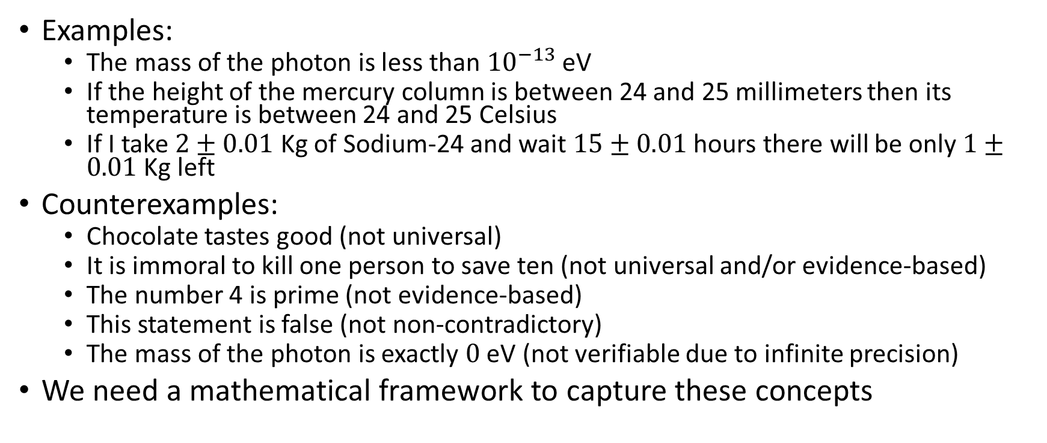
Examples of verifiable statements
Examples:
The mass of the photon is less than ${10}^{−13}$ eV
If the height of the mercury column is between 24 and 25 millimeters then its temperature is between 24 and 25 Celsius
If I take $2±0.01$ Kg of Sodium-24 and wait $15±0.01$ hours there will be only $1±0.01$ Kg left
Counterexamples:
Chocolate tastes good (not universal)
It is immoral to kill one person to save ten (not universal and/or evidence-based)
The number 4 is prime (not evidence-based)
This statement is false (not non-contradictory)
The mass of the photon is exactly $0$ eV (not verifiable due to infinite precision)
We need a mathematical framework to capture these concepts

Slide 8
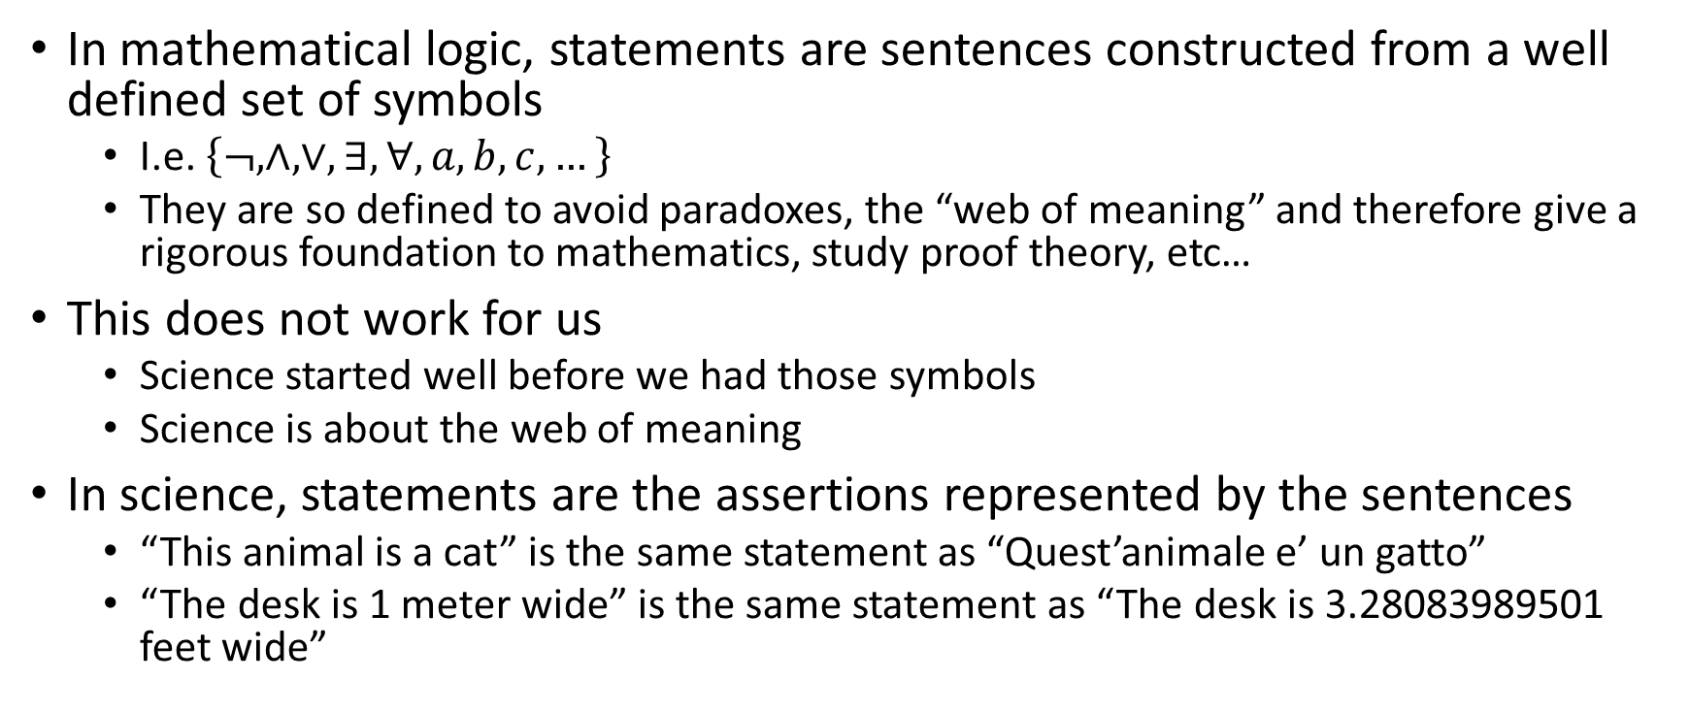
Statements
In mathematical logic, statements are sentences constructed from a well defined set of symbols
I.e. $\left\{¬,∧,∨,∃,∀,a,b,c,…\right\}$
They are so defined to avoid paradoxes, the “web of meaning” and therefore give a rigorous foundation to mathematics, study proof theory, etc…
This does not work for us
Science started well before we had those symbols
Science is about the web of meaning
In science, statements are the assertions represented by the sentences
“This animal is a cat” is the same statement as “Quest’animale e’ un gatto”
“The desk is 1 meter wide” is the same statement as “The desk is 3.28083989501 feet wide”

Slide 9
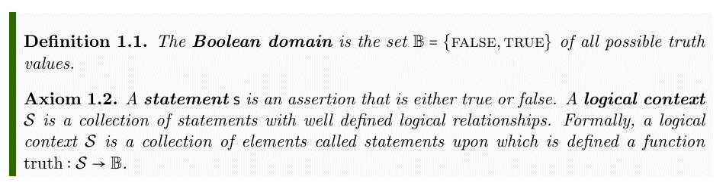
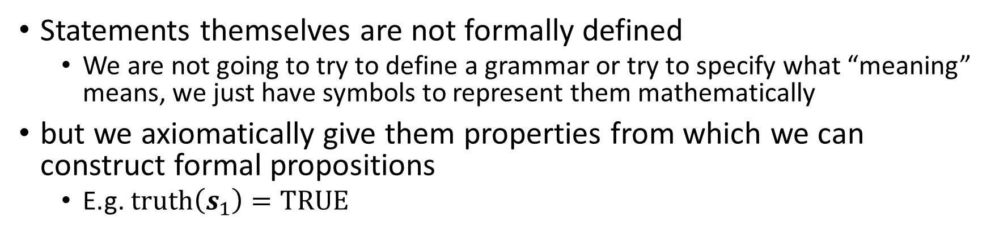
Statements
Statements themselves are not formally defined
We are not going to try to define a grammar or try to specify what “meaning” means, we just have symbols to represent them mathematically
but we axiomatically give them properties from which we can construct formal propositions
E.g. $truth\left(s_{1}\right)=TRUE$

Slide 10
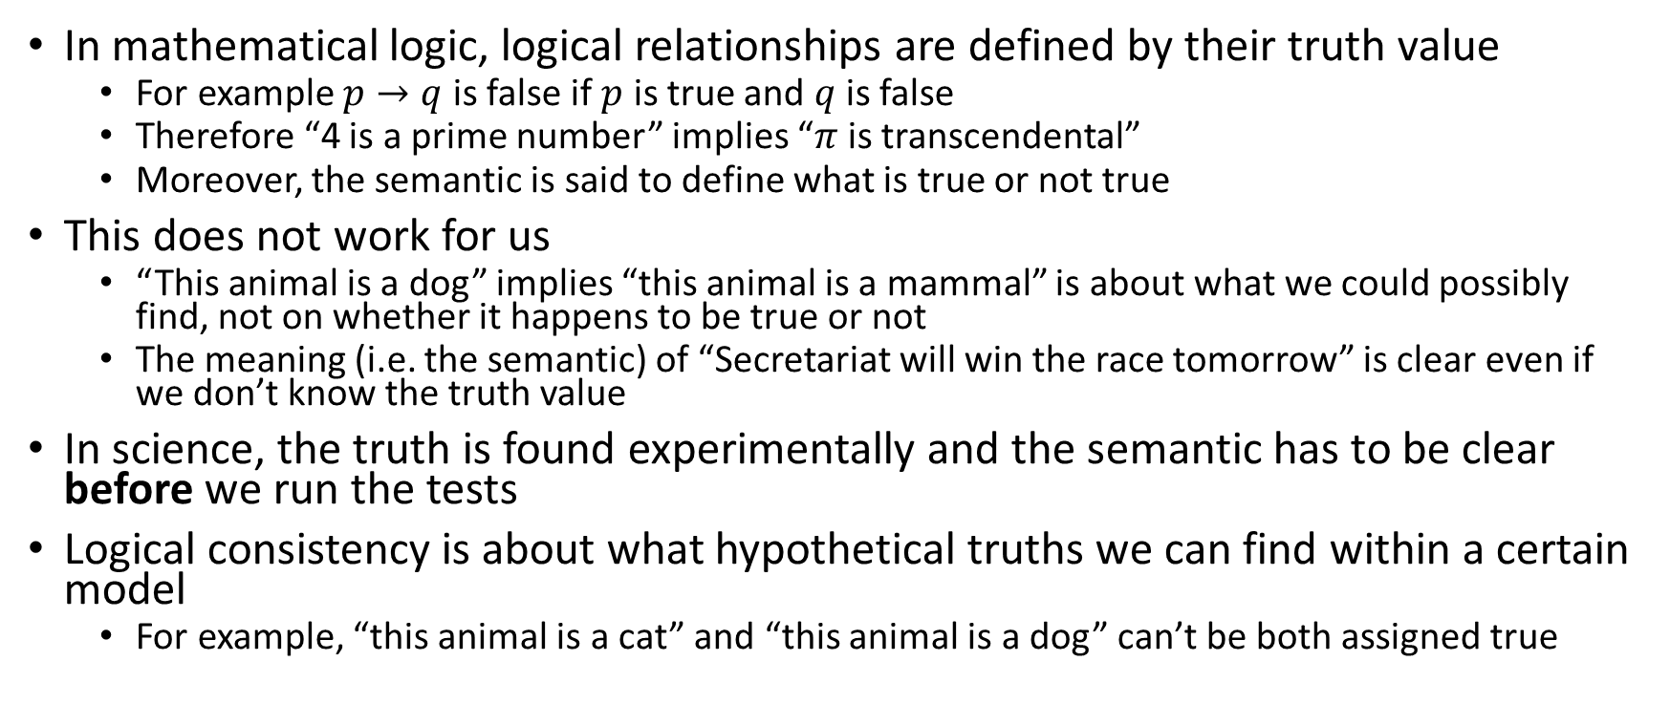
Assignments
In mathematical logic, logical relationships are defined by their truth value
For example $p→q$ is false if $p$ is true and $q$ is false
Therefore “4 is a prime number” implies “$π$ is transcendental”
Moreover, the semantic is said to define what is true or not true
This does not work for us
“This animal is a dog” implies “this animal is a mammal” is about what we could possibly find, not on whether it happens to be true or not
The meaning (i.e. the semantic) of “Secretariat will win the race tomorrow” is clear even if we don’t know the truth value
In science, the truth is found experimentally and the semantic has to be clear before we run the tests
Logical consistency is about what hypothetical truths we can find within a certain model
For example, “this animal is a cat” and “this animal is a dog” can’t be both assigned true

Slide 11
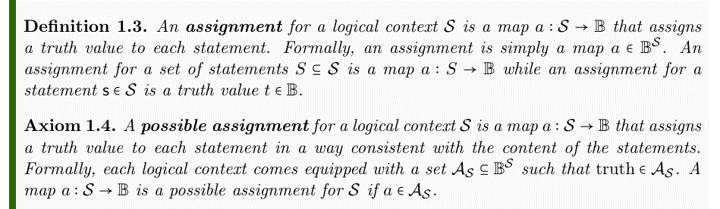
Assignments
As with statements, we don’t try to formalize how the possible assignments are derived
It would require “meaning”
but we axiomatically give them properties from which we can construct formal propositions

Slide 12
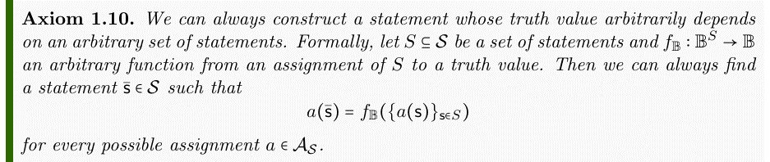
Statements as functions of other statements
This allows us to create functions of statements
In particular, we have negation (logical NOT), conjunction (logical AND) and disjunction (logical OR)
Note that logical operators are not symbolic connectors
They are algebraic operations

Slide 13
Formal system for informal statements
Those three axioms are enough to capture all the semantic structure we need to guarantee logical consistency even on informal statements
Any set of consistent statements that have a universal truth will fit the axioms
A set of inconsistent statements violates the second axiom as there would be no possible assignment

Slide 14
Statement equivalence
They allow to distinguish between different notions of equivalence
Are the same statement
“This animal is a bird” = “Questo animale e’ un uccello”
“This animal is a bird” ≡ “This animal has feathers”
truth(“This animal is a bird”) = truth(“That animal is a mammal”)
Must have the same truth
Happen to have the same truth

Slide 15
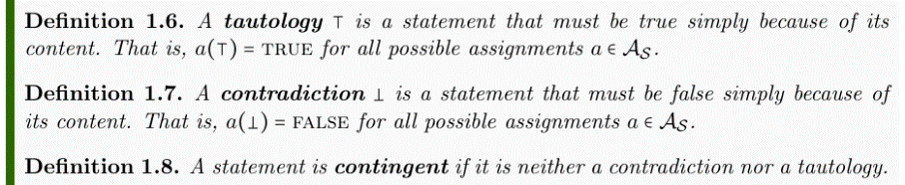
Tautologies and contradictions
We can distinguish between statements based on the truth values they are allowed
“This swan is a bird” is a tautology, “This cat is a dog” is a contradiction and “This animal is a cat” is contingent

Slide 16
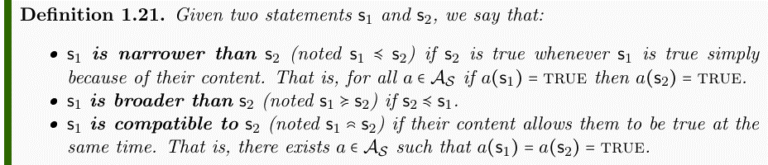
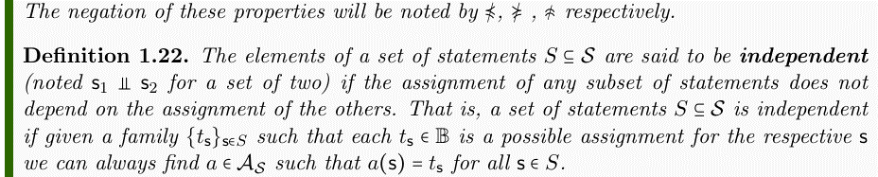
Other semantic relationships

Slide 17
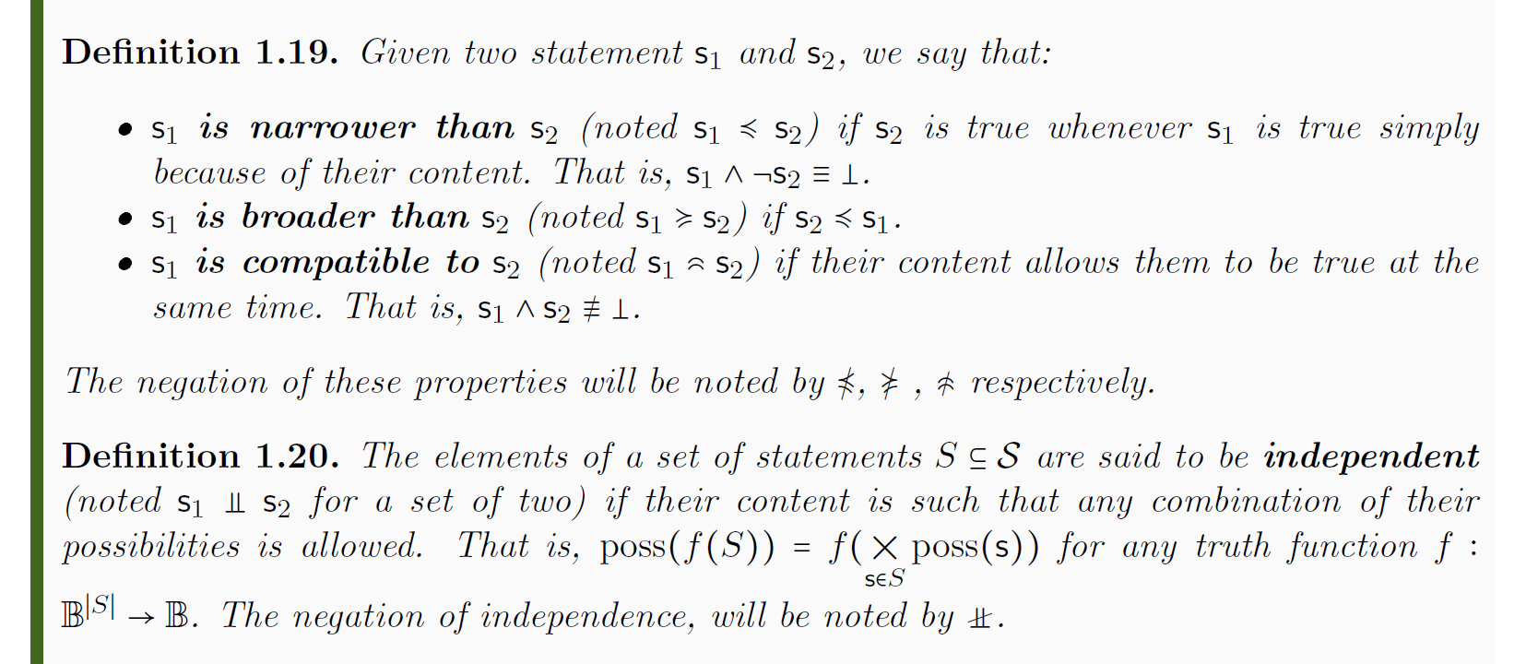
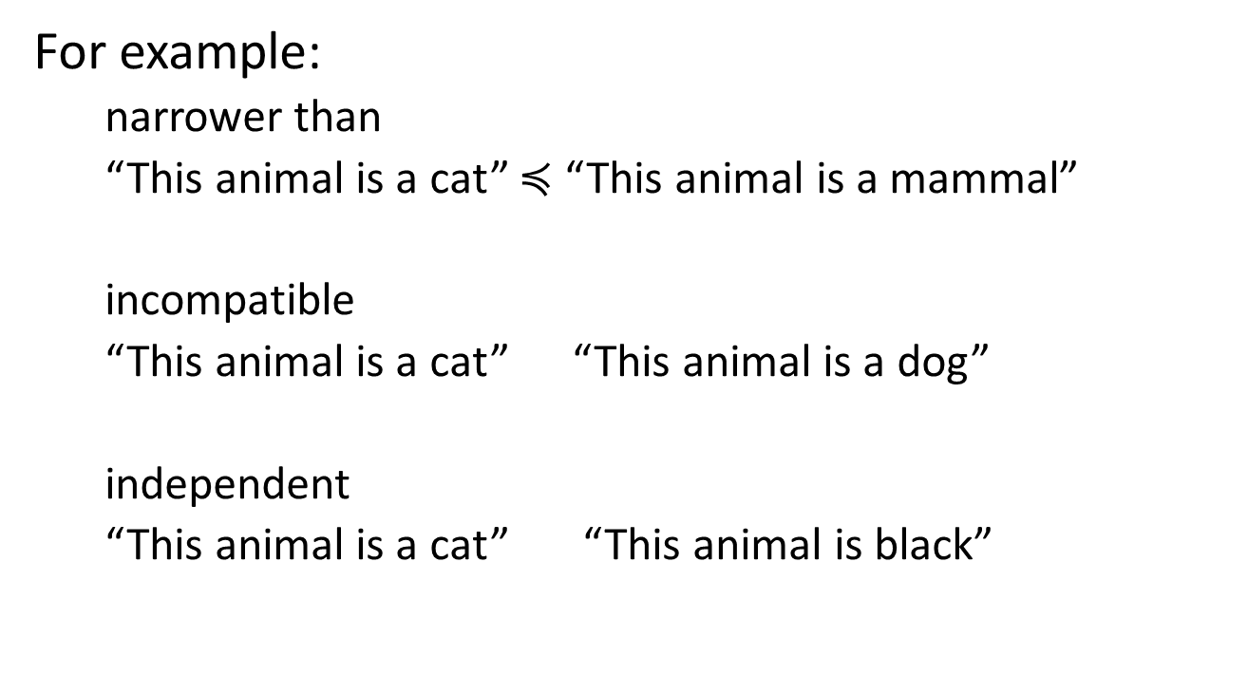
Other semantic relationships
For example:
narrower than
“This animal is a cat” $≼$ “This animal is a mammal”
incompatible
“This animal is a cat” “This animal is a dog”
independent
“This animal is a cat” “This animal is black”

Slide 18
Logical context as an algebraic structure
We can prove that a logical context is a complete Boolean algebra, that narrowness imposes a partial order, …
The algebraic structure we defined on the logical context captures the minimum logical and semantic relationships between our statements to guarantee universality and non-contradiction
Any further structure we impose on a logical context to capture other semantic relationships will need to interact with the previous structure in a well defined manner
That is, the notions of equivalence, independence, ordering, etc… defined on this structure will be inherited in some fashion by all other structures

Slide 19
Verifiable statements
Now that we have a framework rich enough to capture all the statement relationships we need, we turn our attention to experimental verification
A statement is verifiable if we have a repeatable procedure that terminates successfully in finite time if and only if the statement is true
This is hard to define formally so we won’t
Note that not all statements are experimentally verifiable
We can verify that “there exists extra-terrestrial life” or that “the mass of the photon is less than 10⁻¹⁸ eV”
We cannot verify that “there exists no extra-terrestrial life” or that “the mass of the photon is exactly 0 eV”

Slide 20
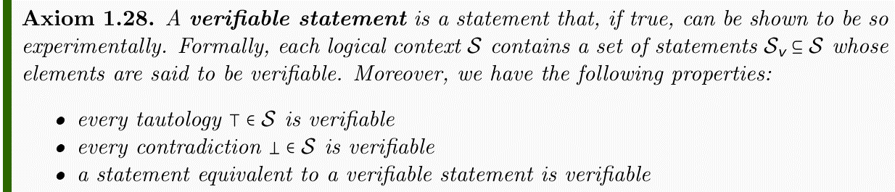
Verifiable statements
What makes a statement verifiable is not formally defined
There is a sense that trying to fully specify what can be measured is equivalent to already knowing the laws of physics
But we have to ask: under what operations is the set of verifiable statements closed?
Is it a Boolean algebra?

Slide 21
Logic of verifiable statements
We can’t always test negation
The test is not guaranteed to terminate if the test is unsuccessful
If we can, we say the statement is decidable
We can always test the finite conjunction
Just test one statement at a time: if they are all true all tests will terminate in finite time
We cannot have infinitely many tests though: we wouldn’t terminate in finite time
We can always test the countable disjunction
Once just one test terminates successfully, we are done
We cannot extend to uncountably many: we wouldn’t be able to find the test that terminates in finite time

Slide 22
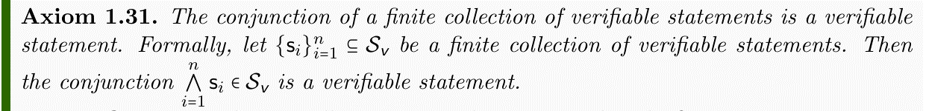
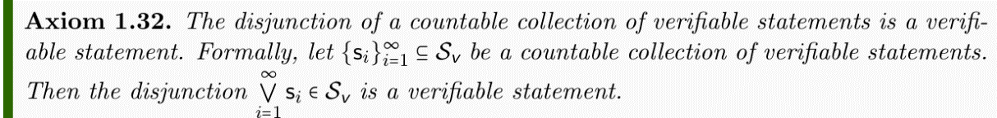
Logic of verifiable statements

Slide 23
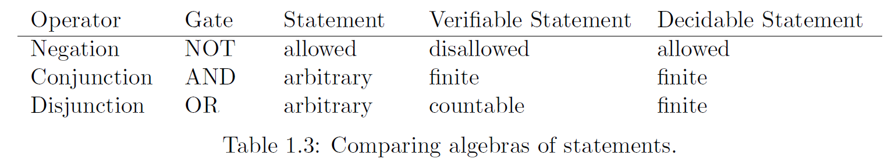



Comparing algebras
$$𝒮_{d}$$
$$𝒮_{v}$$
$$𝒮$$

Slide 24
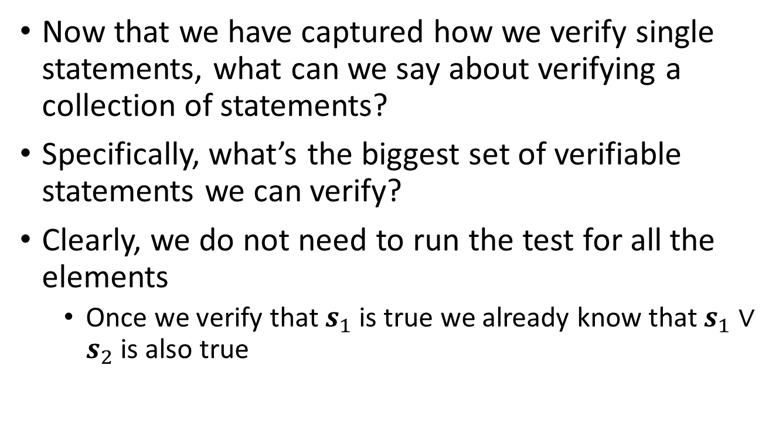
Sets of verifiable statements
Now that we have captured how we verify single statements, what can we say about verifying a collection of statements?
Specifically, what’s the biggest set of verifiable statements we can verify?
Clearly, we do not need to run the test for all the elements
Once we verify that $s_{1}$ is true we already know that $s_{1}∨s_{2}$ is also true

Slide 25
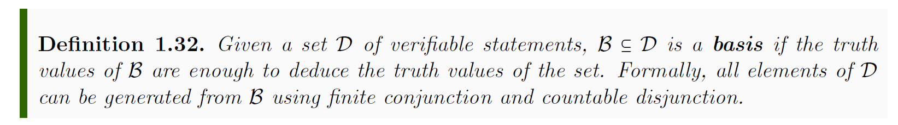
Basis
What is the biggest basis we can experimentally test?
A countable set
Even with unlimited time, we can only test countably many statements

Slide 26
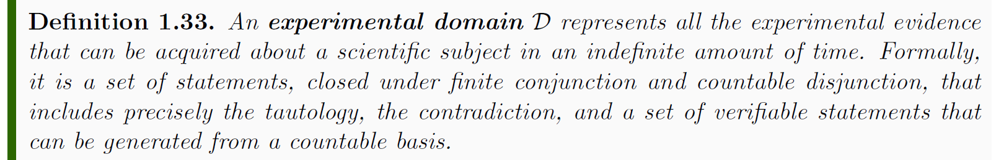
Experimental domain
This represents the biggest set of verifiable statements we can test
Any scientific theory, in the end, is equivalent to a set of verifiable statements, which forms at most an experimental domain

Slide 27
Predictions
Science is also about making predictions, but not all predictions are directly verifiable
For example, “there exists no extra-terrestrial life” predicts that the test for “there exists extra-terrestrial life” is never going to terminate
While we cannot always experimentally confirm negation, it still makes sense logically as a possible way things could be

Slide 28
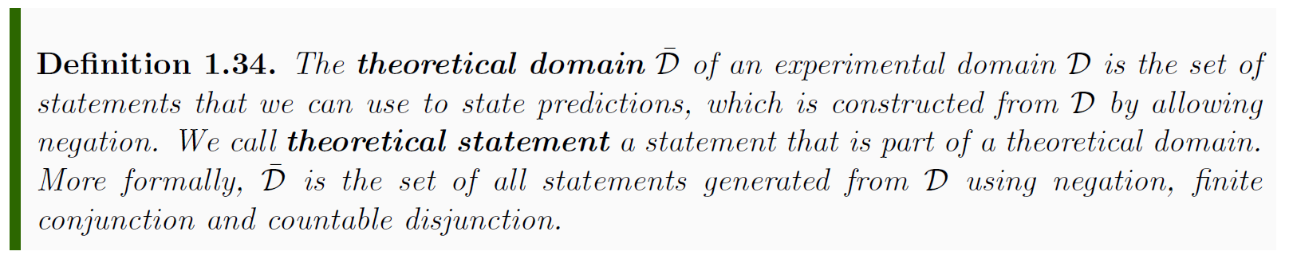
Theoretical domain
This represents all statements that give meaningful predictions to (and only to) the verifiable statements in the domain

Slide 29
Possibilities for the domain
Among all the predictions we look for the ones that give the full picture
For example, if we knew “This animal is a cat” to be true, we would also know that “This animal has whiskers” and “This animal is a mammal” are true while “This animal has feathers” is false

Slide 30
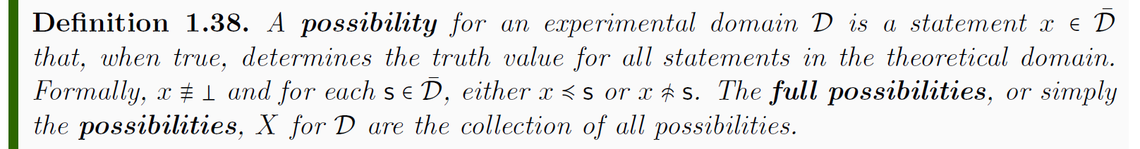
Possibilities for the domain
A possibility, if true, gives a prediction for all theoretical and verifiable statements
The set of possibilities corresponds to all the cases we can experimentally distinguish given the experimental domain

Slide 31
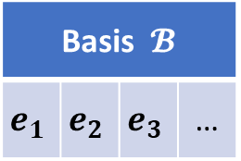
Start with a countable set of verifiable statements (the most we can verify experimentally)
Basis $𝓑$
$$e_{1}$$ | $$e_{2}$$ | $$e_{3}$$ | …

Slide 32
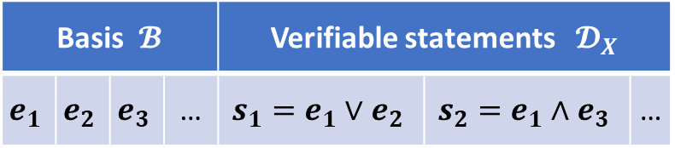
Construct all verifiable statements that can be verified from the basis (close under finite conjunction and countable disjunction)
Basis $𝓑$ |  |  |  | Verifiable statements $𝓓_{X}$
$$e_{1}$$ | $$e_{2}$$ | $$e_{3}$$ | … | $$s_{1}=e_{1}∨e_{2}$$ | $$s_{2}=e_{1}∧e_{3}$$ | …

Slide 33
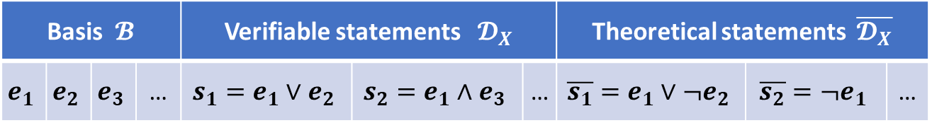
Construct all statements that give a prediction for those verifiable statements (close under negation as well)
Basis $𝓑$ |  |  |  | Verifiable statements $𝓓_{X}$ |  |  | Theoretical statements $\overline{𝓓_{X}}$
$$e_{1}$$ | $$e_{2}$$ | $$e_{3}$$ | … | $$s_{1}=e_{1}∨e_{2}$$ | $$s_{2}=e_{1}∧e_{3}$$ | … | $$\overline{s_{1}}=e_{1}∨¬e_{2}$$ | $$\overline{s_{2}}=¬e_{1}$$ | …

Slide 34
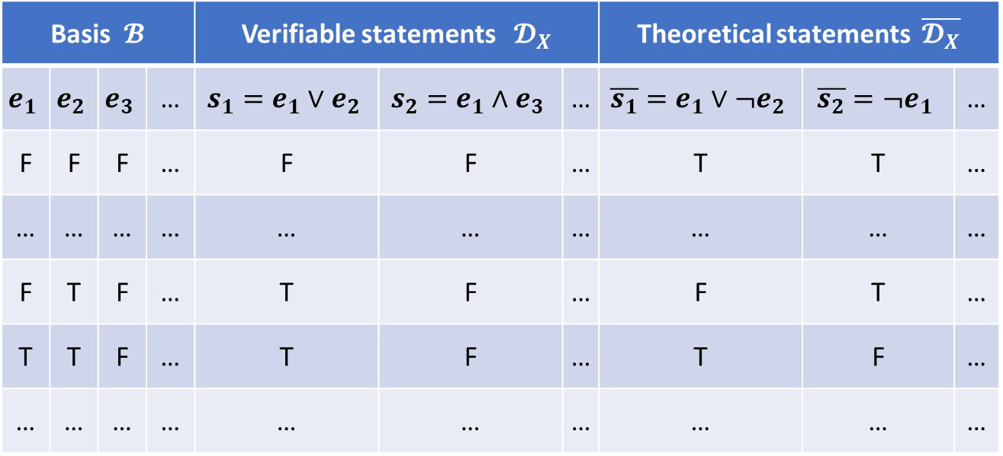
Consider all truth assignments: it is sufficient to assign the basis
Basis $𝓑$ |  |  |  | Verifiable statements $𝓓_{X}$ |  |  | Theoretical statements $\overline{𝓓_{X}}$
$$e_{1}$$ | $$e_{2}$$ | $$e_{3}$$ | … | $$s_{1}=e_{1}∨e_{2}$$ | $$s_{2}=e_{1}∧e_{3}$$ | … | $$\overline{s_{1}}=e_{1}∨¬e_{2}$$ | $$\overline{s_{2}}=¬e_{1}$$ | …
F | F | F | … | F | F | … | T | T | …
… | … | … | … | … | … | … | … | … | …
F | T | F | … | T | F | … | F | T | …
T | T | F | … | T | F | … | T | F | …
… | … | … | … | … | … | … | … | … | …

Slide 35
Remove truth assignments that are not possible
Basis $𝓑$ |  |  |  | Verifiable statements $𝓓_{X}$ |  |  | Theoretical statements $\overline{𝓓_{X}}$
$$e_{1}$$ | $$e_{2}$$ | $$e_{3}$$ | … | $$s_{1}=e_{1}∨e_{2}$$ | $$s_{2}=e_{1}∧e_{3}$$ | … | $$\overline{s_{1}}=e_{1}∨¬e_{2}$$ | $$\overline{s_{2}}=¬e_{1}$$ | …
F | F | F | … | F | F | … | T | T | …
… | … | … | … | … | … | … | … | … | …
F | T | F | … | T | F | … | F | T | …
T | T | F | … | T | F | … | T | F | …
… | … | … | … | … | … | … | … | … | …

Slide 36


Each consistent truth assignment is associated with a possibility of the domain
Basis $𝓑$ |  |  |  | Verifiable statements $𝓓_{X}$ |  |  | Theoretical statements $\overline{𝓓_{X}}$
$$e_{1}$$ | $$e_{2}$$ | $$e_{3}$$ | … | $$s_{1}=e_{1}∨e_{2}$$ | $$s_{2}=e_{1}∧e_{3}$$ | … | $$\overline{s_{1}}=e_{1}∨¬e_{2}$$ | $$\overline{s_{2}}=¬e_{1}$$ | …
F | F | F | … | F | F | … | T | T | …
… | … | … | … | … | … | … | … | … | …
F | T | F | … | T | F | … | F | T | …
T | T | F | … | T | F | … | T | F | …
… | … | … | … | … | … | … | … | … | …
Possibilities $X$
$$x=¬e_{1}∧e_{2}∧¬e_{3}∧…$$
For each consistent truth assignment we have a minterm that is true only in that case. Each minterm is a possibility of the domain.

Slide 37
Each consistent truth assignment is associated with a possibility of the domain
Basis $𝓑$ |  |  |  | Verifiable statements $𝓓_{X}$ |  |  | Theoretical statements $\overline{𝓓_{X}}$
$$e_{1}$$ | $$e_{2}$$ | $$e_{3}$$ | … | $$s_{1}=e_{1}∨e_{2}$$ | $$s_{2}=e_{1}∧e_{3}$$ | … | $$\overline{s_{1}}=e_{1}∨¬e_{2}$$ | $$\overline{s_{2}}=¬e_{1}$$ | …
F | F | F | … | F | F | … | T | T | …
… | … | … | … | … | … | … | … | … | …
F | T | F | … | T | F | … | F | T | …
T | T | F | … | T | F | … | T | F | …
… | … | … | … | … | … | … | … | … | …
Possibilities $X$
$$x=¬e_{1}∧e_{2}∧¬e_{3}∧…$$
For each consistent truth assignment we have a minterm that is true only in that case. Each minterm is a possibility of the domain.
The role of logic (and math) in science is to capture
what is consistent (i.e. the possibilities) and what is verifiable (i.e. the verifiable statements) and the corresponding logical relationships

Slide 38
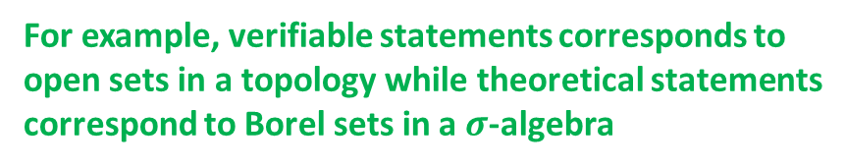
Each consistent truth assignment is associated with a possibility of the domain
Basis $𝓑$ |  |  |  | Verifiable statements $𝓓_{X}$ |  |  | Theoretical statements $\overline{𝓓_{X}}$
$$e_{1}$$ | $$e_{2}$$ | $$e_{3}$$ | … | $$s_{1}=e_{1}∨e_{2}$$ | $$s_{2}=e_{1}∧e_{3}$$ | … | $$\overline{s_{1}}=e_{1}∨¬e_{2}$$ | $$\overline{s_{2}}=¬e_{1}$$ | …
F | F | F | … | F | F | … | T | T | …
… | … | … | … | … | … | … | … | … | …
F | T | F | … | T | F | … | F | T | …
T | T | F | … | T | F | … | T | F | …
… | … | … | … | … | … | … | … | … | …
Possibilities $X$
$$x=¬e_{1}∧e_{2}∧¬e_{3}∧…$$
For each consistent truth assignment we have a minterm that is true only in that case. Each minterm is a possibility of the domain.
For example, verifiable statements corresponds to open sets in a topology while theoretical statements correspond to Borel sets in a $σ$-algebra

Slide 39
Basis $𝓑$ |  |  |  | Verifiable statements $𝓓_{X}$ |  |  | Theoretical statements $\overline{𝓓_{X}}$
$$e_{1}$$ | $$e_{2}$$ | $$e_{3}$$ | … | $$s_{1}=e_{1}∨e_{2}$$ | $$s_{2}=e_{1}∧e_{3}$$ | … | $$\overline{s_{1}}=e_{1}∨¬e_{2}$$ | $$\overline{s_{2}}=¬e_{1}$$ | …
F | F | F | … | F | F | … | T | T | …
… | … | … | … | … | … | … | … | … | …
F | T | F | … | T | F | … | F | T | …
T | T | F | … | T | F | … | T | F | …
… | … | … | … | … | … | … | … | … | …
Possibilities $X$
The lines of the truth table (i.e. the possible assignments) are the points

Slide 40
Basis $𝓑$ |  |  |  | Verifiable statements $𝓓_{X}$ |  |  | Theoretical statements $\overline{𝓓_{X}}$
$$e_{1}$$ | $$e_{2}$$ | $$e_{3}$$ | … | $$s_{1}=e_{1}∨e_{2}$$ | $$s_{2}=e_{1}∧e_{3}$$ | … | $$\overline{s_{1}}=e_{1}∨¬e_{2}$$ | $$\overline{s_{2}}=¬e_{1}$$ | …
F | F | F | … | F | F | … | T | T | …
… | … | … | … | … | … | … | … | … | …
F | T | F | … | T | F | … | F | T | …
T | T | F | … | T | F | … | T | F | …
… | … | … | … | … | … | … | … | … | …
Possibilities $X$
Each column is a set (i.e. the set of possibilities that are true in that column)

Slide 41
conjunction and disjunction becomes intersection and union
Basis $𝓑$ |  |  |  | Verifiable statements $𝓓_{X}$ |  |  | Theoretical statements $\overline{𝓓_{X}}$
$$e_{1}$$ | $$e_{2}$$ | $$e_{3}$$ | … | $$s_{1}=e_{1}∨e_{2}$$ | $$s_{2}=e_{1}∧e_{3}$$ | … | $$\overline{s_{1}}=e_{1}∨¬e_{2}$$ | $$\overline{s_{2}}=¬e_{1}$$ | …
F | F | F | … | F | F | … | T | T | …
… | … | … | … | … | … | … | … | … | …
F | T | F | … | T | F | … | F | T | …
T | T | F | … | T | F | … | T | F | …
… | … | … | … | … | … | … | … | … | …
Possibilities $X$
The experimental domain is the topology (i.e. each verifiable statement is an open set)

Slide 42
Basis $𝓑$ |  |  |  | Verifiable statements $𝓓_{X}$ |  |  | Theoretical statements $\overline{𝓓_{X}}$
$$e_{1}$$ | $$e_{2}$$ | $$e_{3}$$ | … | $$s_{1}=e_{1}∨e_{2}$$ | $$s_{2}=e_{1}∧e_{3}$$ | … | $$\overline{s_{1}}=e_{1}∨¬e_{2}$$ | $$\overline{s_{2}}=¬e_{1}$$ | …
F | F | F | … | F | F | … | T | T | …
… | … | … | … | … | … | … | … | … | …
F | T | F | … | T | F | … | F | T | …
T | T | F | … | T | F | … | T | F | …
… | … | … | … | … | … | … | … | … | …
Possibilities $X$
The basis of the experimental domain is a sub-basis of the topology

Slide 43
negation and countable disjunction becomes complement and countable union
Basis $𝓑$ |  |  |  | Verifiable statements $𝓓_{X}$ |  |  | Theoretical statements $\overline{𝓓_{X}}$
$$e_{1}$$ | $$e_{2}$$ | $$e_{3}$$ | … | $$s_{1}=e_{1}∨e_{2}$$ | $$s_{2}=e_{1}∧e_{3}$$ | … | $$\overline{s_{1}}=e_{1}∨¬e_{2}$$ | $$\overline{s_{2}}=¬e_{1}$$ | …
F | F | F | … | F | F | … | T | T | …
… | … | … | … | … | … | … | … | … | …
F | T | F | … | T | F | … | F | T | …
T | T | F | … | T | F | … | T | F | …
… | … | … | … | … | … | … | … | … | …
Possibilities $X$
The theoretical domain is the 𝝈-algebra (i.e. each theoretical statement is a Borel set)

Slide 44
Logical consistency and mathematics
Mathematical structures deal with logical consistency
Most mathematicians, in fact, focus on whether the objects are well defined and not whether they can be found in practice (e.g. axiom of choice)
As we want science to be logically consistent, physical theories will be mathematical structures but not all mathematical structures can be physical theories
For example, as an experimental domain must have a countable basis, the cardinality of the possibilities (the cases we can distinguish experimentally) is at most that of the continuum

Slide 45
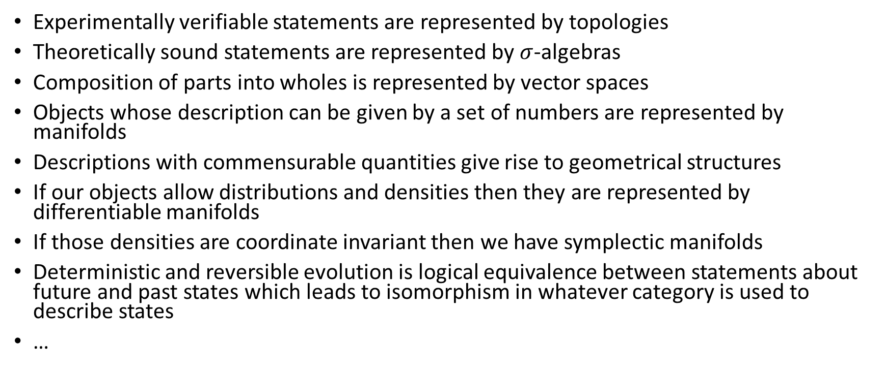
Mathematics captures the semantic structure
Experimentally verifiable statements are represented by topologies
Theoretically sound statements are represented by $σ$-algebras
Composition of parts into wholes is represented by vector spaces
Objects whose description can be given by a set of numbers are represented by manifolds
Descriptions with commensurable quantities give rise to geometrical structures
If our objects allow distributions and densities then they are represented by differentiable manifolds
If those densities are coordinate invariant then we have symplectic manifolds
Deterministic and reversible evolution is logical equivalence between statements about future and past states which leads to isomorphism in whatever category is used to describe states
…

Slide 46
Mathematics captures the semantic structure
Once the semantic structure of the theory is made clear, the mathematical structure follows and there is a perfect mapping between mathematical concepts and physical concepts
Every mathematical theorem can be read line by line as a physical argument
If there is no perfect mapping, then either the theory is incomplete (i.e. some physical concept is not captured by the mathematical framework) or not completely physical (i.e. some mathematical objects do not correspond to physical ones)
The converse is not true, even if the mathematical structure of a theory is made clear, its semantic structure cannot be reconstructed
Two different scientific theories can have the same mathematical structure

Slide 47
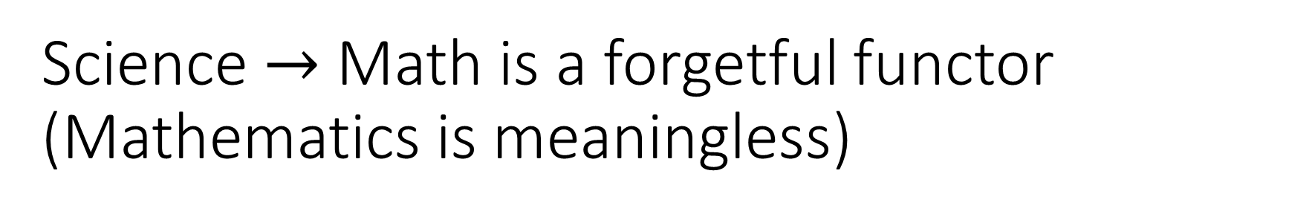
Science $→$ Math is a forgetful functor (Mathematics is meaningless)
Note that the way we made our discourse “precise” was not by making everything “precise” but by dropping what couldn’t be made precise
What is the meaning of a statement, what does it mean for it to be true, how does the meaning rule out assignments, when can we say that a statements is verifiable, … these cannot be formalized
But what is left out is the actual physics
the fact that those symbols represent statements in the real world, that the labels we use to identify statements represent quantities that correspond to specific measurements, that those statements have relationships

Slide 48
Reformulation
A model change, then, can then happen in two ways: within the same context or by changing context altogether
If the context/experimental domain is the same, we have a purely mathematical reformulation
the meaning of the statements must remain the same, what is verifiable is the same
we can only change how the relationships are captured mathematically
If the context/experimental domain is different, we have a different physical theory
the meaning of the statement may change, how tests are mapped to statements may change
unavoidable with new experimental techniques, different assumptions,
whether or not the mathematical structure is the same is inconsequential
Naturally, model changes are a continuum, they are never formalized, so whether a particular case falls in one category or the other can be a matter of opinio

Slide 49
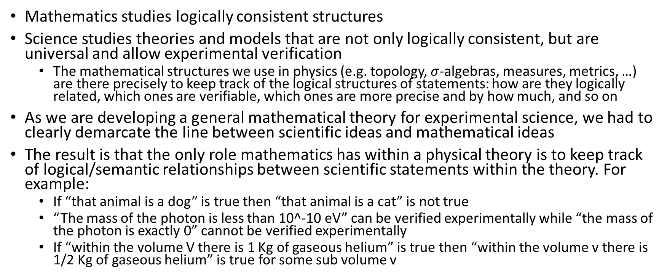
Conclusion
Mathematics studies logically consistent structures
Science studies theories and models that are not only logically consistent, but are universal and allow experimental verification
The mathematical structures we use in physics (e.g. topology, $σ$-algebras, measures, metrics, …) are there precisely to keep track of the logical structures of statements: how are they logically related, which ones are verifiable, which ones are more precise and by how much, and so on
As we are developing a general mathematical theory for experimental science, we had to clearly demarcate the line between scientific ideas and mathematical ideas
The result is that the only role mathematics has within a physical theory is to keep track of logical/semantic relationships between scientific statements within the theory. For example:
If “that animal is a dog” is true then “that animal is a cat” is not true
“The mass of the photon is less than 10^-10 eV” can be verified experimentally while “the mass of the photon is exactly 0” cannot be verified experimentally
If “within the volume V there is 1 Kg of gaseous helium” is true then “within the volume v there is 1/2 Kg of gaseous helium” is true for some sub volume v

Slide 50
General mathematical theory of experimental science
Experimental verifiability leads to topological spaces, sigma-algebras, …
State-level assumptions
Infinitesimal reducibility
leads to classical phase space
Irreducibility
leads to quantum state space
Process-level assumptions
Hamilton’s equations $\frac{d}{dt}\left(q, p\right)=\left(\frac{∂H}{∂p},−\frac{∂H}{∂q}\right)$
Deterministic and reversible evolution
leads to isomorphism on state space
Schroedinger equation $$ıℏ\frac{∂}{∂t}ψ=Hψ$$
Non-reversible evolution
Thermodynamics
Euler-Lagrange equations $δ∫L\left(q, \dot{q},t\right)=0$
…
Kinematic equivalence
leads to massive particles
For more information, see http://assumptionsofphysics.org

