Slide 1

The Fundamental Connections Between Classical Hamiltonian Mechanics, Quantum Mechanics and Information Entropy
Gabriele Carcassi and Christine Aidala
May 31, 2019
Quantum2019

Slide 2
Assumptions of Physics
This talk is part of a broader project called Assumptions of Physics (see http://assumptionsofphysics.org/)
The aim of the project is to find a handful of physical principles and assumptions from which the basic laws of physics can be derived
To do that we want to develop a general mathematical theory of experimental science: the theory that studies scientific theories
A formal framework that forces us to clarify our assumptions
From those assumptions the mathematical objects are derived
Each mathematical object has a clear physical meaning and no object is unphysical
Gives us concepts and tools that span across different disciplines
Allows to explore what happens when the assumptions fail, possibly leading to new physics ideas

Slide 3



General mathematical theory of experimental science
Experimental verifiability leads to topological spaces, sigma-algebras, …
State-level assumptions
Infinitesimal reducibility
leads to classical phase space
Irreducibility
leads to quantum state space
Process-level assumptions
Hamilton’s equations $\frac{d}{dt}\left(q, p\right)=\left(\frac{∂H}{∂p},−\frac{∂H}{∂q}\right)$
Deterministic and reversible evolution
leads to isomorphism on state space
Schroedinger equation $$ıℏ\frac{∂}{∂t}ψ=Hψ$$
Non-reversible evolution
Thermodynamics
Euler-Lagrange equations $δ∫L\left(q, \dot{q},t\right)=0$
…
Kinematic equivalence
leads to massive particles

Slide 4
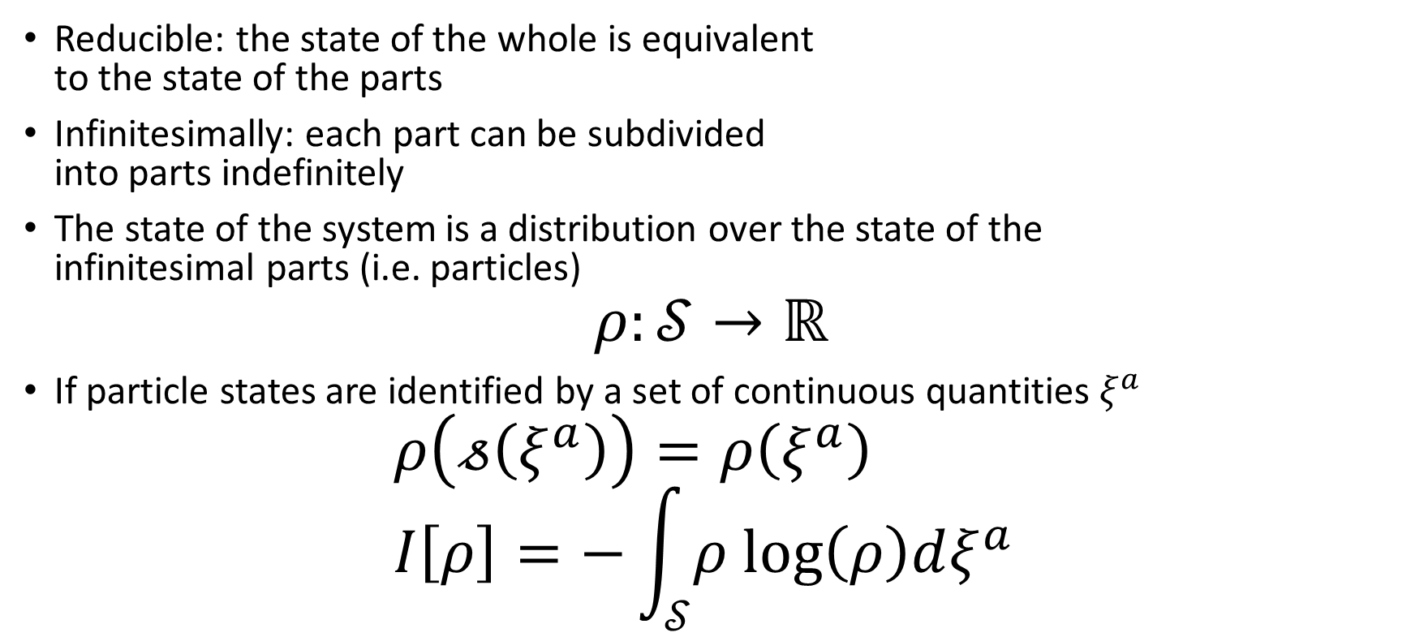
Assumption of infinitesimal reducibility
Reducible: the state of the whole is equivalent to the state of the parts
Infinitesimally: each part can be subdivided into parts indefinitely
The state of the system is a distribution over the state of the infinitesimal parts (i.e. particles)
$$ρ:𝒮→ℝ$$
If particle states are identified by a set of continuous quantities $ξ^{a}$
$$ρ\left(𝓈\left(ξ^{a}\right)\right)=ρ\left(ξ^{a}\right) \\ I\left[ρ\right]=−\int_{𝒮}{ρ log\left(ρ\right)dξ^{a} }$$

Slide 5
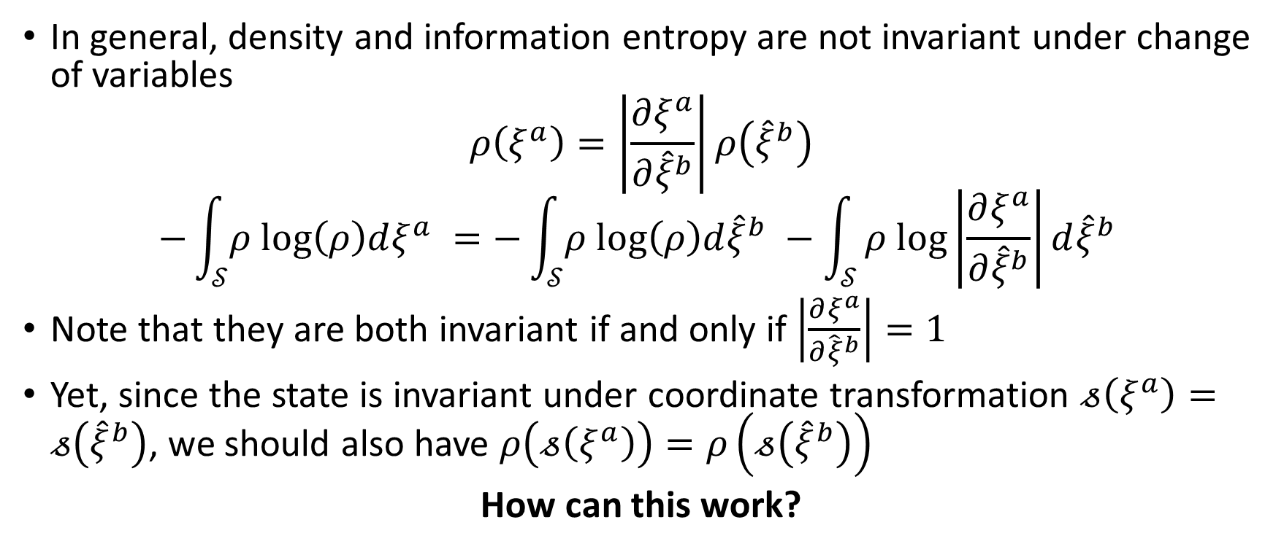
Distributions and change of variables
In general, density and information entropy are not invariant under change of variables
$$ρ\left(ξ^{a}\right)=\left|\frac{∂ξ^{a}}{∂{\hat{ξ}}^{b}}\right|ρ\left({\hat{ξ}}^{b}\right)$$
$$−\int_{𝒮}{ρ log\left(ρ\right)dξ^{a} }=−\int_{𝒮}{ρ log\left(ρ\right)d{\hat{ξ}}^{b} }−\int_{𝒮}{ρ log\left|\frac{∂ξ^{a}}{∂{\hat{ξ}}^{b}}\right|d{\hat{ξ}}^{b} }$$
Note that they are both invariant if and only if $\left|\frac{∂ξ^{a}}{∂{\hat{ξ}}^{b}}\right|=1$
Yet, since the state is invariant under coordinate transformation $𝓈\left(ξ^{a}\right)=𝓈\left({\hat{ξ}}^{b}\right)$, we should also have $ρ\left(𝓈\left(ξ^{a}\right)\right)=ρ\left(𝓈\left({\hat{ξ}}^{b}\right)\right)$
How can this work?

Slide 6
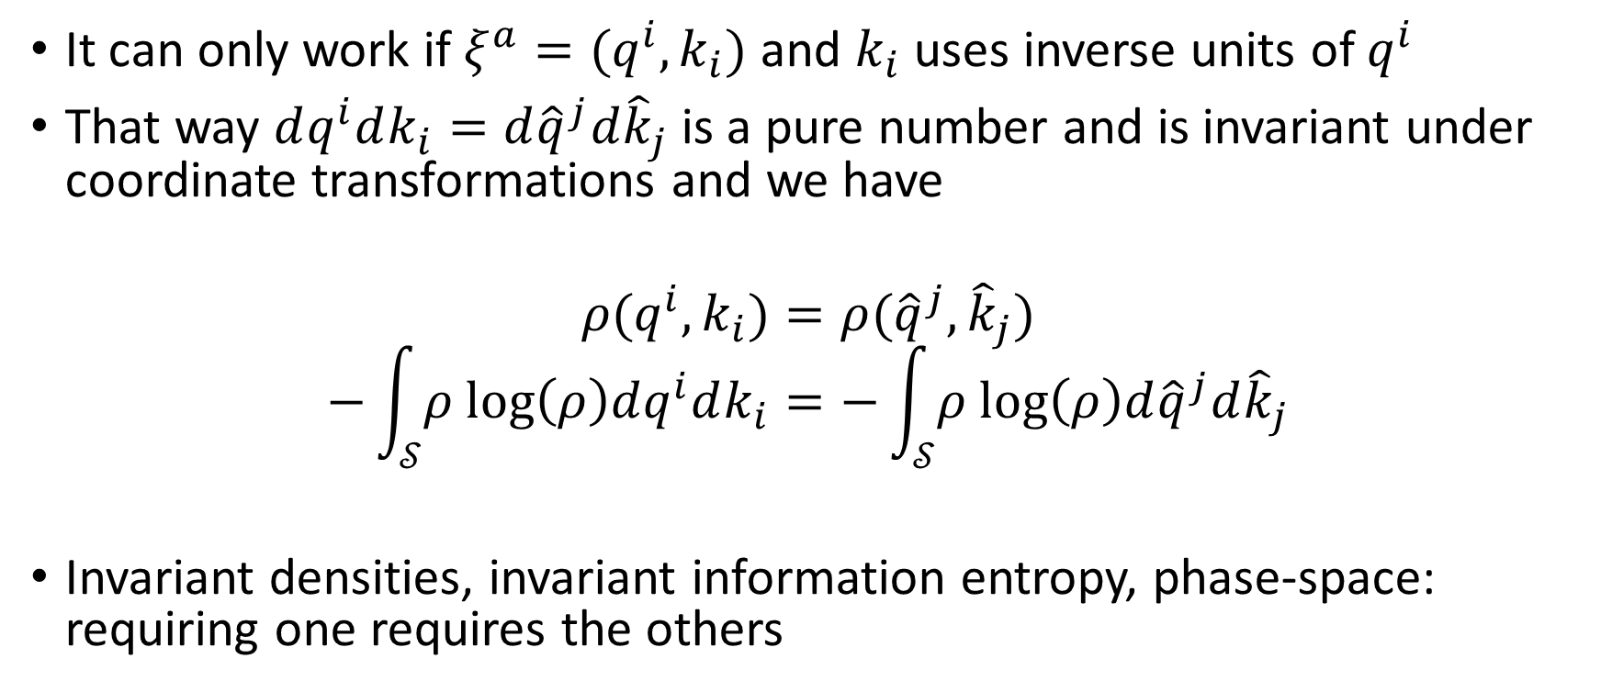
Invariant distributions
It can only work if $ξ^{a}=(q^{i},k_{i})$ and $k_{i}$ uses inverse units of $q^{i}$
That way $dq^{i}dk_{i}=d{\hat{q}}^{j}d{\hat{k}}_{j}$ is a pure number and is invariant under coordinate transformations and we have
$$ρ(q^{i},k_{i})=ρ({\hat{q}}^{j},{\hat{k}}_{j})$$
$$−\int_{𝒮}{ρ log\left(ρ\right)dq^{i}dk_{i}}=−\int_{𝒮}{ρ log\left(ρ\right)d{\hat{q}}^{j}d{\hat{k}}_{j}}$$
Invariant densities, invariant information entropy, phase-space: requiring one requires the others

Slide 7
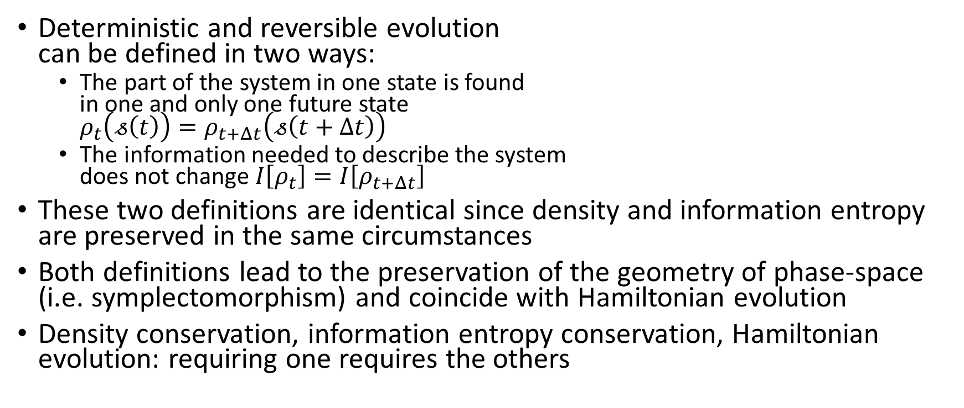
Deterministic and reversible evolution
Deterministic and reversible evolution can be defined in two ways:
The part of the system in one state is found in one and only one future state $ρ_{t}\left(𝓈\left(t\right)\right)=ρ_{t+Δt}\left(𝓈\left(t+Δt\right)\right)$
The information needed to describe the system does not change $I\left[ρ_{t}\right]=I\left[ρ_{t+Δt}\right]$
These two definitions are identical since density and information entropy are preserved in the same circumstances
Both definitions lead to the preservation of the geometry of phase-space (i.e. symplectomorphism) and coincide with Hamiltonian evolution
Density conservation, information entropy conservation, Hamiltonian evolution: requiring one requires the others
time

Slide 8
Deterministic and reversible evolution
Deterministic and reversible evolution (i.e. state densities are mapped one-to-one)
System isolation (i.e. the state of the system does not depend on anything else)
Conservation of information entropy (i.e. the information required to describe the system does not change in time)
Conservation of energy (i.e. Hamiltonian evolution)
These four concepts are the same concept from different angles

Slide 9
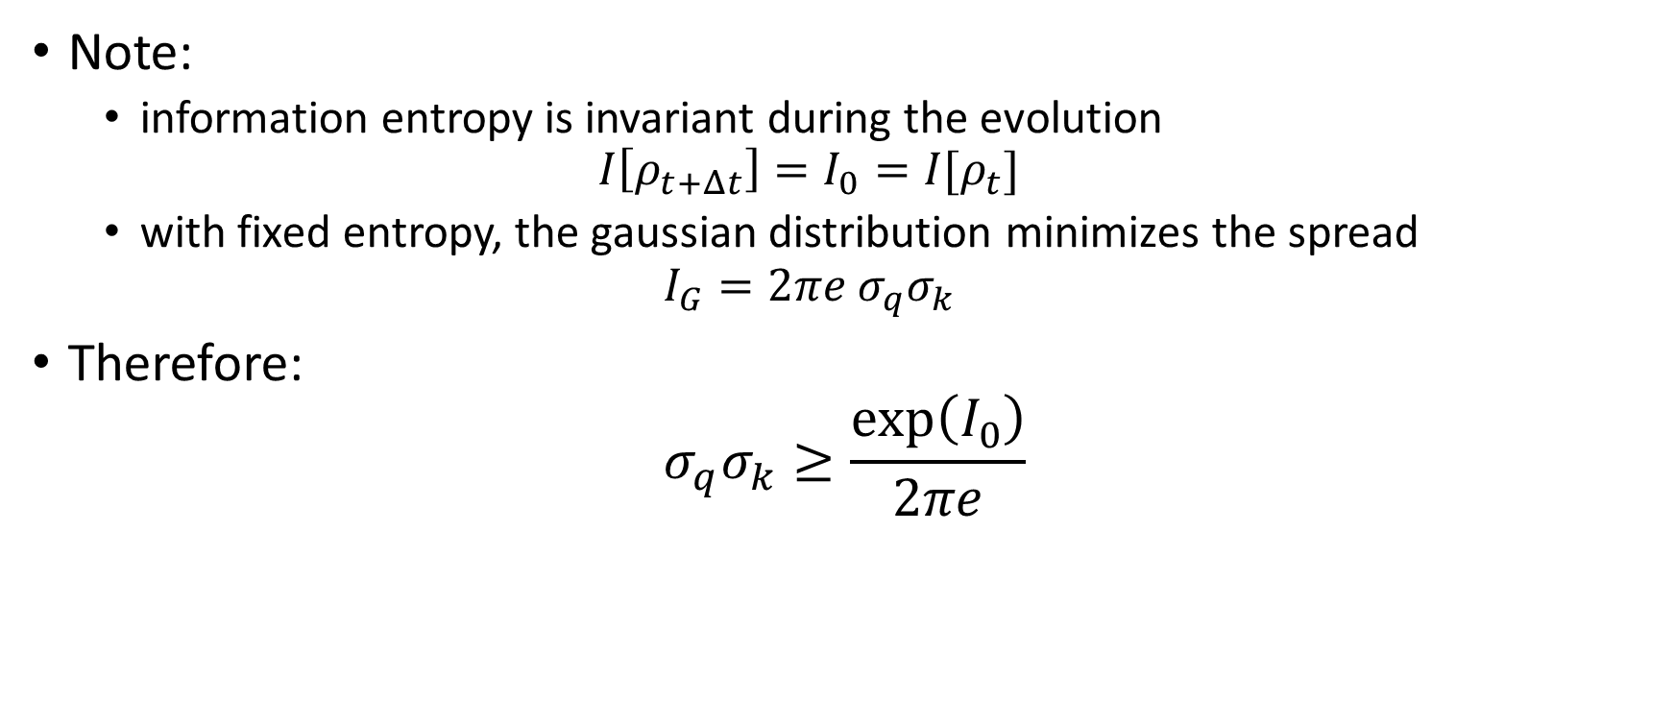
Classical uncertainty
Note:
information entropy is invariant during the evolution $I\left[ρ_{t+Δt}\right]=I_{0}=I[ρ_{t}]$
with fixed entropy, the gaussian distribution minimizes the spread $I_{G}=2πe σ_{q}σ_{k}$
Therefore:
$$σ_{q}σ_{k}≥\frac{\exp\left(I_{0}\right)}{2πe}$$

Slide 10

Classical state
$$ρ(q^{i},k_{i})$$
Information Entropy
time
0
We always have access to the internal dynamics
Any initial value for information entropy is allowed: we can study arbitrarily small parts

Slide 11

Classical state
Quantum state
$$ρ(q^{i},k_{i})$$
$$ψ(q^{i})$$
Information Entropy
?
time
time
0
We always have access to the internal dynamics
We have no access to the internal dynamics
Any initial value for information entropy is allowed: we can study arbitrarily small parts
All pure quantum states have the same information entropy (i.e. zero): no description for parts

Slide 12
Information about the internal dynamics
Consider a muon
while we can’t predict when and how, it will (most likely) decay into an electron and two neutrinos
if we assume it’s the internal dynamics that causes the decay, then information about the internal dynamics is mapped to the state of the decay products
It is difficult to imagine that any process where the particle number changes (e.g. absorption, emission, decay) will not “expose” or “hide” information about the internal dynamics
More or less information is now accessible
Neither classical mechanics nor quantum mechanics would be able to properly describe this case

Slide 13
Conclusions
Even in physics, we can proceed deductively, from physical assumptions to mathematical equations
Deterministic and reversible evolution, system isolation, conservation of information entropy and conservation of energy are different aspects of the same concept
If you want to understand when each one is violated, you probably need to understand how all are violated
The “only” difference between a classical and a quantum system is what one can tell about the parts of the system
In classical mechanics everything; in quantum mechanics nothing
Physical theories are about large systems being conceptually divided into small parts, not about small parts being combined into large systems
We start from large systems (i.e. planets, balls) and can progressively study the internal dynamics in terms of smaller and smaller systems (i.e. molecules, atoms, fundamental particles). The game stops not because there is no more internal dynamics but because it is not (yet?) accessible.

Slide 14



General mathematical theory of experimental science
Experimental verifiability leads to topological spaces, sigma-algebras, …
State-level assumptions
Infinitesimal reducibility
leads to classical phase space
Irreducibility
leads to quantum state space
Process-level assumptions
Hamilton’s equations $\frac{d}{dt}\left(q, p\right)=\left(\frac{∂H}{∂p},−\frac{∂H}{∂q}\right)$
Deterministic and reversible evolution
leads to isomorphism on state space
Schroedinger equation $$ıℏ\frac{∂}{∂t}ψ=Hψ$$
Non-reversible evolution
Thermodynamics
Euler-Lagrange equations $δ∫L\left(q, \dot{q},t\right)=0$
…
Kinematic equivalence
leads to massive particles

Slide 15
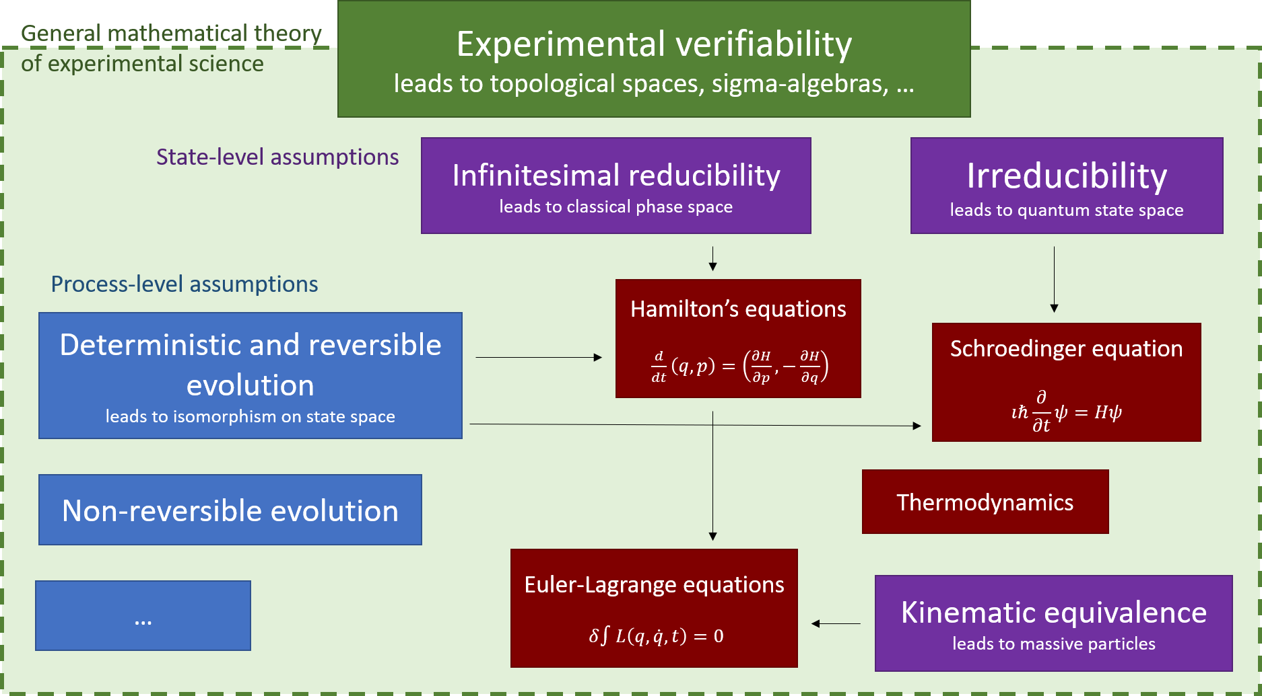
For more information
From physical assumptions to classical and quantum Hamiltonian and Lagrangian particle mechanics Gabriele Carcassi et al 2018 J. Phys. Commun. 2 045026
Topology and Experimental Distinguishability Christine A. Aidala, Gabriele Carcassi, and Mark J. Greenfield, Top. Proc. 54 (2019) pp. 271-282
Assumptions of Physics project website: http://assumptionsofphysics.org/

