Slide 1



Uncovering the Assumptions of Physics
$$𝒮_{d}$$
$$𝒮_{v}$$
time
$$𝒮$$
Christine A. Aidala
Physics Department, University of Michigan
In collaboration with Gabriele Carcassi
http://assumptionsofphysics.org/
?
time
time

Slide 2
Assumptions of Physics
The aim of the project is to find a handful of physical principles and assumptions from which the basic laws of physics can be derived
To do that we want to develop a general mathematical theory of experimental science: the theory that studies scientific theories
A formal framework that forces us to clarify our assumptions
From those assumptions the mathematical objects are derived
Each mathematical object has a clear physical meaning and no object is unphysical
Gives us concepts and tools that span across different disciplines
Gives us a better understanding of what the laws of physics are and what they represent

Slide 3



General mathematical theory of experimental science
Experimental verifiability leads to topological spaces, sigma-algebras, …
State-level assumptions
Infinitesimal reducibility
leads to classical phase space
Irreducibility
leads to quantum state space
Process-level assumptions
Hamilton’s equations $\frac{d}{dt}\left(q, p\right)=\left(\frac{∂H}{∂p},−\frac{∂H}{∂q}\right)$
Deterministic and reversible evolution
leads to isomorphism on state space
Schroedinger equation $$ıℏ\frac{∂}{∂t}ψ=Hψ$$
Non-reversible evolution
Thermodynamics
Euler-Lagrange equations $δ∫L\left(q, \dot{q},t\right)=0$
…
Kinematic equivalence
leads to massive particles

Slide 4
Assumptions of Physics
The scope of the project is broad, touching elements of many different disciplines
Yet it is the ability to see how the different pieces fit that makes it very rewarding
In this talk we’ll go through at least the major starting points and hopefully give a sense of how they lead to certain branches of known physics, and the types of insight this approach can provide

Slide 5
Principle of Scientific Objectivity
Science is:
universal (same for everybody)
non-contradictory (logically consistent)
evidence-based (experimentally verifiable)

Slide 6
Verifiable statements
The principle of scientific objectivity tells us that science deals with assertions that are:
either true or false (non-contradictory)
for everybody (universal)
and experimentally verifiable (evidence-based)
We call such assertions verifiable statements
The first two requirements are the same as in classical logic.
The third means we have an experimental test that we can run and, if the statement is true, it completes successfully in finite time

Slide 7
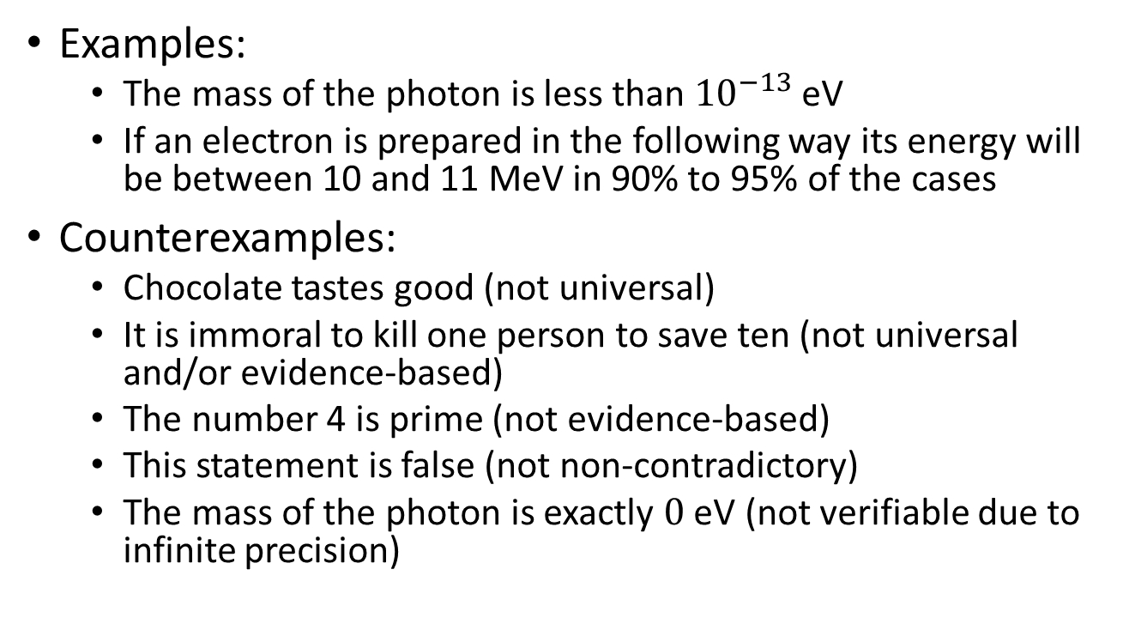
Examples of verifiable statements
Examples:
The mass of the photon is less than ${10}^{−13}$ eV
If an electron is prepared in the following way its energy will be between 10 and 11 MeV in 90% to 95% of the cases
Counterexamples:
Chocolate tastes good (not universal)
It is immoral to kill one person to save ten (not universal and/or evidence-based)
The number 4 is prime (not evidence-based)
This statement is false (not non-contradictory)
The mass of the photon is exactly $0$ eV (not verifiable due to infinite precision)

Slide 8
Logic of verifiable statements (negation)
Due to finite time verification, verifiable statements do not allow the same operations (i.e. the same algebra) as logical statements
For example, we may consider “there exists extra-terrestrial life” a verifiable statement with the following test
1. Point a radio-telescope in a particular direction
2. If signs of life are found, terminate successfully
3. Go back to 1 with a new direction or with greater sensitivity
But this test does not verify “there doesn’t exist extra-terrestrial life”, since it would never terminate in this case
The negation of a verifiable statement is not necessarily verifiable
We call decidable statements those for which the negation is also verifiable (i.e. the test always terminates either successfully or not)

Slide 9
Logic of verifiable statements (conjunction)
We can take a set of verifiable statements and create the conjunction (i.e. the logical AND)
“The horizontal velocity of the ball is between 0 and 1 m/s” AND “the vertical velocity of the ball is between 3 and 4 m/s”
Since we can verify each statement, we simply verify all of them one at a time. But we can only combine finitely many statements, or we would never finish checking all of them.
The finite conjunction of verifiable statements is a verifiable statement

Slide 10
Logic of verifiable statements (disjunction)
We can take a set of verifiable statements and create the disjunction (i.e. the logical OR)
“The horizontal velocity of the ball is between 0 and 1 m/s” OR “the horizontal of the ball is between 3 and 4 m/s”
Since we can verify each statement, we can verify them one at a time and, as long as one is verified, the disjunction is verified. Since we don’t need to verify all of them, we can combine infinitely many. But they have to be countably many or we wouldn’t find the test that terminates in finite time.
The countable disjunction of verifiable statements is a verifiable statement

Slide 11
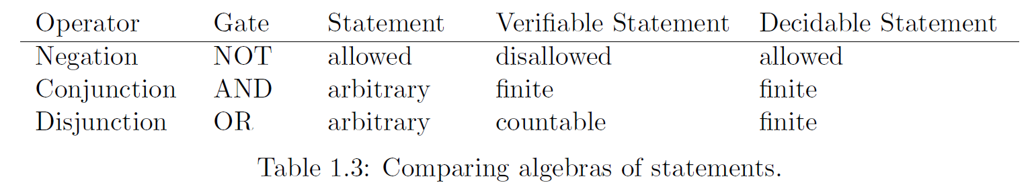



Logic of verifiable statements
We can summarize the different algebras for the different types of statements
In a physical theory we will need to keep track of which statements are decidable, which are verifiable and which are neither
$$𝒮_{d}$$
$$𝒮_{v}$$
$$𝒮$$

Slide 12
Scientific models and domains
A scientific model or theory, then, is fully specified by a set of verifiable statements, which, together with their algebra, forms the most fundamental mathematical structure in our general theory: an experimental domain
The set has to be countable because, even with infinite time, we can’t verify more than those
The possible cases identified in the theory are those experimentally distinguishable
The finiteness required by experimental verification is a major constraint on what mathematical structures are possible in experimental science
For example, a set of physically distinguishable cases will never have cardinality greater than that of the continuum

Slide 13
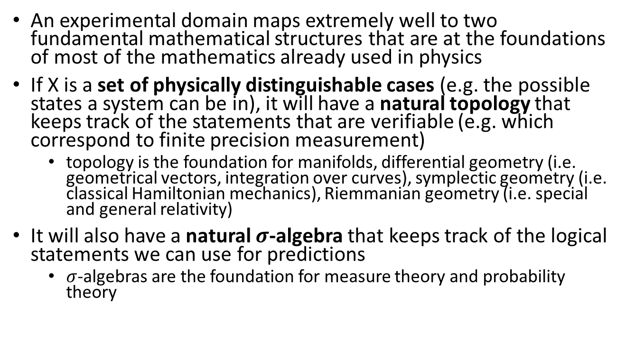

Link to topology and $σ$-algebras
An experimental domain maps extremely well to two fundamental mathematical structures that are at the foundations of most of the mathematics already used in physics
If X is a set of physically distinguishable cases (e.g. the possible states a system can be in), it will have a natural topology that keeps track of the statements that are verifiable (e.g. which correspond to finite precision measurement)
topology is the foundation for manifolds, differential geometry (i.e. geometrical vectors, integration over curves), symplectic geometry (i.e. classical Hamiltonian mechanics), Riemmanian geometry (i.e. special and general relativity)
It will also have a natural $σ$-algebra that keeps track of the logical statements we can use for predictions
$σ$-algebras are the foundation for measure theory and probability theory

Slide 14
Takeaway
Specifying a scientific theory means specifying a (countable) set of verifiable statements and their logical relationships. The role of mathematical structures in physics is to formalize the logical relationships between verifiable statements.
The mere requirement of experimental verification (i.e. the algebra of verifiable statements) already provides a link to two fundamental mathematical structures, which therefore we can always use in any physical theory
The idea is that we can rebuild the other mathematical structures piece by piece so that we spell out the physical assumptions implicit in the most primitive objects, like quantities represented by integers and real numbers
For example, measuring distance with a ruler can be broken down into more fundamental verifiable statements like “the object is after the 5 cm mark”, “the object is before the 5.3 cm mark”
Nothing will need to be interpreted, there will be no unphysical mathematical artifacts, all mathematical proofs will correspond to physical arguments carried out formally

Slide 15
Assumption of Determinism and Reversibility
The system undergoes deterministic and reversible time evolution: given the initial state, we can identify the final state; given the final state, we can reconstruct the initial state
time

Slide 16
Determinism and reversibility
Naively one may think determinism and reversibility is simply a one-to-one map between states, but if we focus on the verifiable statements about the states we realize that it has to be much more constrained
Every verifiable statement about the initial state has to map to a verifiable statement about the final state and vice-versa
As verifiable statements are captured by a topology, the transformation has to be a homeomorphism (i.e. a continuous transformation with continuous inverse)
On the real numbers, in fact, continuous transformations map finite precision measurements to finite precision measurements

Slide 17
Determinism and reversibility
If our state is described by a density distribution in some space, then finite densities have to map to finite densities
This means the transformation has to be a diffeomorphism (i.e. differentiable transformation) as the Jacobian always needs to be well defined
If our state is composed of parts, then the evolution of the composition has to be the composition of the evolution of the parts
If we use vector spaces to capture state composition (i.e. addition) then the evolution must be a linear transformation
If the state has a “magnitude” (e.g. amount of material, total probability) then the magnitude needs to be conserved
If we use a norm to capture the magnitude then the evolution must be a unitary transformation

Slide 18
Takeaway
Determinism and reversibility is more than a one-to-one map: it has to preserve the nature of the system and the type of description
Mathematically it will be an isomorphism in the category used to capture states, the associated verifiable statements, and their logical structure
Determinism and reversibility is an assumption that can be taken to be valid in specific contexts with specific state definitions
The state of a balloon is position and velocity or pressure and volume depending whether we study its motion or its expansion. If we puncture the balloon, neither of those state definitions is sufficient to predict the future states and the evolution is not deterministic and reversible.

Slide 19
Assumption of Infinitesimal Reducibility
The system is reducible to its parts: giving the state of the whole is equivalent to giving the state of the parts. The system can be subdivided indefinitely.
time

Slide 20
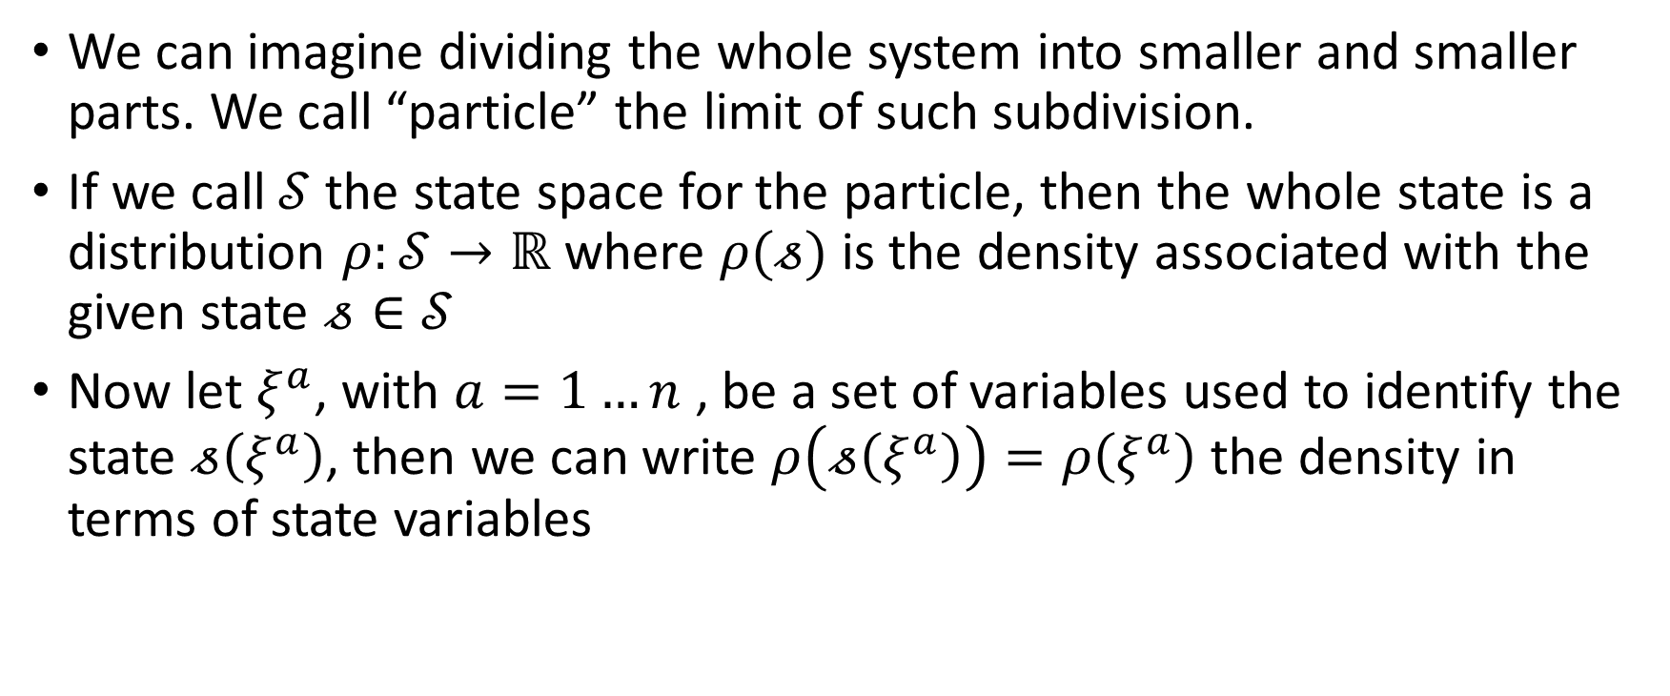
State is a distribution over particle states
We can imagine dividing the whole system into smaller and smaller parts. We call “particle” the limit of such subdivision.
If we call $𝒮$ the state space for the particle, then the whole state is a distribution $ρ:𝒮→ℝ$ where $ρ(𝓈)$ is the density associated with the given state $𝓈∈𝒮$
Now let $ξ^{a}$, with $a=1…n$ , be a set of variables used to identify the state $𝓈\left(ξ^{a}\right)$, then we can write $ρ\left(𝓈\left(ξ^{a}\right)\right)=ρ\left(ξ^{a}\right)$ the density in terms of state variables

Slide 21
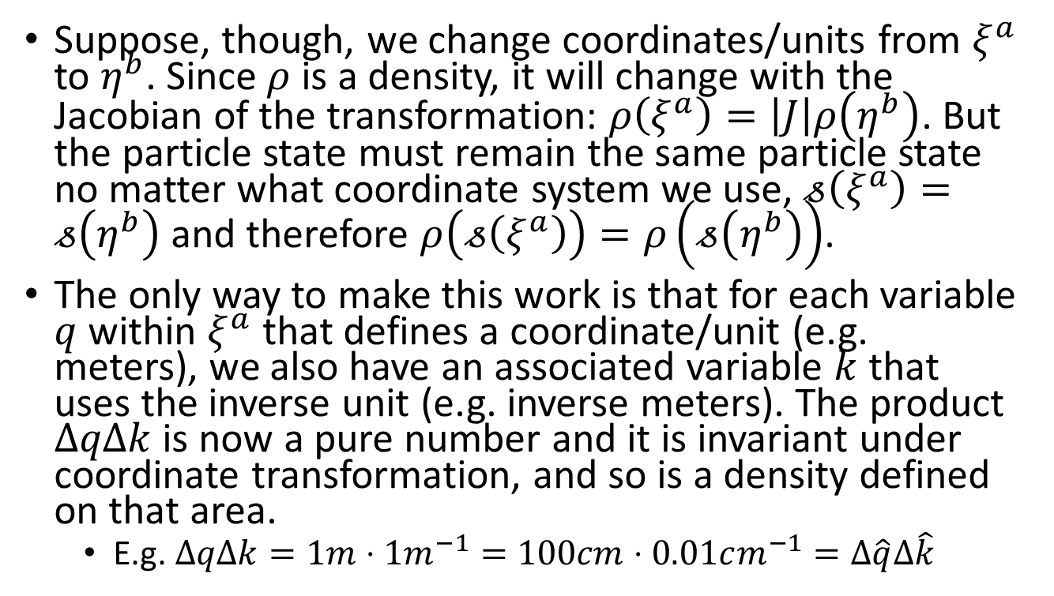
Invariant distributions
Suppose, though, we change coordinates/units from $ξ^{a}$ to $η^{b}$. Since $ρ$ is a density, it will change with the Jacobian of the transformation: $ρ\left(ξ^{a}\right)=\left|J\right|ρ\left(η^{b}\right)$. But the particle state must remain the same particle state no matter what coordinate system we use, $𝓈\left(ξ^{a}\right)=𝓈\left(η^{b}\right)$ and therefore $ρ\left(𝓈\left(ξ^{a}\right)\right)=ρ\left(𝓈\left(η^{b}\right)\right)$.
The only way to make this work is that for each variable $q$ within $ξ^{a}$ that defines a coordinate/unit (e.g. meters), we also have an associated variable $k$ that uses the inverse unit (e.g. inverse meters). The product $ΔqΔk$ is now a pure number and it is invariant under coordinate transformation, and so is a density defined on that area.
E.g. $ΔqΔk=1m⋅1m^{−1}=100cm⋅0.01cm^{−1}=Δ\hat{q}Δ\hat{k}$

Slide 22
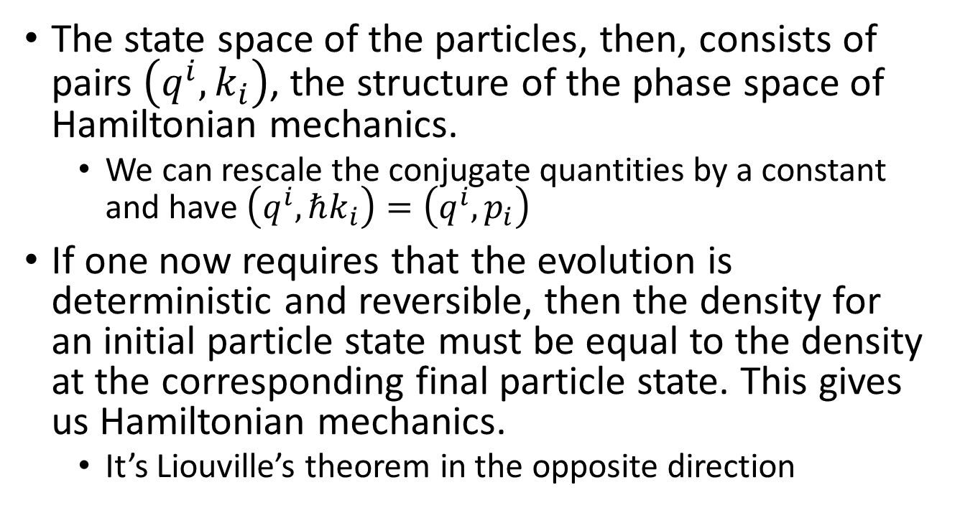
Hamiltonian mechanics
The state space of the particles, then, consists of pairs $\left(q^{i},k_{i}\right)$, the structure of the phase space of Hamiltonian mechanics.
We can rescale the conjugate quantities by a constant and have $\left(q^{i},ℏk_{i}\right)=\left(q^{i},p_{i}\right)$
If one now requires that the evolution is deterministic and reversible, then the density for an initial particle state must be equal to the density at the corresponding final particle state. This gives us Hamiltonian mechanics.
It’s Liouville’s theorem in the opposite direction

Slide 23
Takeaways
Hamiltonian mechanics is the deterministic and reversible evolution of infinitesimal parts of a reducible system
Both the structure of the state space and the laws of evolution are derived
That is, we know why the laws of motion are differentiable and why we have conjugate pairs of state variables
If the future and past states are determined only by the present state, then the state of other systems does not matter: the system is isolated. Therefore we have shown that an isolated system conserves energy.
Note that this was derived as a consequence of the mere definitions

Slide 24
Assumption of Kinematic Equivalence
Studying the motion (kinematics) is equivalent to studying the state evolution (dynamics). That is, giving the trajectory is equivalent to giving the state.

Slide 25
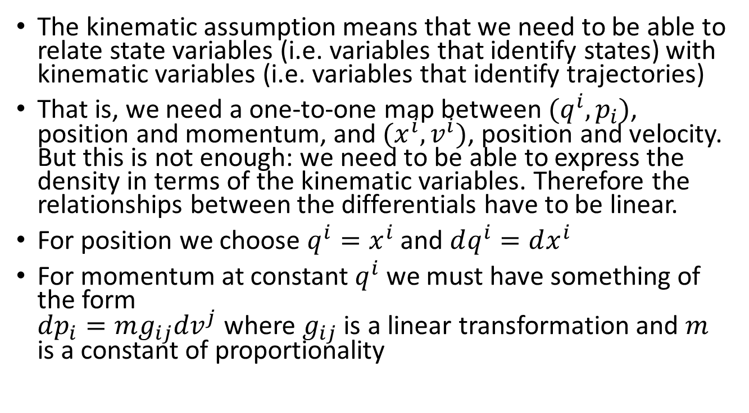
States and trajectories
The kinematic assumption means that we need to be able to relate state variables (i.e. variables that identify states) with kinematic variables (i.e. variables that identify trajectories)
That is, we need a one-to-one map between $(q^{i},p_{i})$, position and momentum, and $(x^{i}, v^{i})$, position and velocity. But this is not enough: we need to be able to express the density in terms of the kinematic variables. Therefore the relationships between the differentials have to be linear.
For position we choose $q^{i}=x^{i}$ and $dq^{i}=dx^{i}$
For momentum at constant $q^{i}$ we must have something of the form $dp_{i}=mg_{ij}{dv}^{j}$ where $g_{ij}$ is a linear transformation and $m$ is a constant of proportionality

Slide 26
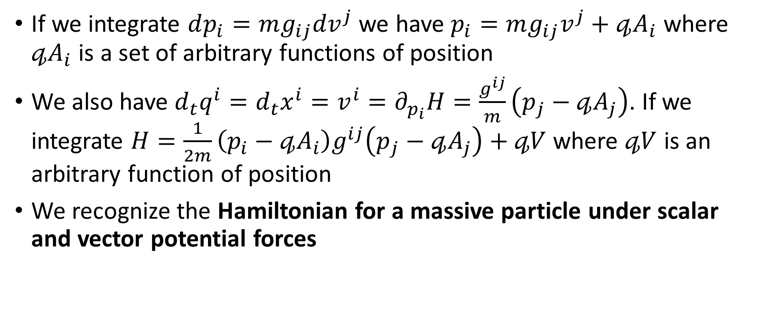
Massive particles under conservative forces
If we integrate $dp_{i}=mg_{ij}{dv}^{j}$ we have $p_{i}=mg_{ij}v^{j}+𝓆A_{i}$ where $𝓆A_{i}$ is a set of arbitrary functions of position
We also have $d_{t}q^{i}=d_{t}x^{i}=v^{i}=∂_{p_{i}}H=\frac{g^{ij}}{m}\left(p_{j}−𝓆A_{j}\right)$. If we integrate $H=\frac{1}{2m}\left(p_{i}−𝓆A_{i}\right)g^{ij}\left(p_{j}−𝓆A_{j}\right)+𝓆V$ where $𝓆V$ is an arbitrary function of position
We recognize the Hamiltonian for a massive particle under scalar and vector potential forces

Slide 27

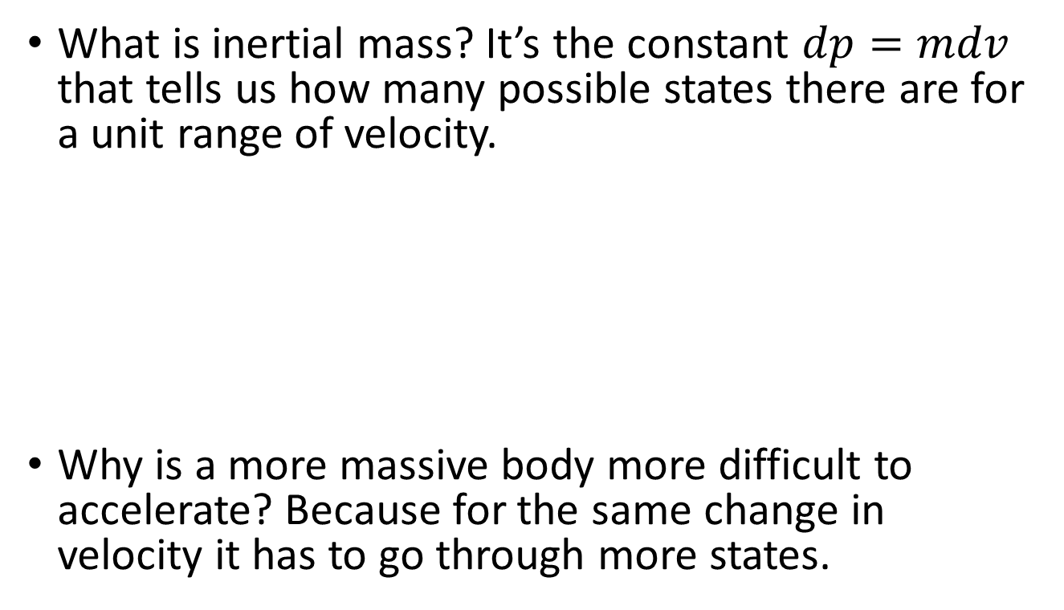

Inertial mass
What is inertial mass? It’s the constant $dp=mdv$ that tells us how many possible states there are for a unit range of velocity.
Why is a more massive body more difficult to accelerate? Because for the same change in velocity it has to go through more states.
More massive object = more states
$$v_{0}$$
$$v_{1}$$

Slide 28
Massless particles
Note that massless particles (e.g. photons) do not satisfy kinematic equivalence: the velocity is always the same so it is not enough to reconstruct the value of momentum. Multiple states will travel through the same trajectory
The fact that the mass is zero does not mean that they are very easy to accelerate. It means there is no relation between momentum and speed.

Slide 29
Takeaways
Massive particles under conservative forces are infinitesimal parts of a system for which the trajectory is enough to reconstruct its deterministic and reversible state evolution
Mass is the scaling factor between the number of trajectories identified by a range of velocity and the number of states identified by a range of momentum

Slide 30
Assumption of Irreducibility
The system is irreducible to its parts: giving the state of the whole tells us nothing about the states of the parts.
?
time

Slide 31
Irreducibility and random processes
With infinitesimal reducibility we could track the motion of each part of the system. With irreducibility, instead, we cannot: any part could have been mapped to any other part of the same size.
We will have a stable overall distribution where the parts are constantly randomly shifting around
The parts are identified by random variables and their evolution is a pure random process
The strength of the random process within a fraction of the system will be proportional to the size of that fraction (more parts with which to switch)

Slide 32
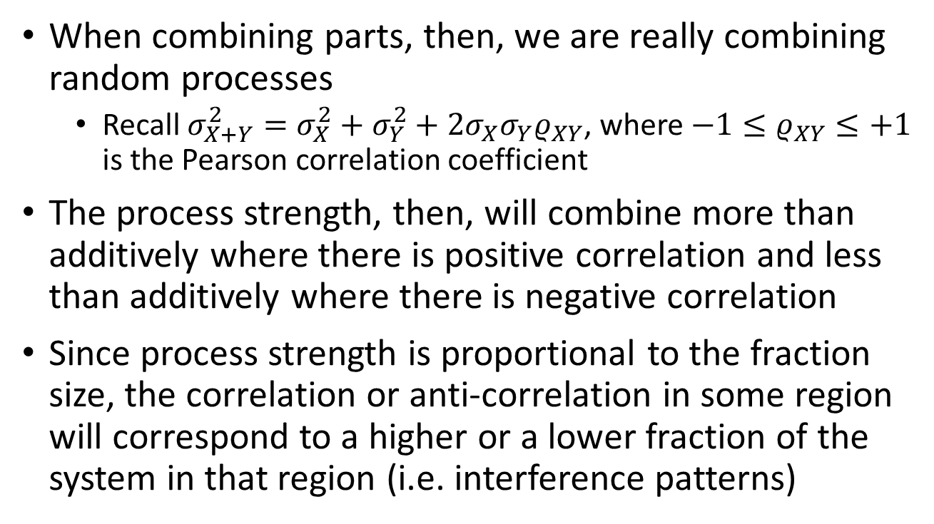
Combining parts and interference
When combining parts, then, we are really combining random processes
Recall $σ_{X+Y}^{2}=σ_{X}^{2}+σ_{Y}^{2}+2σ_{X}σ_{Y}ρ_{XY}$, where $−1≤ρ_{XY}≤+1$ is the Pearson correlation coefficient
The process strength, then, will combine more than additively where there is positive correlation and less than additively where there is negative correlation
Since process strength is proportional to the fraction size, the correlation or anti-correlation in some region will correspond to a higher or a lower fraction of the system in that region (i.e. interference patterns)

Slide 33
Distribution spread
Note that the knowledge of the whole tells us something about the parts: namely that they have to be within that whole
If we shrink the spread of the whole system in both position and momentum, then we are restricting the random processes: we are reducing the states available to the parts
In the limit, if the whole system were at one point in both position and momentum, we would know the position and momentum of all parts, these would not be able to randomly fluctuate within the distribution: the system is no longer irreducible
An irreducible system, then, must have a minimum spread for the system in position and momentum

Slide 34
Non-locality
Now suppose the system is spread over a long distance
Suppose we interact, within a region, with part of the system.
Given that the system is irreducible, we cannot tag one part and therefore we can’t interact only with part of the system: we will interact with the whole, even if parts are distant
Yet, since the motion of the parts is purely random, we cannot use this non-local interaction to transfer messages, introduce cause-effect relationships, and so on

Slide 35
Takeaway
The irreducibility of the system leads to the state space of quantum particle mechanics
A complex number is used to represent an element of the vector space formed by two random variables; the cosine of phase differences represents the Pearson correlation coefficient
The deterministic and reversible evolution of an irreducible system leads to the Schroedinger equation
The non-deterministic evolution, in certain cases, leads to the projection (i.e. collapse)

Slide 36
Overall takeaway
It takes few assumptions to recover the basics of classical and quantum Hamiltonian particle mechanics
These assumptions seem simple but they pack a lot more consequences than one would think at first and they help clarify the realm of applicability of the theories
The assumptions tell us how states are related in time (i.e. past and future), at different scales (i.e. whole and parts) and to trajectories. These relatively few concepts are of a general nature and allow us to focus on the essentials of the different theories and understand what is common and what is different

Slide 37
Current activities and possible opportunities for contribution

Slide 38
Current activities and possible opportunities for contribution
Extend – Bring different areas within the framework
Literature search on math/physics/philosophy of science for other areas, investigate other approaches, understand what parts can fit and be used
Consolidate – Take the published ideas and make them more rigorous
Review current material and provide feedback, work on the more precise mathematical formulation where missing
Popularize – Prepare material to make the work more accessible

Slide 39
Extend
Currently working on thermodynamics and statistical mechanics
The idea is to substitute deterministic and reversible evolution with non-reversibility at the macro level, which leads to equilibria (i.e. the same final state is reached with different initial states).
At the micro level, instead, we would have non-determinism. This means knowledge of the initial micro-state is not enough to predict the final micro-state, i.e. more information is needed: an increase in information entropy.
What parts of other approaches can we use? How much can be derived from these simple premises? What recombination of established concepts provides the most insight with the fewest starting points? What mathematical tools are the most appropriate?
Other areas of future extensions: field theories (classical and quantum), gravitation, quantum hydrodynamics/stochastic mechanics, . . .

Slide 40
Consolidate
Review what (we think) is finished
Extend the formal framework to distributions and densities
The formal framework right now roughly stops at manifolds (i.e. physically distinguishable cases that can be identified by a set of numeric variables). The next step is to formalize the concept of a distribution from statements like “The mass within volume V is between 1 and 2 grams”.
This should provide a bridge between statistics, measure theory and differential geometry
Other extensions to the formal framework: probability theory, states and processes, …

Slide 41
Popularize
Find better ways to convey the information
Figures, examples, …
Prepare material for undergraduate audiences
Prepare didactic material
E.g. supplemental material aimed at different standard courses
Prepare videos or other multimedia material

Slide 42
For further information
See our project website: http://assumptionsofphysics.org/
Includes links to conference presentations, published papers, drafts of first three chapters of a book, series of videos, Gabriele Carcassi’s blog on the foundations of physics

Slide 43
General mathematical theory of experimental science
Experimental verifiability leads to topological spaces, sigma-algebras, …
State-level assumptions
Infinitesimal reducibility
leads to classical phase space
Irreducibility
leads to quantum state space
Process-level assumptions
Hamilton’s equations $\frac{d}{dt}\left(q, p\right)=\left(\frac{∂H}{∂p},−\frac{∂H}{∂q}\right)$
Deterministic and reversible evolution
leads to isomorphism on state space
Schroedinger equation $$ıℏ\frac{∂}{∂t}ψ=Hψ$$
Non-reversible evolution
Thermodynamics
Euler-Lagrange equations $δ∫L\left(q, \dot{q},t\right)=0$
…
Kinematic equivalence
leads to massive particles
http://assumptionsofphysics.org/

