Slide 1



turning physics inside-out
Gabriele Carcassi and Christine A. Aidala
Physics Department University of Michigan

Slide 2
The foundations of physics has a methodology problem
Reverse Physics aims to adopt approaches that are more in line with foundations of mathematics, to break physics into a set of physical and mathematical conditions with well-understood logical relationships
“When the math is derived from the right physical assumptions, the physical assumptions can be derived from the math.”

Slide 3
Goals of Reverse Physics
Framework/interpretation/formulation/theory neutral
Allow for each result to be independently formulated from the other
Uncover “paradoxes” and develop standards of rigor appropriate for physics
Clarify the logical dependencies of physical/mathematical conditions
Identify core constitutive requirements of physical theories
The “big four” of Reverse Physics

Slide 4
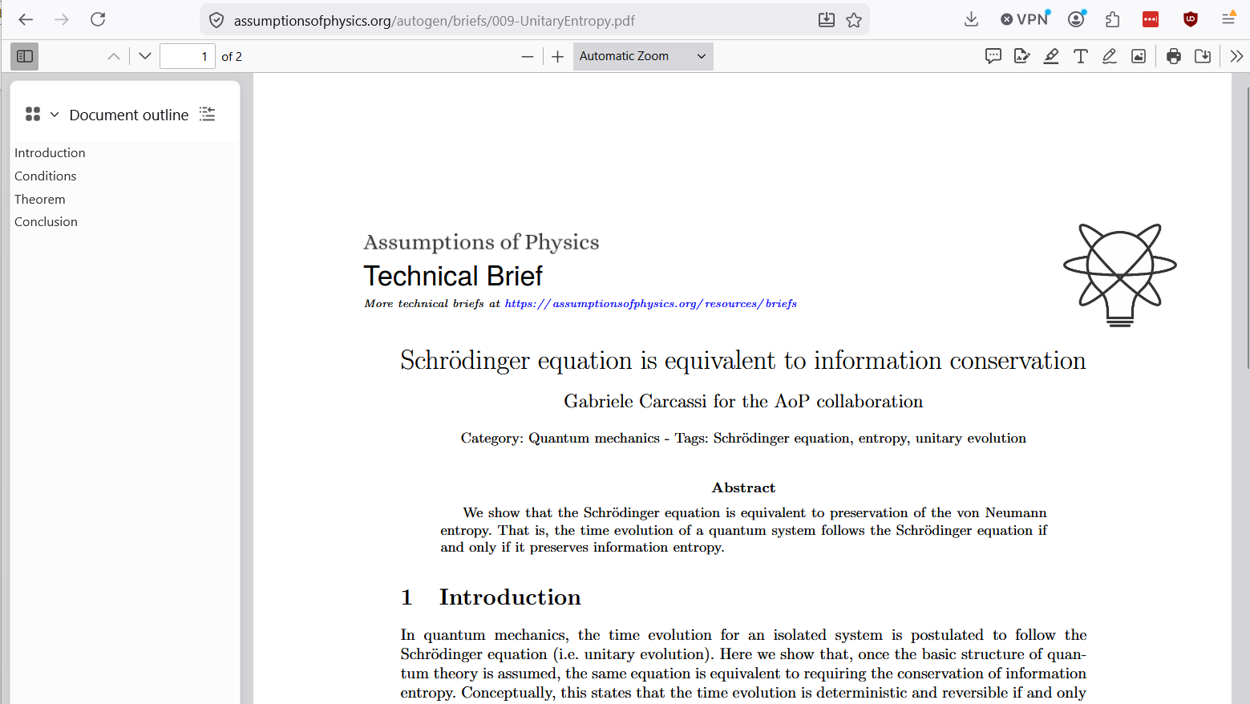
Show, don’t tell!
And now a series of random results to show how Reverse Physics works
Warning: no time to go through each in details
Wherever possible, QRCode to papers or technical briefs

Slide 5
The actual content of mathematical structures

Slide 6




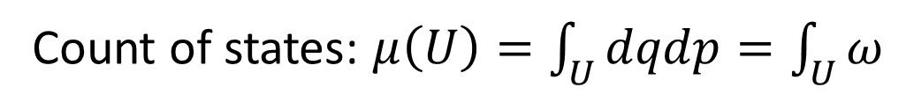




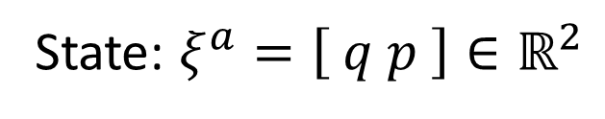






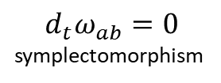

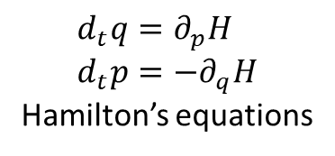
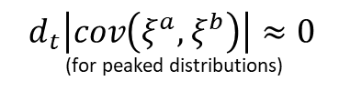


Hamiltonian mechanics 1 DOF $⟺$ Det/Rev
$$d_{t}μ\left(U\right)=0$$
$$⟺$$
$$d_{t}\log{μ\left(U\right)}=0$$
$$⟺$$
$$⟺$$
$d_{t}\int{−ρ\log{ρ}dμ}=0$
$$⟺$$
Conservation of state count
Conservation of thermodynamic entropy
$$⟺$$
$$⟺$$
Conservation of information entropy
$$⟺$$
$$⟺$$
$$⟺$$
$$⟺$$
$$d_{t}\left|cov\left(ξ^{a},ξ^{b}\right)\right|≈0$$ (for peaked distributions)
$$d_{t}ω_{ab}=0$$ symplectomorphism
Determinism and reversibility
$$⟺$$
$$⟺$$
$$⟺$$
Conservation of uncertainty
$$d_{t}q=∂_{p}H \\ d_{t}p=−∂_{q}H$$ Hamilton’s equations
All equivalent conditions!!!
Base theory:
State: $ξ^{a}=\left[ q p \right]∈ℝ^{2}$
Count of states: $μ\left(U\right)=\int_{U}{dqdp}=\int_{U}{ω}$

Slide 7




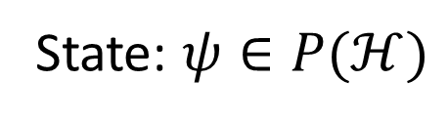






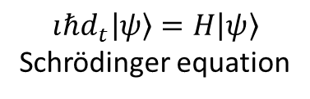



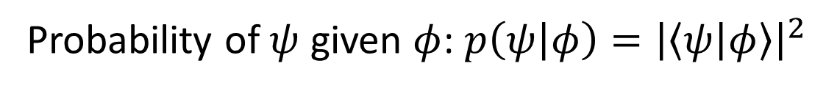
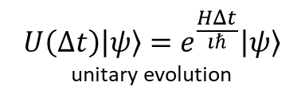

Schrödinger equation $⟺$ Det/Rev
$ψ(0)=φ$ iff $ψ(t)=e^{\frac{HΔt}{ıℏ}}φ$
$$⟺$$
$$d_{t}\text{tr}\left(−ρ\log{ρ}\right)=0$$
$$⟺$$
$$…$$
$$⟺$$
$$⟺$$
Bijective map of state and probability
Conservation of information entropy
$$⟺$$
$$⟺$$
…
$$⟺$$
$$⟺$$
$$⟺$$
$$U\left(Δt\right)\left|ψ\right\rangle =e^{\frac{HΔt}{ıℏ}}\left|ψ\right\rangle$$ unitary evolution
Determinism and reversibility
$$⟺$$
$$ıℏd_{t}\left|ψ\right\rangle =H\left|ψ\right\rangle$$ Schrödinger equation
All equivalent conditions!!!
Base theory:
State: $ψ∈P(ℋ)$
Probability of $ψ$ given $φ$: $p\left(ψ | φ\right)={\left|\left\langle ψ | φ\right\rangle \right|}^{2}$

Slide 8



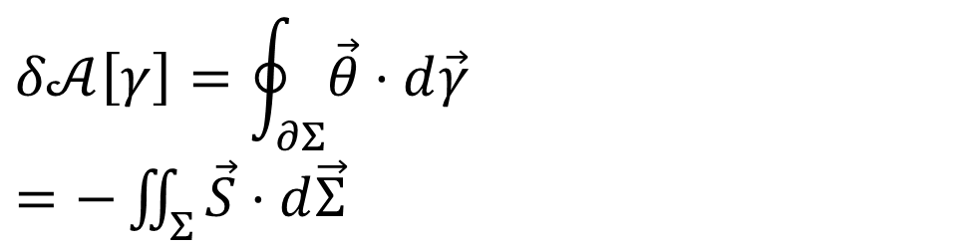


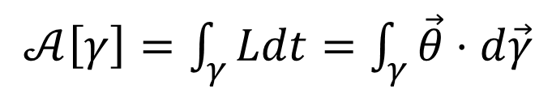







Reversing the principle of stationary action
DR
$p\frac{dq}{dt}+0\frac{dp}{dt}−H\frac{dt}{dt}$
$$\left[p,0,−H\left(q,p\right)\right]$$
KE
$$∇⋅\vec{S}=0$$
$$\vec{S}=−∇×\vec{θ}$$
$𝒜\left[γ\right]=\int_{γ}{Ldt}=\int_{γ}{\vec{θ}⋅d\vec{γ}}$
No state is “lost” or “created” as time evolves
(Minus sign to recover Ham eq)
Sci Rep 13, 12138 (2023)
unphysical
The action is the line integral of the vector potential of the flow of states
$$p$$
$$q$$
Variation of the action
$$Σ$$
Gauge independent, physical!
$$δ𝒜\left[γ\right]=\oint_{∂Σ}{\vec{θ}⋅d\vec{γ}}$$ $=−\iint_{Σ}{\vec{S}⋅d\vec{Σ}}$
$$γ$$
$$γ′$$
$$t$$
Variation of the action measures the flow of states (physical). Variation = 0 $⇒$ flow of states tangent to the path.

Slide 9
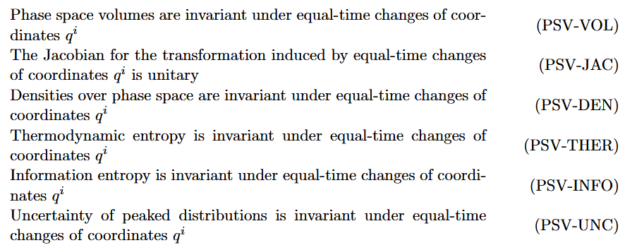
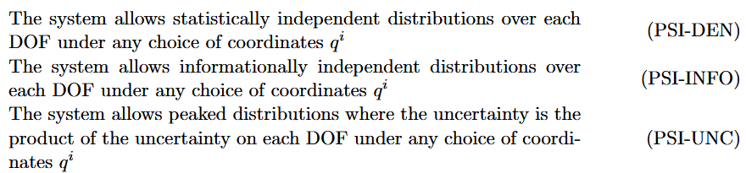








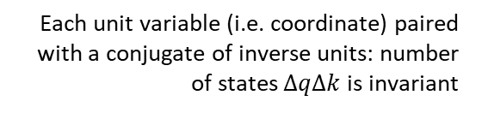




Reversing phase-space
Hamiltonian Privilege, Erkenn (2023)
Stud Hist Phil 71, 082020, 60-71 (2020)
Each unit variable (i.e. coordinate) paired with a conjugate of inverse units: number of states $ΔqΔk$is invariant
$\hat{q}=100 cm/m q$
$$x↦x^{3}$$
$$1$$
$Δk=1 m^{−1}$
$$1$$
$Δ\hat{k}=0.01 cm^{−1}$
$$x$$
$$x^{3}$$
$Δ\hat{q}=100 cm$
$Δq=1 m$
Density, entropy, uniform distributions NOT in general coordinate invariant
Phase space (symplectic) structure is the only one that supports coordinate invariant density, entropy, state count
Invariance of entropy/state count + DOF independence
$⟺$ structure of phase space (i.e. conjugate pairs)

Slide 10

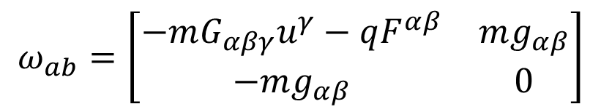
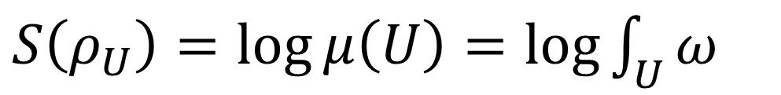

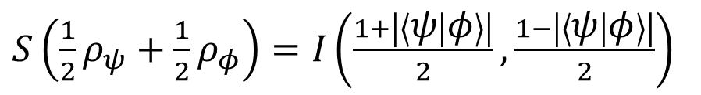
Geometry is entropy
Classical mechanics
Quantum mechanics
$S\left(ρ_{U}\right)=\log{μ\left(U\right)}=\log{\int_{U}{ω}}$
$S\left(\frac{1}{2}ρ_{ψ}+\frac{1}{2}ρ_{φ}\right)=I\left(\frac{1+\left|\left\langle ψ | φ\right\rangle \right|}{2},\frac{1−\left|\left\langle ψ | φ\right\rangle \right|}{2}\right)$
$$=−\frac{1+\left|\left\langle ψ | φ\right\rangle \right|}{2}\log{\frac{1+\left|\left\langle ψ | φ\right\rangle \right|}{2}}−\frac{1−\left|\left\langle ψ | φ\right\rangle \right|}{2}\log{\frac{1−\left|\left\langle ψ | φ\right\rangle \right|}{2}}$$
Symplectic form determines and is determined by the entropy of all uniform joint and marginal (DOF) distributions
Born rule determines and is determined by the entropy of all equal mixtures of pairs of pure states
$$∂_{α}g_{βγ}−∂_{β}g_{αγ}$$
$$ω_{ab}=\left[\begin{matrix}−mG_{αβγ}u^{γ}−qF^{αβ} & mg_{αβ} \\ −mg_{αβ} & 0\end{matrix}\right]$$
Metric tensor appears as the position-velocity part of the symplectic form

Slide 11
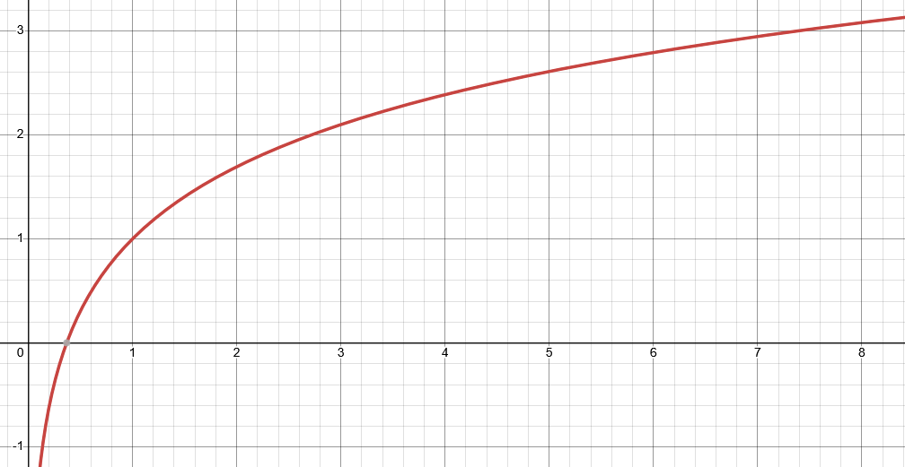

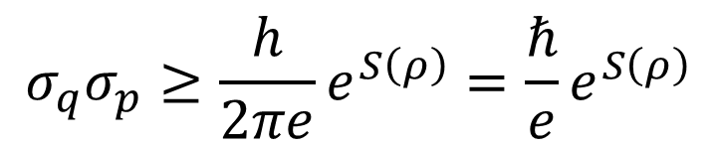

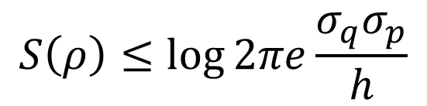



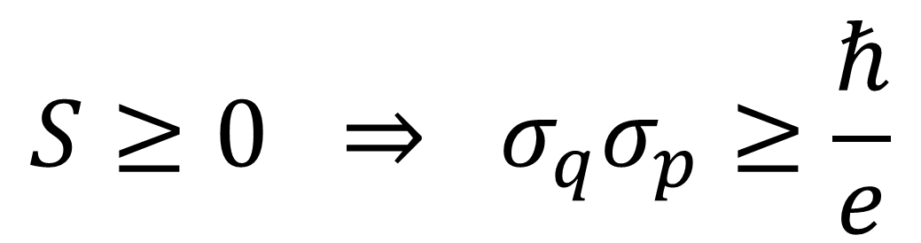
Classical uncertainty principle
$S\left(ρ\right)=−∫ρ\log{hρ}dqdp$
$$S$$
Fixes units Uniform distribution over volume $h$ has zero entropy
excluded by gaussian bound
$$S\left(ρ\right)≤\log{2πe\frac{σ_{q}σ_{p}}{h}}$$
Gaussian maximizes entropy for a given uncertainty
$$\frac{σ_{x}σ_{p}}{ℏ}$$
excluded by 3rd law of thermodynamics
$$σ_{q}σ_{p}≥\frac{h}{2πe}e^{S\left(ρ\right)}=\frac{ℏ}{e}e^{S\left(ρ\right)}$$
Entropy puts a lower bound on the uncertainty
$$S≥0 ⇒ σ_{q}σ_{p}≥\frac{ℏ}{e}$$

Slide 12
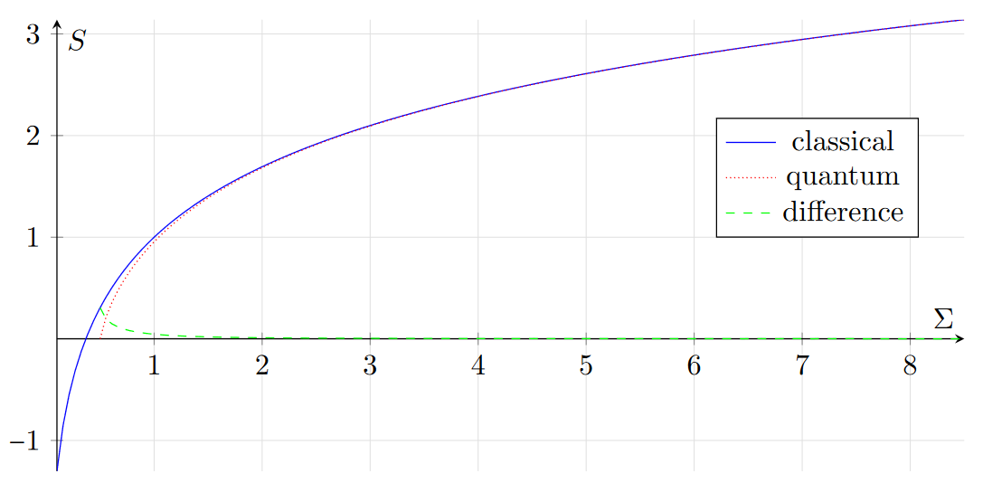
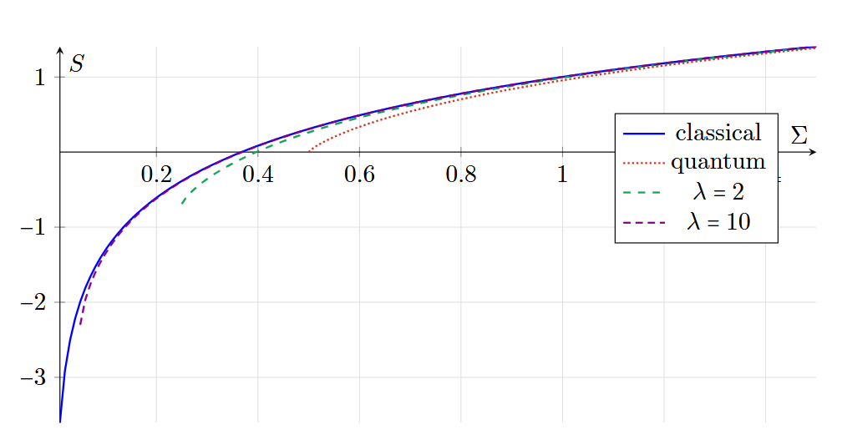




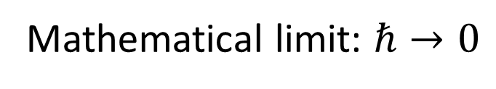


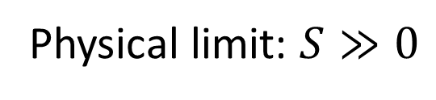
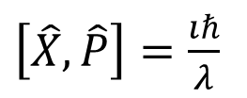


Classical mechanics as high entropy limit
like $c→∞$
Physical limit: $S≫0$
like $\frac{v}{c}≪1$
Mathematical limit: $ℏ→0$
$$T(ρ)$$
$$\frac{σ_{q}σ_{p}}{ℏ}$$
Phys. Scr. 101 065105 (2026)
$$\left[X,P\right]=ıℏ$$
$$\left[T\left(X\right),T\left(P\right)\right]=λıℏ$$
$$\left[T\left(\hat{X}\right),T\left(\hat{P}\right)\right]=ıℏ$$
$\left[\hat{X},\hat{P}\right]=\frac{ıℏ}{λ}$
Physical limit: increase the entropy of mixed states
Mathematical limit: decrease the entropy of pure states

Slide 13


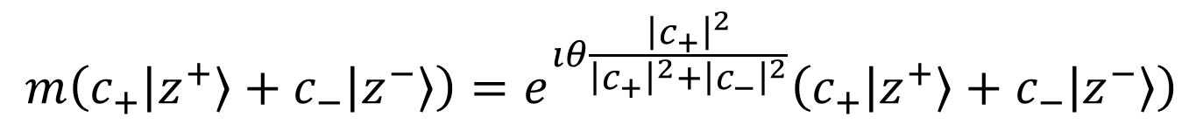
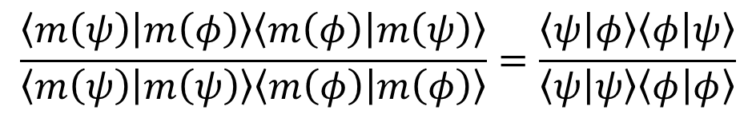
Non-linear representation in QM
This map introduces a total phase based on all coefficients
const. $θ∈(0,2π)$
$$m\left(c_{+}\left|z^{+}\right\rangle +c_{−}\left|z^{−}\right\rangle \right)=e^{ıθ\frac{{\left|c_{+}\right|}^{2}}{{\left|c_{+}\right|}^{2}+{\left|c_{−}\right|}^{2}}}\left(c_{+}\left|z^{+}\right\rangle +c_{−}\left|z^{−}\right\rangle \right)$$
Non-linear map…
$$\frac{\left\langle m\left(ψ\right) | m\left(φ\right)\right\rangle \left\langle m\left(φ\right) | m\left(ψ\right)\right\rangle }{\left\langle m\left(ψ\right) | m\left(ψ\right)\right\rangle \left\langle m\left(φ\right) | m\left(φ\right)\right\rangle }=\frac{\left\langle ψ | φ\right\rangle \left\langle φ | ψ\right\rangle }{\left\langle ψ | ψ\right\rangle \left\langle φ | φ\right\rangle }$$
… that preserves the physics (i.e. Born rule)
Linearity is a mathematical convenience, not a physical necessity

Slide 14

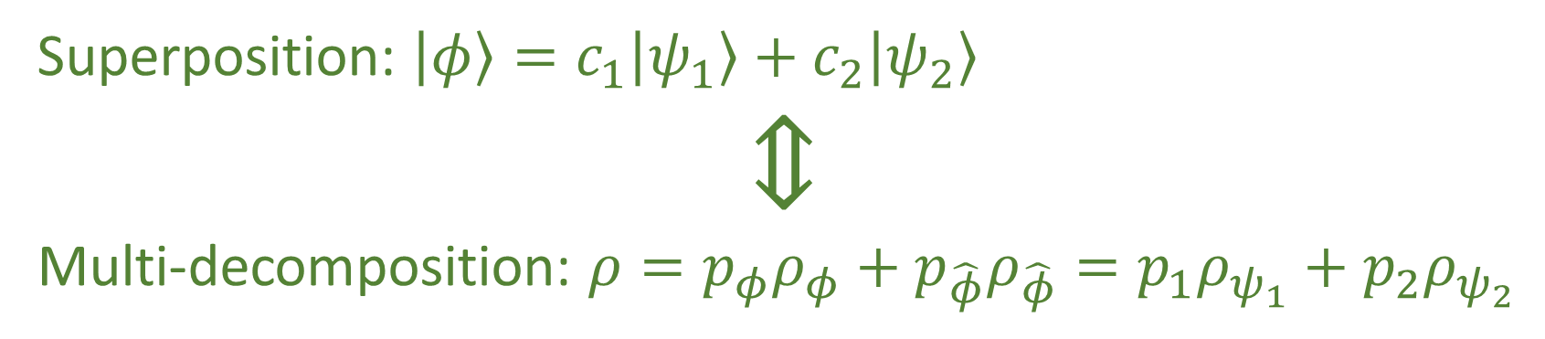
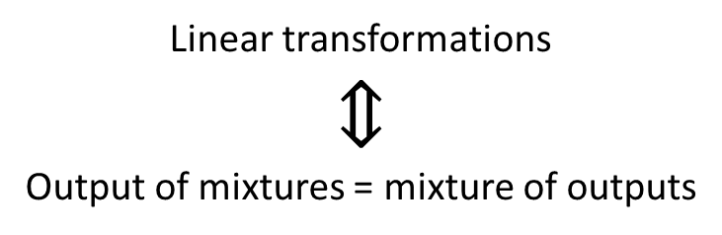
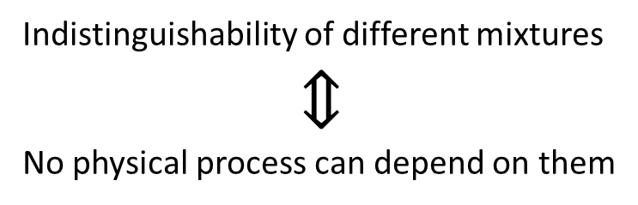
Superposition is multi-decomposition
Property of the vector space representation
Superposition: $\left|φ\right\rangle =c_{1}\left|ψ_{1}\right\rangle +c_{2}\left|ψ_{2}\right\rangle$
$$⇕$$ Multi-decomposition: $ρ=p_{φ}ρ_{φ}+p_{\hat{φ}}ρ_{\hat{φ}}=p_{1}ρ_{ψ_{1}}+p_{2}ρ_{ψ_{2}}$
Impossible in classical probability (i.e. Choquet simplex)
Property of distinguishability of preparations
Linear transformations
$$⇕$$
Output of mixtures = mixture of outputs
Indistinguishability of different mixtures
$$⇕$$
No physical process can depend on them

Slide 15
Paradoxes and standards of rigor

Slide 16

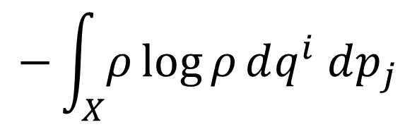

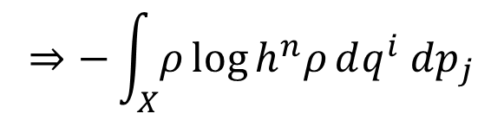
Poor dimensional checking in statistical mechanics
Definition of Gibbs entropy
$$−\int_{X}{ρ\log{ρ}dq^{i} dp_{j}}$$
$$⇒−\int_{X}{ρ\log{h^{n}ρ}dq^{i} dp_{j}}$$
When deriving Sackur–Tetrode equation
Density is not a pure number
You can’t “approximate physical dimensions”!!!
$$length^{N}≄length^{N−1}$$

Slide 17
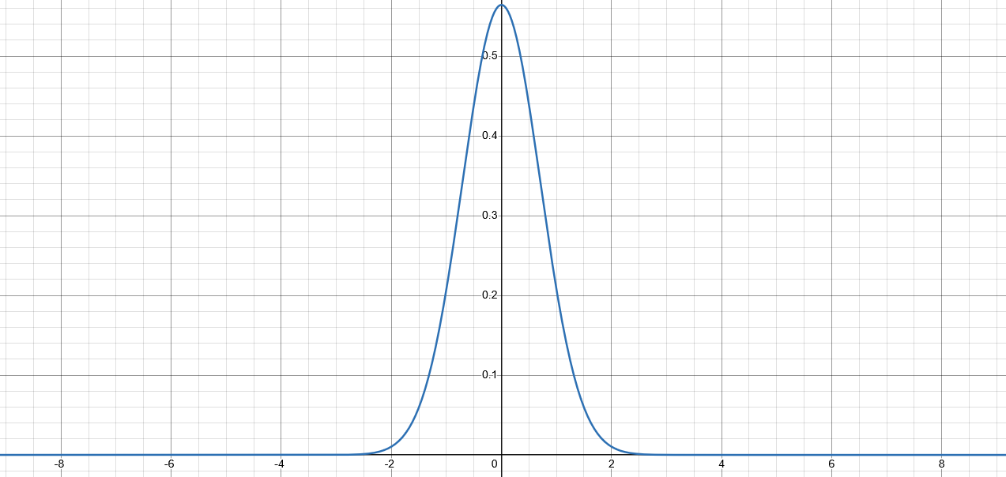
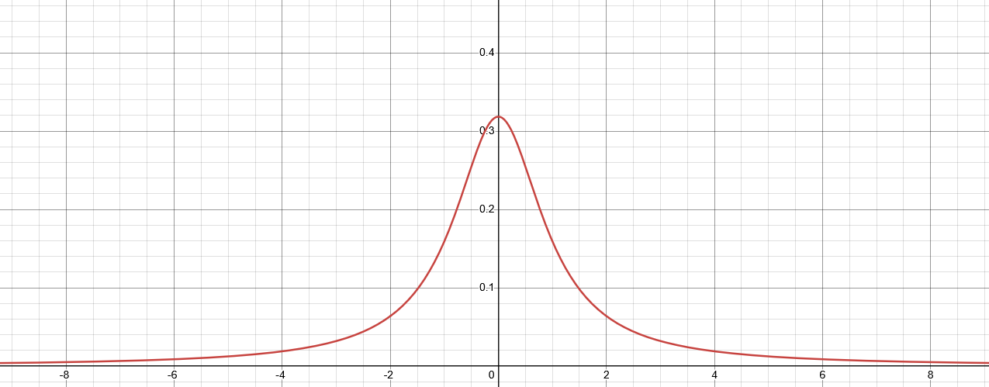


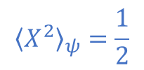




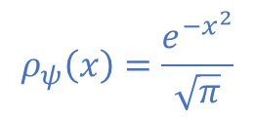

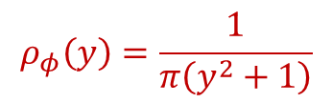
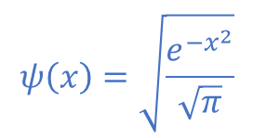
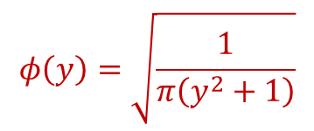
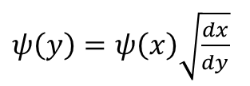
Inconsistent expectations in Hilbert spaces
Quantum Stud.: Math. Found. 12, 13 (2025)
Different observers see finite/infinite expectation
$$ψ\left(x\right)=\sqrt{\frac{e^{−x^{2}}}{\sqrt{π}}}$$
$$∫{\left|ψ\right|}^{2}dx=1$$
$$y=\tan\left(\frac{π}{2}\operatorname{erf}\left(x\right)\right)$$
$$ρ_{ψ}\left(x\right)=\frac{e^{−x^{2}}}{\sqrt{π}}$$
$${\left\langle X^{2}\right\rangle }_{ψ}=\frac{1}{2}$$
$ψ\left(y\right)=ψ\left(x\right)\sqrt{\frac{dx}{dy}}$
Expectation can have finite/infinite oscillations
$$φ\left(y\right)=\sqrt{\frac{1}{π\left(y^{2}+1\right)}}$$
$$∫{\left|φ\right|}^{2}dy=1$$
$x\left(x_{0},t\right)=x_{0}\cos^{2}{\frac{πt}{2}}+\tan\left(\frac{π}{2}\operatorname{erf}\left(x_{0}\right)\right)\sin^{2}{\frac{πt}{2}}$
$$ρ_{φ}\left(y\right)=\frac{1}{π\left(y^{2}+1\right)}$$
$${\left\langle Y^{2}\right\rangle }_{φ}→∞$$
Every continuous linear operator defined on the whole Hilbert space is bounded $⇒$ position/momentum/energy/number of particles are not defined on the whole Hilbert space!!!

Slide 18

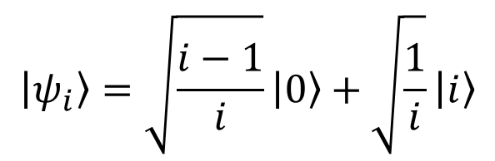
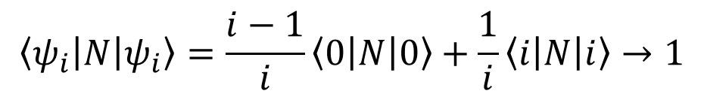

Inconsistent convergence in Hilbert spaces
Consider the sequence of states given by
$$\left\langle ψ_{i}\left|N\right|ψ_{i}\right\rangle =\frac{i−1}{i}\left\langle 0\left|N\right|0\right\rangle +\frac{1}{i}\left\langle i\left|N\right|i\right\rangle →1$$
$$\left|ψ_{i}\right\rangle =\sqrt{\frac{i−1}{i}}\left|0\right\rangle +\sqrt{\frac{1}{i}}\left|i\right\rangle$$
$$\left|ψ_{i}\right\rangle →\left|0\right\rangle$$
The state converges to the ground state while the energy level converges to the first level

Slide 19
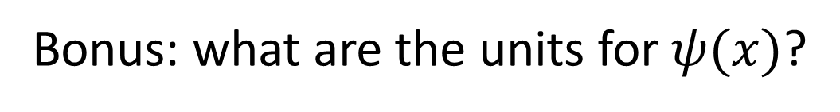


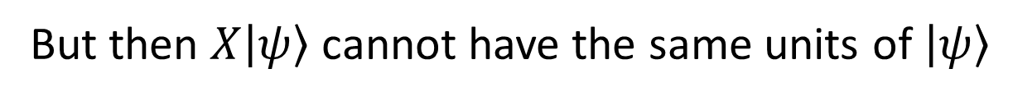
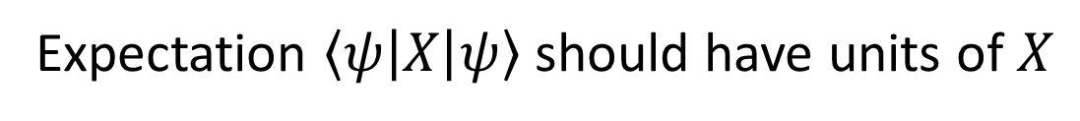
Inconsistent units for quantum observables
Suppose $X$ is an observable
Expectation $\left\langle ψ\left|X\right|ψ\right\rangle$ should have units of $X$
But then $X\left|ψ\right\rangle$ cannot have the same units of $\left|ψ\right\rangle$
But then $X\left|ψ\right\rangle +\left|ψ\right\rangle$ makes no physical sense
Therefore, $X$ cannot be a map within the same space
Bonus: what are the units for $ψ(x)$?
Then why in some relativistic settings do they use the Fourier transform for a scalar function?

Slide 20



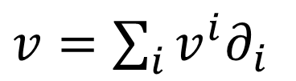

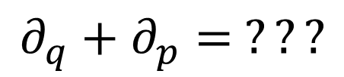



Tangent vectors in differential geometry
Defined as derivations
$v=\sum_{i}{v^{i}∂_{i}}$
$$v:C^{∞}\left(X\right)→ℝ$$
component
basis
In polar coordinates
Mathematically precise $⇏$ physically precise
$$∂_{r}+∂_{θ}= ???$$
$$\left[m\right]$$
$\left[rad\right]$
Doesn’t work with units
In phase space
$$∂_{q}+∂_{p}= ???$$
$\left[m\right]$
$\left[kg m s^{−1}\right]$

Slide 21


The Born rule is equivalent to the von Neumann entropy
We CAN analyze logical dependencies between conditions that are both mathematically precise and physically meaningful

Slide 22
Logical dependencies and base theories

Slide 23


Classical conditions and their relationships
MPPF
Core assumptions
Physical theories
CST: Classical STates
NM: Newtonian Mechanics
HM: Hamiltonian Mechanics LM: Lagrangian Mechanics MPPF: Massive Particles under Potential Forces
LM
IR: Infinitesimal Reducibility IND: INDependent DOF W/FKE: Weak/Full Kinematic Equivalence
DR: Determinism+Reversibility
FKE
NM
HM
WKE
CST
DR
Each assumption is an equivalence class of multiple conditions
IR
IND

Slide 24


Quantum pure states are not enough
Rays do not need the inner product
You CAN endow quantum pure states with classical probability distributions and Hamiltonian mechanics
E.g. Classical Larmor precession

Slide 25

Quantum ensembles rule out classical mechanics
Trace requires the inner product!
Classical and quantum ensembles are incompatible
Since BR-BORN is independent from QE-DENS, QE-DENS is responsible for the incompatibility

Slide 26

Base theory for all of physics
Collection of conditions that MUST be true in all physical theories
Part of the base theory
Base theory $≠$ Theory of everything

Slide 27
Foundational pillars

Slide 28






Experimental verifiability
Science is evidence based $⇒$ Statements are associated to experimental tests
Verifiable statement | Test Result
T | SUCCESS (in finite time)
F | UNDEFINED
 | FAILURE (in finite time)
Theoretical statements
$int(A)$ corresponds to the verifiable part of a statement
$$s$$ | Test
T | S
 | U
F | U
 | F
Verifiable statements
Possibilities
$∂A$ corresponds to the undecidable part of a statement
$ext(A)$ corresponds to the falsifiable part of a statement
Open sets
Points
Inference relationship $𝓇:𝒟_{Y}→𝒟_{X}$ such that $𝓇\left(s\right)≡s$
Borel sets
Experimental verifiability $⇒$ topology and $σ$-algebra
Experimental relationships must be topologically continuous
Causal relationship $f:X→Y$ such that $x≼f\left(x\right)$

Slide 29








Reproducibility and ensembles
Scientific laws describe reproducible relationships $⇒$ Ensembles
$$P$$
Ensembles are outputs of repeatable processes
$P_{1}$
$$e_{1}$$
$$S_{p}$$
$$pe_{1}+\left(1−p\right)e_{2}$$
Statistical mixing $⇒$ Linear structures in physics
$P_{2}$
$$e_{2}$$
Note: mixing coefficients are NOT probabilities

Slide 30






Ensemble variability
Variability of the elements within an ensemble $⇒$ Entropy
$$e_{1}$$
$$…$$
Mutually exclusive $⟺$ orthogonality
$⇕$
Maximal variability increase during mixing
$$e_{2}$$
more variability
$$…$$
Variability $⇒$ Probabilities, inner product and geometry
Probability $⟺$ Mixtures of mutually exclusive ensembles
Classical mechanics/probability $⟺$ All pure states are mutually exclusive
Pure states $⟺$ Best preparations $⇎$ No variability

Slide 31






Equilibria
States must exist for at least a short time $⇒$ Equilibria
$$X(t)$$
$$\left\{x\left(t\right),y\left(t\right)\right\}$$
Of system/environment interactions that don’t matter/we are not sensitive to
Of internal processes at faster scales that don’t matter/we are not sensitive to
$$x$$
$$x(t)$$
$$y(t)$$
$$dt$$
Least developed part
This requirement allows us to properly talk about different physical objects
Equilibria $⇒$ Symmetries, differentiability, Lie algebras

Slide 32
The foundations of physics has a methodology problem
Reverse Physics gives us a powerful methodology, more in line with foundational approaches of other disciplines, that gives us a lot more and more precise insights and opens new avenues of research

