Slide 1
Kinematics vs Dynamics
Gabriele Carcassi

Slide 2
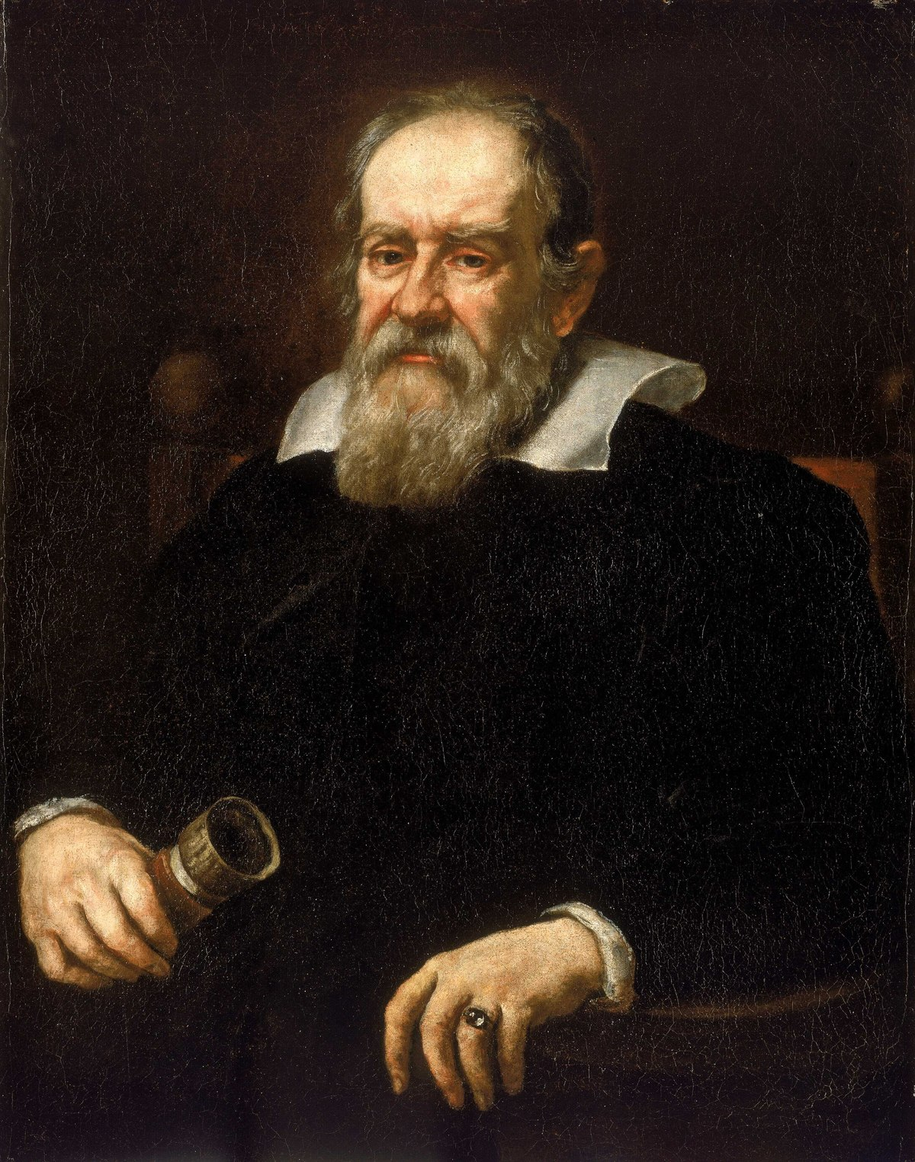
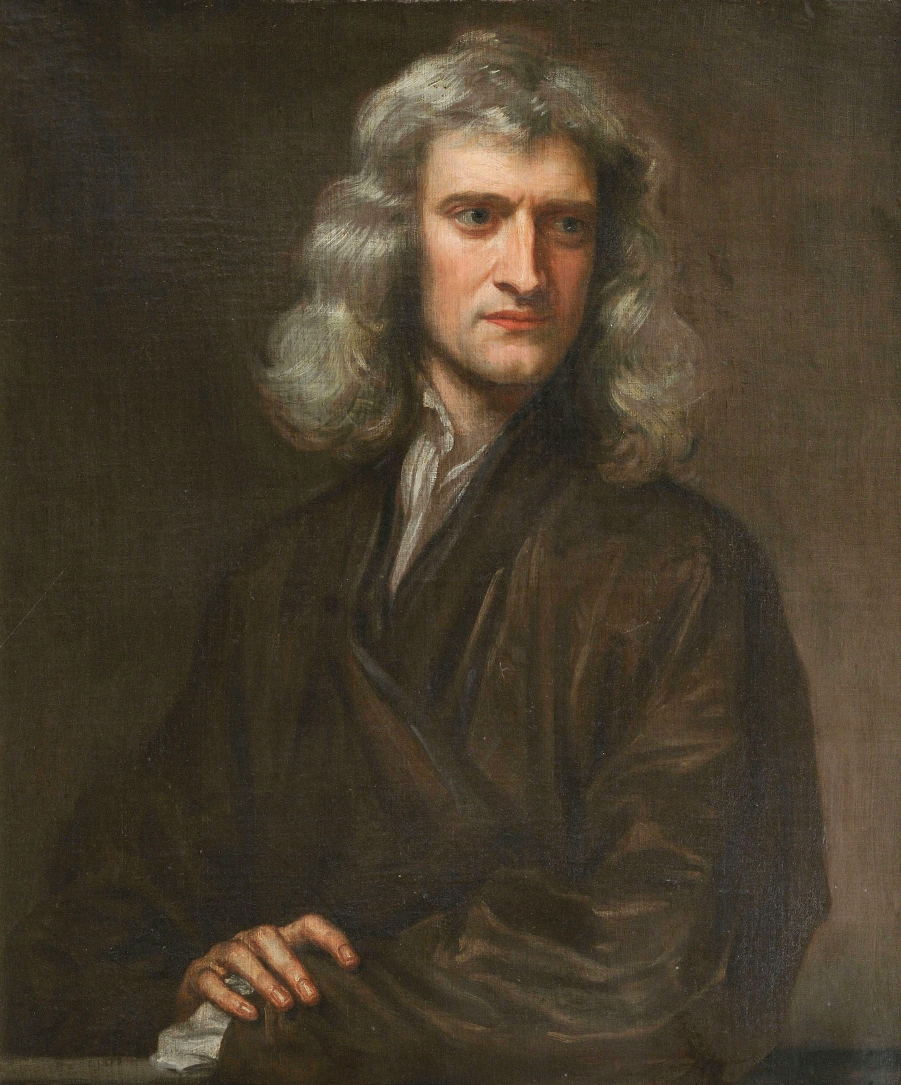
What Galileo Worked on
Kinematics: Describe the motion of a system in space and time (position, velocity, acceleration)
Dynamics: Describe the cause of motion (Force, mass, momentum, energy)
What Newton Worked on
Notes:
The kinematics is not enough to reconstruct the dynamics
Lagrangian hides the connection
Kinematics: what Galileo did, Newton did
Image sources: https://en.wikipedia.org/wiki/Galileo_Galilei
https://en.wikipedia.org/wiki/Isaac_Newton

Slide 3










State
Dynamics
Evolution
Newtonian Mechanics:
$x^{i}$ and $v^{i}$
$${F^{i}(x}^{j},v^{k},t)$$
$$F^{i}=d_{t}mv^{i}$$
position
velocity
Lagrangian Mechanics:
$x^{i}$ and $v^{i}$
$${L(x}^{i},v^{j},t)$$
$$∂_{x^{i}}L=d_{t}∂_{v^{i}}L$$
$$d_{t}q^{i}=∂_{p^{i}}H$$
Hamiltonian Mechanics:
$q^{i}$ and $p_{i}$
$${H(q}^{i},p_{j},t)$$
position
conjugate momentum
$$d_{t}p^{i}=∂_{q^{i}}H$$
Notes:
TODO: transform it into a “Table”
Equations of motion (instead of Evolution of he system)
Mechanics are the rows
TODO: add hyperregularity of Lagrangian

Slide 4
Particle Under Linear Drag :
Suppose we have a system described by the equation $ma=−bv$
Velocity:
Drag:

Slide 5
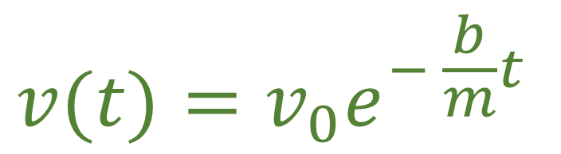



Particle Under Linear Drag: Newtonian Mechanics
$$F=ma=−bv$$
$$\frac{dv}{dt}=−\frac{b}{m}v$$
Initial velocity
$$⇒$$
$$v(t)=v_{0}e^{− \frac{b}{m}t}$$

Slide 6


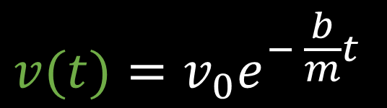






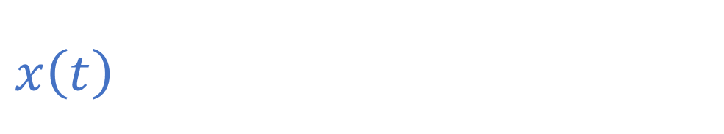


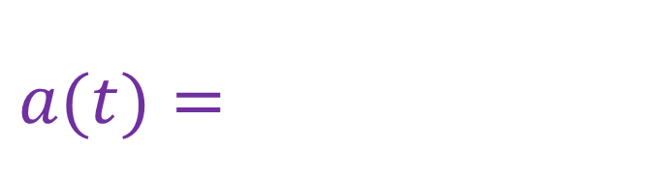

$$F=ma=−bv$$
Initial velocity
$$x$$
Initial position
$$x_{0}+\frac{m}{b}v_{0}$$
$$x\left(t\right)=x_{0}+v_{0}\frac{m}{b}(1−e^{− \frac{b}{m}t})$$
$$v$$
$$x_{0}$$
$$v(t)=v_{0}e^{− \frac{b}{m}t}$$
$$v_{0}$$
$$t$$
$$a(t)=−v_{0}\frac{b}{m}e^{− \frac{b}{m}t}$$
$$t$$
$$a$$
$$t$$
Kinematics
$$−\frac{b}{m}v_{0}$$

Slide 7

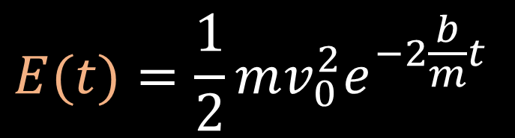




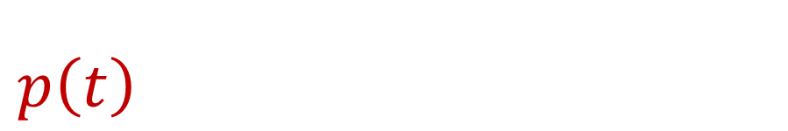

$$F=ma=−bv$$
$$E$$
$$\frac{1}{2}mv_{0}^{2}$$
$$E(t)=\frac{1}{2}mv_{0}^{2}e^{−2\frac{b}{m}t}$$
$$p\left(t\right)=mv(t)={mv}_{0}e^{− \frac{b}{m}t}$$
$$p$$
$$t$$
$${mv}_{0}$$
Dynamics
$$t$$

Slide 8



Lagrangian for linear drag?
$$L=\frac{1}{2}mv^{2}e^{\frac{b}{m}t}$$
$$∂_{x}L=0=d_{t}∂_{v}L=d_{t}\left(mv_{ }e^{\frac{b}{m}t}\right) \\ =mae^{\frac{b}{m}t}+\frac{b}{m}mve^{\frac{b}{m}t}=e^{\frac{b}{m}t}\left(ma+bv\right)$$
Recover particle under linear drag!!!
$$ma=−bv$$

Slide 9







Hamiltonian for linear drag?
$$L=\frac{1}{2}mv^{2}e^{\frac{b}{m}t}$$
$$p=∂_{v}L$$
$$H=pv−L$$
$$p=∂_{v}L=mve^{\frac{b}{m}t}$$
$$v=\frac{p}{m}e^{− \frac{b}{m}t}$$
$$H=pv−L=p\frac{p}{m}e^{− \frac{b}{m}t}−\frac{1}{2}m{\left(\frac{p}{m}e^{− \frac{b}{m}t}\right)}^{2}e^{ \frac{b}{m}t} \\ =\frac{p^{2}}{m}e^{− \frac{b}{m}t}−\frac{1}{2}\frac{p^{2}}{m}e^{− \frac{b}{m}t}$$
$$H=\frac{1}{2}\frac{p^{2}}{m}e^{− \frac{b}{m}t}$$

Slide 10







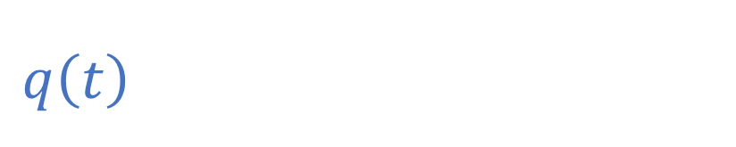

$d_{t}q=$ $∂_{p}H=\frac{p}{m}e^{− \frac{b}{m}t}$
$$H=\frac{1}{2}\frac{p^{2}}{m}e^{− \frac{b}{m}t}$$
$$d_{t}p=−∂_{q}H=0$$
$$q$$
Initial momentum
$$q_{0}+\frac{p_{0}}{b}$$
Initial position
$$q\left(t\right)=q_{0}+\frac{p_{0}}{b}\left(1−e^{− \frac{b}{m}t}\right)$$
$$q_{0}$$
$$t$$
$$p\left(t\right)=p_{0}$$
Same kinematics!

Slide 11

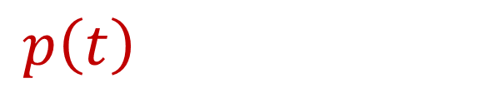
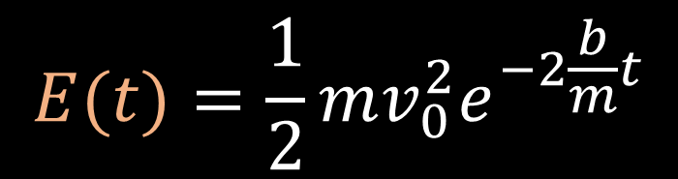

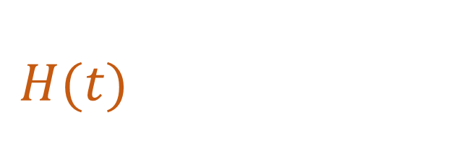




$$H(t)=\frac{1}{2}\frac{p_{0}^{2}}{m}e^{− \frac{b}{m}t}$$
$$E$$
$${\frac{p_{0}^{2}}{2m}}_{0}$$
Mismatch in
dynamics
$$E(t)=\frac{1}{2}mv_{0}^{2}e^{−2\frac{b}{m}t}$$
$$t$$
$$p$$
$$p\left(t\right)=p_{0}=mv_{0}$$
$$p_{0}$$
$$mv\left(t\right)=mv_{0}e^{− \frac{b}{m}t}$$
$$t$$

Slide 12

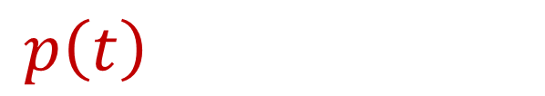


$$p\left(t\right)=p_{0}=mv_{0}$$
Impose
$$p\left(t\right)=\hat{m}\left(t\right)v\left(t\right)$$
$$mv\left(t\right)=mv_{0}e^{− \frac{b}{m}t}$$
$$\hat{m}\left(t\right)=\frac{p\left(t\right)}{v\left(t\right)}=me^{\frac{b}{m}t }$$
Variable mass!

Slide 13




Variable Mass System:
Velocity:
Mass:
$$\hat{m}$$
$$\hat{m}\left(t\right)=\frac{p\left(t\right)}{v\left(t\right)}=me^{\frac{b}{m}t }$$
$$m$$
$$t$$
Notes:
Add picture of a variable mass system

Slide 14





Variable Mass System: Newtonian Mechanics
$$F^{i}=d_{t}\left(\hat{m}v^{i}\right)=d_{t}\hat{m}v^{i}\text{+ }\hat{m}a^{i}$$
$$\hat{m}a^{i}=F^{i}−d_{t}\hat{m}v^{i}$$
$$m{ae}^{\frac{b}{m}t}=0−d_{t}me^{\frac{b}{m}t}v=−\frac{b}{m}me^{\frac{b}{m}t}v=−bve^{\frac{b}{m}t}$$
$$F=ma=−bv$$
$⇒$We have the same equation as a particle under linear drag

Slide 15







Hamiltonian for Variable Mass System?
$$p=mve^{\frac{b}{m}t}$$
$$v=\frac{p}{m}e^{− \frac{b}{m}t}$$
$$\hat{m}=\frac{p}{v}=me^{\frac{b}{m}t}$$
$$H=pv−L$$
$$L=\frac{1}{2}mv^{2}e^{\frac{b}{m}t}$$
$$H=\frac{1}{2}\frac{{p(t)}^{2}}{m}e^{− \frac{b}{m}t}=\frac{1}{2}\frac{{p(t)}^{2}}{\hat{m}(t)}=\frac{1}{2}\hat{m}\left(t\right)v^{2}\left(t\right)=E(t)$$
$⇒$Now the dynamics of the system are correct

Slide 16



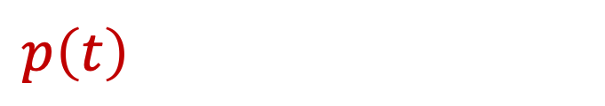


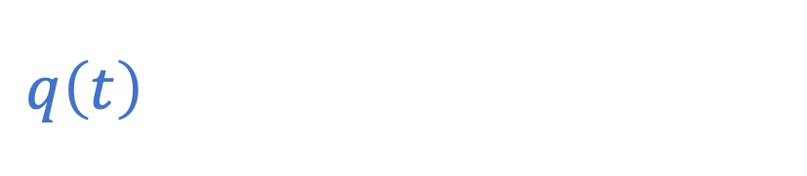

$d_{t}q=$ $∂_{p}H=\frac{p}{m}e^{− \frac{b}{m}t}$
$$H=\frac{1}{2}\frac{p^{2}}{m}e^{− \frac{b}{m}t}=\frac{1}{2}\hat{m}\left(t\right)v^{2}\left(t\right)$$
$$d_{t}p=−∂_{q}H=0$$
$$q$$
Initial momentum
$$q_{0}+\frac{p_{0}}{b}$$
Initial position
$$q\left(t\right)=q_{0}+\frac{p_{0}}{b}\left(1−e^{− \frac{b}{m}t}\right)$$
$$q_{0}$$
$$t$$
$$p\left(t\right)=p_{0}=\hat{m}\left(t\right)v\left(t\right)$$
Same kinematics!

Slide 17
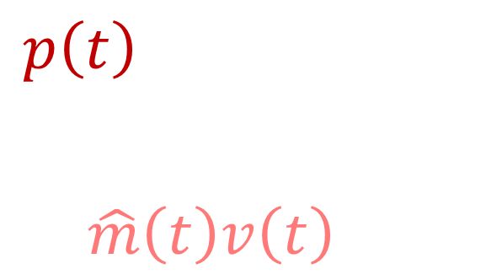

$$H\left(t\right)=\frac{1}{2}\frac{p_{0}^{2}}{m}e^{− \frac{b}{m}t}=\frac{1}{2}\frac{{p\left(t\right)}^{2}}{\hat{m}\left(t\right)} \\ =\frac{1}{2}\hat{m}\left(t\right)v^{2}\left(t\right)=E(t)$$
$$E$$
$${\frac{p_{0}^{2}}{2m}}_{0}$$
$$t$$
Same dynamics!
$$p$$
$$p\left(t\right)=p_{0} \\ =mv_{0}e^{\frac{b}{m}t }e^{−\frac{b}{m}t } \\ =\hat{m}\left(t\right)v\left(t\right)$$
$$p_{0}$$
$$t$$

Slide 18





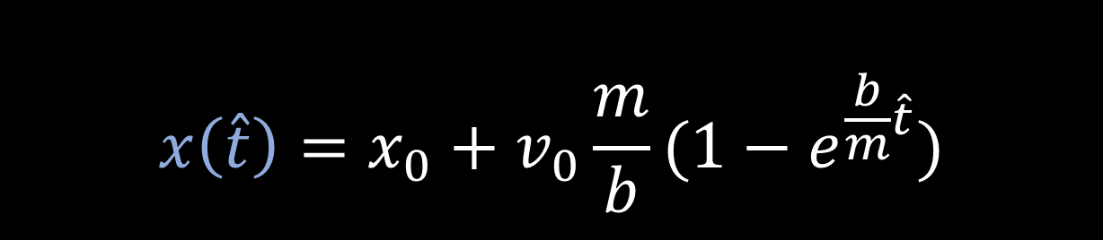

We can also model the same kinematic equation for a system in a non-inertial frame
$$x\left(\hat{t}\right)=x_{0}+v_{0}\frac{m}{b}(1−e^{\frac{b}{m}\hat{t}})$$
$$x\left(t\right)=x_{0}+v_{0}t$$
$$x$$
$$x$$
$$t=\frac{m}{b}(1−e^{\frac{b}{m}\hat{t}})$$
$$t$$
$$\hat{t}$$
Notes:
Image: draw a map of t to t^ (play around with t vs q and t^ vs q

Slide 19




Non-Inertial Frame: Newtonian Mechanics
Keeping the position variable the same:
$$\hat{t}=\hat{t}(t)$$
$F^{i}=d_{t}\hat{t}d_{\hat{t}}\left(mv^{i}\right)=$ $d_{t}\hat{t}d_{\hat{t}}(md_{t}\hat{t}d_{\hat{t}}x^{i}$)
Setting $\hat{m}=md_{t}\hat{t}$:
$$F^{i}=d_{t}\hat{t}d_{\hat{t}}(\hat{m}d_{\hat{t}}x^{i})=d_{t}\hat{t}{\hat{F}}^{i}$$
We now have a variable effective mass due to a slowing down of time
like in special relativity

Slide 20



Calculate the “effective” mass
$$d_{\hat{t}}t=d_{\hat{t}}\left(\frac{m}{b}(1−e^{\frac{b}{m}\hat{t}})\right)=\frac{m}{b}d_{\hat{t}}\left(1−e^{\frac{b}{m}\hat{t}}\right)$$
$$=−\frac{m}{b}d_{\hat{t}}e^{− \frac{b}{m}\hat{t}}=\frac{m}{b}\frac{b}{m}e^{− \frac{b}{m}\hat{t}}=e^{− \frac{b}{m}\hat{t}}$$
Same as variable mass case!
$$\hat{m}=md_{t}\hat{t}=m{(d}_{\hat{t}}{t)}^{−1 }=me^{\frac{b}{m}\hat{t}}$$

Slide 21



Calculate the apparent force
$F=0$ in the inertial frame
$$0=d_{t}\left(mv\right)=d_{t}\left(md_{t}x\right)=d_{t}\hat{t}d_{\hat{t}}\left(md_{t}\hat{t}d_{\hat{t}}x\right)=e^{\frac{b}{m}\hat{t}}d_{\hat{t}}\left(me^{\frac{b}{m}\hat{t}}\hat{v}\right)$$
$$= e^{\frac{b}{m}\hat{t}}(m\frac{b}{m}e^{\frac{b}{m}\hat{t}}\hat{v}+me^{\frac{b}{m}\hat{t}}\hat{a})=e^{2\frac{b}{m}\hat{t}}\left(b\hat{v}+m\hat{a}\right)$$
$$m\hat{a}=−b\hat{v}$$
Apparent force

Slide 22




Dynamics
Kinematics
Linear Drag
$$x$$
$$x_{0}+\frac{m}{b}v_{0}$$
Variable Mass
$$x_{0}$$
$$t$$
Non-Inertial Frame

Slide 24
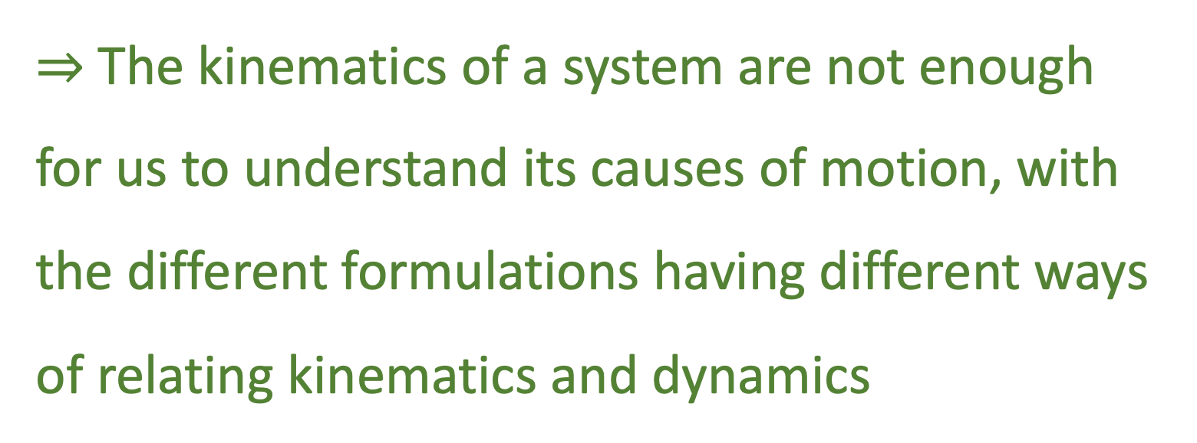
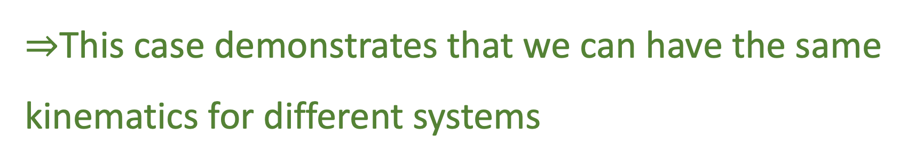
Big Picture:
$⇒$This case demonstrates that we can have the same kinematics for different systems
$⇒$The kinematics of a system are not enough for us to understand its causes of motion, with the different formulations having different ways of relating kinematics and dynamics

Slide 25
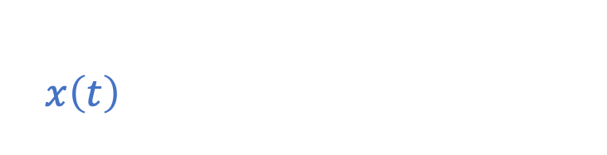


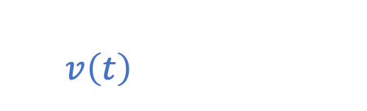


Particle Under Linear Drag: Graphs For Newtonian Mechanics
$$x\left(t\right)=x_{0}+v_{0}\frac{m}{b}\left(1−e^{− \frac{k}{m}t}\right)$$
$$x$$
$$v$$
$$v\left(t\right)=v_{0}e^{− \frac{k}{m}t}$$
$$a$$
$$x_{0}+\frac{m}{b}v_{0}$$
$$v_{0}$$
$$t$$
$$a\left(t\right)=−v_{0}\frac{b}{m}e^{− \frac{k}{m}t}$$
$$x_{0}$$
$$−\frac{b}{m}v_{0}$$
$$t$$
$$t$$
$$E$$
$$E\left(t\right)=\frac{1}{2}mv_{0}^{2}e^{− 2\frac{b}{m}t}$$
$$\frac{1}{2}mv_{0}^{2}$$
$$E(t)$$
$$t$$
Notes:
To Soon: create visual of the example (do with all)
make clear these are Newtonian

Slide 26
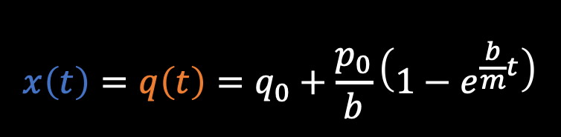







Particle Under Linear Drag Graphs:
$$x\left(t\right)=q\left(t\right)=q_{0}+\frac{p_{0}}{b}\left(1−e^{\frac{b}{m}t}\right)$$
$$p\left(t\right)=p_{0}=mv_{0}$$
$$H(t)=\frac{1}{2}\frac{p^{2}}{m}e^{− \frac{b}{m}t}$$
$$x$$
$$E$$
$$p$$
$$x_{0}+\frac{m}{b}v_{0}$$
$${\frac{p_{0}^{2}}{2m}}_{0}$$
$$p_{0}$$
$$mv\left(t\right)=mv_{0}e^{− \frac{b}{m}t}$$
$$E\left(t\right)=\frac{1}{2}mv_{0}^{2}e^{−2\frac{b}{m}t}$$
$$x_{0}$$
$$t$$
$$t$$
$$t$$
The kinematics for this system seem to be correct, but the dynamics seem off
Notes:
To Soon: create visual of the example (do with all)
make clear these are Newtonian

Slide 27



Lagrangian for Variable Mass System?
$$L=\frac{1}{2}mv^{2}e^{\frac{b}{m}t}$$
We can apply the same Lagrangian:
$$∂_{x}L=0=d_{t}∂_{v}L=d_{t}\left(mv_{ }e^{\frac{b}{m}t}\right) \\ =mae^{\frac{b}{m}t}+\frac{b}{m}mve^{\frac{b}{m}t}=e^{\frac{b}{m}t}\left(ma+bv\right)$$
Recover Variable Mass System!!!
$$ma=−bv$$

Slide 28
Lagrangian for Variable Mass System?
$$L=\frac{1}{2}mv^{2}e^{\frac{b}{m}t}$$
We can apply the same Lagrangian:
$$∂_{x}L=0=d_{t}∂_{v}L=d_{t}\left(mv_{ }e^{\frac{b}{m}t}\right) \\ =mae^{\frac{b}{m}t}+\frac{b}{m}mve^{\frac{b}{m}t}=e^{\frac{b}{m}t}\left(ma+bv\right)$$
Recover Variable Mass System!!!
$$ma=−bv$$

