Slide 2

Newtonian
$$≠$$
Lagrangian
Hamiltonian
Newtonian
Systems
Lagrangian
Systems
Hamiltonian
Systems

Slide 3

Dissipative
Lagrangian/ Hamiltonian?
Velocity:
Drag:
$$L=\frac{1}{2}mv^{2}e^{\frac{b}{m}t}$$
It’s complicated…

Slide 4














One set of equations
$$\frac{dq}{dt}=\frac{∂H}{∂p}$$
$$p$$
$$S^{b}ω_{ba}=S_{a}=∂_{a}H$$
$$\frac{dp}{dt}=−\frac{∂H}{∂q}$$
$$v$$
$$ω(v,w)$$
$$w$$
$$q$$
$$ω(\hat{v},\hat{w})$$
$$\hat{w}$$
$$\hat{v}$$
$$p$$
$$U$$
12 different perspectives
$$q$$
$$\hat{U}$$

Slide 5
A formal system for all physics
Informal
Formal
physics
math
Is it possible?

Slide 6
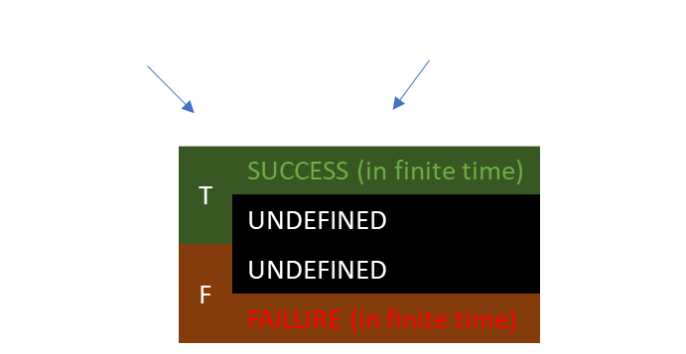
The logical structure
of scientific theories

Slide 7



Determinism/reversibility
+ DOF independence
$$⟺$$
$$\frac{dq^{i}}{dt}=\frac{∂H}{∂p_{i}}$$
Hamiltonian Mechanics
$$\frac{dp_{i}}{dt}=−\frac{∂H}{∂q^{i}}$$

Slide 8
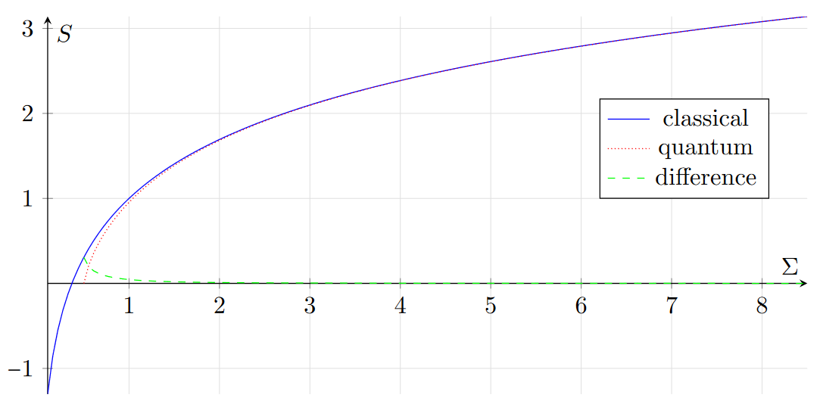



$$σ_{x}σ_{p}≥\frac{ℏ}{e}$$
excluded by Gaussian bound
Classical analogues
excluded by 3rd law of thermodynamics
$$x$$
$$p_{x}$$

