Slide 1


The Assumptions of Physics 2023-24 status
Gabriele Carcassi and Christine A. Aidala
Physics Department University of Michigan
https://assumptionsofphysics.org

Slide 2



About the project
Identify a handful of physical starting points from which the basic laws can be rigorously derived
For example:
Infinitesimal reducibility $⇒$ Classical state
Irreducibility $⇒$ Quantum state
https://assumptionsofphysics.org
?
time
time
This also requires rederiving all mathematical structures from physical requirements
For example:
Science is evidence based $⇒$ scientific theory must be characterized by experimentally verifiable statements $⇒$ topology and $σ$-algebras

Slide 3
Different approach to the foundations of physics
Find ultimate theory
approximation
…
Typical approaches
Construct interpretations
Weak interactions
QED -Electromagnetism
Measurement problem
Role of the observer
QCD – Strong Interactions
Electro-weak
Quantum mechanics
Contextuality
Local realism
General Relativity
Grand Unified Theory
Ontology of observables
What “really” happens
Theory of Everything
Our approach
Find a minimal set of physical assumptions from which to rigorously rederive the laws
General physical principles and requirements
General mathematical framework
Specific assumptions
Classical mechanics
Quantum mechanics
derivation
Thermodynamics
…
specialization

Slide 4
Underlying perspective
Foundations of physics
Foundations of mathematics
Metaphysical reality
What really exists
Philosophy of science
How exactly do we draw that boundary?
Physical theories
Idealized account of physical reality
Physical reality
What can be studied experimentally
How exactly does the abstraction/idealization process work?

Slide 5
Space of the well-posed scientific theories
Physical theories
Unitary evolution
Specializations of the general theory under the different assumptions
Hamiltonian mechanics
Quantum state-space
Classical phase-space
Infinitesimal reducibility
Determinism/
reversibility
Irreducibility
Assumptions
States and processes
General theory
Information granularity
Basic requirements and definitions valid in all theories
Experimental verifiability

Slide 6


Reverse physics: Start with the equations, reverse engineer physical assumptions/principles
Reverse Physics
Physics
Smallest set of assumptions required to rederive the theory
Physical theory
Physical result/ effect/prediction
$$S^{q}=\frac{dq}{dt}=\frac{∂H}{∂p}$$
Reverse Mathematics
Mathematics
Smallest set of axioms required to prove the theorem
Theorem
Mathematical result/ corollary/calculation
$$S^{p}=\frac{dp}{dt}=−\frac{∂H}{∂q}$$
Found Phys 52, 40 (2022)
Goal: “Elevate” the discussion from mathematical constructs to physical principles, assumptions and requirements
Physical mathematics: Start from scratch and rederive all mathematical structures from physical requirements
Physics
Physical requirements
Semantics
Physical mathematics
Goal: Construct a perfect one-to-one map between mathematical and physical objects

Slide 7
Reverse Physics: Classical mechanics
Assumptions of Physics, Michigan Publishing (v2 2023)
J. Phys. Commun. 2 045026 (2018)

Slide 8












7 equivalent characterizations of Hamiltonian mechanics
12 in the book
one DOF
(1) Hamilton’s equations
(2) Divergenceless displacement
$$p$$
$$S^{q}=\frac{dq}{dt}=\frac{∂H}{∂p}$$
$$div\left(S^{a}\right)=\frac{∂S^{q}}{∂q}+\frac{∂S^{p}}{∂p}=0$$
$$q$$
$$S^{p}=\frac{dp}{dt}=−\frac{∂H}{∂q}$$
(3) Area conservation ($|J|$ = 1)
(4) Deterministic and reversible evolution
(7) Uncertainty conservation
$$dQdP=|J|dqdp$$
Area conservation $⟺$ state count conservation
for peaked distributions
$$\left|Σ\left(t+dt\right)\right|=\left|J\right|\left|Σ\left(t\right)\right|\left|J\right|$$
$⟺$ deterministic and reversible evolution
(5) Deterministic and thermodynamically reversible evolution
(6) Information conservation
$$S=k_{B}\log{W}$$
$$I\left[ρ\left(t+dt\right)\right]=I\left[ρ\left(t\right)\right]−∫ρ\log{|J|}dqdp$$
Area conservation $⟺$ entropy conservation
$⟺$ thermodynamically reversible evolution
A full understanding of classical mechanics means understanding these connections

Slide 9

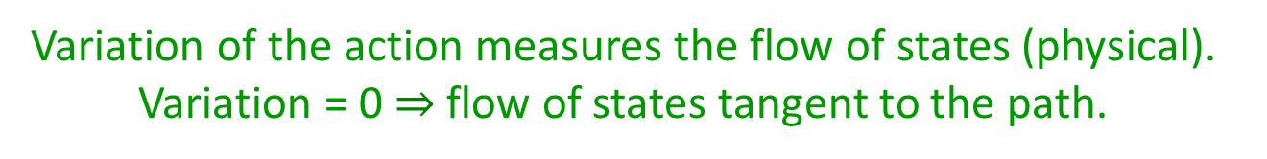
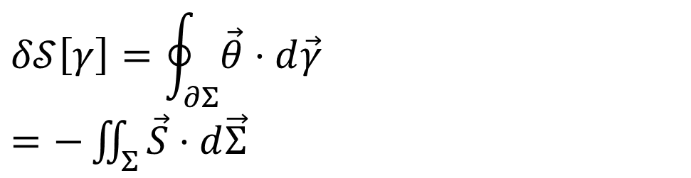


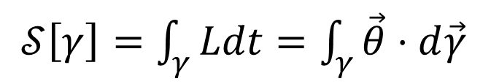





Reversing the principle of least action
DR
KE
$$∇⋅\vec{S}=0$$
$$\vec{S}=−∇×\vec{θ}$$
$𝒮\left[γ\right]=\int_{γ}{Ldt}=\int_{γ}{\vec{θ}⋅d\vec{γ}}$
No state is “lost” or “created” as time evolves
(Minus sign to match convention)
Sci Rep 13, 12138 (2023)
The action is the line integral of the vector potential (unphysical)
$$p$$
$$q$$
Variation of the action
$$Σ$$
Gauge independent, physical!
$$δ𝒮\left[γ\right]=\oint_{∂Σ}{\vec{θ}⋅d\vec{γ}}$$ $=−\iint_{Σ}{\vec{S}⋅d\vec{Σ}}$
$$γ$$
$$γ′$$
$$t$$
Variation of the action measures the flow of states (physical). Variation = 0 $⇒$ flow of states tangent to the path.

Slide 10







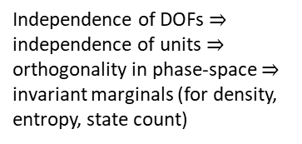

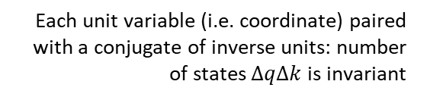

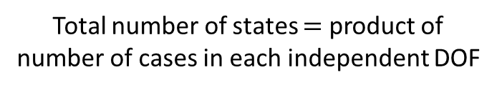




Reversing phase-space
Hamiltonian Privilege, Erkenn (2023)
Stud Hist Phil 71, 082020, 60-71 (2020)
Each unit variable (i.e. coordinate) paired with a conjugate of inverse units: number of states $ΔqΔk$is invariant
$\hat{q}=100 cm/m q$
$$x↦x^{3}$$
$$1$$
$Δk=1 m^{−1}$
$$1$$
$Δ\hat{k}=0.01 cm^{−1}$
$$x$$
$$x^{3}$$
$Δ\hat{q}=100 cm$
$Δq=1 m$
Density, entropy, uniform distributions NOT in general coordinate invariant
Phase space (symplectic) structure is the only one that supports coordinate invariant density, entropy, state count
Only 3 spatial dimensions are possible
Independence of DOFs $⇒$ independence of units $⇒$ orthogonality in phase-space $⇒$ invariant marginals (for density, entropy, state count)
Hamiltonian mechanics preserves count of states and DOF independence over time
2-sphere the only symplectic manifold
$$(q^{y},k_{y})$$
$$ω_{ab}=\left[\begin{matrix}0 & 1 \\ −1 & 0\end{matrix}\right]⊗δ_{j}^{i}$$
Directional DOF
$$(q^{x},k_{x})$$
Orthogonality/independence across DOFs
Total number of states $=$ product of number of cases in each independent DOF
Symplectic form (geometric structure of phase space)
Areas/possibilities in each DOF
Invariance at equal time (relativity) gives us the structure of phase space

Slide 11

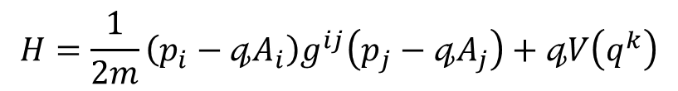

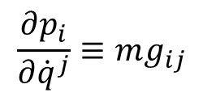

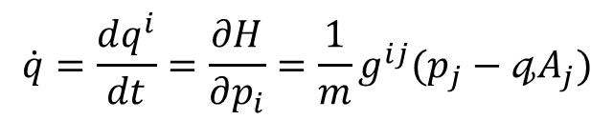



Massive particles under potential forces
Kinematic equivalence assumption: the state can be recovered from space-time trajectories
Integration of the previous expression
$$p_{i}=mg_{ij}{\dot{q}}^{j}+𝓆A_{i}\left(q^{k}\right)$$
$$\dot{q}=\frac{dq^{i}}{dt}=\frac{∂H}{∂p_{i}}=\frac{1}{m}g^{ij}(p_{j}−𝓆A_{j})$$
$$p$$
$$z$$
$$\frac{∂p_{i}}{∂{\dot{q}}^{j}}≡mg_{ij}$$
$$y$$
Must be a linear transformation in terms of coordinates
$$q$$
$$H=\frac{1}{2m}\left(p_{i}−𝓆A_{i}\right)g^{ij}\left(p_{j}−𝓆A_{j}\right)+𝓆V\left(q^{k}\right)$$
$$x$$
Fixes the units
Hamiltonian for massive particles under potential forces
Mass quantifies number of states per unit of velocity
Higher mass $⇒$ more states to go through $⇒$ harder to accelerate
BUT
Zero mass $⇒$ zero states within finite range of velocity $⇒$ velocity is fixed
The laws themselves are highly constrained by simple assumptions

Slide 12


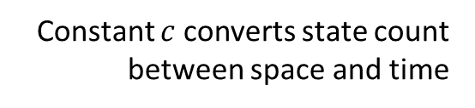

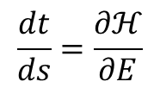


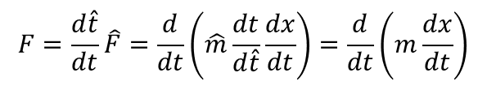




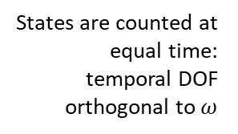


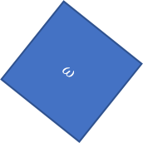


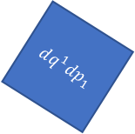
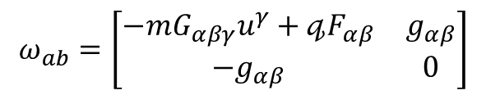
Relativistic mechanics
Relativistic aspects without space-time and in Newtonian mechanics
Classical antiparticles
$$p$$
potential of the displacement
$$F=\frac{d\hat{t}}{dt}\hat{F}=\frac{d}{dt}\left(\hat{m}\frac{dt}{d\hat{t}}\frac{dx}{dt}\right)=\frac{d}{dt}\left(m\frac{dx}{dt}\right)$$
$$q$$
$$\frac{dt}{ds}=\frac{∂ℋ}{∂E}$$
$$θ=[p^{i},−H,0, 0]$$
$$t$$
energy-momentum co-vector
rest mass scaled by time dilation
Affine parameter anti-aligned with time:
parameterization “goes back” in time
Lorentzian relativity is the only “correct” one
No clear idea what $G_{αβγ}$ is…
Inertial forces?
Minkowski signature appears on the extended phase space
Metric tensor quantifies states charted by position and velocity
$$ω=dq^{1}dp_{1}+dq^{2}dp_{2}$$
$$ω=dq^{1}dp_{1}−dtdE$$
$$ω_{ab}=\left[\begin{matrix}−mG_{αβγ}u^{γ}+𝓆F_{αβ} & g_{αβ} \\ −g_{αβ} & 0\end{matrix}\right]$$
$$ω$$
$$dq^{1}dp_{1}=ω+dtdE$$
$$dq^{2}dp_{2}$$
States are counted at equal time: temporal DOF orthogonal to $ω$
$$dq^{1}dp_{1}$$
$$t$$
instants in time
$$dq^{1}dp_{1}$$
positions in space
$$dtdE$$
$$ω$$
$$q$$
Indep DOF are orthogonal
Constant $c$ converts state count between space and time

Slide 13

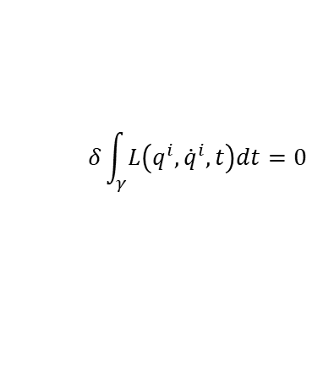








Assumptions of classical mechanics
$$\frac{dq^{i}}{dt}=\frac{∂H}{∂p_{i}}$$
$$\frac{dp_{i}}{dt}=−\frac{∂H}{∂q^{i}}$$
$$δ\int_{γ}{L\left(q^{i},{\dot{q}}^{i},t\right)dt}=0$$
$$[q^{i},p_{i}]$$
(IR) Infinitesimal reducibility
Classical Phase Space
Hamiltonian Mechanics
Lagrangian Mechanics
+
+
+
Massive particles under potential forces
(DR) Determinism /Reversibility
weak
+
(IND) Degree of freedom independence
(KE) Kinematic Equivalence
full
$$H=\frac{1}{2m}\left(p_{i}−𝔮A_{i}\right)g^{ij}\left(p_{j}−𝔮A_{j}\right)+𝔮V$$
$$ρ_{1}ρ_{2}⇒ρ$$
$$p$$
$$p$$
$$z$$
$$y$$
$$q$$
$$q$$
$$x$$
Newtonian Mechanics
Hamiltonian Mechanics
Lagrangian Mechanics

Slide 14
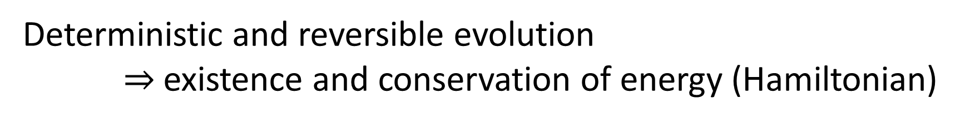
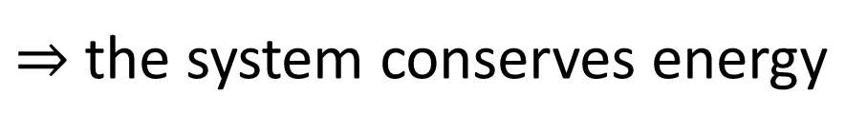
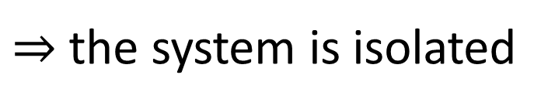
Reverse physics gives us links between theories
Deterministic and reversible evolution $⇒$existence and conservation of energy (Hamiltonian)
Why?
Stronger version of the first law of thermodynamics
Deterministic and reversible evolution
$⇒$ past and future depend only on the state of the system
$⇒$ the evolution does not depend on anything else
$⇒$ the system is isolated
First law of thermodynamics!
$⇒$ the system conserves energy
Notes:
Structure of phase space exactly what is needed to do statistical mechanics - Comes out of invariance of the entropy under coordinate transformations

Slide 15
Reverse Physics: Thermodynamics

Slide 16
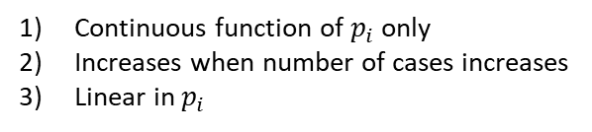
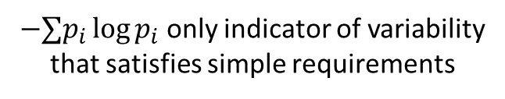
Shannon entropy as variability
Eur. J. Phys. 42, 045102 (2021)
more variability
Meaning depends on the type of distribution
Statistical distribution: variability of what is there
?
less variability
Probability distribution: variability of what could be there
?
Shannon entropy quantifies the variability of the elements within a distribution
Credence distribution: variability of what one believes to be there
$−∑p_{i}\log{p_{i}}$ only indicator of variability that satisfies simple requirements
This characterization works across disciplines
Continuous function of $p_{i}$ only
Increases when number of cases increases
Linear in $p_{i}$

Slide 17


Shannon entropy as variability
Is it alive?
Eur. J. Phys. 42, 045102 (2021)
Is it human made?
$$W$$
Does it live on land?
…
…
…
$$\frac{1}{N}\log{W}≈−∑p_{i}\log{p_{i}}$$
Efficient game of twenty questions
…
More variability, more permutations
…
Variability is also quantified by the logarithm of the number of possible permutations per element
More variability, more questions
Variability is quantified by the expected minimum number of questions required to identify an element
More variability for a distribution at equilibrium, more fluctuations, more physical entropy

Slide 18
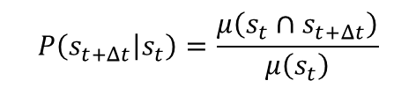
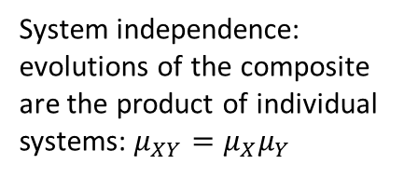
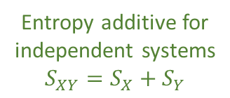


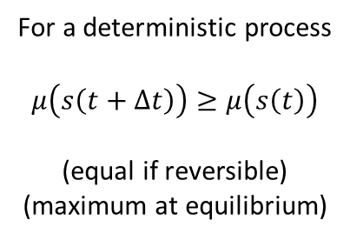







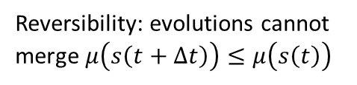
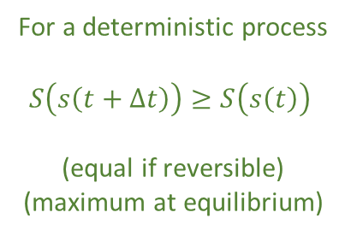

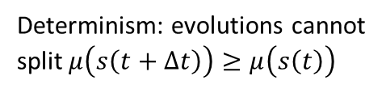

Entropy as logarithm of evolutions
$μ\left(s_{t}\right)$: how many evolutions go through $s_{t}$?
Process entropy: $S=\log{μ}$
$$P\left(s_{t+Δt} | s_{t}\right)=\frac{μ\left(s_{t}∩s_{t+Δt}\right)}{μ\left(s_{t}\right)}$$
Determinism: evolutions cannot split $μ\left(s\left(t+Δt\right)\right)≥μ\left(s\left(t\right)\right)$
$$μ=2$$
$$μ=1$$
$$μ=2$$
Reversibility: evolutions cannot merge $μ\left(s\left(t+Δt\right)\right)≤μ\left(s\left(t\right)\right)$
$$t−Δt$$
$$t$$
$$t+Δt$$
For a deterministic process
$$μ\left(s\left(t+Δt\right)\right)≥μ\left(s\left(t\right)\right)$$
(equal if reversible)
(maximum at equilibrium)
For a deterministic process
$S\left(s\left(t+Δt\right)\right)≥S\left(s\left(t\right)\right)$
(equal if reversible)
(maximum at equilibrium)
$$t−Δt$$
$$t$$
$$t+Δt$$
System independence: evolutions of the composite are the product of individual systems: $μ_{XY}=μ_{X}μ_{Y}$
Entropy additive for independent systems
$$S_{XY}=S_{X}+S_{Y}$$
$$\left\{x\left(t\right),y\left(t\right)\right\}$$
$$x(t)$$
$$y(t)$$

Slide 19
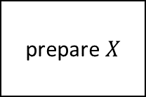
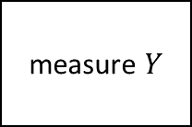
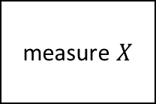
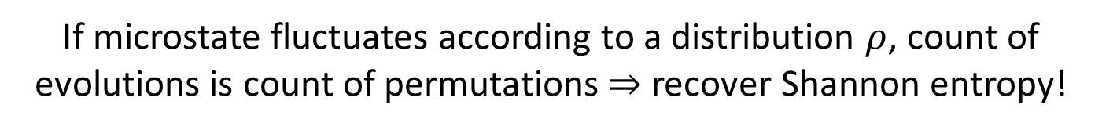
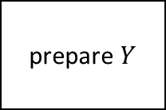
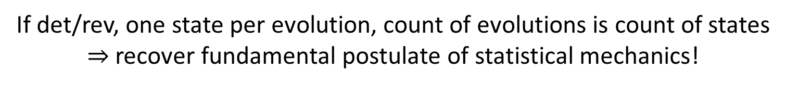
Entropy as logarithm of evolutions
$μ\left(s_{t}\right)$: how many evolutions go through $s_{t}$?
Process entropy: $S=\log{μ}$
prepare $X$
interaction
measure $X$
Note: defining an evolution count is necessary in physics
prepare $Y$
measure $Y$
We compose processes by connecting inputs and outputs: all evolutions must connect!
Recovers other notions of entropy!
If det/rev, one state per evolution, count of evolutions is count of states
$⇒$ recover fundamental postulate of statistical mechanics!
If microstate fluctuates according to a distribution $ρ$, count of evolutions is count of permutations$⇒$ recover Shannon entropy!

Slide 20

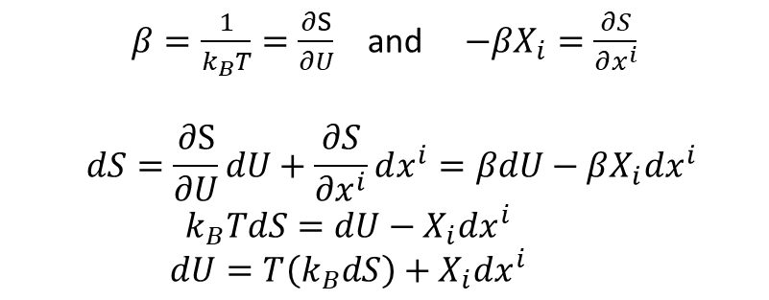

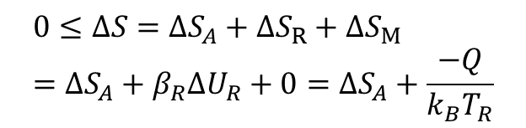


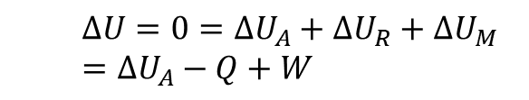




“Reversing” thermodynamics
Assume states are equilibria of faster scale processes
$β=\frac{1}{k_{B}T}=\frac{∂S}{∂U}$ and $−βX_{i}=\frac{∂S}{∂x^{i}}$
$$dS=\frac{∂S}{∂U}dU+\frac{∂S}{∂x^{i}}dx^{i}=βdU−βX_{i}dx^{i} \\ k_{B}TdS=dU−X_{i}dx^{i} \\ dU=T\left(k_{B}dS\right)+X_{i}dx^{i}$$
Define intensive quantities
Assume states identified by extensive properties
Assume one of these quantities is energy $U$
$$S(U,x^{i})$$
Existence of equation of state
Recover usual relationships
Study interplay of changes of energy and entropy
$$ΔU=0=ΔU_{A}+ΔU_{R}+ΔU_{M} \\ =ΔU_{A}−Q+W$$
First law recovered from existence and conservation of Hamiltonian
$$R$$
Reservoir: energy only state variable, entropy linear function of energy
Recover first law
All energy stored in entropy
$$Q$$
$$0≤ΔS=ΔS_{A}+ΔS_{R}+ΔS_{M} \\ =ΔS_{A}+β_{R}ΔU_{R}+0=ΔS_{A}+\frac{−Q}{k_{B}T_{R}}$$
Mechanical system: same entropy for all states
$$A$$
$$M$$
$$W$$
No energy stored in entropy
Recover second law
$$β=\frac{1}{k_{B}T}=0$$
Second law recovered from definition of entropy as count of evolutions

Slide 21




3rd law and principle of maximal description
Can be formulated as:
$$μ=3$$
Count of evolutions
Every substance has a finite positive entropy, but at the absolute zero of temperature the entropy may become zero, and does so become in the case of perfect crystalline substances.
$S=\log{μ(x)}$
Count of evolutions can’t be $<1$ therefore $S$ can’t be $<0$
G. N. Lewis and M. Randall
3rd law can be restated as:
No state can describe a system more accurately than stating the system is not there in the first place.
Better “special case” than “crystalline substance”
Null state $∅$: system is absent (e.g. gas with zero particles)
Principle of maximal description
$$A=A∪∅$$
$S_{A}=S_{A∪∅}=S_{A}+S_{∅}⇒S_{∅}=0$
We can reformulate the 3rd law of thermodynamics as a logical necessity
Entropy for the null state of any system must be $0$

Slide 22
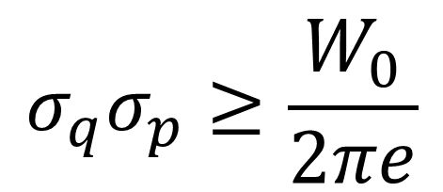



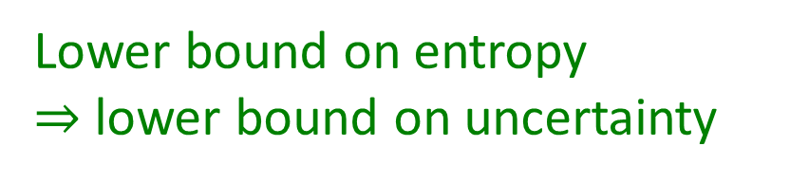


$$S[ρ]$$
Classical uncertainty principle
Region with classical distributions
Classical mechanics has no lower bound on entropy $⇒$ violates third law! What happens if we impose one?
Let $W_{0}$ the volume of phase space over which a uniform distribution has zero entropy.
Minimum uncertainty
$$σ_{q}σ_{p}≥\frac{W_{0}}{2πe}$$
Int J Quant Inf 18, 01, 1941025 (2020)
$$σ_{q}σ_{p}$$
Equality for independent Gaussians
$$0$$
Excluded by 3rd law
Lower bound on entropy $⇒$ lower bound on uncertainty
Don’t need the full quantum theory to derive the uncertainty principle: only the lower bound on entropy

Slide 23
3rd law of thermodynamics and uncertainty principle
Classical mechanics
Third law of thermodynamics
Lower bound on entropy
+
Uncertainty principle
Quantum mechanics
Principle of maximal description
No state can describe a system more accurately than stating the system is not there in the first place
The uncertainty principle is a consequence of the principle of maximal description
Can we understand the rest of quantum mechanics in the same way?

Slide 24
Reverse Physics: Quantum mechanics

Slide 25









Quantum mechanics as irreducibility
Classical
Quantum
Entropy
Minimum uncertainty
$$p$$
?
time
0
time
$$q$$
Can prepare ensembles at arbitrarily low entropy: we can study arbitrarily small parts
Entropy is bounded at zero: we cannot study parts
Can’t squeeze ensemble arbitrarily
We always have access to the internal dynamics
No access to the internal dynamics
Superluminar effects that can’t carry information
Probability of transition
Non-locality
$$\left|x^{+}\right\rangle$$
$$\left|y^{+}\right\rangle$$
$$\left|x^{−}\right\rangle$$
$$\left|y^{−}\right\rangle$$
Can’t refine ensembles $⇒$ Can’t interact with parts
Can’t refine ensembles $⇒$ Can’t extract information
$$p\left(x^{+} | y^{−}\right)=p(y^{−}|x^{+})$$
Symmetry of the inner product

Slide 26



















Time evolution and measurements
$$ρ_{I}$$
$$P$$
$ρ_{O}=P\left(ρ_{I}\right)$
Any process (deterministic or stochastic) will take an ensemble as input and return an ensemble as output
$$P\left(p_{1}ρ_{1}+p_{2}ρ_{2}\right)=p_{1}P\left(ρ_{1}\right)+p_{2}P\left(ρ_{2}\right)$$
$$\left|E_{1}\right\rangle$$
$$\left|E_{1}\right\rangle$$
Deterministic and reversible
Measurement
$$ρ_{I}$$
$$P$$
$$ρ_{O}$$
$$P^{−1}$$
$$ρ_{I}$$
$$ρ_{I}$$
$$P$$
$$ρ_{O}$$
$$P$$
$$ρ_{O}$$
$$Δθ$$
Conserves probability and allows an “inverse”
Must be repeatable
$⇒$ Unitary operation
$⇒$ Projection
$$|E_{0}⟩$$
$$|E_{0}⟩$$
Measurement problem: unitary $⇏$ projections … projections $⇒$ unitary
Unitary evolution $≡$ sequence of infinitesimal projections
Unitary evolution is for det/rev, isolated processes System being measured can’t be isolated

Slide 27


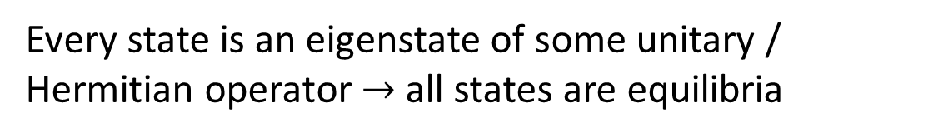



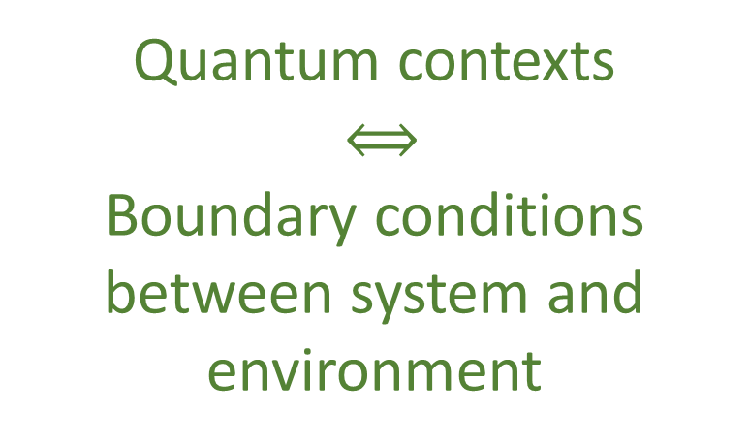





Parallels between QM and thermodynamics
$$U=e^{\frac{OΔt}{ıℏ}}$$
Eigenstates $→$ states unchanged by the process $→$ equilibria of the process
Every state is an eigenstate of some unitary / Hermitian operator $→$ all states are equilibria
Quantum contexts
$⟺$
Boundary conditions between system and environment
Every mixed state commutes with some unitary operator (same eigenstates used calculate entropy)
Spin up meas.
Equilibration
$$[N_{1},V,T]$$
$$\left|x^{+}\right\rangle$$
$$\left|z^{+}\right\rangle$$
Projections $⟺$ Measurements
$$[μ,V,T]$$
$$\left|z^{−}\right\rangle$$
$$[N_{2},V,T]$$
Unitary $⟺$ Quasi-static
Different equilibria, different variables
Different contexts, different variables
$$[….,V,T]$$

Slide 28

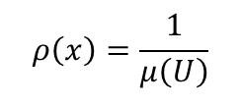








Entropic nature of physical theories
Thermodynamics/Statistical mechanics are not built on top of mechanics
Mechanics is the ideal case of thermodynamics/statistical mechanics
Best preparation $⇒$ pure state
Best process $⇒$ map between pure states
$$μ\left(U\right)$$
Standard probability
$$ρ\left(x\right)=\frac{1}{μ\left(U\right)}$$
The geometric structure of both classical and quantum mechanics is ultimately an entropic structure
Symplectic manifold
We can only prepare/measure ensembles. Ensembles can offer a unified way of thinking about states.
$ρ$ uniform over $U$
Information theory
$$H\left(ρ\right)=\log{μ\left(U\right)}$$
$$\left\langle ψ | φ\right\rangle$$
Quantum probability
$$p\left(ψ | φ\right)={\left|\left\langle ψ | φ\right\rangle \right|}^{2}$$
Projective Hilbert space
$$ρ=\frac{1}{2}ρ_{ψ}+\frac{1}{2}ρ_{φ}$$
Quantum information theory
$$H\left(ρ\right)=H\left(\frac{1+\sqrt{p}}{2},\frac{1−\sqrt{p}}{2}\right)$$

Slide 29







$S=0$
$S=0$
$$S→−∞$$
$$S=0$$
$$S→+∞$$
$$S→+∞$$
$$S→+∞$$
Quantum
Classical discrete infinite
Classical continuum
Quantum mechanics is a hybrid between discrete and continuum
Quantum pure states form a manifold (like classical continuum) where each state has zero entropy (like classical discrete)
Quantum mixed states have no single decomposition in terms of pure states, classical continuum mixed states have no single decomposition in terms of zero entropy states

Slide 30


Recovering QM from assumptions on ensembles
$$\left|E_{1}\right\rangle$$
Ensembles can mix $⇒$ Form a convex space
Irreducibility $⇒$ Extreme points in the convex space
Continuous time $⇒$ Extreme points form a manifold (not discrete)
Frame-invariance $⇒$ Manifold is symplectic
$$|E_{0}⟩$$
Homogeneity $⇒$ All two dimensional subspaces are spheres
2-sphere only symplectic sphere
Is this enough to recover complex projective spaces?

Slide 31
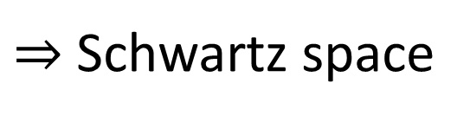
Unphysicality of Hilbert spaces
Hilbert space: complete inner product vector space
Redundant on finite-dimensional spaces. For infinite-dimensional spaces, it allows us to construct states with infinite expectation values from states with finite expectation values
Exactly captures measurement probability/entropy of mixtures and superposition/statistical mixing
Physically required
Extremely physically suspect!!!
$⇒$ Thus requires us to include unitary transformations (e.g. change of representations and finite time evolution) that change finite expectation values into infinite ones
Suppose we require all polynomials of position and momentum to have finite expectation
$⇒$ Schwartz space
Maybe more physically appropriate?
Closed under Fourier transforms
Used as starting point for theories of distributions

Slide 32
QM postulates revisited
$⇒$ Recover mathematical structure of quantum mechanics from properties of ensembles
State postulate: states are rays of a complex vector space
Recovered from properties of ensembles and rules of ensemble mixing
Measurement postulate: projection measurement and Born rule
Projections as processes with equilibria
Born rule recoverable from entropy of mixing
Composite system postulate: tensor product for composite system
Derived from other postulates
PRL 126, 110402 (2021)
Evolution postulate: unitary evolution (Schrödinger equation)
Deterministic/reversible evolution

Slide 33
What about field theories?
Classical field theory (EM fields, general relativity, …)
Quantum field theory (QED, QCD, Electroweak, …)
We lack the “correct math” to generalize

Slide 34
Physical mathematics

Slide 35
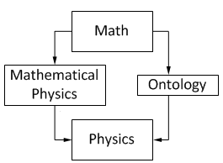
In modern physics, mathematics is used as the foundation of our physical theories
Mathematical content of a theory can never tell us the full physical content
From Hossenfelder’s Lost in Math: “[…] finding a neat set of assumptions from which the whole theory can be derived, is often left to our colleagues in mathematical physics […]”
David Hilbert: “Mathematics is a game played according to certain simple rules with meaningless marks on paper.”
Bertrand Russell: “It is essential not to discuss whether the first proposition is really true, and not to mention what the anything is, of which it is supposed to be true.”
Physics
We need to identify which parts of mathematics are “correct” to capture physical properties in a specific realm of applicability
Physical requirements
Semantics
Physical Mathematics
From Wikipedia “Mathematical Physics”
Mathematical structures must be justified by physical requirements

Slide 36
Physical mathematics
Physics
Physics is defined in terms of physical objects and operational definitions
Informal
Formal
Physical requirements
Semantics
physics
math
Under assumptions, idealizations and approximations, physical objects and their properties are expressed with a formal system through axioms and definitions.
Physical mathematics
All physical content is captured by the definitions and axioms
The map between informal and formal is the most delicate and important step, and it is also the least studied!!!

Slide 37


Examples: symplectic space and probability spaces
Hamiltonian mechanics
Phase space (symplectic manifold)
Hamiltonian evolution
Differentiable manifold
Symplectic structure
Manifold
Differentiable structure
Determinism/reversibility
Observer independent count of states
Topological space
Locally $ℝ^{n}$
Infinitesimal reducibility
Experimentally distinguishable cases with verifiable statements
Identified by independent continuous quantities
We can see what each additional mathematical layer represents and under what assumptions
Probability space
Set of points
$σ$-algebra
Measure
Experimentally distinguishable cases
Statements associated with experimental tests
Probability that a statement is true

Slide 38
Space of the well-posed scientific theories
Physical theories
Unitary evolution
Specializations of the general theory under the different assumptions
Hamiltonian mechanics
Quantum state-space
Classical phase-space
Infinitesimal reducibility
Determinism/
reversibility
Irreducibility
Assumptions
States and processes
General theory
Information granularity
Basic requirements and definitions valid in all theories
Experimental verifiability

Slide 39












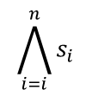


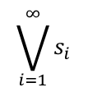
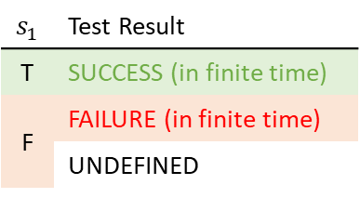

Logic of experimental verifiability
Top. Proc. 54 pp. 271-282 (2019)
verifiable statements
$$𝒮$$
$$s_{1}$$ | Test Result
T | SUCCESS (in finite time)
F | FAILURE (in finite time)
 | UNDEFINED
$$\bigwedge_{i=i}^{n}{s_{i}}$$
$$𝒮_{\text{v}}$$
Finite conjunction (logical AND)
$$s_{1}$$
$$s_{2}$$
$$s_{3}$$
statements
All tests must succeed
$$s_{1}$$
experimental test
Countable disjunction (logical OR)
$$\bigvee_{i=1}^{∞}{s_{i}}$$
$$s_{1}$$
$$s_{2}$$
$$s_{3}$$
$$…$$
Physical theories (evidence based)
$⇒$ all theoretical statements associated with tests
One successful test is sufficient
Operator | Gate | Statement | Theoretical Statement | Verifiable Statement | Decidable Statement
Negation | NOT | allowed | allowed | disallowed | allowed
Conjunction | AND | arbitrary | countable | finite | finite
Disjunction | OR | arbitrary | countable | countable | finite
$$𝒮_{d}$$
$$𝒮_{v}$$
$$𝒮_{t}$$
$$𝒮$$
Some mathematical theories (formally well-posed) have “too many statements” to be physically meaningful

Slide 40
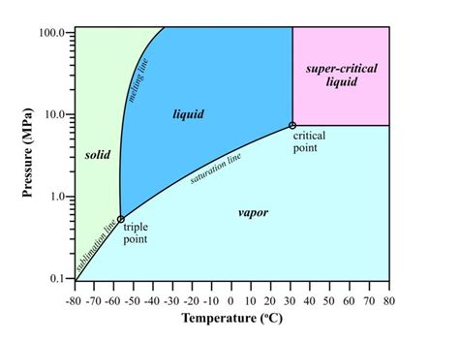

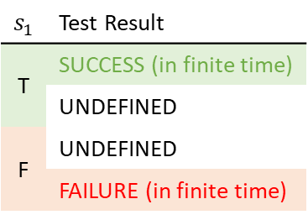










Topology and $σ$-algebra
Experimental verifiability $⇒$ topology and $σ$-algebras (foundation of geometry, probability, …)
Theoretical statements
$int(A)$ corresponds to the verifiable part of a statement
$$s_{1}$$ | Test Result
T | SUCCESS (in finite time)
 | UNDEFINED
F | UNDEFINED
 | FAILURE (in finite time)
Verifiable statements
Perfect map between math and physics
Possibilities
$∂A$ corresponds to the undecidable part of a statement
$ext(A)$ corresponds to the falsifiable part of a statement
NB: in physics, topology and $σ$-algebra are parts of the same logic structure
Open sets
Points
Open set $(\text{5}\text{09.5, 510.5})$ $⟺$ Verifiable “the mass of the electron is 510 $±$ 0.5 KeV”
Borel sets
Closed set $[510]$ $⟺$ Falsifiable “the mass of the electron is exactly 510 KeV”
Borel set $ℚ$ ($int\left(ℚ\right)∪ext\left(ℚ\right)=∅$) $⟺$Theoretical “the mass of the electron in KeV is a rational number” (undecidable)
Inference relationship $𝓇:𝒟_{Y}→𝒟_{X}$ such that $𝓇\left(s\right)≡s$
$$𝒟_{X}$$
$$𝒟_{Y}$$
Topologically continuous consistent with analytic discontinuity on isolated points
Inference relationship $$⟺$$ Causal relationship
Relationships must be topologically continuous
$$X$$
$$Y$$
Causal relationship $f:X→Y$ such that $x≼f\left(x\right)$
Phase transition $⟺$ Topologically isolated regions

Slide 41


















Quantities and ordering
Phys. Scr. 95 084003 (2020)
Goal: deriving the notion of quantities and numbers (i.e. integers, reals, …) from an operational (metrological) model
A reference (i.e. a tick of a clock, notch on a ruler, sample weight with a scale) is something that allows us to distinguish between a before and an after
before
on
after
Mathematically, it is a triple $\left(b,o,a\right)$ such that:
$b$ and $a$ are verifiable
The reference has an extent ($o≢ ⊥$)
If it’s not before or after, it is on ($¬b∧¬a≼o$)
If it’s before and after, it is on ($b∧a≼o$)
Numbers defined by metrological assumptions, NOT by ontological assumptions
Dense
The hard part is to recover ordering. After that, recovering reals and integers is simple.
$$o_{1}$$
$$o_{3}$$
$$o_{2}$$
$$⇒ \left(X,≤\right)≅(ℝ,≤)$$
To define an ordered sequence of possibilities, the references must be (nec/suff conditions):
+
Strict
Aligned
Refinable
Sparse
before
on
after
$$b_{2}$$
$$a_{2}$$
$$o_{3}$$
$$o_{1}$$
$$o_{2}$$
$$o_{2}$$
$$⇒ \left(X,≤\right)≅(ℤ,≤)$$
$$o_{1}$$
$$o_{2}$$
$$o_{1}$$
$$b_{1}$$
$$a_{1}$$
$$⇒ \left(X,≤\right)$$
Assumptions untenable at Planck scale: no consistent ordering: no “objective” “before” and “after”

Slide 42
Space of the well-posed scientific theories
Physical theories
Unitary evolution
Specializations of the general theory under the different assumptions
Hamiltonian mechanics
Quantum state-space
Classical phase-space
Infinitesimal reducibility
Determinism/
reversibility
Irreducibility
Assumptions
States and processes
General theory
Information granularity
Basic requirements and definitions valid in all theories
Experimental verifiability

Slide 43










Information granularity
Logical relationships $⟺$ Topology/$σ$-algebra
Granularity relationships $⟺$ Geometry/Probability/Information
“The position of the object is between 0 and 1 meters” $≼$ “The position of the object is between 0 and 1 kilometers”
“The fair die landed on 1” $≼$ “The fair die landed on 1 or 2”
“The first bit is 0 and the second bit is 1” $≼$ “The first bit is 0”
“The position of the object is between 0 and 1 meters” $⋖$ “The position of the object is between 2 and 3 kilometers”
“The fair die landed on 1” $⋖$ “The fair die landed on 3 or 4”
“The first bit is 0 and the second bit is 1” $⋖$ “The third bit is 0”
$⇒$ Measure theory, geometry, probability theory, information theory, … all quantify the level of granularity of different statements
A partially ordered set allows us to compare size at different level of infinity and to keep track of incommensurable quantities (i.e. physical dimensions)
$$p$$
D
E
$$μ_{u}:\overline{𝒟}→ℝ$$
Once a “unit” is chosen, a measure quantifies the granularity of another statement with respect to the unit
B
C
$$q$$
A
A $⋖$ B $⋖$ C $⋖$ E
C $≰$ D
$μ_{u}\left(u\right)=1$ $s_{1}$ $⋖$ $s_{2}$ $⇒μ_{u}\left(s_{1}\right)≤μ_{u}\left(s_{2}\right)$
$μ_{u}\left(s_{1}∨s_{2}\right)=μ_{u}\left(s_{1}\right)+μ_{u}\left(s_{2}\right)$ if $s_{1}$ and $s_{2}$ are incompatible
D $≰$ C
However, quantum mechanics requires a “twist” at the measure theoretic level

Slide 44






























Need for non-additive measure
entropy of uniform distribution
Single point
Finite continuous range
count of states
$$μ(U)$$
$$\log{μ(U)}$$
$$μ(U)$$
$$\log{μ(U)}$$
$$H\left(ρ_{U}\right)=\log{μ\left(U\right)}$$
Counting measure
Assume usual link between entropy and count of states
$$μ\left(U\right)=\#U$$
$1$
$0$
$+∞$
$+∞$
Number of points
Lebesgue measure
$$A$$
$$μ\left(\left[a,b\right]\right)=b−a$$
$0$
$−∞$
$<∞$
$<∞$
$$C$$
Interval size
“Quantized” measure
$$B$$
$$μ\left(U\right)=2^{H(ρ_{U})}$$
$1$
$0$
$<∞$
$<∞$
$$μ\left(\left\{A\right\}\right)=2^{0}=1$$
Entropy over uniform distribution
$$μ\left(\left\{A,B\right\}\right)=2^{1}=2$$
Pick two!
not additive
Single point is a single case (i.e. $μ\left(\left\{ψ\right\}\right)=1$)
Finite range carries finite information (i.e. $μ\left(U\right)<∞$)
Measure is additive for disjoint sets (i.e. $μ\left(∪U_{i}\right)=∑μ\left(U_{i}\right)$)
$$μ\left(\left\{A,C\right\}\right)<2=μ\left(\left\{A\right\}\right)+μ\left(\left\{C\right\}\right)$$
$$μ\left(\left\{A,B,C\right\}\right)<2=μ\left(\left\{A,B\right\}\right)$$
not monotonic
Physically, we count states all else equal
In quantum mechanics, literally $1+1≤2$
Contextuality $⟺$ non-additive measure

Slide 45






Differentiability in math
Mathematicians have developed several, increasingly abstract, definitions for differentials, derivatives, integrations, tangent vectors… are they suitable for physics?
Differentiable manifold
Manifold
Differentiable structure
Changes of coordinates are differentiable
Vector defined as derivation of a scalar function
Defined on top of Fréchet derivative
$$v:C^{∞}\left(X,ℝ\right)→C^{∞}\left(X,ℝ\right)$$
vector basis
Differentials defined as linear functions of vectors
$$v\left(f\right)=v^{i}∂_{i}f$$
$$dx:V→ℝ$$
So are convectors, like momentum
Does not make sense physically!
$$dx\left(v\right)=dx\left(v^{i}∂_{i}\right)=v^{x}$$
velocity is not a derivation
momentum is not a function of a derivation
derivations $∂_{i}$ depend on units and can’t be summed (e.g. $∂_{r}+∂_{θ}$)
Two mathematical notions of differentials (the new one and the one hidden in the Fréchet derivative)
Infinitesimal objects are limits of finite objects, not the other way around
Integrals defined on top of differential forms
$$\int_{γ}{dx}=Δx$$

Slide 46













Differentiability in physics
$$dv=\left(v_{1},v_{2},v_{3},…\right)$$
Infinitesimal reducibility $⇒$ differentiability
$$\lim_{i→∞}{\frac{v_{i}}{a_{i}}}=t$$
Tangent vector
General notion of differential as an infinitesimal change in ANY vector space
Convergence at all points $⇒$ differentiability of curve
Infinitesimal surface change
$$dσ=\left((v_{1}⊗w_{1}),(v_{2}⊗w_{2}), …\right)$$
$$\lim_{i→∞}{\frac{v_{i}⊗w_{i}}{a_{i}}}=t$$
Time
Space
Temperature
Differentiable function: infinitesimal changes map to infinitesimal changes
Manifold displacement (unit free)
t
$$x(t)$$
x
T$(x)$
T
$$dx^{i}e_{i}=dP$$
Quantity
Map between the two
dt
$$\frac{dx}{dt}$$
dx
$$\frac{dT}{dx}$$
dT
Differentiable space: infinitesimal changes are well-defined
Differential
Coordinate displacement
(units of $x^{i}$)
Derivative: map between differentials
$$dx^{i}=\frac{dx^{i}}{dt}dt$$
$$dT=\frac{∂T}{∂x^{i}}dx^{i}$$
gradient (covector)
Goal: one notion of derivative
velocity (vector)

Slide 47





















Differentiability: forms and linear functionals
Starting point: finite values defined on finite regions
$k$-functional
$k$-surface
$k$-form
$k$-vector
$$f_{k}\left(σ^{k}\right)=∫θ_{k}(dσ^{k})$$
Thinking in terms of relationships between finite objects leads to better physical intuition
Physically measurable quantities
zero-form
Differential forms: infinitesimal limit
Temperature: $T(P)$
Work: $W\left(γ\right)=\sum_{i}{W\left(γ_{i}\right)}=∫f\left(dγ\right)$ $f=dW/dγ$
Magnetic flux: $Φ\left(σ\right)=\sum_{i}{Φ\left(σ_{i}\right)}=∬B\left(dσ\right)$ $B=dΦ/dσ$
Mass: $m\left(V\right)=\sum_{i}{m\left(V_{i}\right)}=∭ρ\left(dV\right)$ $ρ=dm/dV$
one-form
two-form
The mathematics is contingent upon the assumption of infinitesimal reducibility (e.g. mass in volumes sums only if boundary effects can be neglected)
three-form
Assume additivity over disjoint regions
We can define functionals that act on boundaries
exterior functional
$$g_{k+1}$$
$$f_{k}$$
$$f^{k}$$
Given a functional
$$∂V^{k+1}=σ^{k}$$
$$V^{k+1}$$
$$d/dV^{k+1}$$
$\int_{V^{k+1}}{}$
$$d/dσ^{k}$$
$\int_{σ^{k}}{}$
Define higher dimensional functional that acts on the boundary
$$ω_{k+1}$$
$$∂$$
$$θ_{k}$$
$$g^{k+1}(V^{k+1})≡f^{k}\left(σ^{k}\right)$$
exterior derivative
Exterior functional
$$∂∂f^{k}\left(σ^{k+2}\right)=f^{k}\left(∂∂σ^{k+2}\right)=f^{k}\left(∅\right)=0$$
Reversing the exterior derivative is finding a (non-unique) potential
Boundary of a boundary is the empty set $⇒$ exterior derivative of exterior derivative is zero

Slide 48
Space of the well-posed scientific theories
Physical theories
Unitary evolution
Specializations of the general theory under the different assumptions
Hamiltonian mechanics
Quantum state-space
Classical phase-space
Infinitesimal reducibility
Determinism/
reversibility
Irreducibility
Assumptions
States and processes
General theory
Information granularity
Basic requirements and definitions valid in all theories
Experimental verifiability

Slide 49




States and processes
Base the notion of states on ensembles
Good ideas on how to proceed Slides would get old fast
Ensembles form a convex space
Identity: $1ρ_{1}+0ρ_{2}=ρ_{1}$
Idempotence: $p_{1}ρ_{1}+p_{2}ρ_{1}=ρ_{1}$
Commutativity: $p_{1}ρ_{1}+p_{2}ρ_{2}=p_{2}ρ_{2}+p_{1}ρ_{1}$
Associativity: $p_{1}ρ_{1}+{\overline{p}}_{1}\left(\frac{p_{2}}{{\overline{p}}_{1}}ρ_{2}+\frac{p_{3}}{{\overline{p}}_{1}}ρ_{3}\right)={\overline{p}}_{3}\left(\frac{p_{1}}{{\overline{p}}_{3}}ρ_{1}+\frac{p_{2}}{{\overline{p}}_{3}}ρ_{2}\right)+p_{3}ρ_{3}$
$\sum_{i}{p_{i}ρ_{i}}$
And require an entropy defined
Strictly concave: $S\left(p_{1}ρ_{1}+p_{2}ρ_{2}\right)≥p_{1}S\left(ρ_{1}\right)+p_{2}S\left(ρ_{2}\right)$
Bounded increase: $S\left(p_{1}ρ_{1}+p_{2}ρ_{2}\right)≤I\left(p_{1},p_{2}\right)+p_{1}S\left(ρ_{1}\right)+p_{2}S\left(ρ_{2}\right)$
Shannon entropy, increase due to mixing
Is it a vector space?
$$pρ_{1}+\overline{p}ρ_{2}=pρ_{1}+\overline{p}ρ_{3} ⟹ ρ_{2}=ρ_{3}$$
May not be necessary
Jensen-Shannon divergence
$$0≤S\left(\frac{1}{2}ρ_{1}+\frac{1}{2}ρ_{2}\right)−\frac{1}{2}\left(S\left(ρ_{1}\right)+S\left(ρ_{2}\right)\right)≤1$$
Square of a distance function
Related to the Fisher-Rao metric
Defines the geometry of the space
How much the entropy increases during mixing

Slide 50

Wrapping it up
Different approach to the foundations of physics
No interpretations, no theories of everything: physically meaningful starting points from which we can rederive the laws and the mathematical frameworks they need
Reverse physics (reverse engineer principles from the known laws)
Classical mechanics is “completed”; very good ideas for both thermodynamics and quantum mechanics; still do not know how to generalize to field theories
Physical mathematics (rederive the mathematical structures from scratch)
Topology and $σ$-algebras are derived from experimental verifiability; measure theory still needs major work; differentiability we have a good idea; started to formalize states/processes
The goal is ambitious and requires a wide collaboration
Always looking for people to collaborate with in physics, math, philosophy, …

