Slide 1
Unphysicality of Hilbert space
Gabriele Carcassi
Notes:
This video is based on our recent paper that shows how Hilbert spaces do not handle infinity in a way that is physically meaningful. Infinity in physics is potential, we can imagine to measure higher and higher values. We do not measure an actual infinity. Hilbert spaces treat infinity as actual: they include states, pure state not statistical mixtures, that have say, infinite average energy… or infinite average position. Which is kind of a problem: where am I supposed to put my detector? Worst of all, the same state can have finite average position for me and infinite for you. I think the principle of relativity may have a tiny problem with that… But wait! There is more! You can evolve finite expectation to infinite expectation… in finite time! And then evolve it back to finite expectation… in finite time! So you oscillate from finite to infinite to finite to infinite on and on… If you are like me, and want to make sure that our physical theories are really about things we can produce and measure in a lab… It’s a problem. Also, you may know that quantum field theory have problems with infinities… maybe, just maybe, these are related? And if we understand how to fix the first, maybe, just maybe, we fix at least some of the others?
To me this seemed like an obvious problem, so I didn’t quite understand why this hadn’t been already highlighted and addressed. Then we went through peer review… “The question of whether the limiting states are actually physical or merely idealisations is rather pointless.” Is it really such an outrageous proposition that the math should represent physical things… in a physical theory? If you want, I’ll make a separate video to go through that, and how I am now very skeptical that we’ll ever converge to a solid foundations of quantum mechanics. But while ranting is fun, it doesn’t solve the problem.
What does solve the problem? What we always do here: go through the details. This is what we are going to do.
First, we are going to see what it means to have physical mathematical definition, how ideally the mapping between math and physics should work. Then, we break down the mathematical definition of a Hilbert space, and see what properties correspond to physical requirements and which do not. A Hilbert space is a vector space with an inner product. This part we need. It is physical because without it, we cannot talk about entropy, statistical mixtures, probability and so on… we would not have the physics. A Hilbert space is also closed under Cauchy sequences. This is what brings in the bad infinity, and we’ll see how. That part is what should be stripped out. That’s the problem. We’ll see how Schwartz spaces, in some cases, are much better… but they are not a general solution. The point of this video: let’s at least realize we have a problem. So let’s get started!

Slide 2
Mathematical representation
Physical world
well-defined mathematical objects
different physical objects prepared in different ways
?
?
?
ill-defined
ill-defined
A physical theory is well-posed if every physical and mathematical object has a counterpart

Slide 3
Mathematical representation
Physical world
Physical specifications
Mathematical definition
A mathematical definition is physical if it captures and only captures an aspect of the physical system

Slide 4




Example: inertial mass in Newtonian mechanics
$$\vec{F}$$
$$\vec{a}$$
$$m$$
$$m∈ℝ$$
Unphysical: mass can’t be negative
The physics tells us that mass can’t be negative, not the math
Bonus questions: can the inertial mass be zero in Newtonian mechanics?
does the gravitational mass have the same constraints?

Slide 5


What is a Hilbert space?
vector space $c_{1}\left|ψ\right\rangle +c_{2}\left|φ\right\rangle$
with an inner product $\left\langle φ | ψ\right\rangle$
and Cauchy complete $\sum_{i=1}^{∞}{c_{i}\left|ψ_{i}\right\rangle }$ converges if $\sum_{i=1}^{∞}{{\left|c_{i}\right|}^{2}}$ converges
tells us which infinite linear combinations are allowed
(redundant for finite dimensions)

Slide 6




$$c_{1}\left|ψ\right\rangle +c_{2}\left|φ\right\rangle$$
Requires the inner product
Only valid if $ψ$ and $φ$ are orthogonal
If not orthogonal, need inner product to renormalize
$$p_{1}={\left|c_{1}\right|}^{2}$$
$$p_{2}={\left|c_{2}\right|}^{2}$$
Connection to measurements
Inner product vector space seems physical…
But what is a superposition? Is it purely a mathematical decomposition or is it a physical property? Since states are defined up to a total phase, cannot be wholly physical… The inner product is about “measurements”, which are subject to interpretations.

Slide 7





Characterize superposition and inner product in terms of ensembles and mixtures (interpretation independent)
A pure state $ψ$ is expressible as a superposition of other pure states $φ_{i}$ if and only if there is a mixed state $ρ$ that can be equivalently expressed as a mixture of $φ_{i}$ or as a mixture of $ψ$ and other pure states
if and only if
$ρ=\sum_{i}{p_{i}\left|φ_{i}\right\rangle \left\langle φ_{i}\right|}$
$\left|ψ\right\rangle =\sum_{i}{c_{i}\left|φ_{i}\right\rangle }$
$ρ=p_{ψ}\left|ψ\right\rangle \left\langle ψ\right|+\sum_{i}{p_{i}\left|ψ_{i}\right\rangle \left\langle ψ_{i}\right|}$
Superposition $⟺$ multiple decomposition
Quantum mechanics allows multiple decompositions of mixed states, therefore it must exactly allow the linear combinations of vector spaces

Slide 8





Characterize superposition and inner product in terms of ensembles and mixtures (interpretation independent)
The probability of measuring $φ$ having prepared $ψ$ can be uniquely determined by the entropy of their equal mixture
$ρ=\frac{1}{2}\left|ψ\right\rangle \left\langle ψ\right|+\frac{1}{2}\left|φ\right\rangle \left\langle φ\right|$
$$p={\left|\left\langle ψ | φ\right\rangle \right|}^{2}$$
$$S(ρ)=−\frac{1+\sqrt{p}}{2}\log{\frac{1+\sqrt{p}}{2}}−\frac{1−\sqrt{p}}{2}\log{\frac{1−\sqrt{p}}{2}}$$
Inner product $⟺$ entropy
Quantum mechanics allows multiple decompositions of mixed states, therefore it must exactly allow the linear combinations of vector spaces

Slide 9
Complex inner product spaces are physical
when used to represent the state space of quantum mechanics
They represent, and only represent, mathematical properties with a physical correspondence
Linear combinations $⟺$ statistical mixing (and superpositions)
Inner product $⟺$ entropy (and probability of measurements)

Slide 10







What is Cauchy completeness?
not completeness of basis!!!
Norm of the difference
Inner product induces a distance function
$$d\left(ψ,φ\right)=\left|\left\langle ψ−φ|ψ−φ\right\rangle \right|$$
Too complicated to understand physically!
Cauchy sequence: the distance between elements becomes “small”
$$ψ_{1},ψ_{2},ψ_{3},…,ψ_{n},…$$
Distance cutoff
$$d\left(ψ_{i},ψ_{j}\right)$$
$$ψ_{1}$$
$$ψ_{2}$$
$$ψ_{3}$$
$$⋮$$
$$ψ_{n}$$
$$⋮$$
$$ψ_{1}$$ | $$ψ_{2}$$ | $$ψ_{3}$$ | $$⋯$$ | $$ψ_{n}$$ | $$⋯$$
$$d_{11}$$ | $$d_{12}$$ | $$d_{13}$$ | $$⋯$$ | $$d_{1n}$$ | $$⋯$$
$$d_{21}$$ | $$d_{22}$$ | $$d_{23}$$ | $$⋯$$ | $$d_{2n}$$ | $$⋯$$
$$d_{31}$$ | $$d_{32}$$ | $$d_{33}$$ | $$⋯$$ | $$d_{3n}$$ | $$⋯$$
$$⋮$$ | $$⋮$$ | $$⋮$$ | $$⋱$$ | $$⋯$$ | $$⋯$$
$$d_{n1}$$ | $$d_{n2}$$ | $$d_{n3}$$ | $$⋮$$ | $$d_{nn}$$ | $$⋯$$
$$⋮$$ | $$⋮$$ | $$⋮$$ | $$⋮$$ | $$⋮$$ | $$⋱$$
Pick $r∈ℝ$ $r>0$
Find $n∈ℕ$ $n>0$
$d_{ij}<r$ for all $i,j>n$

Slide 11

What is Cauchy completeness? Much simpler terms!
Suppose $\left|ψ_{i}\right\rangle ∈ℋ$ is an orthonormal basis then $\sum_{i}{c_{i}}\left|ψ_{i}\right\rangle ∈ℋ$if and only if $\sum_{i}{{\left|c_{i}\right|}^{2}}<∞$
If the sum of the square of the coefficients converges, so does the vector sum
Mathematically nice… but physically?

Slide 12






Suppose the operator $N$ counts the number of particles and $\left|i\right\rangle ∈ℋ$ are the eigenstates with $i$ particles
Not guaranteed to converge
The expectation is $⟨N⟩=\left\langle ψ\left|N\right|ψ\right\rangle$
$$\left|ψ\right\rangle =c_{i}\left|i\right\rangle$$
$\sum_{i=1}^{+∞}{⟨ψ|i⟩⟨i|N|ψ⟩}=\sum_{i=1}^{+∞}{i⟨ψ|i⟩⟨i|ψ⟩}=\sum_{i=1}^{+∞}{i{\left|c_{i}\right|}^{2}}$
$c_{i}=\frac{\sqrt{6}}{πi}$
$⟨ψ|ψ⟩=\sum_{i}{\frac{6}{π^{2}}\frac{1}{i^{2}}}=1$
Example
Harmonic series diverges! Infinitely many particles!
$\left\langle ψ\left|N\right|ψ\right\rangle =\sum_{i}{\frac{6}{π^{2}}\frac{1}{i^{2}}i}=\frac{6}{π^{2}}\sum_{i}{\frac{1}{i}}=+∞$

Slide 13

Every continuous linear operator defined on the whole Hilbert space is bounded $⇒$ every continuous unbounded operator is not defined on the whole Hilbert space
e.g. position, momentum, energy, number of particles, …
We need infinite dimensional spaces to model quantities that are unbounded (no upper limit),
Hilbert spaces force us to include objects for which the expectation of those quantities is infinite

Slide 14
Physically justified: we must be able to make finite statistical mixtures and entropy must be well-defined
vector space $c_{1}\left|ψ\right\rangle +c_{2}\left|φ\right\rangle$
with an inner product $\left\langle φ | ψ\right\rangle$
and Cauchy complete $\sum_{i=1}^{∞}{c_{i}\left|ψ_{i}\right\rangle }$ converges if $\sum_{i=1}^{∞}{{\left|c_{i}\right|}^{2}}$ converges
Physically unjustified: we cannot guarantee the existence of infinite statistical mixtures (especially if they lead to infinite expectations)

Slide 15
Can’t you simply ignore the “bad” states, as everyone else does?
If we were able to characterize the “bad” states, we could also characterize the “good” states, and therefore give the right mathematical definition
In math, bigger is not always better!

Slide 16

Volume $μ\left(U\right)$ a measure on the Borel algebra of the Euclidean space
$$μ:Σ_{ℝ^{3}}→\left[0,+∞\right]$$
$U$ must be a Borel set (i.e. a set generated by the union, intersection and complement of parallelepiped)
If you try to extend the notion of volume to all sets (i.e. the power set of the Euclidean space) you bump into problems (e.g. Banach-Tarski paradox)
Can’t you simply ignore the “bad” states, as everyone else does?
No: you may not be able to define “good objects” on the extended space

Slide 17
Problems dragged in by Cauchy completeness

Slide 18
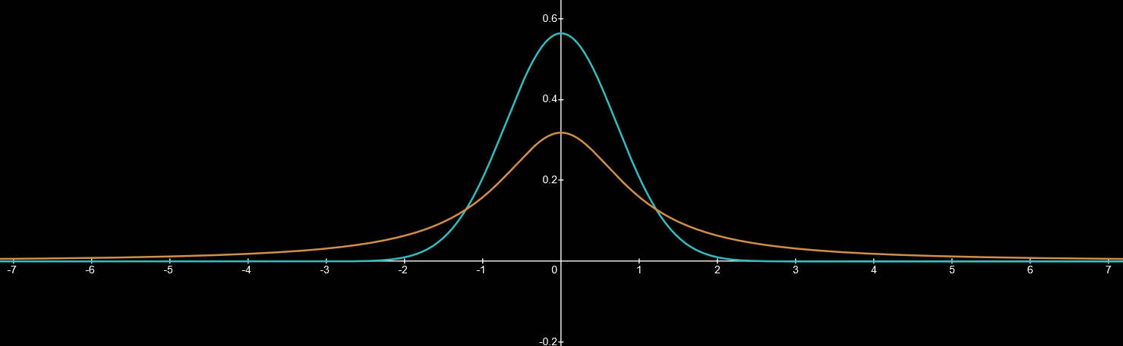
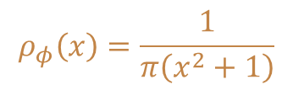



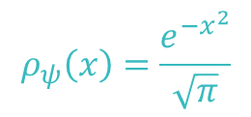



Infinite expectation
$$ψ\left(x\right)=\sqrt{\frac{e^{−x^{2}}}{\sqrt{π}}}$$
$$φ\left(x\right)=\sqrt{\frac{1}{π\left(x^{2}+1\right)}}$$
Wave function
$$ρ_{ψ}\left(x\right)=\frac{e^{−x^{2}}}{\sqrt{π}}$$
$$ρ_{φ}\left(x\right)=\frac{1}{π\left(x^{2}+1\right)}$$
Probability density
Expectation of position
$${\left\langle X\right\rangle }_{ψ}=0$$
$${\left\langle X\right\rangle }_{φ}=0$$
$${\left\langle X^{2}\right\rangle }_{ψ}=\frac{1}{2}$$
$${\left\langle X^{2}\right\rangle }_{φ}→∞$$
Expectation of position squared

Slide 19
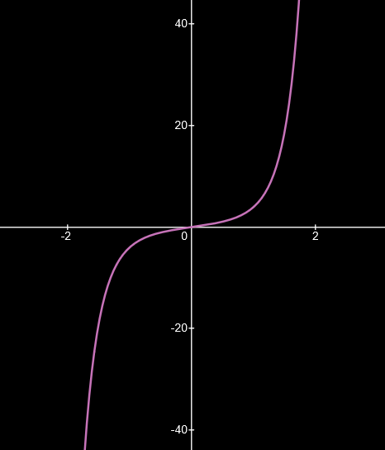





Infinite expectation from change of coordinates
We can have $ρ\left(x\right)=\frac{e^{−x^{2}}}{\sqrt{π}}$ in one set of coordinates and $ρ\left(y\right)=\frac{1}{π\left(y^{2}+1\right)}$ in another
Therefore, we have $\left\langle X^{2}\right\rangle =\frac{1}{2}$ for one observer and $\left\langle Y^{2}\right\rangle →∞$ for the other
Under a change of coordinates $ρ\left(y\right)dy=ρ\left(x\right)dx$
$$\frac{1}{π\left(y^{2}+1\right)}dy=\frac{e^{−x^{2}}}{\sqrt{π}}dx$$
$$d\left(\frac{\arctan{y}}{π}\right)=d\left(\frac{\operatorname{erf}\left(x\right)}{2}\right)$$
$$\arctan{y}=\frac{π}{2}\operatorname{erf}\left(x\right)$$
$$y=\tan\left(\frac{π}{2}\operatorname{erf}\left(x\right)\right)$$

Slide 20






Infinite expectation from change of coordinates
How do wave functions transform?
This is a unitary transformation!
$ρ\left(y\right)=ρ\left(x\right)\frac{dx}{dy}$
$ψ\left(y\right)=ψ\left(x\right)\sqrt{\frac{dx}{dy}}$
$$y=\tan\left(\frac{π}{2}\operatorname{erf}\left(x\right)\right)$$
$$ψ\left(x\right)=\sqrt{\frac{e^{−x^{2}}}{\sqrt{π}}}$$
$$\frac{dy}{dx}=\sec^{2}\left(\frac{π}{2}\operatorname{erf}\left(x\right)\right)\sqrt{π}e^{−x^{2}}$$
$$=\left(\tan^{2}\left(\frac{π}{2}\operatorname{erf}\left(x\right)\right)+1\right)\sqrt{π}e^{−x^{2}}$$
$$=\left(y^{2}+1\right)\sqrt{π}e^{−x^{2}}$$
$$ψ\left(y\right)=\sqrt{\frac{1}{π\left(y^{2}+1\right)}}$$
Note: both change of coordinates and time evolution are unitary transformations…

Slide 21








Infinite expectation from time evolution
Let $ρ(x,t)$ be the evolution of the probability in time.
We can have $ρ\left(x, 2n\right)=\frac{e^{−x^{2}}}{\sqrt{π}}$ at “even times” and $ρ\left(x, 2n+1\right)=\frac{1}{π\left(x^{2}+1\right)}$ at “odd times”
Initial position
Time
$x\left(x_{0},t\right)=x_{0}\cos^{2}{\frac{πt}{2}}+\tan\left(\frac{π}{2}\operatorname{erf}\left(x_{0}\right)\right)\sin^{2}{\frac{πt}{2}}$
Final position
$$\left\langle X^{2}\left(0\right)\right\rangle =0$$
$$\left\langle X^{2}\left(1\right)\right\rangle =∞$$
$$\left\langle X^{2}\left(2\right)\right\rangle =0$$
$$\left\langle X^{2}\left(3\right)\right\rangle =∞$$
$$…$$
Corresponds to a one-parameter family of unitary operators $U_{t}$ that is strongly continuous (i.e. $\lim_{t→t_{o}}U_{t}→U_{t_{0}}$)

Slide 22

All Hilbert spaces with basis of the same cardinality are isomorphic
$$L^{2}\left(ℝ^{n}\right)=L^{2}\left(ℝ^{m}\right)$$
All have countable basis (e.g. product of eigenstates of harmonic oscillators in orthogonal directions)
There exists a unitary transformation between the state space of a single particle and the state space of a billion particles
(you can encode the information of a billion particles into one)

Slide 23
Mathematical representation
Physical world
If we work with Hilbert spaces, our theorems must work ALSO on non-physical objects
?
ill-defined
We are in this case

Slide 24




Wait: can’t you do the same expectation trick in classical mechanics?
Yes! But…
In classical mechanics, you can always have distributions with compact support (i.e. finite range) in both position and momentum
$$ρ\left(q,p\right)$$
momentum
$$p$$
(i.e. you can always cut off the infinity)
$$q$$
position
In quantum mechanics, you can’t!
Paley-Wiener theorem: the Fourier transform of a function with compact support is an entire function. An entire function does not have compact support.
$⇒$ We cannot require the expectations of all functions of position and momentum to be finite

Slide 25



Are there alternatives?
Require the expectation of all polynomials of position and momentum to be finite
Limited to $ℝ^{n}$
$⇒$ Schwartz space: infinitely differentiable functions that go to zero at infinity faster than any polynomial (i.e. like an exponential)
elements fully identified by the expectations
it is an inner product space with the same norm as $L^{2}$
it is a dense subset of $L^{2}$
its closure under Cauchy sequences recovers the Hilbert space
a sequence converges in Schwartz if and only if the expectation of all polynomials of position and momentum converges
$S\left(ℝ^{n}\right)≠S\left(ℝ^{m}\right)$ if $n≠m$
closed under Fourier transform
plays a fundamental role in the theory of distributions - objects like the δ-function are mathematically defined on top of the Schwartz space
the Hermite polynomials, the solutions of the harmonic oscillator, are Schwartz functions
Some nice properties

