Slide 1
Reversing Hamiltonian Mechanics
Gabriele Carcassi

Slide 2






Single Dimension Hamiltonian Mechanics
$$\frac{dq}{dt}=\frac{∂H}{∂p}$$
$$d_{t}q=S^{q}(q, p)$$
$$S^{q}=∂_{p}H$$
$$\frac{dp}{dt}=−\frac{∂H}{∂q}$$
$$S^{p}=−∂_{q}H$$
$$d_{t}p=S^{p}(q, p)$$
(HM-1D)

Slide 3








$$H(q,p)$$
$$p$$
$H=\frac{p^{2}}{2m}+kq^{2}$
$$4$$
$$3$$
$$2$$
$$H=1$$
$$q$$

Slide 4




$\vec{∇}H\left(q,p\right)=\left[\begin{matrix}∂_{p}H \\ ∂_{q}H\end{matrix}\right]$
$$\vec{∇}H\left(q,p\right)$$
$$p$$
$$4$$
$$3$$
$=\left[\begin{matrix}\frac{p}{m} \\ 2kq\end{matrix}\right]$
$$2$$
$$H=1$$
$$q$$
$H=\frac{p^{2}}{2m}+kq^{2}$

Slide 5




$\vec{S}\left(q,p\right)=\left[\begin{matrix}S^{q} \\ S^{p}\end{matrix}\right]$
$$\vec{S}\left(q,p\right)$$
$$p$$
$$4$$
$$=\left[\begin{matrix}d_{t}q \\ d_{t}p\end{matrix}\right]=\left[\begin{matrix}∂_{p}H \\ −∂_{q}H\end{matrix}\right]$$
$$3$$
$$2$$
$$H=1$$
$$q$$
$$={\text{P}}_{}^{90°}\left(\vec{∇}H\right)$$

Slide 6














$$\vec{S}\left(q,p\right)$$
$$p$$
$$ω=\left[\begin{matrix}0 & 1 \\ −1 & 0\end{matrix}\right]$$
$$\left[ω_{ab}\right]=\left[\begin{matrix}ω_{qq} & ω_{qp} \\ ω_{pq} & ω_{pp}\end{matrix}\right]$$
$$3$$
$$4$$
$$2$$
$$H=1$$
$$q$$
$$\vec{S}=ω \vec{∇}H$$
$$S^{b}ω_{ba}=∂_{a}H$$
$$\left[\begin{matrix}S^{q} \\ S^{p}\end{matrix}\right]=\left[\begin{matrix}0 & 1 \\ −1 & 0\end{matrix}\right]\left[\begin{matrix}∂_{q}H \\ ∂_{p}H\end{matrix}\right]$$
$$=\left[\begin{matrix}∂_{p}H \\ −∂_{q}H\end{matrix}\right]$$
$$S^{q}ω_{qp}=∂_{p}H$$
$$S^{p}ω_{pq}=∂_{q}H$$
(HM-G)

Slide 8






$$\vec{S}\left(q,p\right)$$
$$p$$
$$\vec{∇}×F=\left[\begin{matrix}∂_{y}F_{z}−∂_{z}F_{y} \\ ∂_{z}F_{x}−∂_{x}F_{z} \\ ∂_{x}F_{y}−∂_{y}F_{x}\end{matrix}\right]$$
$$\vec{∇}×\left[\begin{matrix}0 \\ 0 \\ H\end{matrix}\right]=\left[\begin{matrix}∂_{y}H−0 \\ 0−∂_{x}H \\ 0−0\end{matrix}\right]$$
$$3$$
$$4$$
$$2$$
$$H=1$$
$$q$$
$$ω \vec{∇}H=\left[\begin{matrix}∂_{p}H \\ −∂_{q}H\end{matrix}\right]$$
Note: $ω \vec{∇}$ is “similar” $\vec{∇}×$
$$∂_{a}S^{a}=∂_{q}S^{q}+∂_{p}S^{p}$$
$$=∂_{q}∂_{p}H−∂_{p}∂_{q}H=0$$
Recall: $\vec{∇}⋅ \vec{∇}×F=0$
Similar result!
Displacement field is divergenceless

Slide 9







Note, in 2D “surfaces” are “lines”
(i.e. 2D – 1D = 1D)
$$∂_{a}S^{a}=0 ⟺$$
$$p$$
$\oint{\vec{S}×\vec{dξ}}=0$
$$P$$
$\oint{\left(S^{q}dp−S^{p}dq\right)}=0$
$$q$$
Flow of states is incompressible
$$O$$

Slide 10

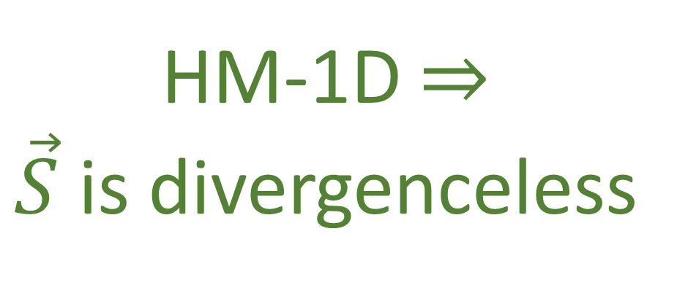






$$\oint{\left(S^{q}dp−S^{p}dq\right)}$$
$$p$$
$$P$$
$$=\oint{(∂_{p}Hdp+∂_{q}Hdq)}$$
$$q$$
$$O$$
$$=\oint{dH=0}$$
HM-1D $⇒$ $\vec{S}$ is divergenceless

Slide 11



Prove the converse!
$$p$$
$$P$$
Suppose $\vec{S}$ is divergenceless
$$q$$
The flow through any two lines
connecting $H(O)$ and $H(P)$ must equal
$$O$$
The flow between $O$ and $P$ is path
independent
Notes:
TODO: organize text

Slide 12



$$p$$
Assigning $H\left(O\right)=0$
$$P$$
$H\left(P\right)=\int_{OP}{(S^{q}dp−S^{p}dq)}$
$$q$$
$$O$$
$$dH=∂_{q}Hdq+∂_{p}Hdp=−S^{p}dq+S^{q}dp$$
A divergenceless vector field admits
a stream function $H$

Slide 13
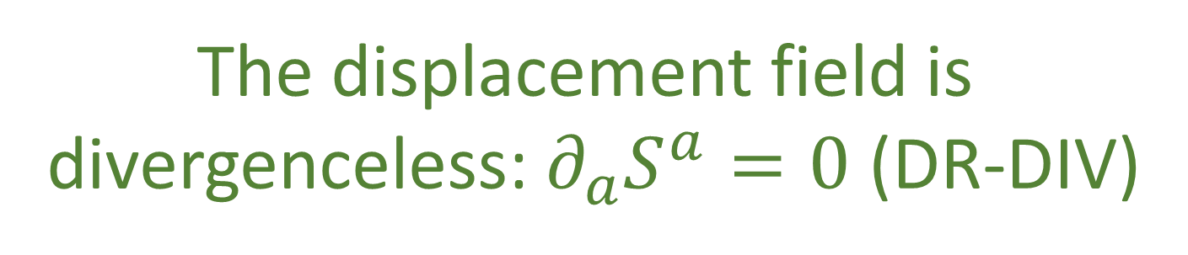



HM-1D $⇒$ $\vec{S}$ is divergenceless
$$p$$
$$P$$
$\vec{S}$ is divergenceless $⇒$ HM-1D
$$q$$
HM-1D $⟺$
$$O$$
The displacement field is
divergenceless: $∂_{a}S^{a}=0$ (DR-DIV)

Slide 15





Transformation of infinitesimal volumes
$$p$$
$${\hat{ξ}}^{a}={\hat{ξ}}^{a}\left(ξ^{b}\right)$$
$$d{\hat{ξ}}^{a}=∂_{b}{\hat{ξ}}^{a}dξ^{b}$$
$$q$$
$$d{\hat{ξ}}^{1}…d{\hat{ξ}}^{n}=\left|∂_{b}{\hat{ξ}}^{a}\right|dξ^{1}…dξ^{n}$$
For a general manifold
$$d\hat{q}d\hat{p}=\left|\begin{matrix}∂_{q}\hat{q} & ∂_{p}\hat{q} \\ ∂_{q}\hat{p} & ∂_{p}\hat{p}\end{matrix}\right|dqdp$$
Phase space

Slide 16





$$\text{Let} \hat{q} \text{and} \hat{p} \text{represent} \text{the} \text{evolution} \text{of} q \text{and} p$$
$$p$$
$$\text{after} \text{an} \text{infinitesimal} \text{time} \text{step} δt\text{:}$$
$$\hat{p}=p+S^{p}δt$$
$$\hat{q}=q+S^{q}δt$$
$$∂_{b}{\hat{ξ}}^{a}=\left[\begin{matrix}1+∂_{q}S^{q}δt & ∂_{q}S^{q}δt \\ ∂_{q}S^{p}δt & 1+∂_{p}S^{p}δt\end{matrix}\right]$$
$$q$$
$$\left|∂_{b}{\hat{ξ}}^{a}\right|=\left(1+∂_{q}S^{q}δt\right)\left(1+∂_{p}S^{p}δt\right)−∂_{q}S^{p}∂_{q}S^{q}δt^{2}$$
$$=1+\left(∂_{q}S^{q}+∂_{p}S^{p}\right)δt+O(δt^{2})$$
$∂_{a}S^{a}$!!!

Slide 17




$$\left|∂_{b}{\hat{ξ}}^{a}\right|=\left(1+∂_{q}S^{q}δt\right)\left(1+∂_{p}S^{p}δt\right)−∂_{q}S^{p}∂_{q}S^{q}δt^{2}$$
$$p$$
$$=1+\left(∂_{q}S^{q}+∂_{p}S^{p}\right)δt+O(δt^{2})$$
$\left|∂_{b}{\hat{ξ}}^{a}\right|=1$ $⟺$ $∂_{a}S^{a}=0$
$$q$$
HM-1D $⟺$ DR-DIV $⟺$
The Jacobian of the time evolution is unitary:
$\left|∂_{b}{\hat{ξ}}^{a}\right|=1$ (DR-JAC)

Slide 18
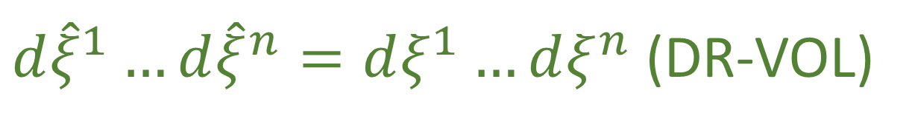





$$\int_{\hat{U}}{d\hat{q}d\hat{p}}=\int_{U}{\left|\begin{matrix}∂_{q}\hat{q} & ∂_{p}\hat{q} \\ ∂_{q}\hat{p} & ∂_{p}\hat{p}\end{matrix}\right|}dqdp$$
$$p$$
$$U$$
$$=\int_{U}{dqdp}$$
$$\hat{U}$$
$$q$$
DR-JAC $⟺$
Volumes are conserved through the evolution:
$d{\hat{ξ}}^{1}…d{\hat{ξ}}^{n}=dξ^{1}…dξ^{n}$ (DR-VOL)

Slide 19



Transformation of densities
$$\left|∂_{b}{\hat{ξ}}^{a}\right|\hat{ρ}\left({\hat{ξ}}^{a}\right)=ρ\left(ξ^{b}\right)$$
$$=\hat{ρ}\left({\hat{ξ}}^{a}\right)$$
DR-JAC $⟺$
Densities are conserved through the
evolution: $\hat{ρ}\left({\hat{ξ}}^{a}\right)=ρ\left(ξ^{b}\right)$ (DR-DEN)

Slide 21













Area$\left(v^{a},w^{a}\right)=v^{q}w^{p}−v^{p}w^{q}=v^{a}ω_{ab }w^{b}$
$$p$$
Area is conserved if
$${\hat{ω}}_{ab}=ω_{ab}$$
$$v$$
$$ω(v,w)$$
$$w$$
$${\hat{v}}^{a}=∂_{b}{\hat{ξ}}^{a}v^{b}$$
$${\hat{w}}^{a}=∂_{b}{\hat{ξ}}^{a}w^{b}$$
$$q$$
$$\hat{ω}(\hat{v},\hat{w})$$
$$\hat{w}$$
${\hat{v}}^{c}ω_{cd }{\hat{w}}^{d}={v^{a}∂}_{a}{\hat{ξ}}^{c}ω_{cd}∂_{b}{\hat{ξ}}^{d}w^{b}=v^{a}{\hat{ω}}_{ab }w^{b}$
$$\hat{v}$$
DR-VOL $⟺$
The evolution leaves $ω_{ab}$ invariant:
${\hat{ω}}_{ab}=ω_{ab}$ (DI-SYMP)

Slide 22


















Sides and angle can change
$$v$$
$$\hat{w}$$
$$ω(v,w)$$
$$\hat{ω}(\hat{v},\hat{w})$$
$$\hat{v}$$
$$\hat{ω}(\hat{v},\hat{w})$$
$$w$$
$$\hat{v}$$
$$\hat{ω}(\hat{v},\hat{w})$$
$$\hat{w}$$
$$\hat{w}$$
$$\hat{v}$$
$$\hat{ω}(\hat{v},\hat{w})$$
$$\hat{v}$$
$$\hat{w}$$
$$\hat{ω}(\hat{v},\hat{w})$$
$$\hat{v}$$
$$\hat{w}$$
Different volume
Different orientation (negative Jacobian)
Notes:
TODO: exaggerate changes so that it is clear what is changed and that they can change a lot.

Slide 23





Jacobian transformation to two other variables $f$ and $g$
Poisson bracket!
$$\left|\begin{matrix}∂_{q}f & ∂_{p}f \\ ∂_{q}g & ∂_{p}g\end{matrix}\right|=∂_{q}f∂_{p}g−∂_{p}f∂_{q}g=\left\{f,g\right\}$$
We can express the Poisson bracket:$\left\{f,g\right\}=−∂_{a}fω^{ab}∂_{b}g=∂_{b}gω^{ba}∂_{a}f$
is the inverse of $ω_{ab}$
$$ω^{ab}=\left[\begin{matrix}ω^{qq} & ω^{qp} \\ ω^{pq} & ω^{pp}\end{matrix}\right]=\left[\begin{matrix}0 & −1 \\ 1 & 0\end{matrix}\right]$$
$$ω_{ab}ω^{bc}=δ_{a}^{c}=\left[\begin{matrix}1 & 0 \\ 0 & 1\end{matrix}\right]$$

Slide 24


$$\left\{f,g\right\}=∂_{q}f∂_{p}g−∂_{p}f∂_{q}g=−∂_{a}fω^{ab}∂_{b}g$$
invariance of $ω$ is invariance of Poisson bracket
$$\hat{\left\{f,g\right\}}=∂_{\hat{q}}f∂_{\hat{p}}g−∂_{\hat{p}}f∂_{\hat{q}}g=−∂_{a}f{\hat{ω}}^{ab}∂_{b}g$$
DI-SYMP $⟺$
The evolution leaves the Poisson
brackets invariant (DI-POI)

Slide 25

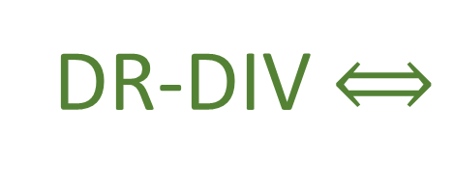



Flow THROUGH the curve
$$p$$
$$\int{S^{a}×dξ^{b}}=\int{{(S}^{q}dp−S^{p}dq)}$$
$$\int{S^{a}ω_{ab}dξ^{b}}=\int{S_{b}⋅dξ^{b}}$$
$$q$$
${90}^{∘}$ rotation
Flow ALONG the curve
DR-DIV $⟺$
The rotated displacement field is
curl free: $∂_{a}S_{b}−∂_{b}S_{a}=0$ (DI-CURL)
Notes:
TODO: add “gradient field” on the picture

Slide 26
Physical Characterizations

Slide 27

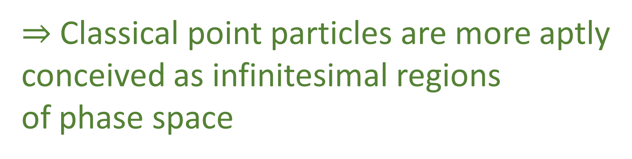



What we have shown so far is that the defining characteristic
$$p$$
but the transport of areas and densities mechanics is not the
$$v$$
$$ω(v,w)$$
$$w$$
of Hamiltonian mechanics is not the transport of points,
$$q$$
$$\hat{ω}(\hat{v},\hat{w})$$
transport of points, but the transport of areas and densities
$$\hat{w}$$
$$\hat{v}$$
$⇒$ Classical point particles are more aptly
conceived as infinitesimal regions
of phase space
Notes:
TODO: take the picture from the other slide
There would actually be no reason for the Hamiltonian equations of motion to be
differentiable if were about points, since differentiable equations are what is needed
to define the Jacobian, the transport of areas, or of densities defined on those areas

Slide 28
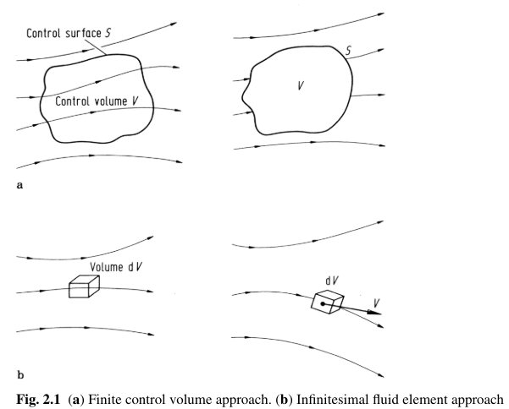
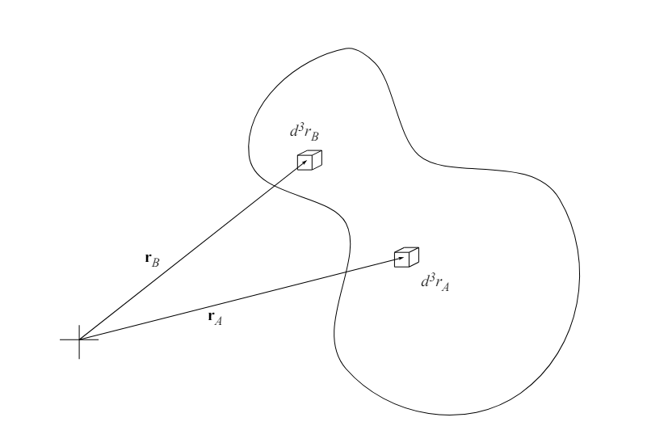
This matches how classical mechanics is used:
the objects we study are not point-like and can only be
considered point-like if their size is negligible compared
to the scale of the problem
This also matches how fluid mechanics
and continuum mechanics:
Wendt, J. F. (Ed.). (2008).
Computational Fluid Dynamics
where we study the motion of infinitesimal parts of material
Styer, D. F. (2023)
Statistical Mechanics
Notes:
TODO: search in Wikipedia images on fluid mechanics and continuum mechanics
There would actually be no reason for the Hamiltonian equations of motion to be
differentiable if were about points, since differentiable equations are what is needed
to define the Jacobian, the transport of areas, or of densities defined on those areas

Slide 29

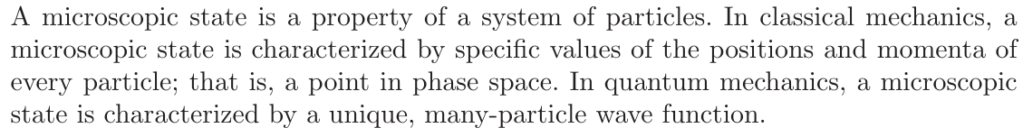
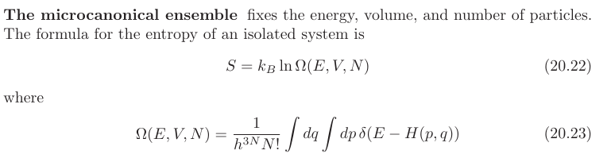
Styer, D. F. (2023)
Statistical Mechanics
Swendsen, R. H. (2012). An Introduction to Statistical Mechanics and Thermodynamics
Notes:
TODO: search in Wikipedia images on fluid mechanics and continuum mechanics
There would actually be no reason for the Hamiltonian equations of motion to be
differentiable if were about points, since differentiable equations are what is needed
to define the Jacobian, the transport of areas, or of densities defined on those areas

Slide 30

Swendsen, R. H. (2012). An Introduction to Statistical Mechanics and Thermodynamics
Hamiltonian mechanics, then, map regions while preserving the number of states
Meaning that for each initial state, there is one and only one final state
DR-VOL $⟺$
The evolution is deterministic and
reversable (DR-EV)
Notes:
From Book: “Note that by reversible here we mean that given the final state we can reconstruct the initial state. Given that areas measure the number of states, DR-EV is equivalent to DR-VOL, which means this is another characterization of Hamiltonian mechanics. We can also see a connection to DR-DEN. If we assign a density to an initial state, and we claim that all and only the elements that start in that initial state will end in a particular final state, we will expect the density of the corresponding final state to match. That is, if the evolution is deterministic and reversible, it may shuffle around a distribution, but it will never be able to spread it or concentrate it”

Slide 31
This explains why we are unable to model
systems that are dissipative
Hamiltonian evolutions transport of a
probability distribution
A dissipative system will have an attractor:
a point or a region to which
given enough time which will cause the
density to concentrate over the attractor
Hamiltonian evolutions also can’t have unstable points
or regions from which the system always goes away
for the same reason
Notes:
What may be confusing is that the motion of a particle under linear drag may seem reversible, in the sense that we are able to, given the final position and momentum, reconstruct the initial values. Mathematically, it maps points one-to-one and would seem to satisfy DREV, even though it is not a Hamiltonian system. This is a perfect example of how focusing on just the points leads to the wrong physical intuition. Physically, we would say that a one meter range of position allows for more configurations than a one centimeter range, even though mathematically they have the same number of points. If we understand that states are infinitesimal areas of phase space, we can see that a dissipative system, though it does map the center points of infinitesimal areas one-to-one, it does not map the full infinitesimal area one-to-one. In this sense dissipative systems fail to be reversible.

Slide 32




Deterministic and reversible evolution
Environment
$⇒$ past and future depend only on
the state of the system
System
$⇒$ the evolution does not depend
on anything else
$⇒$ the system is isolated
First law of thermodynamics!
$⇒$ the system conserves energy
We can make an argument for this based on physical considerations:
A system that is deterministic and reversible only depends on
the state of the system itself which makes it an isolated system
Thermodynamics tells us that isolated systems conserve energy
Notes:
TODO: maybe call X the state of the system and Y the state of the environment
Structure of phase space exactly what is needed to do statistical mechanics - Comes out of invariance of the entropy under coordinate transformations

Slide 33
Environment
A dissipative system not being
reversable seems true on
thermodynamic grounds
System
Thermodynamic reversibility is the existence of a process that can undo
the systems change rather than the ability to reconstruct its initial state
Alternatively, a process is thermodynamically
reversible if it conserves thermodynamic entropy
Notes:
TODO: same system/env picture, but make the line dashed and a double arrow in between

Slide 34




Deterministic and reversible evolution
Y
$⇒$ past and future depend only on
the state of the system
X
$⇒$ the evolution does not depend
on anything else
$⇒$ the system is isolated
First law of thermodynamics!
$⇒$ the system conserves energy
We can make an argument for this based on physical considerations:
A system that is deterministic and reversible only depends on
the state of the system itself which makes it an isolated system
Thermodynamics tells us that isolated systems conserve energy
Notes:
TODO: maybe call X the state of the system and Y the state of the environment
Structure of phase space exactly what is needed to do statistical mechanics - Comes out of invariance of the entropy under coordinate transformations

Slide 35
Y
A dissipative system not being
reversable seems true on
thermodynamic grounds
X
Thermodynamic reversibility is the existence of a process that can undo
the systems change rather than the ability to reconstruct its initial state
Alternatively, a process is thermodynamically
reversible if it conserves thermodynamic entropy
Notes:
TODO: same system/env picture, but make the line dashed and a double arrow in between

Slide 36


Thermodynamic Entropy: $S=k_{B}\log{W}$
Since the logarithm is a bijective function, conservation of areas of
phase space is equivalent to the conservation of entropy.
DR-VOL $⟺$
The evolution is deterministic and
thermodynamically Reversible (DR-THER)

Slide 37



The other type of entropy that is also fundamental in both statistical
mechanics and information theory is:
the Gibbs/Shannon entropy $I\left[ρ\left(ξ^{a}\right)\right]=−\int{ρ\log{ρ}dξ^{1}}…dξ^{n}$
$$I\left[ρ\left(ξ^{a}\right)\right]=−\int{ρ\log{ρ}dξ^{1}}…dξ^{n}= \int{\hat{ρ}\left({\hat{ξ}}^{b}\right)\left|∂_{a}{\hat{ξ}}^{b}\right|\log\left(\hat{ρ}\left({\hat{ξ}}^{b}\right) | ∂_{a}{\hat{ξ}}^{b}|\right)}dξ^{1}…dξ^{n}$$
$$=−\int{\hat{ρ}\left({\hat{ξ}}^{b}\right)}\log\left(\hat{ρ}\left({\hat{ξ}}^{b}\right) | ∂_{a}{\hat{ξ}}^{b}|\right)dξ^{1}…dξ^{n}$$
$$=−\int{\hat{ρ}\left({\hat{ξ}}^{b}\right)\log{\hat{ρ}\left({\hat{ξ}}^{b}\right)}}dξ^{1}…dξ^{n}−\int{\hat{ρ}\left({\hat{ξ}}^{b}\right)}\log{{|∂}_{a}\hat{ξ}|dξ^{1}…dξ^{n}}$$
$$=I\left[\hat{ρ}\left({\hat{ξ}}^{b}\right)\right]−\int{\hat{ρ}\left({\hat{ξ}}^{b}\right)}\log{{|∂}_{a}\hat{ξ}|dξ^{1}…dξ^{n}}$$
Notes:
TODO: look for ideas for picture in textbooks, videos, etc about information theory?
TODO: with image, motivation – information entropy is number of bits needed to identify an elements, det/rev must mean the same information to identify past and future elements

Slide 38






$$I\left[ρ\left(ξ^{a}\right)\right] =I\left[\hat{ρ}\left({\hat{ξ}}^{b}\right)\right]−\int{\hat{ρ}\left({\hat{ξ}}^{b}\right)}\log{{|∂}_{a}\hat{ξ}|dξ^{1}…dξ^{n}}$$
Information entropy remains constant
if and only if the logarithm of the
Jacobian determinant is zero, which
means that Jacobian is one
$$x$$
$$\left|J\right|<1$$
$$\left|J\right|>1$$
$$\left|J\right|<1$$
$$y$$
Notes:
TODO: upped diagram closer to a constant. When stretching/compressing, the area in each section should look the same
The fact that determinism and reversibility is equivalent to conservation of information entropy should not be, in retrospect, surprising. Given a distribution, its information entropy quantifies the average amount of information needed to specify a particular element chosen according to that distribution. If the evolution is deterministic and reversible, giving the initial state is equivalent to giving the final state and therefore the information to describe one or the other must be the same. Determinism and reversibility, then, can be understood as the informational equivalence between past and future descriptions.

Slide 39
$$I\left[ρ\left(ξ^{a}\right)\right] =I\left[\hat{ρ}\left({\hat{ξ}}^{b}\right)\right]−\int{\hat{ρ}\left({\hat{ξ}}^{b}\right)}\log{{|∂}_{a}\hat{ξ}|dξ^{1}…dξ^{n}}$$
Information entropy remains constant
if and only if the logarithm of the
Jacobian determinant is zero, which
means that Jacobian is one
$$x$$
$$\left|J\right|<1$$
$$\left|J\right|>1$$
$$\left|J\right|<1$$
$$y$$
Notes:
TODO: upped diagram closer to a constant. When stretching/compressing, the area in each section should look the same
The fact that determinism and reversibility is equivalent to conservation of information entropy should not be, in retrospect, surprising. Given a distribution, its information entropy quantifies the average amount of information needed to specify a particular element chosen according to that distribution. If the evolution is deterministic and reversible, giving the initial state is equivalent to giving the final state and therefore the information to describe one or the other must be the same. Determinism and reversibility, then, can be understood as the informational equivalence between past and future descriptions.

Slide 40

$$I\left[ρ\left(ξ^{a}\right)\right] =I\left[\hat{ρ}\left({\hat{ξ}}^{b}\right)\right]−\int{\hat{ρ}\left({\hat{ξ}}^{b}\right)}\log{{|∂}_{a}\hat{ξ}|dξ^{1}…dξ^{n}}$$
$\left|∂_{b}{\hat{ξ}}^{a}\right|=1$ $⟺$ $\log\left|∂_{b}{\hat{ξ}}^{a}\right|=0⟺I\left[ρ\left(ξ^{a}\right)\right] =I\left[\hat{ρ}\left({\hat{ξ}}^{b}\right)\right]$
DR-JAC $⟺$
The evolution conserves
information entropy (DR-INFO)

Slide 41




Given a multivariable distribution , the uncertainty is
characterized by the covariance matrix:
evolution of covariance matrix
$$p$$
$$cov\left(ξ^{a},ξ^{b}\right)=\left[\begin{matrix}σ_{q}^{2} & cov_{q,p} \\ cov_{p,q} & σ_{p}^{2}\end{matrix}\right]$$
$$q$$
whose determinant gives the coordinate independent
quantity to characterize uncertainty
we can use the linearized transformation to see how
the uncertainty evolves after an infinitesimal time step
$δt$ if the distribution is narrow enough
Notes:
TODO: put the axis on the ellipses. Make them move according to the map
TODO: another slide to show that the ellipses can do (which is essentially analog to what the vectors and parallelogram could do)

Slide 42
Given a multivariable distribution , the uncertainty is
characterized by the covariance matrix:
evolution of covariance matrix
$$p$$
$$cov\left(ξ^{a},ξ^{b}\right)=\left[\begin{matrix}σ_{q}^{2} & cov_{q,p} \\ cov_{p,q} & σ_{p}^{2}\end{matrix}\right]$$
$$q$$
whose determinant gives the coordinate independent
quantity to characterize uncertainty
we can use the linearized transformation to see how
the uncertainty evolves after an infinitesimal time step
$δt$ if the distribution is narrow enough
Notes:
TODO: put the axis on the ellipses. Make them move according to the map
TODO: another slide to show that the ellipses can do (which is essentially analog to what the vectors and parallelogram could do)

Slide 43
Given a multivariable distribution , the uncertainty is
characterized by the covariance matrix:
evolution of covariance matrix
$$p$$
$$cov\left(ξ^{a},ξ^{b}\right)=\left[\begin{matrix}σ_{q}^{2} & cov_{q,p} \\ cov_{p,q} & σ_{p}^{2}\end{matrix}\right]$$
$$q$$
whose determinant gives the coordinate independent
quantity to characterize uncertainty
we can use the linearized transformation to see how
the uncertainty evolves after an infinitesimal time step
$δt$ if the distribution is narrow enough
Notes:
TODO: put the axis on the ellipses. Make them move according to the map
TODO: another slide to show that the ellipses can do (which is essentially analog to what the vectors and parallelogram could do)

Slide 44
Original
Length, width, and angle can change
Different volume
Notes:
TODO: redo like infinitesimal areas
TODO: put the axis on the ellipses. Make them move according to the map
TODO: another slide to show that the ellipses can do (which is essentially analog to what the vectors and parallelogram could do)

Slide 45
Original
Length, width, and angle can change
Different volume
Notes:
TODO: redo like infinitesimal areas
TODO: put the axis on the ellipses. Make them move according to the map
TODO: another slide to show that the ellipses can do (which is essentially analog to what the vectors and parallelogram could do)

Slide 46
Original
Length, width, and angle can change
Different volume
Notes:
TODO: redo like infinitesimal areas
TODO: put the axis on the ellipses. Make them move according to the map
TODO: another slide to show that the ellipses can do (which is essentially analog to what the vectors and parallelogram could do)

Slide 47

$$\left|cov\left({\hat{ξ}}^{c},{\hat{ξ}}^{d}\right)\right|=\left|∂_{a}{\hat{ξ}}^{c}cov\left(ξ^{a},ξ^{b}\right)∂_{b}{\hat{ξ}}^{d}\right|=\left|∂_{a}{\hat{ξ}}^{c}\right| \left|cov\left(ξ^{a},ξ^{b}\right)\right|\left|∂_{b}{\hat{ξ}}^{d}\right|$$
$$\left|∂_{a}{\hat{ξ}}^{c}\right|=1=\left|∂_{b}{\hat{ξ}}^{d}\right|⟺\left|cov\left(ξ^{a},ξ^{b}\right)\right|=\left|cov\left({\hat{ξ}}^{c},{\hat{ξ}}^{d}\right)\right|$$
DR-JAC $⟺$
The evolution conserves the uncertainty
of peaked distributions (DR-UNC)

Slide 48
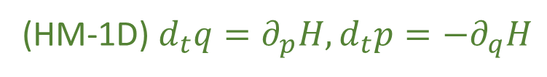

We have found twelve equivalent characterizations for a single degree of freedom
(HM-1D) $d_{t}q=∂_{p}H,d_{t}p=−∂_{q}H$
(HM-G) $S_{a}=S^{b}ω_{ba}$
(DR-DIV) The displacement field for a one dimensional Hamiltonian is divergenceless: $∂_{a}S^{a}=0$
(DR-JAC) The Jacobian of the time evolution is unitary: $\left|∂_{b}{\hat{ξ}}^{a}\right|=1$
(DR-VOL) Volumes are conserved through the evolution: $d{\hat{ξ}}^{1}…d{\hat{ξ}}^{n}=dξ^{1}…dξ^n$
(DR-DEN) Densities are conserved through the evolution: $\hat{ρ}\left({\hat{ξ}}^{a}\right)=ρ\left(ξ^{b}\right)$
(DI-SYMP) The evolution leaves $ω_{ab}$ invariant: ${\hat{ω}}_{ab}=ω_{ab}$
(DI-POI) The evolution leaves the Poisson brackets invariant
(DI-CURL) The rotated displacement field is curl free: $∂_{a}S_{b}−∂_{b}S_{a}=0$
(DR-EV) The evolution is deterministic and reversable
(DR-THER) The evolution is deterministic and thermodynamically Reversible
(DR-INFO) The evolution conserves information entropy
(DR-UNC) The evolution conserves the uncertainty of peaked distributions
Notes:
TODO: move the tags in front

Slide 50
Big Picture
We have found twelve equivalent characterizations that link
Hamiltonian mechanics, vector calculus, differential geometry,
statistical mechanics, thermodynamics, information theory and
plain statistics for a single degree of freedom
These characteristics show that Hamiltonian
mechanics is meant to describe systems for which
the assumption of determinism and reversibility
is inherent.

Slide 51

Hamiltonian evolutions transport a probability
distribution point by point, with the probability
density remaining the same as it move through space
Cover, T. M., & Thomas, J. A. (2006). Elements of information theory.

Slide 52






$\vec{S}\left(q,p\right)=\left[S^{q},S^{p}\right]=[d_{t}q,d_{t}p]$ Harmonic oscillator $H=\frac{p^{2}}{2m}+kq^{2}$
$$p$$
$$4$$
$$3$$
$$2$$
$$H=1$$
$$q$$

Slide 53
The surface plot of the Hamiltonian for a Harmonic oscillator $H=\frac{p^{2}}{2m}+kq^{2}$
The Gradient
The Displacement Field
Given: $ω_{ab}=\left[\begin{matrix}ω_{qq} & ω_{qp} \\ ω_{pq} & ω_{pp}\end{matrix}\right]=\left[\begin{matrix}0 & 1 \\ −1 & 0\end{matrix}\right]$ we can write $S_{a}=S^{b}ω_{ba}=∂_{a}H$

Slide 54









The Flow of the Displacement Field $S^{a}$
Difference of the Hamiltonian at the Two Points:
$∆H=\int_{OP}{S^{a}} × dξ^{b}$
$$p$$
$$p$$
$$P$$
$$O$$
$$q$$
$$q$$
Geometrically, this means: $\oint{\left(S^{q}dp−S^{p}dq\right)=0}$
Since we are in two dimensional space and a hyper surface surface has dimension $n−1=2−1=1$
$$\oint{\left(S^{q}dp−S^{p}dq\right)=\oint{∂_{p}Hdp+∂_{q}Hdq)=\oint{dH=0}}}$$

Slide 55



The displacement field $S^{a}$ transports areas of phase space to equal areas of phase space
Hamiltonian evolutions transport a probability distribution point by point, with the probability density remaining the same as it move through space
$$p$$
$$q$$
Denoting $\hat{v}=∂_{b}{\hat{ξ}}^{a}v^{b}$ and$\hat{w}=∂_{b}{\hat{ξ}}^{a}w^{b}$, the invariance of the area can be written
$${\hat{v}}^{c}ω_{cd}{\hat{w}}^{d}=v^{a}∂_{a}{\hat{ξ}}^{c}ω_{cd}∂_{b}{\hat{ξ}}^{d}w^{b}=v^{a}{\hat{ω}}_{ab}w^{b}$$
$$v^{a}ω_{ab}w^{b}={\hat{v}}^{c}ω_{cd}{\hat{w}}^{d}$$
$⇒$the evolution leave $ω_{ab}$ invariant: ${\hat{ω}}_{ab}=ω_{ab}$

