Slide 1
Multiple degrees of Freedom
Gabriele Carcassi

Slide 2
First show the relationships that stay the same
Then show the relationships that change/generalize (are different arguments, difficult to make a parallel)
Recap that the one that changes is “complete” and implies the lesser (one about surfaces/lines, other about volumes)
Orthogonality of DOF = independence
Area cons + ortho => volumes (to explain previous finding)

Slide 3










Hamilton’s Equations
Single DOF
$$d_{t}q=∂_{p}H$$
$$d_{t}p=−∂_{q}H$$
$$d_{t}q^{i}=∂_{p_{i}}H$$
$$d_{t}p_{i}=−∂_{q^{i}}H$$
(HM-1D)
(HM-ND)
$$S^{q}=∂_{p}H$$
$$S^{p}=−∂_{q}H$$
$$ξ^{a}=[q^{i}, p^{i}]$$
$$S^{a}=d_{t}ξ^{a}=[d_{t}q^{i},d_{t}p^{i}]$$
$$S^{q^{i}}=∂_{p_{i}}H$$
$$S^{p_{i}}=−∂_{q^{i}}H$$

Slide 4
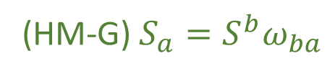
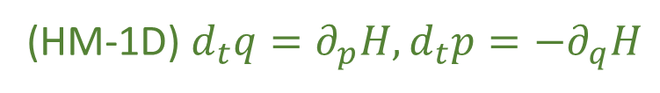
We have found twelve equivalent characterizations for a single degree of freedom
(HM-1D) $d_{t}q=∂_{p}H,d_{t}p=−∂_{q}H$
(HM-G) $S_{a}=S^{b}ω_{ba}$
(DR-DIV) The displacement field for a one dimensional Hamiltonian is divergenceless: $∂_{a}S^{a}=0$
(DR-JAC) The Jacobian of the time evolution is unitary: $\left|∂_{b}{\hat{ξ}}^{a}\right|=1$
(DR-VOL) Volumes are conserved through the evolution: $d{\hat{ξ}}^{1}…d{\hat{ξ}}^{n}=dξ^{1}…dξ^n$
(DR-DEN) Densities are conserved through the evolution: $\hat{ρ}\left({\hat{ξ}}^{a}\right)=ρ\left(ξ^{b}\right)$
(DI-SYMP) The evolution leaves $ω_{ab}$ invariant: ${\hat{ω}}_{ab}=ω_{ab}$
(DI-POI) The evolution leaves the Poisson brackets invariant
(DI-CURL) The rotated displacement field is curl free: $∂_{a}S_{b}−∂_{b}S_{a}=0$
(DR-EV) The evolution is deterministic and reversable
(DR-THER) The evolution is deterministic and thermodynamically Reversible
(DR-INFO) The evolution conserves information entropy
(DR-UNC) The evolution conserves the uncertainty of peaked distributions

Slide 5













Single DOF
$$ω=\left[\begin{matrix}0 & 1 \\ −1 & 0\end{matrix}\right]⊗I_{n}$$
$$\left[ω_{ab}\right]=\left[\begin{matrix}ω_{q^{i}q^{j}} & ω_{q^{i}p_{j}} \\ ω_{p_{i}q^{j}} & ω_{p_{i}p_{j}}\end{matrix}\right]$$
$$ω=\left[\begin{matrix}0 & 1 \\ −1 & 0\end{matrix}\right]$$
$$\left[ω_{ab}\right]=\left[\begin{matrix}ω_{qq} & ω_{qp} \\ ω_{pq} & ω_{pp}\end{matrix}\right]$$
$$\vec{S}=ω \vec{∇}H$$
$$\left[\begin{matrix}S^{q} \\ S^{p}\end{matrix}\right]=\left[\begin{matrix}0 & 1 \\ −1 & 0\end{matrix}\right]\left[\begin{matrix}∂_{q}H \\ ∂_{p}H\end{matrix}\right]=\left[\begin{matrix}∂_{p}H \\ −∂_{q}H\end{matrix}\right]$$
$$S_{a}=S^{b}ω_{ba}=∂_{a}H$$
$$\left[\begin{matrix}S^{q^{i}} \\ S^{p_{i}}\end{matrix}\right]=\left[\begin{matrix}0 & I_{n} \\ −I_{n} & 0\end{matrix}\right]\left[\begin{matrix}∂_{q^{i}}H \\ ∂_{p_{i}}H\end{matrix}\right]=\left[\begin{matrix}∂_{p_{i}}H \\ −∂_{q^{i}}H\end{matrix}\right]$$
$$S^{q}ω_{qp}=∂_{p}H$$
$$S^{p}ω_{pq}=∂_{q}H$$
(HM-G)
$$S_{a}=S^{b}ω_{ba}=∂_{a}H$$
$$S^{q^{i}}ω_{q^{i}p_{i}}=∂_{p_{i}}H$$
$$S^{p_{i}}ω_{p_{i}q^{i}}=∂_{q^{i}}H$$
(SF-ND)

Slide 7


$ω_{ab}$preforms a $90$ degree rotation within each degree of freedom,
switching components between position and momentum
Given: $v^{a}=[{v^{q}}^{i},v^{p_{i}}]$ then $v_{a}=v^{b}ω_{ba}=[−v^{p_{i}},v^{q^{i}}]$
Insight: the displacement field is still equal to the gradient of $H$ rotated $90$ degrees,
except there are now multiple ways to preform this rotation
It is only the rotation defined by $ω_{ab}$ that works

Slide 8









$ω_{ab}$preforms a $90$ degree rotation within each degree of freedom,
switching components between position and momentum
Given: $v^{a}=[{v^{q}}^{i},v^{p_{i}}]$ then $v_{a}=v^{b}ω_{ba}=[−v^{p_{i}},v^{q^{i}}]$
Insight: the displacement field is still equal to the gradient of $H$ rotated $90$ degrees,
except there are now multiple ways to preform this rotation
It is only the rotation defined by $ω_{ab}$ that works
$$p_{2}$$
$$p_{1}$$
$$q^{2}$$
$$p_{2}$$
$$p_{1}$$
$$q^{2}$$
$$q^{1}$$
$$q^{1}$$

Slide 9








$$p_{2}$$
$$p_{1}$$
$$q^{2}$$
$$p_{2}$$
$$p_{1}$$
$$q^{2}$$
$$q^{1}$$
$$q^{1}$$

Slide 10




$$p_{2}$$
$$p_{1}$$
$$q^{2}$$
$$p_{2}$$
$$p_{1}$$
$$q^{2}$$
$$q^{1}$$
$$q^{1}$$

Slide 11
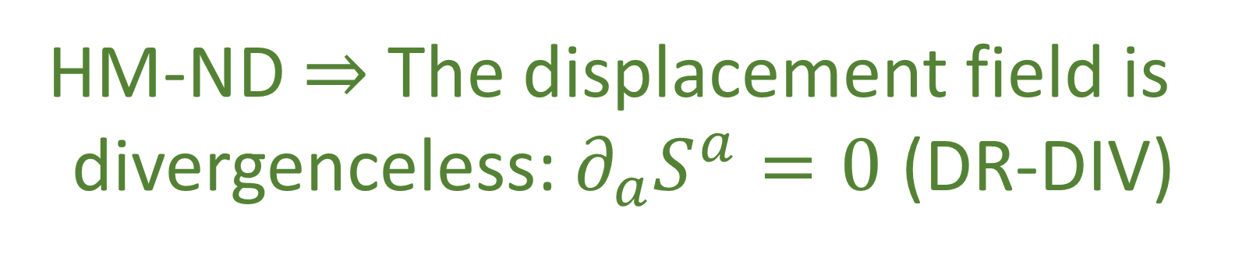







Single DOF
$$∂_{a}S^{a}=∂_{q^{i}}S^{q^{i}}+∂_{p_{i}}S^{p_{i}}=∂_{q^{i}}∂_{p_{i}}H−∂_{p_{i}}∂_{q^{i}}H=0$$
$$∂_{a}S^{a}=∂_{q}S^{q}+∂_{p}S^{p}$$
$$p_{2}$$
$$p_{1}$$
$$q^{2}$$
$$=∂_{q}∂_{p}H−∂_{p}∂_{q}H$$
$$=0$$
$$q^{1}$$
HM-ND $⇒$ The displacement field is
divergenceless: $∂_{a}S^{a}=0$ (DR-DIV)

Slide 12

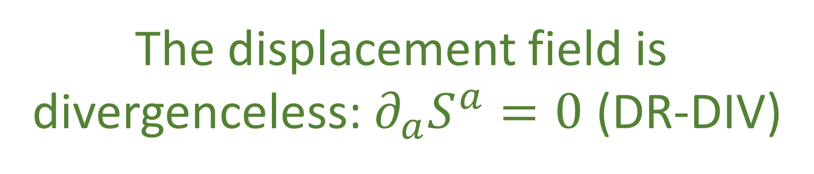

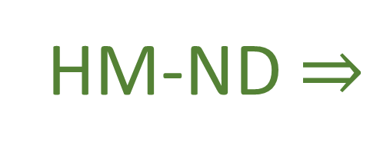
$$∂_{a}S^{a}=∂_{q^{i}}S^{q^{i}}+∂_{p_{i}}S^{p_{i}}$$
Single DOF
$$∂_{a}S^{a}=∂_{q}S^{q}+∂_{p}S^{p}$$
$$=∂_{q}∂_{p}H−∂_{p}∂_{q}H$$
$$=∂_{q^{i}}∂_{p_{i}}H−∂_{p_{i}}∂_{q^{i}}H=0$$
$$=0$$
HM-ND $⇒$
The displacement field is
divergenceless: $∂_{a}S^{a}=0$ (DR-DIV)

Slide 13
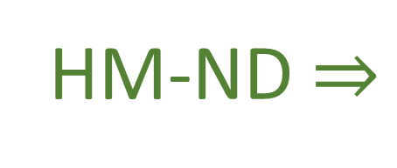








$$p_{2}$$
$$p_{1}$$
$$q^{2}$$
$$∂_{a}S^{a}=∂_{q^{i}}S^{q^{i}}+∂_{p_{i}}S^{p_{i}}$$
$$=∂_{q^{i}}∂_{p_{i}}H−∂_{p_{i}}∂_{q^{i}}H=0$$
$$q^{1}$$
Single DOF:
$$∂_{a}S^{a}=0$$
HM-ND $⇒$
The displacement field is
divergenceless: $∂_{a}S^{a}=0$ (DR-DIV)

Slide 14



$$p_{2}$$
$$p_{1}$$
$$q^{2}$$
$$∂_{a}S^{a}=∂_{q^{i}}S^{q^{i}}+∂_{p_{i}}S^{p_{i}}$$
$$=∂_{q^{i}}∂_{p_{i}}H−∂_{p_{i}}∂_{q^{i}}H=0$$
$$q^{1}$$
Single DOF
$$∂_{a}S^{a}=∂_{q}S^{q}+∂_{p}S^{p}$$
$$=∂_{q}∂_{p}H−∂_{p}∂_{q}H$$
HM-ND $⇒$
$$=0$$
The displacement field is
divergenceless: $∂_{a}S^{a}=0$ (DR-DIV)

Slide 15













Let $\hat{q}$and $\hat{p}$ represent the evolution of q and p after an infinitesimal time step $δt$
$${\hat{q}}^{i}=q^{i}+S^{q^{i}}δt$$
Single DOF
$${\hat{p}}_{i}=p_{i}+S^{p_{i}}δt$$
$$\hat{p}=p+S^{p}δt$$
$$\hat{q}=q+S^{q}δt$$
$$∂_{b}{\hat{ξ}}^{a}=\left[\begin{matrix}δ_{j}^{i}+∂_{q^{j}}S^{q^{i}}δt & ∂_{p_{j}}S^{q^{i}}δt \\ ∂_{q^{j}}S^{p_{i}}δt & δ_{i}^{j}+∂_{p_{j}}S^{p_{i}}δt\end{matrix}\right]$$
$$∂_{b}{\hat{ξ}}^{a}=\left[\begin{matrix}1+∂_{q}S^{q}δt & ∂_{p}S^{q}δt \\ ∂_{q}S^{p}δt & 1+∂_{p}S^{p}δt\end{matrix}\right]$$
$$p$$
$$\left|∂_{b}{\hat{ξ}}^{a}\right|=1+\left(∂_{q}S^{q}+∂_{p}S^{p}\right)δt+O(δt^{2})$$
$$\left|∂_{b}{\hat{ξ}}^{a}\right|=\left|δ_{j}^{i}+∂_{q^{j}}S^{q^{i}}δt\right|\left|δ_{i}^{j}+∂_{p_{j}}S^{p_{i}}δt\right|$$
$$−\left|∂_{p_{j}}S^{q^{i}}δt\right|\left|∂_{q^{j}}S^{p_{i}}δt\right|$$
$∂_{a}S^{a}$!!!
$$=1+\left(∂_{q^{i}}S^{q^{i}}+∂_{p_{i}}S^{p_{i}}\right)δt+O(δt^{2})$$
$$q$$
$∂_{a}S^{a}$!!!

Slide 16
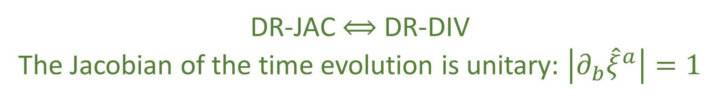



$\left|∂_{b}{\hat{ξ}}^{a}\right|=1$ $⟺$ $∂_{a}S^{a}=0$
DR-JAC $⟺$ DR-DIV
The Jacobian of the time evolution is unitary: $\left|∂_{b}{\hat{ξ}}^{a}\right|=1$
The Jacobian is still the multiplicative factor between past and future areas and densities
$$⇒$$
Volumes are conserved through the evolution: $d{\hat{ξ}}^{1}…d{\hat{ξ}}^{n}=dξ^{1}…dξ^n$ (DR-VOL)
Densities are conserved through the evolution: $\hat{ρ}\left({\hat{ξ}}^{a}\right)=ρ\left(ξ^{b}\right)$ (DR-DEN)
DR-DIV $⟺$DR-JAC $⟺$ DR-VOL $⟺$ DR-DEN

Slide 17





The displacement field $S^{a}$ has $2n$ components
Conditions DR-DIV, DR-JAC, DR-VOL, and DR-DEN all specify a single restraint giving
$2n−1$ components
The choice of Hamiltonian provides another constraint, leaving $2n−2$ choices
Single Degree of Freedom:
$$n=1$$
$$2n−2=0$$
no choices remain
Multiple Degrees of Freedom:
$$n>1$$
$$2n−2≠0$$
choices remain
HM-ND $⇒$ DR-DIV $⟺$DR-JAC $⟺$ DR-VOL $⟺$ DR-DEN
DR-DIV $⟺$DR-JAC $⟺$ DR-VOL $⟺$ DR-DEN $⇏$ HM-ND

Slide 18












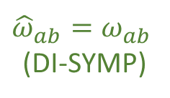

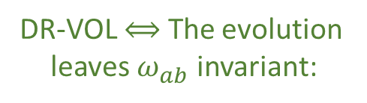

Single DOF
$${\hat{ω}}_{ab}=∂_{a}\hat{ξ}ω_{cd}∂_{b}{\hat{ξ}}^{d}$$
Area$\left(v^{a},w^{a}\right)=v^{q}w^{p}−v^{p}w^{q}=v^{a}ω_{ab }w^{b}$
$$=\left(δ_{a}^{c}+∂_{a}S^{c}δt\right)ω_{cd}\left(δ_{b}^{d}+∂_{b}S^{d}δt\right)$$
$$=ω_{ab}+\left(∂_{a}S^{c}ω_{cb}+ω_{ad}∂_{b}S^{d}\right)δt+O\left(δt^{2}\right)$$
$$=ω_{ab}+\left(∂_{a}{(S}^{c}ω_{cb})+∂_{b}(S^{d}ω_{ad})\right)δt+O\left(δt^{2}\right)$$
$$=ω_{ab}+\left(∂_{a}{(S}^{c}ω_{cb})−∂_{b}(S^{d}ω_{da})\right)δt+O\left(δt^{2}\right)$$
$${\hat{v}}^{a}=∂_{b}{\hat{ξ}}^{a}v^{b}$$
Area is conserved if
$${\hat{ω}}_{ab}=ω_{ab}$$
$${\hat{w}}^{a}=∂_{b}{\hat{ξ}}^{a}w^{b}$$
${\hat{v}}^{c}ω_{cd }{\hat{w}}^{d}={v^{a}∂}_{a}{\hat{ξ}}^{c}ω_{cd}∂_{b}{\hat{ξ}}^{d}w^{b}=v^{a}{\hat{ω}}_{ab }w^{b}$
Invariance of $ω_{ab}$:
$$p_{2}$$
$$p_{1}$$
$$q^{2}$$
DR-VOL $⟺$ The evolution
leaves $ω_{ab}$ invariant:
${\hat{ω}}_{ab}=ω_{ab}$
(DI-SYMP)
$$∂_{a}{(S}^{c}ω_{cb})−∂_{b}\left(S^{d}ω_{da}\right)=0$$
$$∂_{a}S_{b}−∂_{b}S_{a}=0$$
$$q^{1}$$
DI-SYMP $⟺$ DI-CURL

Slide 19



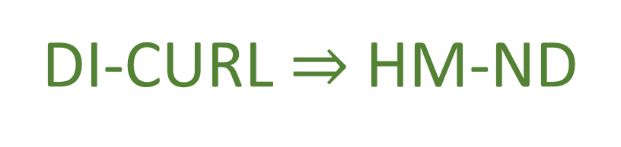
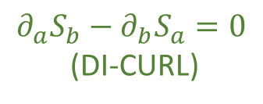





Single DOF
$$∂_{a}S_{b}−∂_{b}S_{a}=∂_{a}\left(S^{c}ω_{cb}\right)−∂_{b}(S^{c}ω_{ca})$$
Flow THROUGH the curve
$$\int{S^{a}×dξ^{b}}=\int{{(S}^{q}dp−S^{p}dq)}$$
$$=∂_{a}∂_{b}H−∂_{b}∂_{a}H=0$$
${90}^{∘}$ rotation
Flow ALONG the curve
HM-ND $⇒$ DI-CURL
$$\int{S^{a}ω_{ab}dξ^{b}}=\int{S_{b}⋅dξ^{b}}$$
$$p_{2}$$
$$p_{1}$$
$$q^{2}$$
DR-DIV $⇔$ The rotated
displacement field is curl free:
Conversely: given $S_{a}$ is curl free
$$∂_{a}S_{b}−∂_{b}S_{a}=0$$
(DI-CURL)
$$S_{a}=S^{b}ω_{ba}=∂_{a}H$$
$$q^{1}$$
DI-CURL $⇒$ HM-ND

Slide 20






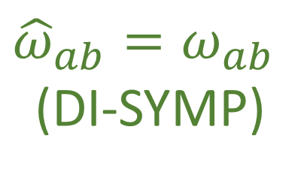

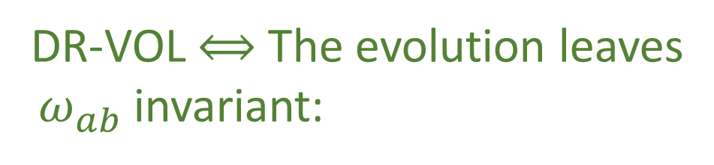



Multiple Degrees of Freedom
Single Degree of Freedom
$${\hat{ω}}_{ab}=∂_{a}\hat{ξ}ω_{cd}∂_{b}{\hat{ξ}}^{d}$$
Area$\left(v^{a},w^{a}\right)=v^{q}w^{p}−v^{p}w^{q}=v^{a}ω_{ab }w^{b}$
$$=\left(δ_{a}^{c}+∂_{a}S^{c}δt\right)ω_{cd}\left(δ_{b}^{d}+∂_{b}S^{d}δt\right)$$
$$=ω_{ab}+\left(∂_{a}S^{c}ω_{cb}+ω_{ad}∂_{b}S^{d}\right)δt+O\left(δt^{2}\right)$$
$$=ω_{ab}+\left(∂_{a}{(S}^{c}ω_{cb})+∂_{b}(S^{d}ω_{ad})\right)δt+O\left(δt^{2}\right)$$
$$=ω_{ab}+\left(∂_{a}{(S}^{c}ω_{cb})−∂_{b}(S^{d}ω_{da})\right)δt+O\left(δt^{2}\right)$$
$${\hat{v}}^{a}=∂_{b}{\hat{ξ}}^{a}v^{b}$$
Area is conserved if
$${\hat{ω}}_{ab}=ω_{ab}$$
$${\hat{w}}^{a}=∂_{b}{\hat{ξ}}^{a}w^{b}$$
${\hat{v}}^{c}ω_{cd }{\hat{w}}^{d}={v^{a}∂}_{a}{\hat{ξ}}^{c}ω_{cd}∂_{b}{\hat{ξ}}^{d}w^{b}=v^{a}{\hat{ω}}_{ab }w^{b}$
Invariance of $ω_{ab}$:
DR-VOL $⟺$ The evolution leaves
$ω_{ab}$ invariant:
$$∂_{a}{(S}^{c}ω_{cb})−∂_{b}\left(S^{d}ω_{da}\right)=0$$
$$∂_{a}S_{b}−∂_{b}S_{a}=0$$
${\hat{ω}}_{ab}=ω_{ab}$
(DI-SYMP)
DI-SYMP $⟺$ DI-CURL

Slide 21


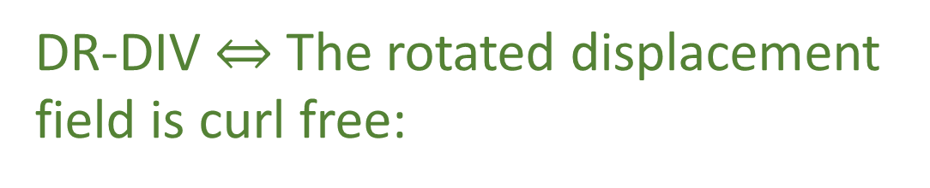
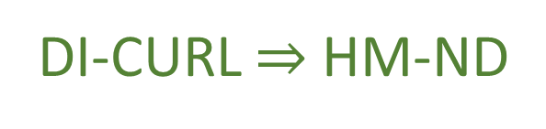

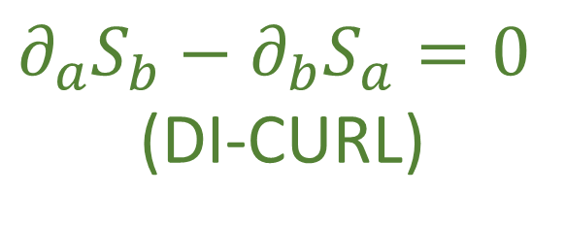





Multiple Degrees of Freedom
Single Degree of Freedom
Flow THROUGH the curve
$$\int{S^{a}×dξ^{b}}=\int{{(S}^{q}dp−S^{p}dq)}$$
$$∂_{a}S_{b}−∂_{b}S_{a}=∂_{a}\left(S^{c}ω_{cb}\right)−∂_{b}(S^{c}ω_{ca})$$
${90}^{∘}$ rotation
Flow ALONG the curve
$$=∂_{a}∂_{b}H−∂_{b}∂_{a}H=0$$
$$\int{S^{a}ω_{ab}dξ^{b}}=\int{S_{b}⋅dξ^{b}}$$
HM-ND $⇒$ DI-CURL
Conversely: given $S_{a}$ is curl free
DR-DIV $⇔$ The rotated displacement
field is curl free:
$$S_{a}=S^{b}ω_{ba}=∂_{a}H$$
$$∂_{a}S_{b}−∂_{b}S_{a}=0$$
(DI-CURL)
DI-CURL $⇒$ HM-ND

Slide 23



Insight: HM-ND $⟺$ DI-SYMP $⟺$ DI-CURL $⟺$ DI-POI
The relationship between Poisson brackets and $ω^{ab}$
is the same in the general case
DI-SYMP $⟺$ DI-POI
HM-ND $⟺$ DI-SYMP $⟺$ DI-CURL $⟺$ DI-POI

Slide 24



HM-ND
DR-DIV
DI-CURL
DR-JAC
$$⟺$$
$$⇒$$
$$⟺$$
DI-POI
DR-VOL
DI-SYMP
DR-DEN

Slide 25

So far for the general case we have:
HM-ND $⟺$ DI-SYMP $⟺$ DI-CURL $⟺$ DI-POI
fully characterize Hamiltonian mechanics
HM-ND $⇒$ DR-DIV $⟺$DR-JAC $⟺$ DR-VOL $⟺$ DR-DEN
DR-DIV $⟺$DR-JAC $⟺$ DR-VOL $⟺$ DR-DEN $⇏$ HM-ND
Conditions DR-DIV, DR-JAC, DR-VOL, and DR-DEN
are weaker and don’t fully recover Hamiltonian
mechanics.

Slide 26
We need to build a stronger geometrical intuition for
DI-SYMP, DI-CURL, and DI-POI
which are the more fundamental set of assumptions

Slide 27

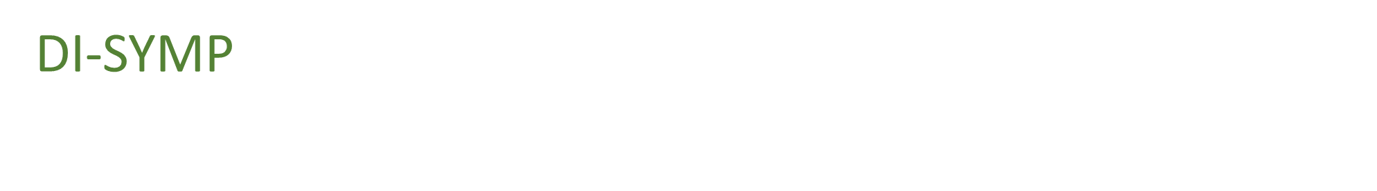




DI-SYMP tells us that $v^{a}ω_{ab}ω^{b}$ is a conserved quantity,
no matter what vectors $v^{a}$and $w^{b}$ we choose
$$p$$
For a single degree of freedom,
this represented the area
of the parallelogram formed
by the two vectors
$$v$$
$$ω(v,w)$$
$$w$$
$$q$$
Notes:
Area is also the volume

Slide 28



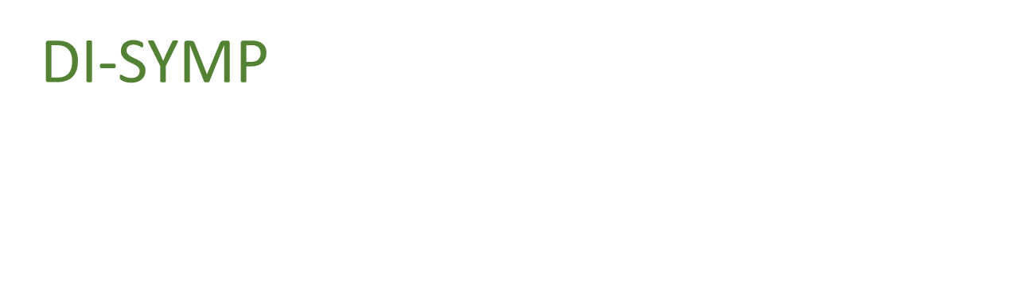







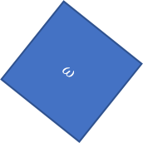





DI-SYMP tells us that $v^{a}ω_{ab}ω^{b}$
is a conserved quantity, no matter
what vectors $v^{a}$and $w^{b}$ we choose
$$p_{2}$$
$$p_{1}$$
$$q^{2}$$
$$v$$
$$ω(\hat{v},\hat{w})$$
$$\hat{v}$$
$$ω(v,w)$$
$$\hat{w}$$
$$w$$
$$q^{1}$$
For a single degree of freedom,
this represented the area
of the parallelogram formed
by the two vectors
$$\hat{v}$$
$$\hat{w}$$
$$\hat{v}$$
$$ω(\hat{v},\hat{w})$$
$$ω(\hat{v},\hat{w})$$
$$\hat{w}$$
$$ω$$
$$dq^{2}dp_{2}$$
$$dq^{1}dp_{1}$$
WARNING: analogy!!!
Notes:
TODO: in the 4d diagram, add projections on q1p1

Slide 29



To understand this for the general case we can look at the
outer product decomposition for $ω_{ab}$ we saw in SF-ND
$$ω=\left[\begin{matrix}0 & 1 \\ −1 & 0\end{matrix}\right]⊗I_{n}$$
$$\left[ω_{ab}\right]=\left[\begin{matrix}ω_{q^{i}q^{j}} & ω_{q^{i}p_{j}} \\ ω_{p_{i}q^{j}} & ω_{p_{i}p_{j}}\end{matrix}\right]$$
SF-ND
Insight: what happens within a degree of
freedom is different from what happens
across degrees of freedom

Slide 30











Single DOF
$$1≤x≤n$$
$$1≤y≤n$$
$$v=v^{q}e_{q^{x}}+v^{p}e_{p_{x}}$$
$$w=w^{q}e_{q^{x}}+w^{p}e_{p_{x}}$$
$v=v^{q}e_{q^{x}}+v^{p}e_{p_{x}}$ and $w=w^{q}e_{q^{y}}+w^{p}e_{p_{y}}$
$$v^{a}ω_{ab}ω^{b}=v^{q}ω^{p}−v^{p}w^{q}$$
$$v^{a}ω_{ab}ω^{b}=0$$
Within each degree of freedom, $ω_{ab}$
computes the area of the parallelogram.
Orthogonality between different degrees of freedom!
Since $ω_{ab}$ is conserved, parallelograms
within any degree of freedom will be
mapped to parallelograms of the same size.
Since $ω_{ab}$ is conserved, orthogonality is
preserved during the evolution.
$ω_{ab}$ defines areas within different degrees
of freedom and the angles between them
Notes:
TODO: add the typical scalar product with two vectors, and angles; move metric tensor on separate slide

Slide 31





In general relativity and Riemannian geometry, the metric tensor $g_{ij}$
defines the geometry by defining the scalar product between vectors.
Given: $v^{i}$ and $w^{j}$
$$v^{i}g_{ij}w^{j}=\left|v\right|\left|w\right|cosθ_{vw}$$
$$v^{i}⋅w^{j}=\left|v\right|\left|w\right|cosθ_{vw}$$
$g_{ij}$ defines lengths and angles
Notes:
TODO: add the typical scalar product with two vectors, and angles; move metric tensor on separate slide

Slide 32

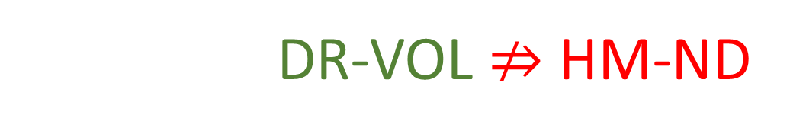
Since areas and orthogonality are preserved,
volumes are also preserved
This shows us why HM-ND $⇒$ DR-VOL
And why DR-VOL $⇏$ HM-ND
Since an evolution could stretch one degree of
freedom while shrinking another by the
same amount, conserving volumes, but not
the areas of each degree of freedom
Notes:
TODO: add picture

Slide 33








For example, take the system of equations:
$$d_{t}q^{1}={S^{q}}^{1}=\frac{p_{1}}{m}$$
$$d_{t}p_{1}=S^{p_{1}}=−bp_{1}$$
Particle under linear drag
$$d_{t}q^{2}={S^{q}}^{2}=\frac{p_{2}}{m}$$
a particle accelerated proportionally
to its momentum
$$d_{t}p_{2}=S^{p_{2}}=bp_{2}$$
$$∂_{a}S^{a}=∂_{q^{1}}\frac{p_{1}}{m}+∂_{p_{1}}\left(bp_{1}\right)+∂_{q^{2}}\frac{p_{2}}{m}+∂_{p_{2}}\left(bp_{2}\right)=−b+b=0$$
Divergence is zero: DR-DIV and DR-VOL are satisfied
$$(y,p_{y})$$
$$(y′,{p′}_{y})$$
$$(x,p_{x})$$
$$(x′,{p′}_{x})$$
Notes:
TODO: picture where you stretch one DOF and compress the other

Slide 34


However:
$$∂_{q^{1}}S_{p_{1}}−∂_{p_{1}}S_{q^{1}}=∂_{q^{1}}S^{q^{1}}ω_{q^{1}p_{1}}−∂_{p_{1}}S^{p_{1}}ω_{p_{1}q^{1}}$$
$$=∂_{q^{1}}\frac{p_{1}}{m}\left(1\right)−∂_{p_{1}}(−bp_{1})(−1)$$
$$=−b$$
Curl of $S_{a}$is not zero: DI-CURL is not satisfied, nor are DI-SYMP and HM-DM
This system is not Hamiltonian because we are not preserving the Areas
within each independent degree of freedom
$$(y,p_{y})$$
$$(y′,{p′}_{y})$$
$$(x,p_{x})$$
$$(x′,{p′}_{x})$$

Slide 35











$$θ$$
$$w$$
$$v⋅w=\left|v\right|\left|w\right|cos{(θ}_{vw})=\left|v\right|\left|w\right|cos{(θ}_{vw})=$$
$$θ$$
$$φ$$
$$v$$
$$w$$
$${\text{P}}_{}^{90°}v$$
$$φ$$
$$w$$
$$φ$$
$${\text{P}}_{}^{90°}v$$
Notes:
TOTHINK: Show that scalar product is the area with one vector rotated?

Slide 36
Turning attention to the physics

Slide 37
Note that conditions:
(DR-EV) The evolution is deterministic and reversable
(DR-THER) The evolution is deterministic and thermodynamically Reversible
(DR-INFO) The evolution conserves information entropy
(DR-UNC) The evolution conserves the uncertainty of peaked distributions
Are equivalent to DR-VOL and DR-JAC
determinism and reversibility is a constitutive assumption
of Hamiltonian mechanics in the general case, but it
cannot be the only one.

Slide 38
we would like to find a condition that is independent of DR.
Since DI-SYMP implies DR-VOL, mathematics does not give us
two independent conditions we can map to the physics.
Note: the mapping between physical and mathematical
conditions does not need to be one to one.
Notes:
This is kind of awkward in the next slide or as its own slide, so maybe just say it over the slide before

Slide 39


We saw that determinism and reversibility forces the evolution map
to be both bijective and volume preserving.
Mathematically, there can be a bijection that is not volume preserving
or a volume preserving map that is not bijective.
However, a physically meaningful deterministic and reversible
map must do both.
Physically independent?
So we would get that HM-ND $⇒$HR-EV
And that HM-ND $⇒$ another physical condition

Slide 40


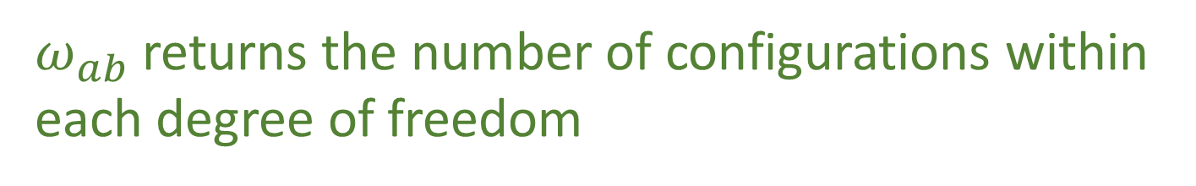

The phase space volume quantifies the number of states in the region.
Thus, the area on each degree of freedom identifies the number of
configurations for that degree of freedom
Given vectors:
$v=v^{q}e_{q^{x}}+v^{p}e_{p_{x}}$ and $w=w^{q}e_{q^{x}}+w^{p}e_{p_{x}}$
number of configurations constrained on a single degree of freedom $x$:
$$v^{q}w^{p}−v^{p}w^{q}$$
$$v^{a}ω_{ab}ω^{b}=v^{q}ω^{p}−v^{p}w^{q}$$
$ω_{ab}$ returns the number of configurations within
each degree of freedom

Slide 41
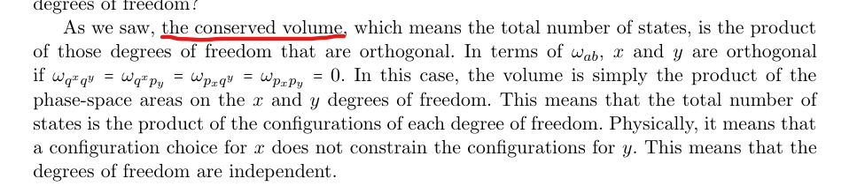


The volume is conserved so the total number of states is the product of
the degrees of freedom that are orthogonal
In terms of $ω_{ab}$, $x$ and $y$ are orthogonal if:
$$ω_{q^{x}q^{y}}=ω_{q^{x}p_{y}}=ω_{p_{x}q^{y}}=ω_{p_{x}p_{y}}=0$$
This means that the total number of states is the product of the
configurations of reach degree of freedom.
Physically, this means that a configuration choice for $x$
does not constrain the configurations for $y$
degrees of freedom are independent

Slide 42
There are two different notions of independence:
Say we have a rabbit farm and describe its state with the number of
male and female rabbits
Male
Female

Slide 43


There are two different notions of independence:
If there are 231 female rabbits, in principle we don’t know anything
about the number of males
we may expect the population of both sexes to be
about equal but this does not describe something
about the nature of the variables themselves:
it describes the nature of rabbit farms
$$?$$
$$231$$
Independent

Slide 44

There are two different notions of independence:
Now we could choose to describe the rabbit farm with another set of
variables: the number of females and the total number of rabbits
Total rabbits
$$\text{Female}$$

Slide 45


There are two different notions of independence:
If there are $231$ female rabbits, then there must be at least $231$ total
rabbits
$$≥231$$
$$231$$
Not Independent

Slide 46


This type of independence is different from the notion of
independence in terms of statistics and probability
This is in terms of if the probability distribution factorizes
That is, if $P(f,m)$ is the probability that a particular rabbit
farm has $f$ females and $m$ males, the distributions of males
$P(m)$ and females $P(f)$ are independent if:
$P\left(f,m\right)=P(f)$ $P(m)$

Slide 47
We have two notions of independence, one based on the
variables themselves and one on the probability distribution
The orthogonal directions in phase space are independent in
the first, stronger sense. Since the degrees of freedom are
Independent regardless of the probability distribution one may
put on top of them

Slide 48




Note that there is a link between the two types of independent
Given any distribution $P\left(f\right)$ on females, we can choose any
distribution $P\left(m\right)$ on males and set $P\left(f,m\right)=P\left(f\right)P\left(m\right)$
However, suppose choose $P\left(f\right)$ and want to find $P\left(f+m\right)$
such that $P\left(f,f+m\right)=P\left(f\right)P(f+m)$
The probability $P(f+m)$ must be zero for all values smaller
than the greatest value of $f$ such that$P\left(f\right)≠0$
If there is no greatest value for $f$, for example if
$f$ follows a geometric distribution, no $P\left(f+m\right)$
Can be independent of $P(f)$

Slide 49

Conclusions:
IND-DOF $⟺$ IND-STAT $⟺$ IND-INFO $⟺$ IND-UNC
(IND-DOF) The system is decomposable into independent DOFs
(IND-STAT) The system allows statistically independent distributions
over each DOF
(IND-INFO) The system allows informationally independent distributions
over each DOF
(IND-UNC) The system allows peaked distributions
where the uncertainty is the product of the uncertainty
on each DOF

Slide 50
These conditions are independent from DR, as we could have a
deterministic and reversible system that cannot be broken into separate
degrees of freedom, or a that can be broken into separate degrees of
freedom that is not deterministic and reversable
The question then is whether assuming independent degrees of freedom
and deterministic and reversible evolution is enough to recover
Hamiltonian mechanics.

Slide 51


Firstly: can we recover $ω_{ab}$
Assuming that the configuration can be broken up into
independent degrees of freedom we must be able to define the
count of configurations for each degree of freedom, and
independent degrees of freedom must be orthogonal
The fact that $ω_{ab}$ will return zero if it acts on directions belonging
to independent degrees of freedom, tells us that $ω_{ab}$
counts not just configurations, but independent
configurations

Slide 52




This would seem to restrict $ω_{ab}$ to:
$$ω_{ab}=\left[\begin{matrix}0 & 1 \\ −1 & 0\end{matrix}\right]⨂\left[\begin{matrix}a_{1} & 0 & \text{⋯} & 0 \\ 0 & a_{2} & \text{⋯} & 0 \\ \text{⋮} & … & \text{⋱} & \text{⋮} \\ 0 & 0 & \text{⋯} & a_{4}\end{matrix}\right]$$
$ω_{ab}$ must return the area in each degree of freedom:
constrains the left matrix of the outer product to the one above
$ω_{ab}$ needs to return zero across independent
degrees of freedom constrains the right matrix of
the outer product to be diagonal

Slide 53



Note: $q^{i}$ and $p_{i}$ are not only variable that form independent DOFs
If we take two independent DOFs $x$ and $y$, $x+y$, and $x −y$, they will
also form independent degrees of freedom.
$ω_{ab}$ defines orthogonality for all DOFs
Changing $x$ and $y$ to $x+y$ and $x−y$ will effectively apply a rotation on
the diagonal matrix, which will remain diagonal only if the
coefficients on the diagonal are the same.

Slide 54


For $ω_{ab}$ to properly capture the independence of linear combinations of
independent DOFs, the diagonal matrix must have the same coefficient
This coefficient represents the freedom we have in choosing the units of
omega with respect to the units of everything else. In SI units, the product
between $q^{i}$and $p_{i}$ is in $J ⋅ s$ and we set the coefficient to 1
Therefore expressing the number of configurations with the same units for all DOFs
is not an extra constraint, but it is necessary to keep track of the dependency
relationship for all degrees of freedom.

Slide 55
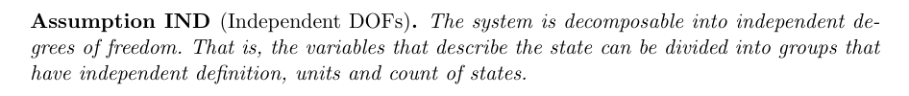
The other constitutive assumption of Hamiltonian mechanics is:

Slide 57
$$p_{2}$$
$$p_{1}$$
$$q^{2}$$
$$q^{1}$$
$$p_{2}$$
$$p_{1}$$
$$q^{2}$$
$$q^{1}$$
Notes:
TODO: potato diagram is for divergencelessness; Line diagram is for curllessness

Slide 58




Math Bank
$${\hat{ω}}_{ab}=∂_{a}\hat{ξ}ω_{cd}∂_{b}{\hat{ξ}}^{d}=\left(δ_{a}^{c}+∂_{a}S^{c}δt\right)ω_{cd}\left(δ_{b}^{d}+∂_{b}S^{d}δt\right)$$
$$=ω_{ab}+\left(∂_{a}S^{c}ω_{cb}+ω_{ad}∂_{b}S^{d}\right)δt+O\left(δt^{2}\right)$$
$$=ω_{ab}+\left(∂_{a}{(S}^{c}ω_{cb})+∂_{b}(S^{d}ω_{ad})\right)δt+O\left(δt^{2}\right)$$
$$=ω_{ab}+\left(∂_{a}{(S}^{c}ω_{cb})−∂_{b}(S^{d}ω_{da})\right)δt+O\left(δt^{2}\right)$$
Invariance of $ω_{ab}$: $∂_{a}{(S}^{c}ω_{cb})−∂_{b}(S^{d}ω_{da})$
In terms of the rotated displacement field $S_{a}$ we have the more compact form $∂_{a}S_{b}−∂_{b}S_{a}=0$
the rotated displacement field is the gradient of the Hamiltonian
$$∂_{a}S_{b}−∂_{b}S_{a}=∂_{a}\left(S^{c}ω_{cb}\right)−∂_{b}\left(S^{c}ω_{ca}\right)=∂_{a}∂_{b}H−∂_{b}∂_{a}H=0$$
$$S_{a}=S^{b}ω_{ba}=ω_{a}H$$

Slide 59






$v=v^{q}e_{q^{x}}+v^{p}e_{p_{x}}$ and $w=w^{q}e_{q^{x}}+w^{p}e_{p_{x}}$
One degree of freedom:
$$v^{a}ω_{ab}ω^{b}=v^{q}ω^{p}−v^{p}w^{q}$$
Two degrees of freedom:
$$v^{a}ω_{ab}ω^{b}=0$$
$$v^{i}g_{ij}w^{j}=\left|v\right|\left|w\right|cosθ_{vw}$$
$$d_{t}q^{1}={S^{q}}^{1}=\frac{p_{1}}{m}$$
$$d_{t}p_{1}=S^{p_{1}}=−bp_{1}$$
$$d_{t}q^{2}={S^{q}}^{2}=\frac{p_{2}}{m}$$
$$d_{t}p_{2}=S^{p_{2}}=bp_{2}$$

Slide 60

$$∂_{a}S^{a}=∂_{q^{1}}\frac{p_{1}}{m}+∂_{p_{1}}\left(bp_{1}\right)+∂_{q^{2}}\frac{p_{2}}{m}+∂_{p_{2}}\left(bp_{2}\right)=−b+b=0$$
$$∂_{q^{1}}S_{p_{1}}−∂_{p_{1}}S_{q^{1}}=∂_{q^{1}}S^{q^{1}}ω_{q^{1}p_{1}}−∂_{p_{1}}S^{p_{1}}ω_{p_{1}q^{1}}=∂_{q^{1}}\frac{p_{1}}{m}\left(1\right)−∂_{p_{1}}(−bp_{1})(−1)=−b$$
$$ω_{ab}=\left[\begin{matrix}0 & 1 \\ −1 & 0\end{matrix}\right]⨂\left[\begin{matrix}a_{1} & 0 & \text{⋯} & 0 \\ 0 & a_{2} & \text{⋯} & 0 \\ \text{⋮} & … & \text{⋱} & \text{⋮} \\ 0 & 0 & \text{⋯} & a_{4}\end{matrix}\right]$$

Slide 61
Image/images
Notes:
Look at foundations 2016 slides and others for images

Slide 62




Total number of states is the product between the cases in each d.o.f volume is product of the areas→ d.o.f. orthogonal in phase space
$$(y,p_{y})$$
$$(y′,{p′}_{y})$$
$$(x,p_{x})$$
$$(x′,{p′}_{x})$$
Number of cases on each d.o.f. remains the same (area of each d.o.f)
Total number of cases product of all cases (orthogonal d.o.f.)

Slide 63






Relationships within degrees of freedom
Motion preserves area of each independent d.o.f (uncertainty,
entropy and number of states)
$$p_{i}$$
$${p′}_{i}$$
$$x_{i}$$
$$V^{i}×W^{i}=V^{i^{′}}×W^{i^{′}}$$
$${x′}_{i}$$
$$V^{i}\left[\begin{matrix}0 & 1 \\ −1 & 0\end{matrix}\right]W^{i}$$

Slide 64


Relationships within degrees of freedom
Motion preserves area of each independent d.o.f (uncertainty,
entropy and number of states)
$$p_{i}$$
$${p′}_{i}$$
$$x_{i}$$
$$V^{i}×W^{i}=V^{i^{′}}×W^{i^{′}}$$
$${x′}_{i}$$
$$V^{i}\left[\begin{matrix}0 & 1 \\ −1 & 0\end{matrix}\right]W^{i}$$

Slide 65






Relationships across degrees of freedom
Independent d.0.f.
remain perpendicular (remain independent)
$$x_{i}$$
$${x′}_{i}$$
$$V^{i}∙W^{j}=0=V^{i^{′}}∙W^{j^{′}}$$
$$x_{j}$$
$${x′}_{j}$$
$$V^{i}\left[\begin{matrix}… & 0 & 0 \\ 0 & … & 0 \\ 0 & 0 & …\end{matrix}\right]W^{j}$$

Slide 66
















Reversing phase-space
Hamiltonian Privilege, Erkenn (2023)
Stud Hist Phil 71, 082020, 60-71 (2020)
Each unit variable (i.e. coordinate) paired with a conjugate of inverse units: number of states $ΔqΔk$is invariant
$\hat{q}=100 cm/m q$
$$x↦x^{3}$$
$$1$$
$Δk=1 m^{−1}$
$$1$$
$Δ\hat{k}=0.01 cm^{−1}$
$$x$$
$$x^{3}$$
$Δ\hat{q}=100 cm$
$Δq=1 m$
Density, entropy, uniform distributions NOT in general coordinate invariant
Phase space (symplectic) structure is the only one that supports coordinate invariant density, entropy, state count
Only 3 spatial dimensions are possible
Independence of DOFs $⇒$ independence of units $⇒$ orthogonality in phase-space $⇒$ invariant marginals (for density, entropy, state count)
Hamiltonian mechanics preserves count of states and DOF independence over time
2-sphere the only symplectic manifold
$$(q^{y},k_{y})$$
$$ω_{ab}=\left[\begin{matrix}0 & 1 \\ −1 & 0\end{matrix}\right]⊗δ_{j}^{i}$$
Directional DOF
$$(q^{x},k_{x})$$
Orthogonality/independence across DOFs
Total number of states $=$ product of number of cases in each independent DOF
Symplectic form (geometric structure of phase space)
Areas/possibilities in each DOF
Invariance at equal time (relativity) gives us the structure of phase space

Slide 67





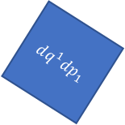
Relativistic mechanics
Lorentzian relativity is the only “correct” one
Minkowski signature appears on the extended phase space
$$ω=dq^{1}dp_{1}+dq^{2}dp_{2}$$
$$ω=dq^{1}dp_{1}−dtdE$$
$$ω$$
$$dq^{1}dp_{1}=ω+dtdE$$
$$dq^{2}dp_{2}$$
$$dq^{1}dp_{1}$$
$$dq^{1}dp_{1}$$
$$dtdE$$
$$ω$$
Indep DOF are orthogonal

Slide 68








$$H(q,p)$$
$$p$$
$H=\frac{p^{2}}{2m}+kq^{2}$
$$4$$
$$3$$
$$2$$
$$H=1$$
$$q$$

Slide 69




$\vec{∇}H\left(q,p\right)=\left[\begin{matrix}∂_{p}H \\ ∂_{q}H\end{matrix}\right]$
$$\vec{∇}H\left(q,p\right)$$
$$p$$
$$4$$
$$3$$
$=\left[\begin{matrix}\frac{p}{m} \\ 2kq\end{matrix}\right]$
$$2$$
$$H=1$$
$$q$$
$H=\frac{p^{2}}{2m}+kq^{2}$

Slide 70




$\vec{S}\left(q,p\right)=\left[\begin{matrix}S^{q} \\ S^{p}\end{matrix}\right]$
$$\vec{S}\left(q,p\right)$$
$$p$$
$$4$$
$$=\left[\begin{matrix}d_{t}q \\ d_{t}p\end{matrix}\right]=\left[\begin{matrix}∂_{p}H \\ −∂_{q}H\end{matrix}\right]$$
$$3$$
$$2$$
$$H=1$$
$$q$$
$$={\text{P}}_{}^{90°}\left(\vec{∇}H\right)$$

