Slide 1
Introduction to Physical Mathematics

Slide 2
Prevalent attitude among physicists
Math is a just tool for calculation, whose technical details are better left to mathematicians

Slide 3
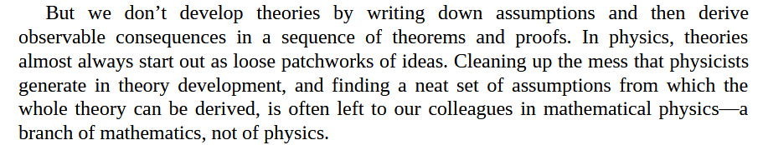
Sabine Hossenfelder – Lost in Math

Slide 4
We use mathematics to specify our models, not just do calculations, and specifying physical models is the whole point of physics

Slide 5
There is no single way to “clean up the mess”: each axiom and definition represents a choice in mathematical modeling

Slide 6

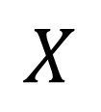
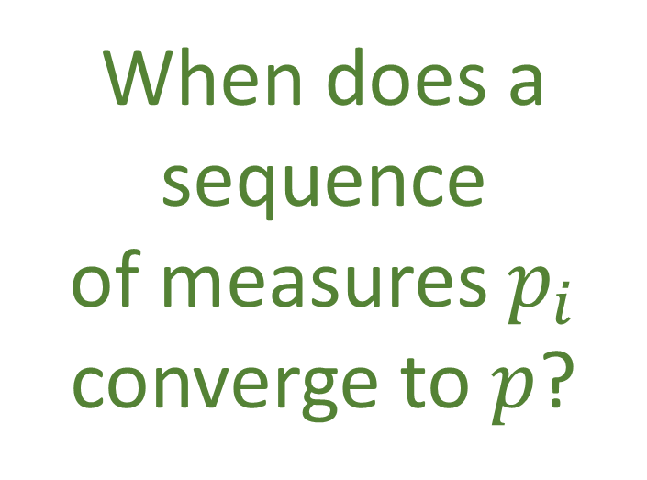

When does a sequence of measures $p_{i}$ converge to $p$?
$$p:Σ_{X}→\left[0,1\right]$$
Probability measure on $X$
$$X$$

Slide 7
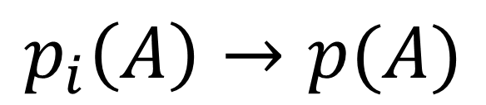
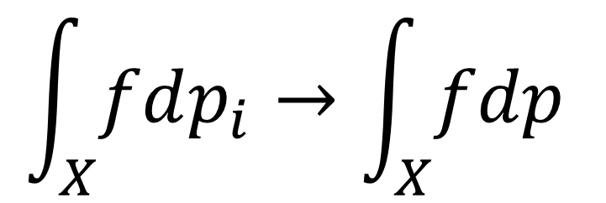
$$\int_{X}{fdp_{i}}→\int_{X}{fdp}$$
Weak convergence
Strong convergence
$$p_{i}\left(A\right)→p(A)$$

Slide 8
$$\int_{X}{fdp_{i}}→\int_{X}{fdp}$$
Weak convergence
Expectation of all continuous random variables converges
Strong convergence
$$p_{i}\left(A\right)→p(A)$$
Probability of any event converges

Slide 9

$$⋯$$
0
0.5
1
0
0.5
1
0
0.5
1
0
0.5
1
0
0.5
1
Here is a series of probability distributions from 0 to 1 Does it strongly converge to a uniform distribution?

Slide 10
$$⋯$$
0
0.5
1
0
0.5
1
0
0.5
1
0
0.5
1
0
0.5
1
Pick an interval (i.e. an event) As the frequency increases more peaks are going to enter the interval The number of full peaks and full valleys coincides The probability will converge
Converges strongly!
A uniform distribution and infinite oscillations are the same!

Slide 11

What about the entropy?
$$⋯$$
0
0.5
1
0
0.5
1
0
0.5
1
0
0.5
1
0
0.5
1
All $p_{i}$ have the same entropy
Entropy is one bit higher
Entropy does not converge!?!
If we use the inner product to define convergence, you get a stronger convergence criterion, which is equivalent to the convergence of the entropy

Slide 12
Choosing a convergence criterion (i.e. choosing a topology) means deciding when two objects become physically indistinguishable
i.e. what counts as an approximation
It’s a physical choice!!!

Slide 13
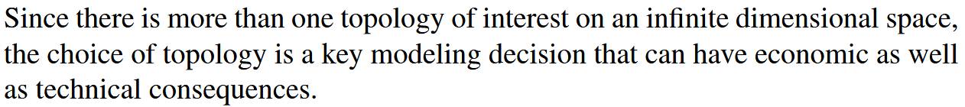



Slide 14
Mathematicians are ill-equipped to make physical choices!!!
They will “clean up the mess” by making unphysical choices
So, we end up with
THE WRONG MATH

Slide 15
Examples of unphysical mathematics

Slide 16


In differential geometry, tangent vectors are derivations
$$v:C^{∞}\left(X\right)→C^{∞}(X)$$
$$v=v^{i}∂_{i}$$
component
basis

Slide 17



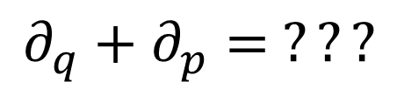



In differential geometry, tangent vectors are derivations
$$v:C^{∞}\left(X\right)→C^{∞}(X)$$
$$v=v^{i}∂_{i}$$
component
basis
In polar coordinates
$$∂_{r}+∂_{θ}= ???$$
$$\left[m\right]$$
$\left[rad\right]$
Doesn’t work with units
In phase space
$$∂_{q}+∂_{p}= ???$$
Mathematically precise $⇏$ physically precise
$\left[m\right]$
$\left[Kg m s^{−1}\right]$

Slide 18
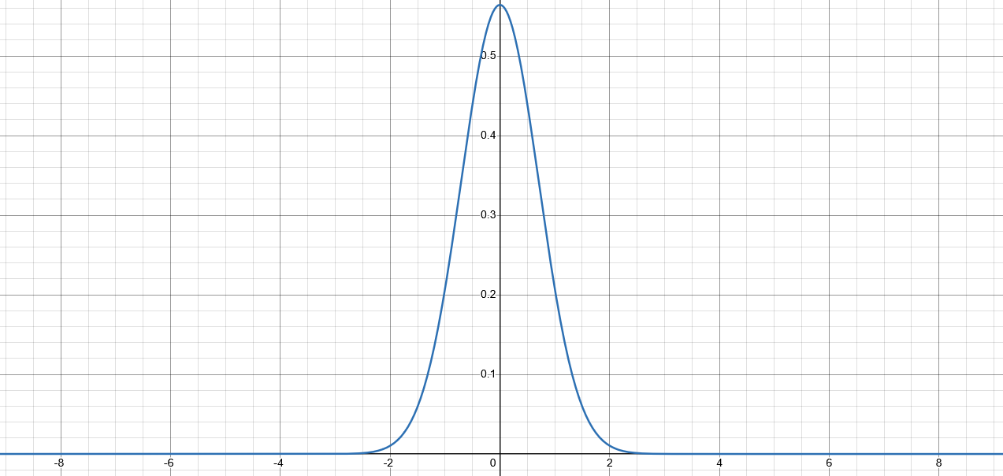
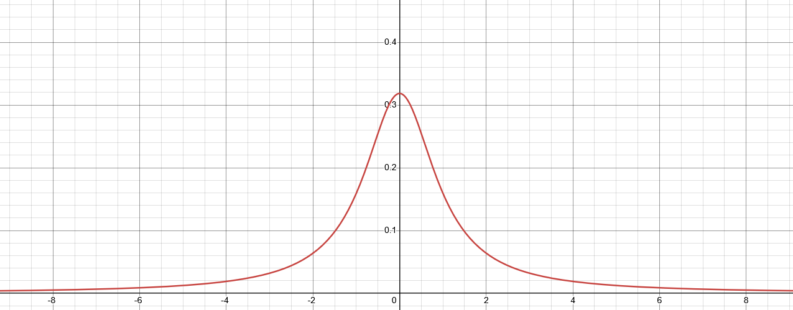

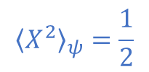

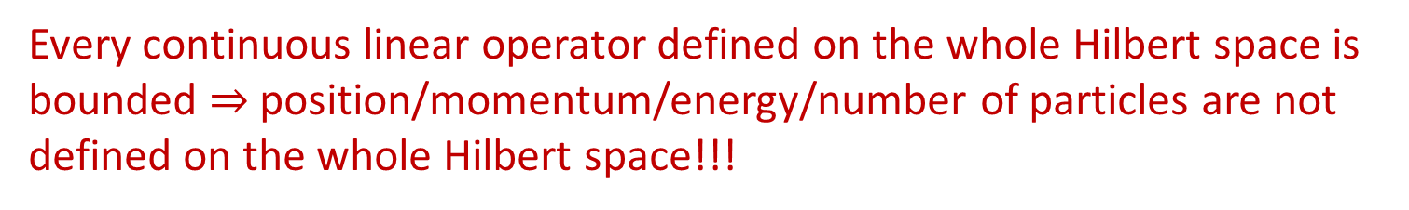


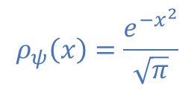

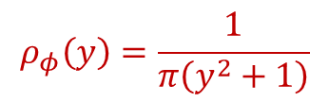
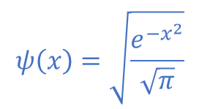
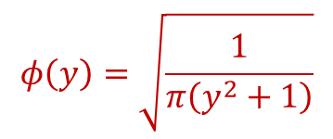
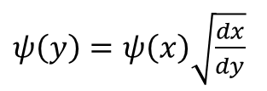
Hilbert space
Quantum states represented by $L^{2}$
Different observers see finite/infinite expectation
$$ψ\left(x\right)=\sqrt{\frac{e^{−x^{2}}}{\sqrt{π}}}$$
$$y=\tan\left(\frac{π}{2}\operatorname{erf}\left(x\right)\right)$$
$$∫{\left|ψ\right|}^{2}dx=1$$
$ψ\left(y\right)=ψ\left(x\right)\sqrt{\frac{dx}{dy}}$
$$ρ_{ψ}\left(x\right)=\frac{e^{−x^{2}}}{\sqrt{π}}$$
$${\left\langle X^{2}\right\rangle }_{ψ}=\frac{1}{2}$$
Expectation can have finite-to-infinite oscillations
$$φ\left(y\right)=\sqrt{\frac{1}{π\left(y^{2}+1\right)}}$$
$$∫{\left|φ\right|}^{2}dx=1$$
$x\left(x_{0},t\right)=x_{0}\cos^{2}{\frac{πt}{2}}+\tan\left(\frac{π}{2}\operatorname{erf}\left(x_{0}\right)\right)\sin^{2}{\frac{πt}{2}}$
$$ρ_{φ}\left(y\right)=\frac{1}{π\left(y^{2}+1\right)}$$
$${\left\langle Y^{2}\right\rangle }_{φ}→∞$$
Every continuous linear operator defined on the whole Hilbert space is bounded $⇒$ position/momentum/energy/number of particles are not defined on the whole Hilbert space!!!

Slide 19
Physical world (informal system)
Mathematical representation
(formal system)
well-defined physical
objects
well-defined mathematical objects
?
?
?
ill-defined
ill-defined
Current state of the art in theoretical physics

Slide 20
Physical world (informal system)
Mathematical representation
(formal system)
well-defined physical
objects
well-defined mathematical objects
Physical specifications
Mathematical definition
A mathematical definition is physical if it captures and only captures an aspect of the physical system

Slide 21
Mathematicians have developed standards of rigor for their discipline
What standard of rigor should we have for physical mathematics?
How do we make physics rigorous?

Slide 22
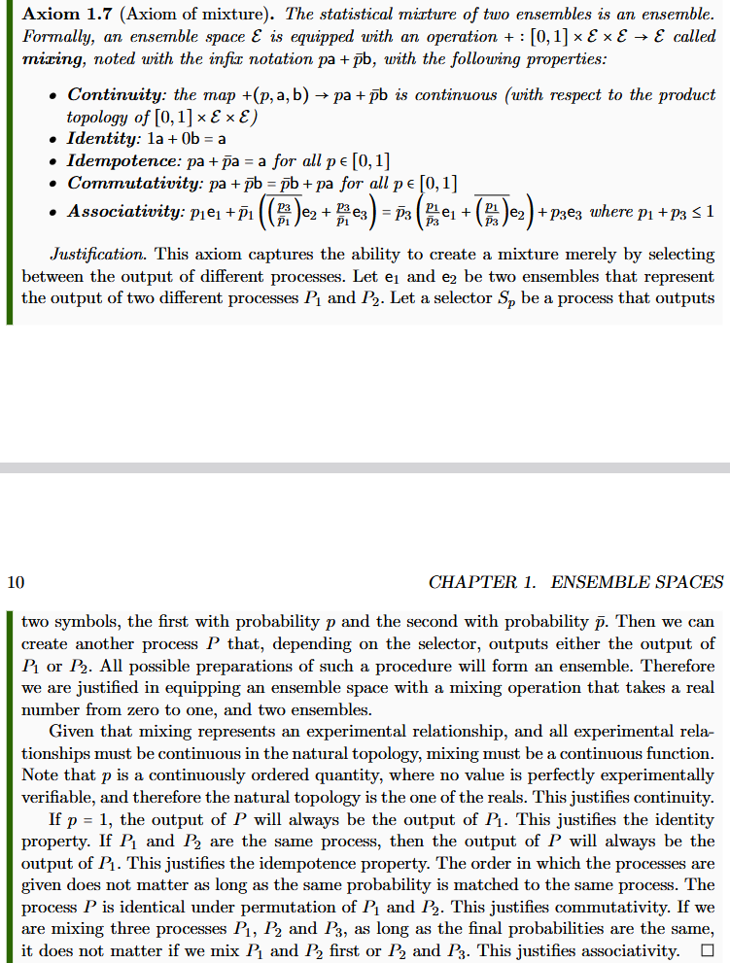
Informal intuitive statement
(something that makes sense to a physicist or an engineer)

Slide 23
Informal intuitive statement
(something that makes sense to a physicist or an engineer)
Formal requirement
(something a mathematician will find precise)

Slide 24







Informal intuitive statement
(something that makes sense to a physicist or an engineer)
Formal requirement
(something a mathematician will find precise)
Show that the formal requirement follows from the intuitive statement
$$P$$
Clear idea of what is being modelled
$P_{1}$
$$e_{1}$$
$$S_{p}$$
$$pe_{1}+\left(1−p\right)e_{2}$$
$P_{2}$
$$e_{2}$$

Slide 25
Informal intuitive statement
(something that makes sense to a physicist or an engineer)
Formal requirement
(something a mathematician will find precise)
Show that the formal requirement follows from the intuitive statement
Justification uses previous findings
$$P$$
Physical mathematics must start with most basic structures
$P_{1}$
$$e_{1}$$
$$S_{p}$$
$$pe_{1}+\left(1−p\right)e_{2}$$
$P_{2}$
$$e_{2}$$

Slide 26

Informal intuitive statement
(something that makes sense to a physicist or an engineer)
Formal requirement
(something a mathematician will find precise)
Show that the formal requirement follows from the intuitive statement
$$\left(1−p_{1}\right)\left(1−\frac{p_{3}}{1−p_{1}}\right)=1−p_{1}−p_{3}=\left(1−p_{3}\right)\left(1−\frac{p_{1}}{1−p_{3}}\right)$$
$$P$$
$P_{1}$
$$e_{1}$$
$$pe_{1}+\left(1−p\right)e_{2}$$
Properties justified by understanding the model
$$S_{p}$$
$P_{2}$
$$e_{2}$$

Slide 27
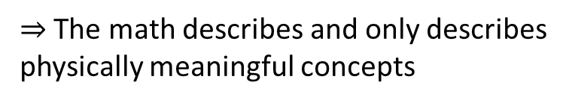
Informal intuitive statement
(something that makes sense to a physicist or an engineer)
Formal requirement
(something a mathematician will find precise)
Show that the formal requirement follows from the intuitive statement
There is no question as to what the math describes
The properties are justified by, are a consequence of, what the model describes
Every math proof can be understood physically
$⇒$ The math describes and only describes physically meaningful concepts
It’s physical mathematics

Slide 28
The goal of physical mathematics is to recover ALL mathematical structures used in physics from clear physical requirements
Physics
Physical requirements
Semantics
Clarify realm of applicability of each mathematical structure
Perfect map between math and physics
Physical mathematics
Provide a generalized structure for all physical theories
It’s a better way to do physics
It forces you to think a lot deeper about physics, what it means to have an experimentally based theory, what it means to define a state, what is entropy or energy, …
It’s not just a “math thing”

Slide 29

Logic of experimental verifiability $$⇓$$ topologies and $σ$-algebras

Slide 30
$⇒$ Science is about statements that are associated to experimental tests
Statements must be either true or false for everybody
Tests may or may not terminate (i.e. may be inconclusive)
Statement | Test Result
T | SUCCESS (in finite time)
 | UNDEFINED
F | UNDEFINED
 | FAILURE (in finite time)
two-valued logic
three-valued logic
Verifiable statement | Test Result
T | SUCCESS (in finite time)
F | UNDEFINED
 | FAILURE (in finite time)

Slide 31
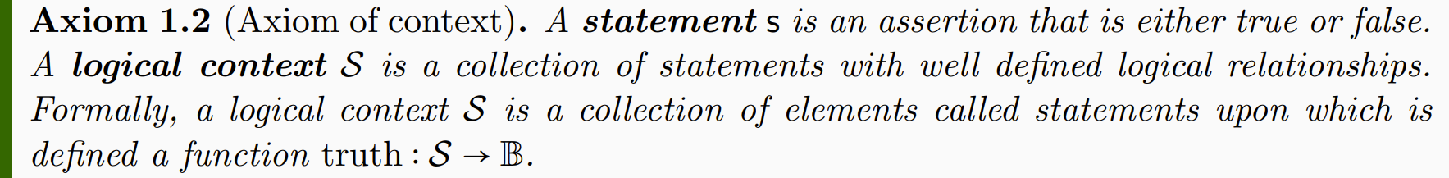
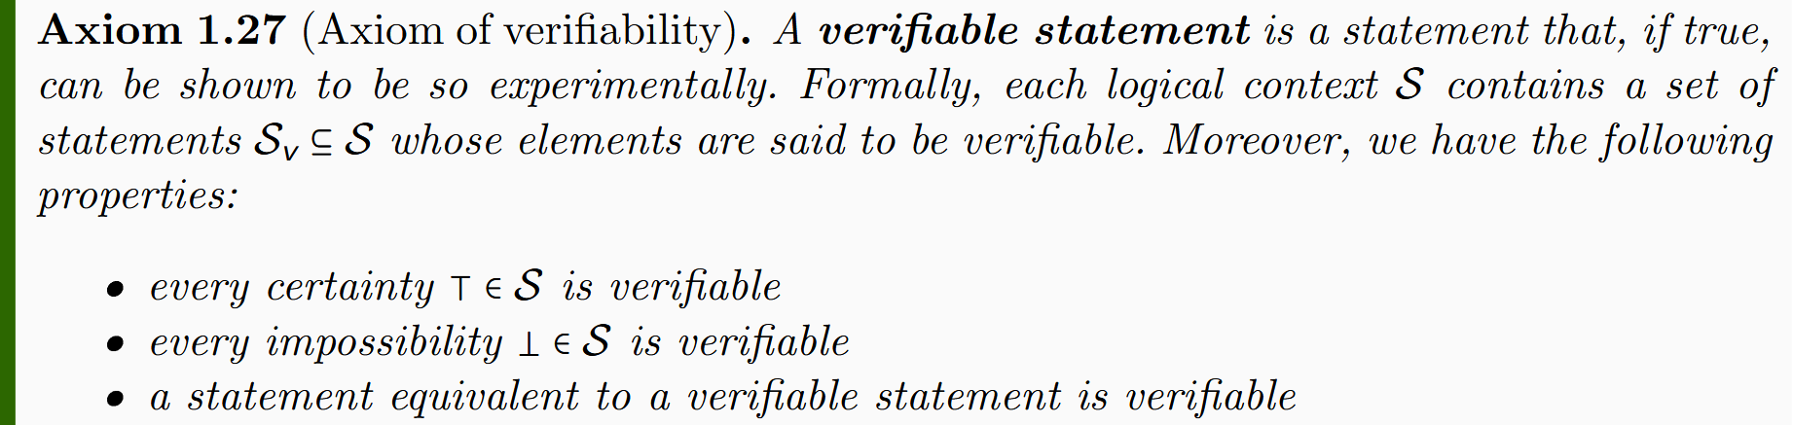
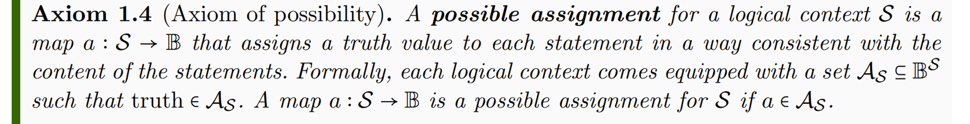
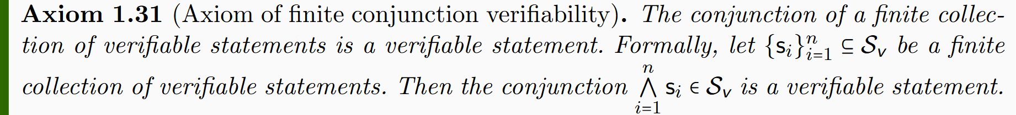
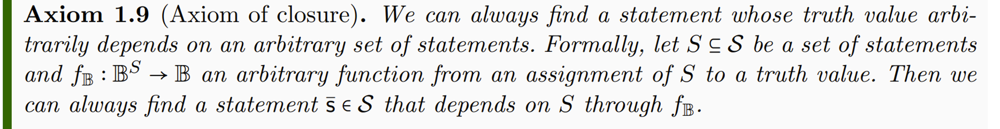
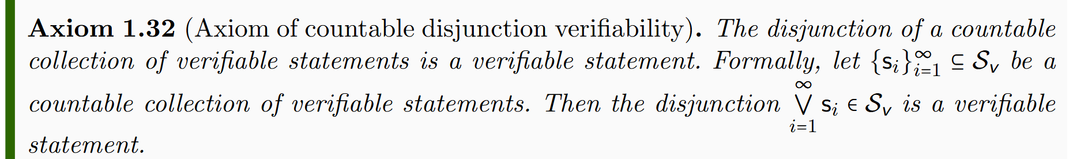
Axioms of logic
Axioms of verifiability
Lead to standard logic (i.e. Boolean algebra)
Lead to intuitionist logic (i.e. Heyting algebra)
two-valued logic
three-valued logic

Slide 32
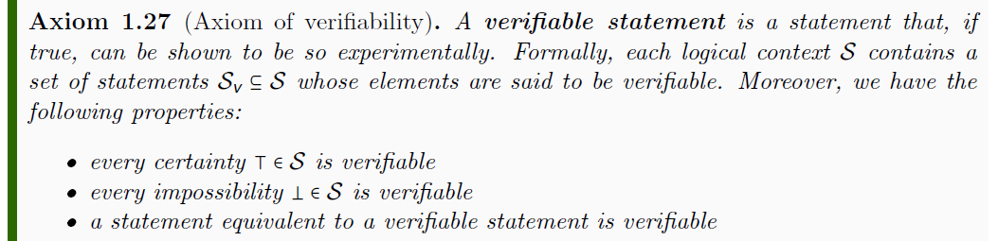



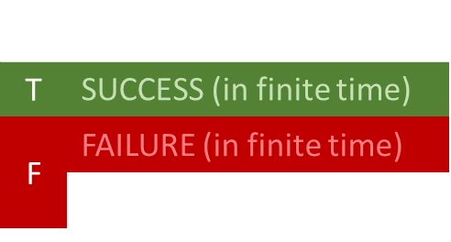
$$𝒮$$
$$s_{1}$$ | Test Result
T | SUCCESS (in finite time)
F | FAILURE (in finite time)
 | UNDEFINED
$$𝒮_{\text{v}}$$
$$s_{1}$$
experimental test
Tests are not part of the formal system

Slide 33
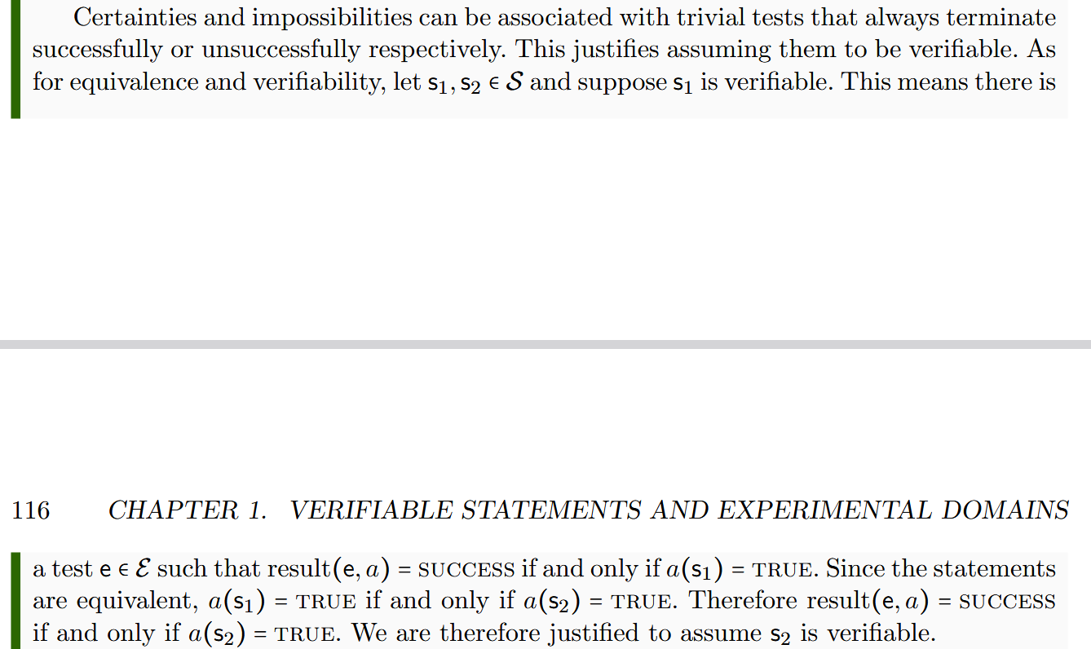
Justification for the properties

Slide 34
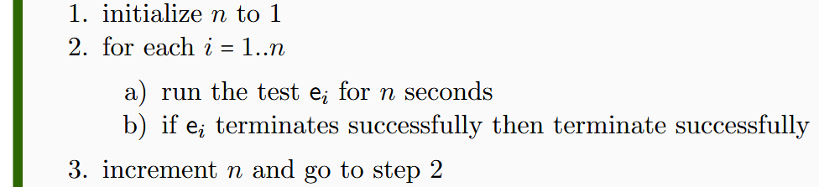

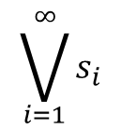
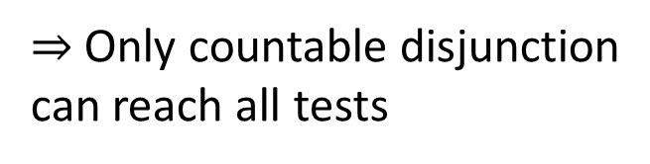



Check that ONE test terminates successfully
watch out for non-termination!
$$\bigvee_{i=1}^{∞}{s_{i}}$$
$$s_{1}$$
$$s_{2}$$
$$s_{3}$$
$$…$$
$⇒$ Only countable disjunction can reach all tests

Slide 35

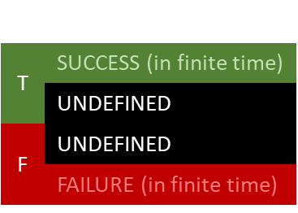
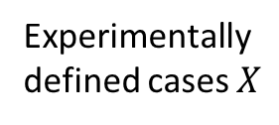






Topology and $σ$-algebra
Theoretical domain ${\overline{𝒟}}_{X}$
$int(A)$ corresponds to the verifiable part of a statement
Experimental domain $𝒟_{X}$
Theoretical statements
$$s_{1}$$ | Test Result
T | SUCCESS (in finite time)
 | UNDEFINED
F | UNDEFINED
 | FAILURE (in finite time)
Verifiable statements
Possibilities
$∂A$ corresponds to the undecidable part of a statement
$ext(A)$ corresponds to the falsifiable part of a statement
Topology ${\text{T}}_{X}$
Experimentally defined cases $X$
Open sets
Points
Borel sets
Borel algebra $Σ_{X}$
Perfect map between math and physics
Open set $(\text{5}\text{09.5, 510.5})$ $⟺$ Verifiable “the mass of the electron is 510 $±$ 0.5 KeV”
Closed set $[510]$ $⟺$ Falsifiable “the mass of the electron is exactly 510 KeV”
Borel set $ℚ$ ($int\left(ℚ\right)∪ext\left(ℚ\right)=∅$) $⟺$Theoretical “the mass of the electron in KeV is a rational number” (undecidable)

Slide 36
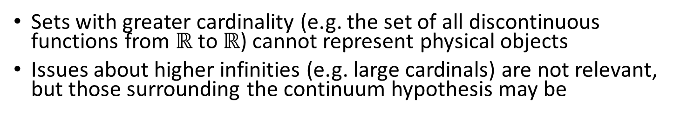



Maximum cardinality of distinguishable cases
$$ℝ$$
Set of distinguishable cases
Each point identified by truth of countably many verifiable stmts
Correspond to binary expansion
FTFFFTTTFTFTT…
TFFTTFTTFFFTF…
FTFFFTTFTFFTF…
FTTFTFTTFTFFT…
0.0100011101011…
0.1001101100010…
0.0100011010010…
0.0110101101001…
1
Most we can test over arbitrarily long time
Correspondence to binary sequence
$\left|X\right|≤|ℝ$|
0
0100011101011…
1001101100010…
0100011010010…
0110101101001…
$$X$$
Sets with greater cardinality (e.g. the set of all discontinuous functions from $ℝ$ to $ℝ$) cannot represent physical objects
Issues about higher infinities (e.g. large cardinals) are not relevant, but those surrounding the continuum hypothesis may be
Notes:
Large cardinals are defined to have a specific property and their existence cannot be proven (or disproven) in standard ZFC.

Slide 37
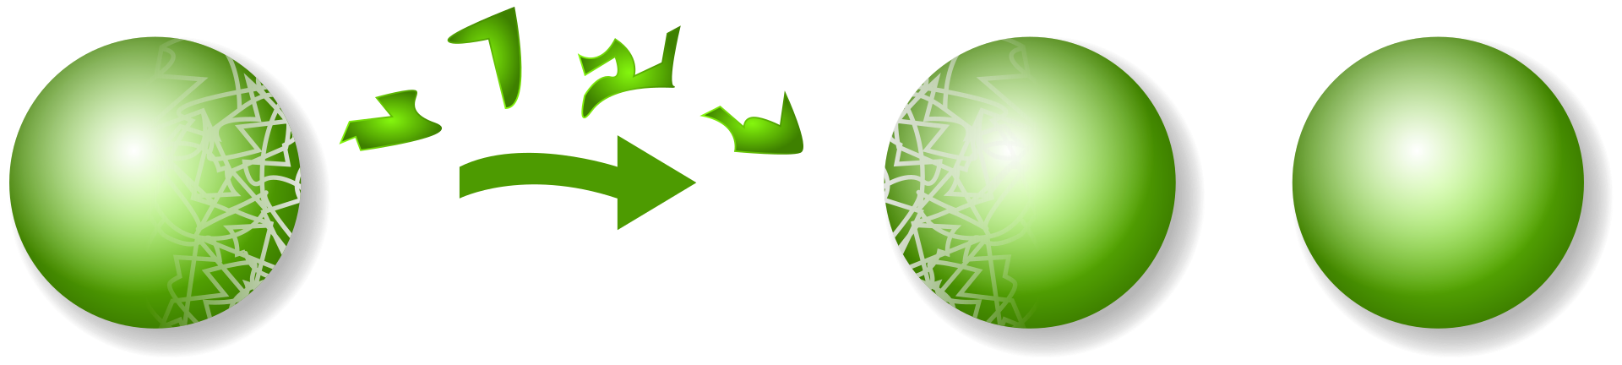
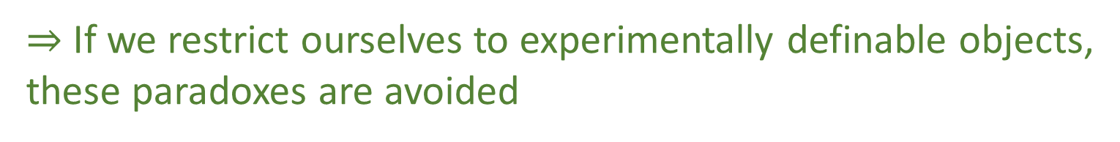
Power set vs Borel algebra
Using the set $2^{ℝ^{n}}$ of all possible subsets for $ℝ^{n}$ is problematic
Notion of size (i.e. measure) cannot be defined on all sets
Using non-measurable sets leads to the Banach-Tarski paradox
wikipedia
These problems are avoided if we restrict ourselves to Borel sets
$⇒$ If we restrict ourselves to experimentally definable objects, these paradoxes are avoided
Physical mathematics can give insight to these foundational issues in mathematics

Slide 38
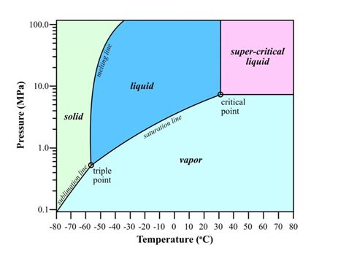
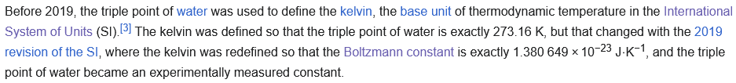
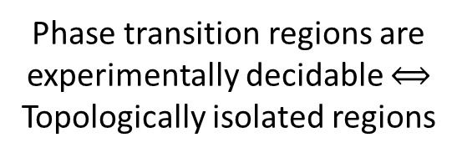

Why functions are well-behaved
Phase transition regions are experimentally decidable $⟺$ Topologically isolated regions
CO2 Phase diagram
Water heat capacity
data from https://www.engineeringtoolbox.com
Figure from https://www.researchgate.net/publication/326492803_Implications_of_Permeability_Uncertainty_During_Three-phase_CO2_Flow_in_a_Basalt_Fracture_Network
Topological continuity $≠$ Analytical continuity
We can verify we are at the triple point
Analytical discontinuity can only happen in regions that are experimentally decidable
We measure the equilibrium of three phases, not the pressure/temperature
from https://en.wikipedia.org/wiki/Triple_point

Slide 39
It is possible to develop a foundation of physics that is both mathematically rigorous and physically meaningful
The mathematical definitions ARE the physical requirements and assumptions
Physical world (informal system)
Mathematical representation
(formal system)
No issues of “interpretations”
Clear realm of applicability of mathematical tools
well-defined physical
objects
well-defined mathematical objects
Physical specifications
Mathematical definition

Slide 40
There is no “just math”
Either the math represents physical objects, then it’s describing physics
Or it doesn’t, and therefore it should be stripped away from the physical theory
Only by understanding the full details of the math and physics (and philosophy) can you make that determination
If you do not know what the well-ordering of the reals is, you are precisely a person that cannot determine whether it is physically significant or not

