Slide 1
Multiple Degrees of Freedom
Gabriele Carcassi

Slide 2















Hamilton’s Equations
S-DOF
$$d_{t}q=∂_{p}H$$
$$d_{t}p=−∂_{q}H$$
$$d_{t}q^{i}=∂_{p_{i}}H$$
$$d_{t}p_{i}=−∂_{q^{i}}H$$
(HM-1D)
(HM-ND)
$$S^{q}=∂_{p}H$$
$$S^{p}=−∂_{q}H$$
$$ξ^{a}=[q^{i}, p_{i}]$$
$$S^{a}=d_{t}ξ^{a}=[d_{t}q^{i},d_{t}p_{i}]$$
$$p_{2}$$
$$p_{1}$$
$$q^{2}$$
$$S^{q^{i}}=∂_{p_{i}}H$$
$$S^{p_{i}}=−∂_{q^{i}}H$$
$$S^{a}$$
$$q^{1}$$

Slide 3














S-DOF
$$ω=\left[\begin{matrix}0 & 1 \\ −1 & 0\end{matrix}\right]⊗I_{n}$$
$$\left[ω_{ab}\right]=\left[\begin{matrix}ω_{q^{i}q^{j}} & ω_{q^{i}p_{j}} \\ ω_{p_{i}q^{j}} & ω_{p_{i}p_{j}}\end{matrix}\right]$$
$$ω=\left[\begin{matrix}0 & 1 \\ −1 & 0\end{matrix}\right]$$
$$\left[ω_{ab}\right]=\left[\begin{matrix}ω_{qq} & ω_{qp} \\ ω_{pq} & ω_{pp}\end{matrix}\right]$$
$$\vec{S}=ω \vec{∇}H$$
$$\left[\begin{matrix}S^{q} \\ S^{p}\end{matrix}\right]=\left[\begin{matrix}0 & 1 \\ −1 & 0\end{matrix}\right]\left[\begin{matrix}∂_{q}H \\ ∂_{p}H\end{matrix}\right]=\left[\begin{matrix}∂_{p}H \\ −∂_{q}H\end{matrix}\right]$$
$${\text{P}}_{}^{90°}$$
$$S_{a}=S^{b}ω_{ba}=∂_{a}H$$
$$\left[\begin{matrix}S^{q^{i}} \\ S^{p_{i}}\end{matrix}\right]=\left[\begin{matrix}0 & I_{n} \\ −I_{n} & 0\end{matrix}\right]\left[\begin{matrix}∂_{q^{i}}H \\ ∂_{p_{i}}H\end{matrix}\right]=\left[\begin{matrix}∂_{p_{i}}H \\ −∂_{q^{i}}H\end{matrix}\right]$$
$$S^{q}ω_{qp}=∂_{p}H$$
$$S^{p}ω_{pq}=∂_{q}H$$
$$S_{a}=S^{b}ω_{ba}=∂_{a}H$$
(HM-G)
$$S^{q^{i}}ω_{q^{i}p_{i}}=∂_{p_{i}}H$$
$$S^{p_{i}}ω_{p_{i}q^{i}}=∂_{q^{i}}H$$

Slide 4











$ω_{ab}$performs a $90°$ rotation within each degree of freedom,
switching components between position and momentum
$v^{a}=[{v^{q}}^{i},v^{p_{i}}]$ $⇒$ $v_{a}=v^{b}ω_{ba}=[−v^{p_{i}},v^{q^{i}}]$
$$p_{2}$$
$$p_{1}$$
$$q^{2}$$
$$p_{2}$$
$$p_{1}$$
$$q^{2}$$
$$q^{1}$$
$$q^{1}$$
Note: multiple ways to perform $90°$rotation
Only the rotation defined by $ω_{ab}$ works

Slide 5

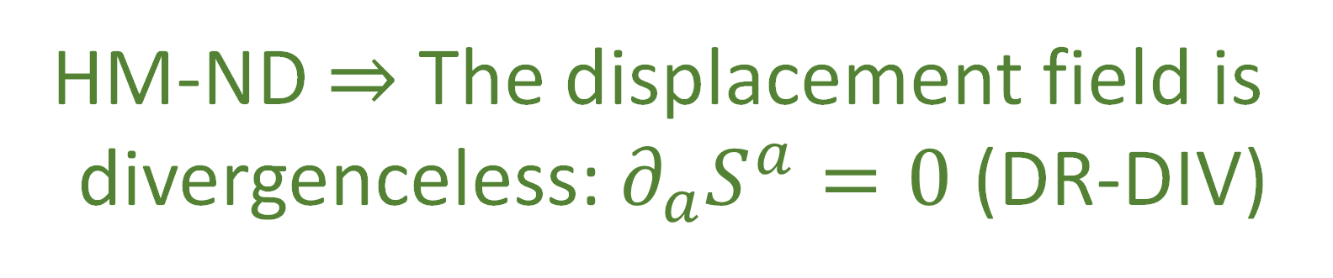





$$p_{2}$$
$$p_{1}$$
$$q^{2}$$
S-DOF
$$∂_{a}S^{a}=∂_{q}S^{q}+∂_{p}S^{p}$$
$$q^{1}$$
$$=∂_{q}∂_{p}H−∂_{p}∂_{q}H$$
$0=∂_{a}S^{a}$ $=∂_{q^{i}}S^{q^{i}}+∂_{p_{i}}S^{p_{i}}$ $=∂_{q^{i}}∂_{p_{i}}H−∂_{p_{i}}∂_{q^{i}}H$
$$=0$$
HM-ND $⇒$ The displacement field is
divergenceless: $∂_{a}S^{a}=0$ (DR-DIV)

Slide 6













Let $\hat{q}$and $\hat{p}$ represent the evolution of q and p after an infinitesimal time step $δt$
$${\hat{q}}^{i}=q^{i}+S^{q^{i}}δt$$
S-DOF
$${\hat{p}}_{i}=p_{i}+S^{p_{i}}δt$$
$$\hat{p}=p+S^{p}δt$$
$$\hat{q}=q+S^{q}δt$$
$$∂_{b}{\hat{ξ}}^{a}=\left[\begin{matrix}δ_{j}^{i}+∂_{q^{j}}S^{q^{i}}δt & ∂_{p_{j}}S^{q^{i}}δt \\ ∂_{q^{j}}S^{p_{i}}δt & δ_{i}^{j}+∂_{p_{j}}S^{p_{i}}δt\end{matrix}\right]$$
$$∂_{b}{\hat{ξ}}^{a}=\left[\begin{matrix}1+∂_{q}S^{q}δt & ∂_{p}S^{q}δt \\ ∂_{q}S^{p}δt & 1+∂_{p}S^{p}δt\end{matrix}\right]$$
$$p$$
$$\left|∂_{b}{\hat{ξ}}^{a}\right|=1+\left(∂_{q}S^{q}+∂_{p}S^{p}\right)δt+O(δt^{2})$$
$$\left|∂_{b}{\hat{ξ}}^{a}\right|=\left|δ_{j}^{i}+∂_{q^{j}}S^{q^{i}}δt\right|\left|δ_{i}^{j}+∂_{p_{j}}S^{p_{i}}δt\right|$$
$$−\left|∂_{p_{j}}S^{q^{i}}δt\right|\left|∂_{q^{j}}S^{p_{i}}δt\right|$$
$∂_{a}S^{a}$!!!
$$=1+\left(∂_{q^{i}}S^{q^{i}}+∂_{p_{i}}S^{p_{i}}\right)δt+O(δt^{2})$$
$$q$$
$∂_{a}S^{a}$!!!

Slide 7
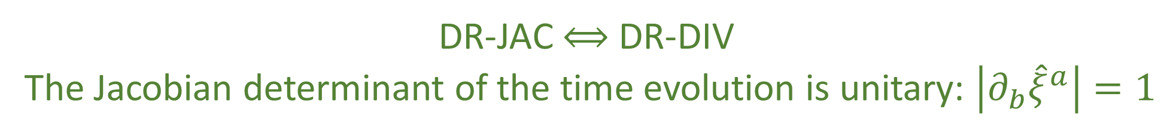



$\left|∂_{b}{\hat{ξ}}^{a}\right|=1$ $⟺$ $∂_{a}S^{a}=0$
DR-JAC $⟺$ DR-DIV
The Jacobian determinant of the time evolution is unitary: $\left|∂_{b}{\hat{ξ}}^{a}\right|=1$
multiplicative factor between past and future volumes and densities
$$⇒$$
Volumes are conserved through the evolution: $d{\hat{ξ}}^{1}⋯d{\hat{ξ}}^{n}=dξ^{1}⋯dξ^{n}$ (DR-VOL)
Densities are conserved through the evolution: $\hat{ρ}\left({\hat{ξ}}^{a}\right)=ρ\left(ξ^{b}\right)$ (DR-DEN)
DR-DIV $⟺$ DR-JAC $⟺$ DR-VOL $⟺$ DR-DEN

Slide 8






The displacement field $S^{a}$ has $2n$ components
Conditions DR-DIV, DR-JAC, DR-VOL, and DR-DEN specify a single constraint giving $2n−1$ components
The choice of Hamiltonian provides another constraint, leaving $2n−2$ choices
Single Degree of Freedom:
$$n=1$$
$$2n−2=0$$
no choices remain
Multiple Degrees of Freedom:
$$n>1$$
$$2n−2≠0$$
choices remain
HM-ND $⇒$ DR-DIV $⟺$DR-JAC $⟺$ DR-VOL $⟺$ DR-DEN
DR-DIV $⟺$DR-JAC $⟺$ DR-VOL $⟺$ DR-DEN $⇏$ HM-ND

Slide 9




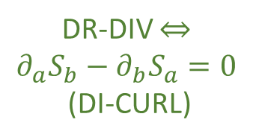
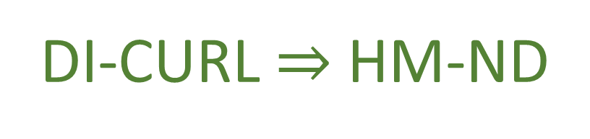






S-DOF
$$∂_{a}S_{b}−∂_{b}S_{a}=∂_{a}\left(S^{c}ω_{cb}\right)−∂_{b}(S^{c}ω_{ca})$$
Flow THROUGH the curve
$$\int{S^{a}×dξ^{b}}$$
$$=∂_{a}∂_{b}H−∂_{b}∂_{a}H=0$$
same only for S-DOF
Flow ALONG the curve
HM-ND $⇒$ DI-CURL
$$\int{S_{b}⋅dξ^{b}}$$
$$p_{2}$$
$$p_{1}$$
$$q^{2}$$
DR-DIV $⇔$ $$∂_{a}S_{b}−∂_{b}S_{a}=0$$
(DI-CURL)
Conversely: given $S_{a}$ is curl free
S-DOF only
$$S_{a}=S^{b}ω_{ba}=∂_{a}H$$
$$q^{1}$$
DI-CURL $⇒$ HM-ND

Slide 10
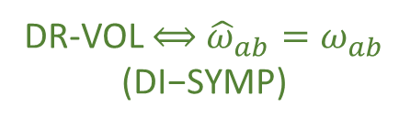




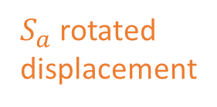







$${\hat{ω}}_{ab}=∂_{a}{\hat{ξ}}^{c}ω_{cd}∂_{b}{\hat{ξ}}^{d}$$
S-DOF
$$=\left(δ_{a}^{c}+∂_{a}S^{c}δt\right)ω_{cd}\left(δ_{b}^{d}+∂_{b}S^{d}δt\right)$$
$$=ω_{ab}+\left(∂_{a}S^{c}ω_{cb}+ω_{ad}∂_{b}S^{d}\right)δt+O\left(δt^{2}\right)$$
$$=ω_{ab}+\left(∂_{a}{(S}^{c}ω_{cb})+∂_{b}(S^{d}ω_{ad})\right)δt+O\left(δt^{2}\right)$$
$$=ω_{ab}+\left(∂_{a}{(S}^{c}ω_{cb})−∂_{b}(S^{d}ω_{da})\right)δt+O\left(δt^{2}\right)$$
Area $\left(v^{a},w^{a}\right)=v^{a}ω_{ab }w^{b}$
${\hat{v}}^{c}ω_{cd }{\hat{w}}^{d}=v^{a}{\hat{ω}}_{ab }w^{b}$
Area is conserved if
$${\hat{ω}}_{ab}=ω_{ab}$$
DR-VOL $⟺$ ${\hat{ω}}_{ab}=ω_{ab}$ $$\text{(}\text{DI}\text{−}\text{SYMP}\text{)}$$
Invariance of $ω_{ab}$:
$$p_{2}$$
$$p_{1}$$
$$q^{2}$$
$$∂_{a}(S^{c}ω_{cb})−∂_{b}\left(S^{d}ω_{da}\right)=0$$
$S_{a}$ rotated displacement
area $≠$ volume M-DOF
$$∂_{a}S_{b}−∂_{b}S_{a}=0$$
$S^{a}$ displacement
$$q^{1}$$
DI-SYMP $⟺$ DI-CURL

Slide 11


$$\left\{f,g\right\}=∂_{q}f∂_{p}g−∂_{p}f∂_{q}g=−∂_{a}fω^{ab}∂_{b}g$$
DI-SYMP $⟺$ DI-POI
invariance of $ω$ is invariance of Poisson bracket
same in
S-DOF and M-DOF
$$\hat{\left\{f,g\right\}}=∂_{\hat{q}}f∂_{\hat{p}}g−∂_{\hat{p}}f∂_{\hat{q}}g=−∂_{a}f{\hat{ω}}^{ab}∂_{b}g$$

Slide 12









HM-ND
$$⟺$$
DI-CURL
DR-JAC
$$⟺$$
DR-DIV
$$⇒$$
$$⟺$$
$$⟺$$
$$⟺$$
$$⟺$$
DI-POI
$$⟺$$
DI-SYMP
DR-DEN
$$⟺$$
DR-VOL
fully characterize Hamiltonian mechanics
weaker conditions
How are they different?
Why are they the same for a S-DOF?

Slide 13
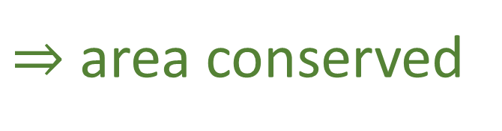









$$v^{a}ω_{ab}w^{b}$$
conserved quantity
$$p_{1}$$
$$ω=\left[\begin{matrix}0 & 1 \\ −1 & 0\end{matrix}\right]$$
S-DOF
$$w$$
$$ω(v,w)$$
$$v$$
$$q^{1}$$
$$v^{a}ω_{ab}w^{b}=v^{q^{1}}ω_{q^{1}p_{1}}w^{p_{1}}=v^{q^{1}}w^{p_{1}}$$
area of parallelogram
$⇒$ area conserved
$⇒$ volume conserved

Slide 14








$$v^{a}ω_{ab}w^{b}$$
conserved quantity
$$p_{2}$$
$$p_{1}$$
$$q^{2}$$
$$ω(v,w)$$
$$w$$
$$v$$
$$ω=\left[\begin{matrix}0 & I_{n} \\ −I_{n} & 0\end{matrix}\right]$$
M-DOF
$$w$$
$$ω(v,w)$$
$$v$$
$$q^{1}$$
$$v^{a}ω_{ab}w^{b}=v^{q^{1}}ω_{q^{1}p_{1}}w^{p_{1}}=v^{q^{1}}w^{p_{1}}$$
area of parallelogram
$$v^{a}ω_{ab}w^{b}=v^{q^{2}}ω_{q^{2}p_{1}}w^{p_{1}}=0$$
zero across DOFs!

Slide 15



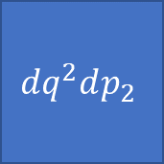
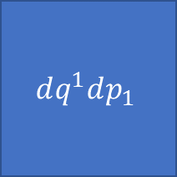
SF-ND
$$ω=\left[\begin{matrix}0 & I_{n} \\ −I_{n} & 0\end{matrix}\right]=\left[\begin{matrix}0 & 1 \\ −1 & 0\end{matrix}\right]⊗I_{n}$$
Scalar product across DOFs
$$ω=∑dq^{i}dp_{i}$$
Cross product within DOF
$$ω$$
Orthogonality of DOFs
$$dq^{2}dp_{2}$$
$$dq^{1}dp_{1}$$
WARNING: analogy!!!

Slide 16





Space(time) geometry vs phase space geometry
(pseudo-)Riemannian
Symplectic
$$g_{ij}$$
$$ω_{ab}$$
Metric tensor
Symplectic form
defines lengths and angles
areas and “angles”
$$ds^{2}=dx^{i}g_{ij}dx^{j}=∑{\left(dx^{i}\right)}^{2}$$
$$ds^{2}=dξ^{a}ω_{ab}dξ^{b}=∑dq^{i}dp_{i}$$
cartesian coordinates
canonical coordinates $(q^{i},p_{i})$

Slide 17
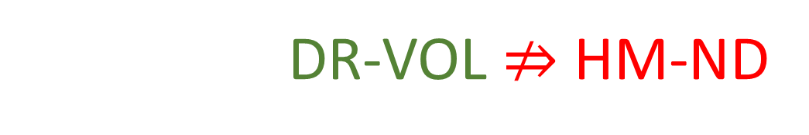

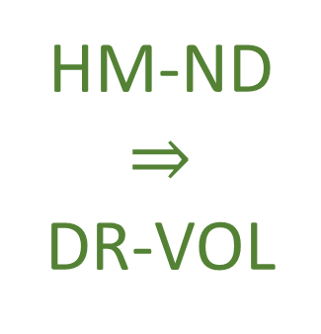






$$⇒$$
Conservation of $ω_{ab}$
Conservation of areas and orthogonality
$$(q^{2},p_{2})$$
$$({\hat{q}}^{2},{\hat{p}}_{2})$$
HM-ND $⇒$ DR-VOL
$$(q^{1},p_{1})$$
$$({\hat{q}}^{1},{\hat{p}}_{1})$$
$$⇒$$
Volume is preserved!
However DR-VOL $⇏$ HM-ND

Slide 18








$$d_{t}q^{1}={S^{q}}^{1}=\frac{p_{1}}{m}$$
$$d_{t}p_{1}=S^{p_{1}}=−bp_{1}$$
Particle under linear drag
$$d_{t}q^{2}={S^{q}}^{2}=\frac{p_{2}}{m}$$
a particle accelerated proportionally
to its momentum
$$d_{t}p_{2}=S^{p_{2}}=bp_{2}$$
$$∂_{a}S^{a}=∂_{q^{1}}\frac{p_{1}}{m}+∂_{p_{1}}\left(−bp_{1}\right)+∂_{q^{2}}\frac{p_{2}}{m}+∂_{p_{2}}\left(bp_{2}\right)=−b+b=0$$
Divergence is zero: DR-DIV and DR-VOL are satisfied
$$(q^{2},p_{2})$$
$$({\hat{q}}^{2},{\hat{p}}_{2})$$
$$(q^{1},p_{1})$$
$$({\hat{q}}^{1},{\hat{p}}_{1})$$
Notes:
TODO: x and y should be q1 and q2

Slide 19

$$d_{t}q^{1}={S^{q}}^{1}=\frac{p_{1}}{m}$$
$$d_{t}p_{1}=S^{p_{1}}=−bp_{1}$$
Particle under linear drag
$$d_{t}q^{2}={S^{q}}^{2}=\frac{p_{2}}{m}$$
a particle accelerated proportionally
to its momentum
$$d_{t}p_{2}=S^{p_{2}}=bp_{2}$$
$$∂_{q^{1}}S_{p_{1}}−∂_{p_{1}}S_{q^{1}}=∂_{q^{1}}S^{q^{1}}ω_{q^{1}p_{1}}−∂_{p_{1}}S^{p_{1}}ω_{p_{1}q^{1}}$$
$$=∂_{q^{1}}\frac{p_{1}}{m}\left(1\right)−∂_{p_{1}}(−bp_{1})(−1)=−b$$
Curl of $S_{a}$is not zero: DI-CURL is not satisfied, nor are DI-SYMP or HM-ND
$$(q^{2},p_{2})$$
$$({\hat{q}}^{2},{\hat{p}}_{2})$$
$$(q^{1},p_{1})$$
$$({\hat{q}}^{1},{\hat{p}}_{1})$$
Notes:
TODO: x and y should be q1 and q2

Slide 20
Turning attention to the physics

Slide 21






Hamiltonian mechanics
$$⇔$$
volume conserved
$$+$$
orthogonality preserved
$$⇔$$
$$⇔$$
$$d_{t}q^{i}=∂_{p_{i}}H$$
determinism/
reversibility
???
$$d_{t}p_{j}=−∂_{q^{j}}H$$

Slide 22






DOFs are orthogonal
$$(q^{2},p_{2})$$
$$⇔$$
Total number of states = product of configurations for each DOF
$$(q^{1},p_{1})$$
$$⇔$$
All combinations across DOFs are possible
$$⇔$$
Choice of configuration of one DOF does not constrain the others
$$⇔$$
DOFs are independent (IND-DOF)

Slide 23







“There are 231 female rabbits”
$⇒$ No constraint on the male population
“There are 231 female rabbits”
$⇒$ “There are at least 231 rabbits”
Number of Females vs. Males
Number of Females vs. Total Population
Rabbit farm example
M
T
$$?$$
$$≥231$$
$$231$$
F
$$231$$
F
Orthogonal DOFs
$$⇔$$
Independent DOFs
Notes:
TODO: Difference of independence in another slide

Slide 24
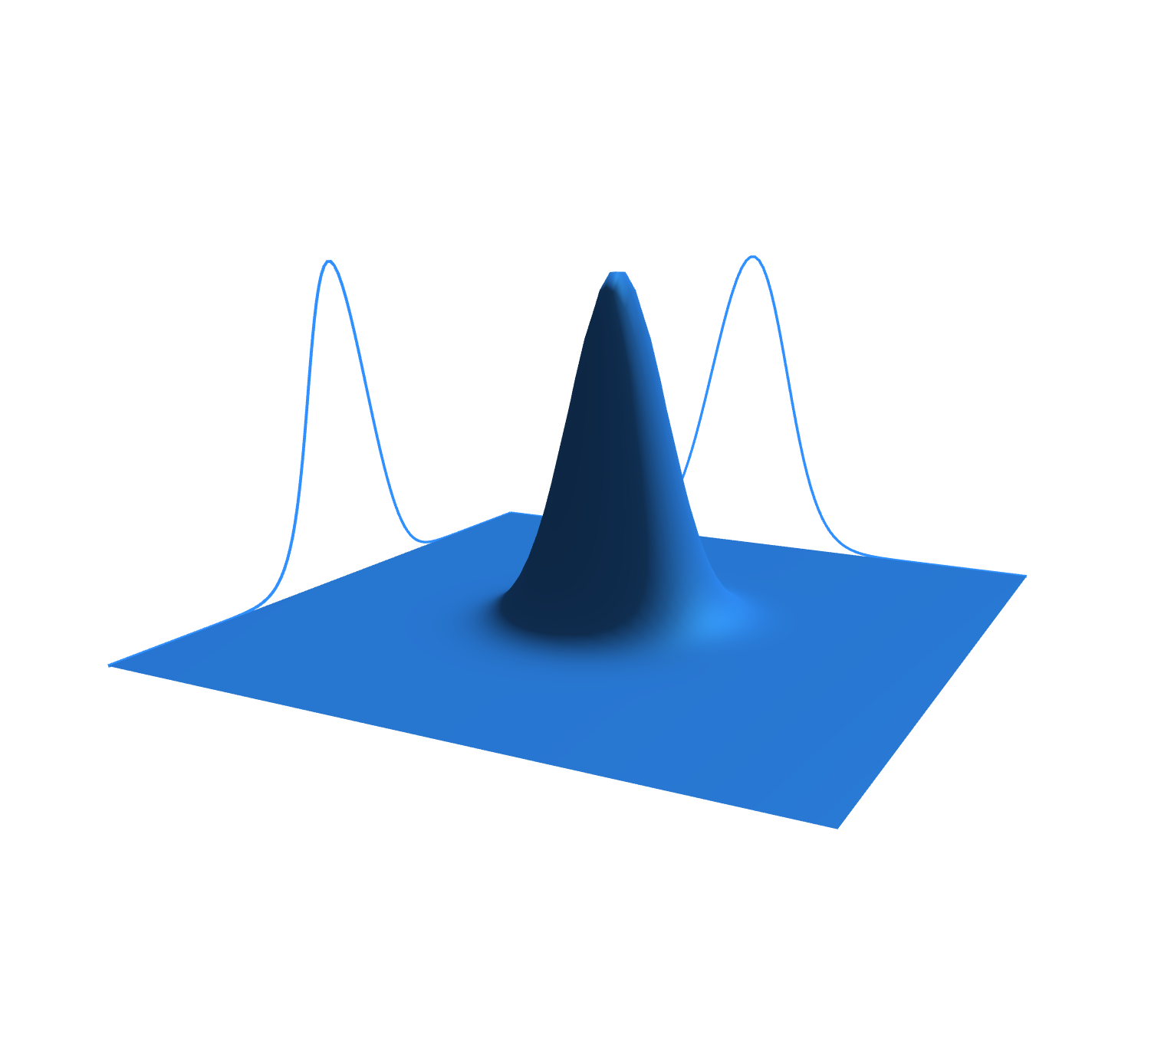








Variable independence
Statistical independence
$$y$$
$$ρ$$
$$x$$
$$y$$
$$x$$
$$\#\left(x,y\right)=\#\left(x\right)\#(y)$$
$$ρ_{XY}\left(x,y\right)=ρ_{X}\left(x\right)ρ_{Y}(y)$$
Count of configurations factorizes
Probability factorizes
(IND-STAT) The system allows statistically independent distributions over each DOF
(IND-DOF) The system is decomposable into independent DOFs
$$⇔$$

Slide 25







$$I\left[ρ_{XY}\right]=I\left[ρ_{X}\right]+I\left[ρ_{Y}\right]$$
$$⇔$$
$$ρ_{XY} =ρ_{X}ρ_{Y}$$
Information independence
Statistical independence
$$⇐$$
$$I\left[ρ_{XY}\right]=−∬ρ_{XY}\log{ρ_{XY}}=−∬ρ_{X}ρ_{Y}\log{ρ_{X}ρ_{Y}}=−∬ρ_{X}ρ_{Y}\log{ρ_{X}}−∬ρ_{X}ρ_{Y}\log{ρ_{Y}}$$
$$=−∫ρ_{Y}∫ρ_{X}\log{ρ_{X}}−∫ρ_{X}∫ρ_{Y}\log{ρ_{Y}}=−∫ρ_{X}\log{ρ_{X}}−∫ρ_{Y}\log{ρ_{Y}}=I\left[ρ_{X}\right]+I\left[ρ_{Y}\right]$$
$$⇒$$
$$I\left[ρ_{X}\right]+I\left[ρ_{Y}\right]=−∫ρ_{X}\log{ρ_{X}}−∫ρ_{Y}\log{ρ_{Y}}=−∬ρ_{XY}\log{ρ_{X}}−∬ρ_{XY}\log{ρ_{Y}}$$
$$=−∬ρ_{XY}\log{ρ_{X}ρ_{Y}}=−∬ρ_{XY}\log{\frac{ρ_{X}ρ_{Y}}{ρ_{XY}}}−∬ρ_{XY}\log{ρ_{XY}}$$
$$\frac{ρ_{X}ρ_{Y}}{ρ_{XY}}=1$$
(IND-INFO) The system allows informationally independent distributions over each DOF
(IND-STAT) The system allows statistically independent distributions over each DOF
$$⇔$$

Slide 26







$$\left|Σ\right|=σ_{X}^{2}σ_{Y}^{2}$$
$$⇔$$
$$ρ_{XY} =ρ_{X}ρ_{Y}$$
Uncertainty factorizes
Statistical independence
for peaked distributions
$$p_{2}$$
$$p_{1}$$
$$q^{2}$$
$$⇐$$
$$\left|Σ\right|=\left|\begin{matrix}σ_{X}^{2} & cov\left(X,Y\right) \\ cov\left(X,Y\right) & σ_{Y}^{2}\end{matrix}\right|=\left|\begin{matrix}σ_{X}^{2} & 0 \\ 0 & σ_{Y}^{2}\end{matrix}\right|=σ_{X}^{2}σ_{Y}^{2}$$
$$q^{1}$$
$$⇒$$
Hadamard's inequality
$$cov(X,Y)=0$$
$Σ$ is symmetric, positive semi-definite
$$\left|Σ\right|≤Πσ_{ii}$$
$⇒$ independence
Equality only if diagonal
for peaked distributions
(IND-UNC) The system allows peaked distributions where the
uncertainty is the product of the uncertainty on each DOF
(IND-STAT) The system allows statistically independent distributions over each DOF
$$⇔$$

Slide 27









$$y$$
$$ρ$$
IND-DOF
$$⟺$$
IND-STAT
$$x$$
$$y$$
$$x$$
$$⟺$$
$$⟺$$
$$p_{2}$$
$$p_{1}$$
$$q^{2}$$
IND-UNC
$$⟺$$
IND-INFO
$$I\left[ρ_{XY}\right]= \\ I\left[ρ_{X}\right]+I\left[ρ_{Y}\right]$$
$$q^{1}$$
$$⇔$$
$$ω_{ab}=\left[\begin{matrix}0 & 1 \\ −1 & 0\end{matrix}\right]⨂\left[\begin{matrix}1 & 0 & \text{⋯} & 0 \\ 0 & 1 & \text{⋯} & 0 \\ \text{⋮} & … & \text{⋱} & \text{⋮} \\ 0 & 0 & \text{⋯} & 1\end{matrix}\right]$$
Orthogonal DOFs

Slide 28
Constitutive assumptions of Hamiltonian mechanics:
Are they enough?
Notes:
TODO: make text more “pictorial” with conditions and dependence/equivalence symbols

Slide 29


Hamiltonian mechanics
$$⇔$$
volume conserved
$$+$$
orthogonality preserved
$$⇔$$
$$⇔$$
$$d_{t}q=∂_{p}H$$
determinism/
reversibility
independence preserved
$$d_{t}p=−∂_{q}H$$
Can determinism and reversibility violate DOF independence?

Slide 30



Let’s study the finite case
Suppose we have two integer variables $1≤x≤3$ and $1≤y≤3$
$3$ possible map types:
preserves statistical independence and
variable independence
$x$ to $x$ and $y$ to $y$
violates statistical independence but
preserves variable independence
$xy$ to $xy$
Removes some cases
(map cannot be reversible)
violates statistical and
variable independence
$⇒$ losing variable independence means losing reversibility
Notes:
TODO: 1) shapes/colors (x and y remain shape and colors but permutated) 2) all circles, xy different shades of the same colors, gets mapped without pattern 3) all circles, all white For all: arrows should show two xy points being mapped. In 3 they map to the same point.

Slide 31

Constitutive assumptions of Hamiltonian mechanics:
They are enough!
IND $⇒$ ability to count configurations for each independent DOF $⇒$ $ω_{ab}$
DR $⇒$ conserve number of states; maximal count for independent DOFs
$⇒$ preserve both volume and orthogonality (i.e. $ω_{ab}$ )
Notes:
TODO: make text more “pictorial” with conditions and dependence/equivalence symbols

Slide 33






Let’s study the finite case
Suppose we have two integer variables $1≤x≤3$ and $1≤y≤3$
$3$ possible maps:
preserves statistical independence and
variable independence
$x$ to $x$ and $y$ to $y$
$$x$$
$$y$$
violates statistical independence but
preserves variable independence
$xy$ to $xy$
$$xy$$
Removes some cases
(map cannot be reversible)
$$x$$
violates statistical and
variable independence
$$y$$
Notes:
TODO: 1) shapes/colors (x and y remain shape and colors but permutated) 2) all circles, xy different shades of the same colors, gets mapped without pattern 3) all circles, all white For all: arrows should show two xy points being mapped. In 3 they map to the same point.

Slide 34



Given vectors:
$v=v^{q}e_{q^{1}}+v^{p}e_{p_{1}}$ and $w=w^{q}e_{q^{1}}+w^{p}e_{p_{1}}$
number of configurations constrained on a single degree of freedom:
$$v^{a}ω_{ab}w^{b}=v^{q}w^{p}−v^{p}w^{q}$$
$ω_{ab}$ returns the number of configurations
within each degree of freedom
Notes:
The phase space volume quantifies the number of states in the region
The area on each degree of freedom identifies the number of configurations for that degree of freedom

Slide 35
First show the relationships that stay the same
Then show the relationships that change/generalize (are different arguments, difficult to make a parallel)
Recap that the one that changes is “complete” and implies the lesser (one about surfaces/lines, other about volumes)
Orthogonality of DOF = independence
Area cons + ortho => volumes (to explain previous finding)

Slide 36

The volume is conserved so the total number of states is the
product of the degrees of freedom that are orthogonal
In terms of $ω_{ab}$, $(q^{1},p_{1})$ and $\left(q^{2},p_{2}\right)$ are orthogonal if:
$$ω_{q^{1}q^{2}}=ω_{q^{1}p_{2}}=ω_{p_{1}q^{2}}=ω_{p_{1}p_{2}}=0$$
the total number of states is the product of the
configurations of each degree of freedom
a configuration choice for $1$ does not
constrain the configurations for $2$
Degrees of freedom are independent

Slide 37
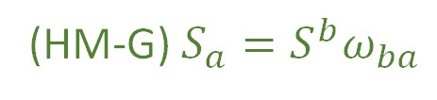
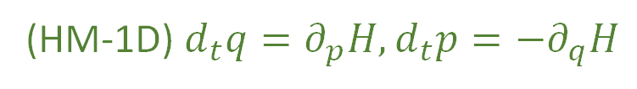
We have found twelve equivalent characterizations for a single degree of freedom
(HM-1D) $d_{t}q=∂_{p}H,d_{t}p=−∂_{q}H$
(HM-G) $S_{a}=S^{b}ω_{ba}$
(DR-DIV) The displacement field for a one dimensional Hamiltonian is divergenceless: $∂_{a}S^{a}=0$
(DR-JAC) The Jacobian of the time evolution is unitary: $\left|∂_{b}{\hat{ξ}}^{a}\right|=1$
(DR-VOL) Volumes are conserved through the evolution: $d{\hat{ξ}}^{1}…d{\hat{ξ}}^{n}=dξ^{1}…dξ^n$
(DR-DEN) Densities are conserved through the evolution: $\hat{ρ}\left({\hat{ξ}}^{a}\right)=ρ\left(ξ^{b}\right)$
(DI-SYMP) The evolution leaves $ω_{ab}$ invariant: ${\hat{ω}}_{ab}=ω_{ab}$
(DI-POI) The evolution leaves the Poisson brackets invariant
(DI-CURL) The rotated displacement field is curl free: $∂_{a}S_{b}−∂_{b}S_{a}=0$
(DR-EV) The evolution is deterministic and reversable
(DR-THER) The evolution is deterministic and thermodynamically Reversible
(DR-INFO) The evolution conserves information entropy
(DR-UNC) The evolution conserves the uncertainty of peaked distributions

Slide 38



Conclusions:
IND-DOF $⟺$ IND-STAT $⟺$ IND-INFO $⟺$ IND-UNC
area is the product of the sides
$$z$$
(IND-DOF) The system is decomposable into independent DOFs
$$y$$
Joint is the product of the marginals
$$x$$
(IND-STAT) The system allows statistically independent distributions over each DOF
$$ρ_{xy}=ρ_{x}ρ_{y}$$
(IND-INFO) The system allows informationally independent distributions
over each DOF
$−∫ρ_{XY}\log{ρ_{XY}}$ $=$ $−∫ρ_{X}\log{ρ_{X}}$ $−∫ρ_{Y}\log{ρ_{Y}}$
(IND-UNC) The system allows peaked distributions where the
uncertainty is the product of the uncertainty on each DOF
$$p_{2}$$
$$p_{1}$$
$$q^{2}$$
covariance matrix
$$q^{1}$$
Notes:
Picture one: area is the product of the sides (all points possible); picture two: is a 2d gaussian with the marginals (to show that the joint is the product of the marginals); picture three: just equation, joint entropy is the sum of the marginal; picture four: ellipses of the covariance matrix aligned with axis, so that the axis of the ellipse project on the axis of the diagrams

Slide 39
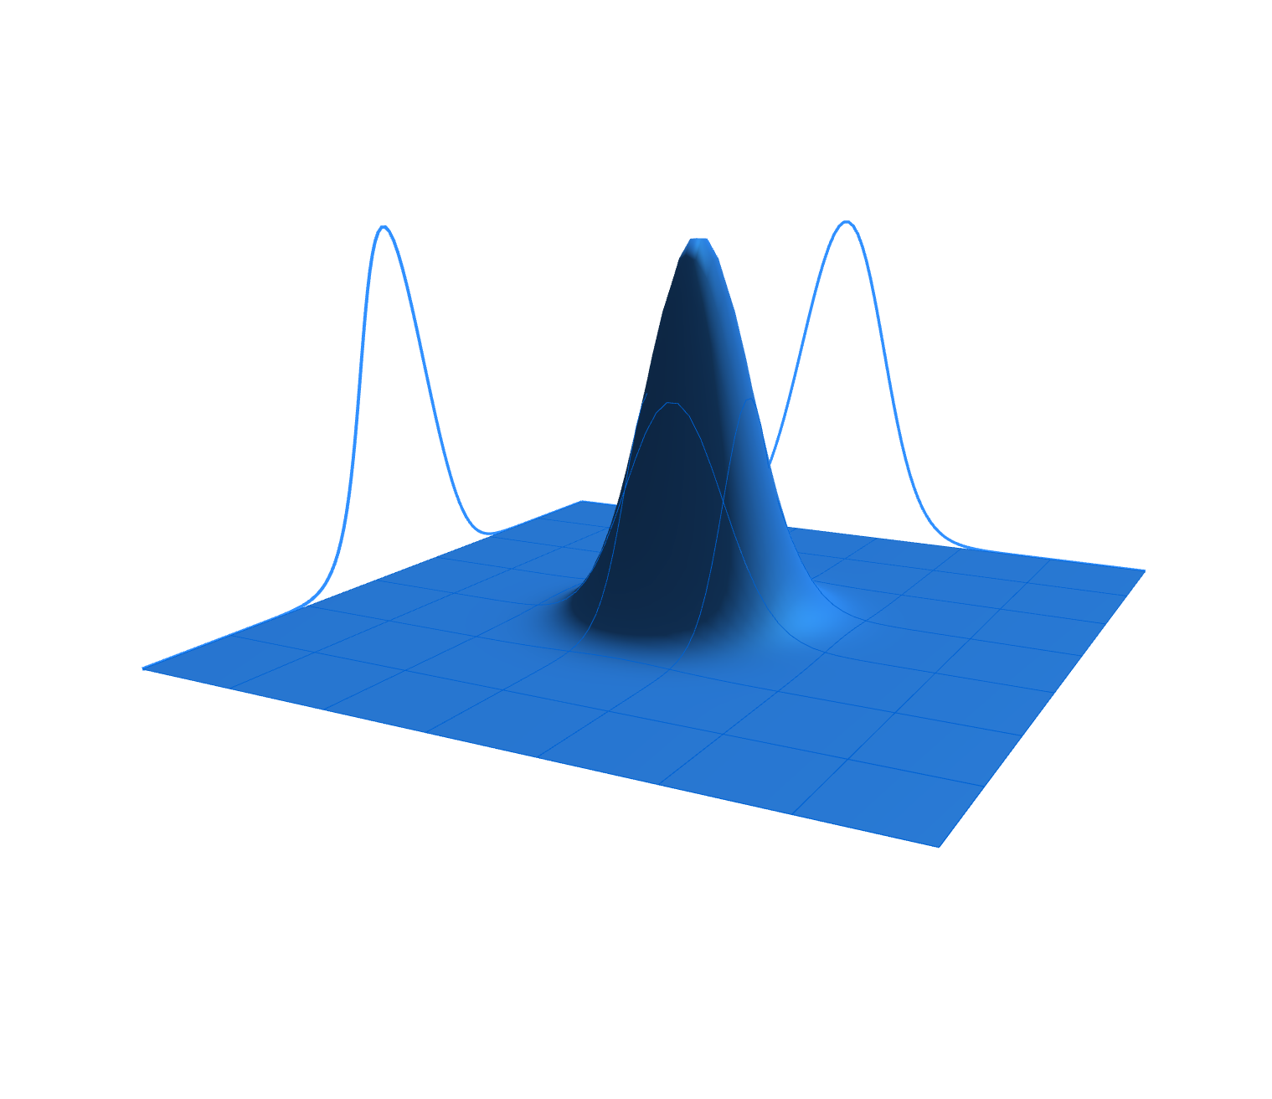
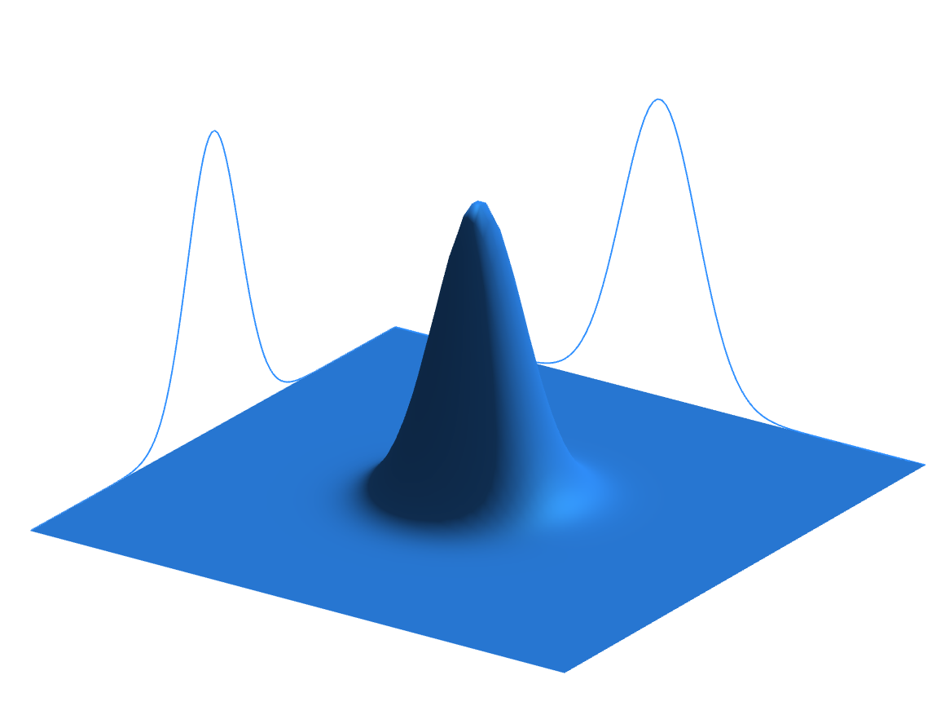
Notes:
I don’t think that you can make the 2-D gaussian in power point

Slide 40

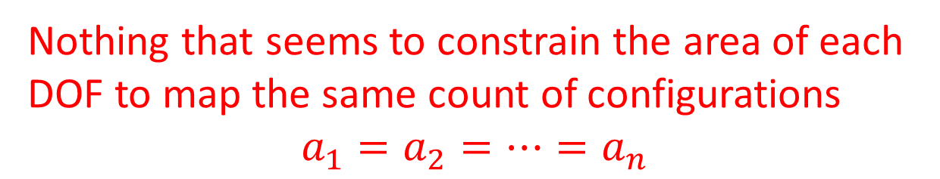



With IND and DR, can we recover $ω_{ab}$?
$ω_{ab}$ needs to return zero across
independent degrees of freedom
$ω_{ab}$ must return the area in
each degree of freedom
$$ω_{ab}=\left[\begin{matrix}0 & 1 \\ −1 & 0\end{matrix}\right]⨂\left[\begin{matrix}a_{1} & 0 & \text{⋯} & 0 \\ 0 & a_{2} & \text{⋯} & 0 \\ \text{⋮} & … & \text{⋱} & \text{⋮} \\ 0 & 0 & \text{⋯} & a_{4}\end{matrix}\right]$$
Nothing that seems to constrain the area of each
DOF to map the same count of configurations
$$a_{1}=a_{2}=…=a_{n}$$
Notes:
TODO: derive omega in steps. Start with just all the omega_qiqj… Then you say: areas withing DOF. Then product of [0 1, -1 0] time matrix. Then: zero across independent DOF. Matrix diagonal. If 1 and 2 are independent, 1 + 2 and 1 – 2 must be independent, all coefficient the same. The coeffient is just a choice of unit. We can find units (i.e. position and conjugate momentum) whose area count states, coefficient is 1.

Slide 41

Note: $q^{i}$ and $p_{i}$ are not only variable that form independent DOFs
If we take two independent DOFs $x$ and $y$, $x+y$, and $x −y$, they will also form
independent degrees of freedom.
rotation on the diagonal matrix
$ω_{ab}$ defines orthogonality for all DOFs $⇒$
coefficients on the diagonal
must be the same
This coefficient represents the freedom we have in choosing the units of
omega with respect to the units of everything else
Therefore expressing the number of configurations with the
same units for all DOFs is necessary to keep track of the
dependency relationship for all degrees of freedom

Slide 42
Our question is now whether DR and IND
are enough to recover HM-ND

Slide 43


IND by itself means the existence of the counting form $ω_{ab}$
DR by itself means the conservation of the total number of states
These two mathematical conditions, by themselves, do not lead to Hamiltonian
mechanics as we need the counting form itself to be conserved
So, we need to know if it makes sense, on physical grounds to have a deterministic
and reversible evolution that can take two independent degrees of
freedom and break their variable independence?
$$(y,p_{2})$$
$$(x,p_{1})$$
Notes:
TODO: can I start with IND (i.e. orthogonal DOF) have DR which conserve

Slide 44

Reasoning:
The only way to make variables no longer independent is to
decrease the number of distinct cases
Cannot happen during deterministic and reversible evolutions!
Also true in the infinite or continuous case, since finite
ranges must be comparable with finite sizes
IND & DR $⇔$ preserving $ω_{ab}⇔$ HM-ND
Connotation:
Two physical conditions taken separately may each impose one mathematical
condition, but it is not necessarily true that imposing them together will only
impose the conjunction of the two mathematical conditions
May indicate that the math we currently
use is not “physically correct”

Slide 45
Reasoning:
The only way to make variables no longer independent is to
decrease the number of distinct cases
Cannot happen during deterministic and reversible evolutions!
Also true in the infinite or continuous case, since finite
ranges must be comparable with finite sizes
Insight: Hamiltonian mechanics is exactly the deterministic and
reversible evolution of a system decomposable into a finite
collection of independent degrees of freedom

Slide 46




Note: Since IND fixes $ω_{ab}$ up to a scalar factor, which could change during the evolution, we
could have the evolution to preserve the independence of DOFs without requiring DR
The volume would stretch or shrink depending on the factor,
stretching or shrinking each DOF by the same amount
Example:
A particle under linear drag in three dimensions
faster particle $⇒$ greater frictional force
$∆p$will become smaller in time
If the friction coefficient is the same for all directions,
all degrees of freedom will shrink at the same rate
tending to zero
Taking the volume as entropy, the only way we can add or remove entropy
to/from a system while preserving IND is by dividing that entropy
contribution equally among each DOF
$$(y,p_{2})$$
preservation of DOF independence gives us
a sort of equipartition of entropy change
$$(x,p_{1})$$
Notes:
TODO: diagram that shrinks all the sides

Slide 47
Conclusion:
We now have a mathematically and physically precise way to
characterize Hamiltonian evolution
Additionally, we have found that Hamiltonian mechanics apply
only to systems described by finitely many independent degrees
of freedom undergoing deterministic and reversible evolution

Slide 49




$$p_{2}$$
$$p_{1}$$
$$q^{2}$$
$$q^{1}$$
$$p_{2}$$
$$p_{1}$$
$$q^{2}$$
$$q^{1}$$
Notes:
TODO: potato diagram is for divergencelessness; Line diagram is for curllessness

Slide 50
Image/images
Notes:
Look at foundations 2016 slides and others for images

Slide 51




Total number of states is the product between the cases in each d.o.f volume is product of the areas→ d.o.f. orthogonal in phase space
$$(y,p_{y})$$
$$(y′,{p′}_{y})$$
$$(x,p_{x})$$
$$(x′,{p′}_{x})$$
Number of cases on each d.o.f. remains the same (area of each d.o.f)
Total number of cases product of all cases (orthogonal d.o.f.)

Slide 52






Relationships within degrees of freedom
Motion preserves area of each independent d.o.f (uncertainty,
entropy and number of states)
$$p_{i}$$
$${p′}_{i}$$
$$x_{i}$$
$$V^{i}×W^{i}=V^{i^{′}}×W^{i^{′}}$$
$${x′}_{i}$$
$$V^{i}\left[\begin{matrix}0 & 1 \\ −1 & 0\end{matrix}\right]W^{i}$$

Slide 53






Relationships within degrees of freedom
Motion preserves area of each independent d.o.f (uncertainty,
entropy and number of states)
$$p_{i}$$
$${p′}_{i}$$
$$x_{i}$$
$$V^{i}×W^{i}=V^{i^{′}}×W^{i^{′}}$$
$${x′}_{i}$$
$$V^{i}\left[\begin{matrix}0 & 1 \\ −1 & 0\end{matrix}\right]W^{i}$$

Slide 54






Relationships across degrees of freedom
Independent d.0.f.
remain perpendicular (remain independent)
$$x_{i}$$
$${x′}_{i}$$
$$V^{i}∙W^{j}=0=V^{i^{′}}∙W^{j^{′}}$$
$$x_{j}$$
$${x′}_{j}$$
$$V^{i}\left[\begin{matrix}… & 0 & 0 \\ 0 & … & 0 \\ 0 & 0 & …\end{matrix}\right]W^{j}$$

Slide 55
















Reversing phase-space
Hamiltonian Privilege, Erkenn (2023)
Stud Hist Phil 71, 082020, 60-71 (2020)
Each unit variable (i.e. coordinate) paired with a conjugate of inverse units: number of states $ΔqΔk$is invariant
$\hat{q}=100 cm/m q$
$$x↦x^{3}$$
$$1$$
$Δk=1 m^{−1}$
$$1$$
$Δ\hat{k}=0.01 cm^{−1}$
$$x$$
$$x^{3}$$
$Δ\hat{q}=100 cm$
$Δq=1 m$
Density, entropy, uniform distributions NOT in general coordinate invariant
Phase space (symplectic) structure is the only one that supports coordinate invariant density, entropy, state count
Only 3 spatial dimensions are possible
Independence of DOFs $⇒$ independence of units $⇒$ orthogonality in phase-space $⇒$ invariant marginals (for density, entropy, state count)
Hamiltonian mechanics preserves count of states and DOF independence over time
2-sphere the only symplectic manifold
$$(q^{y},k_{y})$$
$$ω_{ab}=\left[\begin{matrix}0 & 1 \\ −1 & 0\end{matrix}\right]⊗δ_{j}^{i}$$
Directional DOF
$$(q^{x},k_{x})$$
Orthogonality/independence across DOFs
Total number of states $=$ product of number of cases in each independent DOF
Symplectic form (geometric structure of phase space)
Areas/possibilities in each DOF
Invariance at equal time (relativity) gives us the structure of phase space

Slide 56
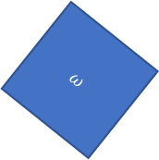



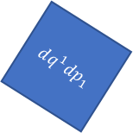




Relativistic mechanics
Lorentzian relativity is the only “correct” one
Minkowski signature appears on the extended phase space
$$ω=dq^{1}dp_{1}+dq^{2}dp_{2}$$
$$ω=dq^{1}dp_{1}−dtdE$$
$$ω$$
$$dq^{1}dp_{1}=ω+dtdE$$
$$dq^{2}dp_{2}$$
$$dq^{1}dp_{1}$$
$$dq^{1}dp_{1}$$
$$dtdE$$
$$ω$$
Indep DOF are orthogonal

Slide 57








$$H(q,p)$$
$$p$$
$H=\frac{p^{2}}{2m}+kq^{2}$
$$4$$
$$3$$
$$2$$
$$H=1$$
$$q$$

Slide 58




$\vec{∇}H\left(q,p\right)=\left[\begin{matrix}∂_{p}H \\ ∂_{q}H\end{matrix}\right]$
$$\vec{∇}H\left(q,p\right)$$
$$p$$
$$4$$
$$3$$
$=\left[\begin{matrix}\frac{p}{m} \\ 2kq\end{matrix}\right]$
$$2$$
$$H=1$$
$$q$$
$H=\frac{p^{2}}{2m}+kq^{2}$

Slide 59




$\vec{S}\left(q,p\right)=\left[\begin{matrix}S^{q} \\ S^{p}\end{matrix}\right]$
$$\vec{S}\left(q,p\right)$$
$$p$$
$$4$$
$$=\left[\begin{matrix}d_{t}q \\ d_{t}p\end{matrix}\right]=\left[\begin{matrix}∂_{p}H \\ −∂_{q}H\end{matrix}\right]$$
$$3$$
$$2$$
$$H=1$$
$$q$$
$$={\text{P}}_{}^{90°}\left(\vec{∇}H\right)$$

Slide 60

Conclusions:
IND-DOF $⟺$ IND-STAT $⟺$ IND-INFO $⟺$ IND-UNC
(IND-DOF) The system is decomposable into independent DOFs
(IND-STAT) The system allows statistically independent distributions
over each DOF
(IND-INFO) The system allows informationally independent distributions
over each DOF
(IND-UNC) The system allows peaked distributions
where the uncertainty is the product of the uncertainty
on each DOF
Notes:
Picture one: area is the product of the sides (all points possible); picture two: is a 2d gaussian with the marginals (to show that the joint is the product of the marginals); picture three: just equation, joint entropy is the sum of the marginal; picture four: ellipses of the covariance matrix aligned with axis, so that the axis of the ellipse project on the axis of the diagrams

Slide 61


Joint is the product of the marginals
Joint Entropy $=$ marginal $1$ $+$ marginal $2+…$marginal $n$
$$p_{2}$$
$$p_{1}$$
$$q^{2}$$
$$(y,p_{y})$$
area is the product of the sides
$$q^{1}$$
$$(x,p_{x})$$
Notes:
Picture one: area is the product of the sides (all points possible); picture two: is a 2d gaussian with the marginals (to show that the joint is the product of the marginals); picture three: just equation, joint entropy is the sum of the marginal; picture four: ellipses of the covariance matrix aligned with axis, so that the axis of the ellipse project on the axis of the diagrams

Slide 62






$ω_{ab}$ defines areas within different degrees
of freedom and the angles between them
$$v^{a}ω_{ab}ω^{b}=0$$
In general relativity and Riemannian geometry, the metric tensor $g_{ij}$
defines the geometry by defining the scalar product between vectors.
$$v^{i}g_{ij}w^{j}=\left|v\right|\left|w\right|cosθ_{vw}$$
$g_{ij}$ defines lengths and angles
$$v^{i}⋅w^{j}=\left|v\right|\left|w\right|cosθ_{vw}$$
Notes:
TODO: add symplectic so that we can compare

Slide 63











$$θ$$
$$w$$
$$v⋅w=\left|v\right|\left|w\right|cos{(θ}_{vw})=\left|v\right|\left|w\right|cos{(θ}_{vw})=$$
$$θ$$
$$φ$$
$$v$$
$$w$$
$${\text{P}}_{}^{90°}v$$
$$φ$$
$$w$$
$$φ$$
$${\text{P}}_{}^{90°}v$$
Notes:
TOTHINK: Show that scalar product is the area with one vector rotated?

Slide 64



$3$ possible Maps:
preserves statistical independence and
variable independence
$X$ to $X$ and $Y$ to $Y$
$XY$ to $XY$
introduces statistical independence but
preserves variable independence
Removes some cases
(map cannot be reversible)
loses variable independence
Notes:
TODO: 3 possible maps. 1) maps X to X and Y to Y (preserves statistical independence) 2) maps XY to XY, scrambling X and Y (introduces statistical independence, but preserve variable independence), 3) removes some cases, but the map cannot be reversible (lose variable independence)

Slide 65

All physical conditions where equivalent to DR-VOL, which is not equivalent to HM-ND
DR-VOL + ? $⇒$ HM-ND
Show that orthogonality = independence
Difference between statistical independence and independence of variable
Show that the 4 IND conditions are equivalent
Show that DR+IND $⇒$ HM-ND
Need a form to count independent configurations for each DOF
Form must be “skew product” time a diagonal matrix
Show that the diagonal matrix must be identity times a coefficient (that can be set to one)
Show that if you start with IND and then DR , IND is conserved

Slide 66


Conditions:
(DR-EV) The evolution is deterministic and reversable
(DR-THER) The evolution is deterministic and thermodynamically Reversible
(DR-INFO) The evolution conserves information entropy
(DR-UNC) The evolution conserves the uncertainty of peaked distributions
Are equivalent to DR-VOL and DR-JAC
DR forces the evolution map to be both bijective and volume preserving
Mathematically, there can be a bijection that is not volume
preserving or a volume preserving map that is not bijective
So we would get that HM-ND $⇒$ DR-EV
Physically independent?
And that HM-ND $⇒$ another physical condition

Slide 67


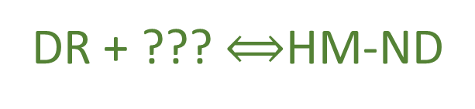
DR
DR-VOL
HM-ND $⇒$ DR-VOL $⟺$ DR
$$⇍$$
DR + ??? $⟺$HM-ND

