Slide 1
The problem with differential geometry
Gabriele Carcassi
Notes:
We are also going to see how units work… because units tells you way you need a differentiable manifold. “I know why you need a manifold, we need to handle spheres!” No, that’s not it. Even in a flat space, when you introduce polar coordinates, you are allowing non-linear coordinates, which break the linear structure. The linear structure can be recovered only locally, through differentiability. And if you don’t understand this… argh! You don’t understand the physics!

Slide 2





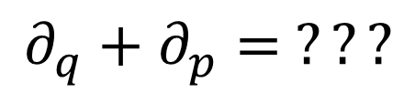



In differential geometry, tangent vectors are derivations
$$v:C^{∞}\left(X\right)→C^{∞}(X)$$
$$v=v^{i}∂_{i}$$
component
basis
In polar coordinates
$$∂_{r}+∂_{θ}= ???$$
$$\left[m\right]$$
$\left[rad\right]$
Doesn’t work with units
In phase space
$$∂_{q}+∂_{p}= ???$$
Mathematically precise $⇏$ physically precise
$\left[m\right]$
$\left[Kg m s^{−1}\right]$

Slide 3
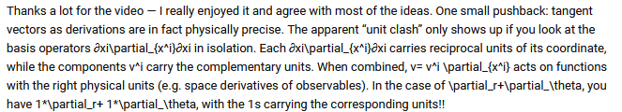

$$1\left[m\right]∂_{r}+1\left[rad\right]∂_{θ}$$

Slide 4










$$V$$
$$+:V×V→V$$
$$e_{1}+e_{2}∈V$$
$$e_{1}$$
$$⋅:ℝ×V→V$$
$$e_{2}$$
$$1e_{1}=e_{1}$$
$$1\left[m\right]∂_{r}≠∂_{r}$$
Can’t be scalar multiplication
These are not in $V$
If this is in $V$
$$v=1\left[m\right]∂_{r}+1\left[rad\right]∂_{θ}$$

Slide 5

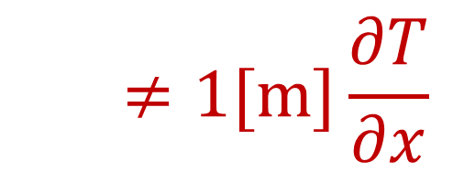



Change of temperature along a direction $\left[K m^{−1}\right]$
$$\frac{∂T}{∂x}≠1[m]\frac{∂T}{∂x}$$
$$T_{1}\left(x\right)=1\frac{K}{m}x$$
$$T_{2}\left(x\right)=1\frac{K}{km}x$$
$$1\left[m\right]\frac{∂T_{1}}{∂x} =1\left[km\right]\frac{∂T_{2}}{∂x}=1K$$

Slide 6


A quantity with a fixed unit is a vector space!
$$1\left[m\right]+3\left[m\right]=4\left[m\right]$$
✓
We can sum (get the same unit) and multiply by a unitless scalar factor (get the same unit)
$$2\left(3\left[m\right]\right)=6\left[m\right]$$
✓

Slide 7


Arrays of quantities form a vector space!
$$\left[\begin{aligned}1 \left[m\right] \\ 3 \left[m\right]\end{aligned}\right]+\left[\begin{aligned}2 \left[m\right] \\ 3 \left[m\right]\end{aligned}\right]=\left[\begin{aligned}3 \left[m\right] \\ 6 \left[m\right]\end{aligned}\right]$$
✓
$$2\left[\begin{aligned}1 \left[m\right] \\ 3 \left[m\right]\end{aligned}\right]=\left[\begin{aligned}2 \left[m\right] \\ 6 \left[m\right]\end{aligned}\right]$$
✓

Slide 8


Units just have to match position in the array
$$\left[\begin{aligned}1 \left[m\right] \\ π \left[rad\right]\end{aligned}\right]+\left[\begin{aligned}2 \left[m\right] \\ π \left[rad\right]\end{aligned}\right]=\left[\begin{aligned}3 \left[m\right] \\ 2π \left[rad\right]\end{aligned}\right]$$
✓
$$2\left[\begin{aligned}1 \left[m\right] \\ π \left[rad\right]\end{aligned}\right]=\left[\begin{aligned}2 \left[m\right] \\ 2π \left[rad\right]\end{aligned}\right]$$
✓

Slide 9









Coordinate transformations are maps between DIFFERENT vector spaces
$$B$$
Cartesian coordinates $\left[m\right] \left[m\right]$
Polar coordinates $\left[m\right] \left[rad\right]$
$$A$$
$$\left[\begin{aligned}1 \left[m\right] \\ 0 \left[m\right]\end{aligned}\right]$$
$$B$$
$$\left[\begin{aligned}0 \left[m\right] \\ 1 \left[m\right]\end{aligned}\right]$$
$$A$$
$$\left[\begin{aligned}1 \left[m\right] \\ 0 \left[rad\right]\end{aligned}\right]$$
$$B$$
$$\left[\begin{aligned}1 \left[m\right] \\ π/2 \left[rad\right]\end{aligned}\right]$$
$$A$$
$$\left[\begin{aligned}1 \left[m\right] \\ 0 \left[m\right]\end{aligned}\right]+\left[\begin{aligned}1 \left[m\right] \\ π/2 \left[rad\right]\end{aligned}\right]$$

Slide 10










Linearity is not preserved!!!
$$D$$
Cartesian coordinates $\left[m\right] \left[m\right]$
Polar coordinates $\left[m\right] \left[rad\right]$
$$B$$
$$C$$
$$A$$
$$\left[\begin{aligned}1 \left[m\right] \\ 0 \left[m\right]\end{aligned}\right]$$
$$B$$
$$\left[\begin{aligned}0 \left[m\right] \\ 1 \left[m\right]\end{aligned}\right]$$
$$A$$
$$\left[\begin{aligned}1 \left[m\right] \\ 0 \left[rad\right]\end{aligned}\right]$$
$$B$$
$$\left[\begin{aligned}1 \left[m\right] \\ π/2 \left[rad\right]\end{aligned}\right]$$
$$A$$
$$A+B=C$$
$$\left[\begin{aligned}1 \left[m\right] \\ 1 \left[m\right]\end{aligned}\right]$$
$$A+B=D$$
$$\left[\begin{aligned}2 \left[m\right] \\ π/2 \left[rad\right]\end{aligned}\right]$$
This is why the position vector does not work!

Slide 11


Coordinate transformations are not continuous over the whole space
Angle $θ$ at the origin is not unique
Angle $θ$ is discontinuous at $0$
This is why we need manifolds!

Slide 12
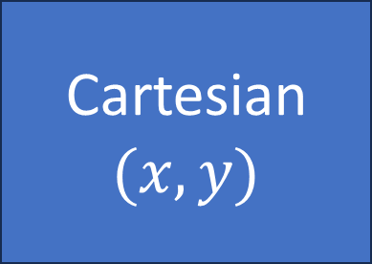
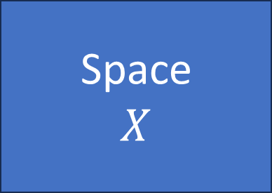


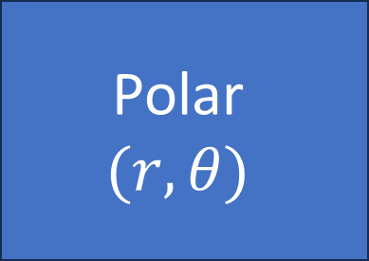
Manifold: set of points with different coordinates
Invertible (and continuous) where defined
Cartesian$(x,y)$
Coordinate charts have units!
$$X_{C}(x,y)$$
No linear structure
Space $$X$$
Polar $$(r,θ)$$
$$X_{P}(r,θ)$$

Slide 13


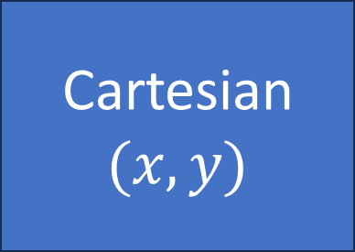
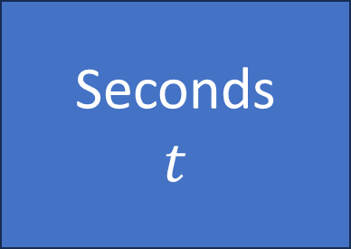

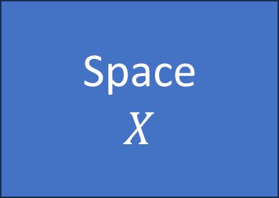






Seconds $$t$$
Cartesian$(x,y)$
$$T_{s}(t)$$
$$γ:T→X$$
$$X_{C}(x,y)$$
Time $$T$$
Space $$X$$
Hours $$h$$
Polar $$(r,θ)$$
$$T_{h}(h)$$
$$X_{P}(r,θ)$$
$$\left[x\left(t\right) y\left(t\right)\right]=X_{C}^{−1}(γ\left(T_{s}\left(t\right)\right)$$

Slide 14
Differentiable map: preserves local linear structure (tangents are mapped to other tangents)
Infinitesimal displacements along a direction remain infinitesimal displacements along a direction!

Slide 15

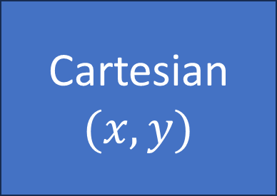


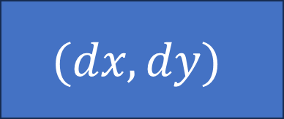




Differentiable manifold: infinitesimal displacements
Cartesian$(x,y)$
$$X_{C}(x,y)$$
Space $$X$$
Covariant/contravariant bases are actually maps from/to differentials of physical quantities to/from differentials of the space!
$$e_{x}=\frac{dX}{dx}$$
$$(dx,dy)$$
$$dX$$
$$e^{x}=\frac{dx}{dX}$$
$$dX=\frac{dX}{d[x y]}\left[dx dy\right]=e_{x}dx+e_{y}dy$$
$$dx=\frac{dx}{dX}dX=e^{x}dX$$

Slide 16




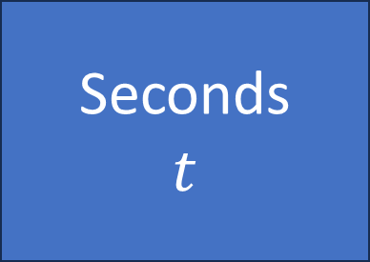

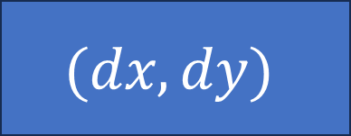



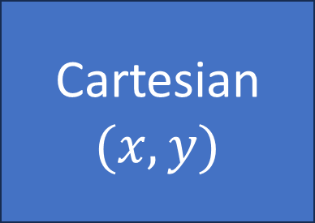



$$T_{s}(t)$$
$$γ:T→X$$
$$X_{C}(x,y)$$
Seconds $$t$$
Time $$T$$
Space $$X$$
Cartesian$(x,y)$
$$dt$$
$$dT$$
$$dX$$
$$(dx,dy)$$
$$e_{t}=\frac{dT}{dt}$$
$$v=\frac{dX}{dT}$$
$$e_{x}=\frac{dX}{dx}$$
In general, in physics “geometric” tensors are maps between differentials (variations)

