Slide 1
The problem with differential geometry
Gabriele Carcassi
Notes:
In a previous videos I quickly showed how tangent spaces in terms of derivation do not work in physics, because the units do not work. This is an example of how mathematical structures defined by mathematicians can be different from the type of structures we need in physics. There were a few comments that pushed back on that with the same objection… so I decided to make a video about it.

Slide 2





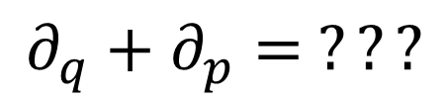



In differential geometry, tangent vectors are derivations
$$v:C^{∞}\left(X\right)→C^{∞}(X)$$
$$v=v^{i}∂_{i}$$
component
basis
In polar coordinates
$$∂_{r}+∂_{θ}= ???$$
$$\left[m\right]$$
$\left[rad\right]$
Doesn’t work with units
In phase space
$$∂_{q}+∂_{p}= ???$$
Mathematically precise $⇏$ physically precise
$\left[m\right]$
$\left[Kg m s^{−1}\right]$

Slide 3

$$1\left[m\right]∂_{r}+1\left[rad\right]∂_{θ}$$

Slide 4










$$V$$
$$+:V×V→V$$
$$e_{1}+e_{2}∈V$$
$$e_{1}$$
$$⋅:ℝ×V→V$$
$$e_{2}$$
$$1e_{1}=e_{1}$$
$$1\left[m\right]∂_{r}≠∂_{r}$$
Can’t be scalar multiplication
These are not in $V$
If this is in $V$
$$v=1\left[m\right]∂_{r}+1\left[rad\right]∂_{θ}$$

Slide 5

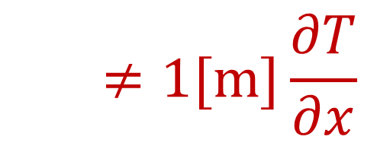



Change of temperature along a direction $\left[K m^{−1}\right]$
$$\frac{∂T}{∂x}≠1[m]\frac{∂T}{∂x}$$
$$T_{1}\left(x\right)=1\frac{K}{m}x$$
$$T_{2}\left(x\right)=1\frac{K}{km}x$$
$$1\left[m\right]\frac{∂T_{1}}{∂x} =1\left[km\right]\frac{∂T_{2}}{∂x}=1K$$

Slide 6


A quantity with a fixed unit is a vector space!
$$1\left[m\right]+3\left[m\right]=4\left[m\right]$$
✓
We can sum (get the same unit) and multiply by a unitless scalar factor (get the same unit)
$$2\left(3\left[m\right]\right)=6\left[m\right]$$
✓

Slide 7


Arrays of quantities form a vector space!
$$\left[\begin{aligned}1 \left[m\right] \\ 3 \left[m\right]\end{aligned}\right]+\left[\begin{aligned}2 \left[m\right] \\ 3 \left[m\right]\end{aligned}\right]=\left[\begin{aligned}3 \left[m\right] \\ 6 \left[m\right]\end{aligned}\right]$$
✓
$$2\left[\begin{aligned}1 \left[m\right] \\ 3 \left[m\right]\end{aligned}\right]=\left[\begin{aligned}2 \left[m\right] \\ 6 \left[m\right]\end{aligned}\right]$$
✓

Slide 8


Units just have to match position in the array
$$\left[\begin{aligned}1 \left[m\right] \\ π \left[rad\right]\end{aligned}\right]+\left[\begin{aligned}2 \left[m\right] \\ π \left[rad\right]\end{aligned}\right]=\left[\begin{aligned}3 \left[m\right] \\ 2π \left[rad\right]\end{aligned}\right]$$
✓
$$2\left[\begin{aligned}1 \left[m\right] \\ π \left[rad\right]\end{aligned}\right]=\left[\begin{aligned}2 \left[m\right] \\ 2π \left[rad\right]\end{aligned}\right]$$
✓

Slide 9









Coordinate transformations are maps between DIFFERENT vector spaces
$$B$$
Cartesian coordinates $\left[m\right] \left[m\right]$
Polar coordinates $\left[m\right] \left[rad\right]$
$$A$$
$$\left[\begin{aligned}1 \left[m\right] \\ 0 \left[m\right]\end{aligned}\right]$$
$$B$$
$$\left[\begin{aligned}0 \left[m\right] \\ 1 \left[m\right]\end{aligned}\right]$$
$$A$$
$$\left[\begin{aligned}1 \left[m\right] \\ 0 \left[rad\right]\end{aligned}\right]$$
$$B$$
$$\left[\begin{aligned}1 \left[m\right] \\ π/2 \left[rad\right]\end{aligned}\right]$$
$$A$$
$$\left[\begin{aligned}1 \left[m\right] \\ 0 \left[m\right]\end{aligned}\right]+\left[\begin{aligned}1 \left[m\right] \\ π/2 \left[rad\right]\end{aligned}\right]$$

Slide 10










Linearity is not preserved!!!
$$D$$
Cartesian coordinates $\left[m\right] \left[m\right]$
Polar coordinates $\left[m\right] \left[rad\right]$
$$B$$
$$C$$
$$A$$
$$\left[\begin{aligned}1 \left[m\right] \\ 0 \left[m\right]\end{aligned}\right]$$
$$B$$
$$\left[\begin{aligned}0 \left[m\right] \\ 1 \left[m\right]\end{aligned}\right]$$
$$A$$
$$\left[\begin{aligned}1 \left[m\right] \\ 0 \left[rad\right]\end{aligned}\right]$$
$$B$$
$$\left[\begin{aligned}1 \left[m\right] \\ π/2 \left[rad\right]\end{aligned}\right]$$
$$A$$
$$A+B=C$$
$$\left[\begin{aligned}1 \left[m\right] \\ 1 \left[m\right]\end{aligned}\right]$$
$$A+B=D$$
$$\left[\begin{aligned}2 \left[m\right] \\ π/2 \left[rad\right]\end{aligned}\right]$$
This is why the position vector does not work!

Slide 11


Coordinate transformations are not continuous over the whole space
Angle $θ$ at the origin is not unique
Angle $θ$ is discontinuous at $0$
This is why we need manifolds!

Slide 12
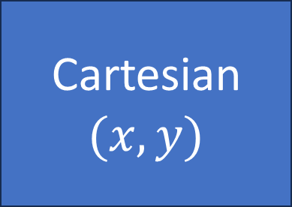
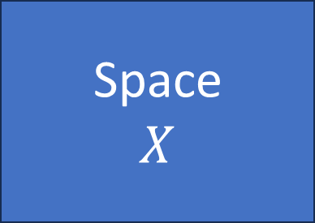


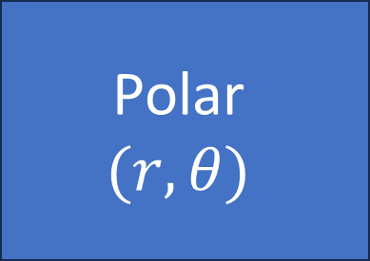
Manifold: set of points with different coordinates
Invertible (and continuous) where defined
Cartesian$(x,y)$
Coordinate charts have units!
$$X_{C}(x,y)$$
No linear structure
Space $$X$$
Polar $$(r,θ)$$
$$X_{P}(r,θ)$$

Slide 13


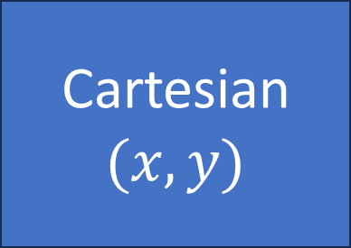
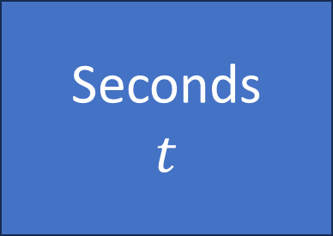

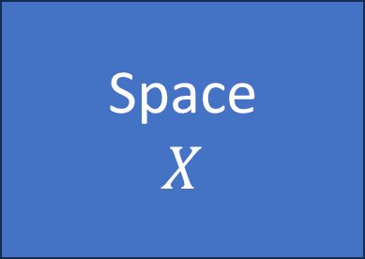






Seconds $$t$$
Cartesian$(x,y)$
$$T_{s}(t)$$
$$γ:T→X$$
$$X_{C}(x,y)$$
Time $$T$$
Space $$X$$
Hours $$h$$
Polar $$(r,θ)$$
$$T_{h}(h)$$
$$X_{P}(r,θ)$$
$$\left[x\left(t\right) y\left(t\right)\right]=X_{C}^{−1}(γ\left(T_{s}\left(t\right)\right)$$

Slide 14
Differentiable map: preserves local linear structure (tangents are mapped to other tangents)
Infinitesimal displacements along a direction remain infinitesimal displacements along a direction!

Slide 15

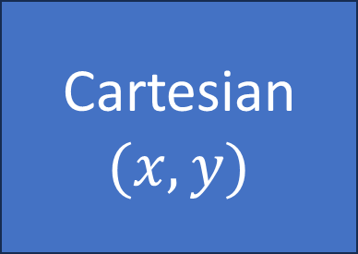


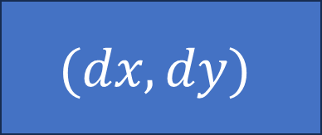




Differentiable manifold: infinitesimal displacements
Cartesian$(x,y)$
$$X_{C}(x,y)$$
Space $$X$$
Covariant/contravariant bases are actually maps from/to differentials of physical quantities to/from differentials of the space!
$$e_{x}=\frac{dX}{dx}$$
$$(dx,dy)$$
$$dX$$
$$e^{x}=\frac{dx}{dX}$$
$$dX=\frac{dX}{d[x y]}\left[dx dy\right]=e_{x}dx+e_{y}dy$$
$$dx=\frac{dx}{dX}dX=e^{x}dX$$

Slide 16




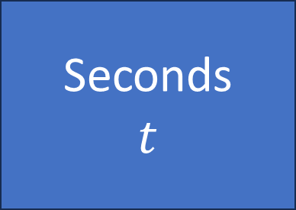

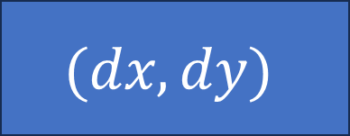



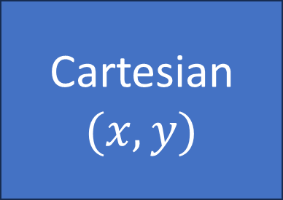



$$T_{s}(t)$$
$$γ:T→X$$
$$X_{C}(x,y)$$
Seconds $$t$$
Time $$T$$
Space $$X$$
Cartesian$(x,y)$
$$dt$$
$$dT$$
$$dX$$
$$(dx,dy)$$
$$e_{t}=\frac{dT}{dt}$$
$$v=\frac{dX}{dT}$$
$$e_{x}=\frac{dX}{dx}$$
In general, in physics “geometric” tensors are maps between differentials (variations)

