Slide 1
Units are harder than you think
Gabriele Carcassi
Notes:
If you never thought too hard about units, you’ll think that given two quantities, the unit of their product is fully determined by the units of the original. Meters times meters? Meter squared! Meters times radian? Meters! Or that operations on units are operations on physical dimensions. Meters over time? Velocity! Joules over meters cubed? Pressure! Or that the way you convert one unit to another depends only on the units. Kilometers in meters? Multiply by a thousand! Celsius to Kelvin? Add 273.15! While these three expectations are met most of the time… there are counter-examples. The reason I know is that twenty years ago I wrote a prototype C-like language that would understand units and physical dimensions. Turns out, you can’t write simple rules to manipulate units and physical dimensions alongside numbers… because to properly handles units, you have to fully understand the physics of the problem. Units and physical dimensions are harder, and more interesting than you think. They force you to understand the physics. That is why I think the trend in advanced theoretical physics to disregard units… it’s just madness.
Anway, units! Let go through those three counter-examples!

Slide 2
The unit of the product is fully determined by the units of the arguments

Slide 3







$θ$ [$rad$]
$r$ [$m$] $h$ [$m$]
Area: $θrh$ [$m^{2}$]
$$h$$
$θr$ [$m$]
$θh$ [$m⋅rad$]
$$r$$
$$θ$$

Slide 4
The unit of the product is fully determined by the units of the arguments
Relationships between quantities matter. Watch out for ratio-like quantities, like angles, solid angles, dB, etc…

Slide 5
Operations on units are operations on physical dimensions

Slide 6






Pressure: $P=\frac{F}{A}$
$$F$$
$$1 Pa=\frac{1 N}{1 m^{2}}$$
$$A$$
In thermodynamics: $P=\frac{∂U}{∂V}$
$$1 Pa=\frac{1 J}{1 m^{3}}$$
Pressure is a type of energy density
But…

Slide 7
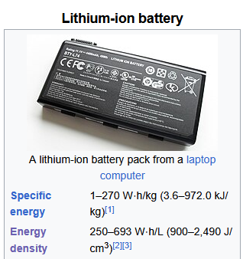
Not all energy density is pressure!
Would not make sense to give it in Pascals!
wikipedia

Slide 8
Operations on units are operations on physical dimensions
The relationships between physical quantities have to be “correct” to lead to the appropriate physical dimension

Slide 9
Value conversion depends only on the initial and final unit

Slide 10
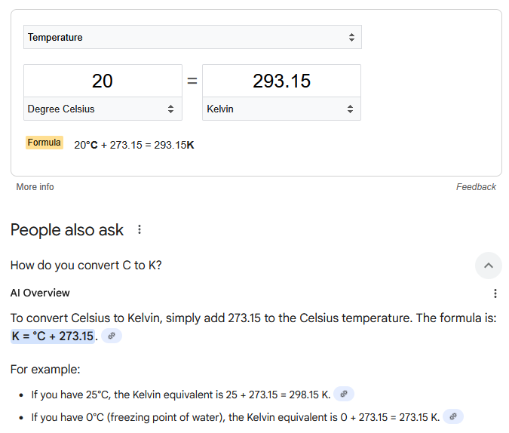
Converting Celsius into Kelvin
The high and low temperatures for today are 31 and 19 °C. The temperature variation is 12 °C.
The high and low temperatures for today are 304.15 and 292.15 K. The temperature variation is 285.15 K.

Slide 11
Value conversion depends only on the initial and final unit

Slide 12
Yeah, but…

