Slide 1
Multiple degrees of Freedom
Gabriele Carcassi

Slide 2






Hamilton’s Equations for Multiple Degrees of Freedom
$$d_{t}q^{i}=∂_{p_{i}}H$$
$$d_{t}p_{i}=−∂_{q^{i}}H$$
(HM-ND)
$$ξ^{a}=[q^{i}, p^{i}]$$
$$S^{a}=d_{t}ξ^{a}=[d_{t}q^{i},d_{t}p^{i}]$$
$$S^{q^{i}}=∂_{p_{i}}H$$
$$S^{p_{i}}=−∂_{q^{i}}H$$

Slide 3








$$\left[ω_{ab}\right]=\left[\begin{matrix}ω_{q^{i}q^{j}} & ω_{q^{i}p_{j}} \\ ω_{p_{i}q^{j}} & ω_{p_{i}p_{j}}\end{matrix}\right]$$
$$ω=\left[\begin{matrix}0 & 1 \\ −1 & 0\end{matrix}\right]⊗I_{n}$$
$$\vec{S}=ω \vec{∇}H$$
$$S^{b}ω_{ba}=∂_{a}H$$
Same as single degree of freedom,
except that now there are multiple
ways to do the rotation, but only the
one defined by $ω_{ab}$ works
$$\left[\begin{matrix}S^{q^{i}} \\ S^{p_{i}}\end{matrix}\right]=\left[\begin{matrix}0 & I_{n} \\ −I_{n} & 0\end{matrix}\right]\left[\begin{matrix}∂_{q^{i}}H \\ ∂_{p_{i}}H\end{matrix}\right]$$
$$=\left[\begin{matrix}∂_{p_{i}}H \\ −∂_{q^{i}}H\end{matrix}\right]$$
$$S^{q^{i}}ω_{q^{i}p_{i}}=∂_{p_{i}}H$$
$$S^{p_{i}}ω_{p_{i}q^{i}}=∂_{q^{i}}H$$
(SF-ND)

Slide 4
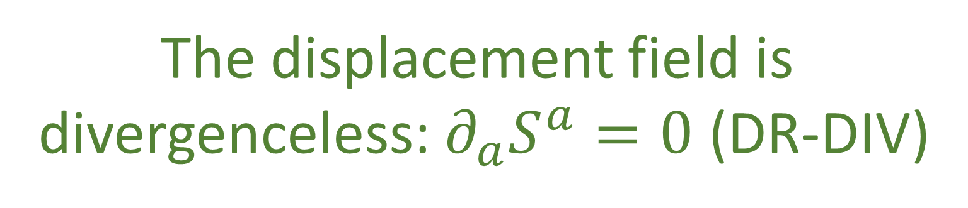

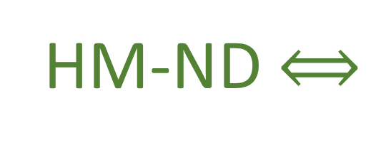
$$∂_{a}S^{a}=∂_{q^{i}}S^{q^{i}}+∂_{p_{i}}S^{p_{i}}=∂_{q^{i}}∂_{p_{i}}H−∂_{p_{i}}∂_{q^{i}}H$$
$$∂_{a}S^{a}=0$$
HM-ND $⟺$
The displacement field is
divergenceless: $∂_{a}S^{a}=0$ (DR-DIV)

Slide 5








$$\text{Let} \hat{q} \text{and} \hat{p} \text{represent} \text{the} \text{evolution} \text{of} q \text{and} p$$
$$p$$
$$\text{after} \text{an} \text{infinitesimal} \text{time} \text{step} δt\text{:}$$
$${\hat{p}}_{i}=p_{i}+S^{p_{i}}δt$$
$${\hat{q}}^{i}=q^{i}+S^{q^{i}}δt$$
$$∂_{b}{\hat{ξ}}^{a}=\left[\begin{matrix}δ_{j}^{i}+∂_{q^{j}}S^{q^{i}}δt & ∂_{p_{j}}S^{q^{i}}δt \\ ∂_{q^{j}}S^{p_{i}}δt & δ_{i}^{j}+∂_{p_{j}}S^{p_{i}}δt\end{matrix}\right]$$
$$q$$
$$\left|∂_{b}{\hat{ξ}}^{a}\right|=\left|δ_{j}^{i}+∂_{q^{j}}S^{q^{i}}δt\right|\left|δ_{i}^{j}+∂_{p_{j}}S^{p_{i}}δt\right|−\left|∂_{p_{j}}S^{q^{i}}δt\right|\left|∂_{q^{j}}S^{p_{i}}δt\right|$$
$$=1+\left(∂_{q^{i}}S^{q^{i}}+∂_{p_{i}}S^{p_{i}}\right)δt+O(δt^{2})$$
$$=1$$
$∂_{a}S^{a}$!!!

Slide 6
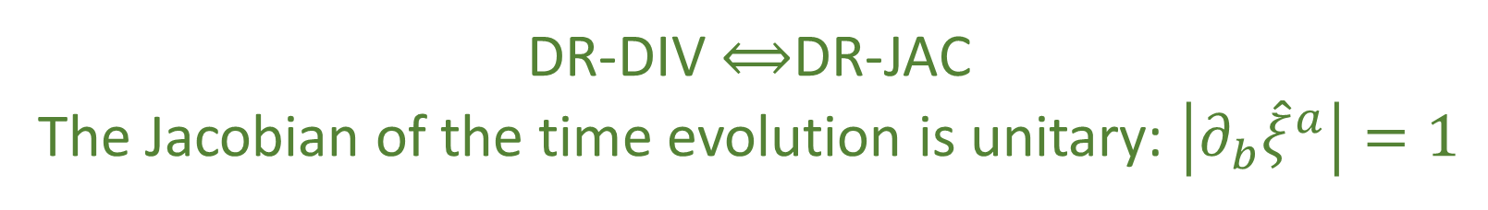



$\left|∂_{b}{\hat{ξ}}^{a}\right|=1$ $⟺$ $∂_{a}S^{a}=0$
DR-DIV $⟺$DR-JAC
The Jacobian of the time evolution is unitary: $\left|∂_{b}{\hat{ξ}}^{a}\right|=1$
The Jacobian is still the multiplicative factor between past and future areas and densities
$$⇒$$
Volumes are conserved through the evolution: $d{\hat{ξ}}^{1}…d{\hat{ξ}}^{n}=dξ^{1}…dξ^n$ (DR-VOL)
Densities are conserved through the evolution: $\hat{ρ}\left({\hat{ξ}}^{a}\right)=ρ\left(ξ^{b}\right)$ (DR-DEN)
DR-DIV $⟺$DR-JAC $⟺$ DR-VOL $⟺$ DR-DEN

Slide 8
Image/images
Notes:
Look at foundations 2016 slides and others for images

Slide 9




Total number of states is the product between the cases in each d.o.f volume is product of the areas→ d.o.f. orthogonal in phase space
$$(y,p_{y})$$
$$(y′,{p′}_{y})$$
$$(x,p_{x})$$
$$(x′,{p′}_{x})$$
Number of cases on each d.o.f. remains the same (area of each d.o.f)
Total number of cases product of all cases (orthogonal d.o.f.)

Slide 10






Relationships within degrees of freedom
Motion preserves area of each independent d.o.f (uncertainty,
entropy and number of states)
$$p_{i}$$
$${p′}_{i}$$
$$x_{i}$$
$$V^{i}×W^{i}=V^{i^{′}}×W^{i^{′}}$$
$${x′}_{i}$$
$$V^{i}\left[\begin{matrix}0 & 1 \\ −1 & 0\end{matrix}\right]W^{i}$$

Slide 11


Relationships within degrees of freedom
Motion preserves area of each independent d.o.f (uncertainty,
entropy and number of states)
$$p_{i}$$
$${p′}_{i}$$
$$x_{i}$$
$$V^{i}×W^{i}=V^{i^{′}}×W^{i^{′}}$$
$${x′}_{i}$$
$$V^{i}\left[\begin{matrix}0 & 1 \\ −1 & 0\end{matrix}\right]W^{i}$$

Slide 12






Relationships across degrees of freedom
Independent d.0.f.
remain perpendicular (remain independent)
$$x_{i}$$
$${x′}_{i}$$
$$V^{i}∙W^{j}=0=V^{i^{′}}∙W^{j^{′}}$$
$$x_{j}$$
$${x′}_{j}$$
$$V^{i}\left[\begin{matrix}… & 0 & 0 \\ 0 & … & 0 \\ 0 & 0 & …\end{matrix}\right]W^{j}$$

Slide 13
















Reversing phase-space
Hamiltonian Privilege, Erkenn (2023)
Stud Hist Phil 71, 082020, 60-71 (2020)
Each unit variable (i.e. coordinate) paired with a conjugate of inverse units: number of states $ΔqΔk$is invariant
$\hat{q}=100 cm/m q$
$$x↦x^{3}$$
$$1$$
$Δk=1 m^{−1}$
$$1$$
$Δ\hat{k}=0.01 cm^{−1}$
$$x$$
$$x^{3}$$
$Δ\hat{q}=100 cm$
$Δq=1 m$
Density, entropy, uniform distributions NOT in general coordinate invariant
Phase space (symplectic) structure is the only one that supports coordinate invariant density, entropy, state count
Only 3 spatial dimensions are possible
Independence of DOFs $⇒$ independence of units $⇒$ orthogonality in phase-space $⇒$ invariant marginals (for density, entropy, state count)
Hamiltonian mechanics preserves count of states and DOF independence over time
2-sphere the only symplectic manifold
$$(q^{y},k_{y})$$
$$ω_{ab}=\left[\begin{matrix}0 & 1 \\ −1 & 0\end{matrix}\right]⊗δ_{j}^{i}$$
Directional DOF
$$(q^{x},k_{x})$$
Orthogonality/independence across DOFs
Total number of states $=$ product of number of cases in each independent DOF
Symplectic form (geometric structure of phase space)
Areas/possibilities in each DOF
Invariance at equal time (relativity) gives us the structure of phase space

Slide 14







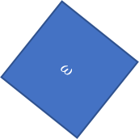
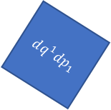
Relativistic mechanics
Lorentzian relativity is the only “correct” one
Minkowski signature appears on the extended phase space
$$ω=dq^{1}dp_{1}+dq^{2}dp_{2}$$
$$ω=dq^{1}dp_{1}−dtdE$$
$$ω$$
$$dq^{1}dp_{1}=ω+dtdE$$
$$dq^{2}dp_{2}$$
$$dq^{1}dp_{1}$$
$$dq^{1}dp_{1}$$
$$dtdE$$
$$ω$$
Indep DOF are orthogonal

