Slide 1
Born rule is entropy
Gabriele Carcassi
Notes:
The Born rule is one of the core components of quantum mechanics. It tells us what the probability to measure a state given that another one was prepared. This gives the mistaken impression that quantum mechanics is about measurements… it’s not. It’s about preparations. The unavoidable variability, uncertainty, that is intrinsic in every preparations. So, we are going to show that the Born rule is equivalent to characterize the entropy, the variability, of preparations. That is, the probability of measuring one state given that another one was prepared can be derived from the entropy of an equal mixture of those two states. The Born rule is entropy, and entropy is the Born rule. Orthogonal states are mutually exclusive states, those that can be prepared under the same conditions. There are a lot of things to say… but I have to keep the video short because I have been busy with conferences, workshops and summer school. So, we’ll just see the Born rule… geometrically! The entropy… geometrically! And how one can be derived from another…. Geometrically! Yes, we are going to use Euclidean geometry and trigonometry, what you learned in your first year of high school… is that when people learn trigonometry? Anyway, no complex numbers, no Hilbert spaces. Let’s get started!

Slide 2

Born rule
Probability of measuring $ψ$ given that I have prepared $φ$
$$p\left(ψ | φ\right)=\frac{\left\langle ψ | φ\right\rangle \left\langle φ | ψ\right\rangle }{\left\langle ψ | ψ\right\rangle \left\langle φ | φ\right\rangle }$$

Slide 3










Born rule
$$ψ$$
$$ψ$$
$$φ$$
$$C$$
$$φ$$
$$θ$$
$$p\left(ψ | φ\right)$$
Vertical distance from the opposite point of $ψ$
$$ψ^{⊥}$$
$$p\left(ψ | φ\right)=\frac{Cψ^{⊥}}{ψψ^{⊥}}=\frac{1+\cos{θ}}{2}=\cos^{2}{\frac{θ}{2}}$$

Slide 4












Born rule
$$ψ$$
$$∠ψφψ^{⊥}={90}^{∘}$$
$∠ψψ^{⊥}φ=\frac{θ}{2}$
$$φ$$
$$C$$
$φψ^{⊥}=ψψ^{⊥}\cos{\frac{θ}{2}}$
$$θ$$
$Cψ^{⊥}=φψ^{⊥}\cos{\frac{θ}{2}}=ψψ^{⊥}\cos^{2}{\frac{θ}{2}}$
$$p\left(ψ | φ\right)$$
$\frac{θ}{2}$
$p\left(ψ | φ\right)=\frac{Cψ^{⊥}}{ψψ^{⊥}}=\cos^{2}{\frac{θ}{2}}$
$$ψ^{⊥}$$

Slide 5

Born rule
$$ψ$$
$$φ$$
$p\left(ψ | φ\right)=\frac{1+\cos{θ}}{2}=\cos^{2}{\frac{θ}{2}}$
$$C$$
$$θ$$
Born rule is an invertible function of the angle on the Bloch sphere!
$$p\left(ψ | φ\right)$$
$\frac{θ}{2}$
$$ψ^{⊥}$$

Slide 6

Von Neumann entropy
Entropy of a mixed state $ρ=\sum_{i}{p_{i}\left|b_{i}\right\rangle \left\langle b_{i}\right|}$
$S\left(ρ\right)=−tr\left(ρ\log{ρ}\right)=−\sum_{i}{p_{i}\log{p_{i}}}$

Slide 7










Von Neumann entropy
$$b_{1}$$
$$b_{1}$$
$$ρ=p_{1}\left|b_{1}\right\rangle \left\langle b_{1}\right|+p_{2}\left|b_{2}\right\rangle \left\langle b_{2}\right|$$
$$p_{2}$$
$$ρ$$
$$ρ$$
$$p_{1}$$
$$b_{2}$$
$$b_{2}$$
$$S\left(ρ\right)=−p_{1}\log{p_{1}}−p_{2}\log{p_{2}}$$

Slide 8
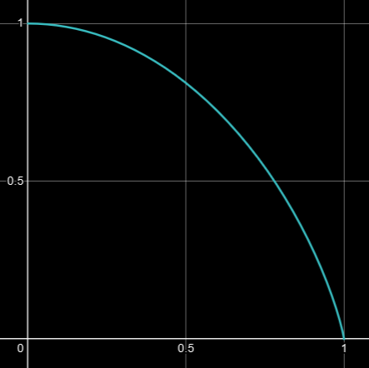











Von Neumann entropy
$$S\left(ρ\right)$$
$$b_{1}$$
$$S\left(ρ\right)$$
$$p_{2}$$
$$ρ$$
$$=−p_{1}\log{p_{1}}$$ $−p_{2}\log{p_{2}}$
$$r$$
$$p_{1}$$
$$r$$
$=−\frac{1+r}{2}\log{\frac{1+r}{2}}$ $−\frac{1−r}{2}\log{\frac{1−r}{2}}$
$$b_{2}$$

Slide 9

Von Neumann entropy
$$b_{1}$$
$$p_{2}$$
$S\left(ρ\right)=−\frac{1+r}{2}\log{\frac{1+r}{2}}−\frac{1−r}{2}\log{\frac{1−r}{2}}$
$$ρ$$
$$r$$
for a two-state system
Entropy is an invertible function of the radial distance in the Bloch ball!
$$p_{1}$$
$$b_{2}$$

Slide 10








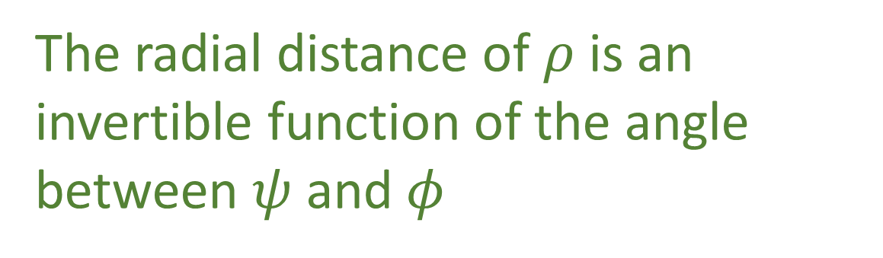
Link between Born rule and entropy
$ρ=\frac{1}{2}\left|ψ\right\rangle \left\langle ψ\right|+\frac{1}{2}\left|φ\right\rangle \left\langle φ\right|$
$$φ$$
$$ρ$$
The radial distance of $ρ$ is an invertible function of the angle between $ψ$ and $φ$
$$ψ^{⊥}$$
$$O$$
$$ψ$$
$$C$$
$$p\left(ψ | φ\right)⟺θ⟺r⟺S\left(ρ\right)$$

Slide 11











Let’s find the relationship between $θ$ and $r$!
$$φ$$
$$ρ$$
$$b_{1}$$
$$O$$
$$ψ$$
$$r=Oρ=\cos{θ_{ψb_{1}}}=\cos{\frac{θ_{ψφ}}{2}}=\sqrt{p\left(ψ | φ\right)}$$
$$b_{2}$$
$$S\left(ρ\right)$$
$S\left(ρ\right)=−\frac{1+\sqrt{p}}{2}\log{\frac{1+\sqrt{p}}{2}}$ $−\frac{1−\sqrt{p}}{2}\log{\frac{1−\sqrt{p}}{2}}$
$$\sqrt{p\left(ψ | φ\right)}$$

Slide 12

Let’s see this relationship geometrically!
$$r=\sqrt{p\left(ψ | φ\right)}$$

Slide 13








$$φ$$
$$ρ$$
$$r$$
$$p\left(ψ | φ\right)$$
$$ψ^{⊥}$$
$$ψ$$
$$O$$
$$C$$

Slide 14


$$∠ψ^{⊥}φψ={90}^{∘}$$
$$ψ^{⊥}φ^{2}=ψ^{⊥}C⋅ψ^{⊥}ψ$$
$$φ$$
$$ρ$$
$$r$$
$$p\left(ψ | φ\right)$$
$$ψ^{⊥}$$
$$ψ$$
$$O$$
$$C$$

Slide 15




$$∠ψ^{⊥}φψ={90}^{∘}$$
$$ψ^{⊥}φ^{2}=ψ^{⊥}C⋅ψ^{⊥}ψ$$
$φψ=2ρψ$
$ψ^{⊥}ψ=2Oψ$
$$φ$$
$$\text{△}ψ^{⊥}φψ∼\text{△}Oρψ$$
$$ρ$$
$ψ^{⊥}φ=2Oρ$
$$r$$
$$p\left(ψ | φ\right)$$
$$ψ^{⊥}$$
$$ψ$$
$$O$$
$$C$$

Slide 16


$$∠ψ^{⊥}φψ={90}^{∘}$$
$$ψ^{⊥}φ^{2}=ψ^{⊥}C⋅ψ^{⊥}ψ$$
$φψ=2ρψ$
$ψ^{⊥}ψ=2Oψ$
$$φ$$
$$\text{△}ψ^{⊥}φψ∼\text{△}Oρψ$$
$⋅\frac{1}{4}$
$$ρ$$
$ψ^{⊥}φ=2Oρ$
$$r$$
$$p\left(ψ | φ\right)$$
$$Oρ^{2}=\frac{ψ^{⊥}C}{2}$$
$$ψ^{⊥}$$
$$ψ$$
$$O$$
$$C$$

Slide 17


$$∠ψ^{⊥}φψ={90}^{∘}$$
$$ψ^{⊥}φ^{2}=ψ^{⊥}C⋅ψ^{⊥}ψ$$
$φψ=2ρψ$
$ψ^{⊥}ψ=2Oψ$
$$φ$$
$$\text{△}ψ^{⊥}φψ∼\text{△}Oρψ$$
$⋅\frac{1}{4}$
$$ρ$$
$ψ^{⊥}φ=2Oρ$
$$r$$
$$p\left(ψ | φ\right)$$
$$Oρ^{2}=\frac{ψ^{⊥}C}{2}$$
$$ψ^{⊥}$$
$$ψ$$
$$O$$
$$C$$
$$r^{2}=p\left(ψ | φ\right)$$
$$r=\sqrt{p\left(ψ | φ\right) }$$

Slide 18

Born rule $⟺$ Entropy
Notes:
So, why is this interesting? First, because having more way to understand the same things gives you more understanding… Second, at least for me, seeing the geometry makes me understand a lot more why things have to be in a certain way. But there is one more conceptual reason. Since the Born rule is a relationship between a preparation and a measurement, it is technically a relationship between two different spaces: the space of initial states and the space of final states. But some measurements are destructive, so you don’t really even have a well-defined space of final states. The inner product, instead, is technically defined on elements of a single space. So, conceptually, there is a little bit of a problem. There is no such problem for entropy: the entropy is the variability of the preparation. The mixture of the two states is defined at equal time, on the same space. It then also meshes well with a lot of other results in Reverse Physics, like that the Schroedinger equation is exactly the evolution that conserves entropy. So, all in all, once you get used to it, there are a lot of advantages… which you can learn if you follow our research on the Assumptions of Physics through this channel, our other research channel, our website and lots of material that we put there. Hope to see you next time!

Slide 20


Let’s find the relationship between $θ$ prove it!
$$p\left(ψ | φ\right)⟺θ⟺r⟺S\left(ρ\right)$$

Slide 21












$$∠QFP={90}^{∘}$$
$$QF^{2}=QC⋅QP$$
$$F$$
$FP=2MP$
$$M$$
$$r$$
$QP=2OP$
$$p$$
$$Q$$
$$P$$
$$O$$
$$C$$
$$\text{△}QFP∼\text{△}OMP$$
$QF=2OM$
$$4OM^{2}=QC⋅2OP$$

Slide 22




$$φ$$
$$ρ=\frac{\overline{ρb_{2}}}{\overline{b_{1}b_{2}}}\left|b_{1}\right\rangle \left\langle b_{1}\right|+\frac{\overline{ρb_{1}}}{\overline{b_{1}b_{2}}}\left|b_{2}\right\rangle \left\langle b_{2}\right|$$
$$ρ$$
$$b_{1}$$
$$=\frac{1+\overline{Oρ}}{2}\left|b_{1}\right\rangle \left\langle b_{1}\right|+\frac{1−\overline{Oρ}}{2}\left|b_{2}\right\rangle \left\langle b_{2}\right|$$
$$O$$
$$ψ$$
$$b_{2}$$
$$r=\overline{Oρ}=\cos{θ_{ψb_{1}}}=\cos{\frac{θ_{ψφ}}{2}}$$
$$ρ=\frac{1+\sqrt{p\left(ψ | φ\right)}}{2}\left|b_{1}\right\rangle \left\langle b_{1}\right|+\frac{1−\sqrt{p\left(ψ | φ\right)}}{2}\left|b_{2}\right\rangle \left\langle b_{2}\right|$$

Slide 23










$$ρ=\frac{\overline{aρ}}{\overline{ab}}\left|b\right\rangle \left\langle b\right|+\frac{\overline{ρb}}{\overline{ab}}\left|a\right\rangle \left\langle a\right|$$
$$ψ$$
$$=\frac{1+\overline{Cρ}}{2}\left|b\right\rangle \left\langle b\right|+\frac{1−\overline{Cρ}}{2}\left|a\right\rangle \left\langle a\right|$$
$$C$$
$$ρ$$
$$a$$
$$b$$
$$\overline{Cρ}=\cos{θ_{ψb}}=\cos{\frac{θ_{ψφ}}{2}}=\left|\left\langle ψ | φ\right\rangle \right|$$
$$φ$$
$$ρ=\frac{1+\left|\left\langle ψ | φ\right\rangle \right|}{2}\left|b\right\rangle \left\langle b\right|+\frac{1−\left|\left\langle ψ | φ\right\rangle \right|}{2}\left|a\right\rangle \left\langle a\right|$$

Slide 24
$$φ$$
$$ρ$$
$$ψ^{⊥}$$
$$O$$
$$ψ$$
$$C$$

Slide 25








$$F$$
$$M$$
$$r$$
$$O$$
$$Q$$
$$P$$
$$p$$
$$C$$

Slide 26

$$F$$
$$M$$
$$r$$
$$O$$
$$Q$$
$$P$$
$$p$$
$$C$$

Slide 27


Von Neumann entropy
$$b_{1}$$
$$b_{1}$$
$$p_{2}$$
$$ρ$$
$$ρ$$
$$r$$
$$p_{1}$$
$$b_{2}$$
$$b_{2}$$
$S\left(ρ\right)=−\frac{1+r}{2}\log{\frac{1+r}{2}}−\frac{1−r}{2}\log{\frac{1−r}{2}}$

