Slide 2
Pure states
are
not enough

Slide 3



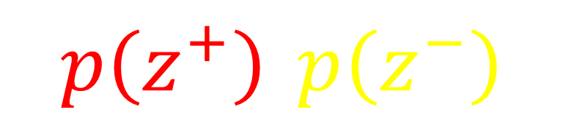




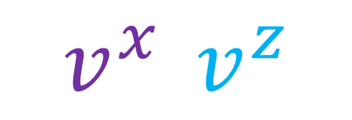

Quantum superpositions explained
$$|z^{+}⟩$$
Physical space vectors
$$p\left(z^{−}\right)$$
$$\left(v^{x}, v^{z}\right)$$
$$θ$$
$$v$$
$${\left(v^{x}\right)}^{2}+{\left(v^{z}\right)}^{2}=1$$
$$p\left(z^{+}\right)$$
Quantum state vectors
$$\left(p\left(z^{+}\right),p\left(z^{−}\right)\right)$$
$$|z^{−}⟩$$
$$p\left(z^{+}\right)+p\left(z^{−}\right)=1$$

Slide 4
There are no “superposition states”
$$|z^{+}⟩$$
Physical space vectors
$$p\left(z^{−}\right)$$
$$\left(v^{x}, v^{z}\right)$$
$$θ$$
$$v$$
$${\left(v^{x}\right)}^{2}+{\left(v^{z}\right)}^{2}=1$$
$$p\left(z^{+}\right)$$
Quantum state vectors
$$\left(p\left(z^{+}\right),p\left(z^{−}\right)\right)$$
$$|z^{−}⟩$$
$$p\left(z^{+}\right)+p\left(z^{−}\right)=1$$

Slide 5
Directional vs quantum state vectors
$$|z^{+}⟩$$
Physical space vectors
$$p\left(z^{−}\right)$$
$$\left(v^{x}, v^{z}\right)$$
$$θ$$
$$v$$
$${\left(v^{x}\right)}^{2}+{\left(v^{z}\right)}^{2}=1$$
$$p\left(z^{+}\right)$$
Quantum state vectors
$$\left(p\left(z^{+}\right),p\left(z^{−}\right)\right)$$
$$|z^{−}⟩$$
$$p\left(z^{+}\right)+p\left(z^{−}\right)=1$$

Slide 6






Superposition is multi-decomposition
$$|ψ_{1}⟩$$
$$|\hat{φ}⟩$$
$\left|φ\right\rangle =c_{1}\left|ψ_{1}\right\rangle +c_{2}\left|ψ_{2}\right\rangle$
$$⇕$$
$$ρ=p_{φ}ρ_{φ}+p_{\hat{φ}}ρ_{\hat{φ}}=p_{1}ρ_{ψ_{1}}+p_{2}ρ_{ψ_{2}}$$
$$ρ$$
$$|φ⟩$$
$$|ψ_{2}⟩$$

Slide 7








Born rule
$$⇕$$
Entropy
Geometric explanation
$$φ$$
$$ρ$$
$$r$$
$$p\left(ψ | φ\right)$$
$$ψ^{⊥}$$
$$O$$
$$C$$

Slide 8

Born rule - $p\left(ψ | φ\right)$
$$⇕$$
Entropy - $S\left(\frac{1}{2}ψ+\frac{1}{2}φ\right)$
Geometric explanation

Slide 9







Quantum probability and entropy
$$φ$$
$$ρ$$
Their geometric relationship
$$r$$
$$p\left(ψ | φ\right)$$
$$ψ^{⊥}$$
$$O$$
$$C$$

