Slide 1
Reversing Hamiltonian Mechanics
Gabriele Carcassi

Slide 2

Show that the equations characterize a vector field: the displacement
Show that the displacement is a 90 rotation of the gradient of the Hamiltonian
Introduce $S_{a}$ and $ω$
Divergenceless, potential, flow depends only on endpoints
Unitary Jacobian, conservation of area
Conservation of density
Symplectic form
…

Slide 3






For Single Dimension Newtonian Mechanics
$$\frac{dq}{dt}=\frac{∂H}{∂p}$$
$$d_{t}q=S^{q}(q, p)$$
$$S^{q}=∂_{p}H$$
$$\frac{dp}{dt}=−\frac{∂H}{∂q}$$
$$d_{t}p=S^{p}(q, p)$$
$$S^{p}=−∂_{q}H$$

Slide 4








$H=\frac{p^{2}}{2m}+kq^{2}$
$$H(q,p)$$
$$p$$
$$4$$
$$3$$
$$2$$
$$H=1$$
$$q$$

Slide 5





$\vec{∇}H\left(q,p\right)=\left[\begin{matrix}∂_{p}H \\ ∂_{q}H\end{matrix}\right]$
$$\vec{∇}H\left(q,p\right)$$
$$p$$
$$H(q,p)$$
$=\left[\begin{matrix}\frac{p}{m} \\ 2kq\end{matrix}\right]$
$$4$$
$$3$$
$$2$$
$$H=1$$
$$q$$
$H=\frac{p^{2}}{2m}+kq^{2}$

Slide 6






$\vec{S}\left(q,p\right)=\left[\begin{matrix}S^{q} \\ S^{p}\end{matrix}\right]$
$$\vec{S}\left(q,p\right)$$
$$p$$
$$H(q,p)$$
$$4$$
$$=\left[\begin{matrix}d_{t}q \\ d_{t}p\end{matrix}\right]=\left[\begin{matrix}∂_{p}H \\ −∂_{q}H\end{matrix}\right]$$
$$3$$
$$2$$
$$H=1$$
$$q$$
$$={\text{P}}_{}^{90°}\left(\vec{∇}H\right)$$

Slide 7













$$\vec{S}\left(q,p\right)$$
$$p$$
$$ω=\left[\begin{matrix}0 & 1 \\ −1 & 0\end{matrix}\right]$$
$$\left[ω_{ab}\right]=\left[\begin{matrix}ω_{qq} & ω_{qp} \\ ω_{pq} & ω_{pp}\end{matrix}\right]$$
$$3$$
$$4$$
$$2$$
$$H=1$$
$$q$$
$$\vec{S}=ω \vec{∇}H$$
$$S^{b}ω_{ba}=∂_{a}H$$
$$\left[\begin{matrix}S^{q} \\ S^{p}\end{matrix}\right]=\left[\begin{matrix}0 & 1 \\ −1 & 0\end{matrix}\right]\left[\begin{matrix}∂_{q}H \\ ∂_{p}H\end{matrix}\right]$$
$$=\left[\begin{matrix}∂_{p}H \\ −∂_{q}H\end{matrix}\right]$$
$$S^{q}ω_{qp}=∂_{p}H$$
$$S^{p}ω_{pq}=∂_{q}H$$

Slide 8











$$\vec{S}\left(q,p\right)$$
$$p$$
$$\vec{∇}×F=\left[\begin{matrix}∂_{y}F_{z}−∂_{z}F_{y} \\ ∂_{z}F_{x}−∂_{x}F_{z} \\ ∂_{x}F_{y}−∂_{y}F_{x}\end{matrix}\right]$$
$$\vec{∇}×\left[\begin{matrix}0 \\ 0 \\ H\end{matrix}\right]=\left[\begin{matrix}∂_{y}H−0 \\ 0−∂_{x}H \\ 0−0\end{matrix}\right]$$
$$3$$
$$4$$
$$2$$
$$H=1$$
$$q$$
$$ω \vec{∇}H=\left[\begin{matrix}∂_{p}H \\ −∂_{q}H\end{matrix}\right]$$
Note: $ω \vec{∇}$ is “similar” $\vec{∇}×$
Displacement field is divergenceless
Recall: $\vec{∇}⋅ \vec{∇}×F=0$
$$∂_{a}S^{a}=∂_{q}S^{q}+∂_{p}S^{p}$$
$$=∂_{q}∂_{p}H−∂_{p}∂_{q}H=0$$
Flow of states is incompressible
Similar result!

Slide 9




The flow of the displacement field $S^{a}$
$$p$$
$$\oint{\left(S^{q}dp−S^{p}dq\right)=0}$$
$$P$$
$$q$$
$$O$$

Slide 10





$$p$$
$$\oint{\left(S^{q}dp−S^{p}dq\right)=0}$$
$$P$$
$$O$$
$$q$$

Slide 11






The flow of the displacement field $S^{a}$
$$p$$
hyper-surfaces have dimensions $n−1$
$$P$$
Since we are in two dimensions: $2−1=1$
$$q$$
Our hyper-surfaces are lines
$$O$$
$$\oint{\left(S^{q}dp−S^{p}dq\right)=\oint{(∂_{p}Hdp+∂_{q}Hdq)=}\oint{dH=0}}$$

Slide 12


The flow of the displacement field $S^{a}$
$$p$$
Each divergenceless field in two dimensions
admits a stream function $H$
$$P$$
$$q$$
The flow through any two lines connecting
$H(O)$ and $H(P)$ must be zero and thus equal
$$O$$
Any line connecting $O$ and $P$ depends only on the states
and is path independent

Slide 13

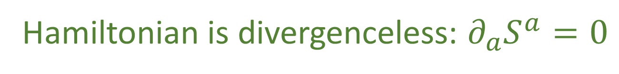


The flow of the displacement field $S^{a}$
Assigning $H\left(O\right)=0$
$$p$$
$$P$$
$H\left(P\right)=\int_{OP}{(S^{q}dp−S^{p}dq)}$
$$q$$
$$O$$
$$dH=∂_{q}Hdq+∂_{p}Hdp=−S^{p}dq+S^{q}dp$$
$⇒T$he displacement field for a one dimensional
Hamiltonian is divergenceless: $∂_{a}S^{a}=0$

Slide 14
Now let us turn our attention to the way
regions are transported by the evolution

Slide 15






Difference of the Hamiltonian at the Two Points:
$∆H=\int_{OP}{S^{a}} × dξ^{b}$
When transforming infinitesimal volumes
$$p$$
$${\hat{ξ}}^{a}={\hat{ξ}}^{a}\left(ξ^{b}\right)$$
$$d{\hat{ξ}}^{a}=∂_{b}{\hat{ξ}}^{a}dξ^{b}$$
$$q$$
$$d{\hat{ξ}}^{1}…d{\hat{ξ}}^{n}=\left|∂_{b}{\hat{ξ}}^{a}\right|dξ^{1}…dξ^{n}$$
$$d\hat{q}d\hat{p}=\left[\begin{matrix}∂_{q}\hat{q} & ∂_{p}\hat{q} \\ ∂_{q}\hat{p} & ∂\hat{p}\end{matrix}\right]dqdp$$

Slide 16


Difference of the Hamiltonian at the Two Points:
$∆H=\int_{OP}{S^{a}} × dξ^{b}$
When transforming infinitesimal volumes
$$p$$
$${\hat{ξ}}^{a}={\hat{ξ}}^{a}\left(ξ^{b}\right)$$
$$d{\hat{ξ}}^{a}=∂_{b}{\hat{ξ}}^{a}dξ^{b}$$
$$d{\hat{ξ}}^{1}…d{\hat{ξ}}^{n}=\left|∂_{b}{\hat{ξ}}^{a}\right|dξ^{1}…dξ^{n}$$
$$q$$
$$d\hat{q}d\hat{p}=\left[\begin{matrix}∂_{q}\hat{q} & ∂_{p}\hat{q} \\ ∂_{q}\hat{p} & ∂\hat{p}\end{matrix}\right]dqdp$$

Slide 17
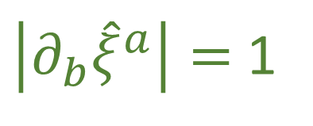





Difference of the Hamiltonian at the Two Points:
$$\text{If} \hat{q} \text{and} \hat{p} \text{represent} \text{the} \text{evolution} \text{of} q \text{and} p$$
$∆H=\int_{OP}{S^{a}} × dξ^{b}$
$$\text{after} \text{an} \text{infinitesimal} \text{time} \text{step} δt\text{:}$$
$$p$$
$$\hat{p}=p+S^{p}δt$$
$$\hat{q}=q+S^{q}δt$$
$$∂_{b}{\hat{ξ}}^{a}=\left[\begin{matrix}1+∂_{q}S^{q}δt & ∂_{q}S^{q}δt \\ ∂_{q}S^{p}δt & 1+∂_{p}S^{p}δt\end{matrix}\right]$$
$$q$$
$$\left|∂_{b}{\hat{ξ}}^{a}\right|=\left(1+∂_{q}S^{q}δt\right)\left(1+∂_{p}S^{p}δt\right)−∂_{q}S^{p}∂_{q}S^{q}δt^{2}$$
$$=1+\left(∂_{q}S^{q}+∂_{p}S^{p}\right)δt+O(δt^{2})$$
$⇒$the Jacobian of the time evolution is unitary:
$\left|∂_{b}{\hat{ξ}}^{a}\right|=$ 1

Slide 18
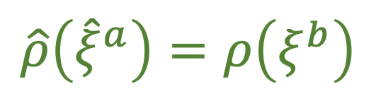

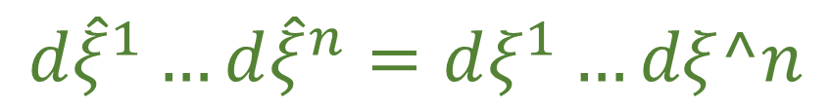


Difference of the Hamiltonian at the Two Points:
$$d\hat{q}d\hat{p}=\left[\begin{matrix}∂_{q}\hat{q} & ∂_{p}\hat{q} \\ ∂_{q}\hat{p} & ∂\hat{p}\end{matrix}\right]dqdp=dqdp$$
$∆H=\int_{OP}{S^{a}} × dξ^{b}$
$$p$$
$⇒$Volumes are conserved through the evolution
$$d{\hat{ξ}}^{1}…d{\hat{ξ}}^{n}=dξ^{1}…dξ^n$$
$$q$$
Densities: $\left|∂_{b}{\hat{ξ}}^{a}\right|\hat{ρ}\left({\hat{ξ}}^{a}\right)=ρ\left(ξ^{b}\right)$
$⇒$Densities being conserved through the evolution
$$\hat{ρ}\left({\hat{ξ}}^{a}\right)=ρ\left(ξ^{b}\right)$$

Slide 19





Difference of the Hamiltonian at the Two Points:
$∆H=\int_{OP}{S^{a}} × dξ^{b}$
Given two vectors $v^{a}$ and $w^{a}$, the area of the parallelogram
$$p$$
they form is ${vw}^{q}w^{p}−v^{p}w^{q}$ which can be written $v^{a}ω_{ab }w^{b}$
$${\hat{v}}^{a}=∂_{b}{\hat{ξ}}^{a}v^{b}$$
$${\hat{w}}^{a}=∂_{b}{\hat{ξ}}^{a}w^{b}$$
$$q$$
The invariance of the area can be written:
${\hat{v}}^{c}ω_{cd }{\hat{w}}^{d}={v^{a}∂}_{a}{\hat{ξ}}^{c}ω_{cd}∂_{b}{\hat{ξ}}^{d}w^{b}=v^{a}{\hat{ω}}_{ab }w^{b}$
$⇒$ The evolution leaves $ω_{ab}$ invariant
$${\hat{ω}}_{ab}=ω_{ab}$$
Notes:
TODO: The v and w are small segments. They give a parallelogram. The omega calculates the area. The v and w hat are the small segment transported by the evolution. They can become anything as long as the parallelogram has the same area (as calculated by omega)

Slide 20


It is also useful to look more closely at the definition of the Poisson bracket:
$$\left\{f,g\right\}=∂_{q}f∂_{p}g−∂_{p}f∂_{q}g=\left|\begin{matrix}∂_{q}f & ∂_{p}f \\ ∂_{q}g & ∂_{p}g\end{matrix}\right|$$
We can express the Poisson bracket:$\left\{f,g\right\}=−∂_{a}fω^{ab}∂_{b}g=∂_{b}gω^{ba}∂_{a}f$
Where$ω^{ab}=\left[\begin{matrix}ω^{qq} & ω^{qp} \\ ω^{pq} & ω^{pp}\end{matrix}\right]=\left[\begin{matrix}0 & −1 \\ 1 & 0\end{matrix}\right]$is the inverse of $ω_{ab}$
$⇒$ The evolution leaves the Poisson
brackets invariant

Slide 21





The displacement field $S^{a}$ transports areas of
phase space to equal areas of phase space
$$p$$
We can express the flow through the displacement field:
$$q$$
$$\int{{(S}^{a}dp−S^{p}dq)=\int{S^{a}ω_{ab}dξ^{b}}=\int{S_{b}dξ^{b}}}$$
$⇒$ the $\text{rotated} \text{displacement} \text{field} \text{is} \text{curl} \text{free}$
$$∂_{a}S_{b}−∂_{b}S_{a}=0$$

Slide 22
Physical Characterizations

Slide 23

What we have shown so far is that the defining characteristic of Hamiltonian
mechanics is not the transport of points, but the transport of areas and densities
$⇒$ Classical point particles are more aptly conceived
as infinitesimal regions of phase space
Notes:
TODO: picture is the one with the vectors and transported vectors that have parallelograms with the same area
There would actually be no reason for the Hamiltonian equations of motion to be
differentiable if were about points, since differentiable equations are what is needed
to define the Jacobian, the transport of areas, or of densities defined on those areas

Slide 24
This matches how classical mechanics is used:
the objects we study are not point-like and can only be considered point-like
if their size is negligible compared to the scale of the problem
This also matches how fluid mechanics and continuum mechanics:
where we study the motion of infinitesimal parts of material
Notes:
TODO: search in Wikipedia images on fluid mechanics and continuum mechanics
There would actually be no reason for the Hamiltonian equations of motion to be
differentiable if were about points, since differentiable equations are what is needed
to define the Jacobian, the transport of areas, or of densities defined on those areas

Slide 25
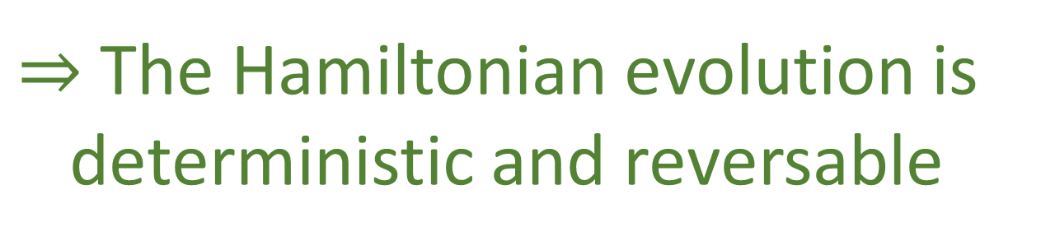
Hamiltonian evolutions transport a probability
distribution point by point, with the probability
density remaining the same as it move through space
In statistical mechanics, we physically
interpret volumes of regions in
phase space, as representing the
number of states.
Hamiltonian mechanics, then, map regions
while preserving the number of states
Meaning that for each initial state, there is one and only one final state
$⇒$ The Hamiltonian evolution is
deterministic and reversable
Notes:
TODO: first slide on det/rev only about areas=number of states
TODO: separate slide for density (move picture to next slide)
From Book: “Note that by reversible here we mean that given the final state we can reconstruct the initial state. Given that areas measure the number of states, DR-EV is equivalent to DR-VOL, which means this is another characterization of Hamiltonian mechanics. We can also see a connection to DR-DEN. If we assign a density to an initial state, and we claim that all and only the elements that start in that initial state will end in a particular final state, we will expect the density of the corresponding final state to match. That is, if the evolution is deterministic and reversible, it may shuffle around a distribution, but it will never be able to spread it or concentrate it”

Slide 26
This explains why we are unable to model systems that are dissipative
like a particle under linear drag with Hamiltonian mechanics
A dissipative system will have an attractor: a point or a region to which
given enough time which will cause the density to concentrate over
the attractor
Hamiltonian evolutions also can’t have unstable points
or regions from which the system always goes away
for the same reason
Notes:
What may be confusing is that the motion of a particle under linear drag may seem reversible, in the sense that we are able to, given the final position and momentum, reconstruct the initial values. Mathematically, it maps points one-to-one and would seem to satisfy DREV, even though it is not a Hamiltonian system. This is a perfect example of how focusing on just the points leads to the wrong physical intuition. Physically, we would say that a one meter range of position allows for more configurations than a one centimeter range, even though mathematically they have the same number of points. If we understand that states are infinitesimal areas of phase space, we can see that a dissipative system, though it does map the center points of infinitesimal areas one-to-one, it does not map the full infinitesimal area one-to-one. In this sense dissipative systems fail to be reversible.

Slide 27
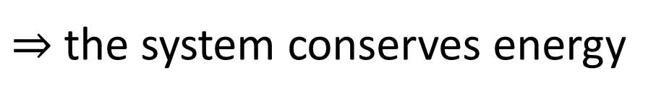

Environment
System
Deterministic and reversible evolution
$⇒$ past and future depend only on the state of the system
$⇒$ the evolution does not depend on anything else
$⇒$ the system is isolated
First law of thermodynamics!
$⇒$ the system conserves energy
Notes:
TODO: maybe call X the state of the system and Y the state of the environment
TODO: merge with the following
Structure of phase space exactly what is needed to do statistical mechanics - Comes out of invariance of the entropy under coordinate transformations

Slide 28
If a system is deterministic and reversible, it admits a Hamiltonian,
a notion of energy, and that its energy is conserved over time
We can make an argument for this based on physical considerations:
A system that is deterministic and reversible only depends on the state
of the system itself which makes it an isolated system
Thermodynamics tells us that isolated
systems conserve energy
Notes:
However, we found that not only does it conserve energy, it defines it. Therefore this link between mechanics and thermodynamics is actually deeper than we may think at first, and we should explore it further.

Slide 29
A dissipative system not being reversable seems true on
thermodynamic grounds
Thermodynamic reversibility is the existence of a process that can undo
the systems change rather than the ability to reconstruct its initial state
Alternatively, a process is thermodynamically reversible if it
conserves thermodynamic entropy
Notes:
TODO: same system/env picture, but make the line dashed and a double arrow in between

Slide 30
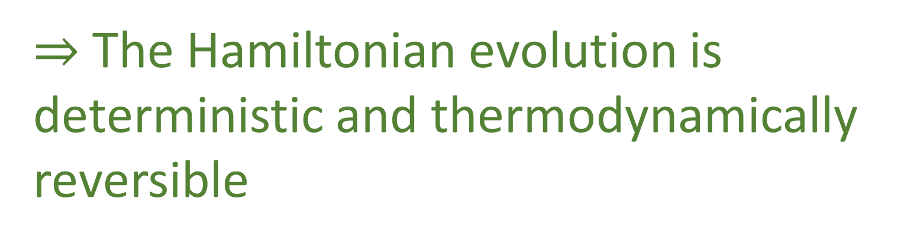

Thermodynamic Entropy: $S=k_{B}\log{W}$
logarithm of the count of states
corresponds to the volume of phase space
Since the logarithm is a bijective function, conservation of areas of
phase space is equivalent to the conservation of entropy.
$⇒$ The Hamiltonian evolution is
deterministic and thermodynamically
reversible

Slide 31



The other type of entropy that is also fundamental in both statistical
mechanics and information theory is:
the Gibbs/Shannon entropy $I\left[ρ\left(ξ^{a}\right)\right]=−\int{ρ\log{ρ}dξ^{1}}…dξ^{n}$
$$I\left[ρ\left(ξ^{a}\right)\right]=−\int{ρ\log{ρ}dξ^{1}}…dξ^{n}= \int{\hat{ρ}\left({\hat{ξ}}^{b}\right)\left|∂_{a}{\hat{ξ}}^{b}\right|\log\left(\hat{ρ}\left({\hat{ξ}}^{b}\right) | ∂_{a}{\hat{ξ}}^{b}|\right)}dξ^{1}…dξ^{n}$$
$$=−\int{\hat{ρ}\left({\hat{ξ}}^{b}\right)}\log\left(\hat{ρ}\left({\hat{ξ}}^{b}\right) | ∂_{a}{\hat{ξ}}^{b}|\right)dξ^{1}…dξ^{n}$$
$$=−\int{\hat{ρ}\left({\hat{ξ}}^{b}\right)\log{\hat{ρ}\left({\hat{ξ}}^{b}\right)}}dξ^{1}…dξ^{n}−\int{\hat{ρ}\left({\hat{ξ}}^{b}\right)}\log{{|∂}_{a}\hat{ξ}|dξ^{1}…dξ^{n}}$$
$$=I\left[\hat{ρ}\left({\hat{ξ}}^{b}\right)\right]−\int{\hat{ρ}\left({\hat{ξ}}^{b}\right)}\log{{|∂}_{a}\hat{ξ}|dξ^{1}…dξ^{n}}$$
Notes:
TODO: look for ideas for picture in textbooks, videos, etc about information theory?
TODO: with image, motivation – information entropy is number of bits needed to identify an elements, det/rev must mean the same information to identify past and future elements

Slide 32

$$I\left[ρ\left(ξ^{a}\right)\right] =I\left[\hat{ρ}\left({\hat{ξ}}^{b}\right)\right]−\int{\hat{ρ}\left({\hat{ξ}}^{b}\right)}\log{{|∂}_{a}\hat{ξ}|dξ^{1}…dξ^{n}}$$
Information entropy remains constant if and only if the logarithm of the
Jacobian determinant is zero, which means that Jacobian is one
The evolution conserves
information entropy (DR-INFO)
Notes:
The fact that determinism and reversibility is equivalent to conservation of information entropy should not be, in retrospect, surprising. Given a distribution, its information entropy quantifies the average amount of information needed to specify a particular element chosen according to that distribution. If the evolution is deterministic and reversible, giving the initial state is equivalent to giving the final state and therefore the information to describe one or the other must be the same. Determinism and reversibility, then, can be understood as the informational equivalence between past and future descriptions.

Slide 33


Lastly, we can look at how Hamiltonian evolution affects uncertainty:
Given a multivariable distribution , the uncertainty is characterized
by the covariance matrix:
$$cov\left(ξ^{a},ξ^{b}\right)=\left[\begin{matrix}σ_{q}^{2} & cov_{q,p} \\ cov_{p,q} & σ_{p}^{2}\end{matrix}\right]$$
whose determinant gives the coordinate independent
quantity to characterize uncertainty
we can use the linearized transformation to see how
the uncertainty evolves after an infinitesimal time step
$δt$ if the distribution is narrow enough
Notes:
TODO: visualize like an ellipse (that is going to conserve area during motion) https://cookierobotics.com/007/

Slide 34

$$\left|cov\left({\hat{ξ}}^{c},{\hat{ξ}}^{d}\right)\right|=\left|∂_{a}{\hat{ξ}}^{c}cov\left(ξ^{a},ξ^{b}\right)∂_{b}{\hat{ξ}}^{d}\right|=\left|∂_{a}{\hat{ξ}}^{c}\right| \left|cov\left(ξ^{a},ξ^{b}\right)\right|\left|∂_{b}{\hat{ξ}}^{d}\right|$$
The uncertainty is unchanged if and only if the Jacobian is unitary
$⇒$ The Hamiltonian evolution conserves
the uncertainty of peaked distributions

Slide 35
Big Picture
We have found twelve equivalent characterizations that link
Hamiltonian mechanics, vector calculus, differential geometry,
statistical mechanics, thermodynamics, information theory and
plain statistics for a single degree of freedom
These characteristics show that Hamiltonian
mechanics is meant to describe systems for which
the assumption of determinism and reversibility
is inherent.

Slide 37
Hamiltonian evolutions transport a probability
distribution point by point, with the probability
density remaining the same as it move through space

Slide 38






$\vec{S}\left(q,p\right)=\left[S^{q},S^{p}\right]=[d_{t}q,d_{t}p]$ Harmonic oscillator $H=\frac{p^{2}}{2m}+kq^{2}$
$$p$$
$$4$$
$$3$$
$$2$$
$$H=1$$
$$q$$

Slide 39
The surface plot of the Hamiltonian for a Harmonic oscillator $H=\frac{p^{2}}{2m}+kq^{2}$
The Gradient
The Displacement Field
Given: $ω_{ab}=\left[\begin{matrix}ω_{qq} & ω_{qp} \\ ω_{pq} & ω_{pp}\end{matrix}\right]=\left[\begin{matrix}0 & 1 \\ −1 & 0\end{matrix}\right]$ we can write $S_{a}=S^{b}ω_{ba}=∂_{a}H$

Slide 40









The Flow of the Displacement Field $S^{a}$
Difference of the Hamiltonian at the Two Points:
$∆H=\int_{OP}{S^{a}} × dξ^{b}$
$$p$$
$$p$$
$$P$$
$$O$$
$$q$$
$$q$$
Geometrically, this means: $\oint{\left(S^{q}dp−S^{p}dq\right)=0}$
Since we are in two dimensional space and a hyper surface surface has dimension $n−1=2−1=1$
$$\oint{\left(S^{q}dp−S^{p}dq\right)=\oint{∂_{p}Hdp+∂_{q}Hdq)=\oint{dH=0}}}$$

Slide 41



The displacement field $S^{a}$ transports areas of phase space to equal areas of phase space
Hamiltonian evolutions transport a probability distribution point by point, with the probability density remaining the same as it move through space
$$p$$
$$q$$
Denoting $\hat{v}=∂_{b}{\hat{ξ}}^{a}v^{b}$ and$\hat{w}=∂_{b}{\hat{ξ}}^{a}w^{b}$, the invariance of the area can be written
$${\hat{v}}^{c}ω_{cd}{\hat{w}}^{d}=v^{a}∂_{a}{\hat{ξ}}^{c}ω_{cd}∂_{b}{\hat{ξ}}^{d}w^{b}=v^{a}{\hat{ω}}_{ab}w^{b}$$
$$v^{a}ω_{ab}w^{b}={\hat{v}}^{c}ω_{cd}{\hat{w}}^{d}$$
$⇒$the evolution leave $ω_{ab}$ invariant: ${\hat{ω}}_{ab}=ω_{ab}$

