Slide 1
Classical entanglement and other quantum analogues
Gabriele Carcassi
Notes:
You have heard that quantum mechanics is weird and cannot be understood. What if I told you we can find analogue of that weirdness in classical mechanics? Classical analogues of the uncertainty principle, diffraction, entanglement? And all you need is one simple trick: follow the laws of thermodynamics!

Slide 2

Quantum uncertainty principle
Limit to the precision of preparation
$$σ_{x}σ_{p}≥\frac{ℏ}{2}$$

Slide 3



No limit in classical mechanics
$$p$$
rectangular
uniform distribution
$$ρ\left(x,p\right)\left\{\begin{aligned}\frac{1}{ΔxΔp} \left(x,p\right)∈U \\ \\ 0 \left(x,p\right)∉U\end{aligned}\right.$$
$$x$$

Slide 4
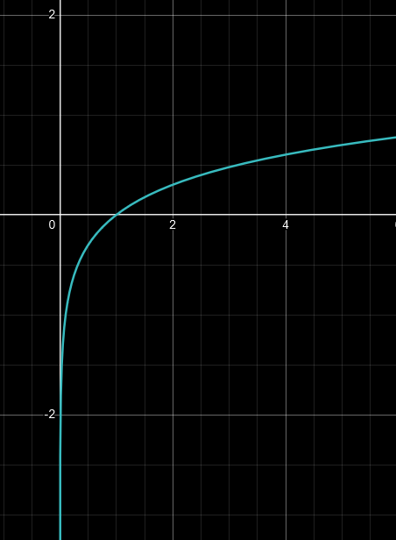

Limit in thermodynamics
$$p$$
rectangular
uniform distribution
$$ρ\left(x,p\right)\left\{\begin{aligned}\frac{1}{ΔxΔp} \left(x,p\right)∈U \\ \\ 0 \left(x,p\right)∉U\end{aligned}\right.$$
$$x$$
3rd law: entropy can’t be negative!!!
$$S=−k_{B}\int{ρ\log{ρ}dxdp}$$ $=k_{B}\log{ΔxΔp}$
rectangular
uniform distribution

Slide 5

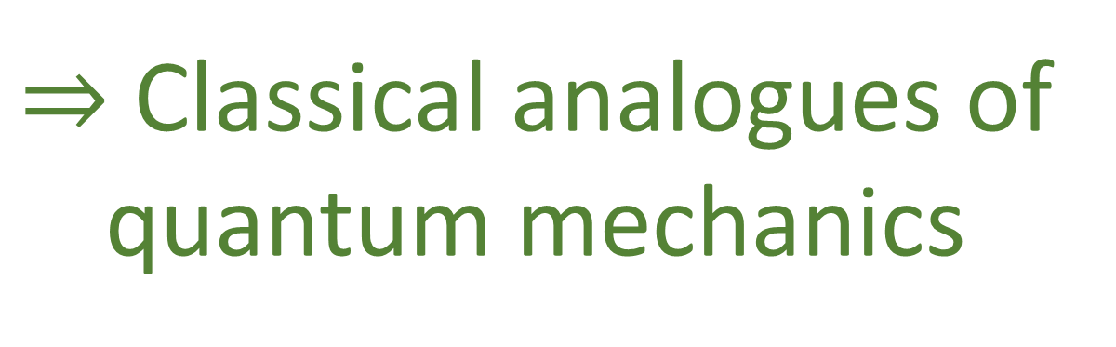
Classical (statistical) mechanics
States are distributions over phase space Entropy given by Shannon/Gibbs entropy
$$+$$
Thermodynamics
Pretend we do not know quantum mechanics exists
Entropy has a lower bound
$⇒$ Classical analogues of quantum mechanics

Slide 6

Can only take the logarithm of a dimensionless quantity!
$$S=−k_{B}\int{ρ\log{ρ}dxdp}$$ $=k_{B}\log{ΔxΔp}$
Let’s fix the units first

Slide 7



Uniform distribution with zero entropy
$$p$$
Define $h$ to be the area of a region that corresponds to zero entropy
$$S=−k_{B}\int{ρ\log{hρ}dxdp}$$ $=k_{B}\log{\frac{ΔxΔp}{h}}$
$$x$$
Equals zero if $ΔxΔp=h$

Slide 8
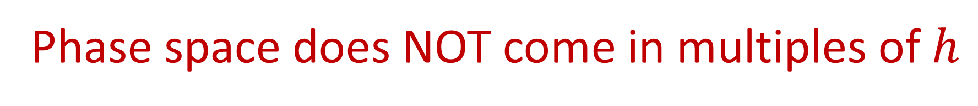

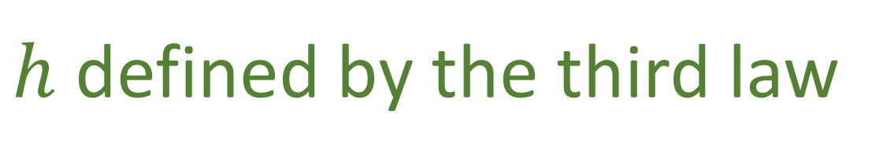



$h$ defined by the third law
we do not know that quantum mechanics exists
Minimum area for a uniform distribution
Phase space does NOT come in multiples of $h$
We can have a uniform distribution over $1.3h$
Discrete
$$≠$$
Quantized
Area comes in integer multiples
Area comes with a lower bound
$$p$$
$$p$$
$$x$$
$$x$$

Slide 9




What is the distribution that minimizes uncertainty at a given entropy?
$$ρ=\frac{1}{2πσ_{x}σ_{p}}e^{−\frac{{\left(x−μ_{x}\right)}^{2}}{2σ_{x}^{2}}}e^{−\frac{{\left(p−μ_{p}\right)}^{2}}{2σ_{p}^{2}}}$$
the Gaussian!!!
Classical uncertainty principle!
$$S\left[ρ\right]=k_{B}\log\left(2πe\frac{σ_{x}σ_{p}}{h}\right)$$
$$σ_{x}σ_{p}≥\frac{h}{2πe}=\frac{ℏ}{e}$$
$$S≥0$$

Slide 10
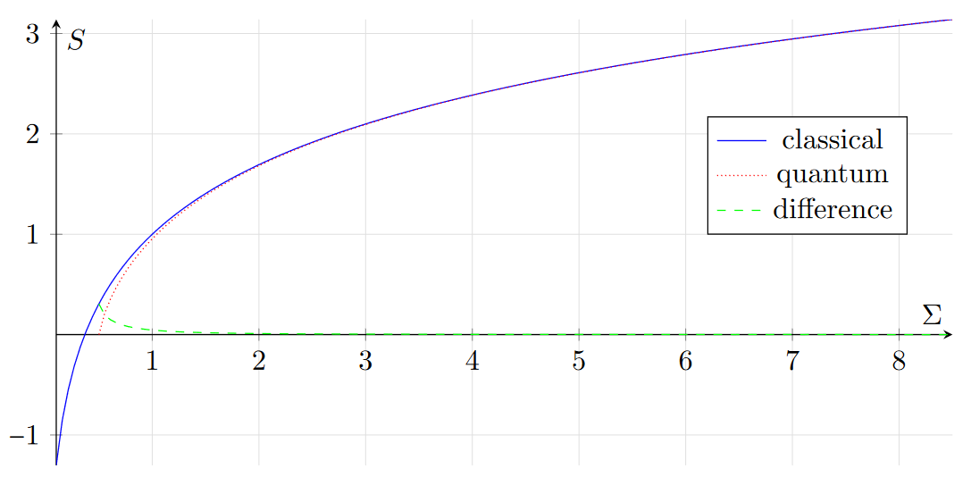



Every classical distribution with non-negative entropy satisfies
Every quantum state, which has non-negative entropy, satisfies
$$σ_{x}σ_{p}≥\frac{ℏ}{e}$$
$$σ_{x}σ_{p}≥\frac{ℏ}{2}$$
$$≈\text{2.718}\text{...}$$
Equality holds for independent Gaussians
Equality holds for Gaussian wave-packets
excluded by Gaussian bound
excluded by 3rd law of thermodynamics

Slide 11
Diffraction
A wave bends around the corner
The smaller the opening, the more it bends
In quantum mechanics, particles do this as well

Slide 12







Smaller opening,
more spread in momentum
Incoming distribution has zero entropy, and very narrow spread in momentum, and large spread in position
$$x$$
$$p_{x}$$
$$x$$
The opening constrains the position to a smaller spread
$$x$$
$$h$$
Can’t have lower entropy
Spread in momentum increases
$$p_{x}$$
$$p_{x}$$
Average vertical momentum is zero

Slide 13
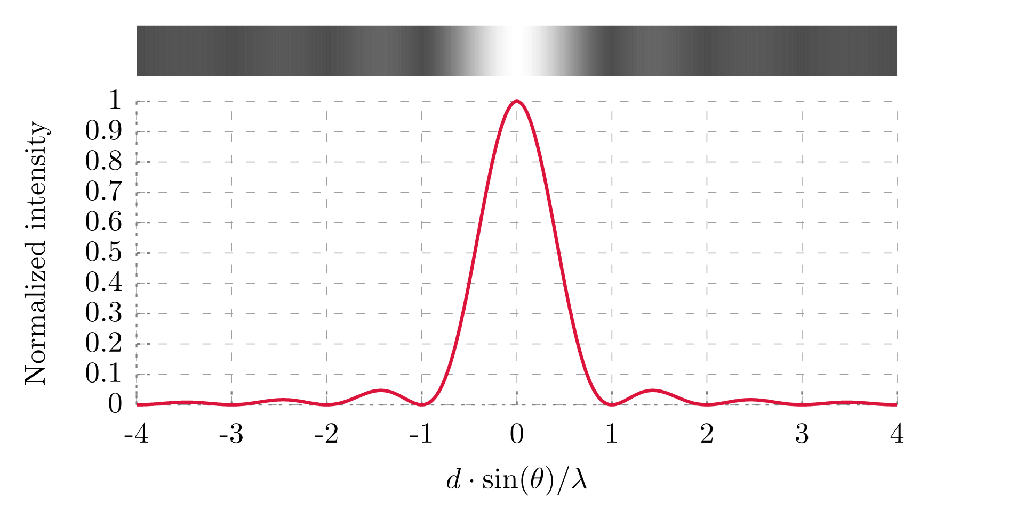
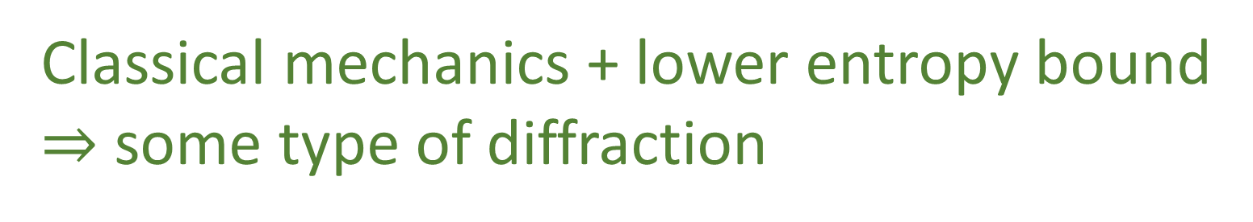


Obviously, this is all qualitative!
Diffraction from a single slit
(Wikipedia)
$$x$$
$$p_{x}$$
No single way to spread the distribution
The argument does not predict the extra peaks
Classical mechanics + lower entropy bound $⇒$ some type of diffraction

Slide 14
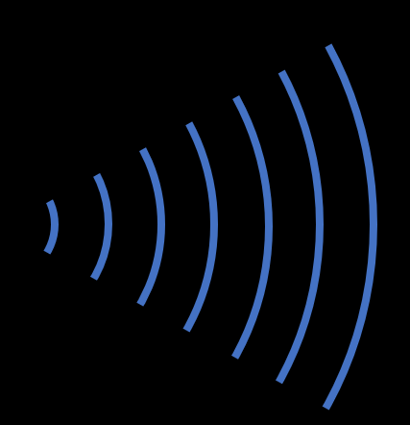


Interference
$$≠$$
$$+$$
Having two slits open is not the same
as having one open at a time

Slide 15
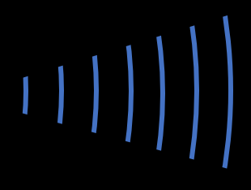











$$≠$$
$$+$$
Incoming distribution
With both slits
With a single slit
$$x$$
$$x$$
$$x$$
$$x$$
$$h$$
$$h$$
$$≠$$
$$+$$
$$p_{x}$$
$$p_{x}$$
$$p_{x}$$
$$p_{x}$$
$$h$$

Slide 16
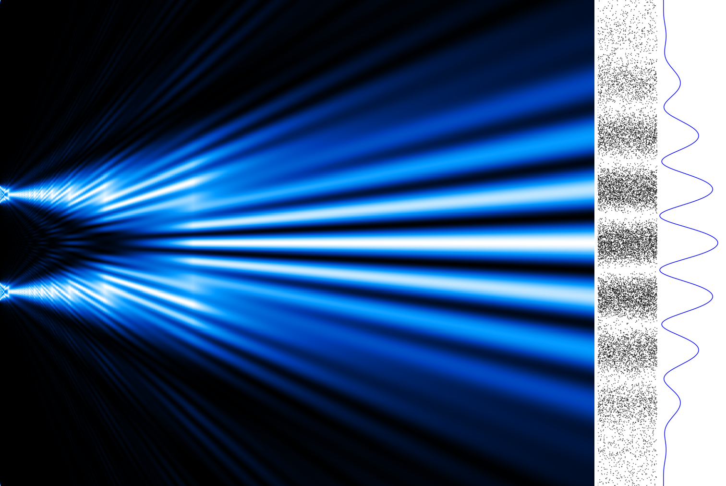




Again, this is all qualitative!
Interference pattern
(From Wikipedia, by Alexandre Gondran)
$$x$$
No single way to spread the distribution
$$h$$
$$p_{x}$$
The argument does not predict the peaks/valley
Entropy is a global constraint
$⇒$ different answer if both slits are open

Slide 17

Entanglement
full specification of the composite system
full specification of the components
$$\left|ψ_{AB}\right\rangle ≠\left|ψ_{A}\right\rangle \left|ψ_{B}\right\rangle$$
does not always give
Composite systems can access more states than those accessible by the two systems independently

Slide 18


In classical mechanics …
$$B$$
… perfectly prepared composite system determines both components
Perfectly prepared! What if we can only prepare up to zero entropy?
$$A$$

Slide 19


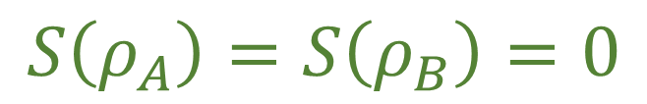
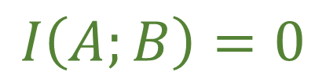







Joint distribution
Joint entropy
Marginal entropies
Mutual entropy
$$B$$
$$ρ_{AB}$$
$$S\left(ρ_{AB}\right)=S\left(ρ_{A}\right)+S\left(ρ_{B}\right)−I(A;B)$$
$$ρ_{B}=\int_{A}{ρ_{AB}dA}$$
$$I\left(A;B\right)=\int_{AB}{ρ_{AB}\log{\frac{ρ_{AB}}{ρ_{A}ρ_{B}}}dAdB}≥0$$
$=0$ $⇔$ independence
Marginals
$$A$$
$$ρ_{A}=\int_{B}{ρ_{AB}dB}$$
$$I\left(A;B\right)=0$$
$$⇔$$
Assume $S\left(ρ_{AB}\right)=0$
$$S\left(ρ_{A}\right)=S\left(ρ_{B}\right)=0$$

Slide 20
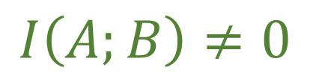
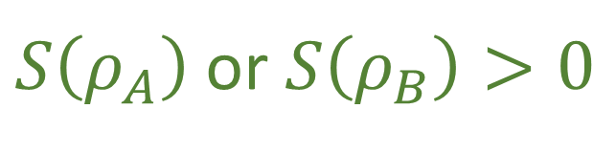
Joint distribution
Joint entropy
Marginal entropies
Mutual entropy
$$B$$
$$ρ_{AB}$$
$$S\left(ρ_{AB}\right)=S\left(ρ_{A}\right)+S\left(ρ_{B}\right)−I(A;B)$$
$$ρ_{B}=\int_{A}{ρ_{AB}dA}$$
$$I\left(A;B\right)=\int_{AB}{ρ_{AB}\log{\frac{ρ_{AB}}{ρ_{A}ρ_{B}}}dAdB}≥0$$
$=0$ $⇔$ independence
Marginals
$$A$$
$$ρ_{A}=\int_{B}{ρ_{AB}dB}$$
$$I\left(A;B\right)≠0$$
$$⇔$$
Assume $S\left(ρ_{AB}\right)=0$
$S\left(ρ_{A}\right)$ or $S\left(ρ_{B}\right)>0$

Slide 21

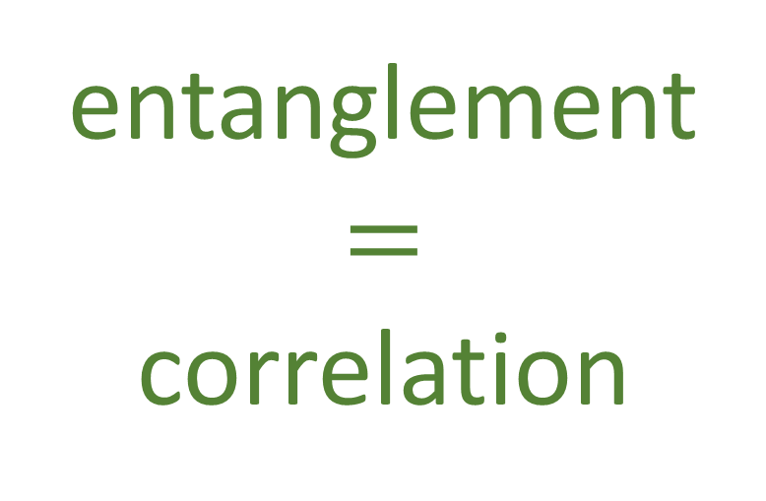




$$B$$
entanglement
$$=$$
correlation
$$B$$
$$ρ_{AB}$$
$$A$$
$$A$$
Not all ensembles at zero entropy are the product of ensembles at zero entropy: composite systems can access more states than those accessible by two systems independently

Slide 22



Purification of a mixed state
Every quantum statistical mixture …
$$ρ_{A}=∑p_{i}\left|ψ_{i}\right\rangle \left\langle ψ_{i}\right|$$
$$ρ_{A}={Tr}_{B}\left(\left|Ψ_{AB}\right\rangle \left\langle Ψ_{AB}\right|\right)$$
$$\left|Ψ_{AB}\right\rangle =∑\sqrt{p_{i}}\left|ψ_{i}\right\rangle \left|φ_{i}\right\rangle$$
… can be expressed as a marginal on an entangled composite system

Slide 23
In classical mechanics …
$$B$$
… perfectly prepared composite system cannot give you a distribution on a marginal
Perfectly prepared! What if we can only prepare up to zero entropy?
$$A$$

Slide 24













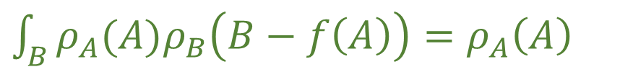
$$S\left(ρ_{AB}\right)=S\left(ρ_{A}\right)+S\left(ρ_{B}\right)−I(A;B)$$
$$B$$
$$B$$
$$B$$
Find $ρ_{B}$ such that $S\left(ρ_{B}\right)=−S(ρ_{A})$
$$S\left(ρ_{AB}\right)=0$$
$$ρ_{AB}=ρ_{A}ρ_{B}$$
e.g. Gaussian with appropriate variance
$$A$$
$$A$$
$$A$$
Start with any distribution $ρ_{A}$ with $S\left(ρ_{A}\right)>0$
Introduce a correlation to increase $S(ρ_{B})$
without changing $ρ_{A}$ and $S(ρ_{AB})$
$$⇒ρ_{AB}(A,B)=ρ_{A}(A)ρ_{B}\left(B−f\left(A\right)\right)$$
$$S\left(ρ_{AB}\right)=0$$
$\int_{B}{ρ_{A}(A)ρ_{B}\left(B−f\left(A\right)\right)}=ρ_{A}\left(A\right)$

Slide 25




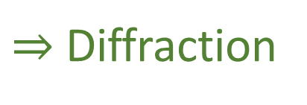





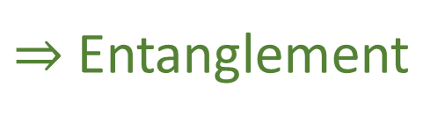
Quantum (pure) state $⟺$ Classical distribution with zero entropy
$⇒$ Uncertainty principle
$$σ_{x}σ_{p}≥\frac{ℏ}{e}$$
excluded by Gaussian bound
Entropy bounds the uncertainty
excluded by 3rd law of thermodynamics
$$x$$
$$x$$
$⇒$ Diffraction
$⇒$ Interference
$$p_{x}$$
Going through two slits expands momentum differently
$$p_{x}$$
Constraining position expands momentum
$$B$$
$⇒$ Entanglement
$⇒$ Purification
Zero entropy on the joint, positive on the marginals
Any distribution with positive entropy can be the marginal of a zero entropy distribution
$$A$$

Slide 26
Notes:
Final comments

Slide 27
Final comments
We can’t create a better theory if we do not understand these details
There must be an argument that goes from lower bound to the entropy to frequency/energy relations

