Slide 1


Quantum probability and quantum information theory require a novel approach to measure theory
Gabriele Carcassi
University of Michigan

Slide 2
We need to fully understand what the mathematical structures we use in physics represent
Topologies and $σ$-algebras correspond to experimentally verifiable statements and statements associated with experimental tests
Top. Proc. 54 pp. 271-282 (2019)
Necessary and sufficient assumptions to model a physical quantity as a real number
Phys. Scr. 95 084003 (2020)
Geometrical and physical interpretation of the action principle
Sci Rep 13, 12138 (2023)
Hamiltonian mechanics is deterministic/reversible evolution of frame invariant distribution (equivalently, conservation of entropy)
Stud Hist Phil 71, 082020, 60-71 (2020)
Assumptions of Physics, Michigan Publishing (v2 2023)

Slide 3

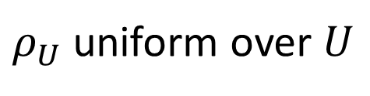

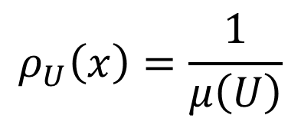
Geometry/probability/information theory are different aspects of the same structure
$$ρ_{U}\left(x\right)=\frac{1}{μ\left(U\right)}$$
$$μ\left(U\right)$$
Classical probability
Symplectic manifold
Information theory
$$H\left(ρ_{U}\right)=\log{μ\left(U\right)}$$
$ρ_{U}$ uniform over $U$
Liouville measure $μ$ (and symplectic form) plays a crucial role
Liouville measure counts the states in a region $U$
Phase space (i.e. position/conjugate momentum) only manifold in which count of states (and configurations of each DOF) is frame invariant

Slide 4

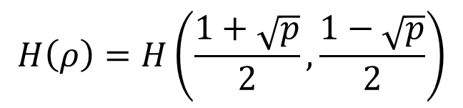
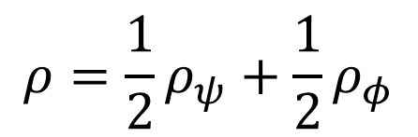

What about quantum mechanics?
$$\left\langle ψ | φ\right\rangle$$
Quantum probability
$$p\left(ψ | φ\right)={\left|\left\langle ψ | φ\right\rangle \right|}^{2}$$
Projective Hilbert space
$$ρ=\frac{1}{2}ρ_{ψ}+\frac{1}{2}ρ_{φ}$$
$$H\left(ρ\right)=H\left(\frac{1+\sqrt{p}}{2},\frac{1−\sqrt{p}}{2}\right)$$
Quantum information theory
Even in quantum mechanics, geometry/probability/information theory are different aspects of the same structure
Different structure from classical one (i.e. can’t use measure theory)
No corresponding way to count states
Can we introduce a quantum analogue for the count of states? Would that give us an insight as to what quantum mechanics is and why we can’t use classical probability?

Slide 5
What is measure theory?

Slide 6


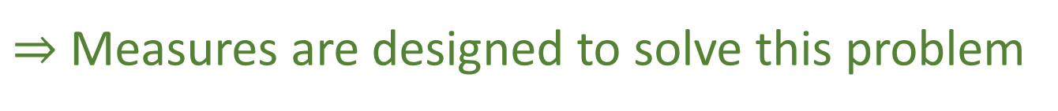
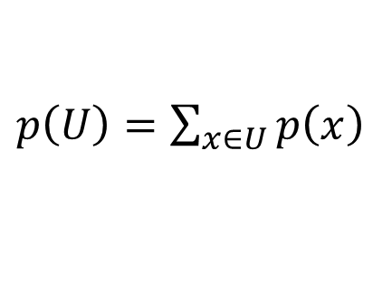

Naïve way to assign probability
$$X$$
$$p:X→[0,1]$$
Assign probability to points (i.e. each possible outcome – the die value is 2)
$$U$$
$p\left(U\right)=\sum_{x∈U}{p\left(x\right)}$
Sum for probability of a set (i.e. each possible event – the die value even)
Does not work on the continuum
E.g. uniform distribution between zero and one
$⇒$ Measures are designed to solve this problem

Slide 7


A measure assign a number (e.g. “size”, “probability”, …) to each subsets (not just points)
$$p\left(\left[0,1\right]\right)=1$$
$$μ:Σ_{x}→[0,+∞]$$
e.g.
$$p\left(\left[0,1/2\right]\right)=1/2$$
$σ$-algebra (collection of subsets – those associated with an experimental test)
Countable additivity is a fundamental axiom of measure theory
$μ\left(∪_{i}U_{i}\right)=\sum_{i}{μ\left(U_{i}\right)}$
Disjoint sets

Slide 8
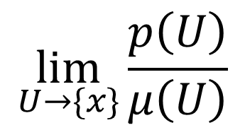
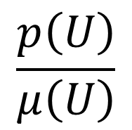


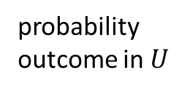
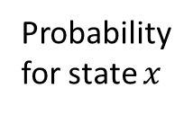
In physics, two types of measures:
quantifying measures
probability measure
- number of states - initial conditions - measurement outcomes
probability outcome in $U$
$$μ\left(U\right)$$
$$p\left(U\right)$$
$μ\left(X\right)$ can be infinite
$$p\left(X\right)=1$$
$$\frac{p\left(U\right)}{μ\left(U\right)}$$
$$\lim_{U→\{x\}}{\frac{p\left(U\right)}{μ\left(U\right)}}$$
Average probability per state
Probability for state $x$

Slide 9
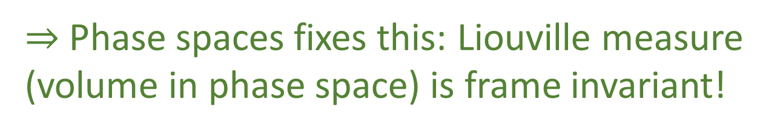


Discrete case
Continuous case
$$μ\left(U\right)=\#U$$
$$μ\left(U\right)=∑(b_{i}−a_{i})$$
Counting measure: cardinality of the set
Lebesgue measure: sum of interval lengths
Probability
Probability density
$$\lim_{U→\{x\}}{\frac{p\left(U\right)}{μ\left(U\right)}}=\frac{p\left(\left\{x\right\}\right)}{μ\left(\left\{x\right\}\right)}=p\left(\left\{x\right\}\right)$$
$$\lim_{U→\{x\}}{\frac{p\left(U\right)}{μ\left(U\right)}}=ρ(x)$$
Radon–Nikodym derivative
Note: Lebesgue measure depends on units! Not frame invariant!
$⇒$ Phase spaces fixes this: Liouville measure (volume in phase space) is frame invariant!

Slide 10
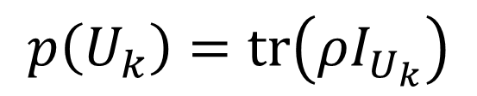
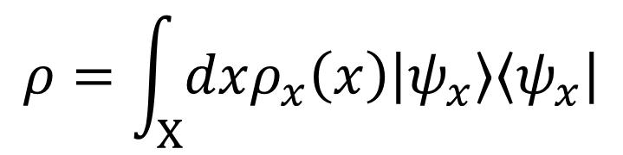
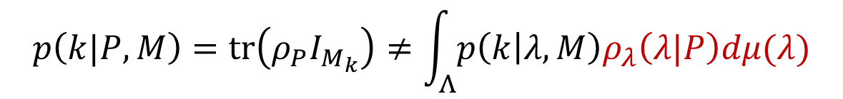
In quantum mechanics
Classical probability on preparations and measurement outcomes
(measure depends on whether the observable is discrete (e.g. energy level) or continuous (e.g. position, momentum) )
$$ρ=\int_{X}{dxρ_{x}\left(x\right)\left|ψ_{x}\right\rangle \left\langle ψ_{x}\right|}$$
$$p\left(U_{k}\right)=tr\left(ρI_{U_{k}}\right)$$
measure on pure preparations
(also symplectic/Liouville!)
Probability density on preparations
Probability measure on outcomes
No probability or quantifying measure on states!
Uses measure theory
$$p\left(k|P,M\right)=tr\left(ρ_{P}I_{M_{k}}\right)≠\int_{Λ}{p\left(k | λ,M\right)ρ_{λ}\left(λ|P\right)dμ(λ)}$$
“Classical” hidden variables

Slide 11
How should we count states in quantum mechanics?

Slide 12



Classical statistical mechanics links count of states and entropy
$$S\left(ρ_{U}\right)=\log{μ\left(U\right)}$$
Count of states
Shannon/Gibbs entropy
Uniform distribution over $U$
Fundamental postulate of statistical mechanics
Quantum statistical mechanics has a somewhat related expression
$$S\left(ρ_{U}\right)≤\log\left(\dim_{ℂ}{(\operatorname{span}\left(U\right)}\right)$$
Equal for a uniform distribution over $\operatorname{span}\left(U\right)$
Von Neumann entropy
Uniform distribution over $U$
Dimensionality of subspace

Slide 13


How can we count states in QM?
Information theory links number of possible message and entropy
$$S\left(ρ\right)=n$$
$$2^{n}$$
Messages encodable in n bits
Shannon/Gibbs/von Neumann entropy
Average bits per message
Distributions for message source
If we have a uniform distribution and imagine using one state for each possible message
$$S\left(ρ_{U}\right)=\log\left(μ\left(U\right)\right)$$

Slide 14

Statistical mechanics and information theory suggest the same link between entropy and count of states!
$$S\left(ρ_{U}\right)=\log{μ\left(U\right)}$$
Count of states
Shannon/Gibbs/von Neumann entropy
Uniform distribution over $U$
What type of “measure” do we get?

Slide 15








Calculate the measure for sets of 1 and 2 points
$$μ\left(\left\{ψ\right\}\right)=2^{S\left(\left|ψ\right\rangle \left\langle ψ\right|\right)}=2^{0}=1$$
$$0≤…≤1$$
$$μ\left(\left\{ψ,φ\right\}\right)=2^{S\left(\frac{1}{2}\left|ψ\right\rangle \left\langle ψ\right|+\frac{1}{2}\left|φ\right\rangle \left\langle φ\right|\right)}=2^{− \frac{1+\sqrt{p}}{2}\log{\frac{1+\sqrt{p}}{2}} − \frac{1−\sqrt{p}}{2}\log{\frac{1−\sqrt{p}}{2}}}≤2$$
Additive on orthogonal states
Measure not additive otherwise
$$1+1=2$$
$$1+1<2$$
$$μ\left(\left\{ψ\right\}\right)$$
$$μ\left(\left\{ψ\right\}\right)$$
$$μ\left(\left\{ψ,ψ\right\}\right)$$
$$μ\left(\left\{ψ\right\}\right)$$
$$μ\left(\left\{ψ\right\}\right)$$
$$μ\left(\left\{ψ,ψ\right\}\right)$$
Recall that all the geometry/probability/information theory rederivable from this measure – all quantum effects are ultimately due to this

Slide 16

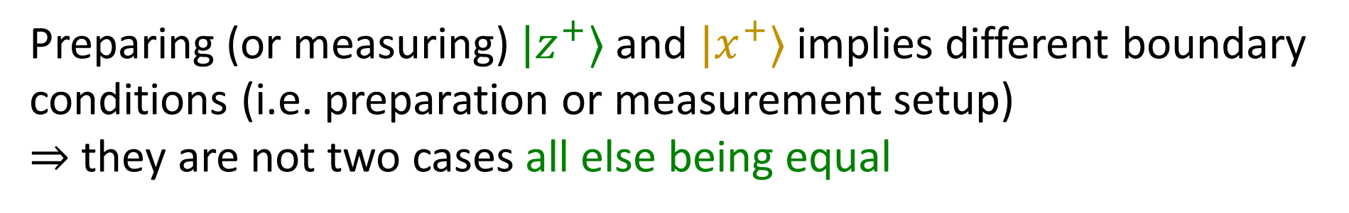
Why do $|z^{+}⟩$ and $|z^{−}⟩$ correspond to two cases, but $|z^{+}⟩$ and $|x^{+}⟩$ correspond to fewer cases?
The state of a system is never completely independent from the environment
There is a cat inside a box $⇒$ the box is not on the surface of the sun
Preparing (or measuring) $|z^{+}⟩$ and $|x^{+}⟩$ implies different boundary conditions (i.e. preparation or measurement setup)
$⇒$ they are not two cases all else being equal
Contextuality $⟺$ non-additive measure

Slide 17
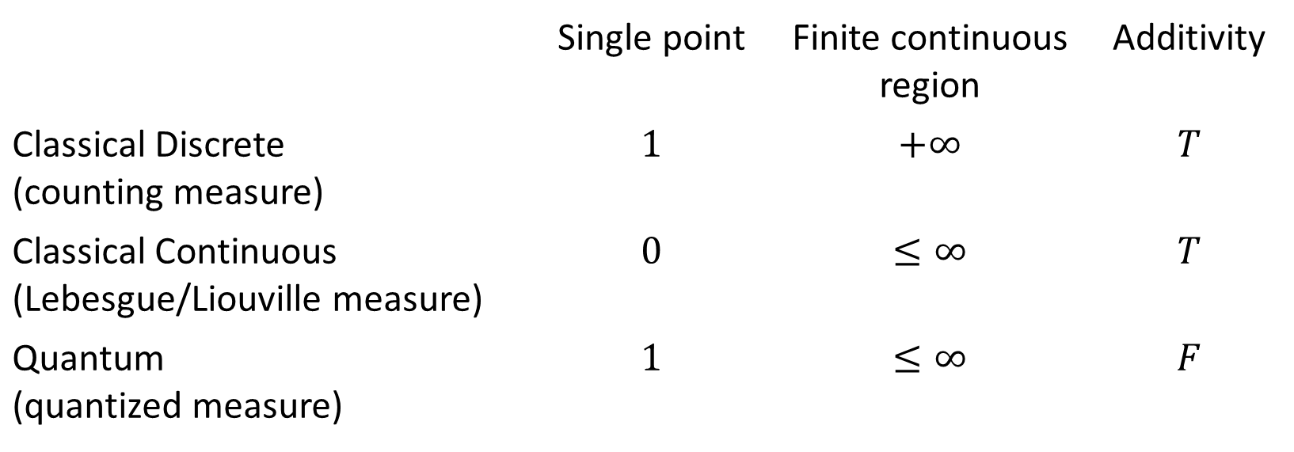
Comparing measures
All three measures can be defined on a two dimensional sphere
 | Single point | Finite continuous region | Additivity
Classical Discrete (counting measure) | $$1$$ | $$+∞$$ | $$T$$
Classical Continuous (Lebesgue/Liouville measure) | $$0$$ | $$≤∞$$ | $$T$$
Quantum (quantized measure) | $$1$$ | $$≤∞$$ | $$F$$

Slide 18
Single point is a single case (i.e. $μ\left(\left\{ψ\right\}\right)=1$)
Finite range carries finite information (i.e. $μ\left(U\right)<∞$)
Measure is additive for disjoint sets (i.e. $μ\left(∪_{i}U_{i}\right)=\sum_{i}{μ\left(U_{i}\right)}$)
Pick two!
Discrete classical mechanics (counting measure) picks 1 and 3 Continuum classical mechanics (Lebesgue measure) picks 2 and 3
Quantum mechanics picks 1 and 2
What is quantized? The count of states!

Slide 19
Quantization is fixing the quantifying measure
so that it is bounded from below by one: each state counts as one.
This comes at a price: non-additivity. This is what makes the probability and measure theory “non-classical”. This implies contextuality: some states cannot be prepared at-all-else-being-equal.

Slide 20
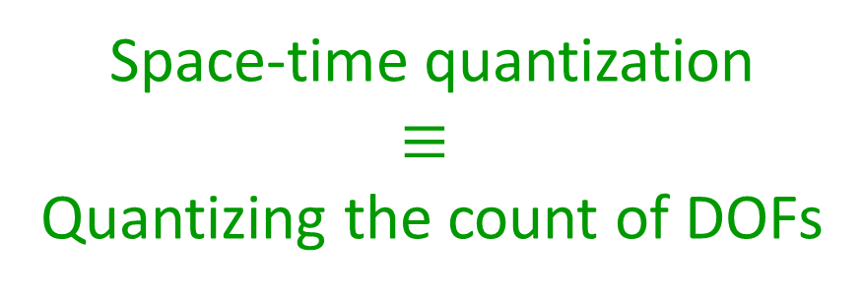
Quantization of space-time will most likely
require a quantized measure
In a field theory, one (independent) DOF at each point (i.e. local commutation relationship)
$⇒$ Measure of volume “counts” independent DOFs in a region
Lebesgue measure gives us regions with measure less than one $⇒$ less than one DOF
Space-time quantization $$≡$$
Quantizing the count of DOFs

Slide 21
Further work
Counting/Lebesgue measures unique (in some sense). Is the quantized measure unique?
Does it constrain the type of space, like a frame invariant count of states does? Is there another way to do quantization?
In general, what are necessary requirements on quantifying measures?
Consistency requirements between sets of 2 and sets of 3 elements? What does entropy strict concavity imply?
How does it work on composite system?
Clarify the relationship with entanglement.
Can we put a quantized measure on a Riemannian space (e.g. space-time)?
We have a link between symplectic and Rimannian geometry… would that help?
Can we define a theory of integration over these non-additive measures, so that we can define probability distributions directly over states?
All non-additive theories of integrations we found are based on monotone “measures”, but the quantized measure is not even monotone (i.e. if you add points to a set, the measure can decrease).
All of this likely needs advances in math

Slide 23
I spent the last decade looking closely at the foundations of mathematics as a whole and different subfields (i.e. measure theory, theory of integration, theory of differentiability, etc…), so let me share an insight
We have the
In physics, we typically consider math as a series of tools that allow us to make some calculations, and that it is the job of the mathematicians to give us the “good ones”.
Wrong Math
Wrong approach!
Math is a series of arbitrary axioms and definitions. These are useful only insofar that they capture properties, assumptions about physical systems that are valid in well understood set of circumstances. A useful generalization of a mathematical structure is one that zones in on assumptions that must be valid in a larger number of physical settings.
How can we expect mathematicians to figure out for us what are the “correct” physical assumptions?

Slide 24
Link between non-additivity and non-contextuality

Slide 25
One obvious way to recover the count of states in quantum mechanics
$$S\left(ρ_{U}\right)=\log{μ\left(U\right)}$$
Count of states is additive only within the same context (i.e. orthogonal states)
Only in the same context then states are count with all-else-being-equal

Slide 26



Calculating the measure for sets of 1 and 2 points
Additive on orthogonal states
Measure not additive
Measure not monotonic
$$1+1$$
$$1+1=2$$
$$1+1<2$$
$$2+1<2$$
$$S\left(ρ_{ψ}\right)=S\left(ρ_{ψ}\right)=S\left(ρ_{ψ}\right)=0$$
$$S\left(ρ_{\{ψ,ψ\}}\right)=1$$
$$S\left(ρ_{\{ψ,ψ\}}\right)=1$$
Quantum mechanics requires a new approach to measure theory (which is the basis of probability theory, information theory, theory of integration, differential geometry, …)
ONLY
This is the source of “quantum weirdness”
What is the physical meaning of this?

Slide 27

In quantum mechanics
$$μ\left(\left\{ψ\right\}\right)=2^{S\left(\left|ψ\right\rangle \left\langle ψ\right|\right)}=2^{0}=1$$
Additive on orthogonal states
Measure not additive
Measure not monotonic
$$1+1$$
$$1+1=2$$
$$1+1<2$$
$$2+1<2$$
$$S\left(ρ_{ψ}\right)=S\left(ρ_{ψ}\right)=S\left(ρ_{ψ}\right)=0$$
$$S\left(ρ_{\{ψ,ψ\}}\right)=1$$
$$S\left(ρ_{\{ψ,ψ\}}\right)=1$$
Quantum mechanics requires a new approach to measure theory (which is the basis of probability theory, information theory, theory of integration, differential geometry, …)
ONLY
This is the source of “quantum weirdness”
What is the physical meaning of this?
$$μ\left(\left\{ψ,φ\right\}\right)=2^{S\left(\frac{1}{2}\left|ψ\right\rangle \left\langle ψ\right|+\frac{1}{2}\left|φ\right\rangle \left\langle φ\right|\right)}=2^{− \frac{1+\sqrt{p}}{2}\log{\frac{1+\sqrt{p}}{2}} − \frac{1−\sqrt{p}}{2}\log{\frac{1−\sqrt{p}}{2}}}$$

Slide 28
Quantization is really putting a lower bound to the measure

Slide 29
Lead a project called Assumptions of Physics
https://assumptionsofphysics.org/
Find a set of minimal physical assumptions from which the laws can be rederived
Reverse Physics: Start with the equations, reverse engineer physical assumptions/principles
What are the basic concepts/idealizations behind the different physical theories?
Physical Mathematics: Start from scratch and rederive everything from physical requirements
Which mathematical structures (or which parts) are physical?

Slide 30
Easiest way to show the difference?
Quantum information theory: entropy cannot be negative but conditional entropy can
Classical information theory (discrete): neither entropy nor conditional entropy can be negative
Classical information theory (continuous): both entropy and conditional entropy can be negative
Quantum mechanics “mixes” discrete and continuous features
Neither classical/quantum can fully contain (and only contain) the other
$⇒$ rules of geometry/probability/information theory are different in classical and quantum mechanics

Slide 31
Conclusion
Both classical and quantum mechanics are composed of two macro parts
Logic/Topology/$σ$-algebra keeps track of the logic of experimentally verifiable statements
Geometry/Probability/Information Theory keeps track of the count of states
The first part has the same structure (no difference in logic)
The second part (as formulated right now) has a different structure
Discrete, continuous and quantum spaces each have a different structure precisely because the count of states is defined differently
We should study these “quantized measures” on their own merit
See if they are unique
Likely needed to quantize space-time

