Slide 1
Negative probability
Gabriele Carcassi
Notes:
You may have heard of the use of negative probability, or pseud-probability, in quantum mechanics. Quantum states can be described by a “probability density” over position and momentum… The Wigner function, or the Husimi Q representation, or Glauber–Sudarshan P representation… except that the “probability” can be negative. And you may have wondered, like me, what is negative probability? Does it represent something physical or is it just a useful mathematical tool? And why can we do it? Is it something specific to quantum mechanics?
Three months ago, while working on a generalized theory of ensembles for my Assumptions of Physics project, I realized that, actually, you should always expect “pseudo-probability” representation for any physical theory, and that the classical case is the special case. So, I though I’d make a video right away, partly because making these videos forces me to reunderstand the complex stuff in the simplest terms I can. In fact, I’ll even try the multiple level of explanation thing. I’ll give you a “basic explanation,” with pictures and little math, and then an “advanced explanation” that talks a bit more about density matrices and Wigner function.
Though I have to warn you: if you are expecting some mysterious and fascinating metaphysical insight you’ll be disappointed. There is no such thing. It’s just that the space of ensemble is always a vector spaces, and vector spaces admit affine coordinates. But that also means that we can fully understand the thing without metaphysical mumbo-jumbo! Let’s get start.

Slide 3
Basic explanation

Slide 4






Space of classical probability distributions
$$\left[\frac{4}{5},\frac{1}{5},0\right]$$
$$a$$
$$\left[\frac{1}{3},\frac{1}{3},\frac{1}{3}\right]$$
$$b$$
$$c$$
$⇒$ Simplex

Slide 5

Space of quantum (mixed) states
Not a simplex!
too horribly complicated to visualize
$⇒$ Complex projective space

Slide 6
Bit vs qubit
Two-state classical system
Two-state quantum system

Slide 7
Suppose we really want to describe quantum states with a classical probability
Can we fit a ball in a simplex?

Slide 8




Embedding quantum space inside a classical space
$$|1⟩$$
Distinguishable cases are not quantum states!
Not all probability distributions correspond to quantum states!
$$|−⟩$$
$$|+⟩$$
$$|0⟩$$

Slide 9
Can we fit a simplex in a ball?

Slide 10




Embedding classical space inside a quantum space
$$|1⟩$$
Distinguishable cases are quantum states!
All probability distributions correspond to quantum states!
$$|−⟩$$
$$|+⟩$$
Not all quantum states correspond to probability distributions!
$$|0⟩$$

Slide 11







$$a$$
Lower probability means further from the vertex
$$\left[1,0,0\right]$$
$$\left[\frac{1}{3},\frac{1}{3},\frac{1}{3}\right]$$
Negative probability goes “outside” classical space
$$b$$
$$c$$
$$\left[0,\frac{1}{2},\frac{1}{2}\right]$$
$$\left[−\frac{1}{2},\frac{3}{4},\frac{3}{4}\right]$$

Slide 12
Embedding classical space inside a quantum space
$$|1⟩$$
Distinguishable cases are quantum states!
All probability distributions correspond to quantum states!
$$|−⟩$$
$$|+⟩$$
Some quantum states correspond to pseudo-probability distributions!
Those outside the simplex will have some negative values
$$|0⟩$$

Slide 13
Does negative probability mean something physical?
In general, NO!
We could pick a different tetrahedron, and now the states with negative probability are different

Slide 14
Do all pseudo-probability distributions correspond to quantum states?
NO!
At some point, you go out of the sphere as well. In fact, it is difficult (in general) to characterize which pseudo-probability distributions are valid.

Slide 15
Is it a probability?
NO, never!
It does not correspond to probability of outcomes, only actual classical contexts correspond to measured probability

Slide 16
So, what are pseudo-probability distributions?
A very useful mathematical representation!
“Negative probability” or “pseudo-probability” distribution is simply misleading “Affine representation” would be more precise and less misleading

Slide 17
Advanced explanation

Slide 18











Linear vs affine vs convex combinations
Start with
two points $v$ and $w$
$$v$$
$$av+bw$$
Linear combinations
$$a+b∈ℝ$$
$$a,b∈ℝ$$
$⇒$ Plane spanned by $v$ and $w$
$$w$$
$$O$$
Affine combinations
$$a+b=1$$
$$a,b∈ℝ$$
$⇒$ Line connecting $v$ and $w$
Convex combination
$$a+b=1$$
$$a,b∈\left[0,1\right]$$
$⇒$ Segment connecting $v$ and $w$

Slide 19




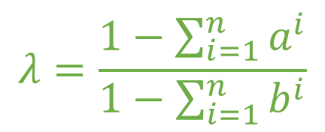



Vector spaces always allow affine “coordinates”
vector
vector basis
extra vector
$v=\sum_{i=1}^{n}{a^{i}e_{i}}$
$e_{0}=\sum_{i=1}^{n}{b^{i}e_{i}}$
for any $λ$
$v=v+λ\left(e_{0}−e_{0}\right)=\sum_{i=1}^{n}{a^{i}e_{i}}+λe_{0}−λ\sum_{i=1}^{n}{b^{i}e_{i}}=λe_{0}+\sum_{i=1}^{n}{\left(a^{i}−λb^{i}\right)e_{i}}$
Want affine combination
$1=λ+\sum_{i=1}^{n}{\left(a^{i}−λb^{i}\right)}=λ+\sum_{i=1}^{n}{a^{i}}−λ\sum_{i=1}^{n}{b^{i}}$ $=λ\left(1−\sum_{i=1}^{n}{b^{i}}\right)+\sum_{i=1}^{n}{a^{i}}$
Why must we have $1−\sum_{i=1}^{n}{b^{i}}≠0$ ?
$$λ=\frac{1−\sum_{i=1}^{n}{a^{i}}}{1−\sum_{i=1}^{n}{b^{i}}}$$
$v=λe_{0}+\sum_{i=1}^{n}{\left(a^{i}−λb^{i}\right)e_{i}}$
${\left\{e_{i}\right\}}_{i=1}^{n}$ affine basis

Slide 20



Convex space
$$v$$
Set that always allows convex combinations
Statistical mixtures are convex combinations
$$w$$
$$pe_{1}+\left(1−p\right)e_{2}$$
Also
Space of statistical ensembles is a convex subset of a real vector space

Slide 21







Space of quantum ensembles (i.e. density matrices/operators) is a convex subset of a real vector space
$$e_{1}$$
Finite dimensional case
$$ρ=∑λ^{i}e_{i}$$
$$∑λ^{i}=1$$
$$e_{2}$$
$$e_{4}$$
$⇒$ Every ensemble is an affine combination of an affine basis
$$e_{3}$$

Slide 22






Infinite dimensional case: Wigner quasi-probability distributions
For each state (mixed or pure), we want a function $W\left(x,p\right)$ such that
$$=tr\left(Aρ\right)=$$
$$\iint{a\left(x,p\right)W\left(x,p\right)dxdp}$$
$$\left\langle A\right\rangle$$
$$=\left\langle ψ\left|A\right|ψ\right\rangle =$$
Since both trace and integral are linear operators, the map $ρ↦W\left(x,p\right)$ must be linear
$⇒$ $W\left(x,p\right)$ is an affine representation
Many such representations!

Slide 23
Infinite dimensional case: Wigner quasi-probability distributions
Wigner representation requires products correspond to symmetrized operator averages
$$\iint{x^{2}p^{2}W\left(x,p\right)dxdp}=\left\langle \frac{1}{6}\left(X^{2}P^{2}+XPXP+XPPX+PXXP+PXPX+P^{2}X^{2}\right)\right\rangle$$

Slide 24
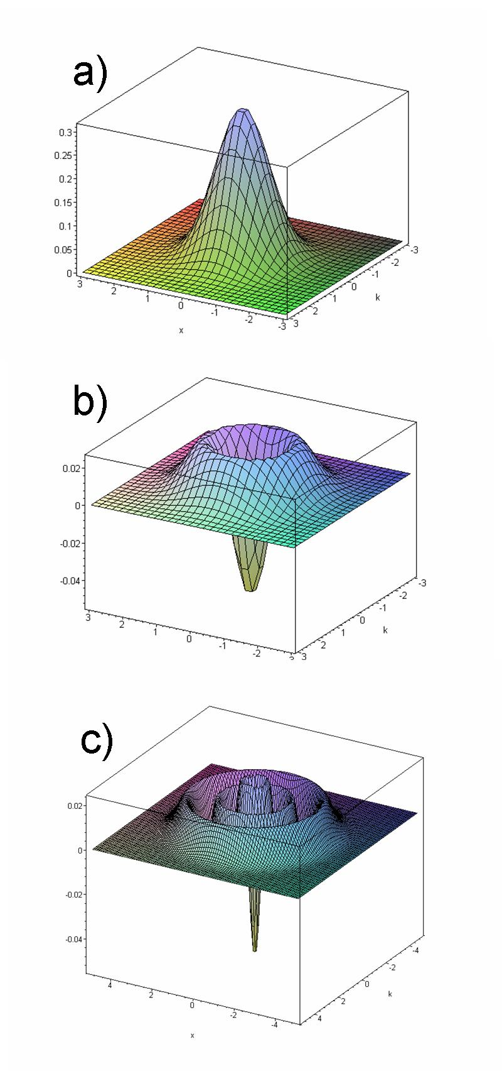



Quasi-probability distribution
Wigner function for first two solutions of the harmonic oscillator
Wigner function
$$W\left(x,p\right)=\frac{1}{πℏ}\int_{X}{\left\langle x−y\left|ρ\right|x+y\right\rangle e^{2ıpy/ℏ}dy}$$
Can be negative: no clear meaning
Recovers marginal distributions
$$ρ\left(x\right)=⟨x|ρ|x⟩=∫W\left(x,p\right)dp$$
$$ρ\left(p\right)=⟨p|ρ|p⟩=∫W\left(x,p\right)dx$$
Wikipedia

Slide 25
Not all functions that integrate to one are valid quantum states
To be expected: ensembles are a bounded convex subset of the vector space
Not all non-negative functions that integrate to one (i.e. “probability distributions”) are valid quantum states
To be expected: a Gaussian that violates the uncertainty principle cannot correspond to a valid quantum state
Not all quantum states correspond to non-negative functions that integrate to one (i.e. “probability distributions”)
For pure states, $W\left(x,p\right)≥0$ if and only if $ψ=e^{−ax^{2}+bx+c}$ (i.e. Gaussian wave-packet)
Not all states are “probabilities” (i.e. convex combinations) Not all “probabilities” (i.e. convex combinations) are states

Slide 26
Takeaways
Negative probabilities are simply affine combinations
ALL vector spaces allow affine combinations The only physical requirement is that ensembles are subsets of a vector space (which is ALWAYS true)
Infinitely many ways to represent states with affine combinations
No intrinsic meaning to negative probability
One can choose the representation more useful for a specific problem
No “best” representation

Slide 28

$$|1⟩$$
$$θ$$
$$|−⟩$$
$$|+⟩$$
$$|0⟩$$

Slide 29
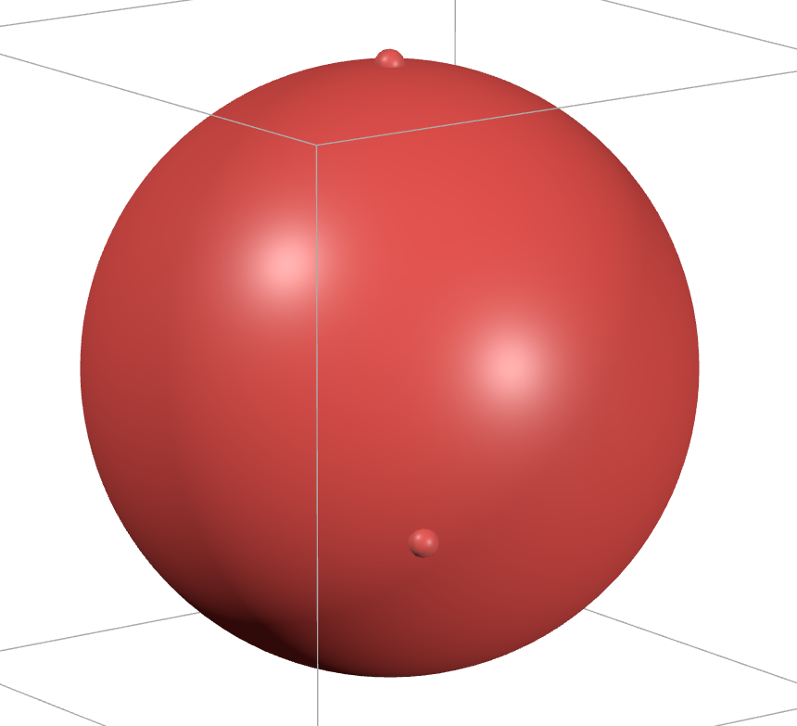
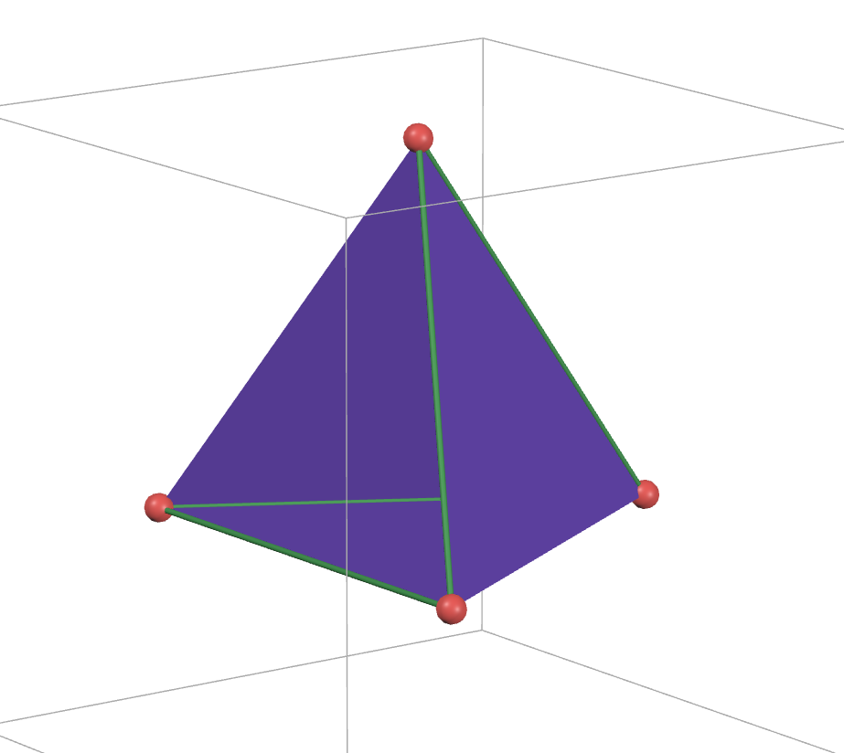
$$|1⟩$$
$$|−⟩$$
$$|+⟩$$
$$|0⟩$$

Slide 30














Linear vs affine vs convex combinations
$$v$$
Linear combinations: $av+bw$ with $a+b∈ℝ$
$$w$$
$$v$$
$⇒$ Plane spanned by $v$ and $w$
Start with two vectors
$$w$$
$$v$$
Affine combinations: $av+bw$ with $a+b=1$
$⇒$ Line connecting $v$ and $w$
$$w$$
Convex combinations: $av+bw$ with $a+b=1$
and $a,b∈\left[0,1\right]$
$$v$$
$⇒$ Line connecting $v$ and $w$
$$w$$

Slide 31


















Linear vs affine vs convex combinations
$$v$$
$$v+w$$
Start with two points
$$a+b∈ℝ$$
$$a,b∈ℝ$$
$$v$$
$$w$$
Linear combinations
$⇒$ Plane spanned by $v$ and $w$
$$av+bw$$
$$w$$
$$O$$
$$v$$
$$a+b=1$$
$$a,b∈ℝ$$
$$\left[0,1\right]v+\left[0,1\right]w$$
Affine combinations
$$w$$
$⇒$ Line connecting $v$ and $w$
$$v$$
Convex combination
$$a+b=1$$
$$a,b∈\left[0,1\right]$$
$⇒$ Segment connecting $v$ and $w$
$$w$$

