Slide 1
Kinematics vs Dynamics
Gabriele Carcassi
Notes:
In a previous video we saw that Newtonian mechanics is “bigger” than Lagrangian mechanics, as not all Newtonian systems admit a Lagrangian description. Now, if you asked: which systems are these, I’d tell you: the non conservative one. And some of you would say: wait a minute: I have seen a Lagrangian, or a Hamiltonian for dissipative systems. You just need time varying Hamiltonians! But how can it be? You see: Hamiltonian systems do not allow equilibria. And dissipative systems, once they lose their energy, they reach an equilibria. So, are those Lagrangian really describing dissipative system? No! They are not! But you should not take my word for it. You should look at the details and double check yourself.
So, we’ll go through the details of one example. Particle under lineardrag. We will find a Lagrangian and a Hamiltonian for it. And we’ll see that they are not quite right. And they are more likely describing something else entirely. You’ll be the judge of what makes the most sense. And then I’ll conclude with a small rant about physical precision vs mathematical precision…

Slide 2
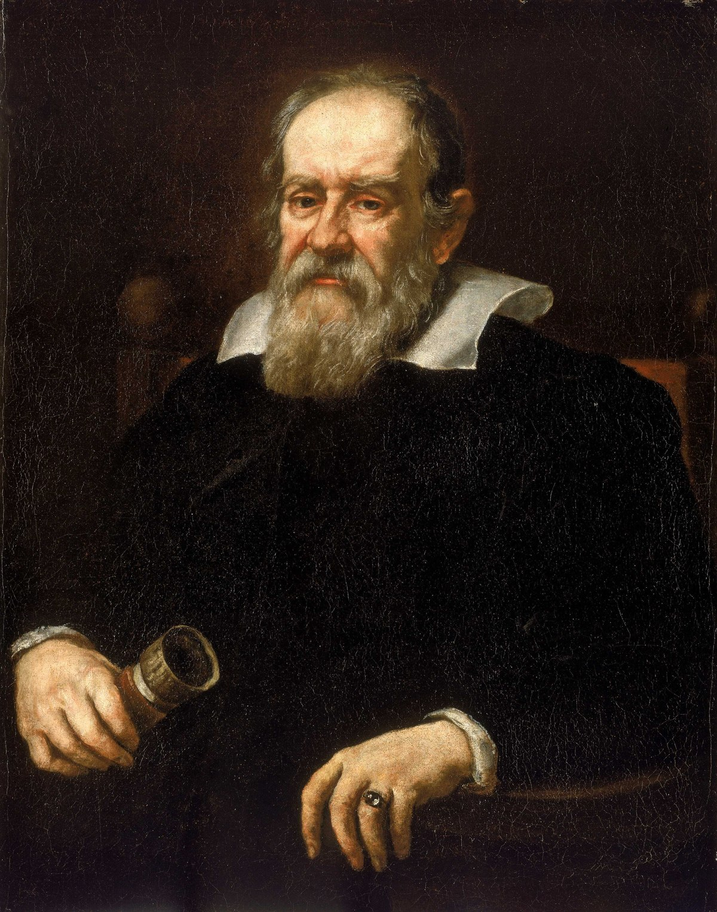
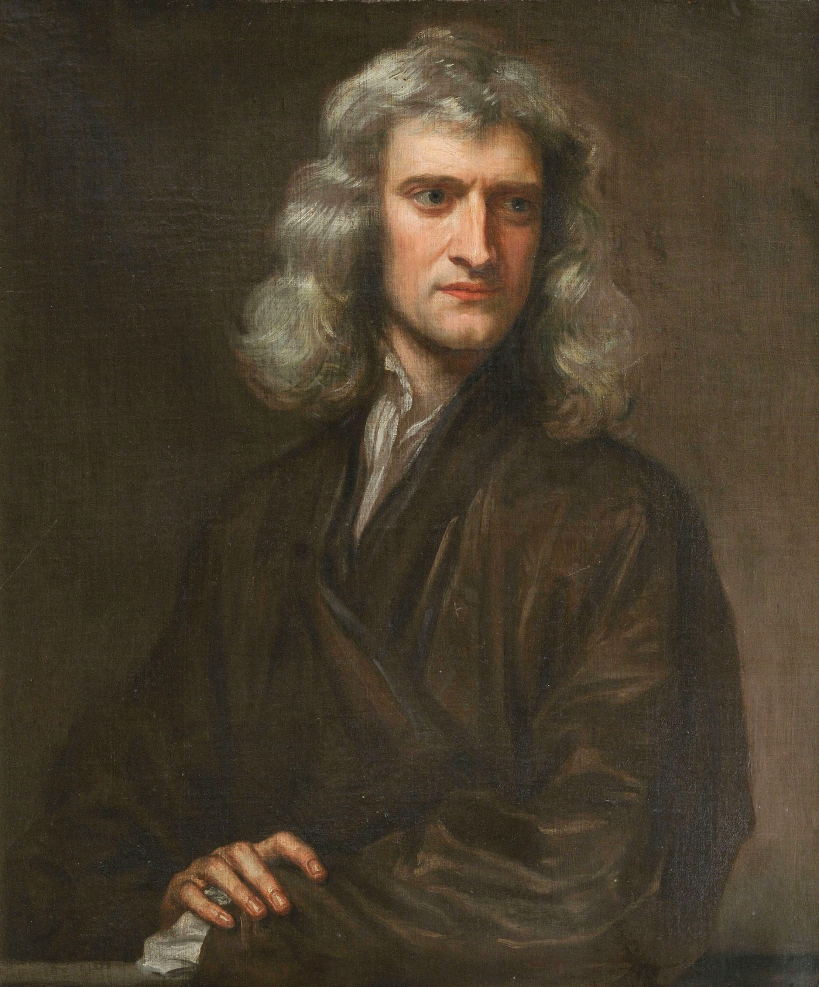
What Galileo worked on
Kinematics: Describe the motion of a system in space and time (position, velocity, acceleration)
Dynamics: Describe the cause of motion (force, mass, momentum, energy)
What Newton worked on
Notes:
The kinematics is not enough to reconstruct the dynamics
Lagrangian hides the connection
Kinematics: what Galileo did, Newton did
Image sources: https://en.wikipedia.org/wiki/Galileo_Galilei
https://en.wikipedia.org/wiki/Isaac_Newton

Slide 3










State
Dynamics
Evolution
Newtonian Mechanics:
$x^{i}$ and $v^{i}$
$${F^{i}(x}^{j},v^{k},t)$$
$$F^{i}=d_{t}mv^{i}$$
position
velocity
Lagrangian Mechanics:
$x^{i}$ and $v^{i}$
$${L(x}^{i},v^{j},t)$$
$$∂_{x^{i}}L=d_{t}∂_{v^{i}}L$$
$$d_{t}q^{i}=∂_{p_{i}}H$$
Hamiltonian Mechanics:
$q^{i}$ and $p_{i}$
$${H(q}^{i},p_{j},t)$$
position
conjugate momentum
$$d_{t}p_{i}=∂_{q^{i}}H$$
Notes:
TODO: transform it into a “Table”
Equations of motion (instead of Evolution of he system)
Mechanics are the rows
TODO: add hyperregularity of Lagrangian

Slide 4

Particle Under Linear Drag
Velocity:
Drag:
$F=ma=−bv$

Slide 5
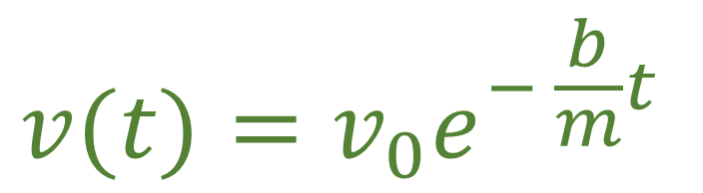



Particle Under Linear Drag: Newtonian Mechanics
$$F=ma=−bv$$
$$\frac{dv}{dt}=−\frac{b}{m}v$$
Initial velocity
$$⇒$$
$$v(t)=v_{0}e^{− \frac{b}{m}t}$$

Slide 6


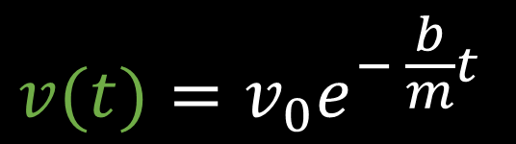






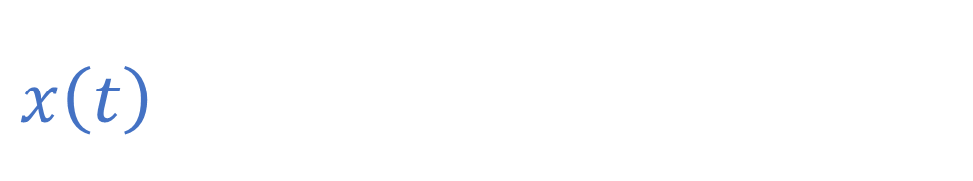


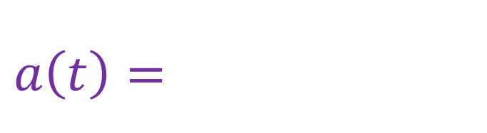

$$F=ma=−bv$$
Initial velocity
$$x$$
Initial position
$$x_{0}+\frac{m}{b}v_{0}$$
$$x\left(t\right)=x_{0}+v_{0}\frac{m}{b}(1−e^{− \frac{b}{m}t})$$
$$v$$
$$x_{0}$$
$$v(t)=v_{0}e^{− \frac{b}{m}t}$$
$$v_{0}$$
$$t$$
$$a\left(t\right)=−v_{0}\frac{b}{m}e^{− \frac{b}{m}t}$$
$$t$$
$$a$$
$$t$$
Kinematics
$$−\frac{b}{m}v_{0}$$

Slide 7

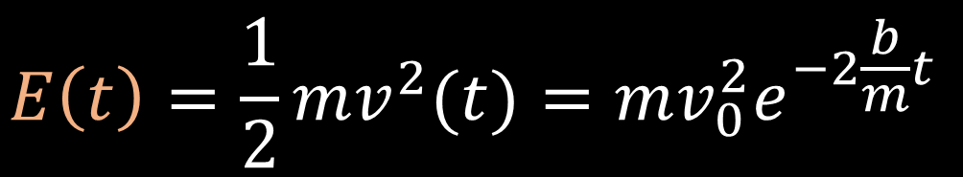




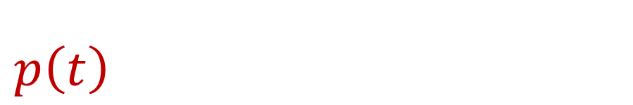

$$F=ma=−bv$$
$$E$$
$$\frac{1}{2}mv_{0}^{2}$$
$$E\left(t\right)=\frac{1}{2}mv^{2}(t)=mv_{0}^{2}e^{−2\frac{b}{m}t}$$
$$p\left(t\right)=mv(t)={mv}_{0}e^{− \frac{b}{m}t}$$
$$p$$
$$t$$
$${mv}_{0}$$
Dynamics
$$t$$

Slide 8



Lagrangian for linear drag?
$$L=\frac{1}{2}mv^{2}e^{\frac{b}{m}t}$$
$$∂_{x}L=0=d_{t}∂_{v}L=d_{t}\left(mv_{ }e^{\frac{b}{m}t}\right) \\ =mae^{\frac{b}{m}t}+\frac{b}{m}mve^{\frac{b}{m}t}=e^{\frac{b}{m}t}\left(ma+bv\right)$$
Recover particle under linear drag!!!
$$ma=−bv$$

Slide 9







Hamiltonian for linear drag?
$$L=\frac{1}{2}mv^{2}e^{\frac{b}{m}t}$$
$$p=∂_{v}L$$
$$H=pv−L$$
$$p=∂_{v}L=mve^{\frac{b}{m}t}$$
$$v=\frac{p}{m}e^{− \frac{b}{m}t}$$
$$H=pv−L=p\frac{p}{m}e^{− \frac{b}{m}t}−\frac{1}{2}m{\left(\frac{p}{m}e^{− \frac{b}{m}t}\right)}^{2}e^{ \frac{b}{m}t} \\ =\frac{p^{2}}{m}e^{− \frac{b}{m}t}−\frac{1}{2}\frac{p^{2}}{m}e^{− \frac{b}{m}t}$$
$$H=\frac{1}{2}\frac{p^{2}}{m}e^{− \frac{b}{m}t}$$

Slide 10







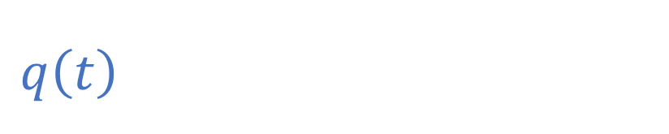

$d_{t}q=$ $∂_{p}H=\frac{p}{m}e^{− \frac{b}{m}t}$
$$H=\frac{1}{2}\frac{p^{2}}{m}e^{− \frac{b}{m}t}$$
$$d_{t}p=−∂_{q}H=0$$
$$q$$
Initial momentum
$$q_{0}+\frac{p_{0}}{b}$$
Initial position
$$q\left(t\right)=q_{0}+\frac{p_{0}}{b}\left(1−e^{− \frac{b}{m}t}\right)$$
$$q_{0}$$
$$t$$
$$p\left(t\right)=p_{0}$$
Same kinematics!

Slide 11

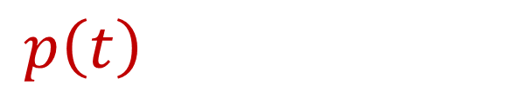
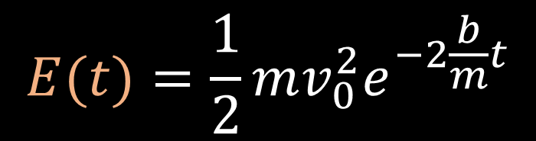

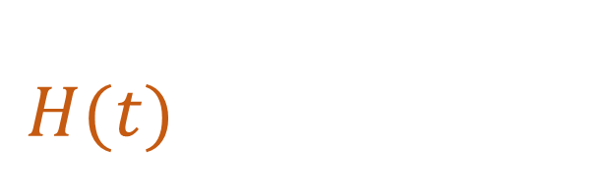




$$H(t)=\frac{1}{2}\frac{p_{0}^{2}}{m}e^{− \frac{b}{m}t}$$
$$E$$
$${\frac{p_{0}^{2}}{2m}}_{0}$$
Mismatch in
dynamics
$$E(t)=\frac{1}{2}mv_{0}^{2}e^{−2\frac{b}{m}t}$$
$$t$$
$$p$$
$$p\left(t\right)=p_{0}=mv_{0}$$
$$p_{0}$$
$$mv\left(t\right)=mv_{0}e^{− \frac{b}{m}t}$$
$$t$$

Slide 12




The Hamiltonian is not always the energy
Conjugate momentum is not always kinetic momentum
Then what exactly are they?
kind of true…
$$p_{α}=mg_{αβ}u^{β}+𝔮A_{α}$$
but nothing to do with this case
No drag
Drag
No drag
$$p=mv$$
$$p≠mv$$
$p=mv$?

Slide 13
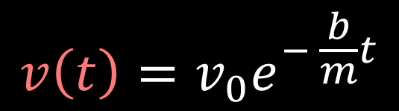
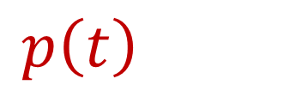


$$p\left(t\right)=p_{0}$$
Suppose
$$p\left(t\right)=\hat{m}\left(t\right)v\left(t\right)$$
$$v\left(t\right)=v_{0}e^{− \frac{b}{m}t}$$
$$\hat{m}\left(t\right)=\frac{p\left(t\right)}{v\left(t\right)}=me^{\frac{b}{m}t }$$
Variable mass!

Slide 14




Variable Mass System:
Velocity:
Mass:
$$\hat{m}$$
$$\hat{m}\left(t\right)=\frac{p\left(t\right)}{v\left(t\right)}=me^{\frac{b}{m}t }$$
$$m$$
$$t$$
Notes:
Add picture of a variable mass system

Slide 15





Variable Mass System: Newtonian Mechanics
$$F^{i}=d_{t}\left(\hat{m}v^{i}\right)=d_{t}\hat{m}v^{i}\text{+ }\hat{m}a^{i}$$
$$\hat{m}\left(t\right)=me^{\frac{b}{m}t }$$
$$m{ae}^{\frac{b}{m}t}=0−d_{t}me^{\frac{b}{m}t}v=−\frac{b}{m}me^{\frac{b}{m}t}v=−bve^{\frac{b}{m}t}$$
$$F=ma=−bv$$
$⇒$We have the same equation as a particle under linear drag
With different physics!

Slide 16







Hamiltonian for Variable Mass System?
$$p=mve^{\frac{b}{m}t}$$
$$v=\frac{p}{m}e^{− \frac{b}{m}t}$$
$$\hat{m}=\frac{p}{v}=me^{\frac{b}{m}t}$$
$$H=pv−L$$
$$L=\frac{1}{2}mv^{2}e^{\frac{b}{m}t}$$
$$H=\frac{1}{2}\frac{{p(t)}^{2}}{m}e^{− \frac{b}{m}t}=\frac{1}{2}\frac{{p(t)}^{2}}{\hat{m}(t)}=\frac{1}{2}\hat{m}\left(t\right)v^{2}\left(t\right)=E(t)$$
$⇒$Now the dynamics of the system are correct

Slide 17
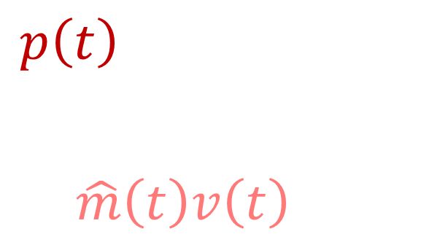

$$H\left(t\right)=\frac{1}{2}\frac{p_{0}^{2}}{m}e^{− \frac{b}{m}t}=\frac{1}{2}\frac{{p\left(t\right)}^{2}}{\hat{m}\left(t\right)} \\ =\frac{1}{2}\hat{m}\left(t\right)v^{2}\left(t\right)=E(t)$$
$$E$$
$${\frac{p_{0}^{2}}{2m}}_{0}$$
$$t$$
Same dynamics!
$$p$$
$$p\left(t\right)=p_{0} \\ =mv_{0}e^{\frac{b}{m}t }e^{−\frac{b}{m}t } \\ =\hat{m}\left(t\right)v\left(t\right)$$
$$p_{0}$$
$$t$$

Slide 18
Same kinematics (i.e. the motion of the body) can be achieved with different dynamics (i.e. causes of motion)
Lagrangian/Hamiltonian mechanics give a particular dynamics for each kinematics: which one?

Slide 19





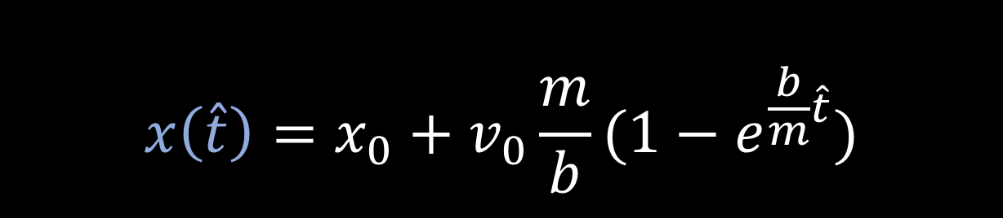

Compare with the motion of a free particle
Does not look that different
$$x\left(\hat{t}\right)=x_{0}+v_{0}\frac{m}{b}(1−e^{\frac{b}{m}\hat{t}})$$
$$x\left(t\right)=x_{0}+v_{0}t$$
$$x$$
$$x$$
$$t=\frac{m}{b}(1−e^{\frac{b}{m}\hat{t}})$$
$$t$$
$$\hat{t}$$
Non-inertial clock
Notes:
Image: draw a map of t to t^ (play around with t vs q and t^ vs q

Slide 20




Non-Inertial clock in Newtonian Mechanics
Keeping the position variable the same:
$$\hat{t}=\hat{t}(t)$$
$F^{i}=d_{t}\hat{t}d_{\hat{t}}\left(mv^{i}\right)=$ $d_{t}\hat{t}d_{\hat{t}}(md_{t}\hat{t}d_{\hat{t}}x^{i}$)
Setting $\hat{m}=md_{t}\hat{t}$:
$$F^{i}=d_{t}\hat{t}d_{\hat{t}}(\hat{m}d_{\hat{t}}x^{i})=d_{t}\hat{t}{\hat{F}}^{i}$$
like in special relativity
We now have a variable effective mass due to the different clock

Slide 21



Calculate the “effective” mass
$$d_{\hat{t}}t=d_{\hat{t}}\left(\frac{m}{b}(1−e^{\frac{b}{m}\hat{t}})\right)=\frac{m}{b}d_{\hat{t}}\left(1−e^{\frac{b}{m}\hat{t}}\right)$$
$$=−\frac{m}{b}d_{\hat{t}}e^{− \frac{b}{m}\hat{t}}=\frac{m}{b}\frac{b}{m}e^{− \frac{b}{m}\hat{t}}=e^{− \frac{b}{m}\hat{t}}$$
Same as variable mass case!
$$\hat{m}=md_{t}\hat{t}=m{(d}_{\hat{t}}{t)}^{−1 }=me^{\frac{b}{m}\hat{t}}$$

Slide 22



Calculate the apparent force
$F=0$ in the inertial frame
$$0=d_{t}\left(mv\right)=d_{t}\left(md_{t}x\right)=d_{t}\hat{t}d_{\hat{t}}\left(md_{t}\hat{t}d_{\hat{t}}x\right)=e^{\frac{b}{m}\hat{t}}d_{\hat{t}}\left(me^{\frac{b}{m}\hat{t}}\hat{v}\right)$$
$$= e^{\frac{b}{m}\hat{t}}(m\frac{b}{m}e^{\frac{b}{m}\hat{t}}\hat{v}+me^{\frac{b}{m}\hat{t}}\hat{a})=e^{2\frac{b}{m}\hat{t}}\left(b\hat{v}+m\hat{a}\right)$$
$$m\hat{a}=−b\hat{v}$$
Apparent force

Slide 23


The dynamics of the Lagrangian/Hamiltonian “for linear drag” are consistent with a free particle in a non-inertial frame and not with a particle under linear drag in an inertial frame
linear drag in inertial frame
$$L=\frac{1}{2}mv^{2}e^{\frac{b}{m}t}$$
$$H=\frac{1}{2}\frac{p^{2}}{m}e^{− \frac{b}{m}t}$$
free particle in non-inertial frame
If you are interested only in the kinematics, fine But a mechanical system is kinematics + dynamics

Slide 24




Since different system may have the same kinematics in different frames
You can’t have frame invariant equations that apply to all systems
Lagrangian/Hamiltonian mechanics fix the system
$$d_{t}q^{i}=∂_{p_{i}}H$$
Only det/rev forces, conservative forces,
forces that do not change entropy
$$∂_{x^{i}}L=d_{t}∂_{v^{i}}L$$
$$d_{t}p_{i}=−∂_{q^{i}}H$$
in all frames
Newtonian mechanics fixes the frame
$$F=ma$$
All forces
only in an inertial frame

Slide 25

We need to be more physically precise
Physically precise $≠$ mathematically precise
Notes:
Not every system that first Hamilton’s equation is a classical mechanical system
Physical precision is not mathematical precision.

Slide 27




Dynamics
Kinematics
Linear Drag
$$x$$
$$x_{0}+\frac{m}{b}v_{0}$$
Variable Mass
$$x_{0}$$
$$t$$
Non-Inertial Frame

Slide 28
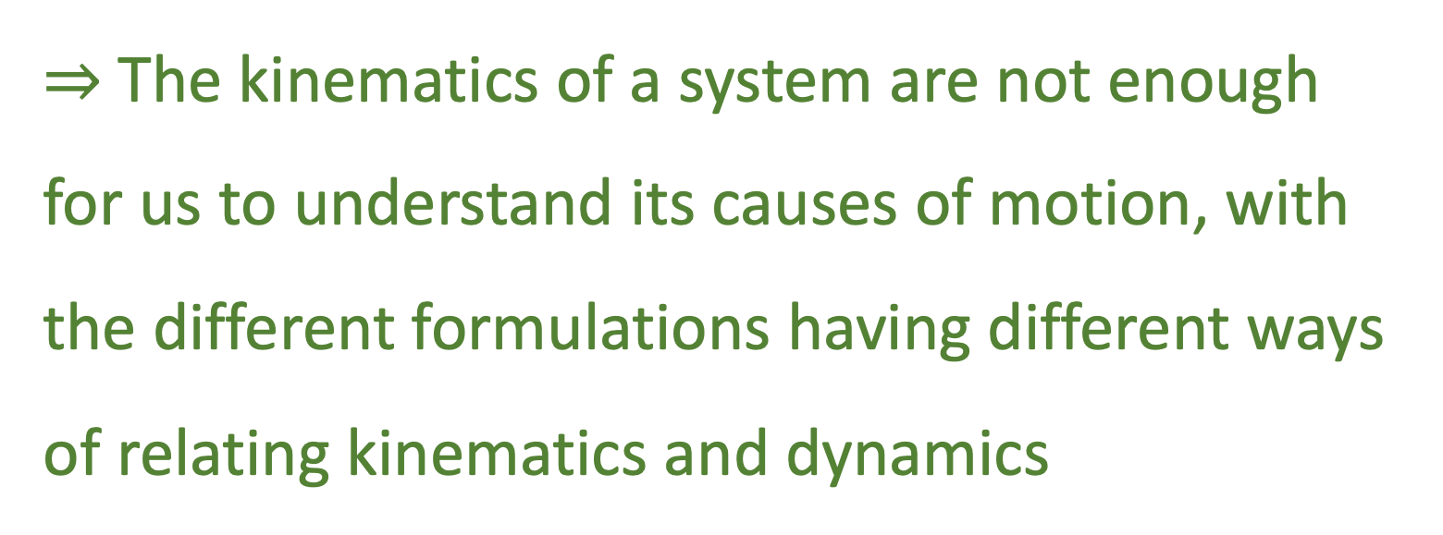
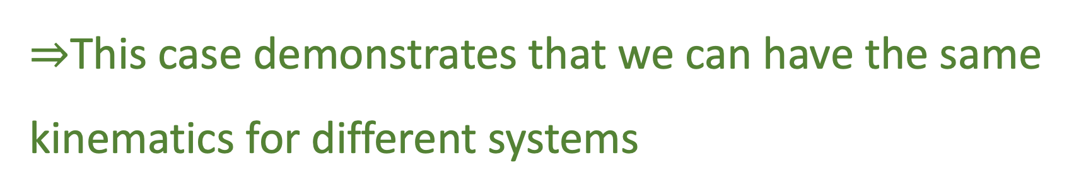
Big Picture:
$⇒$This case demonstrates that we can have the same kinematics for different systems
$⇒$The kinematics of a system are not enough for us to understand its causes of motion, with the different formulations having different ways of relating kinematics and dynamics

Slide 29
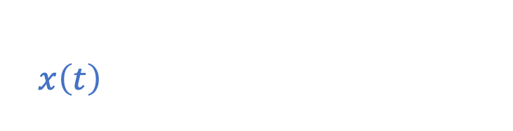


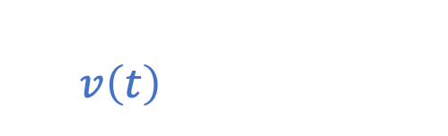


Particle Under Linear Drag: Graphs For Newtonian Mechanics
$$x\left(t\right)=x_{0}+v_{0}\frac{m}{b}\left(1−e^{− \frac{k}{m}t}\right)$$
$$x$$
$$v$$
$$v\left(t\right)=v_{0}e^{− \frac{k}{m}t}$$
$$a$$
$$x_{0}+\frac{m}{b}v_{0}$$
$$v_{0}$$
$$t$$
$$a\left(t\right)=−v_{0}\frac{b}{m}e^{− \frac{k}{m}t}$$
$$x_{0}$$
$$−\frac{b}{m}v_{0}$$
$$t$$
$$t$$
$$E$$
$$E\left(t\right)=\frac{1}{2}mv_{0}^{2}e^{− 2\frac{b}{m}t}$$
$$\frac{1}{2}mv_{0}^{2}$$
$$E(t)$$
$$t$$
Notes:
To Soon: create visual of the example (do with all)
make clear these are Newtonian

Slide 30
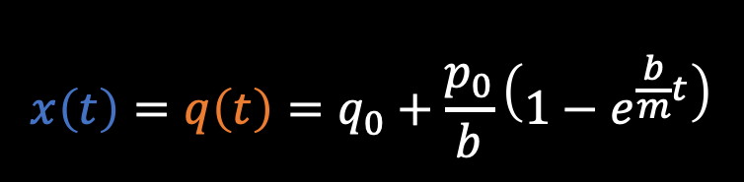







Particle Under Linear Drag Graphs:
$$x\left(t\right)=q\left(t\right)=q_{0}+\frac{p_{0}}{b}\left(1−e^{\frac{b}{m}t}\right)$$
$$p\left(t\right)=p_{0}=mv_{0}$$
$$H(t)=\frac{1}{2}\frac{p^{2}}{m}e^{− \frac{b}{m}t}$$
$$x$$
$$E$$
$$p$$
$$x_{0}+\frac{m}{b}v_{0}$$
$${\frac{p_{0}^{2}}{2m}}_{0}$$
$$p_{0}$$
$$mv\left(t\right)=mv_{0}e^{− \frac{b}{m}t}$$
$$E\left(t\right)=\frac{1}{2}mv_{0}^{2}e^{−2\frac{b}{m}t}$$
$$x_{0}$$
$$t$$
$$t$$
$$t$$
The kinematics for this system seem to be correct, but the dynamics seem off
Notes:
To Soon: create visual of the example (do with all)
make clear these are Newtonian

Slide 31



Lagrangian for Variable Mass System?
$$L=\frac{1}{2}mv^{2}e^{\frac{b}{m}t}$$
We can apply the same Lagrangian:
$$∂_{x}L=0=d_{t}∂_{v}L=d_{t}\left(mv_{ }e^{\frac{b}{m}t}\right) \\ =mae^{\frac{b}{m}t}+\frac{b}{m}mve^{\frac{b}{m}t}=e^{\frac{b}{m}t}\left(ma+bv\right)$$
Recover Variable Mass System!!!
$$ma=−bv$$

Slide 32
Lagrangian for Variable Mass System?
$$L=\frac{1}{2}mv^{2}e^{\frac{b}{m}t}$$
We can apply the same Lagrangian:
$$∂_{x}L=0=d_{t}∂_{v}L=d_{t}\left(mv_{ }e^{\frac{b}{m}t}\right) \\ =mae^{\frac{b}{m}t}+\frac{b}{m}mve^{\frac{b}{m}t}=e^{\frac{b}{m}t}\left(ma+bv\right)$$
Recover Variable Mass System!!!
$$ma=−bv$$

