Slide 1


On the reality of the quantum state once again
Gabriele Carcassi
Physics Department
University of Michigan

Slide 2

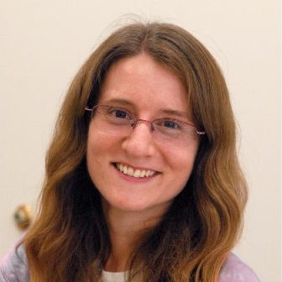


The paper
On the reality of the quantum state once again: a no-go theorem for $ψ$-ontic models
Gabriele Carcassi, Andrea Oldofredi, Christine A. Aidala
Found Phys 54, 14 (2024)
Gabriele Carcassi
Christine A. Aidala
Andrea Oldofredi
University of Michigan
University of Lisbon

Slide 3
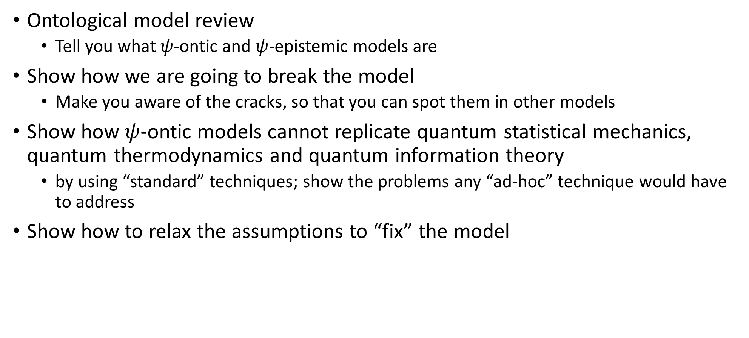
Plan
Ontological model review
Tell you what $ψ$-ontic and $ψ$-epistemic models are
Show how we are going to break the model
Make you aware of the cracks, so that you can spot them in other models
Show how $ψ$-ontic models cannot replicate quantum statistical mechanics, quantum thermodynamics and quantum information theory
by using “standard” techniques; show the problems any “ad-hoc” technique would have to address
Show how to relax the assumptions to “fix” the model

Slide 4
Disclaimer
We are not going to talk about specific interpretations
ONLY about Harrigan-Spekkens categorization
We are not going to talk about epistemic and ontological models in general
ONLY the narrow definition given by the Harrigan-Spekkens categorization
We are not going to talk about the philosophical implications
ONLY the mathematical and physical implications

Slide 5
Ontological model review

Slide 6
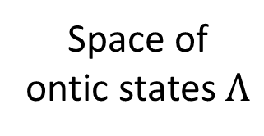
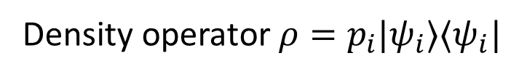
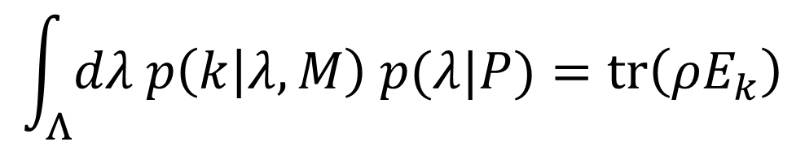
Start with the operational settings for Quantum Mechanics
Preparation protocol $P$
Measurement protocol $M$
Density operator $ρ=p_{i}|ψ_{i}⟩⟨ψ_{i}|$
Measurement values $\left\{k\right\}$
POVM $\left\{E_{k}\right\}$
$p\left(k | P,M\right)=tr\left(ρE_{k}\right)=\sum_{i}{p_{i}{\left|\left\langle φ_{k} | ψ_{i}\right\rangle \right|}^{2}}$
1
Ontological model puts an intermediate step
NB: implicit assumption is that the distribution characterizes lack of knowledge
Space of ontic states $Λ$
Epistemic state
Ontic state
$$\int_{Λ}{dλ p\left(k | λ,M\right) p(λ|P)}=tr\left(ρE_{k}\right)$$

Slide 7
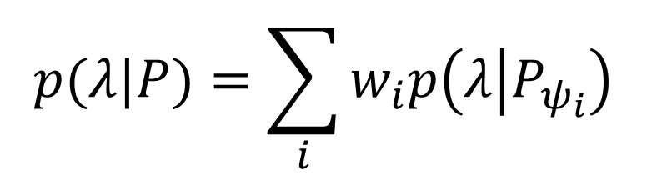
Epistemic states mix using standard (Kolmogorov) probability
2
If $P$ is a mixture of pure states $\left\{ψ_{i}\right\}$ with probabilities $\left\{w_{i}\right\}$
$$p(λ|P)=\sum_{i}{w_{i}p\left(λ | P_{ψ_{i}}\right)}$$
Each ontological model is therefore characterized simply by the epistemic states that correspond to pure states
We will gloss over some technical imprecisions (e.g. probability and probability densities are different objects)

Slide 8





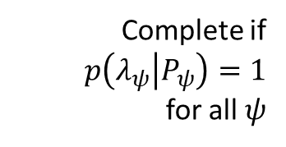



Classify models based on $p\left(λ | P_{ψ_{i}}\right)$
$ψ$-Epistemic models
$ψ$-Ontic models
$$p\left(λ | P_{ψ}\right)$$
$$p\left(λ | P_{φ}\right)$$
$$p\left(λ | P_{ψ}\right)$$
$$p\left(λ | P_{φ}\right)$$
Complete if
$p\left(λ_{ψ} | P_{ψ}\right)=1$
for all $ψ$
$$λ$$
$$λ$$
Can overlap: same ontological state can be prepared in different ways
No overlap: ontological state retains information about preparation
Why these names?

Slide 9
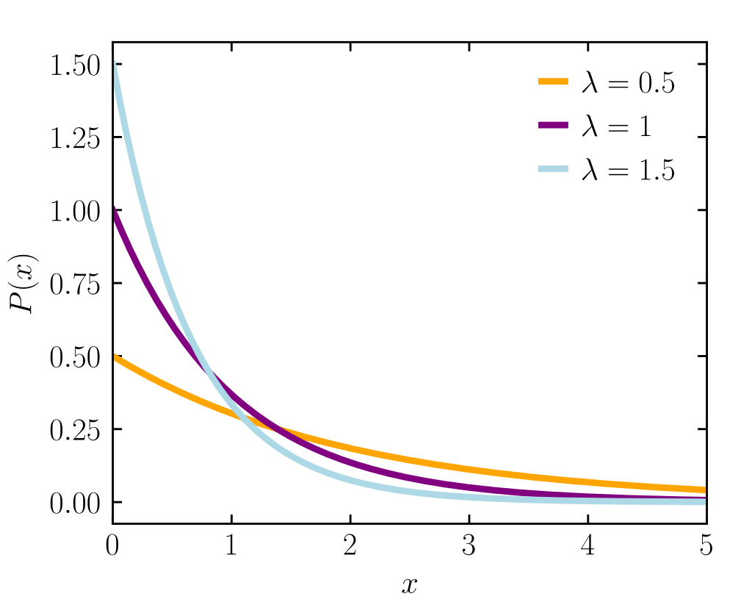


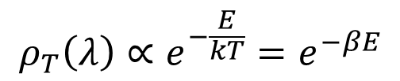

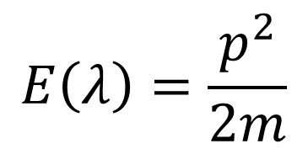






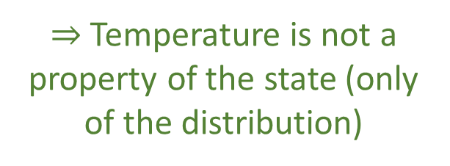
Why these names?
$$ρ_{T}\left(λ\right)∝e^{−\frac{E}{kT}}=e^{−βE}$$
Classical statistical mechanics: energy vs temperature
$$β$$
$$β$$
microstate
$$β$$
$$E\left(λ\right)=\frac{p^{2}}{2m}$$
Each state corresponds to a single value of energy
$$ρ_{T}(E)$$
Different temperature, same microstate
Energy partitions phase space
$$p$$
$$E$$
Wikipedia
Temperature does not partition phase space
$$E(λ)=E_{0}$$
$$q$$
$⇒$ Temperature is not a property of the state (only of the distribution)
$⇒$ Energy is a property of the state

Slide 10
Classify models based on $p\left(λ | P_{ψ_{i}}\right)$
$ψ$-Epistemic models
$ψ$-Ontic models
$$p\left(λ | P_{ψ}\right)$$
$$p\left(λ | P_{φ}\right)$$
$$p\left(λ | P_{ψ}\right)$$
$$p\left(λ | P_{φ}\right)$$
Complete if
$p\left(λ_{ψ} | P_{ψ}\right)=1$
for all $ψ$
$$λ$$
$$λ$$
Can overlap: same ontological state can be prepared in different ways
No overlap: ontological state retains information about preparation
Wave function property of the epistemic state (like temperature)
Wave function property of the ontic state (like energy)
Ruled out by PBR (w/ independent preparation)
What about these?

Slide 11
Can we break the ontological models?

Slide 12
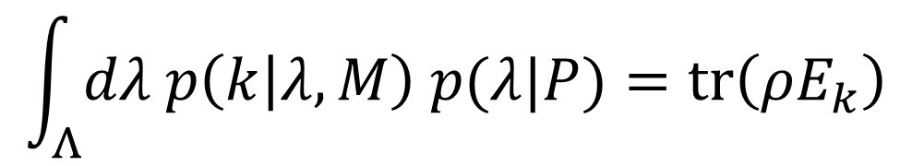

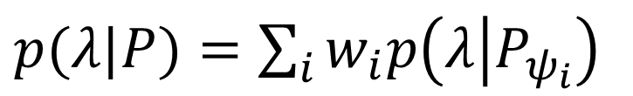
Start with the operational settings for Quantum Mechanics
$$p\left(k | P,M\right)=tr\left(ρE_{k}\right)$$
1
Add an intermediate step (ontic state)
$$\int_{Λ}{dλ p\left(k | λ,M\right) p(λ|P)}=tr\left(ρE_{k}\right)$$
Use classical probability over epistemic states
2
$p(λ|P)=\sum_{i}{w_{i}p\left(λ | P_{ψ_{i}}\right)}$
Can this work?

Slide 13
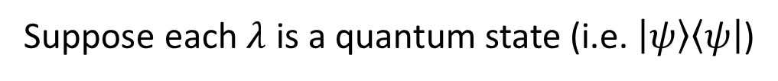
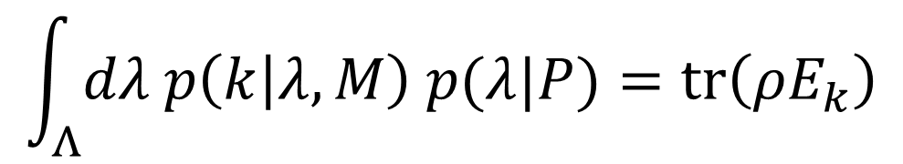
Suppose each $λ$ is a quantum state (i.e. $\left|ψ\right\rangle \left\langle ψ\right|$)
$$\int_{Λ}{dλ p\left(k | λ,M\right) p(λ|P)}=tr\left(ρE_{k}\right)$$
Done!
Hide the inner product there
Not so fast!
Recall that $p(λ|P)$ combines using classical probability
This assumes that quantum statistical mechanics is simply classical statistical mechanics over the space of quantum states
Not the case!

Slide 14
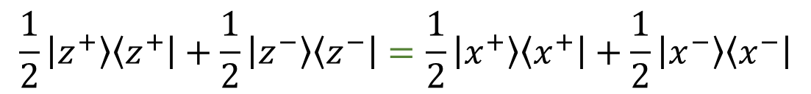
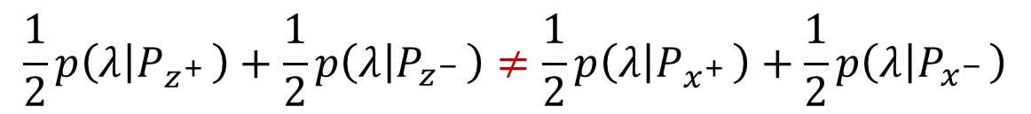
Quantum preparations do not follow classical probability
$$\frac{1}{2}p\left(λ | P_{z^{+ }}\right)+\frac{1}{2}p\left(λ | P_{z^{− }}\right)≠\frac{1}{2}p\left(λ | P_{x^{+ }}\right)+\frac{1}{2}p\left(λ | P_{x^{− }}\right)$$
Multiple decompositions!
$$\frac{1}{2}\left|z^{+}\right\rangle \left\langle z^{+}\right|+\frac{1}{2}\left|z^{−}\right\rangle \left\langle z^{−}\right|=\frac{1}{2}\left|x^{+}\right\rangle \left\langle x^{+}\right|+\frac{1}{2}\left|x^{−}\right\rangle \left\langle x^{−}\right|$$
Inner product determines the equality!
$⇒$ Inner product is not JUST about measurements!
Biggest misconception is that quantum effects are about measurements
The uncertainty principle is about preparations, not measurements!

Slide 15
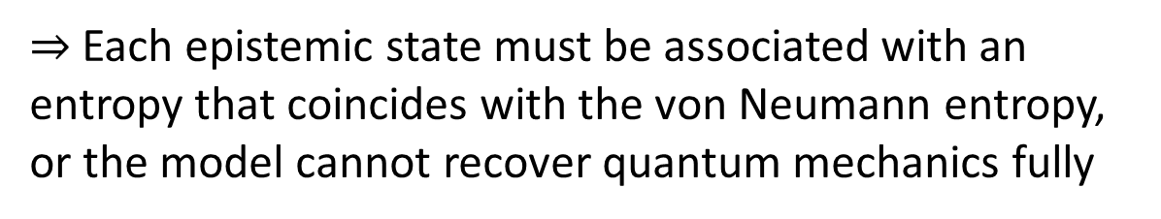
But this recovers all the expectation values of all observables!
Surely, that must be enough!
$$\int_{Λ}{dλ p\left(k | λ,M\right) p(λ|P)}=tr\left(ρE_{k}\right)$$
Not enough!
Quantum statistical mechanics and quantum thermodynamics depend on the thermodynamic entropy, which corresponds to the von Neumann entropy
The von Neumann entropy is defined on preparations, and is not a Hermitian operator! (no eigenstates of entropy)
This is how we break the model
$⇒$ Each epistemic state must be associated with an entropy that coincides with the von Neumann entropy, or the model cannot recover quantum mechanics fully

Slide 16
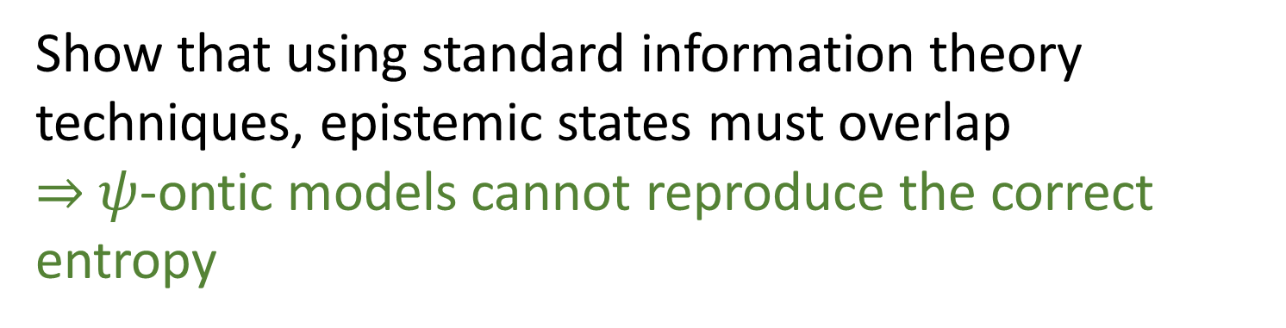
Premise: to reproduce quantum mechanics, one must reproduce all predictions of the theory, including those coming from quantum statistical mechanics and quantum thermodynamics
Show that the degree of overlap between two epistemic states is linked to the entropy of the mixture of the two distributions
Show that using standard information theory techniques, epistemic states must overlap $⇒$ $ψ$-ontic models cannot reproduce the correct entropy

Slide 17
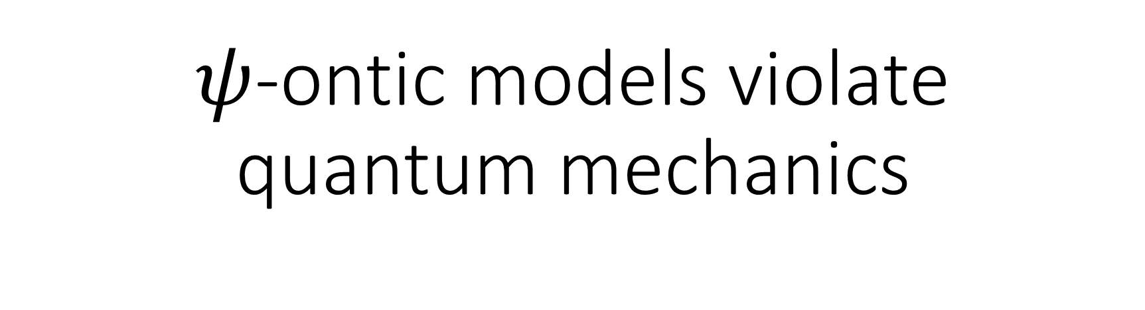
$ψ$-ontic models violate quantum mechanics

Slide 18

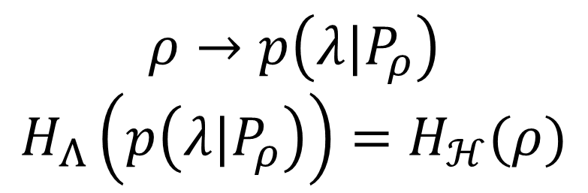


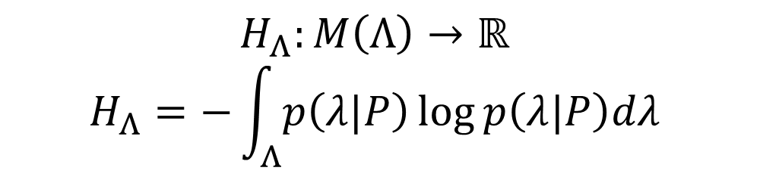

Quantum mechanics
Ontological model
space of mixtures
$M\left(ℋ\right)$ - density operators
$M\left(Λ\right)$ - probability measures
entropy
$$H_{ℋ}:M\left(ℋ\right)→ℝ \\ H_{ℋ}=−tr\left(ρ\log{ρ}\right)$$
$$H_{Λ}:M\left(Λ\right)→ℝ$$
$$H_{Λ}=−\int_{Λ}{p\left(λ|P\right)\log{p\left(λ|P\right)dλ}}$$
Quantum preparation
Epistemic state
$$ρ→p\left(λ|P_{ρ}\right)$$
$$H_{Λ}\left(p\left(λ|P_{ρ}\right)\right)=H_{ℋ}(ρ)$$
Natural choice, given that $M\left(Λ\right)$ is the space of probability measures
Only indicator of variability that is continuous, monotone and linear in probability
Eur. J. Phys. 42, 045102 (2021)
Need

Slide 19
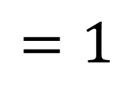
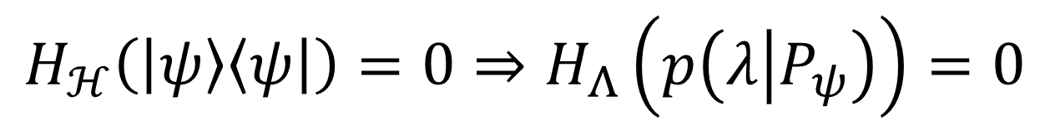
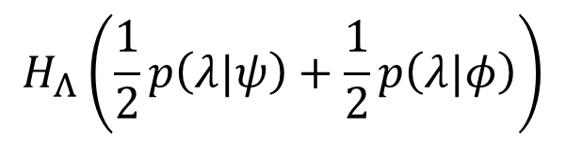
The entropy of a pure state is zero
$$H_{ℋ}\left(\left|ψ\right\rangle \left\langle ψ\right|\right)=0⇒H_{Λ}\left(p\left(λ | P_{ψ}\right)\right)=0$$
probability vs probability density
In a $ψ$-ontic model the distributions are not overlapping
$$H_{Λ}\left(\frac{1}{2}p\left(λ|ψ\right)+\frac{1}{2}p\left(λ|φ\right)\right)$$
$=−\int_{Λ}{\frac{1}{2}\left(p\left(λ|ψ\right)+p\left(λ|φ\right)\right) log\frac{1}{2}\left(p\left(λ|ψ\right)+p\left(λ|φ\right)\right) dλ}$
$=−\int_{U_{ψ}}{\frac{1}{2}p\left(λ|ψ\right) log\frac{1}{2}p\left(λ|ψ\right)dλ}−\int_{U_{φ}}{\frac{1}{2}p\left(λ|φ\right) log\frac{1}{2}p\left(λ|φ\right)}dλ$
$=\frac{1}{2}H_{Λ}\left(p\left(λ|ψ\right)\right)+\frac{1}{2}H_{Λ}\left(p\left(λ|φ\right)\right)−\frac{1}{2}\left[\int_{U_{ψ}}{p\left(λ|ψ\right) }+\int_{U_{φ}}{p\left(λ|φ\right) }\right]log\frac{1}{2}$
$$=1$$

Slide 20
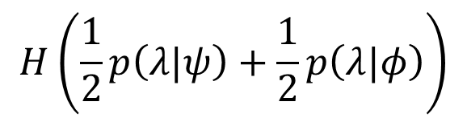
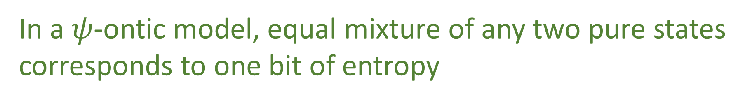

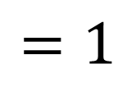
In a $ψ$-ontic model, equal mixture of any two pure states corresponds to one bit of entropy
$$H\left(\frac{1}{2}p\left(λ|ψ\right)+\frac{1}{2}p\left(λ|φ\right)\right)$$
NO GO!
$$=1$$
In QM, it depends on the inner product
$$p={\left|\left\langle ψ | φ\right\rangle \right|}^{2}$$
$$0≤H\left(\frac{1}{2}ρ_{ψ}+\frac{1}{2}ρ_{φ}\right)=−\frac{1+\sqrt{p}}{2}\log{\frac{1+\sqrt{p}}{2}}−\frac{1−\sqrt{p}}{2}\log{\frac{1−\sqrt{p}}{2}}≤1$$
The degree of overlap between epistemic states is constrained by the entropic structure of the mixed states

Slide 21
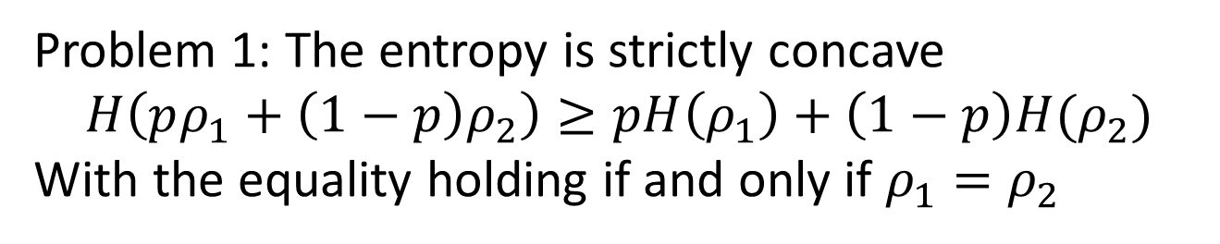
Couldn’t we simply use a different formula for entropy, instead of the standard one?
Sure: provide one! You can’t simply say: we can use another one. You need to show that you can use it for MaxEnt, etc…
Problem 1: The entropy is strictly concave $$H\left(pρ_{1}+\left(1−p\right)ρ_{2}\right)≥pH\left(ρ_{1}\right)+\left(1−p\right)H(ρ_{2})$$
With the equality holding if and only if $ρ_{1}=ρ_{2}$
But the same density operator can correspond to different classical mixtures!
Problem 2: The entropy requires the inner product
The inner product must be “hidden” in both $p\left(k | λ,M\right)$and $H_{Λ}\left(p\left(λ | P\right)\right)$
Other problems: entropy is finite for distributions on finite and infinite states, entropy on composite systems, …

Slide 22
The problem with ontological models

Slide 23


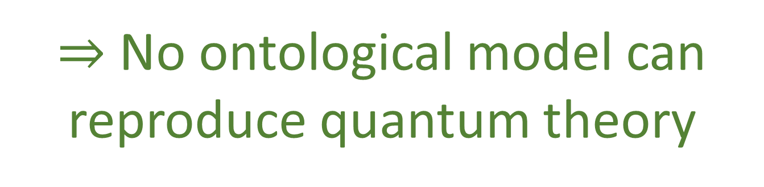
PBR shows that $ψ$-epistemic models (that assume independence) are ruled out
We showed that $ψ$-ontic models are ruled out
In the same way that entropy “knows” about overlap, it “knows” about independence: it is subadditive, with additivity if and only if you have independence. You can construct a similar argument to what we gave to rule out non-independence for $ψ$-epistemic models
That fits the definitions we gave!
$⇒$ No ontological model can reproduce quantum theory

Slide 24
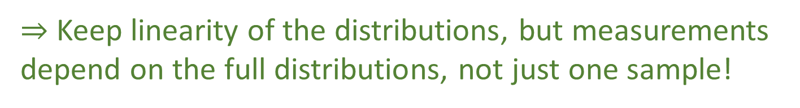
The ontological model is too classical
How can we fix it? Let’s go back to the two assumptions:
NB: implicit assumption is that the distribution characterizes lack of knowledge: everything depends on one sample!
1
Add an intermediate step (ontic state)
$$\int_{Λ}{dλ p\left(k | λ,M\right) p(λ|P)}=tr\left(ρE_{k}\right)$$
Not even true in classical statistical mechanics: temperature depends on the distribution, which describes how the system is fluctuating!
$⇒$ Keep linearity of the distributions, but measurements depend on the full distributions, not just one sample!

Slide 25
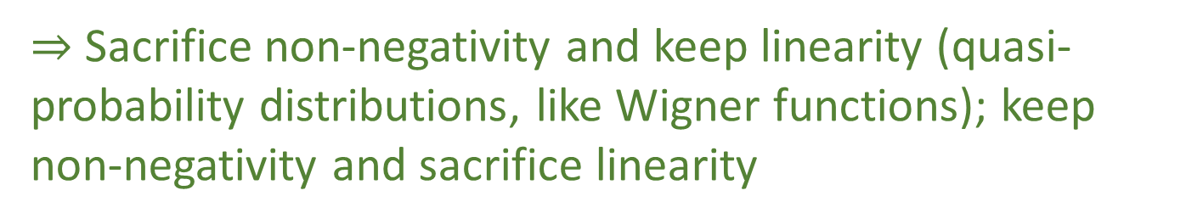
The ontological model is too classical
How can we fix it? Let’s go back to the two assumptions:
Use classical probability over epistemic states
2
$p(λ|P)=\sum_{i}{w_{i}p\left(λ | P_{ψ_{i}}\right)}$
Brings in classical probability
(i.e. additivity of measures)
There are already results that classical probability theory cannot replicate quantum probability: use an extension
$⇒$ Sacrifice non-negativity and keep linearity (quasi-probability distributions, like Wigner functions); keep non-negativity and sacrifice linearity

