Slide 1


Reverse Physics: from laws to physical assumptions
Gabriele Carcassi
Physics Department
University of Michigan

Slide 2


The paper
Reverse Physics – From laws to physical assumptions
Gabriele Carcassi, Christine A. Aidala
Foundations of Physics (2022)
Gabriele Carcassi
Christine A. Aidala
University of Michigan

Slide 3
Reverse Physics
Physics
Smallest set of assumptions required to rederive the theory
Physical theory
Physical result/ effect/prediction
Reverse Mathematics
Mathematics
Smallest set of axioms required to prove the theorem
Theorem
Mathematical result/ corollary/calculation

Slide 4
Plan
Reversing classical Hamiltonian mechanics
Using reverse physics for reformulation. Six alternative characterizations of Hamiltonian mechanics that connect ideas from different fields.
Uncertainty principle in classical and quantum mechanics
Using reverse physics for dependency analysis. Quantum uncertainty principle is not a consequence of the full quantum theory, but just the zero entropy bound on pure states.
The third law of thermodynamics revisited
Using reverse physics for reconceptualization. Zero entropy is associated to the “empty system” (instead of to a “crystalline structure”) making the third law a logical necessity.
Discussion and conclusions

Slide 5
Reversing Hamiltonian mechanics
one degree of freedom

Slide 6

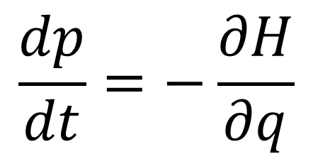
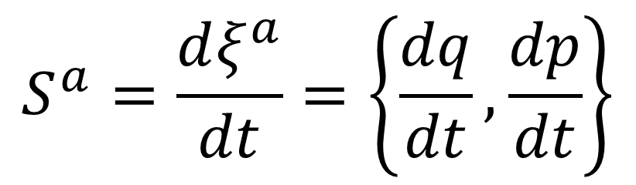
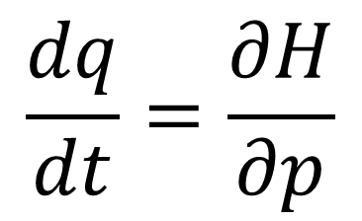

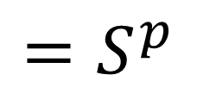

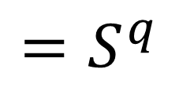
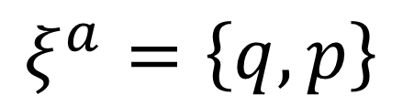

(1) Hamilton’s equations
$$p$$
$$=ξ^{2}$$
$$q$$
$$=ξ^{1}$$
$$\frac{dq}{dt}=\frac{∂H}{∂p}$$
$$=S^{q}$$
$$ξ^{a}=\left\{q,p\right\}$$
$$\frac{dp}{dt}=−\frac{∂H}{∂q}$$
$$=S^{p}$$
$$S^{a}=\frac{dξ^{a}}{dt}=\left\{\frac{dq}{dt},\frac{dp}{dt}\right\}$$

Slide 7

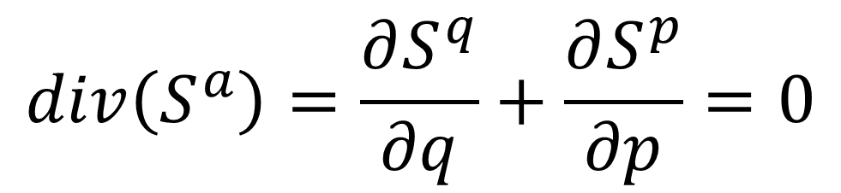
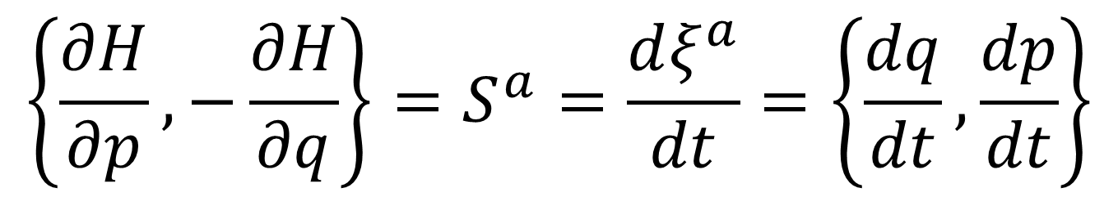
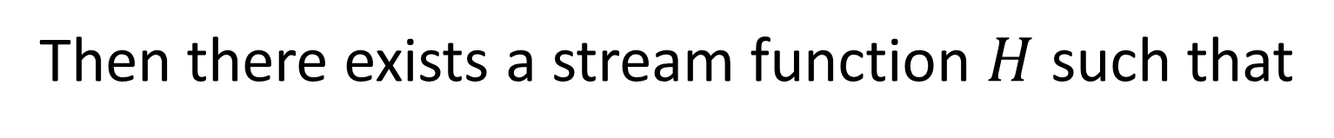
(2) Divergenceless displacement
$$p$$
$$=ξ^{2}$$
Suppose $S^{a}$ divergenceless
$$q$$
$$=ξ^{1}$$
$$div\left(S^{a}\right)=\frac{∂S^{q}}{∂q}+\frac{∂S^{p}}{∂p}=0$$
Then there exists a stream function $H$ such that
$$\left\{\frac{∂H}{∂p},−\frac{∂H}{∂q}\right\}=S^{a}=\frac{dξ^{a}}{dt}=\left\{\frac{dq}{dt},\frac{dp}{dt}\right\}$$

Slide 8
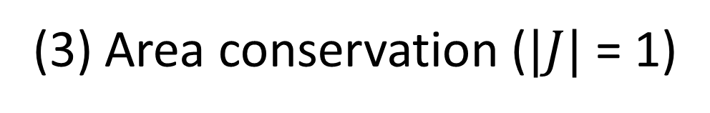
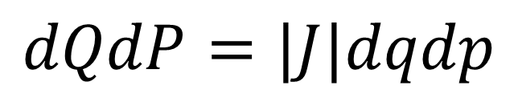
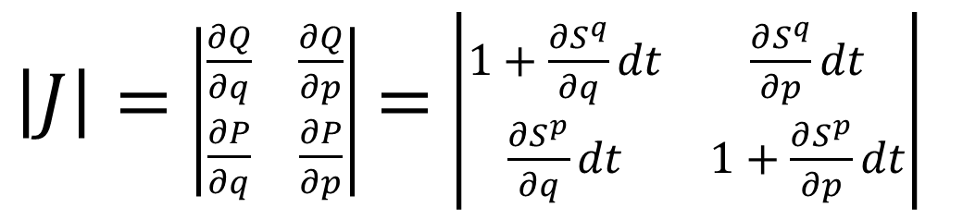

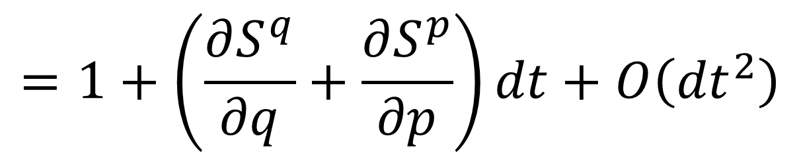
(3) Area conservation ($|J|$ = 1)
$$p$$
$$=ξ^{2}$$
Study how the area evolves
$$q$$
$$=ξ^{1}$$
$$dQdP=|J|dqdp$$
$\left|J\right|=$ $\left|\begin{matrix}\frac{∂Q}{∂q} & \frac{∂Q}{∂p} \\ \frac{∂P}{∂q} & \frac{∂P}{∂p}\end{matrix}\right|$ $=$ $\left|\begin{matrix}1+\frac{∂S^{q}}{∂q}dt & \frac{∂S^{q}}{∂p}dt \\ \frac{∂S^{p}}{∂q}dt & 1+\frac{∂S^{p}}{∂p}dt\end{matrix}\right|$
$$div\left(S^{a}\right)=0$$
$$=1+\left(\frac{∂S^{q}}{∂q}+\frac{∂S^{p}}{∂p}\right)dt+O\left({dt}^{2}\right)$$

Slide 9
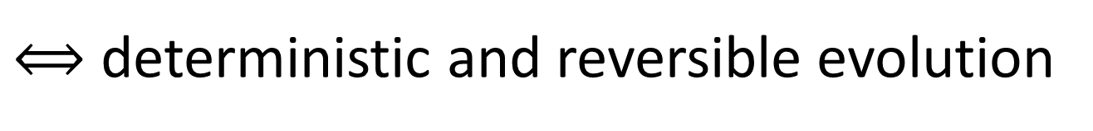


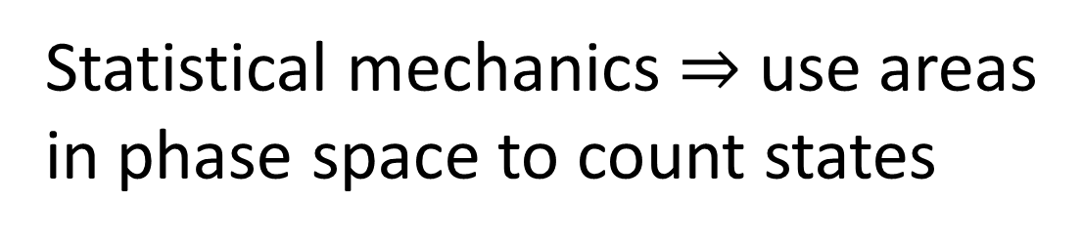



(4) Deterministic and reversible evolution
$$p$$
$$=ξ^{2}$$
$$q$$
$$=ξ^{1}$$
Statistical mechanics $⇒$ use areas in phase space to count states
Area conservation $⟺$ state count conservation
$⟺$ deterministic and reversible evolution
$$p$$
$$=ξ^{2}$$
Key insight: det/rev is not just a bijection! On continuous spaces, counting points is not enough!
$$q$$
$$=ξ^{1}$$
A dissipative force maps points to points, but areas become smaller.

Slide 10
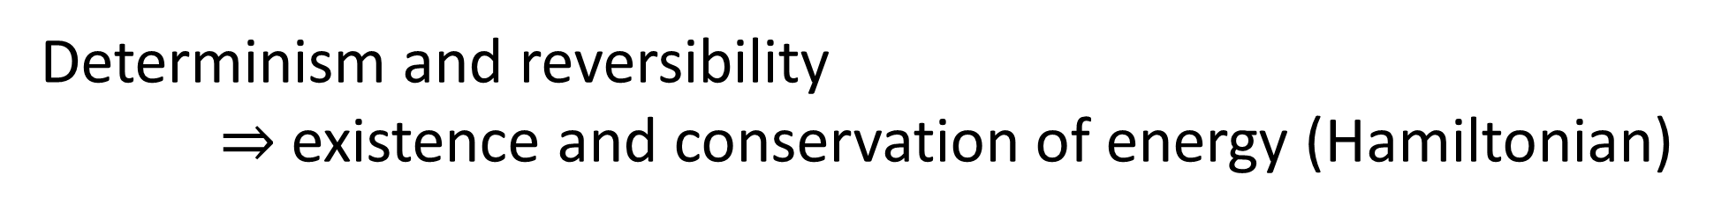
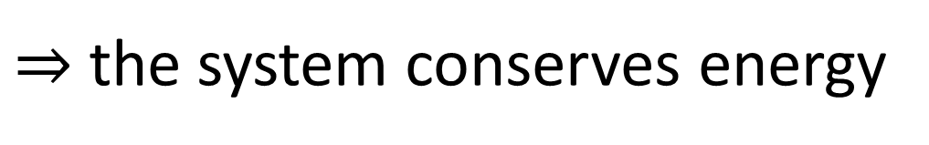
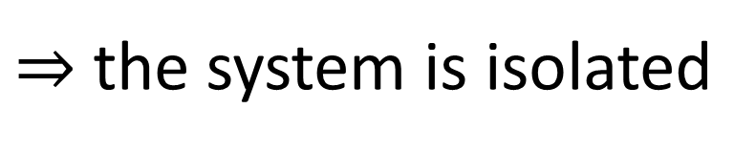
Determinism and reversibility $⇒$existence and conservation of energy (Hamiltonian)
Why?
Stronger version of the first law of thermodynamics
Determinism and reversibility
$⇒$ past and future depend only on the state of the system
$⇒$ the evolution does not depend on anything else
$⇒$ the system is isolated
First law of thermodynamics!
$⇒$ the system conserves energy

Slide 11

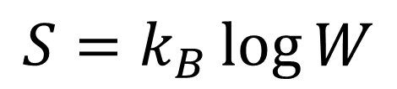

(5) Deterministic and thermodynamically reversible evolution
$$p$$
$$=ξ^{2}$$
$$q$$
$$=ξ^{1}$$
Link between statistical mechanics and thermodynamics
$$S=k_{B}\log{W}$$
Area conservation $⟺$ entropy conservation
$⟺$ thermodynamically reversible evolution

Slide 12
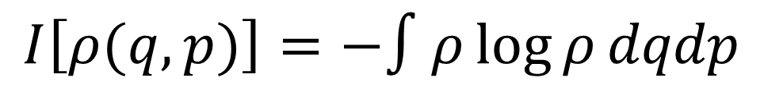

(6) Information conservation
$$p$$
$$=ξ^{2}$$
What about information entropy?
$$q$$
$$=ξ^{1}$$
$$I\left[ρ(q,p)\right]=−∫ρ\log{ρ}dqdp$$
$$I\left[ρ\left(t+dt\right)\right]=I\left[ρ\left(t\right)\right]−∫ρ\log{|J|}dqdp$$
Area conservation $⟺$ information conservation

Slide 13
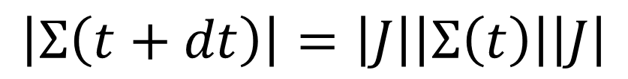
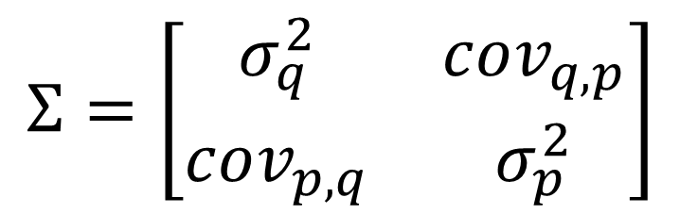

(7) Uncertainty conservation
$$p$$
$$=ξ^{2}$$
What about uncertainty?
covariance matrix
$$q$$
$$=ξ^{1}$$
$$Σ=\left[\begin{matrix}σ_{q}^{2} & cov_{q,p} \\ cov_{p,q} & σ_{p}^{2}\end{matrix}\right]$$
Assuming a “very narrow” distribution
$$\left|Σ\left(t+dt\right)\right|=\left|J\right|\left|Σ\left(t\right)\right|\left|J\right|$$
Area conservation $⟺$ uncertainty conservation

Slide 14
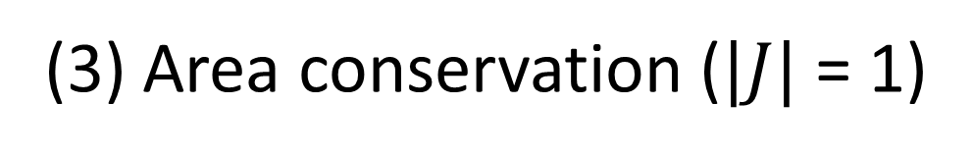
(1) Hamilton’s equations
All equivalent!
(2) Divergenceless displacement
(3) Area conservation ($|J|$ = 1)
They should be thought as a “conceptual cluster”: a series of ideas that “belong together”
(4) Deterministic and reversible evolution (i.e. isolation)
(5) Deterministic and thermodynamically reversible evolution
(6) Information conservation
(7) Uncertainty conservation

Slide 15
Talking points on previous slide
We found connections between Hamiltonian mechanics, vector calculus, differential (symplectic) geometry, statistical mechanics, thermodynamics, information theory and plain statistics
Practical implication: use the perspective more useful for the problem
The existence of these connections means we can’t study the physical foundation of each discipline separately: we need to study the whole cluster

Slide 16
Uncertainty principle in classical and quantum mechanics
one degree of freedom

Slide 17

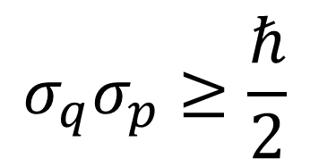
Quantum uncertainty principle
$$σ_{q}σ_{p}≥\frac{ℏ}{2}$$
What is its origin? What “causes” it?
What explains it?
How does $σ_{q}σ_{p}$behave in classical mechanics?

Slide 18
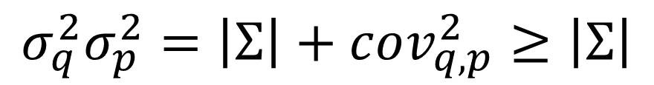
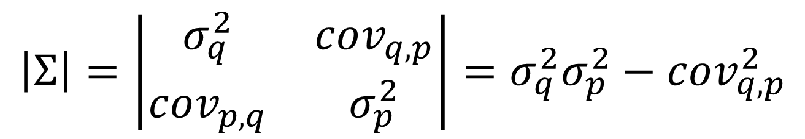


$$\left|Σ\right|=\left|\begin{matrix}σ_{q}^{2} & cov_{q,p} \\ cov_{p,q} & σ_{p}^{2}\end{matrix}\right|=σ_{q}^{2}σ_{p}^{2}−cov_{q,p}^{2}$$
constant of motion
$$σ_{q}^{2}σ_{p}^{2}=\left|Σ\right|+cov_{q,p}^{2}≥\left|Σ\right|$$
Uncertainty is bounded during Hamiltonian evolution
$$p$$
Lowest bound is in absence of correlation
$$q$$
But the bound depends on initial conditions

Slide 19
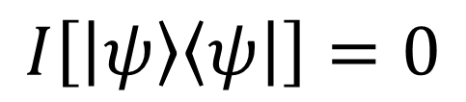
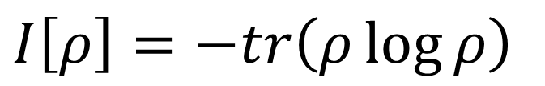

The bound on quantum uncertainty seems to be intrinsic to the nature of the quantum state
Let’s look at the von Neumann entropy
$I\left[ρ\right]=−tr\left(ρ\log{ρ}\right)$
For a pure state $\left|ψ\right\rangle$
lowest possible entropy
$$I\left[\left|ψ\right\rangle \left\langle ψ\right|\right]=0$$
Could this bound, by itself, explain everything?

Slide 20


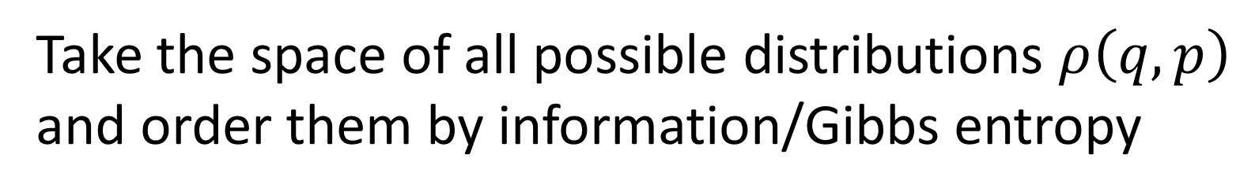



$$−∫ρ\log{ρ}$$
Take the space of all possible distributions $ρ\left(q,p\right)$ and order them by information/Gibbs entropy
Fix the entropy to a constant $I_{0}$ and consider all distributions with that entropy
$$I_{0}$$
They satisfy $σ_{q}σ_{p}≥\frac{e^{I_{0}}}{2πe}$
$$σ_{q}σ_{p}$$
equality for independent Gaussians
Lower bound on entropy $⇒$ lower bound on uncertainty
Inverse does not work: lower bound on uncertainty does not give a lower bound on entropy

Slide 21
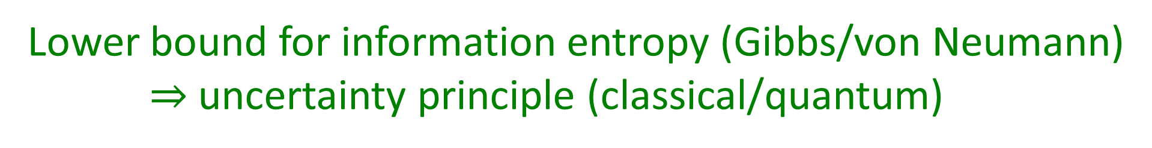
Lower bound for information entropy (Gibbs/von Neumann) $⇒$uncertainty principle (classical/quantum)
We don’t need the full quantum theory to derive the uncertainty principle: only the lower bound on entropy
The difference is that in classical mechanics we can prepare ensembles with arbitrarily low entropy…
But can we really?

Slide 22
The third law of thermodynamics revisited

Slide 23
A lower entropy bound is built into quantum mechanics, but not classical mechanics.
It is also built into thermodynamics in the form of the third law:
Every substance has a finite positive entropy, but at the absolute zero of temperature the entropy may become zero, and does so become in the case of perfect crystalline substances.
G. N. Lewis and M. Randall - Thermodynamics and the free energy of chemical substances
Where does this lower bound come from?

Slide 24

Thermodynamic entropy is additive for independent systems
$$S_{AB}=S_{A}+S_{B}$$
What system acts as a “zero” under system composition? The empty system $∅$: $A∪∅=A$.
$$S_{∅}=S_{∅∅}=S_{∅}+S_{∅}=0$$

Slide 25
What do the empty system and a crystalline structure at zero temperature have in common?
They both have only one way to be: saying “the crystalline structure is at zero temperature” or “the system is not present” both fully determine the state of the system

Slide 26
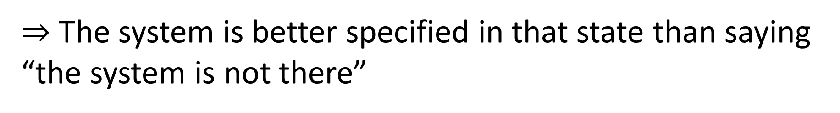
Why can’t we have states with entropy less than that of the empty system?
Suppose we had a system in a negative entropy state
$⇒$ The system is better specified than the empty system
$⇒$ The system is better specified in that state than saying “the system is not there”
But saying “the system is not there” already tells us everything there is to know about the system! Contradiction!

Slide 27
Let us rephrase the third law as:
Principle of maximal description
No state can describe a system more accurately than stating the system is not there in the first place
In practice, this statement is equivalent to the other one we quoted, but it is more of a logical necessity than a phenomenological assumption
It makes for a better foundational starting point

Slide 28
Discussion

Slide 29
A holistic approach
Note: the point of this presentation is to highlight the reverse physics approach
The first important aspect is that reverse physics must be, by its nature, interdisciplinary
The goal is to find those “conceptual clusters” of ideas that belong together to better study physics as a subject and bring more unity to physics
We believe that one cannot really address the foundations of one discipline without the rest
We also believe that approaches that focus too much on one theory as the foundations of everything (i.e. “everything is information” or “everything is constructable/an approximation of quantum mechanics”) will provide far fewer insights

Slide 30
Holistic approach
Assumptions of CM
Classical mechanics
Measure theory
Statistics
Assumptions of physics
Assumptions of QM
Quantum mechanics
Information theory
Differential geometry
Assumptions of TD
Thermo-dynamics
No single fundamental point of view (e.g. “everything is information”)
Foundations of different theories are not disconnected
Find those “conceptual clusters” that span multiple areas of physics, math, …

Slide 31
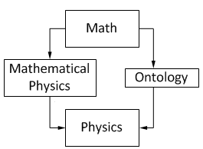
Physics at the center of physics
Physics
Physical requirements
Semantics
Math
From Wikipedia “Mathematical Physics”
Mathematical content of a theory can never tell us the full physical content
What is a state?
How does the theory map to experiments?
Why is one theory appropriate in one context and not in another?

Slide 32
Mathematical starting points: axioms
Effectively arbitrary
Physics: different types of starting points
If physics is objective, it must be true
More necessary
The laws of nature are independent of our choice of coordinates
This must be true, more of a definitional property of a “system”
Any system can be prepared/measured independently
The speed of light is invariant
Empirical fact,
taken to be true as it is verified experimentally
Simplifying assumption: no system is ever perfectly isolated
The system under study is isolated

Slide 33
Conclusions
“Reverse Physics” is an approach to the foundations of physics that starts from the physical laws and aims to “go back” to a suitable minimum number of assumptions
Reformulation. Classical Hamiltonian mechanics can be characterized in 7 different ways, all variations of the general theme of determinism/reversibility
Dependency analysis. The uncertainty principle is fully explained just by the lower bound on entropy
Reconceptualization. The third law of thermodynamics can be reunderstood as stating that “the system is not there” is a complete characterization of a system
The goal is to fully map conceptual relationships and dependencies between different theories, different aspects of the theories, and helping to foster higher level physical reasoning
It is, by its nature, an interdisciplinary endeavor, and it can guide us to create more general physical and mathematical models

Slide 35
Supplemental

Slide 36
Why does classical mechanics fail?
It lacks a lower bound on the entropy, therefore it violates the third law of thermodynamics
What does that mean in physics terms? How can we understand this better?

Slide 37
continuum
Quantifying discrete cases is fundamentally different than quantifying cases over the continuum
discrete
finite measure
zero measure
Why? Because fully identifying a discrete case requires finite information (finitely many experimental tests) while identifying a case from a continuum requires infinite information (an infinite sequence of increasingly precise tests)
This is something most physicists haven’t yet fully digested

Slide 38
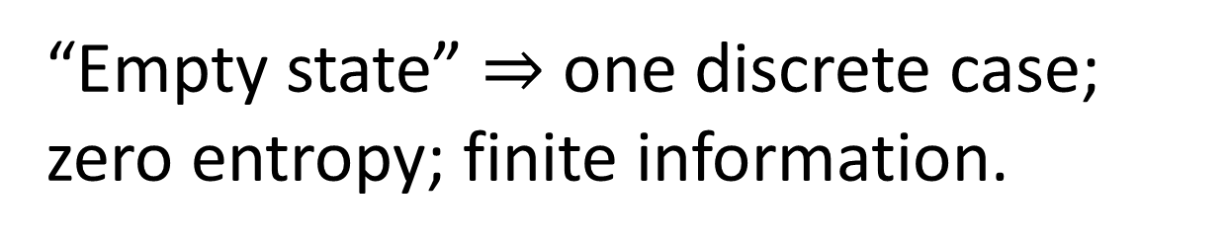
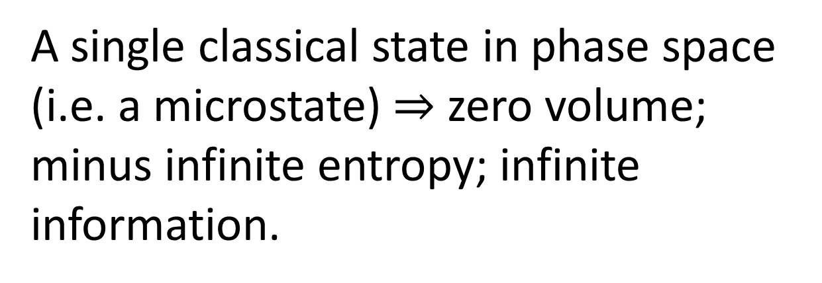
continuum
A single classical state in phase space (i.e. a microstate) $⇒$ zero volume; minus infinite entropy; infinite information.
discrete
finite measure
zero measure
“Empty state” $⇒$ one discrete case; zero entropy; finite information.
quantum: continuum with points of finite measure
Quantum mechanics “fixes” this, by introducing a fixed lower bound on entropy.

