Slide 1
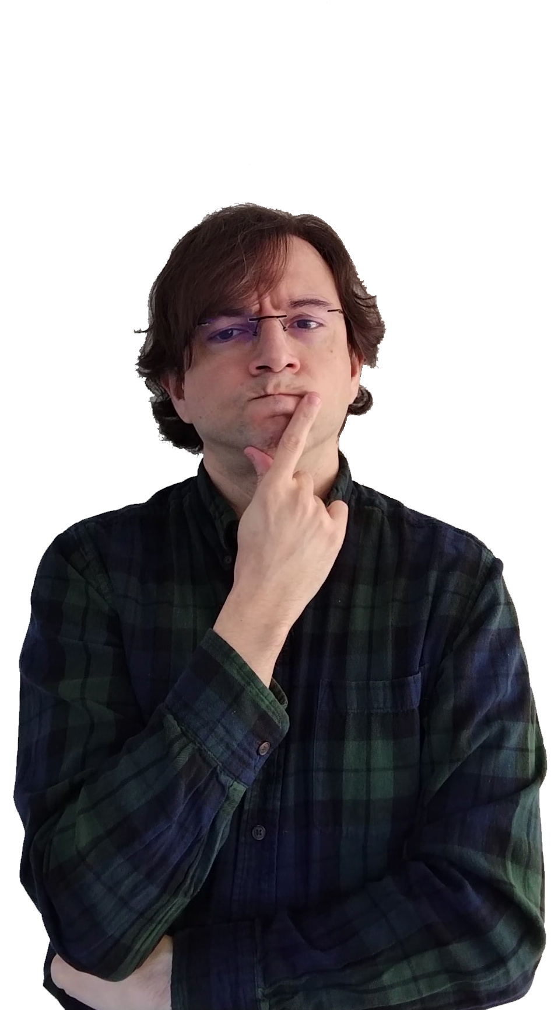

What is a number?
Discussions on the Foundations of Mathematics and Physics

