Slide 1
Kinematics vs Dynamics
Gabriele Carcassi

Slide 2
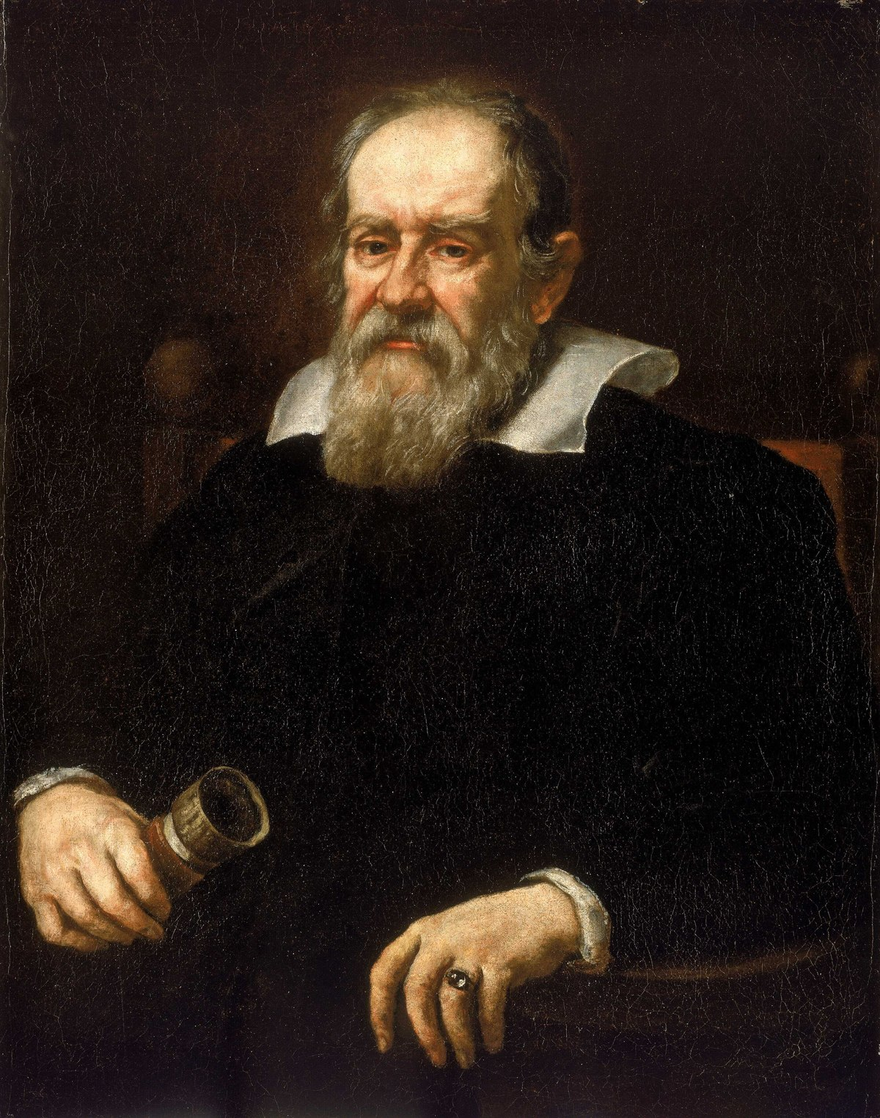
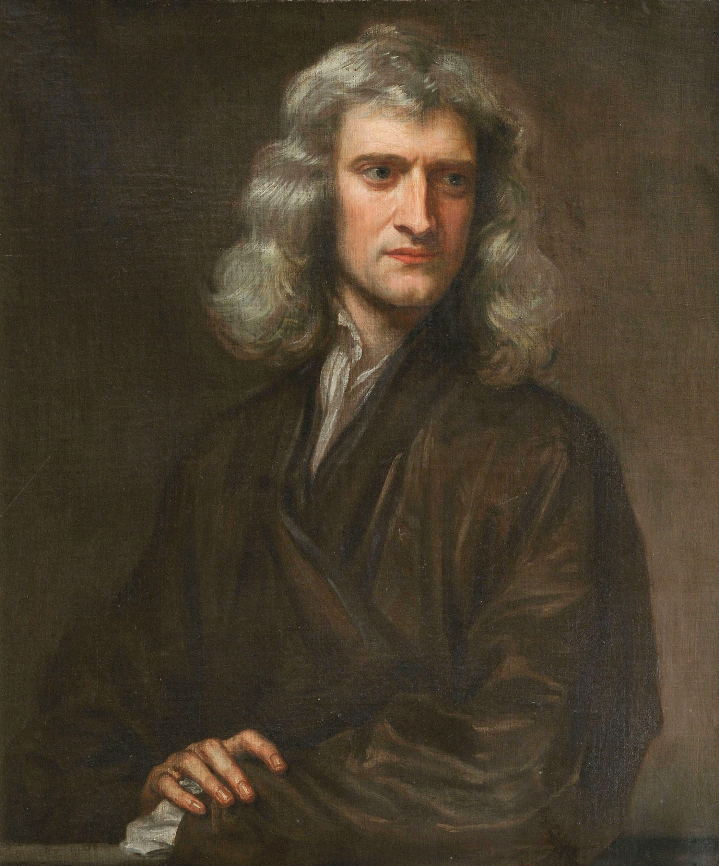
What Galileo Worked on
Kinematics: Describe the motion of a system in space and time (position, velocity, acceleration)
Dynamics: Describe the cause of motion (Force, mass, momentum, energy)
What Newton Worked on
Notes:
The kinematics is not enough to reconstruct the dynamics
Lagrangian hides the connection
Kinematics: what Galileo did, Newton did
Image sources: https://en.wikipedia.org/wiki/Galileo_Galilei
https://en.wikipedia.org/wiki/Isaac_Newton

Slide 3










State
Dynamics
Evolution
Newtonian Mechanics:
$x^{i}$ and $v^{i}$
$${F^{i}(x}^{j},v^{k},t)$$
$$F^{i}\left(x^{j},v^{k},t\right)=d_{t}mv^{i}$$
position
velocity
Only Hyperregular Lagrangian systems have unique solutions: $∂_{v^{i}}∂_{v_{j}} L$ must be invertible
Lagrangian Mechanics:
$x^{i}$ and $v^{i}$
$${L(x}^{i},v^{j},t)$$
$$∂_{x^{i}}L=d_{t}∂_{v^{i}}L$$
position
velocity
$$d_{t}q^{i}=∂_{p^{i}}H$$
Hamiltonian Mechanics:
$x^{i}$ and $v^{i}$
$${H(q}^{i},p_{j},t)$$
position
conjugate momentum
$$d_{t}p^{i}=∂_{q^{i}}H$$
Notes:
TODO: transform it into a “Table”
Equations of motion (instead of Evolution of he system)
Mechanics are the rows
TODO: add hyperregularity of Lagrangian

Slide 4
Particle under linear drag:
Suppose we have a system described by the equation $ma=−bv$
Velocity:
Drag:

Slide 5


















Particle Under Linear Drag For Newtonian Mechanics:
$$x\left(t\right)=x_{0}+v_{0}\frac{m}{b}\left(1−e^{−\frac{k}{m}t}\right)$$
$$x$$
$$v$$
$$v\left(t\right)=v_{0}e^{−\frac{k}{m}t}$$
$$a$$
$$x_{0}+\frac{m}{b}v_{0}$$
$$v_{0}$$
$$t$$
$$a\left(t\right)=−v_{0}\frac{b}{m}e^{−\frac{k}{m}t}$$
$$x_{0}$$
$$−\frac{b}{m}v_{0}$$
$$t$$
$$t$$
$$E$$
$$E\left(t\right)=\frac{1}{2}mv_{0}^{2}e^{−2\frac{b}{m}t}$$
$$\frac{1}{2}mv_{0}^{2}$$
$$E(t)$$
$$t$$
Notes:
To Soon: create visual of the example (do with all)
make clear these are Newtonian

Slide 6








$$L=\frac{1}{2}mv^{2}e^{\frac{k}{m}t}$$
Lagrangian Mechanics:
$$∂_{x}L=0=d_{t}\left(mve^{\frac{k}{m}t}\right)=mae^{\frac{b}{m}t}+\frac{b}{m}mve^{\frac{b}{m}t}=e^{\frac{b}{m}t}(ma+bv)=e^{\frac{b}{m}t}\left(ma+bv\right)$$
$$ma=−bv$$
Hamiltonian Mechanics:
$$p=mve^{\frac{b}{m}t}$$
$$v=\frac{p}{m}e^{−\frac{k}{m}t}$$
$$H=pv−L=p\frac{p}{m}e^{−\frac{b}{m}t}−\frac{1}{2}m{\left(\frac{p}{m}e^{−\frac{b}{m}t}\right)}^{2}e^{−\frac{b}{m}t}=\frac{p^{2}}{m}e^{−\frac{b}{m}t}−\frac{1}{2}\frac{p^{2}}{m}e^{−\frac{b}{m}t}=\frac{1}{2}\frac{p^{2}}{m}e^{\frac{b}{m}t}$$
$d_{t}q=$ $∂_{p}H=\frac{p}{m}e^{\frac{b}{m}t},$
$$d_{t}p=−∂_{p}H=0$$
$$q\left(t\right)=q_{0}+\frac{p_{0}}{b}\left(1−e^{\frac{k}{m}t}\right)$$
$$p\left(t\right)=p_{0}$$

Slide 7





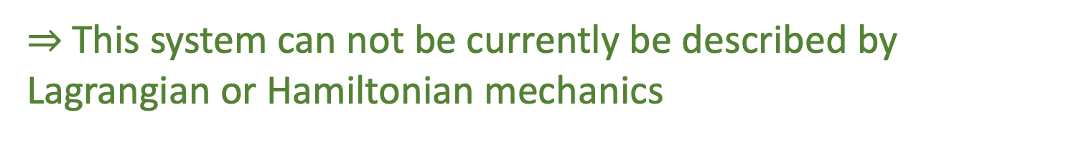







Particle Under Linear Drag for Lagrangian and Hamiltonian Mechanics:
$$q\left(t\right)=q_{0}+\frac{p_{0}}{b}\left(1−e^{\frac{k}{m}t}\right)$$
$$p\left(t\right)=p_{0}=mv_{0}$$
$$p$$
$$H(t)=\frac{1}{2}\frac{p^{2}}{m}e^{−\frac{b}{m}t}$$
$$x$$
$$E$$
$$x_{0}+\frac{m}{b}v_{0}$$
$$p_{0}$$
$${\frac{p_{0}^{2}}{2m}}_{0}$$
$$mv\left(t\right)=mv_{0}e^{−\frac{k}{m}t}$$
$$E\left(t\right)=\frac{1}{2}mv_{0}^{2}e^{−2\frac{b}{m}t}$$
$$x_{0}$$
$$t$$
$$t$$
$$t$$
$⇒$This system can not be currently be described by Lagrangian or Hamiltonian mechanics
Notes:
To Soon: create visual of the example (do with all)
make clear these are Newtonian

Slide 8

Variable Mass System:
Velocity:
Mass:
$$\hat{m}\left(t\right)=\frac{p\left(t\right)}{v\left(t\right)}=me^{\frac{b}{m}t }$$
Notes:
Add picture of a variable mass system

Slide 9


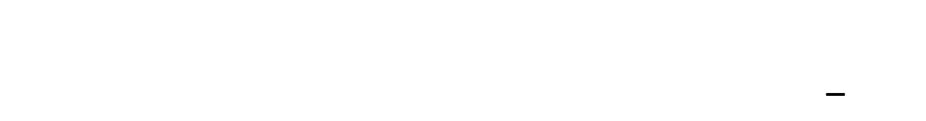





$$\hat{m}$$
Variable Mass System:
$$m$$
For the Hamiltonian we now have:
$$t$$
$p\left(t\right)=mv\left(t\right)e^{\frac{b}{m}t}=$ $\hat{m}\left(t\right)v(t)$
$H\left(t\right)=\frac{1}{2}\frac{p^{2}}{m}e^{−\frac{b}{m}t}=\frac{1}{2}\frac{p^{2}}{\hat{m}}e^{−\frac{b}{m}t}=\frac{1}{2}\hat{m}v^{2}\left(t\right)=E(t)$_
$$p$$
$$E$$
$$p_{0}$$
$${\frac{p_{0}^{2}}{2m}}_{0}$$
$$t$$
$$t$$

Slide 10






Variable Mass System:
$F^{i}=d_{t}\left(\hat{m}v^{i}\right)=d_{t}\hat{m}v^{i}$+ $\hat{m}a^{i}$
$$\hat{m}a^{i}=F^{i}−d_{t}\hat{m}v^{i}$$
In the one dimensional case, if we set $F=0$ and substitute $\hat{m}$
$$me^{\frac{b}{m}t}a=0−d_{t}me^{\frac{b}{m}t}v=−\frac{b}{m}me^{\frac{b}{m}t}v$$
$$ma=−bv$$
$⇒$The same kinematics apply to a system where instead of slowing down due to friction, the body is slowing down due to the conservation of Momentum
$⇒$In Newtonian mechanics, we can readily distinguish between the two cases, but with Lagrangian and Hamiltonian mechanics the dynamic quantities will be different in different cases.

Slide 11
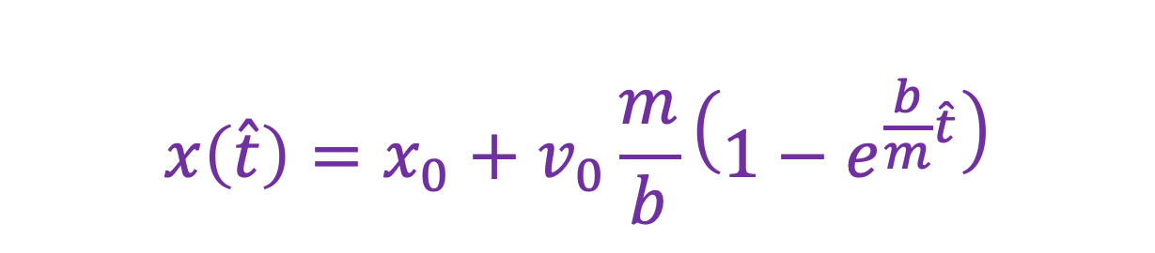






Non-Inertial Frame:
$$x\left(\hat{t}\right)=x_{0}+v_{0}\frac{m}{b}\left(1−e^{\frac{b}{m}\hat{t}}\right)$$
$$x\left(t\right)=x_{0}+v_{0}t$$
$$t=\frac{m}{b}(1−e^{\frac{−b}{m}\hat{t}})$$
$$q$$
$$q$$
$$t$$
$$\hat{t}$$
Notes:
Image: draw a map of t to t^ (play around with t vs q and t^ vs q

Slide 12




Non-Inertial Frame:
Setting $\hat{t}=\hat{t}(t)$:
$F^{i}=d_{t}\hat{t}d_{\hat{t}}\left(mv^{i}\right)=$ $d_{t}\hat{t}d_{\hat{t}}(md_{t}\hat{t}d_{\hat{t}}x^{i}$)
Setting $\hat{m}=md_{t}\hat{t}$:
$$F^{i}=d_{t}\hat{t}d_{\hat{t}}(\hat{m}d_{\hat{t}}x^{i})=d_{t}\hat{t}{\hat{F}}^{i}$$
looking at the problem in this manner, we do not have a true variable mass, but rather a variable effective mass due to a slowing down of time.
like in special relativity

Slide 13




Non-Inertial Frame:
We can verify that this gives us the correct effective mass and force:
$$d_{\hat{t}}t=d_{\hat{t}}\left(\frac{m}{b}\left(1−e^{\frac{−b}{m}\hat{t}}\right)\right)=\frac{−m}{b}d_{\hat{t}}e^{\frac{−b}{m}\hat{t}}=\frac{m}{b}\frac{b}{m}e^{\frac{−b}{m}\hat{t}}=e^{−\frac{b}{m}\hat{t}}$$
$$\hat{m}=md_{t}\hat{t}=m{(d}_{\hat{t}}{t)}^{−1 }=me^{\frac{b}{m}\hat{t}}$$
Setting $F=0$:
$$0=d_{t}\left(mv\right)=d_{t}\left(md_{i}x\right)=d_{t}\hat{t}d_{\hat{t}}\left(md_{t}\hat{t}d_{i}x\right)=e^{\frac{b}{m}\hat{t}}d_{i}\left(e^{\frac{b}{m}\hat{t}}\hat{v}\right)= e^{\frac{b}{m}\hat{t}}(m\frac{b}{m}e^{\frac{b}{m}\hat{t}}\hat{v}+me^{\frac{b}{m}\hat{t}}\hat{a})=e^{2\frac{b}{m}\hat{t}}\left(b\hat{v}+m\hat{a}\right)$$
$$m\hat{a}=−b\hat{v}$$

Slide 14
Big Picture:
This case demonstrates that we can have the same kinematics for different systems
The kinematics of a system are not enough for us to understand its causes of motion, with the different formulations having different ways of relating dynamics and kinematics

