Slide 1
Multiple degrees of Freedom
Gabriele Carcassi

Slide 2
First show the relationships that stay the same
Then show the relationships that change/generalize (are different arguments, difficult to make a parallel)
Recap that the one that changes is “complete” and implies the lesser (one about surfaces/lines, other about volumes)
Orthogonality of DOF = independence
Area cons + ortho => volumes (to explain previous finding)

Slide 3










Hamilton’s Equations
S-DOF
$$d_{t}q=∂_{p}H$$
$$d_{t}p=−∂_{q}H$$
$$d_{t}q^{i}=∂_{p_{i}}H$$
$$d_{t}p_{i}=−∂_{q^{i}}H$$
(HM-1D)
(HM-ND)
$$S^{q}=∂_{p}H$$
$$S^{p}=−∂_{q}H$$
$$ξ^{a}=[q^{i}, p^{i}]$$
$$S^{a}=d_{t}ξ^{a}=[d_{t}q^{i},d_{t}p^{i}]$$
$$S^{q^{i}}=∂_{p_{i}}H$$
$$S^{p_{i}}=−∂_{q^{i}}H$$

Slide 4

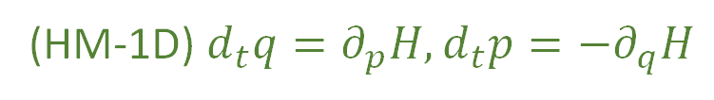
We have found twelve equivalent characterizations for a single degree of freedom
(HM-1D) $d_{t}q=∂_{p}H,d_{t}p=−∂_{q}H$
(HM-G) $S_{a}=S^{b}ω_{ba}$
(DR-DIV) The displacement field for a one dimensional Hamiltonian is divergenceless: $∂_{a}S^{a}=0$
(DR-JAC) The Jacobian of the time evolution is unitary: $\left|∂_{b}{\hat{ξ}}^{a}\right|=1$
(DR-VOL) Volumes are conserved through the evolution: $d{\hat{ξ}}^{1}…d{\hat{ξ}}^{n}=dξ^{1}…dξ^n$
(DR-DEN) Densities are conserved through the evolution: $\hat{ρ}\left({\hat{ξ}}^{a}\right)=ρ\left(ξ^{b}\right)$
(DI-SYMP) The evolution leaves $ω_{ab}$ invariant: ${\hat{ω}}_{ab}=ω_{ab}$
(DI-POI) The evolution leaves the Poisson brackets invariant
(DI-CURL) The rotated displacement field is curl free: $∂_{a}S_{b}−∂_{b}S_{a}=0$
(DR-EV) The evolution is deterministic and reversable
(DR-THER) The evolution is deterministic and thermodynamically Reversible
(DR-INFO) The evolution conserves information entropy
(DR-UNC) The evolution conserves the uncertainty of peaked distributions

Slide 5













S-DOF
$$ω=\left[\begin{matrix}0 & 1 \\ −1 & 0\end{matrix}\right]⊗I_{n}$$
$$\left[ω_{ab}\right]=\left[\begin{matrix}ω_{q^{i}q^{j}} & ω_{q^{i}p_{j}} \\ ω_{p_{i}q^{j}} & ω_{p_{i}p_{j}}\end{matrix}\right]$$
$$ω=\left[\begin{matrix}0 & 1 \\ −1 & 0\end{matrix}\right]$$
$$\left[ω_{ab}\right]=\left[\begin{matrix}ω_{qq} & ω_{qp} \\ ω_{pq} & ω_{pp}\end{matrix}\right]$$
$$\vec{S}=ω \vec{∇}H$$
$$\left[\begin{matrix}S^{q} \\ S^{p}\end{matrix}\right]=\left[\begin{matrix}0 & 1 \\ −1 & 0\end{matrix}\right]\left[\begin{matrix}∂_{q}H \\ ∂_{p}H\end{matrix}\right]=\left[\begin{matrix}∂_{p}H \\ −∂_{q}H\end{matrix}\right]$$
$$S_{a}=S^{b}ω_{ba}=∂_{a}H$$
$$\left[\begin{matrix}S^{q^{i}} \\ S^{p_{i}}\end{matrix}\right]=\left[\begin{matrix}0 & I_{n} \\ −I_{n} & 0\end{matrix}\right]\left[\begin{matrix}∂_{q^{i}}H \\ ∂_{p_{i}}H\end{matrix}\right]=\left[\begin{matrix}∂_{p_{i}}H \\ −∂_{q^{i}}H\end{matrix}\right]$$
$$S^{q}ω_{qp}=∂_{p}H$$
$$S^{p}ω_{pq}=∂_{q}H$$
(HM-G)
$$S_{a}=S^{b}ω_{ba}=∂_{a}H$$
$$S^{q^{i}}ω_{q^{i}p_{i}}=∂_{p_{i}}H$$
$$S^{p_{i}}ω_{p_{i}q^{i}}=∂_{q^{i}}H$$
(SF-ND)

Slide 7










$ω_{ab}$preforms a $90$ degree rotation within each degree of freedom,
switching components between position and momentum
Given: $v^{a}=[{v^{q}}^{i},v^{p_{i}}]$ then $v_{a}=v^{b}ω_{ba}=[−v^{p_{i}},v^{q^{i}}]$
Insight: the displacement field is still equal to the gradient of $H$ rotated $90$ degrees,
except there are now multiple ways to preform this rotation
It is only the rotation defined by $ω_{ab}$ that works
$$p_{2}$$
$$p_{1}$$
$$q^{2}$$
$$p_{2}$$
$$p_{1}$$
$$q^{2}$$
$$q^{1}$$
$$q^{1}$$

Slide 8

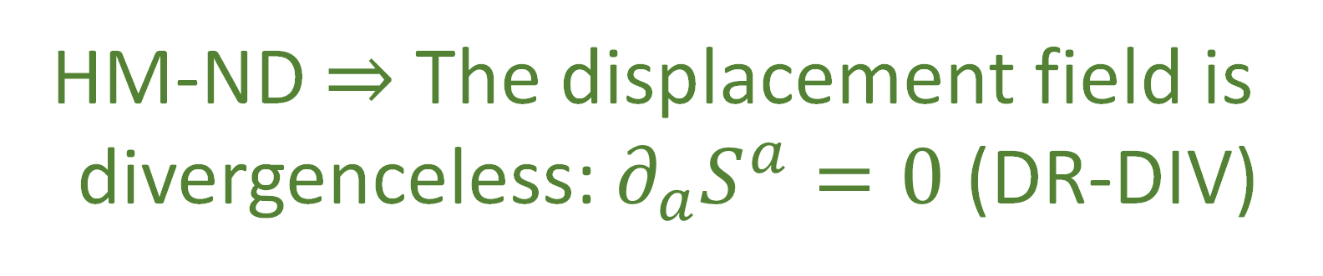





$$p_{2}$$
$$p_{1}$$
$$q^{2}$$
S-DOF
$$∂_{a}S^{a}=∂_{q}S^{q}+∂_{p}S^{p}$$
$$q^{1}$$
$$=∂_{q}∂_{p}H−∂_{p}∂_{q}H$$
$0=∂_{a}S^{a}$ $=∂_{q^{i}}S^{q^{i}}+∂_{p_{i}}S^{p_{i}}$ $=∂_{q^{i}}∂_{p_{i}}H−∂_{p_{i}}∂_{q^{i}}H$
$$=0$$
HM-ND $⇒$ The displacement field is
divergenceless: $∂_{a}S^{a}=0$ (DR-DIV)
Notes:
TODO: rearrange arros

Slide 9













Let $\hat{q}$and $\hat{p}$ represent the evolution of q and p after an infinitesimal time step $δt$
$${\hat{q}}^{i}=q^{i}+S^{q^{i}}δt$$
S-DOF
$${\hat{p}}_{i}=p_{i}+S^{p_{i}}δt$$
$$\hat{p}=p+S^{p}δt$$
$$\hat{q}=q+S^{q}δt$$
$$∂_{b}{\hat{ξ}}^{a}=\left[\begin{matrix}δ_{j}^{i}+∂_{q^{j}}S^{q^{i}}δt & ∂_{p_{j}}S^{q^{i}}δt \\ ∂_{q^{j}}S^{p_{i}}δt & δ_{i}^{j}+∂_{p_{j}}S^{p_{i}}δt\end{matrix}\right]$$
$$∂_{b}{\hat{ξ}}^{a}=\left[\begin{matrix}1+∂_{q}S^{q}δt & ∂_{p}S^{q}δt \\ ∂_{q}S^{p}δt & 1+∂_{p}S^{p}δt\end{matrix}\right]$$
$$p$$
$$\left|∂_{b}{\hat{ξ}}^{a}\right|=1+\left(∂_{q}S^{q}+∂_{p}S^{p}\right)δt+O(δt^{2})$$
$$\left|∂_{b}{\hat{ξ}}^{a}\right|=\left|δ_{j}^{i}+∂_{q^{j}}S^{q^{i}}δt\right|\left|δ_{i}^{j}+∂_{p_{j}}S^{p_{i}}δt\right|$$
$$−\left|∂_{p_{j}}S^{q^{i}}δt\right|\left|∂_{q^{j}}S^{p_{i}}δt\right|$$
$∂_{a}S^{a}$!!!
$$=1+\left(∂_{q^{i}}S^{q^{i}}+∂_{p_{i}}S^{p_{i}}\right)δt+O(δt^{2})$$
$$q$$
$∂_{a}S^{a}$!!!

Slide 10
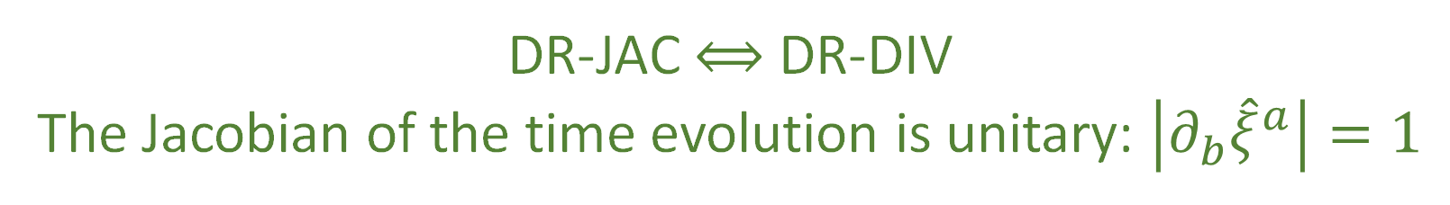



$\left|∂_{b}{\hat{ξ}}^{a}\right|=1$ $⟺$ $∂_{a}S^{a}=0$
DR-JAC $⟺$ DR-DIV
The Jacobian of the time evolution is unitary: $\left|∂_{b}{\hat{ξ}}^{a}\right|=1$
The Jacobian is still the multiplicative factor between past and future areas and densities
$$⇒$$
Volumes are conserved through the evolution: $d{\hat{ξ}}^{1}…d{\hat{ξ}}^{n}=dξ^{1}…dξ^n$ (DR-VOL)
Densities are conserved through the evolution: $\hat{ρ}\left({\hat{ξ}}^{a}\right)=ρ\left(ξ^{b}\right)$ (DR-DEN)
DR-DIV $⟺$DR-JAC $⟺$ DR-VOL $⟺$ DR-DEN

Slide 11





The displacement field $S^{a}$ has $2n$ components
Conditions DR-DIV, DR-JAC, DR-VOL, and DR-DEN all specify a single restraint giving
$2n−1$ components
The choice of Hamiltonian provides another constraint, leaving $2n−2$ choices
Single Degree of Freedom:
$$n=1$$
$$2n−2=0$$
no choices remain
Multiple Degrees of Freedom:
$$n>1$$
$$2n−2≠0$$
choices remain
HM-ND $⇒$ DR-DIV $⟺$DR-JAC $⟺$ DR-VOL $⟺$ DR-DEN
DR-DIV $⟺$DR-JAC $⟺$ DR-VOL $⟺$ DR-DEN $⇏$ HM-ND

Slide 12
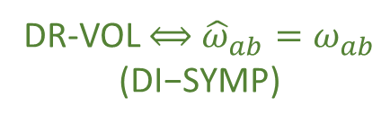












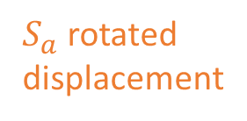



S-DOF
$${\hat{ω}}_{ab}=∂_{a}{\hat{ξ}}^{c}ω_{cd}∂_{b}{\hat{ξ}}^{d}$$
Area $\left(v^{a},w^{a}\right)=v^{a}ω_{ab }w^{b}$
$$=\left(δ_{a}^{c}+∂_{a}S^{c}δt\right)ω_{cd}\left(δ_{b}^{d}+∂_{b}S^{d}δt\right)$$
$$=ω_{ab}+\left(∂_{a}S^{c}ω_{cb}+ω_{ad}∂_{b}S^{d}\right)δt+O\left(δt^{2}\right)$$
$$=ω_{ab}+\left(∂_{a}{(S}^{c}ω_{cb})+∂_{b}(S^{d}ω_{ad})\right)δt+O\left(δt^{2}\right)$$
$$=ω_{ab}+\left(∂_{a}{(S}^{c}ω_{cb})−∂_{b}(S^{d}ω_{da})\right)δt+O\left(δt^{2}\right)$$
${\hat{v}}^{c}ω_{cd }{\hat{w}}^{d}=v^{a}{\hat{ω}}_{ab }w^{b}$
Area is conserved if
$${\hat{ω}}_{ab}=ω_{ab}$$
DR-VOL $⟺$ ${\hat{ω}}_{ab}=ω_{ab}$ $$\text{(}\text{DI}\text{−}\text{SYMP}\text{)}$$
Invariance of $ω_{ab}$:
$$p_{2}$$
$$p_{1}$$
$$q^{2}$$
$S^{a}$ displacement
area $≠$ volume M-DOF
$$∂_{a}(S^{c}ω_{cb})−∂_{b}\left(S^{d}ω_{da}\right)=0$$
$$∂_{a}S_{b}−∂_{b}S_{a}=0$$
$S_{a}$ rotated displacement
$$q^{1}$$
DI-SYMP $⟺$ DI-CURL

Slide 13


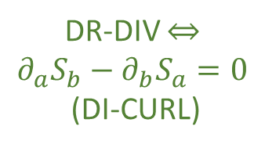
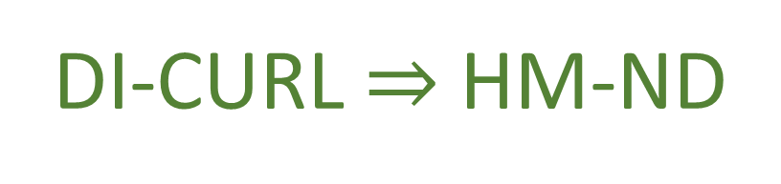




S-DOF
$$∂_{a}S_{b}−∂_{b}S_{a}=∂_{a}\left(S^{c}ω_{cb}\right)−∂_{b}(S^{c}ω_{ca})$$
Flow THROUGH the curve
$$\int{S^{a}×dξ^{b}}$$
$$=∂_{a}∂_{b}H−∂_{b}∂_{a}H=0$$
same only for S-DOF
Flow ALONG the curve
HM-ND $⇒$ DI-CURL
$$\int{S_{b}⋅dξ^{b}}$$
$$p_{2}$$
$$p_{1}$$
$$q^{2}$$
DR-DIV $⇔$ $$∂_{a}S_{b}−∂_{b}S_{a}=0$$
(DI-CURL)
Conversely: given $S_{a}$ is curl free
$$S_{a}=S^{b}ω_{ba}=∂_{a}H$$
$$q^{1}$$
DI-CURL $⇒$ HM-ND

Slide 14



$$\left\{f,g\right\}=∂_{q}f∂_{p}g−∂_{p}f∂_{q}g=−∂_{a}fω^{ab}∂_{b}g$$
The relationship between Poisson brackets and $ω^{ab}$is the same in the general case
invariance of $ω$ is invariance of Poisson bracket
$$\hat{\left\{f,g\right\}}=∂_{\hat{q}}f∂_{\hat{p}}g−∂_{\hat{p}}f∂_{\hat{q}}g=−∂_{a}f{\hat{ω}}^{ab}∂_{b}g$$
DI-SYMP $⟺$ DI-POI
Notes:
TODO: S-DOF on the right

Slide 15









HM-ND
$$⟺$$
DI-CURL
DR-JAC
$$⟺$$
DR-DIV
$$⇒$$
$$⟺$$
$$⟺$$
$$⟺$$
$$⟺$$
DI-POI
$$⟺$$
DI-SYMP
DR-DEN
$$⟺$$
DR-VOL
fully characterize Hamiltonian mechanics
weaker conditions
How are they different?
Why are they the same for a S-DOF?

Slide 16


















$$v^{a}ω_{ab}w^{b}$$
$$p$$
$$v$$
$$ω(\hat{v},\hat{w})$$
$$\hat{v}$$
$$ω(v,w)$$
conserved quantity
$$\hat{w}$$
$$w$$
S-DOF
$$q$$
$$\hat{v}$$
$$v^{q^{1}}w^{p_{1}}−v^{p_{1}}w^{q^{1}}$$
$$\hat{w}$$
$$\hat{v}$$
$$ω(\hat{v},\hat{w})$$
$$ω(\hat{v},\hat{w})$$
area of parallelogram
$$\hat{w}$$
$⇒$ area conserved
$⇒$ volume conserved
Notes:
TODO: remove flow

Slide 17




$$v^{a}ω_{ab}w^{b}$$
$$p_{2}$$
$$p_{1}$$
$$q^{2}$$
$$v$$
$$ω(\hat{v},\hat{w})$$
$$\hat{v}$$
$$ω(v,w)$$
conserved quantity
$$\hat{w}$$
$$w$$
M-DOF
$$q^{1}$$
$$\hat{v}$$
$$v^{q^{1}}w^{p_{1}}−v^{p_{1}}w^{q^{1}}$$
$$\hat{w}$$
$$\hat{v}$$
$$ω(\hat{v},\hat{w})$$
$$ω(\hat{v},\hat{w})$$
area of parallelogram
$$\hat{w}$$
$$v^{q^{1}}ω_{q^{1}p_{2}}w^{p_{2}}=0$$
not area across DOFs!
Notes:
TODO: make it look like you added the two extra dimensions

Slide 18


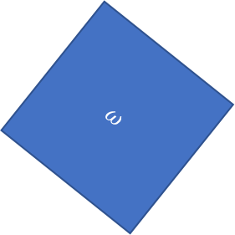
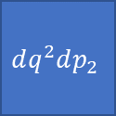
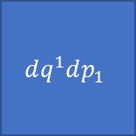


$$ω=\left[\begin{matrix}0 & 1 \\ −1 & 0\end{matrix}\right]⊗I_{n}$$
$$\left[ω_{ab}\right]=\left[\begin{matrix}ω_{q^{i}q^{j}} & ω_{q^{i}p_{j}} \\ ω_{p_{i}q^{j}} & ω_{p_{i}p_{j}}\end{matrix}\right]$$
SF-ND
$$ω=∑dq^{i}dp_{i}$$
$$ω$$
Orthogonality of DOF
$$dq^{2}dp_{2}$$
$$⟺$$
$$dq^{1}dp_{1}$$
WARNING: analogy!!!
DOF independence
Notes:
TODO: in sDOF, omega is just area. In mDOF, omega is area ONLY with matching q and p, and zero for any other combinations => counts configuration within a DOF

Slide 19




Space(time) geometry vs phase space geometry
(pseudo-)Riemmanian
Symplectic
$$g_{ij}$$
$$ω_{ab}$$
Metric tensor
Symplectic form
defines lengths and angles
areas and “angles”
$$ds^{2}=dx^{i}g_{ij}dx^{j}=∑{\left(dx^{i}\right)}^{2}$$
$$ds^{2}=dξ^{a}ω_{ab}dξ^{b}=∑dq^{i}dp_{i}$$
Notes:
TODO cleanup

Slide 20

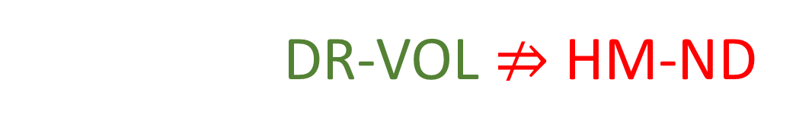

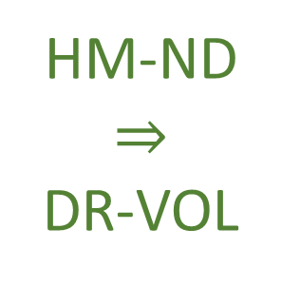





$$⇒$$
Conservation of $ω_{ab}$
Conservation of areas and orthogonality
$$(y,p_{y})$$
$$(y′,{p′}_{y})$$
HM-ND $⇒$ DR-VOL
$$(x,p_{x})$$
$$(x′,{p′}_{x})$$
$$⇒$$
Volume is preserved!
However DR-VOL $⇏$ HM-ND
Notes:
TODO: review

Slide 21








$$d_{t}q^{1}={S^{q}}^{1}=\frac{p_{1}}{m}$$
$$d_{t}p_{1}=S^{p_{1}}=−bp_{1}$$
Particle under linear drag
$$d_{t}q^{2}={S^{q}}^{2}=\frac{p_{2}}{m}$$
a particle accelerated proportionally
to its momentum
$$d_{t}p_{2}=S^{p_{2}}=bp_{2}$$
$$∂_{a}S^{a}=∂_{q^{1}}\frac{p_{1}}{m}+∂_{p_{1}}\left(bp_{1}\right)+∂_{q^{2}}\frac{p_{2}}{m}+∂_{p_{2}}\left(bp_{2}\right)=−b+b=0$$
Divergence is zero: DR-DIV and DR-VOL are satisfied
$$(y,p_{2})$$
$$(y′,{p′}_{2})$$
$$(x,p_{1})$$
$$(x′,{p′}_{1})$$

Slide 22


However:
$$∂_{q^{1}}S_{p_{1}}−∂_{p_{1}}S_{q^{1}}=∂_{q^{1}}S^{q^{1}}ω_{q^{1}p_{1}}−∂_{p_{1}}S^{p_{1}}ω_{p_{1}q^{1}}$$
$$=∂_{q^{1}}\frac{p_{1}}{m}\left(1\right)−∂_{p_{1}}(−bp_{1})(−1)$$
$$=−b$$
Curl of $S_{a}$is not zero: DI-CURL is not satisfied, nor are DI-SYMP and HM-DM
This system is not Hamiltonian because we are not preserving the Areas
within each independent degree of freedom
$$(y,p_{2})$$
$$(y′,{p′}_{2})$$
$$(x,p_{1})$$
$$(x′,{p′}_{1})$$
Notes:
TODO make this one look like the first (i.e. keep the equations, but change the calculation and the end note)

Slide 23
Turning attention to the physics

Slide 24
Note that conditions:
(DR-EV) The evolution is deterministic and reversable
(DR-THER) The evolution is deterministic and thermodynamically Reversible
(DR-INFO) The evolution conserves information entropy
(DR-UNC) The evolution conserves the uncertainty of peaked distributions
Are equivalent to DR-VOL and DR-JAC
determinism and reversibility is a constitutive assumption
of Hamiltonian mechanics in the general case, but it
cannot be the only one.

Slide 25
we would like to find a condition that is independent of DR.
Since DI-SYMP implies DR-VOL, mathematics does not give us
two independent conditions we can map to the physics.
Note: the mapping between physical and mathematical
conditions does not need to be one to one.
Notes:
This is kind of awkward in the next slide or as its own slide, so maybe just say it over the slide before

Slide 26


We saw that determinism and reversibility forces the evolution map
to be both bijective and volume preserving.
Mathematically, there can be a bijection that is not volume preserving
or a volume preserving map that is not bijective.
However, a physically meaningful deterministic and reversible
map must do both.
Physically independent?
So we would get that HM-ND $⇒$HR-EV
And that HM-ND $⇒$ another physical condition

Slide 27


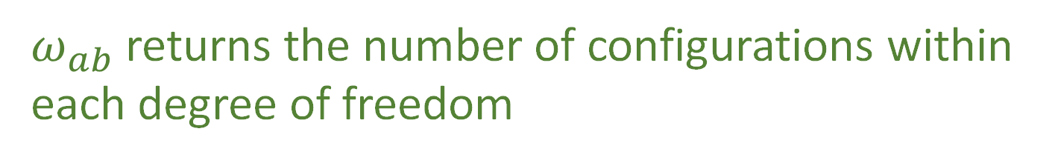

The phase space volume quantifies the number of states in the region.
Thus, the area on each degree of freedom identifies the number of
configurations for that degree of freedom
Given vectors:
$v=v^{q}e_{q^{x}}+v^{p}e_{p_{x}}$ and $w=w^{q}e_{q^{x}}+w^{p}e_{p_{x}}$
number of configurations constrained on a single degree of freedom $x$:
$$v^{q}w^{p}−v^{p}w^{q}$$
$$v^{a}ω_{ab}ω^{b}=v^{q}ω^{p}−v^{p}w^{q}$$
$ω_{ab}$ returns the number of configurations within
each degree of freedom

Slide 28
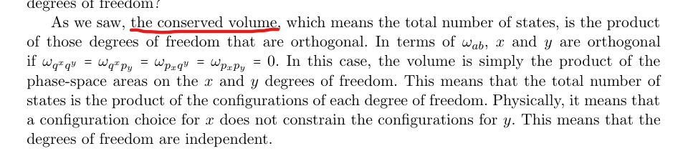


The volume is conserved so the total number of states is the product of
the degrees of freedom that are orthogonal
In terms of $ω_{ab}$, $x$ and $y$ are orthogonal if:
$$ω_{q^{x}q^{y}}=ω_{q^{x}p_{y}}=ω_{p_{x}q^{y}}=ω_{p_{x}p_{y}}=0$$
This means that the total number of states is the product of the
configurations of reach degree of freedom.
Physically, this means that a configuration choice for $x$
does not constrain the configurations for $y$
degrees of freedom are independent

Slide 29
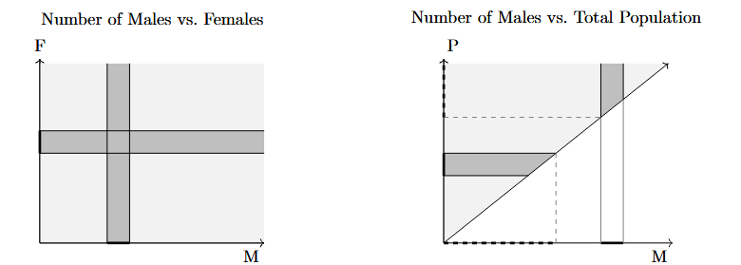
Number of Males vs. Females
Number of Males vs. Total Population
F
T
M
M
Notes:
TODO: orange lines should go all the way through, but the interior should be black outside the valid area

Slide 30
There are two different notions of independence:
Say we have a rabbit farm and describe its state with the number of
male and female rabbits
Male
Female

Slide 31


There are two different notions of independence:
If there are 231 female rabbits, in principle we don’t know anything
about the number of males
we may expect the population of both sexes to be
about equal but this does not describe something
about the nature of the variables themselves:
it describes the nature of rabbit farms
$$?$$
$$231$$
Independent

Slide 32

There are two different notions of independence:
Now we could choose to describe the rabbit farm with another set of
variables: the number of females and the total number of rabbits
Total rabbits
$$\text{Female}$$

Slide 33


There are two different notions of independence:
If there are $231$ female rabbits, then there must be at least $231$ total
rabbits
$$≥231$$
$$231$$
Not Independent

Slide 34


This type of independence is different from the notion of
independence in terms of statistics and probability
This is in terms of if the probability distribution factorizes
That is, if $P(f,m)$ is the probability that a particular rabbit
farm has $f$ females and $m$ males, the distributions of males
$P(m)$ and females $P(f)$ are independent if:
$P\left(f,m\right)=P(f)$ $P(m)$

Slide 35
We have two notions of independence, one based on the
variables themselves and one on the probability distribution
The orthogonal directions in phase space are independent in
the first, stronger sense. Since the degrees of freedom are
Independent regardless of the probability distribution one may
put on top of them

Slide 36



Note that there is a link between the two types of independent
Given any distribution $P\left(f\right)$ on females, we can choose any distribution $P\left(m\right)$
on males and set $P\left(f,m\right)=P\left(f\right)P\left(m\right)$
However, suppose choose $P\left(f\right)$ and want to find $P\left(f+m\right)$ such that
$P\left(f,f+m\right)=P\left(f\right)P(f+m)$
The probability $P(f+m)$ must be zero for all values smaller than the greatest
value of $f$ such that$P\left(f\right)≠0$
If there is no greatest value for $f$, for example if $f$ follows a
geometric distribution, no $P\left(f+m\right)$ can be independent of $P(f)$

Slide 37
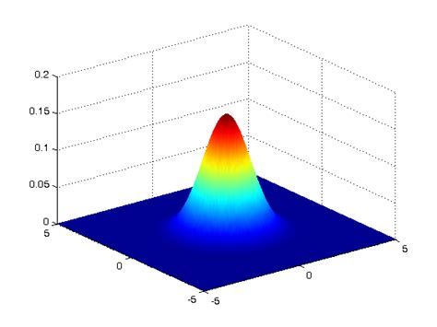


Conclusions:
IND-DOF $⟺$ IND-STAT $⟺$ IND-INFO $⟺$ IND-UNC
area is the product of the sides
(IND-DOF) The system is decomposable into independent DOFs
Joint is the product of the marginals
(IND-STAT) The system allows statistically independent distributions over each DOF
(IND-INFO) The system allows informationally independent distributions
over each DOF
$−∫ρ_{XY}\log{ρ_{XY}}$ $=$ $−∫ρ_{X}\log{ρ_{X}}$ $−∫ρ_{Y}\log{ρ_{Y}}$
$$ρ_{XY}=ρ_{X}ρ_{Y}$$
(IND-UNC) The system allows peaked distributions where the
uncertainty is the product of the uncertainty on each DOF
$$p_{2}$$
$$p_{1}$$
$$q^{2}$$
covariance matrix
$$q^{1}$$
Notes:
Picture one: area is the product of the sides (all points possible); picture two: is a 2d gaussian with the marginals (to show that the joint is the product of the marginals); picture three: just equation, joint entropy is the sum of the marginal; picture four: ellipses of the covariance matrix aligned with axis, so that the axis of the ellipse project on the axis of the diagrams

Slide 38
These conditions are independent from DR, as we could have a
deterministic and reversible system that cannot be broken into separate
degrees of freedom, or a that can be broken into separate degrees of
freedom that is not deterministic and reversable
The question then is whether assuming independent degrees of freedom
and deterministic and reversible evolution is enough to recover
Hamiltonian mechanics.

Slide 39


Firstly: can we recover $ω_{ab}$
Assuming that the configuration can be broken up into
independent degrees of freedom we must be able to define the
count of configurations for each degree of freedom, and
independent degrees of freedom must be orthogonal
The fact that $ω_{ab}$ will return zero if it acts on directions belonging
to independent degrees of freedom, tells us that $ω_{ab}$
counts not just configurations, but independent
configurations

Slide 40




This would seem to restrict $ω_{ab}$ to:
$$ω_{ab}=\left[\begin{matrix}0 & 1 \\ −1 & 0\end{matrix}\right]⨂\left[\begin{matrix}a_{1} & 0 & \text{⋯} & 0 \\ 0 & a_{2} & \text{⋯} & 0 \\ \text{⋮} & … & \text{⋱} & \text{⋮} \\ 0 & 0 & \text{⋯} & a_{4}\end{matrix}\right]$$
$ω_{ab}$ must return the area in each degree of freedom:
constrains the left matrix of the outer product to the one above
$ω_{ab}$ needs to return zero across independent
degrees of freedom constrains the right matrix of
the outer product to be diagonal

Slide 41



Note: $q^{i}$ and $p_{i}$ are not only variable that form independent DOFs
If we take two independent DOFs $x$ and $y$, $x+y$, and $x −y$, they will
also form independent degrees of freedom.
$ω_{ab}$ defines orthogonality for all DOFs
Changing $x$ and $y$ to $x+y$ and $x−y$ will effectively apply a rotation on
the diagonal matrix, which will remain diagonal only if the
coefficients on the diagonal are the same.

Slide 42


For $ω_{ab}$ to properly capture the independence of linear combinations of
independent DOFs, the diagonal matrix must have the same coefficient
This coefficient represents the freedom we have in choosing the units of
omega with respect to the units of everything else. In SI units, the product
between $q^{i}$and $p_{i}$ is in $J ⋅ s$ and we set the coefficient to 1
Therefore expressing the number of configurations with the same units for all DOFs
is not an extra constraint, but it is necessary to keep track of the dependency
relationship for all degrees of freedom.

Slide 43
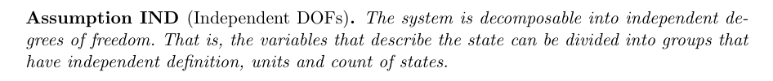


The other constitutive assumption of Hamiltonian mechanics is:
Which gives us the conditions IND-DOF, IND-STAT, IND-INFO,
and INT-UNC which was saw imply the existence of a form $ω_{ab}$
defines independent DOFs and the count
of independent configurations for each DOF
Conversely, assuming HM-ND means defining an
$ω_{ab}$ such that IND is satisfied

Slide 44
Our question is now whether DR and IND
are enough to recover HM-ND

Slide 45
IND by itself means the existence of the counting form $ω_{ab}$
DR by itself means the conservation of the total number of states
These two mathematical conditions, by themselves, do not lead to Hamiltonian
mechanics as we need the counting form itself to be conserved
So, we need to know if it makes sense, on physical grounds to have a deterministic
and reversible evolution that can take two independent degrees of
freedom and break their independence?
Note: we are not referring to statistical independence but rather the one
that tells us that all the combinations of configurations are at least possible

Slide 46

The answer to this question is no, which can be easily seen in
the finite case
Suppose we have two integer variables $1≤x≤3$ and $1≤y≤3$
If they are independent, we have a total of 9 distinct cases
If the evolution is deterministic and reversible, we will still have 9 distinct
cases, which means the variables must remain independent
Note: we could introduce a correlation between $x$ and
$y$, but that there would still be 9 total cases

Slide 47

Reasoning:
The only way to make variables no longer independent is to
decrease the number of distinct cases
Cannot happen during deterministic and reversible evolutions!
Also true in the infinite or continuous case, since finite
ranges must be comparable with finite sizes
IND & DR $⇔$ preserving $ω_{ab}⇔$ HM-ND
Insight: Hamiltonian mechanics is exactly the
deterministic and reversible evolution of a system
decomposable into a finite collection of
independent degrees of freedom.
Notes:
the case of independent variables is maximal as it posits that all combinations of configurations are possible.

Slide 48
Connotations of this conclusion:
Two physical conditions taken separately may each impose one mathematical
condition, but it is not necessarily true that imposing them together will only
impose the conjunction of the two mathematical conditions
May indicate that the math we currently use is not the “physically correct” one
as it does not seem to be capturing the entirety of the physical conditions

Slide 49

Note that we could ask the evolution to o preserve the
independence of DOFs without requiring DR
IND fixes $ω_{ab}$ up to a scalar factor, which could change during
the evolution
The volume would stretch or shrink depending on
the factor, stretching or shrinking each DOF by
the same amount

Slide 50
Example:
A particle under linear drag in three dimensions
Since a faster moving particle will be subjected to a greater frictional force, a spread
in momentum $∆p$will become smaller in time, tending to zero as time increases
If the friction coefficient is the same for all directions, all degrees of
freedom will shrink at the same rate
Taking the volume as entropy, this tells us that the only way we can add or remove
entropy to/from a system while preserving IND is by dividing that
entropy contribution equally among each DOF
In other words, preservation of DOF independence gives us
a sort of equipartition of entropy change

Slide 51
Conclusion:
We now have a mathematically and physically precise way to
characterize Hamiltonian evolution
Additionally, we have found that Hamiltonian mechanics apply
only to systems described by finitely many independent degrees
of freedom undergoing deterministic and reversible evolution

Slide 53
Notes:
TODO: 3 possible maps. 1) maps X to X and Y to Y (preserves statistical independence) 2) maps XY to XY, scrambling X and Y (introduces statistical independence, but preserve variable independence), 3) removes some cases, but the map cannot be reversible (lose variable independence)

Slide 54




$$p_{2}$$
$$p_{1}$$
$$q^{2}$$
$$q^{1}$$
$$p_{2}$$
$$p_{1}$$
$$q^{2}$$
$$q^{1}$$
Notes:
TODO: potato diagram is for divergencelessness; Line diagram is for curllessness

Slide 55




Math Bank
$${\hat{ω}}_{ab}=∂_{a}\hat{ξ}ω_{cd}∂_{b}{\hat{ξ}}^{d}=\left(δ_{a}^{c}+∂_{a}S^{c}δt\right)ω_{cd}\left(δ_{b}^{d}+∂_{b}S^{d}δt\right)$$
$$=ω_{ab}+\left(∂_{a}S^{c}ω_{cb}+ω_{ad}∂_{b}S^{d}\right)δt+O\left(δt^{2}\right)$$
$$=ω_{ab}+\left(∂_{a}{(S}^{c}ω_{cb})+∂_{b}(S^{d}ω_{ad})\right)δt+O\left(δt^{2}\right)$$
$$=ω_{ab}+\left(∂_{a}{(S}^{c}ω_{cb})−∂_{b}(S^{d}ω_{da})\right)δt+O\left(δt^{2}\right)$$
Invariance of $ω_{ab}$: $∂_{a}{(S}^{c}ω_{cb})−∂_{b}(S^{d}ω_{da})$
In terms of the rotated displacement field $S_{a}$ we have the more compact form $∂_{a}S_{b}−∂_{b}S_{a}=0$
the rotated displacement field is the gradient of the Hamiltonian
$$∂_{a}S_{b}−∂_{b}S_{a}=∂_{a}\left(S^{c}ω_{cb}\right)−∂_{b}\left(S^{c}ω_{ca}\right)=∂_{a}∂_{b}H−∂_{b}∂_{a}H=0$$
$$S_{a}=S^{b}ω_{ba}=ω_{a}H$$

Slide 56






$v=v^{q}e_{q^{x}}+v^{p}e_{p_{x}}$ and $w=w^{q}e_{q^{x}}+w^{p}e_{p_{x}}$
One degree of freedom:
$$v^{a}ω_{ab}ω^{b}=v^{q}ω^{p}−v^{p}w^{q}$$
Two degrees of freedom:
$$v^{a}ω_{ab}ω^{b}=0$$
$$v^{i}g_{ij}w^{j}=\left|v\right|\left|w\right|cosθ_{vw}$$
$$d_{t}q^{1}={S^{q}}^{1}=\frac{p_{1}}{m}$$
$$d_{t}p_{1}=S^{p_{1}}=−bp_{1}$$
$$d_{t}q^{2}={S^{q}}^{2}=\frac{p_{2}}{m}$$
$$d_{t}p_{2}=S^{p_{2}}=bp_{2}$$

Slide 57

$$∂_{a}S^{a}=∂_{q^{1}}\frac{p_{1}}{m}+∂_{p_{1}}\left(bp_{1}\right)+∂_{q^{2}}\frac{p_{2}}{m}+∂_{p_{2}}\left(bp_{2}\right)=−b+b=0$$
$$∂_{q^{1}}S_{p_{1}}−∂_{p_{1}}S_{q^{1}}=∂_{q^{1}}S^{q^{1}}ω_{q^{1}p_{1}}−∂_{p_{1}}S^{p_{1}}ω_{p_{1}q^{1}}=∂_{q^{1}}\frac{p_{1}}{m}\left(1\right)−∂_{p_{1}}(−bp_{1})(−1)=−b$$
$$ω_{ab}=\left[\begin{matrix}0 & 1 \\ −1 & 0\end{matrix}\right]⨂\left[\begin{matrix}a_{1} & 0 & \text{⋯} & 0 \\ 0 & a_{2} & \text{⋯} & 0 \\ \text{⋮} & … & \text{⋱} & \text{⋮} \\ 0 & 0 & \text{⋯} & a_{4}\end{matrix}\right]$$

Slide 58
Image/images
Notes:
Look at foundations 2016 slides and others for images

Slide 59




Total number of states is the product between the cases in each d.o.f volume is product of the areas→ d.o.f. orthogonal in phase space
$$(y,p_{y})$$
$$(y′,{p′}_{y})$$
$$(x,p_{x})$$
$$(x′,{p′}_{x})$$
Number of cases on each d.o.f. remains the same (area of each d.o.f)
Total number of cases product of all cases (orthogonal d.o.f.)

Slide 60






Relationships within degrees of freedom
Motion preserves area of each independent d.o.f (uncertainty,
entropy and number of states)
$$p_{i}$$
$${p′}_{i}$$
$$x_{i}$$
$$V^{i}×W^{i}=V^{i^{′}}×W^{i^{′}}$$
$${x′}_{i}$$
$$V^{i}\left[\begin{matrix}0 & 1 \\ −1 & 0\end{matrix}\right]W^{i}$$

Slide 61






Relationships within degrees of freedom
Motion preserves area of each independent d.o.f (uncertainty,
entropy and number of states)
$$p_{i}$$
$${p′}_{i}$$
$$x_{i}$$
$$V^{i}×W^{i}=V^{i^{′}}×W^{i^{′}}$$
$${x′}_{i}$$
$$V^{i}\left[\begin{matrix}0 & 1 \\ −1 & 0\end{matrix}\right]W^{i}$$

Slide 62






Relationships across degrees of freedom
Independent d.0.f.
remain perpendicular (remain independent)
$$x_{i}$$
$${x′}_{i}$$
$$V^{i}∙W^{j}=0=V^{i^{′}}∙W^{j^{′}}$$
$$x_{j}$$
$${x′}_{j}$$
$$V^{i}\left[\begin{matrix}… & 0 & 0 \\ 0 & … & 0 \\ 0 & 0 & …\end{matrix}\right]W^{j}$$

Slide 63
















Reversing phase-space
Hamiltonian Privilege, Erkenn (2023)
Stud Hist Phil 71, 082020, 60-71 (2020)
Each unit variable (i.e. coordinate) paired with a conjugate of inverse units: number of states $ΔqΔk$is invariant
$\hat{q}=100 cm/m q$
$$x↦x^{3}$$
$$1$$
$Δk=1 m^{−1}$
$$1$$
$Δ\hat{k}=0.01 cm^{−1}$
$$x$$
$$x^{3}$$
$Δ\hat{q}=100 cm$
$Δq=1 m$
Density, entropy, uniform distributions NOT in general coordinate invariant
Phase space (symplectic) structure is the only one that supports coordinate invariant density, entropy, state count
Only 3 spatial dimensions are possible
Independence of DOFs $⇒$ independence of units $⇒$ orthogonality in phase-space $⇒$ invariant marginals (for density, entropy, state count)
Hamiltonian mechanics preserves count of states and DOF independence over time
2-sphere the only symplectic manifold
$$(q^{y},k_{y})$$
$$ω_{ab}=\left[\begin{matrix}0 & 1 \\ −1 & 0\end{matrix}\right]⊗δ_{j}^{i}$$
Directional DOF
$$(q^{x},k_{x})$$
Orthogonality/independence across DOFs
Total number of states $=$ product of number of cases in each independent DOF
Symplectic form (geometric structure of phase space)
Areas/possibilities in each DOF
Invariance at equal time (relativity) gives us the structure of phase space

Slide 64
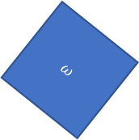



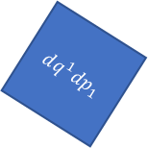




Relativistic mechanics
Lorentzian relativity is the only “correct” one
Minkowski signature appears on the extended phase space
$$ω=dq^{1}dp_{1}+dq^{2}dp_{2}$$
$$ω=dq^{1}dp_{1}−dtdE$$
$$ω$$
$$dq^{1}dp_{1}=ω+dtdE$$
$$dq^{2}dp_{2}$$
$$dq^{1}dp_{1}$$
$$dq^{1}dp_{1}$$
$$dtdE$$
$$ω$$
Indep DOF are orthogonal

Slide 65








$$H(q,p)$$
$$p$$
$H=\frac{p^{2}}{2m}+kq^{2}$
$$4$$
$$3$$
$$2$$
$$H=1$$
$$q$$

Slide 66




$\vec{∇}H\left(q,p\right)=\left[\begin{matrix}∂_{p}H \\ ∂_{q}H\end{matrix}\right]$
$$\vec{∇}H\left(q,p\right)$$
$$p$$
$$4$$
$$3$$
$=\left[\begin{matrix}\frac{p}{m} \\ 2kq\end{matrix}\right]$
$$2$$
$$H=1$$
$$q$$
$H=\frac{p^{2}}{2m}+kq^{2}$

Slide 67




$\vec{S}\left(q,p\right)=\left[\begin{matrix}S^{q} \\ S^{p}\end{matrix}\right]$
$$\vec{S}\left(q,p\right)$$
$$p$$
$$4$$
$$=\left[\begin{matrix}d_{t}q \\ d_{t}p\end{matrix}\right]=\left[\begin{matrix}∂_{p}H \\ −∂_{q}H\end{matrix}\right]$$
$$3$$
$$2$$
$$H=1$$
$$q$$
$$={\text{P}}_{}^{90°}\left(\vec{∇}H\right)$$

Slide 68

Conclusions:
IND-DOF $⟺$ IND-STAT $⟺$ IND-INFO $⟺$ IND-UNC
(IND-DOF) The system is decomposable into independent DOFs
(IND-STAT) The system allows statistically independent distributions
over each DOF
(IND-INFO) The system allows informationally independent distributions
over each DOF
(IND-UNC) The system allows peaked distributions
where the uncertainty is the product of the uncertainty
on each DOF
Notes:
Picture one: area is the product of the sides (all points possible); picture two: is a 2d gaussian with the marginals (to show that the joint is the product of the marginals); picture three: just equation, joint entropy is the sum of the marginal; picture four: ellipses of the covariance matrix aligned with axis, so that the axis of the ellipse project on the axis of the diagrams

Slide 69


Joint is the product of the marginals
Joint Entropy $=$ marginal $1$ $+$ marginal $2+…$marginal $n$
$$p_{2}$$
$$p_{1}$$
$$q^{2}$$
$$(y,p_{y})$$
area is the product of the sides
$$q^{1}$$
$$(x,p_{x})$$
Notes:
Picture one: area is the product of the sides (all points possible); picture two: is a 2d gaussian with the marginals (to show that the joint is the product of the marginals); picture three: just equation, joint entropy is the sum of the marginal; picture four: ellipses of the covariance matrix aligned with axis, so that the axis of the ellipse project on the axis of the diagrams

Slide 70






$ω_{ab}$ defines areas within different degrees
of freedom and the angles between them
$$v^{a}ω_{ab}ω^{b}=0$$
In general relativity and Riemannian geometry, the metric tensor $g_{ij}$
defines the geometry by defining the scalar product between vectors.
$$v^{i}g_{ij}w^{j}=\left|v\right|\left|w\right|cosθ_{vw}$$
$g_{ij}$ defines lengths and angles
$$v^{i}⋅w^{j}=\left|v\right|\left|w\right|cosθ_{vw}$$
Notes:
TODO: add symplectic so that we can compare

Slide 71











$$θ$$
$$w$$
$$v⋅w=\left|v\right|\left|w\right|cos{(θ}_{vw})=\left|v\right|\left|w\right|cos{(θ}_{vw})=$$
$$θ$$
$$φ$$
$$v$$
$$w$$
$${\text{P}}_{}^{90°}v$$
$$φ$$
$$w$$
$$φ$$
$${\text{P}}_{}^{90°}v$$
Notes:
TOTHINK: Show that scalar product is the area with one vector rotated?

