Slide 1
Multiple degrees of Freedom
Gabriele Carcassi

Slide 2
First show the relationships that stay the same
Then show the relationships that change/generalize (are different arguments, difficult to make a parallel)
Recap that the one that changes is “complete” and implies the lesser (one about surfaces/lines, other about volumes)
Orthogonality of DOF = independence
Area cons + ortho => volumes (to explain previous finding)

Slide 3










Hamilton’s Equations
S-DOF
$$d_{t}q=∂_{p}H$$
$$d_{t}p=−∂_{q}H$$
$$d_{t}q^{i}=∂_{p_{i}}H$$
$$d_{t}p_{i}=−∂_{q^{i}}H$$
(HM-1D)
(HM-ND)
$$S^{q}=∂_{p}H$$
$$S^{p}=−∂_{q}H$$
$$ξ^{a}=[q^{i}, p^{i}]$$
$$S^{a}=d_{t}ξ^{a}=[d_{t}q^{i},d_{t}p^{i}]$$
$$S^{q^{i}}=∂_{p_{i}}H$$
$$S^{p_{i}}=−∂_{q^{i}}H$$

Slide 4
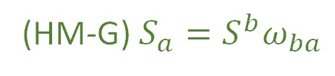
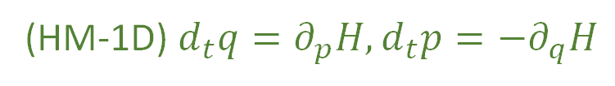
We have found twelve equivalent characterizations for a single degree of freedom
(HM-1D) $d_{t}q=∂_{p}H,d_{t}p=−∂_{q}H$
(HM-G) $S_{a}=S^{b}ω_{ba}$
(DR-DIV) The displacement field for a one dimensional Hamiltonian is divergenceless: $∂_{a}S^{a}=0$
(DR-JAC) The Jacobian of the time evolution is unitary: $\left|∂_{b}{\hat{ξ}}^{a}\right|=1$
(DR-VOL) Volumes are conserved through the evolution: $d{\hat{ξ}}^{1}…d{\hat{ξ}}^{n}=dξ^{1}…dξ^n$
(DR-DEN) Densities are conserved through the evolution: $\hat{ρ}\left({\hat{ξ}}^{a}\right)=ρ\left(ξ^{b}\right)$
(DI-SYMP) The evolution leaves $ω_{ab}$ invariant: ${\hat{ω}}_{ab}=ω_{ab}$
(DI-POI) The evolution leaves the Poisson brackets invariant
(DI-CURL) The rotated displacement field is curl free: $∂_{a}S_{b}−∂_{b}S_{a}=0$
(DR-EV) The evolution is deterministic and reversable
(DR-THER) The evolution is deterministic and thermodynamically Reversible
(DR-INFO) The evolution conserves information entropy
(DR-UNC) The evolution conserves the uncertainty of peaked distributions

Slide 5













S-DOF
$$ω=\left[\begin{matrix}0 & 1 \\ −1 & 0\end{matrix}\right]⊗I_{n}$$
$$\left[ω_{ab}\right]=\left[\begin{matrix}ω_{q^{i}q^{j}} & ω_{q^{i}p_{j}} \\ ω_{p_{i}q^{j}} & ω_{p_{i}p_{j}}\end{matrix}\right]$$
$$ω=\left[\begin{matrix}0 & 1 \\ −1 & 0\end{matrix}\right]$$
$$\left[ω_{ab}\right]=\left[\begin{matrix}ω_{qq} & ω_{qp} \\ ω_{pq} & ω_{pp}\end{matrix}\right]$$
$$\vec{S}=ω \vec{∇}H$$
$$\left[\begin{matrix}S^{q} \\ S^{p}\end{matrix}\right]=\left[\begin{matrix}0 & 1 \\ −1 & 0\end{matrix}\right]\left[\begin{matrix}∂_{q}H \\ ∂_{p}H\end{matrix}\right]=\left[\begin{matrix}∂_{p}H \\ −∂_{q}H\end{matrix}\right]$$
$$S_{a}=S^{b}ω_{ba}=∂_{a}H$$
$$\left[\begin{matrix}S^{q^{i}} \\ S^{p_{i}}\end{matrix}\right]=\left[\begin{matrix}0 & I_{n} \\ −I_{n} & 0\end{matrix}\right]\left[\begin{matrix}∂_{q^{i}}H \\ ∂_{p_{i}}H\end{matrix}\right]=\left[\begin{matrix}∂_{p_{i}}H \\ −∂_{q^{i}}H\end{matrix}\right]$$
$$S^{q}ω_{qp}=∂_{p}H$$
$$S^{p}ω_{pq}=∂_{q}H$$
(HM-G)
$$S_{a}=S^{b}ω_{ba}=∂_{a}H$$
$$S^{q^{i}}ω_{q^{i}p_{i}}=∂_{p_{i}}H$$
$$S^{p_{i}}ω_{p_{i}q^{i}}=∂_{q^{i}}H$$
(SF-ND)

Slide 6










$ω_{ab}$preforms a $90$ degree rotation within each degree of freedom,
switching components between position and momentum
Given: $v^{a}=[{v^{q}}^{i},v^{p_{i}}]$ then $v_{a}=v^{b}ω_{ba}=[−v^{p_{i}},v^{q^{i}}]$
Insight: the displacement field is still equal to the gradient of $H$ rotated $90$ degrees,
except there are now multiple ways to preform this rotation
It is only the rotation defined by $ω_{ab}$ that works
$$p_{2}$$
$$p_{1}$$
$$q^{2}$$
$$p_{2}$$
$$p_{1}$$
$$q^{2}$$
$$q^{1}$$
$$q^{1}$$

Slide 7

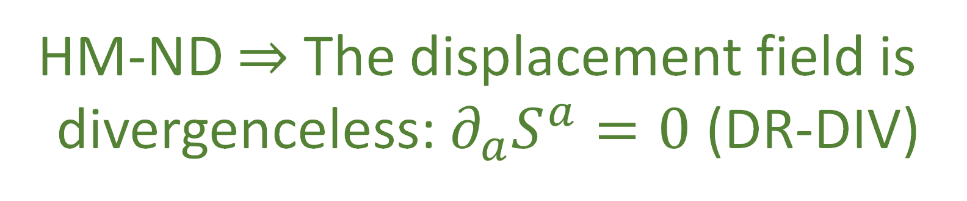





$$p_{2}$$
$$p_{1}$$
$$q^{2}$$
S-DOF
$$∂_{a}S^{a}=∂_{q}S^{q}+∂_{p}S^{p}$$
$$q^{1}$$
$$=∂_{q}∂_{p}H−∂_{p}∂_{q}H$$
$0=∂_{a}S^{a}$ $=∂_{q^{i}}S^{q^{i}}+∂_{p_{i}}S^{p_{i}}$ $=∂_{q^{i}}∂_{p_{i}}H−∂_{p_{i}}∂_{q^{i}}H$
$$=0$$
HM-ND $⇒$ The displacement field is
divergenceless: $∂_{a}S^{a}=0$ (DR-DIV)

Slide 8













Let $\hat{q}$and $\hat{p}$ represent the evolution of q and p after an infinitesimal time step $δt$
$${\hat{q}}^{i}=q^{i}+S^{q^{i}}δt$$
S-DOF
$${\hat{p}}_{i}=p_{i}+S^{p_{i}}δt$$
$$\hat{p}=p+S^{p}δt$$
$$\hat{q}=q+S^{q}δt$$
$$∂_{b}{\hat{ξ}}^{a}=\left[\begin{matrix}δ_{j}^{i}+∂_{q^{j}}S^{q^{i}}δt & ∂_{p_{j}}S^{q^{i}}δt \\ ∂_{q^{j}}S^{p_{i}}δt & δ_{i}^{j}+∂_{p_{j}}S^{p_{i}}δt\end{matrix}\right]$$
$$∂_{b}{\hat{ξ}}^{a}=\left[\begin{matrix}1+∂_{q}S^{q}δt & ∂_{p}S^{q}δt \\ ∂_{q}S^{p}δt & 1+∂_{p}S^{p}δt\end{matrix}\right]$$
$$p$$
$$\left|∂_{b}{\hat{ξ}}^{a}\right|=1+\left(∂_{q}S^{q}+∂_{p}S^{p}\right)δt+O(δt^{2})$$
$$\left|∂_{b}{\hat{ξ}}^{a}\right|=\left|δ_{j}^{i}+∂_{q^{j}}S^{q^{i}}δt\right|\left|δ_{i}^{j}+∂_{p_{j}}S^{p_{i}}δt\right|$$
$$−\left|∂_{p_{j}}S^{q^{i}}δt\right|\left|∂_{q^{j}}S^{p_{i}}δt\right|$$
$∂_{a}S^{a}$!!!
$$=1+\left(∂_{q^{i}}S^{q^{i}}+∂_{p_{i}}S^{p_{i}}\right)δt+O(δt^{2})$$
$$q$$
$∂_{a}S^{a}$!!!

Slide 9
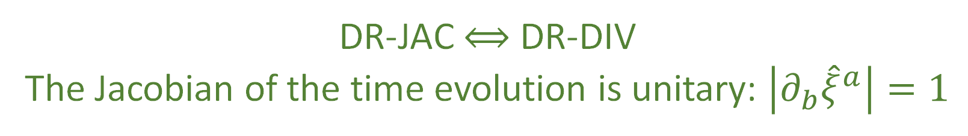



$\left|∂_{b}{\hat{ξ}}^{a}\right|=1$ $⟺$ $∂_{a}S^{a}=0$
DR-JAC $⟺$ DR-DIV
The Jacobian of the time evolution is unitary: $\left|∂_{b}{\hat{ξ}}^{a}\right|=1$
The Jacobian is still the multiplicative factor between past and future areas and densities
$$⇒$$
Volumes are conserved through the evolution: $d{\hat{ξ}}^{1}…d{\hat{ξ}}^{n}=dξ^{1}…dξ^n$ (DR-VOL)
Densities are conserved through the evolution: $\hat{ρ}\left({\hat{ξ}}^{a}\right)=ρ\left(ξ^{b}\right)$ (DR-DEN)
DR-DIV $⟺$DR-JAC $⟺$ DR-VOL $⟺$ DR-DEN

Slide 10





The displacement field $S^{a}$ has $2n$ components
Conditions DR-DIV, DR-JAC, DR-VOL, and DR-DEN all specify a single restraint giving
$2n−1$ components
The choice of Hamiltonian provides another constraint, leaving $2n−2$ choices
Single Degree of Freedom:
$$n=1$$
$$2n−2=0$$
no choices remain
Multiple Degrees of Freedom:
$$n>1$$
$$2n−2≠0$$
choices remain
HM-ND $⇒$ DR-DIV $⟺$DR-JAC $⟺$ DR-VOL $⟺$ DR-DEN
DR-DIV $⟺$DR-JAC $⟺$ DR-VOL $⟺$ DR-DEN $⇏$ HM-ND

Slide 11
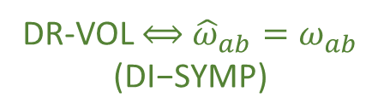












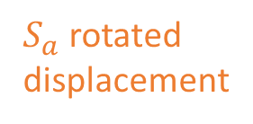



$${\hat{ω}}_{ab}=∂_{a}{\hat{ξ}}^{c}ω_{cd}∂_{b}{\hat{ξ}}^{d}$$
S-DOF
$$=\left(δ_{a}^{c}+∂_{a}S^{c}δt\right)ω_{cd}\left(δ_{b}^{d}+∂_{b}S^{d}δt\right)$$
$$=ω_{ab}+\left(∂_{a}S^{c}ω_{cb}+ω_{ad}∂_{b}S^{d}\right)δt+O\left(δt^{2}\right)$$
$$=ω_{ab}+\left(∂_{a}{(S}^{c}ω_{cb})+∂_{b}(S^{d}ω_{ad})\right)δt+O\left(δt^{2}\right)$$
$$=ω_{ab}+\left(∂_{a}{(S}^{c}ω_{cb})−∂_{b}(S^{d}ω_{da})\right)δt+O\left(δt^{2}\right)$$
Area $\left(v^{a},w^{a}\right)=v^{a}ω_{ab }w^{b}$
${\hat{v}}^{c}ω_{cd }{\hat{w}}^{d}=v^{a}{\hat{ω}}_{ab }w^{b}$
Area is conserved if
$${\hat{ω}}_{ab}=ω_{ab}$$
DR-VOL $⟺$ ${\hat{ω}}_{ab}=ω_{ab}$ $$\text{(}\text{DI}\text{−}\text{SYMP}\text{)}$$
Invariance of $ω_{ab}$:
$$p_{2}$$
$$p_{1}$$
$$q^{2}$$
$$∂_{a}(S^{c}ω_{cb})−∂_{b}\left(S^{d}ω_{da}\right)=0$$
$S^{a}$ displacement
area $≠$ volume M-DOF
$$∂_{a}S_{b}−∂_{b}S_{a}=0$$
$S_{a}$ rotated displacement
$$q^{1}$$
DI-SYMP $⟺$ DI-CURL

Slide 12


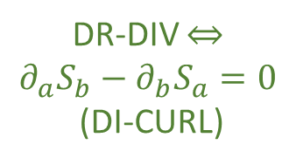
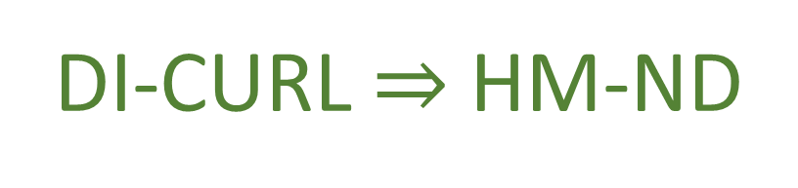




S-DOF
$$∂_{a}S_{b}−∂_{b}S_{a}=∂_{a}\left(S^{c}ω_{cb}\right)−∂_{b}(S^{c}ω_{ca})$$
Flow THROUGH the curve
$$\int{S^{a}×dξ^{b}}$$
$$=∂_{a}∂_{b}H−∂_{b}∂_{a}H=0$$
same only for S-DOF
Flow ALONG the curve
HM-ND $⇒$ DI-CURL
$$\int{S_{b}⋅dξ^{b}}$$
$$p_{2}$$
$$p_{1}$$
$$q^{2}$$
DR-DIV $⇔$ $$∂_{a}S_{b}−∂_{b}S_{a}=0$$
(DI-CURL)
Conversely: given $S_{a}$ is curl free
$$S_{a}=S^{b}ω_{ba}=∂_{a}H$$
$$q^{1}$$
DI-CURL $⇒$ HM-ND

Slide 13



$$\left\{f,g\right\}=∂_{q}f∂_{p}g−∂_{p}f∂_{q}g=−∂_{a}fω^{ab}∂_{b}g$$
The relationship between Poisson
brackets and $ω^{ab}$is the same in
S-DOF and M-DOF
invariance of $ω$ is invariance of Poisson bracket
DI-SYMP $⟺$ DI-POI
$$\hat{\left\{f,g\right\}}=∂_{\hat{q}}f∂_{\hat{p}}g−∂_{\hat{p}}f∂_{\hat{q}}g=−∂_{a}f{\hat{ω}}^{ab}∂_{b}g$$

Slide 14









HM-ND
$$⟺$$
DI-CURL
DR-JAC
$$⟺$$
DR-DIV
$$⇒$$
$$⟺$$
$$⟺$$
$$⟺$$
$$⟺$$
DI-POI
$$⟺$$
DI-SYMP
DR-DEN
$$⟺$$
DR-VOL
fully characterize Hamiltonian mechanics
weaker conditions
How are they different?
Why are they the same for a S-DOF?

Slide 15










$$v^{a}ω_{ab}w^{b}$$
conserved quantity
$$p_{1}$$
$$ω=\left[\begin{matrix}0 & 1 \\ −1 & 0\end{matrix}\right]$$
S-DOF
$$w$$
$$ω(v,w)$$
$$v$$
$$q^{1}$$
$$v^{a}ω_{ab}w^{b}=v^{q^{1}}ω_{q^{1}p_{1}}w^{p_{1}}=v^{q^{1}}w^{p_{1}}$$
area of parallelogram
$⇒$ area conserved
$⇒$ volume conserved

Slide 16








$$v^{a}ω_{ab}w^{b}$$
conserved quantity
$$p_{2}$$
$$p_{1}$$
$$q^{2}$$
$$ω(v,w)$$
$$w$$
$$v$$
$$ω=\left[\begin{matrix}0 & I_{n} \\ −I_{n} & 0\end{matrix}\right]$$
M-DOF
$$w$$
$$ω(v,w)$$
$$v$$
$$q^{1}$$
$$v^{a}ω_{ab}w^{b}=v^{q^{1}}ω_{q^{1}p_{1}}w^{p_{1}}=v^{q^{1}}w^{p_{1}}$$
area of parallelogram
$$v^{a}ω_{ab}w^{b}=v^{q^{2}}ω_{q^{2}p_{2}}w^{p_{2}}=0$$
zero across DOFs!

Slide 17



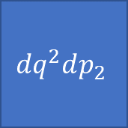
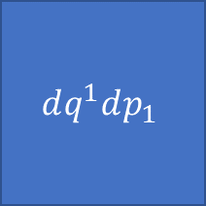


$$ω=\left[\begin{matrix}0 & I_{n} \\ −I_{n} & 0\end{matrix}\right]$$
$$\left[ω_{ab}\right]=\left[\begin{matrix}ω_{q^{i}q^{j}} & ω_{q^{i}p_{j}} \\ ω_{p_{i}q^{j}} & ω_{p_{i}p_{j}}\end{matrix}\right]$$
SF-ND
Orthogonality of DOF
$$ω=∑dq^{i}dp_{i}$$
$$ω$$
$$⟺$$
$$dq^{2}dp_{2}$$
DOF independence
$$dq^{1}dp_{1}$$
WARNING: analogy!!!

Slide 18





Space(time) geometry vs phase space geometry
(pseudo-)Riemannian
Symplectic
$$g_{ij}$$
$$ω_{ab}$$
Metric tensor
Symplectic form
defines lengths and angles
areas and “angles”
$$ds^{2}=dx^{i}g_{ij}dx^{j}=∑{\left(dx^{i}\right)}^{2}$$
$$ds^{2}=dξ^{a}ω_{ab}dξ^{b}=∑dq^{i}dp_{i}$$
cartesian coordinates
canonical coordinates $(q^{i},p_{i})$

Slide 19

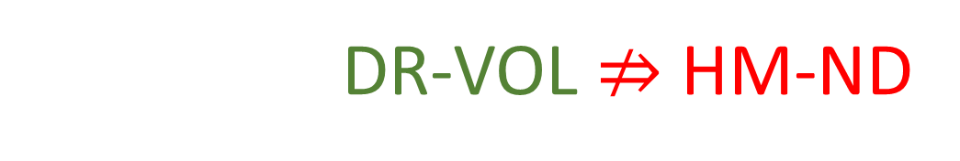

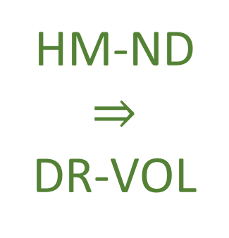





$$⇒$$
Conservation of $ω_{ab}$
Conservation of areas and orthogonality
$$(y,p_{y})$$
$$(y′,{p′}_{y})$$
HM-ND $⇒$ DR-VOL
$$(x,p_{x})$$
$$(x′,{p′}_{x})$$
$$⇒$$
Volume is preserved!
However DR-VOL $⇏$ HM-ND

Slide 20








$$d_{t}q^{1}={S^{q}}^{1}=\frac{p_{1}}{m}$$
$$d_{t}p_{1}=S^{p_{1}}=−bp_{1}$$
Particle under linear drag
$$d_{t}q^{2}={S^{q}}^{2}=\frac{p_{2}}{m}$$
a particle accelerated proportionally
to its momentum
$$d_{t}p_{2}=S^{p_{2}}=bp_{2}$$
$$∂_{a}S^{a}=∂_{q^{1}}\frac{p_{1}}{m}+∂_{p_{1}}\left(−bp_{1}\right)+∂_{q^{2}}\frac{p_{2}}{m}+∂_{p_{2}}\left(bp_{2}\right)=−b+b=0$$
Divergence is zero: DR-DIV and DR-VOL are satisfied
$$(y,p_{2})$$
$$(y′,{p′}_{2})$$
$$(x,p_{1})$$
$$(x′,{p′}_{1})$$

Slide 21

$$d_{t}q^{1}={S^{q}}^{1}=\frac{p_{1}}{m}$$
$$d_{t}p_{1}=S^{p_{1}}=−bp_{1}$$
Particle under linear drag
$$d_{t}q^{2}={S^{q}}^{2}=\frac{p_{2}}{m}$$
a particle accelerated proportionally
to its momentum
$$d_{t}p_{2}=S^{p_{2}}=bp_{2}$$
$$∂_{q^{1}}S_{p_{1}}−∂_{p_{1}}S_{q^{1}}=∂_{q^{1}}S^{q^{1}}ω_{q^{1}p_{1}}−∂_{p_{1}}S^{p_{1}}ω_{p_{1}q^{1}}$$
$$=∂_{q^{1}}\frac{p_{1}}{m}\left(1\right)−∂_{p_{1}}(−bp_{1})(−1)=−b$$
Curl of $S_{a}$is not zero: DI-CURL is not satisfied, nor are DI-SYMP and HM-DM
$$(y,p_{2})$$
$$(y′,{p′}_{2})$$
$$(x,p_{1})$$
$$(x′,{p′}_{1})$$

Slide 22
Turning attention to the physics

Slide 23
Note that conditions:
(DR-EV) The evolution is deterministic and reversable
(DR-THER) The evolution is deterministic and thermodynamically Reversible
(DR-INFO) The evolution conserves information entropy
(DR-UNC) The evolution conserves the uncertainty of peaked distributions
Are equivalent to DR-VOL and DR-JAC
Determinism and reversibility is a constitutive assumption
of Hamiltonian mechanics in the general case, but it
cannot be the only one
Is there another condition independent of DR?

Slide 24


We saw that determinism and reversibility forces the evolution map
to be both bijective and volume preserving
Mathematically, there can be a bijection that is not volume preserving
or a volume preserving map that is not bijective
However, a physically meaningful deterministic and reversible
map must do both
Physically independent?
So we would get that HM-ND $⇒$HR-EV
And that HM-ND $⇒$ another physical condition

Slide 25


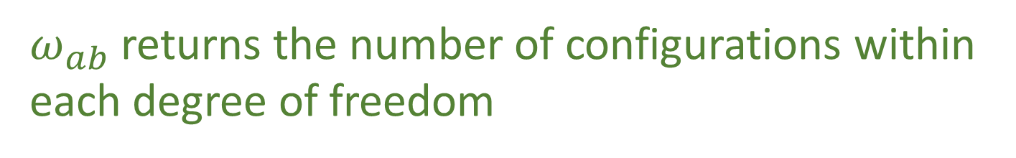
The phase space volume quantifies the number of states in the region
The area on each degree of freedom identifies the number of
configurations for that degree of freedom
Given vectors:
$v=v^{q}e_{q^{x}}+v^{p}e_{p_{x}}$ and $w=w^{q}e_{q^{x}}+w^{p}e_{p_{x}}$
number of configurations constrained on a single degree of freedom $x$:
$$v^{a}ω_{ab}ω^{b}=v^{q}ω^{p}−v^{p}w^{q}$$
$ω_{ab}$ returns the number of configurations within
each degree of freedom

Slide 26
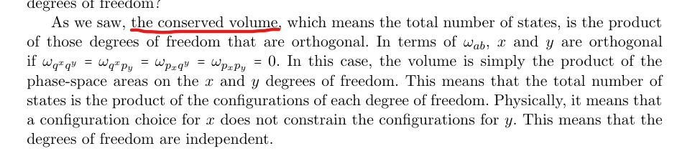


The volume is conserved so the total number of states is the product of
the degrees of freedom that are orthogonal
In terms of $ω_{ab}$, $x$ and $y$ are orthogonal if:
$$ω_{q^{x}q^{y}}=ω_{q^{x}p_{y}}=ω_{p_{x}q^{y}}=ω_{p_{x}p_{y}}=0$$
the total number of states is the product of the
configurations of each degree of freedom
a configuration choice for $x$ does not
constrain the configurations for $y$
degrees of freedom are independent

Slide 27






Rabbit farm example
“There are 231 female rabbits”
$⇒$ “There are at least 231 rabbits”
Number of Females vs. Males
Number of Females vs. Total Population
M
T
$$≥231$$
$$?$$
$$231$$
F
$$231$$
F
“There are 231 female rabbits”
$⇒$ No constraint on the male populations

Slide 28



Variable independence:
Degrees of freedom themselves are independent, regardless
of what probability distribution one may put on top
Statistical independence:
the probability distribution factorizes
$P\left(f,m\right)=P(f)$ $P(m)$
looking back at the rabbit example:
Given any distribution $P\left(f\right)$ on females, we can choose any distribution $P\left(m\right)$ on males
and set $P\left(f,m\right)=P\left(f\right)P\left(m\right)$
Given $P\left(f\right)$ and that we want to find $P\left(f+m\right)$ such that $P\left(f,f+m\right)=P\left(f\right)P(f+m)$,
$P(f+m)$ must be zero for all values smaller than the greatest value of $f$
such that$P\left(f\right)≠0$
Thus, If there is no greatest value for $f$, for example if $f$ follows a
geometric distribution, no $P\left(f+m\right)$ can be independent of $P(f)$

Slide 29
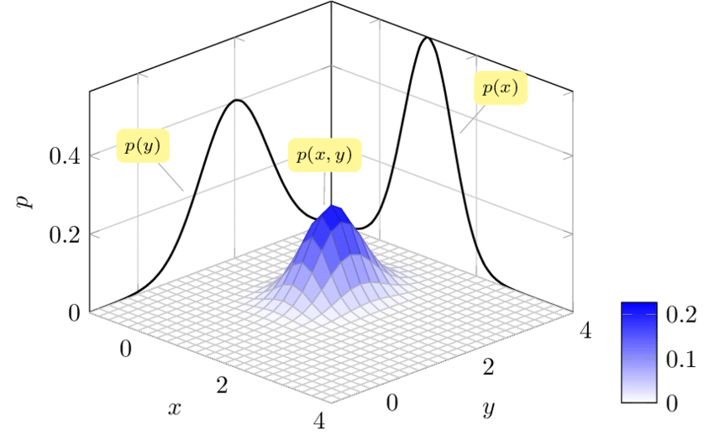



Conclusions:
IND-DOF $⟺$ IND-STAT $⟺$ IND-INFO $⟺$ IND-UNC
area is the product of the sides
(IND-DOF) The system is decomposable into independent DOFs
Joint is the product of the marginals
(IND-STAT) The system allows statistically independent distributions over each DOF
$$Selvan, Raghavendra. \left(2015\right). Bayesian$$
$$tracking of multiple point targets using$$
$$Expectation Maximization.$$
(IND-INFO) The system allows informationally independent distributions
over each DOF
$$ρ_{XY}=ρ_{X}ρ_{Y}$$
$−∫ρ_{XY}\log{ρ_{XY}}$ $=$ $−∫ρ_{X}\log{ρ_{X}}$ $−∫ρ_{Y}\log{ρ_{Y}}$
(IND-UNC) The system allows peaked distributions where the
uncertainty is the product of the uncertainty on each DOF
$$p_{2}$$
$$p_{1}$$
$$q^{2}$$
covariance matrix
$$q^{1}$$
Notes:
Picture one: area is the product of the sides (all points possible); picture two: is a 2d gaussian with the marginals (to show that the joint is the product of the marginals); picture three: just equation, joint entropy is the sum of the marginal; picture four: ellipses of the covariance matrix aligned with axis, so that the axis of the ellipse project on the axis of the diagrams

Slide 30
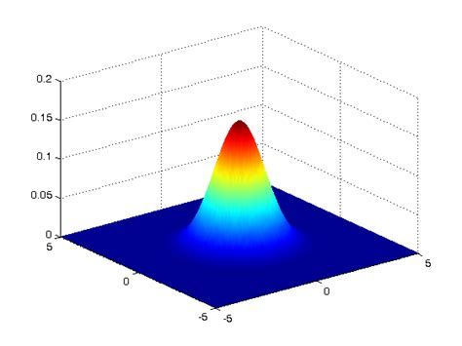
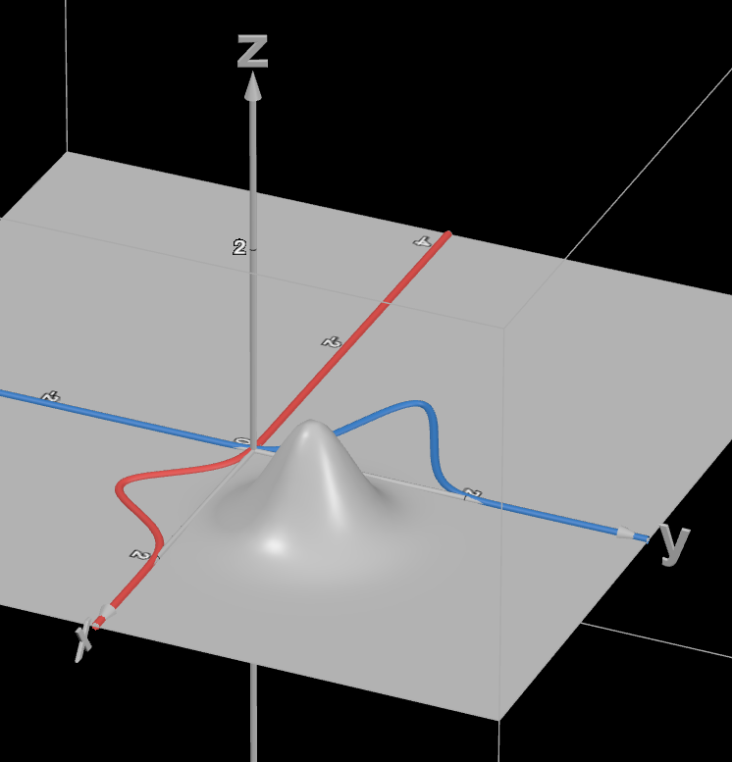
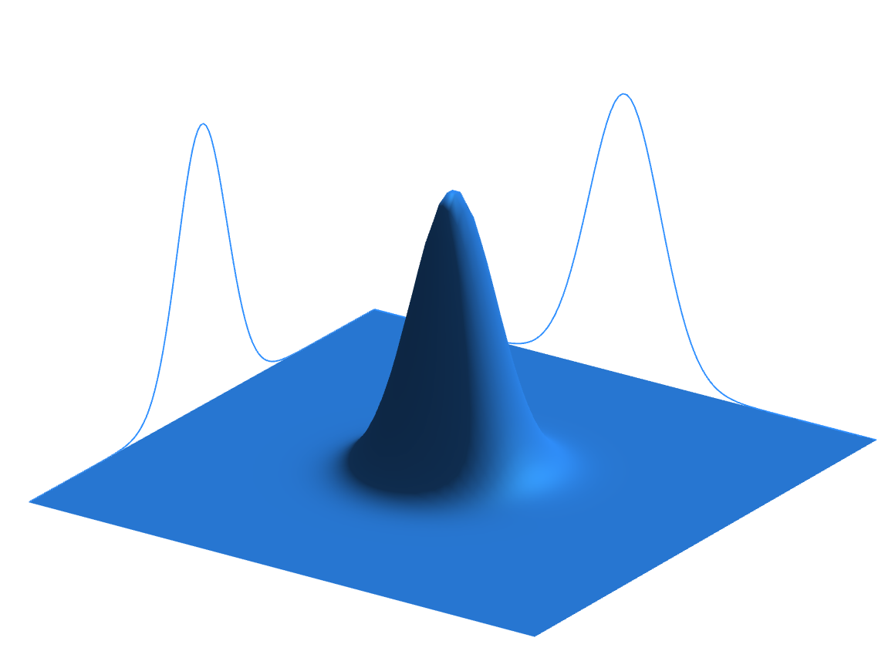


$$ρ_{XY}=ρ_{X}ρ_{Y}$$
$$Selvan, Raghavendra. \left(2015\right). Bayesian tracking of$$
$$multiple point targets using Expectation Maximization.$$
Notes:
I don’t think that you can make the 2-D gaussian in power point

Slide 32
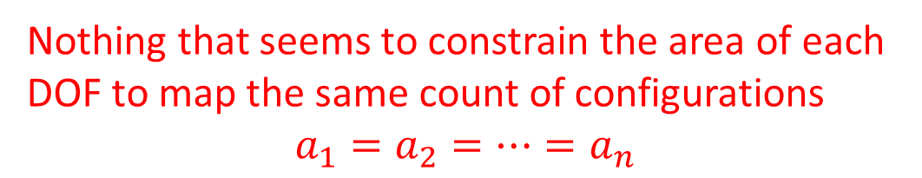





With IND and DR, can we recover $ω_{ab}$?
Assuming IND we must be able to define the count of configurations for each DOF, and
independent degrees of freedom must be orthogonal
The fact that $ω_{ab}$ will return zero if it acts on directions belonging to independent degrees
of freedom, tells us that $ω_{ab}$counts not just configurations, but independent configurations
This would seem to restrict $ω_{ab}$ to:
$ω_{ab}$ needs to return zero across
independent degrees of freedom
$$ω_{ab}=\left[\begin{matrix}0 & 1 \\ −1 & 0\end{matrix}\right]⨂\left[\begin{matrix}a_{1} & 0 & \text{⋯} & 0 \\ 0 & a_{2} & \text{⋯} & 0 \\ \text{⋮} & … & \text{⋱} & \text{⋮} \\ 0 & 0 & \text{⋯} & a_{4}\end{matrix}\right]$$
$ω_{ab}$ must return the area in
each degree of freedom
Nothing that seems to constrain the area of each
DOF to map the same count of configurations
$$a_{1}=a_{2}=…=a_{n}$$

Slide 33


Note: $q^{i}$ and $p_{i}$ are not only variable that form independent DOFs
If we take two independent DOFs $x$ and $y$, $x+y$, and $x −y$, they will also form
independent degrees of freedom.
rotation on the diagonal matrix
$ω_{ab}$ defines orthogonality for all DOFs
coefficients on the diagonal
must be the same
In SI units, the product between $q^{i}$and $p_{i}$ is in $J ⋅ s$
and we set the coefficient to 1
This coefficient represents the freedom we have in choosing the units of
omega with respect to the units of everything else
Therefore expressing the number of configurations with the
same units for all DOFs necessary to keep track of the
dependency relationship for all degrees of freedom

Slide 34
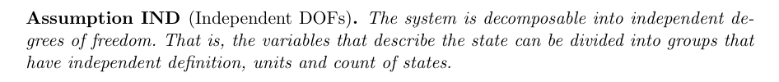


The other constitutive assumption of Hamiltonian mechanics is:
Which gives us the conditions IND-DOF, IND-STAT, IND-INFO,
and INT-UNC which was saw imply the existence of a form $ω_{ab}$
defines independent DOFs and the count of
independent configurations for each DOF
Conversely, assuming HM-ND means defining an
$ω_{ab}$ such that IND is satisfied

Slide 35
Our question is now whether DR and IND
are enough to recover HM-ND

Slide 36
IND by itself means the existence of the counting form $ω_{ab}$
DR by itself means the conservation of the total number of states
These two mathematical conditions, by themselves, do not lead to Hamiltonian
mechanics as we need the counting form itself to be conserved
So, we need to know if it makes sense, on physical grounds to have a deterministic
and reversible evolution that can take two independent degrees of
freedom and break their variable independence?

Slide 37













The answer to this question is no, which can be easily seen in the finite case
Suppose we have two integer variables $1≤x≤3$ and $1≤y≤3$
$3$ possible maps:
$x$ to $x$ and $y$ to $y$
$$x$$
$$x$$
preserves statistical independence and
variable independence
$$y$$
$$y$$
introduces statistical independence but
preserves variable independence
$xy$ to $xy$
$$xy$$
$$xy$$
Removes some cases
(map cannot be reversible)
preserves statistical
independence
$$x$$
$$x$$
loses variable
independence
$$y$$
$$y$$
Notes:
TODO: 1) shapes/colors (x and y remain shape and colors but permutated) 2) all circles, xy different shades of the same colors, gets mapped without pattern 3) all circles, all white For all: arrows should show two xy points being mapped. In 3 they map to the same point.

Slide 38

Reasoning:
The only way to make variables no longer independent is to
decrease the number of distinct cases
Cannot happen during deterministic and reversible evolutions!
Also true in the infinite or continuous case, since finite
ranges must be comparable with finite sizes
IND & DR $⇔$ preserving $ω_{ab}⇔$ HM-ND
Connotation:
Two physical conditions taken separately may each impose one mathematical
condition, but it is not necessarily true that imposing them together will only
impose the conjunction of the two mathematical conditions
May indicate that the math we currently use is not the “physically correct”
one as it does not seem to be capturing the entirety of the physical
conditions!

Slide 39
Reasoning:
The only way to make variables no longer independent is to
decrease the number of distinct cases
Cannot happen during deterministic and reversible evolutions!
Also true in the infinite or continuous case, since finite
ranges must be comparable with finite sizes
Insight: Hamiltonian mechanics is exactly the deterministic and
reversible evolution of a system decomposable into a finite collection
of independent degrees of freedom
Connotation:
Two physical conditions taken separately may each impose one mathematical
condition, but it is not necessarily true that imposing them together will
only impose the conjunction of the two mathematical conditions
May indicate that the math we currently use is not the “physically
correct” one as it does not seem to be capturing the entirety of the
physical conditions!

Slide 40

Note: Since IND fixes $ω_{ab}$ up to a scalar factor, which could change during the
evolution, we could have the evolution to preserve the independence of DOFs
without requiring DR
The volume would stretch or shrink depending on the factor,
stretching or shrinking each DOF by the same amount
Example:
A particle under linear drag in three dimensions
Since a faster moving particle will be subjected to a greater frictional force, a spread in
momentum $∆p$will become smaller in time, tending to zero as time increases
If the friction coefficient is the same for all directions, all degrees of freedom will shrink at
the same rate
Taking the volume as entropy, this tells us that the only way we can add or
remove entropy to/from a system while preserving IND is by dividing that
entropy contribution equally among each DOF
preservation of DOF independence gives us
a sort of equipartition of entropy change

Slide 41
Conclusion:
We now have a mathematically and physically precise way to
characterize Hamiltonian evolution
Additionally, we have found that Hamiltonian mechanics apply
only to systems described by finitely many independent degrees
of freedom undergoing deterministic and reversible evolution

Slide 43




$$p_{2}$$
$$p_{1}$$
$$q^{2}$$
$$q^{1}$$
$$p_{2}$$
$$p_{1}$$
$$q^{2}$$
$$q^{1}$$
Notes:
TODO: potato diagram is for divergencelessness; Line diagram is for curllessness

Slide 44
Image/images
Notes:
Look at foundations 2016 slides and others for images

Slide 45




Total number of states is the product between the cases in each d.o.f volume is product of the areas→ d.o.f. orthogonal in phase space
$$(y,p_{y})$$
$$(y′,{p′}_{y})$$
$$(x,p_{x})$$
$$(x′,{p′}_{x})$$
Number of cases on each d.o.f. remains the same (area of each d.o.f)
Total number of cases product of all cases (orthogonal d.o.f.)

Slide 46






Relationships within degrees of freedom
Motion preserves area of each independent d.o.f (uncertainty,
entropy and number of states)
$$p_{i}$$
$${p′}_{i}$$
$$x_{i}$$
$$V^{i}×W^{i}=V^{i^{′}}×W^{i^{′}}$$
$${x′}_{i}$$
$$V^{i}\left[\begin{matrix}0 & 1 \\ −1 & 0\end{matrix}\right]W^{i}$$

Slide 47






Relationships within degrees of freedom
Motion preserves area of each independent d.o.f (uncertainty,
entropy and number of states)
$$p_{i}$$
$${p′}_{i}$$
$$x_{i}$$
$$V^{i}×W^{i}=V^{i^{′}}×W^{i^{′}}$$
$${x′}_{i}$$
$$V^{i}\left[\begin{matrix}0 & 1 \\ −1 & 0\end{matrix}\right]W^{i}$$

Slide 48






Relationships across degrees of freedom
Independent d.0.f.
remain perpendicular (remain independent)
$$x_{i}$$
$${x′}_{i}$$
$$V^{i}∙W^{j}=0=V^{i^{′}}∙W^{j^{′}}$$
$$x_{j}$$
$${x′}_{j}$$
$$V^{i}\left[\begin{matrix}… & 0 & 0 \\ 0 & … & 0 \\ 0 & 0 & …\end{matrix}\right]W^{j}$$

Slide 49
















Reversing phase-space
Hamiltonian Privilege, Erkenn (2023)
Stud Hist Phil 71, 082020, 60-71 (2020)
Each unit variable (i.e. coordinate) paired with a conjugate of inverse units: number of states $ΔqΔk$is invariant
$\hat{q}=100 cm/m q$
$$x↦x^{3}$$
$$1$$
$Δk=1 m^{−1}$
$$1$$
$Δ\hat{k}=0.01 cm^{−1}$
$$x$$
$$x^{3}$$
$Δ\hat{q}=100 cm$
$Δq=1 m$
Density, entropy, uniform distributions NOT in general coordinate invariant
Phase space (symplectic) structure is the only one that supports coordinate invariant density, entropy, state count
Only 3 spatial dimensions are possible
Independence of DOFs $⇒$ independence of units $⇒$ orthogonality in phase-space $⇒$ invariant marginals (for density, entropy, state count)
Hamiltonian mechanics preserves count of states and DOF independence over time
2-sphere the only symplectic manifold
$$(q^{y},k_{y})$$
$$ω_{ab}=\left[\begin{matrix}0 & 1 \\ −1 & 0\end{matrix}\right]⊗δ_{j}^{i}$$
Directional DOF
$$(q^{x},k_{x})$$
Orthogonality/independence across DOFs
Total number of states $=$ product of number of cases in each independent DOF
Symplectic form (geometric structure of phase space)
Areas/possibilities in each DOF
Invariance at equal time (relativity) gives us the structure of phase space

Slide 50
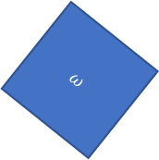



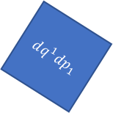




Relativistic mechanics
Lorentzian relativity is the only “correct” one
Minkowski signature appears on the extended phase space
$$ω=dq^{1}dp_{1}+dq^{2}dp_{2}$$
$$ω=dq^{1}dp_{1}−dtdE$$
$$ω$$
$$dq^{1}dp_{1}=ω+dtdE$$
$$dq^{2}dp_{2}$$
$$dq^{1}dp_{1}$$
$$dq^{1}dp_{1}$$
$$dtdE$$
$$ω$$
Indep DOF are orthogonal

Slide 51








$$H(q,p)$$
$$p$$
$H=\frac{p^{2}}{2m}+kq^{2}$
$$4$$
$$3$$
$$2$$
$$H=1$$
$$q$$

Slide 52




$\vec{∇}H\left(q,p\right)=\left[\begin{matrix}∂_{p}H \\ ∂_{q}H\end{matrix}\right]$
$$\vec{∇}H\left(q,p\right)$$
$$p$$
$$4$$
$$3$$
$=\left[\begin{matrix}\frac{p}{m} \\ 2kq\end{matrix}\right]$
$$2$$
$$H=1$$
$$q$$
$H=\frac{p^{2}}{2m}+kq^{2}$

Slide 53




$\vec{S}\left(q,p\right)=\left[\begin{matrix}S^{q} \\ S^{p}\end{matrix}\right]$
$$\vec{S}\left(q,p\right)$$
$$p$$
$$4$$
$$=\left[\begin{matrix}d_{t}q \\ d_{t}p\end{matrix}\right]=\left[\begin{matrix}∂_{p}H \\ −∂_{q}H\end{matrix}\right]$$
$$3$$
$$2$$
$$H=1$$
$$q$$
$$={\text{P}}_{}^{90°}\left(\vec{∇}H\right)$$

Slide 54

Conclusions:
IND-DOF $⟺$ IND-STAT $⟺$ IND-INFO $⟺$ IND-UNC
(IND-DOF) The system is decomposable into independent DOFs
(IND-STAT) The system allows statistically independent distributions
over each DOF
(IND-INFO) The system allows informationally independent distributions
over each DOF
(IND-UNC) The system allows peaked distributions
where the uncertainty is the product of the uncertainty
on each DOF
Notes:
Picture one: area is the product of the sides (all points possible); picture two: is a 2d gaussian with the marginals (to show that the joint is the product of the marginals); picture three: just equation, joint entropy is the sum of the marginal; picture four: ellipses of the covariance matrix aligned with axis, so that the axis of the ellipse project on the axis of the diagrams

Slide 55


Joint is the product of the marginals
Joint Entropy $=$ marginal $1$ $+$ marginal $2+…$marginal $n$
$$p_{2}$$
$$p_{1}$$
$$q^{2}$$
$$(y,p_{y})$$
area is the product of the sides
$$q^{1}$$
$$(x,p_{x})$$
Notes:
Picture one: area is the product of the sides (all points possible); picture two: is a 2d gaussian with the marginals (to show that the joint is the product of the marginals); picture three: just equation, joint entropy is the sum of the marginal; picture four: ellipses of the covariance matrix aligned with axis, so that the axis of the ellipse project on the axis of the diagrams

Slide 56






$ω_{ab}$ defines areas within different degrees
of freedom and the angles between them
$$v^{a}ω_{ab}ω^{b}=0$$
In general relativity and Riemannian geometry, the metric tensor $g_{ij}$
defines the geometry by defining the scalar product between vectors.
$$v^{i}g_{ij}w^{j}=\left|v\right|\left|w\right|cosθ_{vw}$$
$g_{ij}$ defines lengths and angles
$$v^{i}⋅w^{j}=\left|v\right|\left|w\right|cosθ_{vw}$$
Notes:
TODO: add symplectic so that we can compare

Slide 57











$$θ$$
$$w$$
$$v⋅w=\left|v\right|\left|w\right|cos{(θ}_{vw})=\left|v\right|\left|w\right|cos{(θ}_{vw})=$$
$$θ$$
$$φ$$
$$v$$
$$w$$
$${\text{P}}_{}^{90°}v$$
$$φ$$
$$w$$
$$φ$$
$${\text{P}}_{}^{90°}v$$
Notes:
TOTHINK: Show that scalar product is the area with one vector rotated?

Slide 58



$3$ possible Maps:
preserves statistical independence and
variable independence
$X$ to $X$ and $Y$ to $Y$
$XY$ to $XY$
introduces statistical independence but
preserves variable independence
Removes some cases
(map cannot be reversible)
loses variable independence
Notes:
TODO: 3 possible maps. 1) maps X to X and Y to Y (preserves statistical independence) 2) maps XY to XY, scrambling X and Y (introduces statistical independence, but preserve variable independence), 3) removes some cases, but the map cannot be reversible (lose variable independence)

