Slide 1
Classical mechanics as the high-entropy limit of quantum mechanics
Gabriele Carcassi¹, Manuele Landini² and Christine A. Aidala¹
¹Physics Department University of Michigan
²Institut für Experimental Physik und Zentrum für Quantenphysik, Universität Innsbruck
Notes:
This is a modified version of the talk that I just gave at Perimeter Institute, for the 100 years of quantum, which includes a couple of observations that came out of the discussions. The biggest change is title, which makes the underlying claim more prominent. The “quantum principle,” that is what quantum mechanics is all about, is simply that there is a lower bound on the entropy. The third law of thermodynamics. Or, that no information can be acquired below a certain threshold. Or, we cannot prepare systems perfectly. Or, there is always a minimum interaction with the environment. These are all similar statements in the sense that one implies the other. This, to me, is a very important insight and result, so, I am kind of repeating myself if you have seen other talks about our research program. But I have seen other people had to repeat things for 20 years before other noticed… so there is that! Let’s get started.

Slide 2

Textbook introduction to quantum mechanics
Blackbody radiation
Photoelectric effect
There were problems with classical mechanics
Stability of atoms
We futzed around with matrices and waves, to find something new that has some correspondence with classical mechanics
$⇒$ Quantum mechanics!

Slide 3
What is the ultimate reason classical mechanics fails, and how is it fixed by quantum mechanics?
Since some of the classical failures are related to thermodynamics, let’s look at the relationship between entropy and uncertainty in classical mechanics

Slide 4
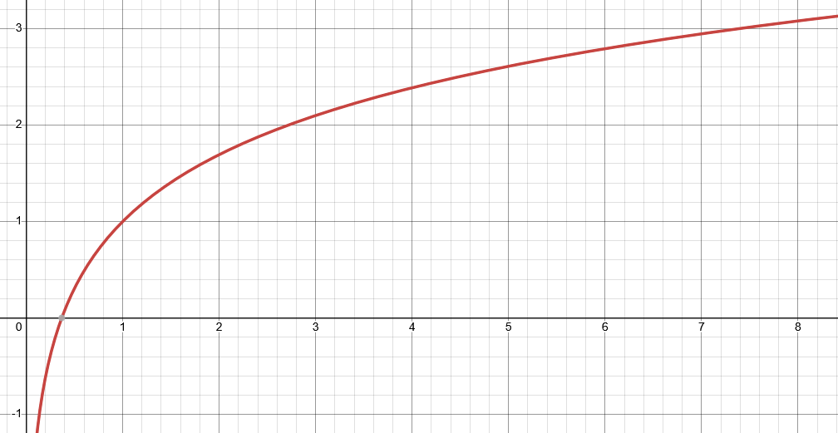



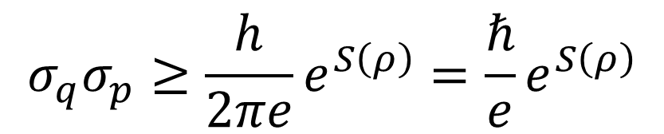
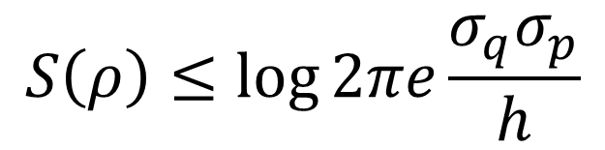
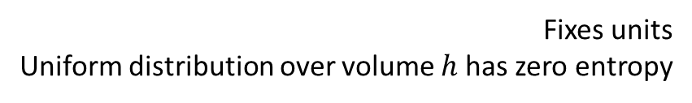
Entropy vs uncertainty
$S\left(ρ\right)=−∫ρ\log{hρ}dqdp$
Let’s plot one against the other
Fixes units Uniform distribution over volume $h$ has zero entropy
$$S$$
Gaussian maximizes entropy for a given uncertainty
excluded by gaussian bound
$$S\left(ρ\right)≤\log{2πe\frac{σ_{q}σ_{p}}{h}}$$
$$σ_{q}σ_{p}≥\frac{h}{2πe}e^{S\left(ρ\right)}=\frac{ℏ}{e}e^{S\left(ρ\right)}$$
$$\frac{σ_{q}σ_{p}}{ℏ}$$
Entropy puts a lower bound on the uncertainty
Is there a universal lower bound to the entropy?

Slide 5

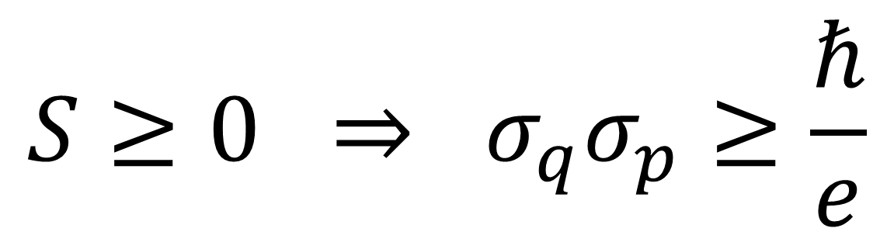

Enter the 3rd law
$$S$$
excluded by gaussian bound
Every substance has a finite positive entropy, but at the absolute zero of temperature the entropy may become zero, and does so become in the case of perfect crystalline substances.
G. N. Lewis and M. Randall, Thermodynamics and the
free energy of chemical substances (McGraw-Hill, 1923)
$$\frac{σ_{x}σ_{p}}{ℏ}$$
excluded by 3rd law of thermodynamics
$$S≥0 ⇒ σ_{q}σ_{p}≥\frac{ℏ}{e}$$
Classical uncertainty principle

Slide 6
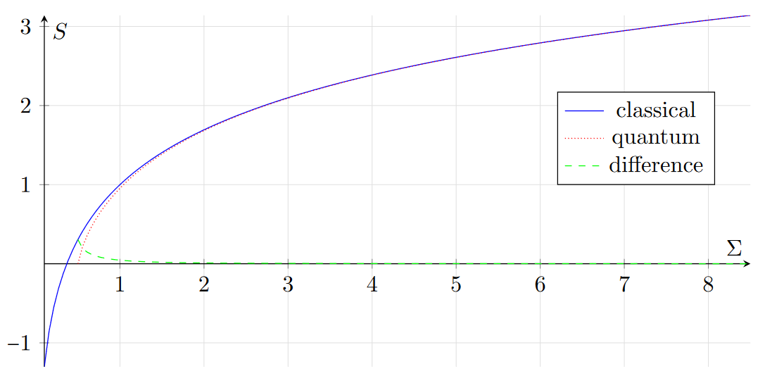
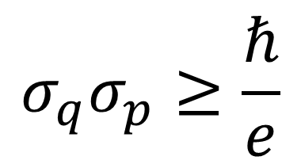
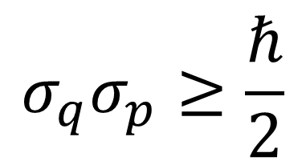



Comparing theories
excluded by gaussian bound
$$σ_{q}σ_{p}≥\frac{ℏ}{e}$$
$$σ_{q}σ_{p}≥\frac{ℏ}{2}$$
classical
quantum
$$\frac{σ_{q}σ_{p}}{ℏ}$$
2.71828…
excluded by 3rd law of thermodynamics
Entropy of quantum states is already non-negative
$$S_{C}=\ln{eσ}$$
The gaussian bound quickly becomes very similar across theories
$S_{Q}=\left(σ+\frac{1}{2}\right)\ln\left(σ+\frac{1}{2}\right)−\left(σ−\frac{1}{2}\right)\ln\left(σ−\frac{1}{2}\right)$
Quantum mechanics incorporates the third law Classical mechanics does not
Conjecture: does quantum mechanics recover classical mechanics at high entropy?

Slide 7
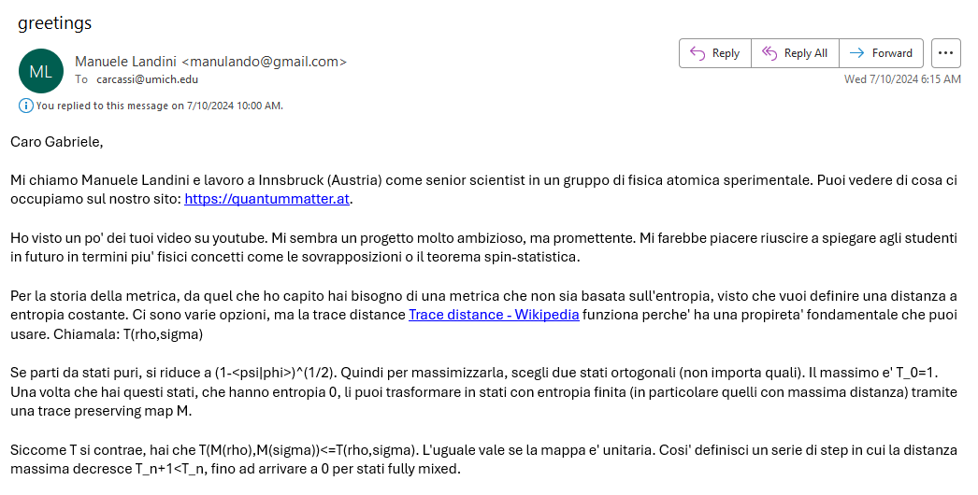
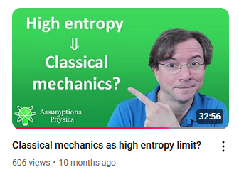
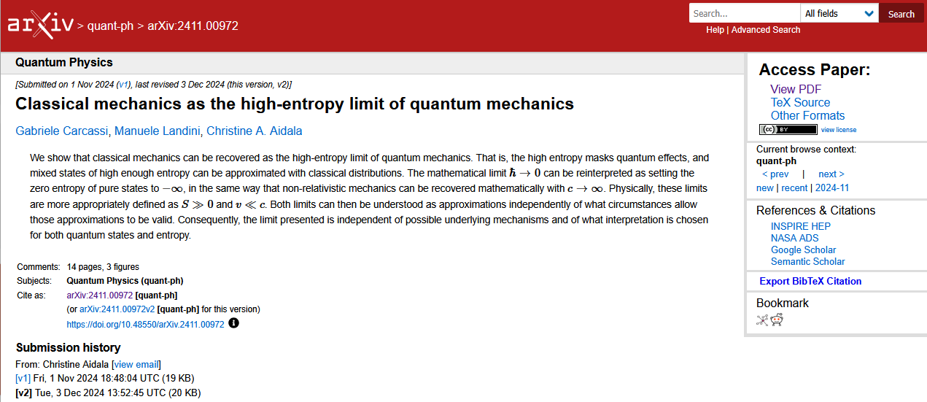
06/01/2024

Slide 8
Reinterpret old results

Slide 9
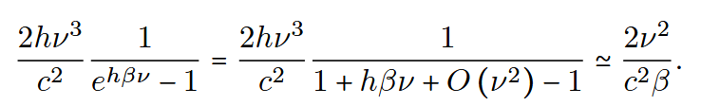
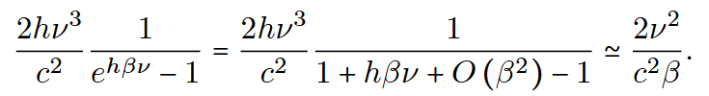
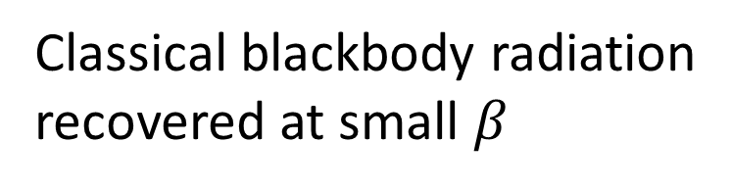
Classical blackbody radiation recovered at small frequencies
At thermal equilibrium, high entropy $⇔$ high temperature $⇔$ low $β$
Classical blackbody radiation recovered at small $β$

Slide 10
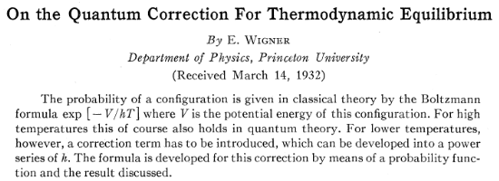

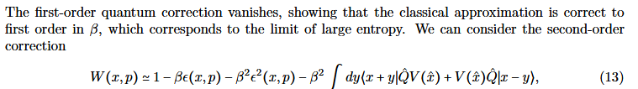
Wigner function of a thermal state
Classical distribution is the leading term of expansion in $ℏ$
At thermal equilibrium, high entropy $⇔$ high temperature $⇔$ low $β$
We recover the same limit and correction with a more meaningful expansion in $β$

Slide 11
Recover classical limit

Slide 12
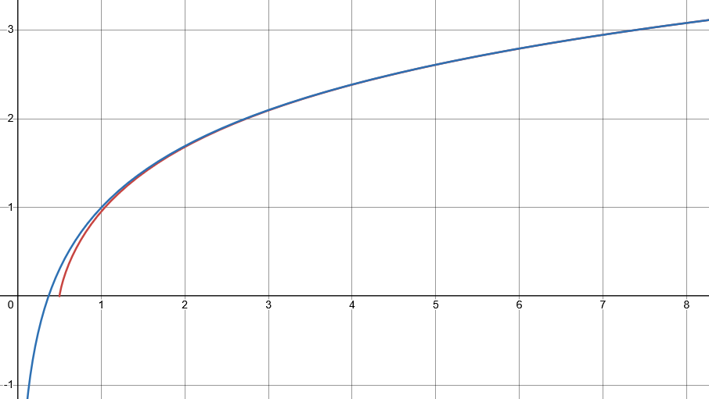

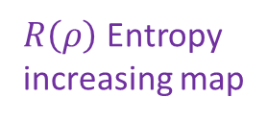




Looking for a map $R(ρ)$ that increases entropy of all mixed states, such that every level set of entropy maps to another level set
$$S$$
$⇒$ Unitary trans. must be mapped to unitary trans.
excluded by gaussian bound
$R\left(ρ\right)$ Entropy increasing map
Unitary map
$$\frac{σ_{x}σ_{p}}{ℏ}$$
excluded by 3rd law of thermodynamics
classical
quantum
$$\left[X,P\right]=ıℏ⇒$$
$$\left[T\left(X\right),T\left(P\right)\right]=λıℏ$$

Slide 13
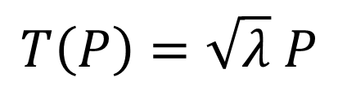
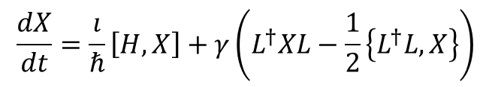
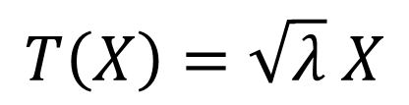


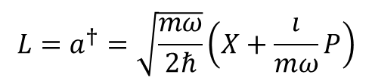
In classical mechanics
$$S\left(R\left(ρ\right)\right)=S\left(ρ\right)+\log{λ}⟺\left\{R\left(x\right),R\left(p\right)\right\}=λ\{x,p\}$$
In quantum mechanics
Jacobian is a constant: all volumes rescaled by the same factor
Stretching map
$$\left[R\left(X\right),R\left(P\right)\right]=λ\left[X,P\right]$$
Pure stretching map
$$T\left(X\right)=\sqrt{λ} X$$
$$T\left(P\right)=\sqrt{λ} P$$
Need to take care of operator ordering!!!
Infinitesimal pure stretching map
$$\frac{dX}{dt}=\frac{ı}{ℏ}\left[H,X\right]+γ\left(L^{†}XL−\frac{1}{2}\left\{L^{†}L,X\right\}\right)$$
Lindblad eq
(open quantum system)
$$L=a^{†}=\sqrt{\frac{mω}{2ℏ}}\left(X+\frac{ı}{mω}P\right)$$
$$γ=λ$$
Anti-normal ordering and Husimi Q are preferred

Slide 14
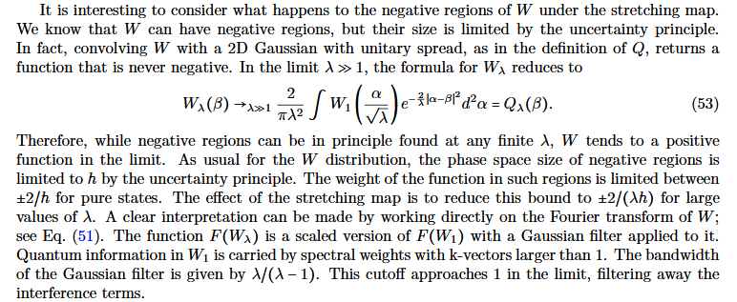
Effects of stretching map on phase space representations
Husimi Q is simply stretched
Wigner function is stretched and convolved with a gaussian, and coincides with the Husimi Q in the limit

Slide 15
Recover mathematical limit

Slide 16
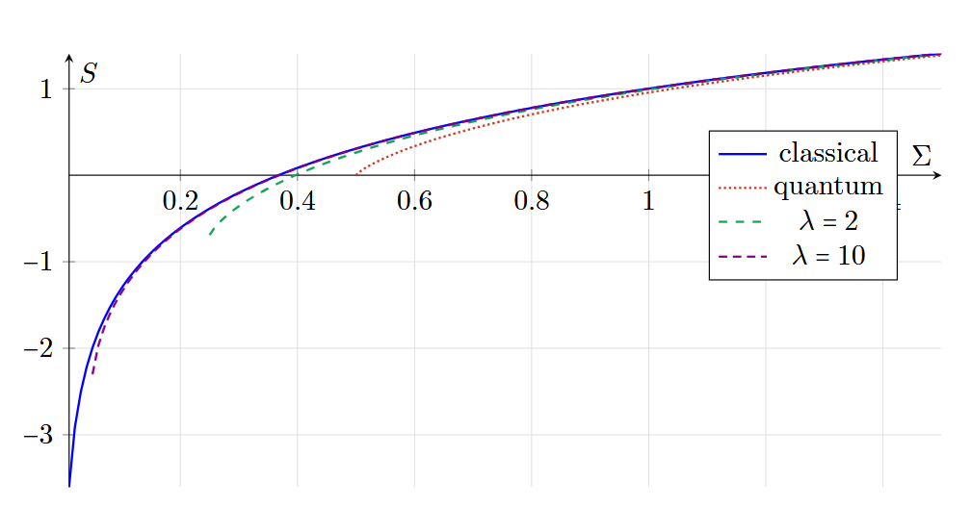
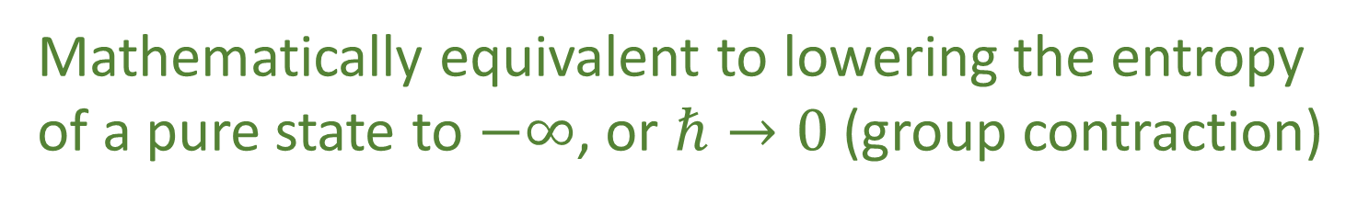
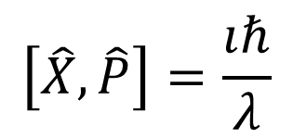



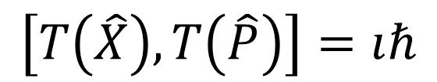
Another perspective: move the pure states to minus infinite entropy
Instead of
$$\left[X,P\right]=ıℏ$$
$$\left[T\left(X\right),T\left(P\right)\right]=λıℏ$$
Redefine original space such that
$$\left[\hat{X},\hat{P}\right]=\frac{ıℏ}{λ}$$
$$\left[T\left(\hat{X}\right),T\left(\hat{P}\right)\right]=ıℏ$$
$λ→∞ ⇒ \frac{ℏ}{λ}→0$
Mathematically equivalent to lowering the entropy of a pure state to $−∞$, or $ℏ→0$ (group contraction)

Slide 17


Low speed
Speed
“$c→∞$”
Classical Mechanics | Relativistic Mechanics
Quantum Mechanics | Quantum Field Theory
High entropy
“$ℏ→0$”
Entropy
No-mechanism limit (same as non-relativistic limit)

Slide 18
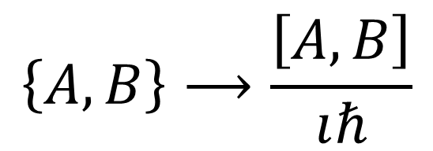
$$\left\{A,B\right\}⟶\frac{\left[A,B\right]}{ıℏ}$$
Dirac’s correspondence principle: give me a theory with an entropic lower bound that recovers the classical one at high entropy
Only one way to do it
Moyal bracket is the unique one-parameter Lie-algebraic deformation of the Poisson bracket
Quantizing a classical theory means putting a lower bound on the entropy

Slide 19



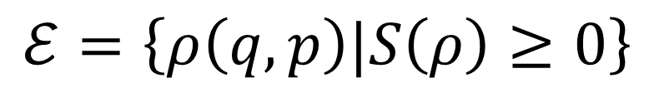
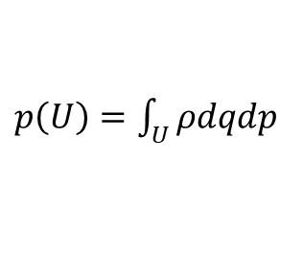

Why can’t we simply keep classical mechanics with a lower bound on the entropy?
$$S$$
excluded by gaussian bound
$$ℰ=\left\{ρ\left(q,p\right)|S\left(ρ\right)≥0\right\}$$
Physically inconsistent!
All probability distributions on classical phase space with non-negative entropy
$$\frac{σ_{x}σ_{p}}{ℏ}$$
excluded by 3rd law of thermodynamics
On one hand, ensembles with lower entropy do not exist
$$ρ\left(q,p\right)$$
momentum
$$p$$
Information below a certain threshold is not accessible
On the other hand, we define probability on arbitrarily small regions
$$q$$
$$U$$
position
There is no minimum threshold for a combined measurement of position and momentum
$p\left(U\right)=\int_{U}{ρdqdp}$

Slide 20
In the next 100 years
Textbook introduction to quantum mechanics
Blackbody radiation
Photoelectric effect
Classical statistical mechanics is incompatible with the third law of thermodynamics
Stability of atoms
Let’s develop a physical theory that
puts a lower bound on the entropy
recovers classical mechanics at high entropy
$⇒$ Quantum mechanics!

Slide 22
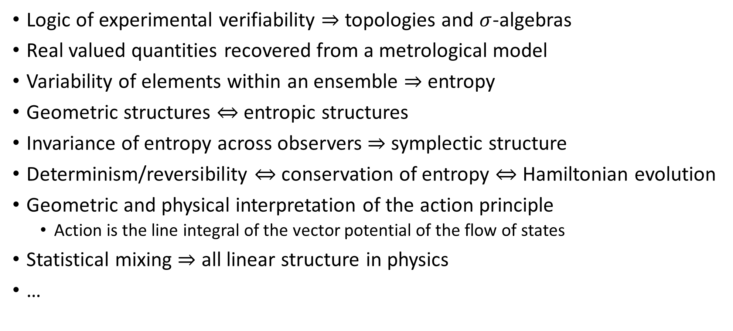
Assumptions of Physics: find a minimal set of physical assumptions from which the physical laws can be rigorously rederived
Logic of experimental verifiability $⇒$ topologies and $σ$-algebras
Real valued quantities recovered from a metrological model
Variability of elements within an ensemble $⇒$ entropy
Geometric structures $⇔$ entropic structures
Invariance of entropy across observers $⇒$ symplectic structure
Determinism/reversibility $⇔$ conservation of entropy $⇔$ Hamiltonian evolution
Geometric and physical interpretation of the action principle
Action is the line integral of the vector potential of the flow of states
Statistical mixing $⇒$ all linear structure in physics
…

Slide 23
More about our project
Project website
https://assumptionsofphysics.org for papers, presentations, …
https://assumptionsofphysics.org/book for our open access book (updated every few years with new results)
YouTube channels
https://www.youtube.com/@gcarcassi Videos with results and insights from the research
https://www.youtube.com/@AssumptionsofPhysicsResearch Research channel, with open questions and livestreamed work sessions
GitHub
https://github.com/assumptionsofphysics Book, research papers, slides for videos...

Slide 24





Main goal of the project
Identify a handful of physical starting points from which the basic laws can be rigorously derived
For example:
Infinitesimal reducibility $⇒$ Classical state
Irreducibility $⇒$ Quantum state
https://assumptionsofphysics.org
?
time
time
This also requires rederiving all mathematical structures from physical requirements
For example:
Science is evidence based $⇒$ scientific theory must be characterized by experimentally verifiable statements $⇒$ topology and $σ$-algebras

