Slide 1
Constructing a formal system for physics
Assumptions of Physics collaboration

Slide 2

Formal system:
primitive notions
e.g. Euclidean geometry
Basic objects that are taken as-is, without definition in terms of other objects
E.g. Points and lines
formal language
Symbols and rules to write sentences in the formal system
E.g. $A,B,C$ for points $\overline{AB}$ for segment
axioms
Statements about primitive objects that are to be taken as true
E.g. Given two points, there is a line that joins them

Slide 3
Formal system for all of mathematics:
Sets + first-order logic + Zermelo–Fraenkel axioms (+ axiom of choice)
Formal system for all of physics:
???

Slide 4
formal language
Physics
Not an issue: we can simply use first-order logic
Physical requirements
Semantics
primitive notions
axioms
These should be justified by the physics
Formal system
Choose axioms/primitive notions so that the justification is straightforward
Physical objects live in the physical (informal) world
Informal
Formal
Mathematical objects are representations of physical objects
(e.g. connection to experiment is outside of the formal system)
physics
math
What can or cannot be captured by the formal system?

Slide 5
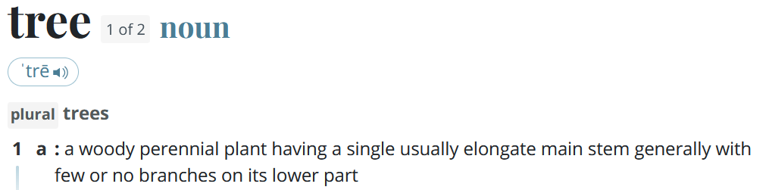
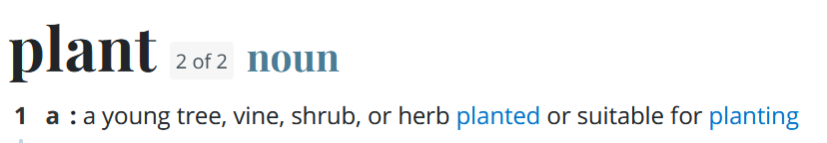

Problems in formalizing physical concepts
From merriam-webster.com:
Web of meaning
No primitive concepts: things are always defined in terms of other things
Conceptual cut
If one looks closely, all physical concepts are well-defined only within a restricted realm of applicability
dreamstime.com
When does an orange become an orange? Can we really define quantities (e.g. distance, time, temperature) with infinite precision? When exactly is an object in thermodynamic equilibrium, such that a temperature is well defined? Since all objects interact gravitationally, does it make sense to talk about isolated systems?

Slide 6
Problems in formalizing physical concepts
Mathematical concepts are “crisper idealizations”
Informal
Formal
Physical concepts are “fuzzy”
physics
math
Mathematical concepts cannot have circular definitions
Physical concepts may have circular definitions
Some concepts will have to remain informal

Slide 7

What should our primitive “informal” notion be?
Guiding principle
Principle of scientific objectivity: science is universal, non-contradictory and evidence based.
Suggest logic as fundamental …
Universal $→$ same for everybody
like mathematics!
Non-contradictory $→$ something is either true or false
Evidence based $→$ truth is determined experimentally
… with some extensions
$⇒$ Logic of experimentally verifiable statements!

Slide 8

Not “verifiable statements”
Chocolate tastes good (not universal)
It is immoral to kill one person to save ten (not universal and/or evidence based)
The number 4 is prime (not evidence based)
This statement is false (not non-contradictory)
The mass of the photon is exactly $0$ eV (not verifiable due to infinite precision)
“Verifiable statements”
The mass of the photon is less than ${10}^{−13}$ eV
If the height of the mercury column is between 24 and 25 millimeters then its temperature is between 24 and 25 Celsius
If I take $2±0.01$ Kg of Sodium-24 and wait $15±0.01$ hours there will be only $1±0.01$ Kg left
A scientific theory needs “at least” the concept of a verifiable statement: good primitive notion

Slide 9


What should be our primitive “formal” notion?
Tempting to try to capture everything into the formal system:
The electron is a fundamental particle and has negative charge
Conversion to formal logic
$$FP\left(e\right)∧NC(e)$$
constant
predicates
Never going to work!
What is an electron? What is mass? What is a physical object? What is a force? …
Web of meaning
Electron vs $β$ particle, particles vs waves
Conceptual cut
Different prime elements/definitions in different theories
When is object heavy enough to be “unmovable”? How do we group objects into the same system? How do we divide system and environment?
Semantic paradoxes
Berry paradox: the smallest positive integer that cannot be described in fewer than twenty-five words

Slide 10

$⇒$ Statements are primitive notions in the formal system
Informal
Formal
The formal system does not know or care about the syntax or semantics of the statement
physics
math
“The mass of the photon is less than ${10}^{−13}$ eV”
“The position of the ball is between 2 and 3 m”
“…”
“the mass of the photon is exactly 0”
“…”
Should statements be the smallest primitive notion?
Can we guarantee universality, non-contradiction and connection to evidence on each statement alone?
Notes:
The statements are “prime elements”, no specified further (in terms of grammar, etc…), structure and meaning of the assertion is not part of the formal system (because it would be impossible… web of meaning)

Slide 11

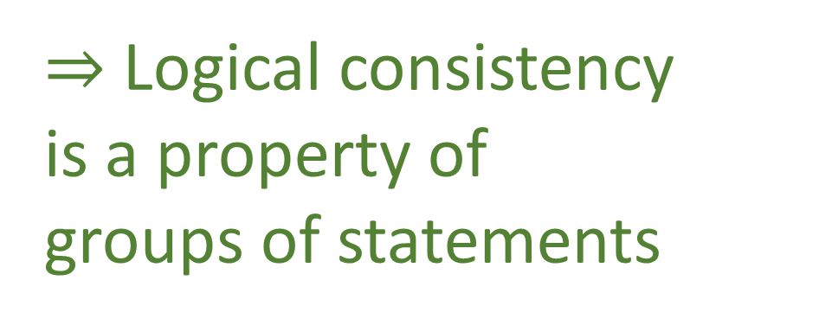

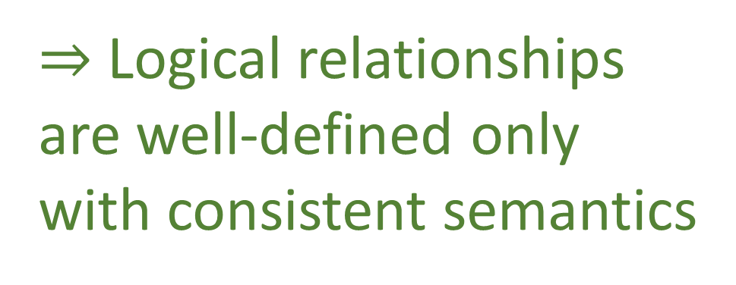
Liar paradox
“This sentence is false”
$⇒$ Logical consistency is a property of groups of statements
No-no paradox
“The next sentence is false”
“The previous sentence is true”
Yablo’s paradox
$S_{1}$: For $i>1$, $S_{i}$ is not true.
$S_{2}$: For $i>2$, $S_{i}$ is not true.
$S_{3}:$ For $i>3$, $S_{i}$ is not true.
…
The pope is the bishop of Rome
$⇒$ Logical relationships are well-defined only with consistent semantics
The bishop can only move diagonally
$⇒$ The pope can only move diagonally

Slide 12

$⇒$ Statements must be grouped into logical contexts
Informal
Formal
Logical context contains all statements that are logically and semantically related
physics
math
$$𝒮$$
“The mass of the photon is less than ${10}^{−13}$ eV”
“The position of the ball is between 2 and 3 m”
“…”
“the mass of the photon is exactly 0”
“…”
Still need connection to experimental evidence!
Notes:
The statements are “prime elements”, no specified further (in terms of grammar, etc…), structure and meaning of the assertion is not part of the formal system (because it would be impossible… web of meaning)

Slide 13

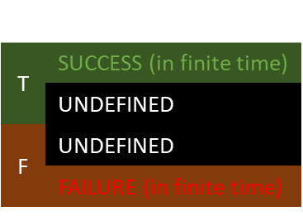
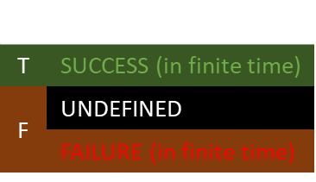

statement
$$s$$ | $$e$$
T | SUCCESS (in finite time)
 | UNDEFINED
F | UNDEFINED
 | FAILURE (in finite time)
Don’t necessarily have a test that always finishes in all cases
$$s$$
$e$
There exists extra terrestrial-life
The mass of the photon is exactly zero
The ratio between the mass of the electron and proton is a rational number
…
experimental test
$$s$$ | $$e$$
T | SUCCESS (in finite time)
F | UNDEFINED
 | FAILURE (in finite time)
Verifiable statement: test guaranteed to finish successfully if and only if the statement is true

Slide 14

$⇒$ Contexts should keep track of verifiable statements
Informal
Formal
physics
math
$$𝒮$$
“The mass of the photon is less than ${10}^{−13}$ eV”
$$𝒮_{V}$$
“The position of the ball is between 2 and 3 m”
“…”
“the mass of the photon is exactly 0”
“…”
Is this primitive enough?
Notes:
The statements are “prime elements”, no specified further (in terms of grammar, etc…), structure and meaning of the assertion is not part of the formal system (because it would be impossible… web of meaning)

Slide 15






$$ℝ$$
$$F=ma$$
“The acceleration is $a±Δa$ m/s²”
“The force is $F±ΔF$ N”
“The mass is $m±Δm$ Kg”
“The mass is $m±Δm$ Kg”$∧$“The acceleration is $a±Δa$ m/s²”
$$⇒$$
“The force is $ma±ΔF$ N”
The equation is really expressing relationships between experimentally verifiable statements

Slide 16
We can construct a formal system for experimental science provided we understand that
Informal
Formal
physics
math
The physics will always live in the informal system
The formal system is made “precise” by removing all things that can’t be captured in a precise way
The logic system needs to be “augmented” to keep track of experimental verifiability (is it enough?)
Primitive notions should be specifically chosen to expose only necessary complexity
Axioms/definitions should be specifically chosen to have straightforward justifications

