Slide 1
Multiple Degrees of Freedom
Gabriele Carcassi

Slide 2















Hamilton’s Equations
S-DOF
$$d_{t}q=∂_{p}H$$
$$d_{t}p=−∂_{q}H$$
$$d_{t}q^{i}=∂_{p_{i}}H$$
$$d_{t}p_{i}=−∂_{q^{i}}H$$
(HM-1D)
(HM-ND)
$$S^{q}=∂_{p}H$$
$$S^{p}=−∂_{q}H$$
$$ξ^{a}=[q^{i}, p_{i}]$$
$$S^{a}=d_{t}ξ^{a}=[d_{t}q^{i},d_{t}p_{i}]$$
$$p_{2}$$
$$p_{1}$$
$$q^{2}$$
$$S^{q^{i}}=∂_{p_{i}}H$$
$$S^{p_{i}}=−∂_{q^{i}}H$$
$$S^{a}$$
$$q^{1}$$

Slide 3














S-DOF
$$ω=\left[\begin{matrix}0 & 1 \\ −1 & 0\end{matrix}\right]⊗I_{n}$$
$$\left[ω_{ab}\right]=\left[\begin{matrix}ω_{q^{i}q^{j}} & ω_{q^{i}p_{j}} \\ ω_{p_{i}q^{j}} & ω_{p_{i}p_{j}}\end{matrix}\right]$$
$$ω=\left[\begin{matrix}0 & 1 \\ −1 & 0\end{matrix}\right]$$
$$\left[ω_{ab}\right]=\left[\begin{matrix}ω_{qq} & ω_{qp} \\ ω_{pq} & ω_{pp}\end{matrix}\right]$$
$$\vec{S}=ω \vec{∇}H$$
$$\left[\begin{matrix}S^{q} \\ S^{p}\end{matrix}\right]=\left[\begin{matrix}0 & 1 \\ −1 & 0\end{matrix}\right]\left[\begin{matrix}∂_{q}H \\ ∂_{p}H\end{matrix}\right]=\left[\begin{matrix}∂_{p}H \\ −∂_{q}H\end{matrix}\right]$$
$${\text{P}}_{}^{90°}$$
$$S_{a}=S^{b}ω_{ba}=∂_{a}H$$
$$\left[\begin{matrix}S^{q^{i}} \\ S^{p_{i}}\end{matrix}\right]=\left[\begin{matrix}0 & I_{n} \\ −I_{n} & 0\end{matrix}\right]\left[\begin{matrix}∂_{q^{i}}H \\ ∂_{p_{i}}H\end{matrix}\right]=\left[\begin{matrix}∂_{p_{i}}H \\ −∂_{q^{i}}H\end{matrix}\right]$$
$$S^{q}ω_{qp}=∂_{p}H$$
$$S^{p}ω_{pq}=∂_{q}H$$
$$S_{a}=S^{b}ω_{ba}=∂_{a}H$$
(HM-G)
$$S^{q^{i}}ω_{q^{i}p_{i}}=∂_{p_{i}}H$$
$$S^{p_{i}}ω_{p_{i}q^{i}}=∂_{q^{i}}H$$

Slide 4











$ω_{ab}$performs a $90°$ rotation within each degree of freedom,
switching components between position and momentum
$v^{a}=[{v^{q}}^{i},v^{p_{i}}]$ $⇒$ $v_{a}=v^{b}ω_{ba}=[−v^{p_{i}},v^{q^{i}}]$
$$p_{2}$$
$$p_{1}$$
$$q^{2}$$
$$p_{2}$$
$$p_{1}$$
$$q^{2}$$
$$q^{1}$$
$$q^{1}$$
Note: multiple ways to perform $90°$rotation
Only the rotation defined by $ω_{ab}$ works

Slide 5

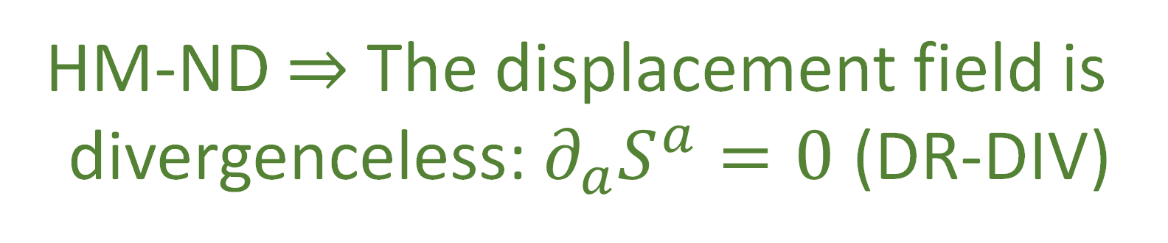





$$p_{2}$$
$$p_{1}$$
$$q^{2}$$
S-DOF
$$∂_{a}S^{a}=∂_{q}S^{q}+∂_{p}S^{p}$$
$$q^{1}$$
$$=∂_{q}∂_{p}H−∂_{p}∂_{q}H$$
$0=∂_{a}S^{a}$ $=∂_{q^{i}}S^{q^{i}}+∂_{p_{i}}S^{p_{i}}$ $=∂_{q^{i}}∂_{p_{i}}H−∂_{p_{i}}∂_{q^{i}}H$
$$=0$$
HM-ND $⇒$ The displacement field is
divergenceless: $∂_{a}S^{a}=0$ (DR-DIV)

Slide 6













Let $\hat{q}$and $\hat{p}$ represent the evolution of q and p after an infinitesimal time step $δt$
$${\hat{q}}^{i}=q^{i}+S^{q^{i}}δt$$
S-DOF
$${\hat{p}}_{i}=p_{i}+S^{p_{i}}δt$$
$$\hat{p}=p+S^{p}δt$$
$$\hat{q}=q+S^{q}δt$$
$$∂_{b}{\hat{ξ}}^{a}=\left[\begin{matrix}δ_{j}^{i}+∂_{q^{j}}S^{q^{i}}δt & ∂_{p_{j}}S^{q^{i}}δt \\ ∂_{q^{j}}S^{p_{i}}δt & δ_{i}^{j}+∂_{p_{j}}S^{p_{i}}δt\end{matrix}\right]$$
$$∂_{b}{\hat{ξ}}^{a}=\left[\begin{matrix}1+∂_{q}S^{q}δt & ∂_{p}S^{q}δt \\ ∂_{q}S^{p}δt & 1+∂_{p}S^{p}δt\end{matrix}\right]$$
$$p$$
$$\left|∂_{b}{\hat{ξ}}^{a}\right|=1+\left(∂_{q}S^{q}+∂_{p}S^{p}\right)δt+O(δt^{2})$$
$$\left|∂_{b}{\hat{ξ}}^{a}\right|=\left|δ_{j}^{i}+∂_{q^{j}}S^{q^{i}}δt\right|\left|δ_{i}^{j}+∂_{p_{j}}S^{p_{i}}δt\right|$$
$$−\left|∂_{p_{j}}S^{q^{i}}δt\right|\left|∂_{q^{j}}S^{p_{i}}δt\right|$$
$∂_{a}S^{a}$!!!
$$=1+\left(∂_{q^{i}}S^{q^{i}}+∂_{p_{i}}S^{p_{i}}\right)δt+O(δt^{2})$$
$$q$$
$∂_{a}S^{a}$!!!

Slide 7
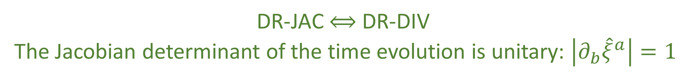
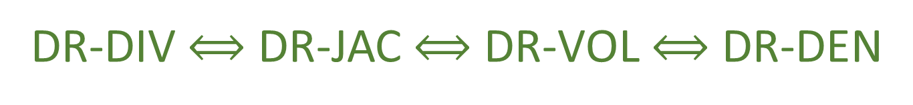


$\left|∂_{b}{\hat{ξ}}^{a}\right|=1$ $⟺$ $∂_{a}S^{a}=0$
DR-JAC $⟺$ DR-DIV
The Jacobian determinant of the time evolution is unitary: $\left|∂_{b}{\hat{ξ}}^{a}\right|=1$
multiplicative factor between past and future volumes and densities
$$⇒$$
Volumes are conserved through the evolution: $d{\hat{ξ}}^{1}⋯d{\hat{ξ}}^{n}=dξ^{1}⋯dξ^{n}$ (DR-VOL)
Densities are conserved through the evolution: $\hat{ρ}\left({\hat{ξ}}^{a}\right)=ρ\left(ξ^{b}\right)$ (DR-DEN)
DR-DIV $⟺$ DR-JAC $⟺$ DR-VOL $⟺$ DR-DEN

Slide 8






The displacement field $S^{a}$ has $2n$ components
Conditions DR-DIV, DR-JAC, DR-VOL, and DR-DEN specify a single constraint giving $2n−1$ components
The choice of Hamiltonian provides another constraint, leaving $2n−2$ choices
Single Degree of Freedom:
$$n=1$$
$$2n−2=0$$
no choices remain
Multiple Degrees of Freedom:
$$n>1$$
$$2n−2≠0$$
choices remain
HM-ND $⇒$ DR-DIV $⟺$DR-JAC $⟺$ DR-VOL $⟺$ DR-DEN
DR-DIV $⟺$DR-JAC $⟺$ DR-VOL $⟺$ DR-DEN $⇏$ HM-ND

Slide 9




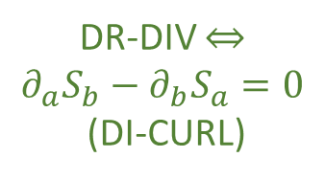
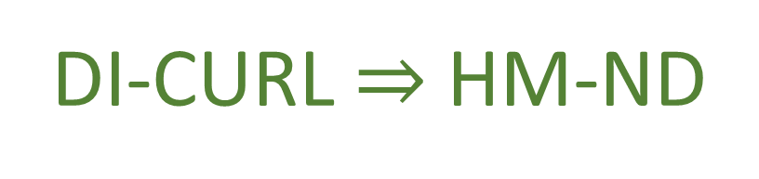






S-DOF
$$∂_{a}S_{b}−∂_{b}S_{a}=∂_{a}\left(S^{c}ω_{cb}\right)−∂_{b}(S^{c}ω_{ca})$$
Flow THROUGH the curve
$$\int{S^{a}×dξ^{b}}$$
$$=∂_{a}∂_{b}H−∂_{b}∂_{a}H=0$$
same only for S-DOF
Flow ALONG the curve
HM-ND $⇒$ DI-CURL
$$\int{S_{b}⋅dξ^{b}}$$
$$p_{2}$$
$$p_{1}$$
$$q^{2}$$
DR-DIV $⇔$ $$∂_{a}S_{b}−∂_{b}S_{a}=0$$
(DI-CURL)
Conversely: given $S_{a}$ is curl free
S-DOF only
$$S_{a}=S^{b}ω_{ba}=∂_{a}H$$
$$q^{1}$$
DI-CURL $⇒$ HM-ND

Slide 10
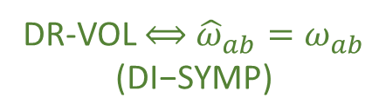




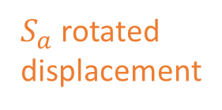







$${\hat{ω}}_{ab}=∂_{a}{\hat{ξ}}^{c}ω_{cd}∂_{b}{\hat{ξ}}^{d}$$
S-DOF
$$=\left(δ_{a}^{c}+∂_{a}S^{c}δt\right)ω_{cd}\left(δ_{b}^{d}+∂_{b}S^{d}δt\right)$$
$$=ω_{ab}+\left(∂_{a}S^{c}ω_{cb}+ω_{ad}∂_{b}S^{d}\right)δt+O\left(δt^{2}\right)$$
$$=ω_{ab}+\left(∂_{a}{(S}^{c}ω_{cb})+∂_{b}(S^{d}ω_{ad})\right)δt+O\left(δt^{2}\right)$$
$$=ω_{ab}+\left(∂_{a}{(S}^{c}ω_{cb})−∂_{b}(S^{d}ω_{da})\right)δt+O\left(δt^{2}\right)$$
Area $\left(v^{a},w^{a}\right)=v^{a}ω_{ab }w^{b}$
${\hat{v}}^{c}ω_{cd }{\hat{w}}^{d}=v^{a}{\hat{ω}}_{ab }w^{b}$
Area is conserved if
$${\hat{ω}}_{ab}=ω_{ab}$$
DR-VOL $⟺$ ${\hat{ω}}_{ab}=ω_{ab}$ $$\text{(}\text{DI}\text{−}\text{SYMP}\text{)}$$
Invariance of $ω_{ab}$:
$$p_{2}$$
$$p_{1}$$
$$q^{2}$$
$$∂_{a}(S^{c}ω_{cb})−∂_{b}\left(S^{d}ω_{da}\right)=0$$
$S_{a}$ rotated displacement
area $≠$ volume M-DOF
$$∂_{a}S_{b}−∂_{b}S_{a}=0$$
$S^{a}$ displacement
$$q^{1}$$
DI-SYMP $⟺$ DI-CURL

Slide 11


$$\left\{f,g\right\}=∂_{q}f∂_{p}g−∂_{p}f∂_{q}g=−∂_{a}fω^{ab}∂_{b}g$$
DI-SYMP $⟺$ DI-POI
invariance of $ω$ is invariance of Poisson bracket
same in
S-DOF and M-DOF
$$\hat{\left\{f,g\right\}}=∂_{\hat{q}}f∂_{\hat{p}}g−∂_{\hat{p}}f∂_{\hat{q}}g=−∂_{a}f{\hat{ω}}^{ab}∂_{b}g$$

Slide 12









HM-ND
$$⟺$$
DI-CURL
DR-JAC
$$⟺$$
DR-DIV
$$⇒$$
$$⟺$$
$$⟺$$
$$⟺$$
$$⟺$$
DI-POI
$$⟺$$
DI-SYMP
DR-DEN
$$⟺$$
DR-VOL
fully characterize Hamiltonian mechanics
weaker conditions
How are they different?
Why are they the same for a S-DOF?

Slide 13
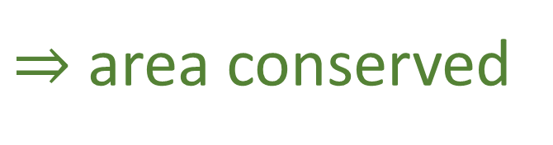
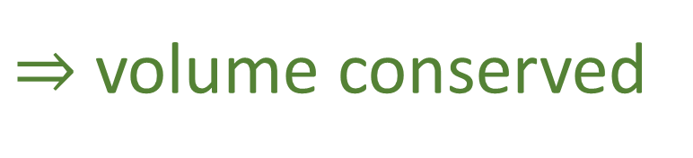








$$v^{a}ω_{ab}w^{b}$$
conserved quantity
$$p_{1}$$
$$ω=\left[\begin{matrix}0 & 1 \\ −1 & 0\end{matrix}\right]$$
S-DOF
$$w$$
$$ω(v,w)$$
$$v$$
$$q^{1}$$
$$v^{a}ω_{ab}w^{b}=v^{q^{1}}ω_{q^{1}p_{1}}w^{p_{1}}=v^{q^{1}}w^{p_{1}}$$
area of parallelogram
$⇒$ area conserved
$⇒$ volume conserved

Slide 14








$$v^{a}ω_{ab}w^{b}$$
conserved quantity
$$p_{2}$$
$$p_{1}$$
$$q^{2}$$
$$ω(v,w)$$
$$w$$
$$v$$
$$ω=\left[\begin{matrix}0 & I_{n} \\ −I_{n} & 0\end{matrix}\right]$$
M-DOF
$$w$$
$$ω(v,w)$$
$$v$$
$$q^{1}$$
$$v^{a}ω_{ab}w^{b}=v^{q^{1}}ω_{q^{1}p_{1}}w^{p_{1}}=v^{q^{1}}w^{p_{1}}$$
area of parallelogram
$$v^{a}ω_{ab}w^{b}=v^{q^{2}}ω_{q^{2}p_{1}}w^{p_{1}}=0$$
zero across DOFs!

Slide 15


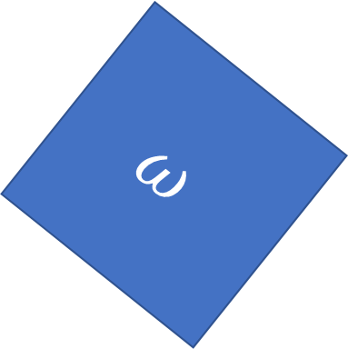
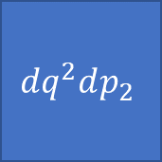
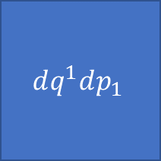
SF-ND
$$ω=\left[\begin{matrix}0 & I_{n} \\ −I_{n} & 0\end{matrix}\right]=\left[\begin{matrix}0 & 1 \\ −1 & 0\end{matrix}\right]⊗I_{n}$$
Scalar product across DOFs
$$ω=∑dq^{i}dp_{i}$$
Cross product within DOF
$$ω$$
Orthogonality of DOFs
$$dq^{2}dp_{2}$$
$$dq^{1}dp_{1}$$
WARNING: analogy!!!

Slide 16





Space(time) geometry vs phase space geometry
(pseudo-)Riemannian
Symplectic
$$g_{ij}$$
$$ω_{ab}$$
Metric tensor
Symplectic form
defines lengths and angles
areas and “angles”
$$ds^{2}=dx^{i}g_{ij}dx^{j}=∑{\left(dx^{i}\right)}^{2}$$
$$ds^{2}=dξ^{a}ω_{ab}dξ^{b}=∑dq^{i}dp_{i}$$
cartesian coordinates
canonical coordinates $(q^{i},p_{i})$

Slide 17
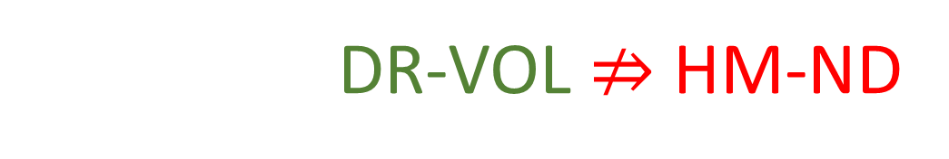

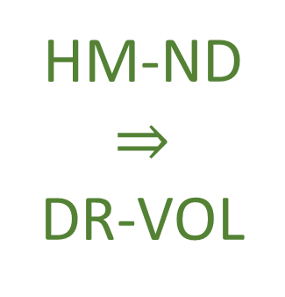






$$⇒$$
Conservation of $ω_{ab}$
Conservation of areas and orthogonality
$$(q^{2},p_{2})$$
$$({\hat{q}}^{2},{\hat{p}}_{2})$$
HM-ND $⇒$ DR-VOL
$$(q^{1},p_{1})$$
$$({\hat{q}}^{1},{\hat{p}}_{1})$$
$$⇒$$
Volume is preserved!
However DR-VOL $⇏$ HM-ND

Slide 18








$$d_{t}q^{1}={S^{q}}^{1}=\frac{p_{1}}{m}$$
$$d_{t}p_{1}=S^{p_{1}}=−bp_{1}$$
Particle under linear drag
$$d_{t}q^{2}={S^{q}}^{2}=\frac{p_{2}}{m}$$
a particle accelerated proportionally
to its momentum
$$d_{t}p_{2}=S^{p_{2}}=bp_{2}$$
$$∂_{a}S^{a}=∂_{q^{1}}\frac{p_{1}}{m}+∂_{p_{1}}\left(−bp_{1}\right)+∂_{q^{2}}\frac{p_{2}}{m}+∂_{p_{2}}\left(bp_{2}\right)=−b+b=0$$
Divergence is zero: DR-DIV and DR-VOL are satisfied
$$(q^{2},p_{2})$$
$$({\hat{q}}^{2},{\hat{p}}_{2})$$
$$(q^{1},p_{1})$$
$$({\hat{q}}^{1},{\hat{p}}_{1})$$
Notes:
TODO: x and y should be q1 and q2

Slide 19

$$d_{t}q^{1}={S^{q}}^{1}=\frac{p_{1}}{m}$$
$$d_{t}p_{1}=S^{p_{1}}=−bp_{1}$$
Particle under linear drag
$$d_{t}q^{2}={S^{q}}^{2}=\frac{p_{2}}{m}$$
a particle accelerated proportionally
to its momentum
$$d_{t}p_{2}=S^{p_{2}}=bp_{2}$$
$$∂_{q^{1}}S_{p_{1}}−∂_{p_{1}}S_{q^{1}}=∂_{q^{1}}S^{q^{1}}ω_{q^{1}p_{1}}−∂_{p_{1}}S^{p_{1}}ω_{p_{1}q^{1}}$$
$$=∂_{q^{1}}\frac{p_{1}}{m}\left(1\right)−∂_{p_{1}}(−bp_{1})(−1)=−b$$
Curl of $S_{a}$is not zero: DI-CURL is not satisfied, nor are DI-SYMP or HM-ND
$$(q^{2},p_{2})$$
$$({\hat{q}}^{2},{\hat{p}}_{2})$$
$$(q^{1},p_{1})$$
$$({\hat{q}}^{1},{\hat{p}}_{1})$$
Notes:
TODO: x and y should be q1 and q2

Slide 20
Turning attention to the physics

Slide 21






Hamiltonian mechanics
$$⇔$$
volume conserved
$$+$$
orthogonality preserved
$$⇔$$
$$⇔$$
$$d_{t}q^{i}=∂_{p_{i}}H$$
determinism/
reversibility
???
$$d_{t}p_{j}=−∂_{q^{j}}H$$

Slide 22






DOFs are orthogonal
$$(q^{2},p_{2})$$
$$⇔$$
Total number of states = product of configurations for each DOF
$$(q^{1},p_{1})$$
$$⇔$$
All combinations across DOFs are possible
$$⇔$$
Choice of configuration of one DOF does not constrain the others
$$⇔$$
DOFs are independent (IND-DOF)

Slide 23







“There are 231 female rabbits”
$⇒$ No constraint on the male population
“There are 231 female rabbits”
$⇒$ “There are at least 231 rabbits”
Number of Females vs. Males
Number of Females vs. Total Population
Rabbit farm example
M
T
$$?$$
$$≥231$$
$$231$$
F
$$231$$
F
Orthogonal DOFs
$$⇔$$
Independent DOFs
Notes:
TODO: Difference of independence in another slide

Slide 24
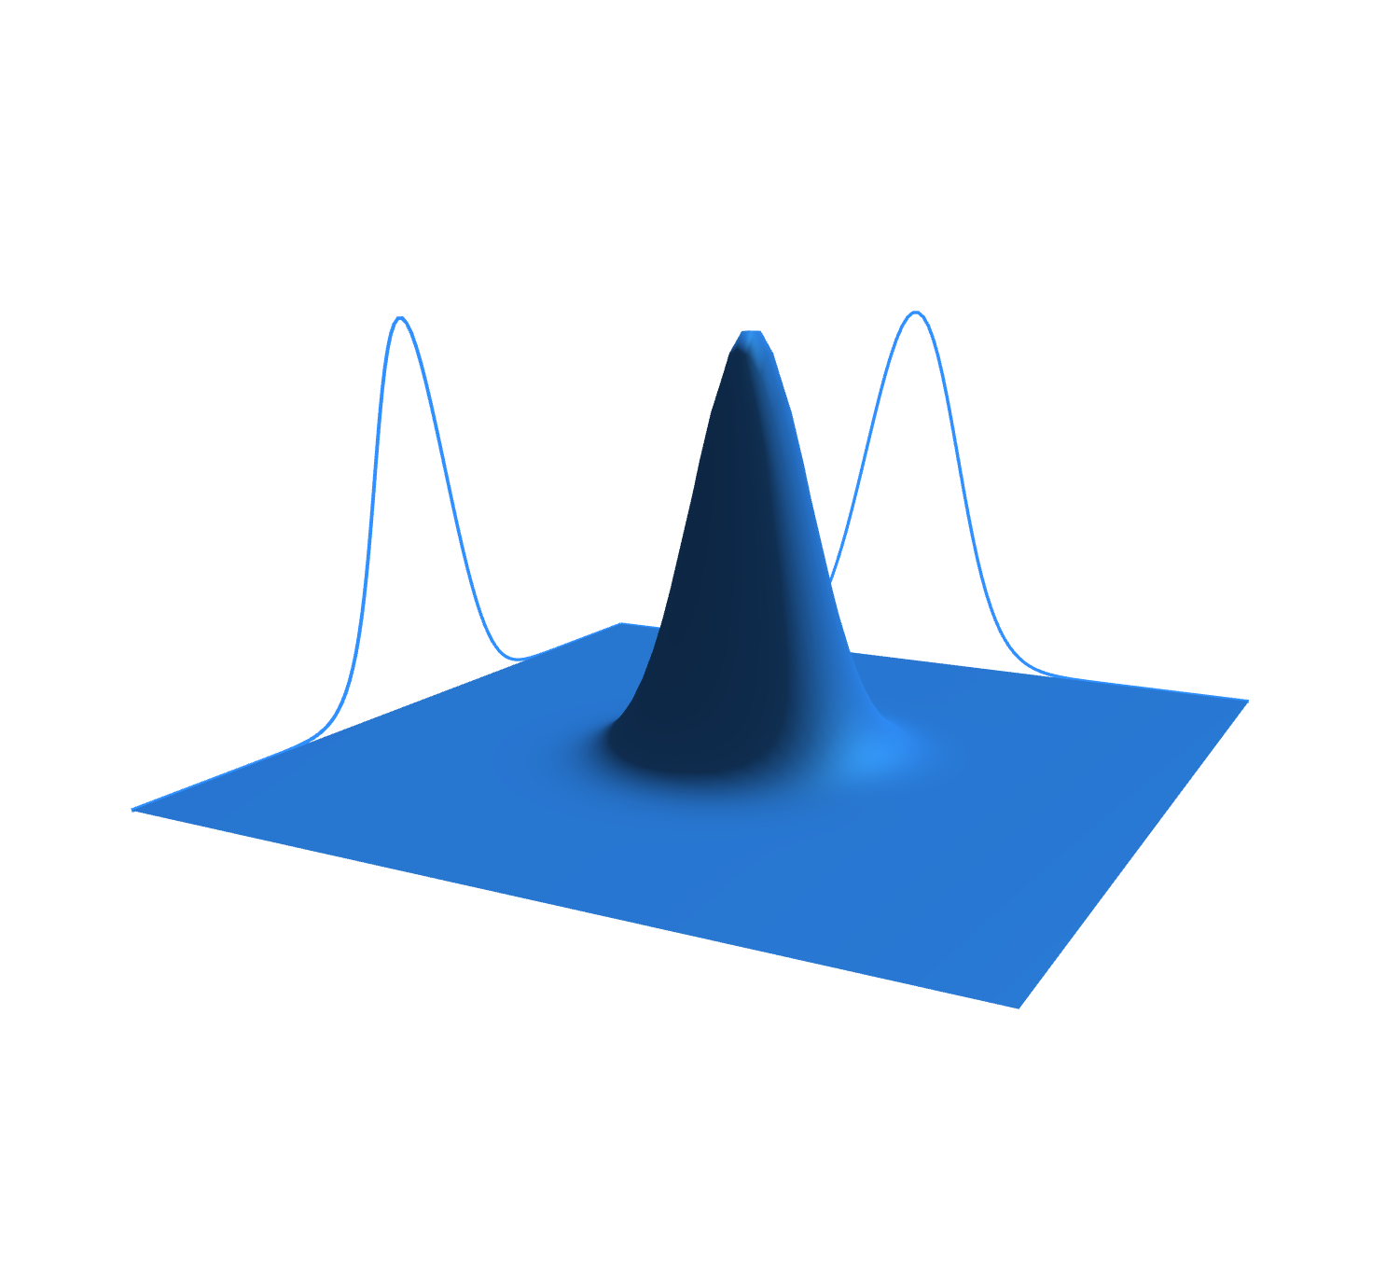








Variable independence
Statistical independence
$$y$$
$$ρ$$
$$x$$
$$y$$
$$x$$
$$\#\left(x,y\right)=\#\left(x\right)\#(y)$$
$$ρ_{XY}\left(x,y\right)=ρ_{X}\left(x\right)ρ_{Y}(y)$$
Count of configurations factorizes
Probability factorizes
(IND-STAT) The system allows statistically independent distributions over each DOF
(IND-DOF) The system is decomposable into independent DOFs
$$⇔$$

Slide 25







$$I\left[ρ_{XY}\right]=I\left[ρ_{X}\right]+I\left[ρ_{Y}\right]$$
$$⇔$$
$$ρ_{XY} =ρ_{X}ρ_{Y}$$
Information independence
Statistical independence
$$⇐$$
$$I\left[ρ_{XY}\right]=−∬ρ_{XY}\log{ρ_{XY}}=−∬ρ_{X}ρ_{Y}\log{ρ_{X}ρ_{Y}}=−∬ρ_{X}ρ_{Y}\log{ρ_{X}}−∬ρ_{X}ρ_{Y}\log{ρ_{Y}}$$
$$=−∫ρ_{Y}∫ρ_{X}\log{ρ_{X}}−∫ρ_{X}∫ρ_{Y}\log{ρ_{Y}}=−∫ρ_{X}\log{ρ_{X}}−∫ρ_{Y}\log{ρ_{Y}}=I\left[ρ_{X}\right]+I\left[ρ_{Y}\right]$$
$$⇒$$
$$I\left[ρ_{X}\right]+I\left[ρ_{Y}\right]=−∫ρ_{X}\log{ρ_{X}}−∫ρ_{Y}\log{ρ_{Y}}=−∬ρ_{XY}\log{ρ_{X}}−∬ρ_{XY}\log{ρ_{Y}}$$
$$=−∬ρ_{XY}\log{ρ_{X}ρ_{Y}}=−∬ρ_{XY}\log{\frac{ρ_{X}ρ_{Y}}{ρ_{XY}}}−∬ρ_{XY}\log{ρ_{XY}}$$
$$\frac{ρ_{X}ρ_{Y}}{ρ_{XY}}=1$$
(IND-INFO) The system allows informationally independent distributions over each DOF
(IND-STAT) The system allows statistically independent distributions over each DOF
$$⇔$$

Slide 26







$$\left|Σ\right|=σ_{X}^{2}σ_{Y}^{2}$$
$$⇔$$
$$ρ_{XY} =ρ_{X}ρ_{Y}$$
Uncertainty factorizes
Statistical independence
for peaked distributions
$$p_{2}$$
$$p_{1}$$
$$q^{2}$$
$$⇐$$
$$\left|Σ\right|=\left|\begin{matrix}σ_{X}^{2} & cov\left(X,Y\right) \\ cov\left(X,Y\right) & σ_{Y}^{2}\end{matrix}\right|=\left|\begin{matrix}σ_{X}^{2} & 0 \\ 0 & σ_{Y}^{2}\end{matrix}\right|=σ_{X}^{2}σ_{Y}^{2}$$
$$q^{1}$$
$$⇒$$
Hadamard's inequality
$$cov(X,Y)=0$$
$Σ$ is symmetric, positive semi-definite
$$\left|Σ\right|≤Πσ_{ii}$$
$⇒$ independence
Equality only if diagonal
for peaked distributions
(IND-UNC) The system allows peaked distributions where the
uncertainty is the product of the uncertainty on each DOF
(IND-STAT) The system allows statistically independent distributions over each DOF
$$⇔$$

Slide 27


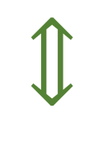





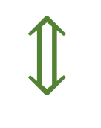
$$y$$
$$ρ$$
IND-DOF
$$⟺$$
IND-STAT
$$x$$
$$y$$
$$x$$
$$⟺$$
$$⟺$$
$$p_{2}$$
$$p_{1}$$
$$q^{2}$$
IND-UNC
$$⟺$$
IND-INFO
$$I\left[ρ_{XY}\right]= \\ I\left[ρ_{X}\right]+I\left[ρ_{Y}\right]$$
$$q^{1}$$
$$⇔$$
$$ω_{ab}=\left[\begin{matrix}0 & 1 \\ −1 & 0\end{matrix}\right]⨂\left[\begin{matrix}1 & 0 & \text{⋯} & 0 \\ 0 & 1 & \text{⋯} & 0 \\ \text{⋮} & … & \text{⋱} & \text{⋮} \\ 0 & 0 & \text{⋯} & 1\end{matrix}\right]$$
Orthogonal DOFs

Slide 28
Constitutive assumptions of Hamiltonian mechanics:
Are they enough?
Notes:
TODO: make text more “pictorial” with conditions and dependence/equivalence symbols

Slide 29


Hamiltonian mechanics
$$⇔$$
volume conserved
$$+$$
orthogonality preserved
$$⇔$$
$$⇔$$
$$d_{t}q=∂_{p}H$$
determinism/
reversibility
independence preserved
$$d_{t}p=−∂_{q}H$$
Can determinism and reversibility violate DOF independence?

Slide 30



Let’s study the finite case
Suppose we have two integer variables $1≤x≤3$ and $1≤y≤3$
$3$ possible map types:
preserves statistical independence and
variable independence
$x$ to $x$ and $y$ to $y$
violates statistical independence but
preserves variable independence
$xy$ to $xy$
Removes some cases
(map cannot be reversible)
violates statistical and
variable independence
$⇒$ losing variable independence means losing reversibility
Notes:
TODO: 1) shapes/colors (x and y remain shape and colors but permutated) 2) all circles, xy different shades of the same colors, gets mapped without pattern 3) all circles, all white For all: arrows should show two xy points being mapped. In 3 they map to the same point.

Slide 31

Constitutive assumptions of Hamiltonian mechanics:
They are enough!
IND $⇒$ ability to count configurations for each independent DOF $⇒$ $ω_{ab}$
DR $⇒$ conserve number of states; maximal count for independent DOFs
$⇒$ preserve both volume and orthogonality (i.e. $ω_{ab}$ )
Notes:
TODO: make text more “pictorial” with conditions and dependence/equivalence symbols

