Slide 1
Action principle: geometric and physical interpretation

Slide 2
Short version

Slide 3


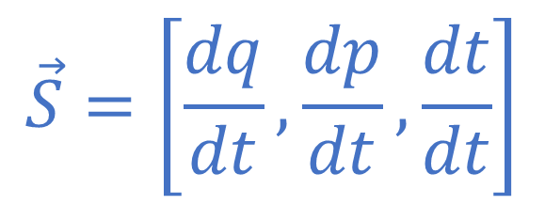


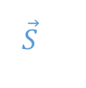

Displacement field
$$p$$
$$\vec{S}=\left[\frac{dq}{dt},\frac{dp}{dt},\frac{dt}{dt}\right]$$
$$q$$
$$γ$$
$$\vec{S}$$
Evolution
$$γ=[q\left(t\right), p\left(t\right), t]$$
$$t$$
Evolutions are field lines of the displacement field
Always tangent to the field

Slide 4



$$p$$
$$q$$
$$Σ$$
Flow through $Σ$
$$\vec{S}$$
$$\iint_{Σ}{\vec{S}⋅d\vec{Σ}}$$
$$t$$
Each evolution contributes to the flow if and only if it goes through the surface

Slide 5







Take a path $γ$, not necessarily an evolution
$$p$$
$$q$$
$$γ$$
$$Σ$$
$$\vec{S}$$
Take a variation $γ′$
There will be a surface $Σ$ between the two, and a flow through it
$$γ′$$
$$t$$
If $γ$ is not an evolution, we can always find a variation for which the flow through $Σ$ is different than zero

Slide 6






If $γ$ is an evolution, it is always parallel to $\vec{S}$
$$p$$
$$q$$
$$γ$$
$$Σ$$
$$\vec{S}$$
Surfaces in the neighborhood of $γ$ are tangent to $\vec{S}$
$$γ′$$
$$t$$
If $γ$ is an evolution, there is no variation for which the flow through $Σ$ is different than zero

Slide 7



The flow of $\vec{S}$ through $Σ$ delimited by $γ$ and a variation $γ′$ is the action
$$p$$
$$q$$
$$γ$$
$$Σ$$
$$\vec{S}$$
$$γ′$$
$$δ\int_{γ}{L\left(q, \dot{q},t\right)dt}=−\iint_{Σ}{\vec{S}⋅d\vec{Σ}}$$
$$t$$
If $γ$ is an evolution, there is no variation for which the flow through $Σ$ is different than zero, the action is stationary

Slide 8
Long version

Slide 9



Action: $𝒮\left[γ\right]=\int_{γ}{L\left(q\left(t\right),\dot{q}\left(t\right), t\right)dt}$
Is it?
Lagranian: $L=T−V$
Lagranian for charged particle: $$L=\frac{1}{2}mv^{2}+qv⋅A−qV$$
Kinetic
???
Potential

Slide 10
Displacement field
$$p$$
$$\vec{S}=\left[\frac{dq}{dt},\frac{dp}{dt},\frac{dt}{dt}\right]$$
$$q$$
$$γ$$
$$\vec{S}$$
Evolution
$$γ=[q\left(t\right), p\left(t\right), t]$$
$$t$$
Evolutions are field lines of the displacement field
Always tangent to the field

Slide 11
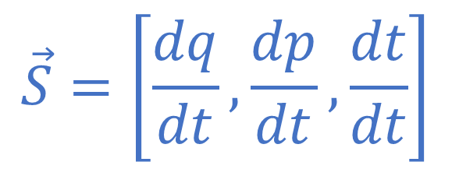





(DR) Determinism and Reversibility
$$p$$
Time is both a variable and a parameter
$$q$$
$$γ$$
$$Σ$$
Evolution
$$\vec{S}$$
$$γ=\left[q\left(t\right), p\left(t\right), t\right]$$
Displacement field
$$\vec{S}=\left[\frac{dq}{dt},\frac{dp}{dt},\frac{dt}{dt}\right]$$
$$t$$
Vector potential
Divergence free
$$\vec{S}=−\vec{∇}×\vec{θ}$$
$$\vec{∇}⋅\vec{S}=0$$
$$∯_{Σ}{\vec{S}⋅d\vec{Σ}} =0$$
Minus sign added to match conventions

Slide 12




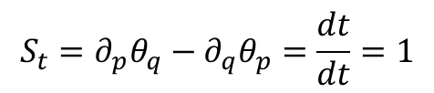


$$\vec{θ}=\left[θ_{q},θ_{p},θ_{t}\right]$$
$$\vec{S}=−\vec{∇}×\vec{θ}$$
Fix gauge
No loss of generality: used gauge freedom and $t$ is both variable and parameter
$$\vec{θ}=\left[θ_{q},0,θ_{t}\right]$$
$$S_{t}=∂_{p}θ_{q}−∂_{q}θ_{p}=\frac{dt}{dt}=1$$
$$\vec{θ}=\left[p,0,θ_{t}\right]$$
Rename function
$$\vec{θ}=\left[p,0,−H\right]$$

Slide 13





$$\vec{S}=−\vec{∇}×\vec{θ}$$
$$\vec{θ}=\left[p,0,−H\left(q,p\right)\right]$$
$$S^{q}=\frac{dq}{dt}=−\left(\frac{∂}{∂p}θ_{t}−\frac{∂}{∂t}θ_{p}\right)=\frac{∂H}{∂p}$$
Hamilton’s equations
$$S^{p}=\frac{dp}{dt}=−\left(\frac{∂}{∂t}θ_{q}−\frac{∂}{∂q}θ_{t}\right)=−\frac{∂H}{∂q}$$
$$S^{p}=\frac{dt}{dt}=−\left(\frac{∂}{∂q}θ_{p}−\frac{∂}{∂p}θ_{q}\right)=1$$

Slide 14


Flow between a path $γ$ and its variation $γ′$
$$p$$
$$q$$
$$γ$$
$$Σ$$
$−\iint_{Σ}{\vec{S}⋅d\vec{Σ}}$
$=\iint_{Σ}{\vec{∇}×\vec{θ}⋅d\vec{Σ}}$
$=\oint_{∂Σ}{\vec{θ}⋅d\vec{γ}}$ $=\int_{γ}{\vec{θ}⋅d\vec{γ}}−\int_{γ^{′}}{\vec{θ}⋅d\vec{γ}}$ $=δ\int_{γ}{\vec{θ}⋅d\vec{γ}}$
$=δ\int_{γ}{\left[p,0,−H\right]⋅\left[\frac{dq}{dt},\frac{dp}{dt},\frac{dt}{dt}\right]dt}$ $=δ\int_{γ}{\left(p\frac{dq}{dt}−H\right)dt}=δ\int_{γ}{L dt}$
$$\vec{S}$$
Hamilton equations
Stokes’ theorem
$$γ′$$
$$t$$
Express in components

Slide 15




If the path $γ$ is an evolution of the system
$$p$$
$$q$$
$$γ$$
$$Σ$$
$$\vec{S}$$
$−\iint_{Σ}{\vec{S}⋅d\vec{Σ}}$ $=δ\int_{γ}{\vec{θ}⋅d\vec{γ}}=0$
$$γ′$$
$$t$$
If the path $γ$ is not an evolution of the system, we can always find a variation $γ′$ such that
$−\iint_{Σ}{\vec{S}⋅d\vec{Σ}}=δ\int_{γ}{\vec{θ}⋅d\vec{γ}}≠0$

