Slide 1
No such thing as quantum logic
Gabriele Carcassi

Slide 2
How quantum mechanics (allegedly) violates classical logic

Slide 3







Review of logic symbols and operations
Negation (NOT) $¬p$
$¬$“There is a bottle on the table” = “There are no bottles on the table”
$$p$$ | $$q$$ | $$¬p$$ | $$p∧q$$ | $$p∨q$$
T | T | F | T | T
T | F | F | F | T
F | T | T | F | T
F | F | T | F | F
Conjunction (AND) $p∧q$
“There is a bottle on the table” $∧$ “There is a glass on the table” = “There is a glass and a bottle on the table”
Disjunction (OR) $p∨q$
“There is a bottle on the table” $∨$ “There is a glass on the table” = “There is a glass or a bottle on the table”

Slide 4

Review of logic symbols and operations
Distributivity law
$$p∧\left(q∨r\right)↔\left(p∧q\right)∨(p∧r)$$
“I will eat chicken” $∧$ $($“I will eat potatoes” $∨$ “I will eat green beans”$)$ $↔$
$($“I will eat chicken” $∧$ “I will eat potatoes”$)∨($“I will eat chicken”$∧$“I will eat green beans”$)$

Slide 5




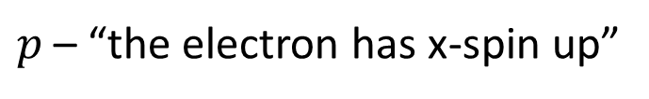
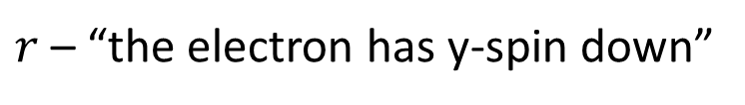

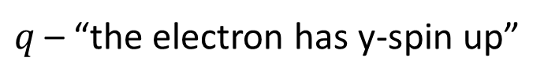




Distributivity law
$$p∧\left(q∨r\right)↔\left(p∧q\right)∨(p∧r)$$
Consider the following statements
$$y$$
$$q$$
$p$ – “the electron has x-spin up”
$$p$$
$$x$$
$q$ – “the electron has y-spin up”
$$r$$
$r$ – “the electron has y-spin down”
Whenever we measure spin in the y direction, it is either up or down: $q∨r=$T
If we prepare spin in one direction, we don’t prepare it in another: $p∧q=p∧r=$F
Suppose $p=$ T
QM violates distributivity!
$p∧\left(q∨r\right)=$ T while $\left(p∧q\right)∨\left(p∧r\right)=$ F

Slide 6
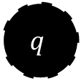
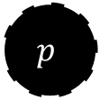

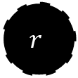
Distributivity law
$$p∧\left(q∨r\right)↔\left(p∧q\right)∨(p∧r)$$
Consider the following scenario
$$p$$
A ball can be placed in position p, above a hatch; when the hatch is open, the ball will land in either position q or r with equal probability (due to the symmetry)
$$q$$
$$r$$
We can make similar misleading claims
the ball must land either on q or r: $q∨r=$T
the ball cannot be in two places at once: $p∧q=p∧r=$F
Suppose $p=$ T
CM violates distributivity!
$p∧\left(q∨r\right)=$ T while $\left(p∧q\right)∨\left(p∧r\right)=$ F

Slide 7











Need to take time into account!!!
Use $i$ for preparation (input) and $o$ for measurement (output)
$$y$$
$$q_{i}$$
$$q_{o}$$
The spin in the y direction is either up or down after a y measurement: $q_{o}∨r_{o}=$T but $q_{i}∨r_{i}=$F if we prepared x-up
$$p_{i}$$
$$p_{o}$$
$$x$$
measurement
$$r_{i}$$
$$r_{o}$$
There is no incompatibility between x direction before the measurement and y direction after the measurement: $p_{i}∧q_{o}=$ T if we prepared x-up and measured y-up but $p_{o}∧q_{o}=$F always
$p_{i}∧\left(q_{o}∨r_{o}\right)=$ T while $\left(p_{i}∧q_{o}\right)∨\left(p_{i}∧r_{o}\right)=$ T
Distributivity not violated

Slide 8


Disjunction (OR)
$q∨r=$T $↔q=$T$\text{or} r=\text{T}$
$$y$$
Whenever we measure spin in the y direction, it is either up or down: $q∨r=$T
$$q$$
$$p$$
$$x$$
$$r$$
This is true even if we prepare x-spin up
But if $p=$T, then $q=r=$F even though $q∨r=$T
Disjunction works differently in QM!

Slide 9

Disjunction (OR)
$q∨r=$T $↔q=$T$\text{or} r=\text{T}$
$$p$$
We can make again similar misleading claims
the ball must land either on q or r: $q∨r=$T
this is true even if we prepared the ball in p
$$q$$
$$r$$
But if $p=$T, then $q=r=$F even though $q∨r=$T
Disjunction works differently in CM!

Slide 10












Again, need to take time into account!!!
The fact that y-spin is either up or down after the measurement tells us nothing in the other cases!
$$y$$
$$q_{i}$$
$$q_{o}$$
no rotation
$$q_{f}$$
$$p_{i}$$
$$p_{o}$$
$$p_{f}$$
$$x$$
measurement
$$r_{i}$$
$$r_{o}$$
90° rotation
$$r_{f}$$
Suppose you rotate y-spin down after the measurement: $p_{f}∨q_{f}=$ T
It does not follow that we must always have x-spin up or y-spin up: $p_{f}∨q_{f}=$ T $↛$ $p_{i}∨q_{i}=$ T and $p_{f}∨q_{f}=$ T $↛$ $p_{o}∨q_{o}=$ T

Slide 11
Disjunction works as it’s supposed to
We can prepare spin in any direction, and only one direction
After a y-measurement, we know that y-spin must be either up or down because those are the possible outputs of the measurement device
Measurement device introduces a constraint at a particular time
In the ball dropping example, the setup also constrains the final states
$$p$$
$$q$$
$$r$$

Slide 12


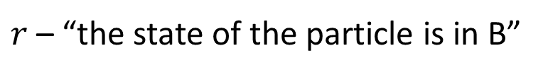
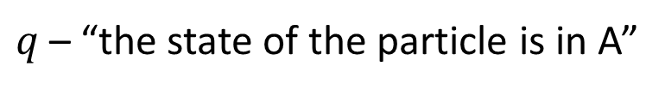



Disjunction (OR)
$q∨r=$T $↔q=$T$\text{or} r=\text{T}$
$$p$$
$q$ – “the state of the particle is in A”
$$ℏ/4$$
$r$ – “the state of the particle is in B”
A
B
$q∨r$ – “the state of the particle is in A$∪$B”
Claim: the statement $q∨r$ can be true but, because of the uncertainty principle ($σ_{x}σ_{p}≥ℏ/2$), $q=r=$F
$$x$$
Disjunction works differently in QM!

Slide 13








Disjunction (OR)
$q∨r=$T $↔q=$T$\text{or} r=\text{T}$
$$y$$
The radius of the sun is about 700,000 km
${1,400,000}^{3}/$2 km³
$q$ – “the sun is in region A”
$$z$$
A
B
$r$ – “the sun is in region B”
$q∨r$ – “the sun is in region A$∪$B”
Claim: the statement $q∨r$ can be true but, because of the size of the sun, $q=r=$F
$$x$$
Disjunction works differently in CM!

Slide 14



Objects have an extension
“the sun is in region A” is misleading
$$y$$
“The whole sun (WS) is in region A” $≠$ “The center of the sun (CS) is in region A”
${1,400,000}^{3}/$2 km³
$$z$$
A
B
“The CS is in region A” $∨$ “The CS is in region B” $=$ “The CS is in region A$∪$B”
“The WS is in region A” $∨$ “The WS is in region B” $≠$ “The WS is in region A$∪$B”
$$x$$
The whole sun can be in region A$∪$B, but only partly in A and B

Slide 15
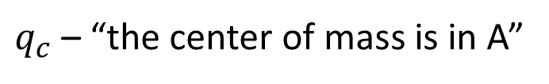


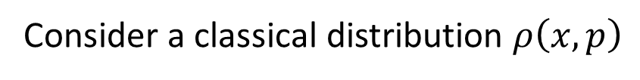

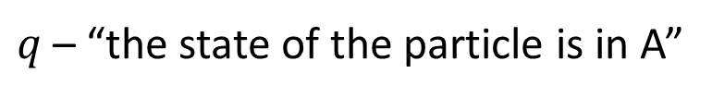
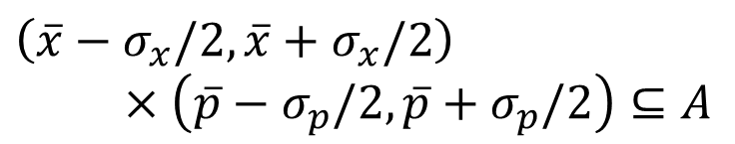



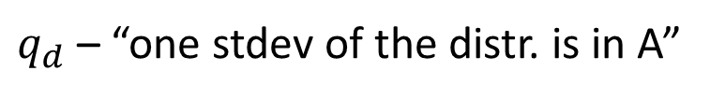
Distributions have an extension
Either statistical or probabilistic
$$p$$
Consider a classical distribution $ρ\left(x,p\right)$
$$ℏ/4$$
$q$ – “the state of the particle is in A”
Ambiguous
A
B
$q_{c}$ – “the center of mass is in A”
$q_{d}$ – “one stdev of the distr. is in A”
$$\left[\overline{x},\overline{p}\right]∈A$$
$\left(\overline{x}−σ_{x}/2,\overline{x}+σ_{x}/2\right)$ $×\left(\overline{p}−σ_{p}/2,\overline{p}+σ_{p}/2\right)⊆A$
$$x$$
$q_{c}∨r_{c}=$ “the center of mass is in A$∪$B”
$q_{d}∨r_{d}≠$ “one stdev of the distr. is in A$∪$B”
Half-sigma in A and half-sigma in B
The disjunction does not always map to the union of the regions (nothing to do with quantum mechanics)

Slide 16
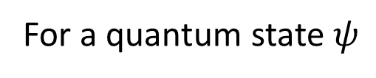
Distributions have an extension
$$p$$
For a quantum state $ψ$
$$ℏ/4$$
$q$ – “the state of the particle is in A”
Ambiguous
A
B
$q_{c}$ – “the center of mass is in A”
$q_{d}$ – “one stdev of the distr. is in A”
$$\left[\overline{x},\overline{p}\right]∈A$$
$\left(\overline{x}−σ_{x}/2,\overline{x}+σ_{x}/2\right)$ $×\left(\overline{p}−σ_{p}/2,\overline{p}+σ_{p}/2\right)⊆A$
$$x$$
$q_{c}∨r_{c}=$ “the center of mass is in A$∪$B”
$q_{d}∨r_{d}≠$ “one stdev of the distr. is in A$∪$B”
Half-sigma in A and half-sigma in B
The disjunction in quantum mechanics works exactly the same (just use quantum expectations)

Slide 17
None of the arguments used to justify quantum logic are valid
If you keep track of time, if you keep track of constraints, if you keep track of the extent of distributions, …
classical and quantum mechanics work EXACTLY the same

Slide 18
In the next section we are going to look at the mathematical details to understand what quantum logic, as a mathematical structure, is. Because that mathematical structure exists, it is somewhat useful for proving some theorems. I’ll argue, though, that the name is misleading. To both understand what this structure is, and why it is named like this, we have to step back, and learn some elements of order theory and lattices, things that are not typically taught. I’ll try and make the introduction as light as I can… but I can’t really do a full course. Yet, it’s all very interesting and beautiful mathematics, that, once you know how to look for it, it’s everywhere!

Slide 19
The mathematics of “quantum” “logic”

Slide 20
We defined the disjunction (OR) of two statements as the statement that is false if and only if both statements are false
You may have noticed:
How could the disjunction, then, be true if none of the original statements is true? Then it wouldn’t be the disjunction at all!!!
It makes no sense!
Causes confusion
Mathematicians like to generalize concepts, which sometimes means changing the definitions, but they often retain the name.
This is why, if you really want to understand things well, you have to know the math really well, so that you can understand whether these generalizations make physical sense or not!

Slide 21










Review of order theory
Given a set $X$, a partial order $≤$ is a binary operation $≤:X×X→\{$ T, F $\}$ that is
reflexive: $a≤a$
antisymmetric: if $a≤b$ and $b≤a$ then $a=b$
transitive: if $a≤b$ and $b≤c$ then $a≤c$
A partially ordered set (POSET) is a tuple $\left(X,≤\right)$ consisting of a set and a partial order
A collection of subsets with “set inclusion” $⊆$ is a POSET
{A,B,C,D}
$$\{a,b,c\}$$
Example: all possible subsets of $\{a,b,c\}$
{A,B,C}
{B,C,D}
{C,D,A}
{D,A,B}
A
B
$$\{a,b\}$$
$$\{a,c\}$$
$$\{b,c\}$$
{A,B}
{B,C}
{C,D}
{D,A}
D
C
$$\{a\}$$
$$\{b\}$$
$$\{c\}$$
Example: sets of adjacent vertices of a square
{A}
{B}
{C}
{D}
$$∅$$
Hasse diagram
{}

Slide 22





Review of order theory
Given a set $X$, a partial order $≤$ is a binary operation $≤:X×X→\{$ T, F $\}$ that is
reflexive: $a≤a$
antisymmetric: if $a≤b$ and $b≤a$ then $a=b$
transitive: if $a≤b$ and $b≤c$ then $a≤c$
A partially ordered set (POSET) is a tuple $\left(X,≤\right)$ consisting of a set and a partial order
A set of logical statements with “implies” $→$ is a POSET
There is a table
I measured $y^{+}$
I prepared $x^{+}$
I measured $y^{−}$
There is a bottle on the table
There is a glass on the table
I prepared $x^{+}$ and measured $y^{+}$
I prepared $x^{+}$ and measured $y^{−}$
There is a glass and a bottle on the table

Slide 23
Review of order theory
Given a set $X$, a partial order $≤$ is a binary operation $≤:X×X→\{$ T, F $\}$ that is
reflexive: $a≤a$
antisymmetric: if $a≤b$ and $b≤a$ then $a=b$
transitive: if $a≤b$ and $b≤c$ then $a≤c$
A partially ordered set (POSET) is a tuple $\left(X,≤\right)$ consisting of a set and a partial order
A collection of subsets with “set inclusion” $⊆$ is a POSET
A set of logical statements with “implies” $→$ is a POSET
The integers or the reals with “less or equal” $≤$ is a partial order
The set of character strings together with “is a substring of” is a POSET
A set of physical objects with “is part of” is a POSET

Slide 24















Review of lattices (order)
Hasse diagrams
$$d$$
$$e$$
A lattice is a POSET $\left(X,≤\right)$ such that for every two elements $a$ and $b$
non-lattice
$$b$$
$$c$$
there exists a least upper bound, called join and noted $a∨b$
there exists a greatest lower bound, called meet and noted $a∧b$
$$a$$
$$h$$
A bounded lattice is a lattice with a greatest element $⊤$ called top and a least element $⊥$ called bottom
$$e$$
$$f$$
$$g$$
lattice
$$b$$
$$c$$
$$d$$
A collection of sets is a lattice if it has unions/intersections
{A,B,C,D}
$$a$$
$$\{a,b,c\}$$
Example: all possible subsets of $\{a,b,c\}$
{A,B,C}
{B,C,D}
{C,D,A}
{D,A,B}
A
B
$$\{a,b\}$$
$$\{a,c\}$$
$$\{b,c\}$$
{A,B}
{B,C}
{C,D}
{D,A}
D
C
$$\{a\}$$
$$\{b\}$$
$$\{c\}$$
Example: sets of adjacent vertices of a square
{A}
{B}
{C}
{D}
lattice
$$∅$$
non-lattice
{}

Slide 25






Review of lattices (order)
Hasse diagrams
$$d$$
$$e$$
A lattice is a POSET $\left(X,≤\right)$ such that for every two elements $a$ and $b$
non-lattice
$$b$$
$$c$$
there exists a least upper bound, called join and noted $a∨b$
there exists a greatest lower bound, called meet and noted $a∧b$
$$a$$
$$h$$
A bounded lattice is a lattice with a greatest element $⊤$ called top and a least element $⊥$ called bottom
$$e$$
$$f$$
$$g$$
lattice
$$b$$
$$c$$
$$d$$
A “complete” collection of statements forms a bounded lattice
$$a$$
The join $a∨b$ is the most restrictive statement implied by both statements $a$ and $b$
The meet $a∧b$ is the most general statement that implies both statements $a$ and $b$
$$e$$
If $b$ is true, then $e=c∨d$ is also true, but $c$ and $d$ may be false
If $c∧d=a$ is true, then $b$ is also true
$$b$$
$$c$$
$$d$$
“disjunction violation” is simply join $≠$ disjunction
$$a$$

Slide 26
Review of lattices (order)
Hasse diagrams
$$d$$
$$e$$
A lattice is a POSET $\left(X,≤\right)$ such that for every two elements $a$ and $b$
non-lattice
$$b$$
$$c$$
there exists a least upper bound, called join and noted $a∨b$
there exists a greatest lower bound, called meet and noted $a∧b$
$$a$$
$$h$$
A bounded lattice is a lattice with a greatest element $⊤$ called top and a least element $⊥$ called bottom
$$e$$
$$f$$
$$g$$
lattice
$$b$$
$$c$$
$$d$$
A collection of sets is a lattice if it has unions/intersections
$$a$$
A “complete” collection of statements forms a bounded lattice
The integers or the reals are a non-bounded lattice, $∨/∧$ are the max/min
The set of character strings ordered by “is a substring of” is not a lattice (but has $⊥$)
Physical objects ordered by “is part of” form a bounded lattice ($⊤$ is everything, $⊥$ is nothing)

Slide 27

Review of Boolean algebra
A distributive lattice is a lattice where join and meet are distributive
A complemented lattice is a bounded lattice with a complement operation $¬$ such that
$a∨¬a=⊤$
$a∧¬a= ⊥$
A Boolean algebra is a complemented distributive lattice
In this case, join $=$ disjunction (OR), meet = conjunction (AND), complement = negation (NOT)
Classical logic = Boolean algebra
in this context
Not all logics are Boolean, but many are lattices E.g. Heyting algebra is used in intuitionist logic

Slide 28




Collection of subsets can also form a Boolean algebra:
join $=$ union, meet = intersection, complement = set complement
Link between logic and set theory
Consider various scientific statements such as:
“the mass of the electron is $500±50$ keV”
“the earth-moon distance is $400,000$ km $±50,000$ km”
“there are 6 flavors of quarks”
…
Statement $⟺$ Subset
The object we are describing
Pattern:
The set of all possible ways the object can be
$$x∈U⊆X$$
A subset of possible ways the object can be

Slide 29

Recap
Join $∨$ and meet $∧$ are generalizations of disjunction and conjunction in the context of lattices
Boolean algebras (which follow the standard rules of “classical” logic) are complemented distributive lattices, which can also be represented as collections of sets where the logic operations become set theoretic (i.e. union, intersection, and complement)
Other types of lattices are used in different contexts (e.g. Heyting algebras in intuitionist logic)

Slide 30

What is “quantum logic”?
In the formal treatment of quantum mechanics, the output of a measurement is an eigenstate of a Hermitian operator
That is, the final state of a measurement is an element of a closed subspace $U$, therefore the only testable statements are “$x∈U$”
Closed means that it contains all its limit points or, equivalently, it’s the complement of an open set
It makes sense, then, to look at the set of all closed subspaces

Slide 31



Set $ℒ$ of closed subspaces
line
$$y$$
Example: take $ℝ^{3}$
$$z$$
The set with the zero vector is a closed subspace
Every line that passes through the origin is a one-dimensional closed subspace
plane
Every plane that passes through the origin is a two-dimensional closed subspace
$$x$$
The whole space is a three-dimensional closed subspace
No more subspaces!
Complex Hilbert spaces work the same way, except they are complex (line $→$ complex plane) and may be infinite dimensional

Slide 32

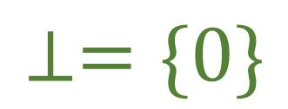
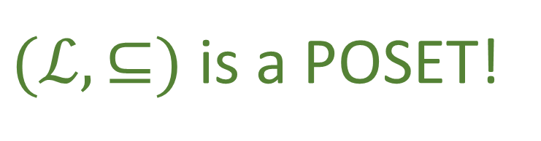
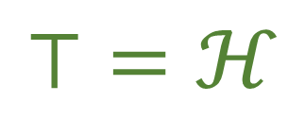

line
Set $ℒ$ of closed subspaces
$$y$$
Let $ℋ$ be a Hilbert space. Let $ℒ$ be the set of all possible closed subspaces. Each subspace is a subset of $ℋ$, so $ℒ$ is a collection of subsets ordered by $⊆$.
$$z$$
$(ℒ,⊆)$ is a POSET!
plane
e.g. a line may or may not be contained by a plane
$$x$$
The whole space $ℋ$ is a closed subspace. All subspaces are subsets of $ℋ$.
e.g. $ℝ^{3}$ contains all lines and planes
$$⊤=ℋ$$
The zero vector, by itself, forms a closed subspace. All subspaces contain the zero vector.
$$⊥=\{0\}$$
e.g. all lines and planes that go through the origin contain the origin

Slide 33

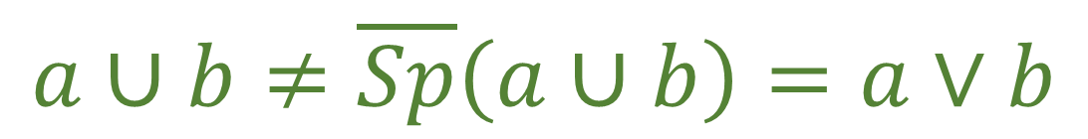
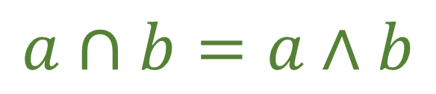


line
Set $ℒ$ of closed subspaces
$$y$$
Take two closed subspaces $a,b∈ℒ$. The intersection $a∩b$ is a closed subspace. It is the largest closed subspace contained by both: it’s the meet!
$$z$$
$$a∩b=a∧b$$
plane
e.g. two planes that pass through the origin may intersect to a line that passes through the origin
$$x$$
The union $a∪b$ is not a closed subspace. The closed linear span of two subspaces is, by definition, the smallest that contains both: it’s the join!
e.g. the union of two lines that pass through the origin is not a plane, but the span is
$$a∪b≠\overline{Sp}\left(a∪b\right)=a∨b$$
not Boolean!
$ℒ$ is a lattice!
... but not a Boolean algebra

Slide 34

“Failure” of disjunction
$q∨r=$T$↮q=$T$\text{or} r=\text{T}$
Translated into lattice operations
“$x∈\overline{Sp}(q,r)$” $=$T $↮$“$x∈q$” $=$ T$\text{or}$“$x∈r$” $=$ T
$x$ can be in the span of $q$ and $r$ without being in either subspace
Obviously doesn’t work! The span contains more elements.

Slide 35



“Failure” of distributivity
$$p∧\left(q∨r\right)↮\left(p∧q\right)∨(p∧r)$$
Translated into lattice operations
“$x∈p∩\overline{Sp}(q,r)$”$↮$“$x∈\overline{Sp}(p∩q,p∩r)$”
E.g. intersection between the line $p$ and the plane identified by lines $q$ and $r$
line
$$y$$
E.g. the plane identified by the intersection of lines $p$ and $q$ and the intersection of lines $p$ and $r$
$$z$$
Doesn’t work! Intersecting with the span is not the same.
plane
$$x$$

Slide 36
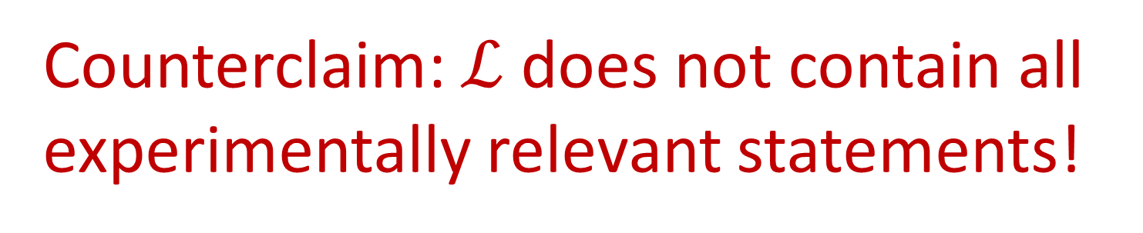

The lattice $ℒ$ is not a Boolean algebra…
… and … ???
Claim: the only relevant statements are those that are results of measurements. Since the lattice of closed subspaces contains all experimentally relevant statements, QM does not follow classical logic!
Counterclaim: $ℒ$ does not contain all experimentally relevant statements!

Slide 37





Probability theory requires classical logic
A probability space is a triple $\left(Ω, Σ_{Ω}, P\right)$
Sample space $Ω$ – the set of all possible outcomes ($\{1,2,3,4,5,6\}$ for a die)
A $σ$-algebra $Σ_{Ω}$ – collection of all events we can consider (even, odd, less than 3,…)
A probability measure $P$ – assigns a probability to each event
Mathematically, a $σ$-algebra is a collection of subsets closed under complement, countable union and countable intersection
Statement $⟺$ Subset
$Σ_{Ω}$is a countably complete Boolean algebra of statements

Slide 38

Probability theory requires classical logic
Quantum mechanics requires probability
Quantum mechanics requires classical logic
No subset of $ℒ$ is a Boolean algebra, therefore $ℒ$ is not sufficient for quantum mechanics

Slide 39










Quantum logic on a qubit
Only statements in quantum logic are: “the system is in no state”, “the system is in exactly state $ψ$”, “the system is in some state”
$$ℋ$$
All states
The whole sphere
$$x^{+}$$
$$y^{+}$$
$$…$$
$$x^{−}$$
One state
One point
$$∅$$
No states
Empty set
Bloch sphere
Hasse diagram for a qubit
Very few statements, you can’t do much: not really a “logic”
No statements about expectation values and probability, no uncertainty
Can’t distinguish between different preparations
The expectation value of $S_{z}$ is zero
“I prepared $x^{+}$” $∨$ “I prepared $x^{−}$” “I prepared $x^{+}$” $∨$ “I prepared $y^{+}$” “I prepared some state”
The spin is in the vertical direction $±5°$

Slide 40




What should we use instead?
Hilbert space $⇒$ normed vector space $⇒$ metric space $⇒$ topological space $⇒$ equipped with a Borel $σ$-algebra $Σ_{ℋ}$
Technically, it’s the projective Hilbert space we are interested in
$Σ_{ℋ}$ is a Boolean algebra (classical logic), it includes quantum logic, it has a clear physical meaning, it includes statements of probability and expectation values, it is what we use to define classical mixtures of quantum states, etc…
$$Σ_{ℋ}$$
$$ℒ$$

Slide 41

Given that quantum mechanics is a probabilistic theory, let’s construct a parallel to classical probabilistic theories.
Consider the space of real valued square integrable functions $ψ(q,p)$ over classical phase space: they also form a Hilbert space with inner product $∫ψ(q,p)φ(q,p)dqdp$. This will also have a lattice of closed subspaces. For example, if $U$ is a closed subset of phase space, the distribution with support $U$ will be a subspace. As in QM, the join will be the span of subspaces, not the union. Therefore the “disjunction” will be violated and distributivity will not be satisfied.
Classical mechanics violates classical logic! It requires quantum logic!
Not really…

Slide 42
“Quantum logic”, as a mathematical structure, exists
The lattice of closed subspaces of the Hilbert space
but it’s neither quantum
It exists for classical mechanics as well
nor logic
It does not contain all statements required in quantum mechanics

Slide 43
There is no such thing as quantum logic
There is the lattice of closed subspaces of a Hilbert space

