Slide 1

Eigenstates of position are not in the Hilbert space
Rigged Hilbert spaces solve some problems, but they add others
$$\left|ψ\right\rangle =ψ(x) \left|x\right\rangle$$
Not all elements in the Hilbert space correspond to physical states
Unbounded observables and infinite dimensional spaces in QM “have a lot of issues”
Understand how the math works
Understand how the physics works
Understand basis in infinite dimensional spaces, understand all the “fancy” terminology (e.g. Hilbert, separable, rigged), …

Slide 2



Finite space:
Whole space is the span of $n$ vectors
$\left|ψ\right\rangle =\sum_{i=1}^{n}{ψ_{i} \left|o_{i}\right\rangle }$
No single way to extend!
Infinite (countable) space:
$\left|ψ\right\rangle =\sum_{i=1}^{+∞}{ψ_{i} \left|o_{i}\right\rangle }$
Which infinite sums are allowed?
Let’s set aside the question whether it is physically tenable
Hilbert spaces (mathematically) tell us which “infinite sums are allowed”

Slide 3
What is a Hilbert space?
vector space (i.e. we can take finite linear combinations)
has an inner product (i.e. we can calculate probabilities)
is complete (i.e. contains the limits of all Cauchy sequences)
tells us which infinite linear combinations are allowed
(redundant for finite dimensions)

Slide 4







What is a Cauchy sequence?
Norm of the difference
Inner product induces a distance function
$$d\left(ψ,φ\right)=\left|\left\langle ψ−φ,ψ−φ\right\rangle \right|$$
Cauchy sequence: the distance between elements becomes “small”
$$ψ_{1},ψ_{2},ψ_{3},…,ψ_{n},…$$
Distance cutoff
$$d\left(ψ_{i},ψ_{j}\right)$$
$$ψ_{1}$$
$$ψ_{2}$$
$$ψ_{3}$$
$$⋮$$
$$ψ_{n}$$
$$⋮$$
$$ψ_{1}$$ | $$ψ_{2}$$ | $$ψ_{3}$$ | $$⋯$$ | $$ψ_{n}$$ | $$⋯$$
$$d_{11}$$ | $$d_{12}$$ | $$d_{13}$$ | $$⋯$$ | $$d_{1n}$$ | $$⋯$$
$$d_{21}$$ | $$d_{22}$$ | $$d_{23}$$ | $$⋯$$ | $$d_{2n}$$ | $$⋯$$
$$d_{31}$$ | $$d_{32}$$ | $$d_{33}$$ | $$⋯$$ | $$d_{3n}$$ | $$⋯$$
$$⋮$$ | $$⋮$$ | $$⋮$$ | $$⋱$$ | $$⋯$$ | $$⋯$$
$$d_{n1}$$ | $$d_{n2}$$ | $$d_{n3}$$ | $$⋮$$ | $$d_{nn}$$ | $$⋯$$
$$⋮$$ | $$⋮$$ | $$⋮$$ | $$⋮$$ | $$⋮$$ | $$⋱$$
Pick $r∈ℝ$ $r>0$
Find $n∈ℕ$ $n>0$
$d_{ij}<r$ for all $i,j>n$

Slide 5

What is a Cauchy sequence? Much simpler terms!
Suppose $\left|o_{i}\right\rangle ∈ℋ$ is a Hilbert basis then $\sum_{i}{ψ_{i}}\left|o_{i}\right\rangle ∈ℋ$if and only if $\sum_{i}{{\left|ψ_{i}\right|}^{2}}<∞$
If the sum of the square of the components converges, so does the vector sum
Mathematically nice… but physically?

Slide 6





Suppose the operator $N$ counts the number of particles and $\left|i\right\rangle ∈ℋ$ are the eigenstates with $i$ particles
Not guaranteed to converge
The expectation is $⟨N⟩=\left\langle ψ\left|N\right|ψ\right\rangle$
$\sum_{i=1}^{+∞}{⟨ψ|i⟩⟨i|N|ψ⟩}=\sum_{i=1}^{+∞}{i⟨ψ|i⟩⟨i|ψ⟩}=\sum_{i=1}^{+∞}{i{\left|ψ_{i}\right|}^{2}}$
$ψ_{i}=\frac{\sqrt{6}}{πi}$
$⟨ψ|ψ⟩=\sum_{i}{\frac{6}{π^{2}}\frac{1}{i^{2}}}=1$
Example
Harmonic series diverges! Infinitely many particles!
$\left\langle ψ\left|N\right|ψ\right\rangle =\sum_{i}{\frac{6}{π^{2}}\frac{1}{i^{2}}i}=\frac{6}{π^{2}}\sum_{i}{\frac{1}{i}}=+∞$

Slide 7

Every continuous linear operator defined on the whole Hilbert space is bounded $⇒$ every continuous unbounded operator is not defined on the whole Hilbert space
e.g. position, momentum, energy, number of particles, …
We need infinite dimensional spaces to model quantities that are unbounded (no upper limit),
Hilbert spaces force us to include objects for which the expectation of those quantities are infinite
Be warned (and careful)

Slide 8








$$O=\left[\begin{matrix}o_{1} & 0 & ⋯ \\ 0 & o_{2} & ⋯ \\ ⋮ & ⋮ & ⋱\end{matrix}\right]$$
$$\left|ψ\right\rangle =∑ψ_{i} \left|o_{i}\right\rangle$$
Discrete observable $O$
$$ψ_{i}=⟨o_{i}\left|ψ\right\rangle$$
Naïve extension to continuum
$$X=\left[\begin{matrix}x & 0 & ⋯ \\ 0 & x+dx & ⋯ \\ ⋮ & ⋮ & ⋱\end{matrix}\right]$$
$$\left|ψ\right\rangle =∫ψ(x) \left|x\right\rangle dx$$
Continuous observable $X$
$$ψ(x)=⟨x\left|ψ\right\rangle$$
… does not quite work!

Slide 9








$$O=\left[\begin{matrix}o_{1} & 0 & ⋯ \\ 0 & o_{2} & ⋯ \\ ⋮ & ⋮ & ⋱\end{matrix}\right]$$
$$\left|ψ\right\rangle =∑ψ_{i} \left|o_{i}\right\rangle$$
Discrete observable $O$
$$ψ_{i}=⟨o_{i}\left|ψ\right\rangle$$
${\left|ψ_{i}\right|}^{2}=p(o_{i})$ is a probability
They work differently under change of variables!!!
${\left|ψ\left(x\right)\right|}^{2}=ρ(x)$ is a probability density
$$X=\left[\begin{matrix}x & 0 & ⋯ \\ 0 & x+dx & ⋯ \\ ⋮ & ⋮ & ⋱\end{matrix}\right]$$
$$\left|ψ\right\rangle =∫ψ(x) \left|x\right\rangle dx$$
Continuous observable $X$
$$ψ(x)=⟨x\left|ψ\right\rangle$$
invertible
$$a=a(o)$$
$$\left|a_{i}\left(o_{i}\right)\right\rangle =\left|o_{i}\right\rangle$$
$${\left|\left\langle o_{i} | ψ\right\rangle \right|}^{2}=p\left(o_{i}\right) \\ =p\left(a_{i}\right)={\left|\left\langle a_{i} | ψ\right\rangle \right|}^{2}$$
$\left|y\left(x\right)\right\rangle =\left|\sqrt{\frac{dy}{dx}}\right|\left|x\right\rangle$
$${\left|\left\langle x | ψ\right\rangle \right|}^{2}=ρ(x) \\ =\frac{dy}{dx}ρ(y) =\frac{dy}{dx}{\left|\left\langle y | ψ\right\rangle \right|}^{2}$$
$$y=y(x)$$

Slide 10
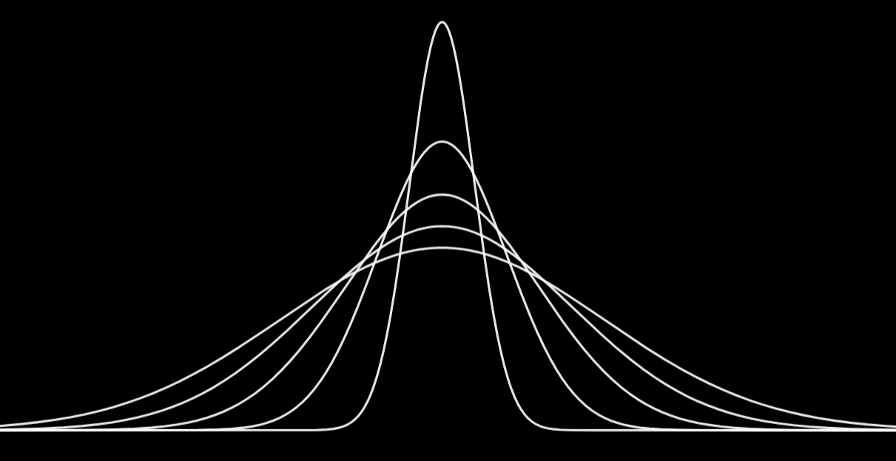






The Dirac delta is the limit of a sequence of Gaussians…
$$ψ_{σ}=\frac{1}{{\left(2πσ^{2}\right)}^{1/4}}e^{−\frac{1}{4}{\left(\frac{x}{σ}\right)}^{2}}$$
$$ψ_{σ}^{†}ψ_{σ}=ρ_{σ}=\frac{1}{\sqrt{2πσ^{2}}}e^{−\frac{1}{2}{\left(\frac{x}{σ}\right)}^{2}}$$
$$\lim_{σ→0}{ψ_{σ}^{†}ψ_{σ}}=\lim_{σ→0}{ρ_{σ}}=δ(x)$$
Delta functions $\left|x\right\rangle$ are not in the Hilbert space
… but not a Cauchy sequence!
are not a basis!!!
$→0$ when $σ_{1}→0$
$$d\left(ψ_{σ_{1}},ψ_{σ_{2}}\right)=2\left(1−\sqrt{\frac{2σ_{1}σ_{2}}{σ_{1}^{2}+σ_{2}^{2}}}\right)$$
Distance cannot be arbitrarily small

Slide 11

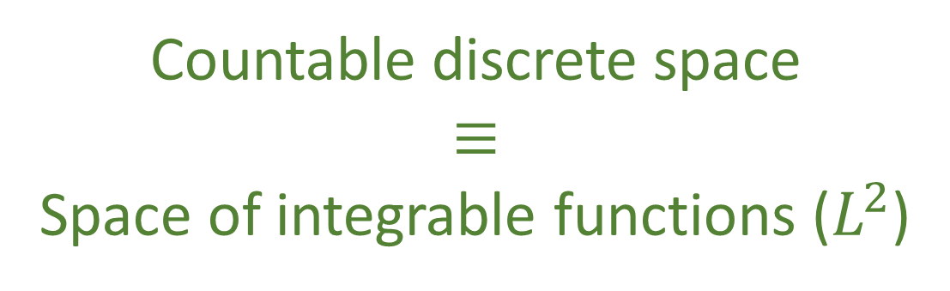


$$H=\frac{P^{2}}{2m}+\frac{1}{2}mω^{2}X^{2}$$
Eigenstates
$$H\left|E_{n}\right\rangle =E_{n}\left|E_{n}\right\rangle$$
Eigenvalues
$$E_{n}=\left(2n+1\right)\frac{ℏ}{2}ω$$
Hermite functions
1D harmonic oscillator
Countable basis!
Countable discrete space $$≡$$ Space of integrable functions ($L^{2}$)

Slide 12

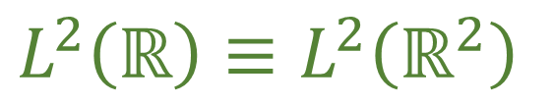



$$H=\frac{P_{x}^{2}+P_{y}^{2}}{2m}+\frac{1}{2}mω^{2}\left(X^{2}+Y^{2}\right)$$
Eigenstates
$$H\left|E_{n_{x},n_{y}}\right\rangle =E_{n_{x},n_{y}}\left|E_{n_{x},n_{y}}\right\rangle$$
2D harmonic oscillator
Countable basis!
$$|1⟩$$
$$|2⟩$$
$$|3⟩$$
$$⋮$$
$$|n⟩$$
$$⋮$$
$$|1,1⟩$$ | $$|1,2⟩$$ | $$|1,3⟩$$ | $$⋯$$ | $$|1,n⟩$$ | $$⋯$$
$$|2,1⟩$$ | $$|2,2⟩$$ | $$|2,3⟩$$ | $$⋯$$ | $$|2,n⟩$$ | $$⋯$$
$$|3,1⟩$$ | $$|3,2⟩$$ | $$|3,3⟩$$ | $$⋯$$ | $$|3,n⟩$$ | $$⋯$$
$$⋮$$ | $$⋮$$ | $$⋮$$ | $$⋱$$ | $$⋯$$ | $$⋯$$
$$|n,1⟩$$ | $$|n,2⟩$$ | $$|n,3⟩$$ | $$⋮$$ | $$|n,n⟩$$ | $$⋯$$
$$⋮$$ | $$⋮$$ | $$⋮$$ | $$⋮$$ | $$⋮$$ | $$⋱$$
Mathematically, there is one (separable) Hilbert space
$$L^{2}\left(ℝ\right)≡L^{2}\left(ℝ^{2}\right)$$

Slide 13






Gelfand triple (rigged Hilbert space)
$$𝒮$$
$$⊂$$
$$ℋ$$
$$⊂$$
$$𝒮^{∗}$$
Schwartz space
Hilbert space
Tempered distributions
Infinitely smooth functions that decay like exponentials (e.g. Gaussians)
Finite expectation for all polynomials of position and momentum
Those expectations uniquely identify a Schwartz function
Closed under Fourier transform
Dense in the Hilbert space
Self-dual
Closure of Schwartz space under Cauchy sequences
Dual of Schwartz space
Contains all limits (including $δ$-Dirac)
All the physics is already in the Schwartz space!!!

Slide 14
We need infinite dimensional spaces for unbounded operators… but unbounded operators are not defined on the whole Hilbert space
Eigenstates of position are not in the Hilbert space (tempered distributions) and do not form a basis
The space of wavefunctions (i.e. square integrable functions) has a countable basis (e.g. eigenfunctions of harmonic oscillator)
Be careful!
Personally, I don’t think we have the “right” structure
(i.e. physically meaningful and mathematically precise)

