Slide 2







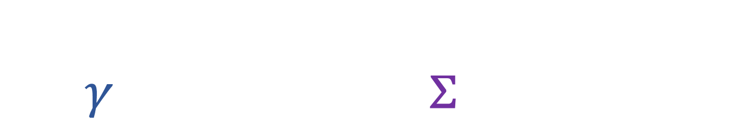
Variation of action
Flow of states
$δ\int_{γ}{Ldt}=−\iint_{Σ}{\vec{S}⋅d\vec{Σ}}$
$$p$$
$$γ$$
$$q$$
$$Σ$$
$$\vec{S}$$
$$γ′$$
$$t$$

Slide 3
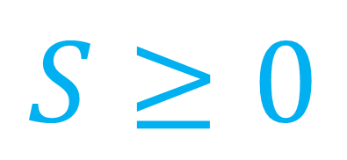



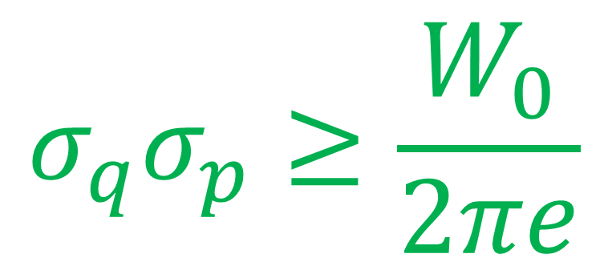
$$S$$
Third law of thermodynamics
$$⇒$$
$$σ_{q}σ_{p}≥\frac{W_{0}}{2πe}$$
$$S≥0$$
$$σ_{q}σ_{p}$$
Classical (and quantum?) uncertainty principle

Slide 4







Quantum mechanics
$$⇒$$
$$⇏$$
No such
thing!
Classical logic
Quantum logic
$$ℏ/4$$
$$x∈A∪B$$
$$↮$$
$$x∈A OR x∈B$$
$$A$$
$$B$$
$x$

Slide 5









$$|z^{+}⟩$$
$$ı|z^{−}⟩$$
Geometry of
$$|z^{−}⟩$$
quantum states
Vector space
$$|z^{+}⟩$$
$$|y^{+}⟩$$
$$|x^{−}⟩$$
$$|x^{+}⟩$$
$$|y^{−}⟩$$
Projective space
$$|z^{−}⟩$$

Slide 6




$$\left|E_{1}\right\rangle$$
Geometry of
Evolutions
quantum
mixed states
Reversible
Max entropy increase
$S=0$
$$|E_{0}⟩$$
Max energy extraction
$$S→+∞$$
Convex space of ensembles

Slide 7



$${\left|\left\langle o_{i} | ψ\right\rangle \right|}^{2}=p\left(o_{i}\right)=p\left(a_{i}\right)={\left|\left\langle a_{i} | ψ\right\rangle \right|}^{2}$$
Infinite
dimensional
Discrete probability
is invariant!
quantum spaces
$$\left|a_{i}\left(o_{i}\right)\right\rangle =\left|o_{i}\right\rangle$$
$${\left|\left\langle x | ψ\right\rangle \right|}^{2}=ρ\left(x\right)=\frac{dy}{dx}ρ(y) =\frac{dy}{dx}{\left|\left\langle y | ψ\right\rangle \right|}^{2}$$
Probability density
is not invariant!
$\left|y\left(x\right)\right\rangle =\left|\sqrt{\frac{dy}{dx}}\right|\left|x\right\rangle$

Slide 8
Channel update
2023 in review
>3000 subscribers! 🎉🎉🎉
Q&A on foundations?
Published papers!
Published papers!
Videos on open problems?
Open research!

Slide 9
Foundations of Physics
Channel introduction
Reverse physics
Physical mathematics

