Slide 1



7 misconceptions in the foundations of physics
Gabriele Carcassi and Christine A. Aidala
Physics Department University of Michigan

Slide 2


Foundations of physics
Foundations of mathematics
Aims to identify a handful of physical starting points from which the basic laws can be rigorously derived.
Philosophy of science
https://assumptionsofphysics.org
Gabriele Carcassi
Christine A. Aidala
University of Michigan

Slide 3
1.
To understand quantum mechanics,
we need the right “interpretation”
Notes:
Measurement problem: we have two rules, one that applies during the evolution of a quantum system by itself; one during measurement. These rules are incompatible to each other. But, ultimately, the measurement should be described by a physical process. We need a lower level description that gives a full account
But we use QM for different objects: fundamental particles, composite particles, atoms, molecules (bucky balls). To keep quantum behavior, it is important that measurements have a resolution not sensitive to the constituents. Therefore we can’t simply give an account at the most fundamental level and be done. Not going to work.
So, why people are still focusing on this?

Slide 4

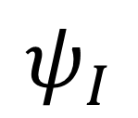
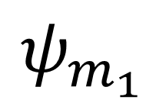

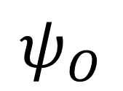
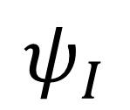

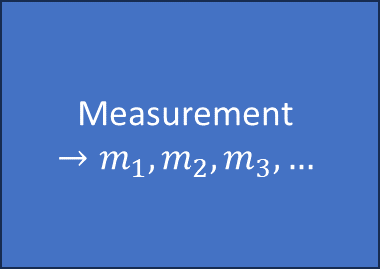
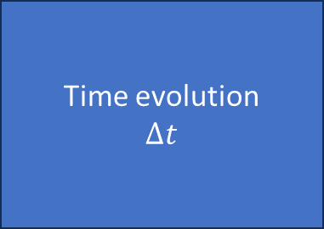
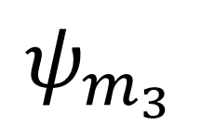


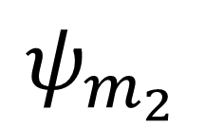

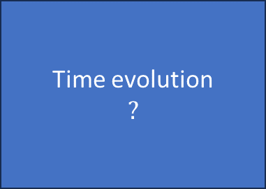
Measurement (projection)
$$ψ_{m_{1}}$$
Time evolution (unitary operation)
Measurement
$$→m_{1},m_{2},m_{3},…$$
$$p_{1}$$
Time evolution
$$Δt$$
$$ψ_{I}$$
$$p_{2}$$
$$ψ_{m_{2}}$$
$$ψ_{I}$$
$$ψ_{O}$$
$$p_{3}$$
$$ψ_{m_{3}}$$
$$…$$
To understand quantum mechanics, we need a full account of what happens during a measurement
Interpretation
Time evolution
$$?$$
$$?$$
$$?$$

Slide 5
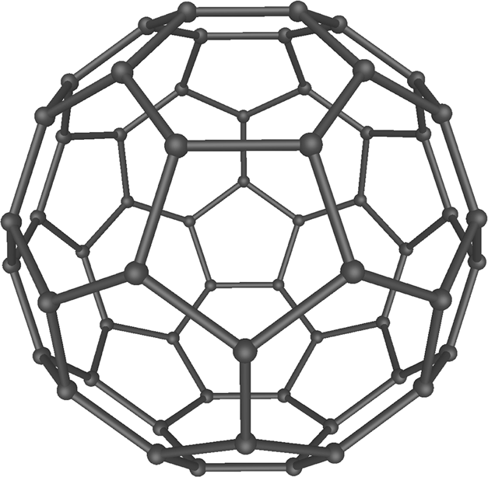
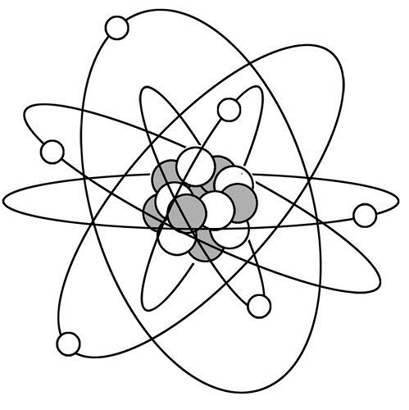
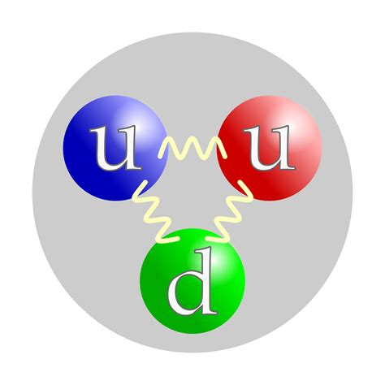

























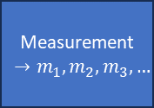





$$e^{−}$$
$$ψ_{m_{1}}$$
$$ψ_{m_{1}}$$
$$ψ_{m_{1}}$$
$$ψ_{m_{1}}$$
Measurement
$$→m_{1},m_{2},m_{3},…$$
$$p_{1}$$
Measurement
$$→m_{1},m_{2},m_{3},…$$
$$p_{1}$$
Measurement
$$→m_{1},m_{2},m_{3},…$$
$$p_{1}$$
Measurement
$$→m_{1},m_{2},m_{3},…$$
$$p_{1}$$
$$ψ_{I}$$
$$p_{2}$$
$$ψ_{m_{2}}$$
$$ψ_{I}$$
$$p_{2}$$
$$ψ_{m_{2}}$$
$$ψ_{I}$$
$$p_{2}$$
$$ψ_{m_{2}}$$
$$ψ_{I}$$
$$p_{2}$$
$$ψ_{m_{2}}$$
$$p_{3}$$
$$p_{3}$$
$$p_{3}$$
$$p_{3}$$
$$ψ_{m_{3}}$$
$$ψ_{m_{3}}$$
$$ψ_{m_{3}}$$
$$ψ_{m_{3}}$$
$$…$$
$$…$$
$$…$$
$$…$$
Unlikely we have one true mechanism, and we need to explain why all these different mechanisms look the same. Why so much focus on this?
Time evolution
$$?$$
$$?$$
$$?$$

Slide 6
2.
Explanations must be about mechanisms
Notes:
Every physical theory defines a set of objects and their behavior at a certain level of detail. Better theories give us a more refined description by going to a lower level. More in depth explanations require better theories.
If a theory is fundamental, this does not work: no more fundamental level. We need a different strategy
Since we have to give definitions, the explanation for its behavior could be intrinsic to the definition. For example: ensemble, processes, mixing of ensembles, processes are linear, deterministic and reversible evolution, measurements -> measurements are evolutions if and only if they do not perturb the system. Any mechanism that will approximately satisfy the definitions will do
Looking at requirements, instead of mechanism, gives a straight forward solution. Why don’t people look for these solutions?

Slide 7
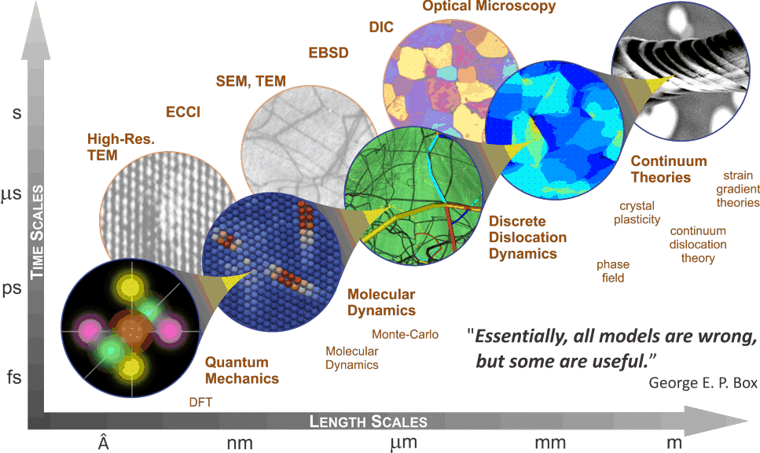
Physics explains the behavior of a physical system in terms of the behavior of the constituents
In a fundamental theory, objects cannot be further decomposed

Slide 8



















Any process (deterministic or stochastic) will take a statistical ensemble as input and return a statistical ensemble as output
$$ρ_{I}$$
$$P$$
$ρ_{O}=P\left(ρ_{I}\right)$
$$ρ_{1}$$
$$p_{1}$$
Statistical ensembles can be mixed
+
$$ρ=p_{1}ρ_{1}+p_{2}ρ_{2}$$
$$ρ_{2}$$
$$p_{2}$$
The output of a mixture must be equal to the mixture of the outputs (i.e. linear in probability)
$$P\left(p_{1}ρ_{1}+p_{2}ρ_{2}\right)=p_{1}P\left(ρ_{1}\right)+p_{2}P\left(ρ_{2}\right)$$
$$ρ_{1}$$
$$ρ_{1}$$
$$P$$
$$p_{1}$$
$$≡$$
$$P\left(ρ_{1}\right)$$
$$P$$
+
+
$$ρ_{2}$$
$$p_{2}$$
$$ρ_{2}$$
$$P$$
$$P\left(ρ_{2}\right)$$

Slide 9












Deterministic and reversible
Measurement
$$ρ_{O}$$
$$P$$
$$ρ_{O}$$
$$P$$
$$ρ_{I}$$
$$P$$
$$P^{−1}$$
$$ρ_{I}$$
$$ρ_{I}$$
$$ρ_{O}$$
Conserves probability and allows an “inverse”
Must be repeatable
$⇒$ Unitary operation
$⇒$ Projection
The difference in behavior is intrinsic to the definitions of deterministic/reversible process and measurement. Any processes that approximately satisfy the requirements will do.
Why aren’t these types of explanations more prominent?

Slide 10
3.
The laws of physics are the laws of the universe
Notes:
The goal of physics is to understand what are the ultimate constituents of the universe and how they behave. The mathematical objects represent real entities in the world. Some go as far as saying that the world is mathematics.
We used a different outlook: the goal of physics is to develop models that, in certain conditions, can be used to describe parts of the physical world. Is the previous position tenable?
First of all, physics should only be about that description that is accessible experimentally. We can develop a logic of verifiable statements, those with a test that terminates in finite time if and only if the statement is true. These behave differently: no negation, finite conjuction. This maps to topologies and sigma-algebras, the foundations of all mathematical tools we use in physics. Typically based on assumptions, such as being able to measure any quantity with arbitrarily low level of precision.
By reasoning about models and assumptions, we can actually derive the mathematical model, so the physical theory is a model. Why is this approach not widespread?

Slide 11
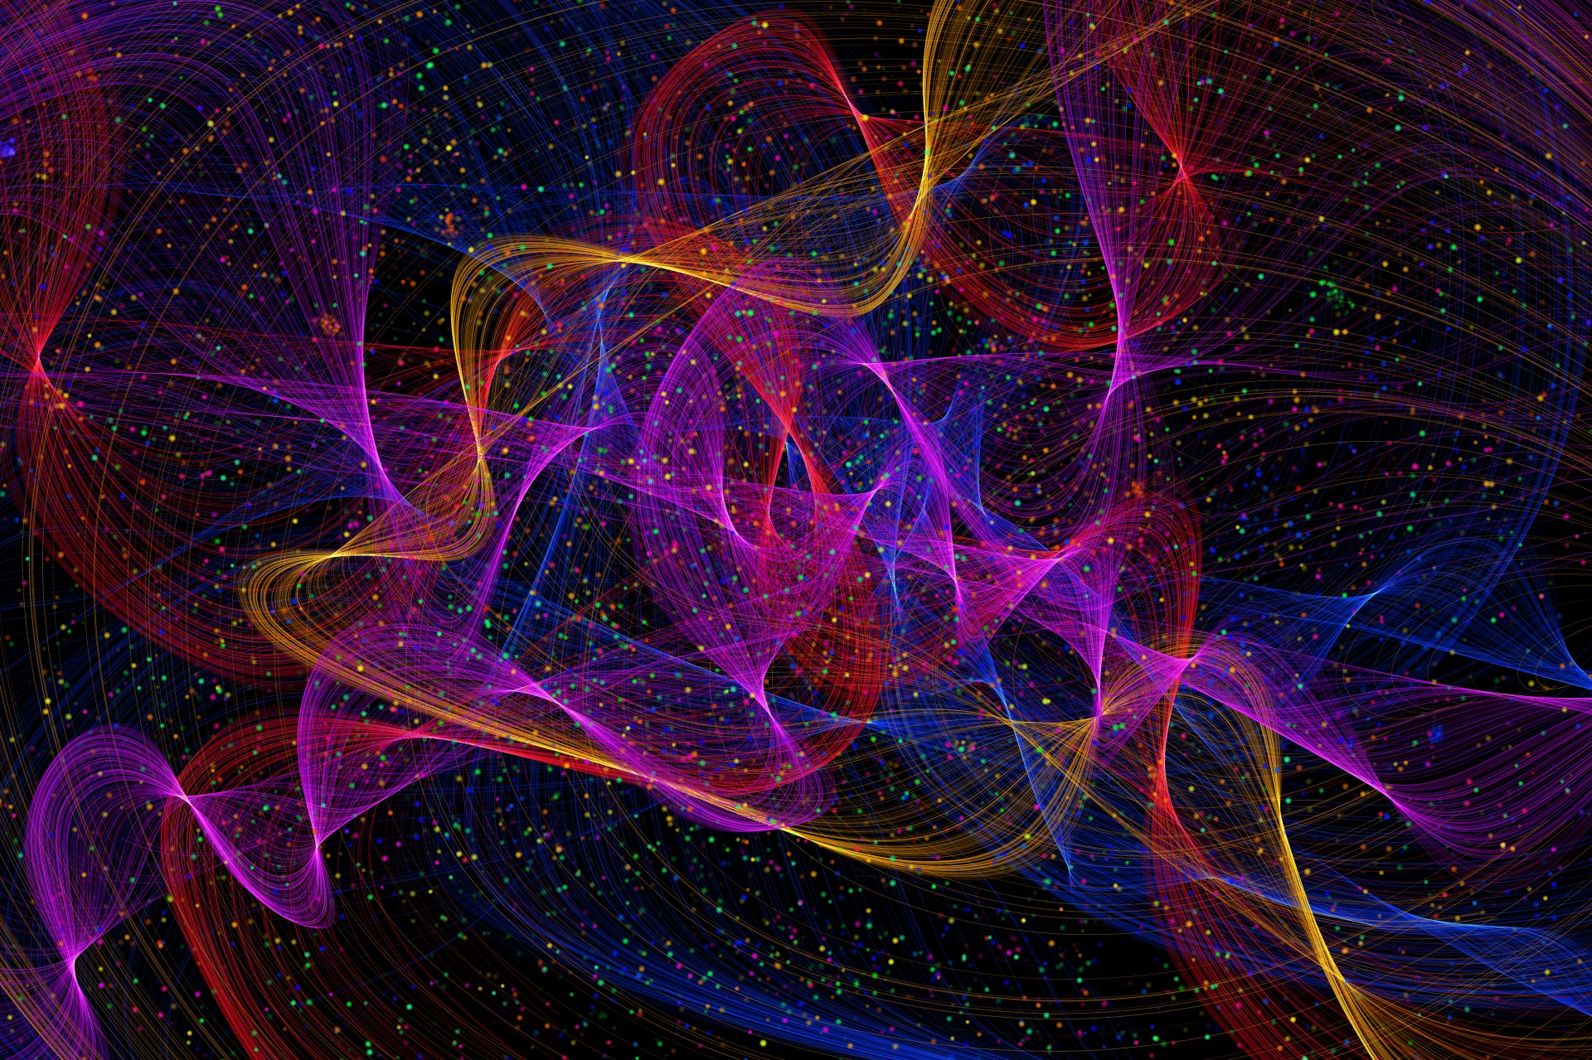
The goal of physics is to understand what are the ultimate constituents of the universe and how they behave. The mathematical objects represent real entities in the world.
Before, we implicitly assumed that physics produces approximate models of what is empirically accessible

Slide 12




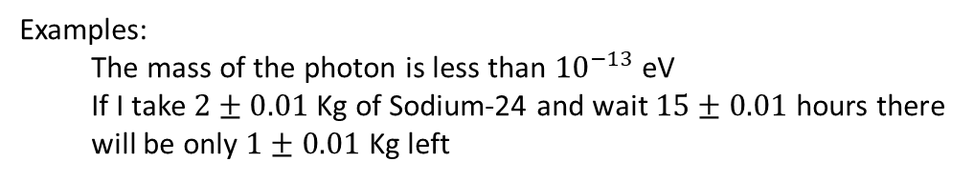


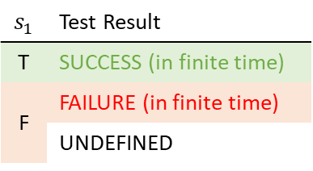

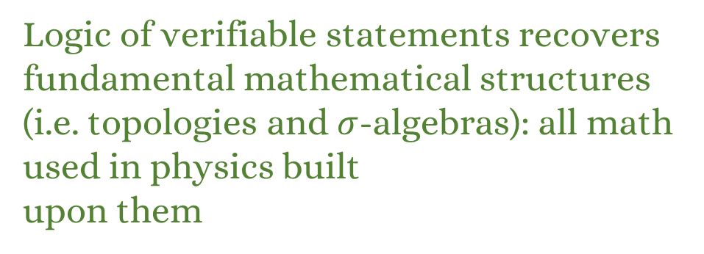


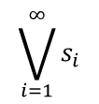

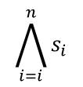
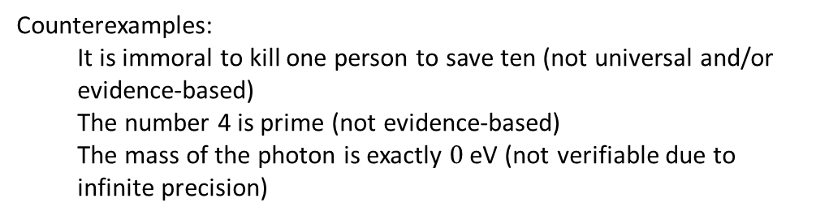
Verifiable statements: assertions that can be experimentally verified in a finite time
verifiable statements
$$𝒮$$
$$s_{1}$$ | Test Result
T | SUCCESS (in finite time)
F | FAILURE (in finite time)
 | UNDEFINED
$$𝒮_{\text{v}}$$
Examples:
The mass of the photon is less than ${10}^{−13}$ eV
If I take $2±0.01$ Kg of Sodium-24 and wait $15±0.01$ hours there will be only $1±0.01$ Kg left
statements
$$s_{1}$$
experimental test
Counterexamples:
It is immoral to kill one person to save ten (not universal and/or evidence-based)
The number 4 is prime (not evidence-based)
The mass of the photon is exactly $0$ eV (not verifiable due to infinite precision)
Logic of verifiable statements recovers fundamental mathematical structures (i.e. topologies and $σ$-algebras): all math used in physics built upon them
Finite conjunction (logical AND)
Countable disjunction (logical OR)
$$\bigwedge_{i=i}^{n}{s_{i}}$$
$$\bigvee_{i=1}^{∞}{s_{i}}$$
$$s_{1}$$
$$s_{2}$$
$$s_{3}$$
$$s_{1}$$
$$s_{2}$$
$$s_{3}$$
$$…$$
All tests must succeed
One successful test is sufficient

Slide 13
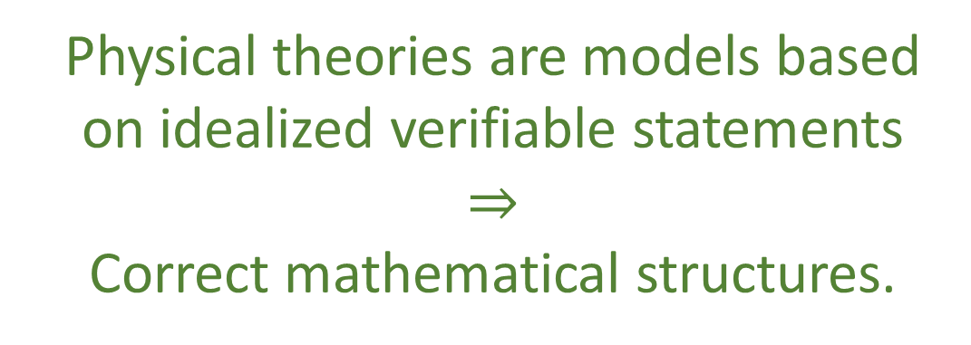
Metaphysical reality
What really exists
Fundamental mathematical structures capture experimental verifiability. Use of real valued quantities is equivalent to a set of highly idealized assumptions on experimentally verifiable statements.
“Correct viewpoint” because it is fruitful
Physical theories are models based on idealized verifiable statements $$⇒$$ Correct mathematical structures.
Physical theories
Idealized account of physical reality
Physical reality
What can be studied experimentally
The most basic mathematical structures can be derived through simple reasoning about empirical models. All this could have been developed/understood a hundred years ago. Why wasn’t it?

Slide 14
4.
The laws of physics are found experimentally
(not by reasoning)
Notes:
Whether the laws of physics are correct or not is found experimentally, not by “reasoning”. The idea that we can sit and think and determine scientific truth is preposterous. Galileo dropped objects from the tower of Pisa to see whether they would be accelerated at the same rate.
Does it have to be that way? Tie the objects together. Inconsistency. Tells us more: an alternative world is not possible. Galileo argued this.
Other examples. Classical states are identified by position and momentum. Does it have to be that way? Turns out that if we want to count states, define entropy or state densities in a way that is coordinate invariant, such that we can all agree on those definitions, then states must be defined in terms of two quantities. Count of states cannot have a unit dependency on the unit we use for position.
The physical law are a lot more constrained. So why don’t people realize that? Because you need to look at the math very closely.

Slide 15
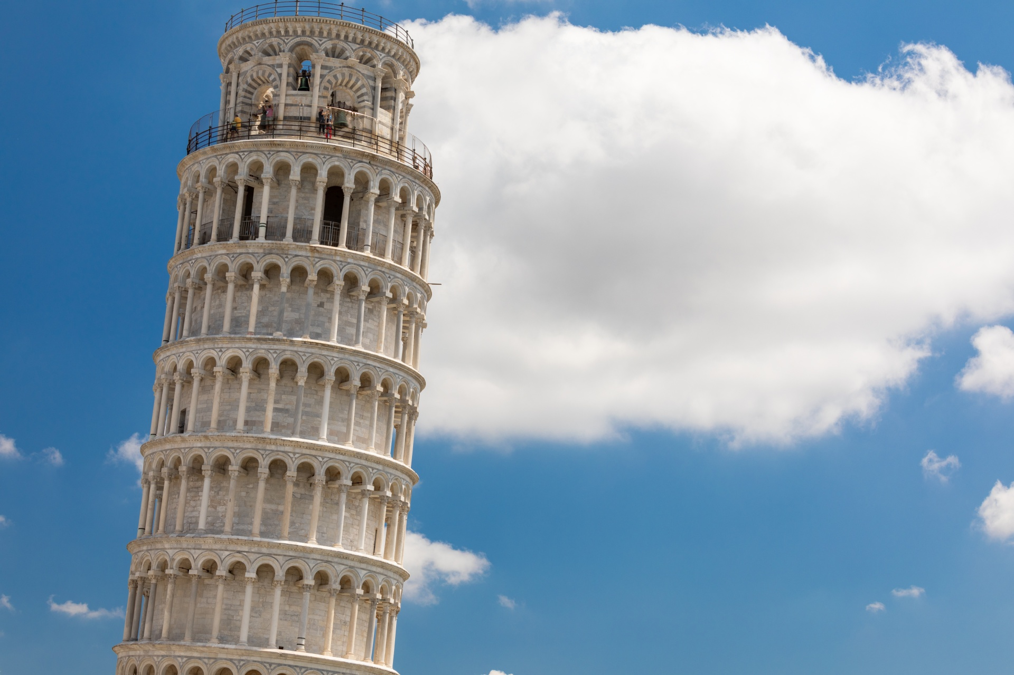
The laws of physics are found experimentally, not by “reasoning”. The idea that we can sit and think and determine scientific truth is preposterous.
Galileo found out that objects fall at the same rate through experimentation, not reasoning!

Slide 16
Suppose heavier objects fall faster than lighter ones
Suppose we connect a heavier object with a lighter
The slower object will slow the faster object and vice-versa:
the combined object will fall more slowly than the heavier part
However, the combined object is heavier than the heavier part,
so it must move faster. But this leads to a contradiction!
Heavier objects cannot fall faster than lighter ones!
We reach a stronger conclusion by arguing!

Slide 17
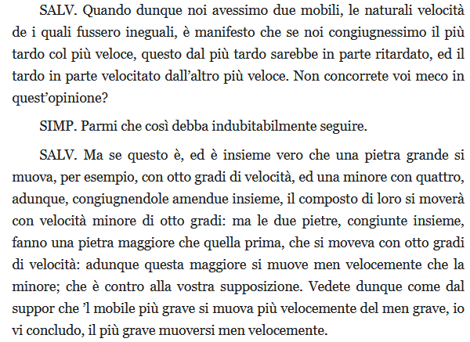
SALV. Then if we had two objects, whose natural velocities were different, it’s clear that if we connected the slower with the faster, the slower would slow the faster and the faster would speed the slower. Wouldn’t you agree?
SIMP. It seems it must follow.
SALV. But if that’s so, and that the big stone moves, for example, with eight units of speed, and the smaller with four, connecting them, the composed system will move with a speed slower than eight units: but the two stones, connected together, will make a bigger stone than the first, that moved with eight units of speed: therefore this bigger one moves slower than the smaller; which is against your supposition. You see, then, how from supposing that the heavier object moves faster then the lighter, I can conclude that the heavier moves more slowly.
That’s exactly what Galileo argued!
Can we find other lines of reasoning to justify other physical ideas?

Slide 18





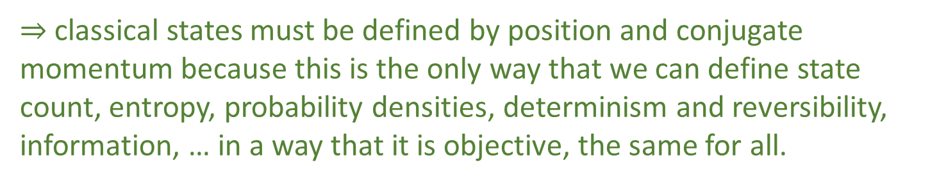


In classical mechanics, states are defined by position and conjugate momentum. Why?
In statistical mechanics, the count of configurations is given by areas of position and conjugate momentum.
Conjugate momentum is expressed in inverse units of position: product of position and momentum does not depend choice of frame. The count of states is frame invariant!
$\hat{q}=100 cm/m q$
$$1$$
$Δp=1 J⋅s⋅ m^{−1}$
$$1$$
$Δ\hat{p}=0.01 J⋅s⋅cm^{−1}$
$Δ\hat{q}=100 cm$
$Δq=1 m$
Suppose we require the count of states to be invariant $⇒$ states must be described by conjugate pairs like position and conjugate momentum
$⇒$ classical states must be defined by position and conjugate momentum because this is the only way that we can define state count, entropy, probability densities, determinism and reversibility, information, … in a way that it is objective, the same for all.
Looking at the math closely, we can find conceptual reasons for a lot of physics… so why isn’t this done more?

Slide 19
5.
Mathematical details are for mathematicians to worry about
Notes:
Mathematics is full of technicalities that are uninteresting to the physics. The job of a physicist is to identify the key relationships and equations of a theory. It’s the job of the mathematician to find the correct formal framework and fix the details.
Attitude comes from how physicists use everything else. Details of civil and mechanical engineering, electronics, data processing, etc… are left to experts. But mathematics is different: mathematics is the language we use to define our models. Especially now, that our theory are just given by mathematical definitions. Those details are the physics. There are technical details that in QFT that are proven to not be solvable. Maybe we have the wrong definitions.
Quantum states are described using Hilbert spaces. Hilbert spaces allow for state with infinite expectation values. Allow for time evolution that makes expectations finite/infinite in finite time. Mathematicians generally do not have the right physical intuition to understand what is appropriate for physics.
So why physicists do not look at these details?

Slide 20
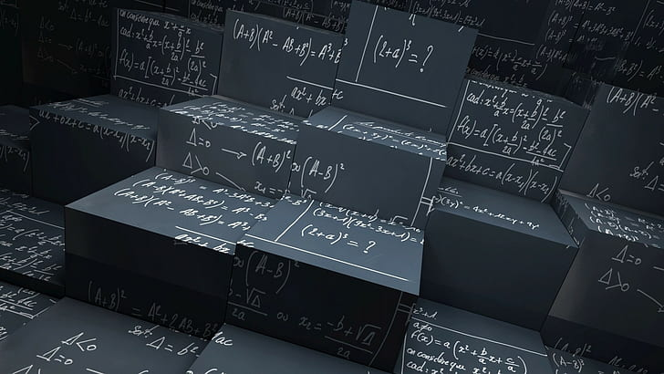
Mathematics is full of technicalities that are uninteresting to the physics. It’s the job of the mathematician to find the correct formal framework and fix the details.
In the same way that the mechanical engineer, electronics engineer, software engineer, … will fix the details of the experimental setup

Slide 21

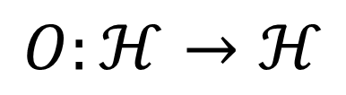

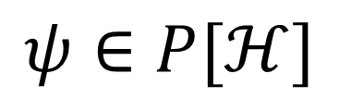
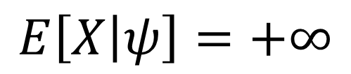
But the mathematics is not just a tool for calculation: it is the language we use to formalize our physical models. How can mathematicians, who are typically not trained in physics, know what the correct features of our physical models are?
In quantum mechanics
State $⇒$ ray in a Hilbert space
Observable $⇒$ Hermitian operator
$$ψ∈P[ℋ]$$
$$O:ℋ→ℋ$$
Unbounded operators cannot be defined on the whole Hilbert space $⇒$ There exists some state for which some quantity (e.g. position, momentum, energy, number of particles, …) is infinite or not defined!
$$E\left[X | ψ\right]=+∞$$
Physically untenable. Mathematical details ARE physically important! Why don’t we have part of the physics community specifically working on developing physically and mathematically sound tools?

Slide 22
6.
There is only one correct way
to do mathematics

Slide 23
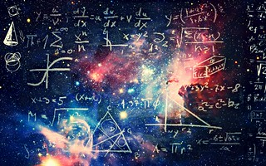
In the same way that there are correct laws of physics, there is correct math. Mathematicians discover the correct structures, organize them, so they will be able to take prototype theories from us physicists and give us the correct structure.

Slide 24
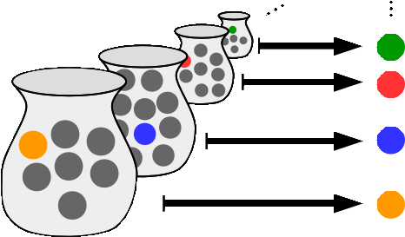
In reality: mathematics is based on axioms and definitions chosen based on specific goals (of mathematicians).
Axiom of Choice
Accept
Reject
What can be formally defined
What can be computed
Existence of objects that cannot be written down with finitely many symbols
Non-existence of objects useful in physics
E.g. well-ordering of the reals
E.g. the real numbers
In physics we care about what can be experimentally identified.
Not only is there more than one correct way to do mathematics, the one physicists are interested in may not be one that mathematicians care about!

Slide 25
7.
A theory of everything is the right foundation for physics

Slide 26
A theory of everything will tell us what happens during measurements (1), in terms of some mechanism (2) describing the most fundamental objects of the universe (3). Since the correct theory is determined experimentally (4), we should focus on building rough prototypes. In the end, the mathematical detail is irrelevant (5) and mathematicians will later find the correct formulation (6).
What should the foundations of physics be about?

Slide 27
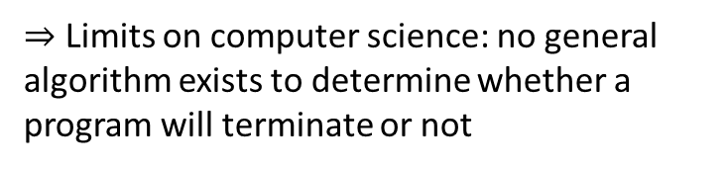
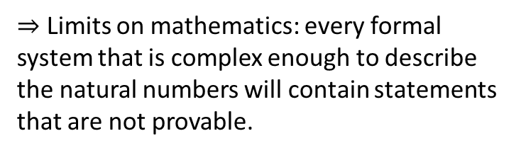

Foundations of mathematics
Define the basic objects and rules (e.g. mathematical logic, set theory) used to do mathematics. Give a formal framework for what can be achieved in mathematics (e.g. proof theory).
$⇒$ Limits on mathematics: every formal system that is complex enough to describe the natural numbers will contain statements that are not provable.
Foundations of computer science
Define the basic objects and rules used to perform computation (e.g. theory of computation, information theory). Give a formal framework for what can be achieved by a computer (e.g. complexity theory).
$⇒$ Limits on computer science: no general algorithm exists to determine whether a program will terminate or not
Foundations of physics?
Define the basic objects and rules used to characterize physical systems. Give a formal framework for what can be achieved through experimentation.
$⇒$ Limits on physics?

Slide 28
Typical approaches
Find ultimate theory
Construct interpretations
approximation
…
Measurement problem
Role of the observer
Quantum mechanics
Weak interactions
QED -Electromagnetism
Contextuality
Local realism
QCD – Strong Interactions
Electro-weak
Ontology of observables
What “really” happens
General Relativity
Grand Unified Theory
Theory of Everything
Our approach
Find a minimal set of physical assumptions from which to rigorously rederive the laws
General physical principles and requirements
General mathematical framework
Specific assumptions
Classical mechanics
Quantum mechanics
derivation
Thermodynamics
…
specialization

Slide 29
Space of the well-posed scientific theories
Physical theories
Unitary evolution
Specializations of the general theory under the different assumptions
Hamiltonian mechanics
Quantum state-space
Classical phase-space
Infinitesimal reducibility
Determinism/
reversibility
Irreducibility
Assumptions
States and processes
General theory
Information granularity
Basic requirements and definitions valid in all theories
Experimental verifiability

Slide 30
We can give physics a more mathematically precise, conceptually consistent and physically meaningful foundation if we overcome these misconceptions
https://assumptionsofphysics.org

